Slide 1

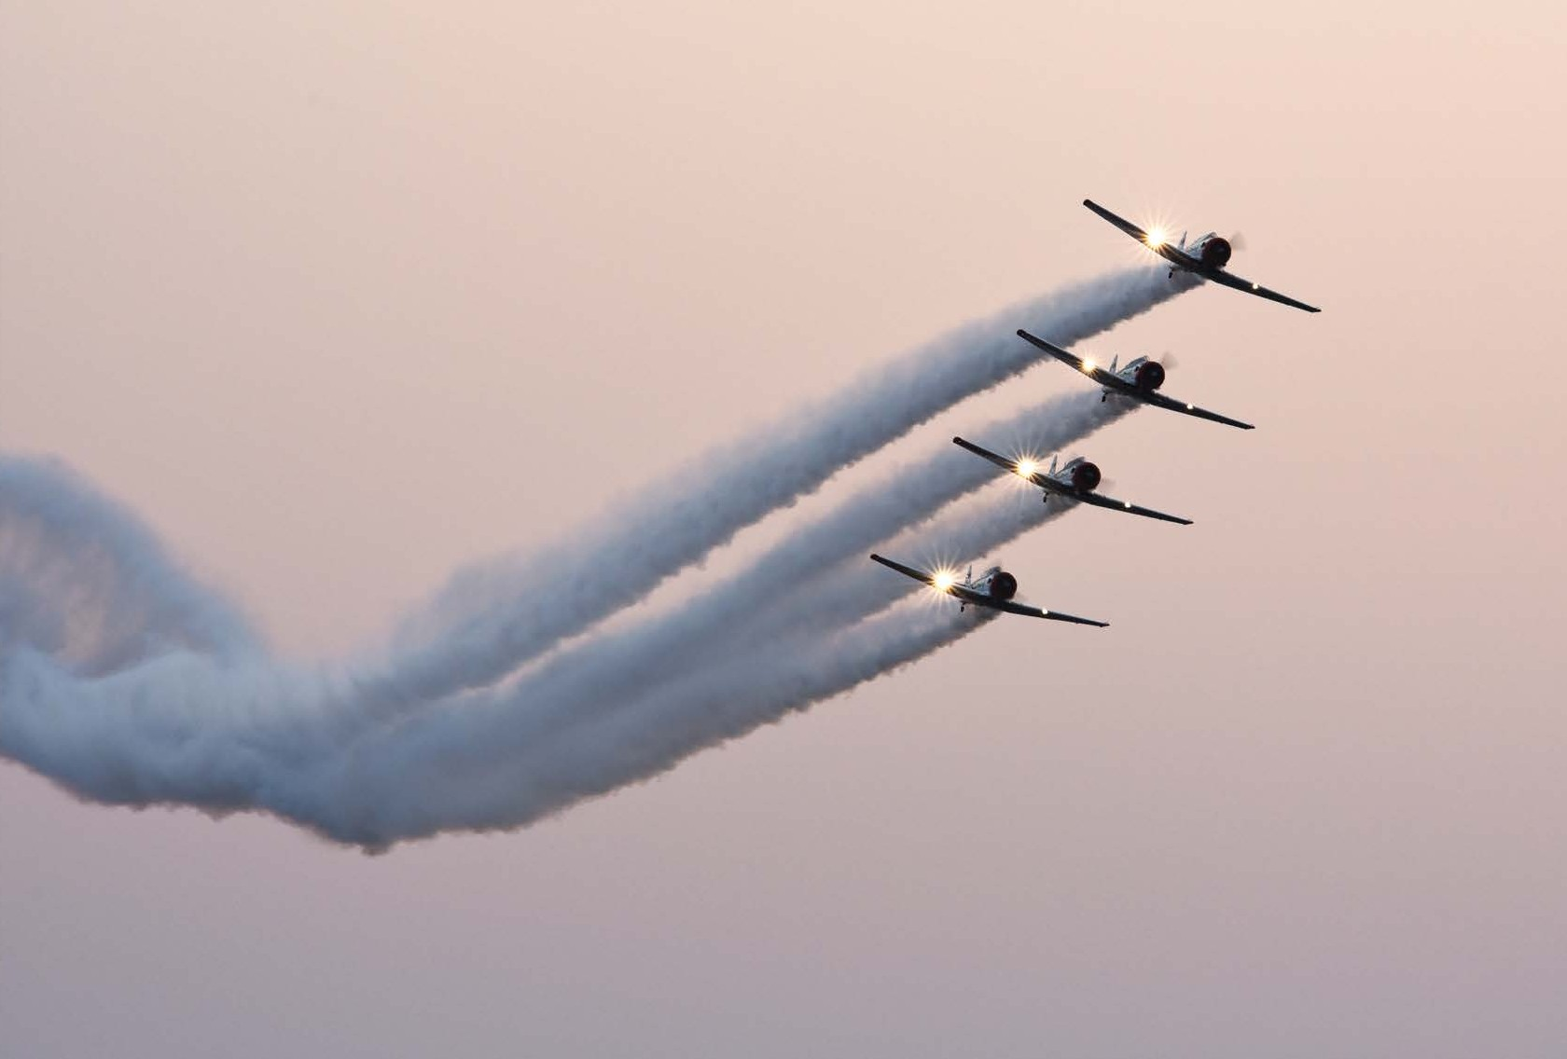





AAD 2022 PRESENTATION
EXPLORING CAPABILITIES AND OPPORTUNITIES IN THE DEFENCE INDUSTRIES IN CZECHIA AND SOUTH AFRICA
11 MAY 2022
10:00-12:00
AIR FORCE BASE WATERKLOOF, CITY OF TSHWANE | SOUTH AFRICA
WWW.AADEXPO.CO.ZA
PARTNERS

Slide 2
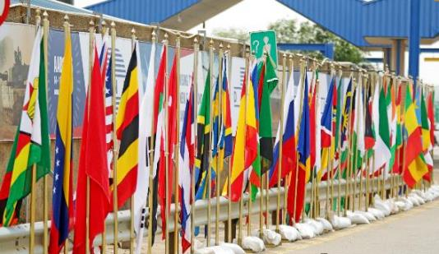
AIM
TO PROVIDE AN OVERVIEW ON AAD 2022
ALL PATHS LEAD TO THE AFRICA AEROSPACE AND DEFENCE EXPO. AFRICA AWAITS!

Slide 3
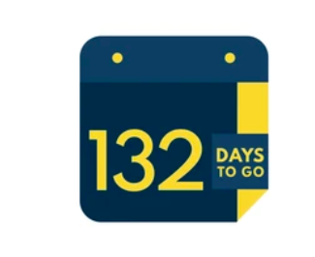
SCOPE
AAD 2022 Overview
AAD 2022 Exhibition
AAD Rates
Contact details

Slide 4
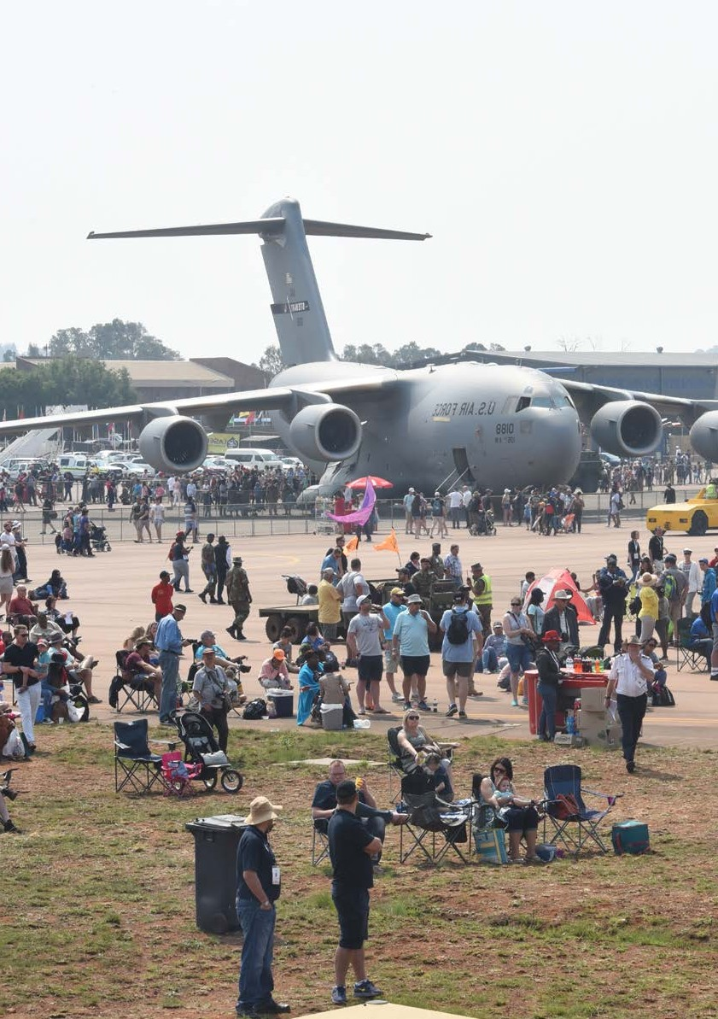
AAD OVERVIEW
The AAD exhibition and air show has been hosted since the year 2000 by the Aerospace Maritime and Defence Industry Association (AMD), the Armaments Corporation of South Africa (Armscor), Commercial Aviation Association of Southern Africa (CAASA), the Department of Defence
AAD2022 will be the 11th edition of the exhibition and air show and is scheduled to take place from 21 to 25 September 2022 at AFB Waterkloof, City of Tshwane.
AAD 2022 THEME: EXPLORING NEW PATHS, SHARING SOLUTIONS AND SHOWCASING INNOVATION AND CAPABILITIES
ALL PATHS LEAD TO THE AFRICA AEROSPACE AND DEFENCE EXPO AFRICA AWAITS!
ALL PATHS LEAD TO THE AFRICA AEROSPACE AND DEFENCE EXPO. AFRICA AWAITS! 1
ALL PATHS LEAD TO THE AFRICA AEROSPACE AND DEFENCE EXPO. AFRICA AWAITS!

Slide 5
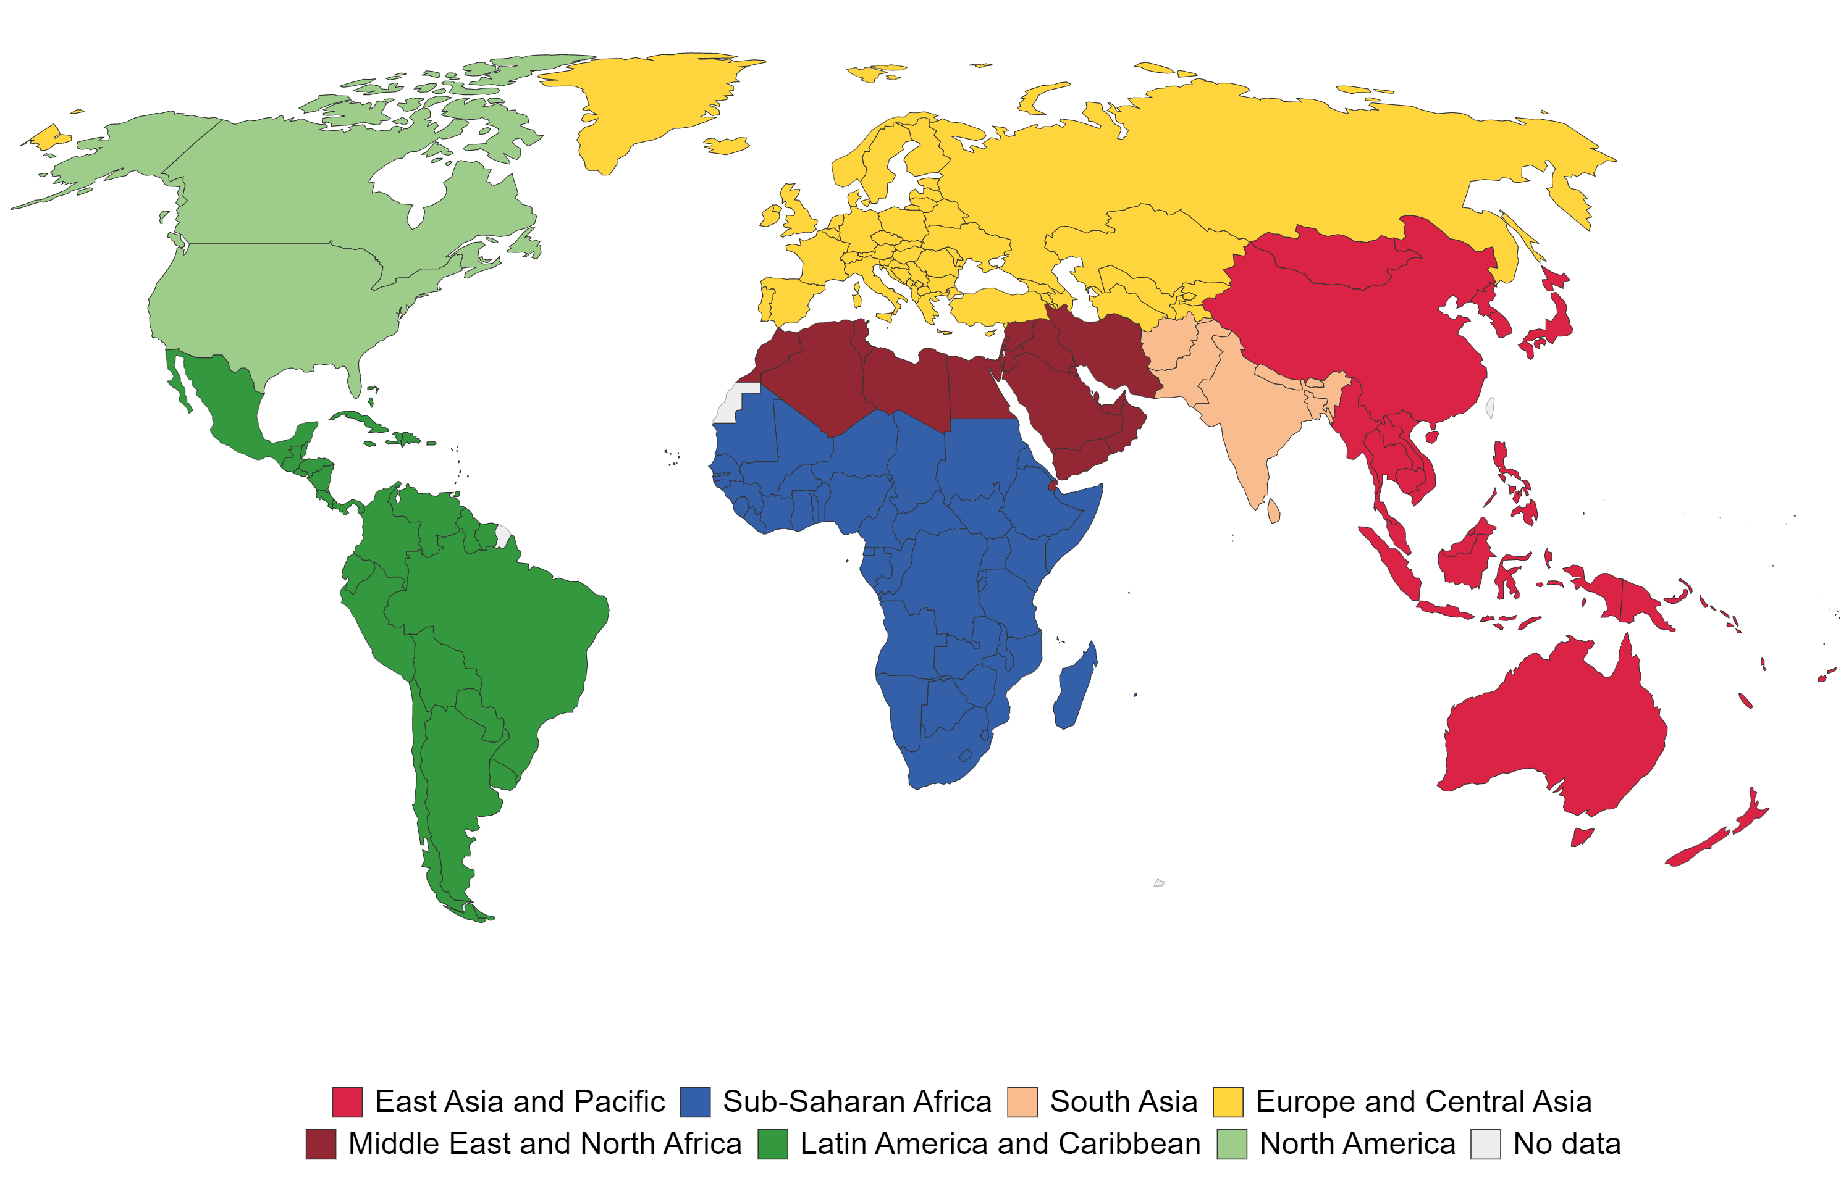

INTERNATIONAL EXHIBITIONS BENCHMARK
AAD is Africa's only exhibition that showcases both Aerospace and Defence technologies.
Ranked amongst the top 6 on the global Defence calendar.
DSEI
IDEF
IDEX
DSA
LAAD
AAD
ALL PATHS LEAD TO THE AFRICA AEROSPACE AND DEFENCE EXPO. AFRICA AWAITS!

Slide 6
AAD 2018 STATISTICS
62
Official delegation from 33 countries
15
National Pavilions
486
Exhibitors from 40 countries
2018 AT A GLANCE
30 129m²
Exhibition space
32 538
Trade visitors from 112 countries
128
Military & civilian aircraft
55 063
General Public visitors
287
Accredited local & international media
ALL PATHS LEAD TO THE AFRICA AEROSPACE AND DEFENCE EXPO. AFRICA AWAITS!

Slide 7
AAD 2022 EXHIBITION
AIR FORCE BASE WATERKLOOF, CITY OF TSHWANE | SOUTH AFRICA
WWW.AADEXPO.CO.ZA
PARTNERS

Slide 8





AAD 2022 Format
Exhibition stands showcasing capabilities
Capability Demonstration’s & Displays
Indoor & outdoor exhibition
Chalet line
Static aircraft part
Airshow Days
On screen demos for land and sea capabilities
Mobility demonstrations
UAV demonstrations (TBC)
3 Trade Days: 21-23 Sep 2022
2 Airshow Days: 24-25 Sep 2022
AAD Innovation Hubs
Parallel Events
GA Hub
UAV Hub
Energy Hub
Conferences
Seminars
B2B Meetings
ALL PATHS LEAD TO THE AFRICA AEROSPACE AND DEFENCE EXPO. AFRICA AWAITS!

Slide 9

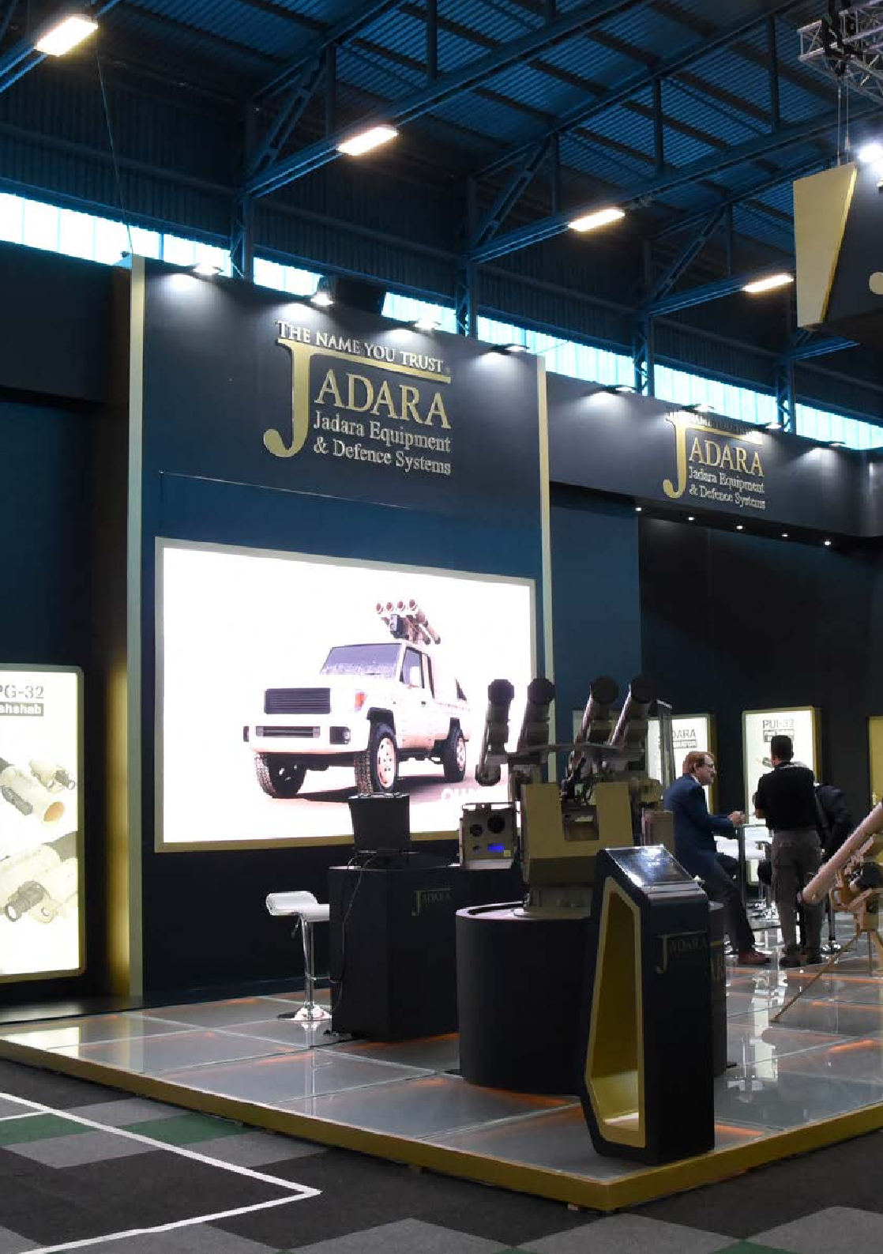








AAD 2022 Target Participants
SPACE TECHNOLOGY
HOMELAND SECURITY
CIVIL AVIATION
ENERGY
Launchers & Spacecrafts
Satellite Navigation
Space Systems & Imaging
Individual Clothing & Equipment
Health & Survival Equipment
Personal Security, Protection & Rescue
Surveillance
Mine Clearance Equipment
Antiterrorism
Special Forces
Commercial Transport Aircrafts
Business & Corporate Aviation Aircrafts
Helicopters
General Aviation Aircrafts
Oil & Gas
Solar
Financial services
Engineering firms
Development Institutions
Petroleum and Refineries
WEAPONS, ARMAMENTS & COMBAT CONTROL SYSTEMS
Missile Weapons & Armaments
Artillery Weapons & Armaments
Lethal & Non-Lethal Ammunition
Pyrotechnics
Launchers & Launching Systems
Fire Control Systems
AIRPORT EQUIPMENT & SERVICES
MILITARY AVIATION & DEFENCE TECHNOLOGY
Military Helicopters
Military Training & Simulation
Air Defence Systems
Combat & Transport Aircrafts
Remotely Piloted Aircraft Systems
C41 / Battlefield Management
Ground Support Equipment & Services
Cargo & Logistics
Airport Security
Air Traffic Management
ATC Equipment
Radar & Navigation Receivers & Transmitters
Simulators & Training Equipment
UAV’S
Airframe Manufacturers
Component / Spare Parts Suppliers
Software Developers
Civil Applications
Military Applications
Law Enforcement Applications
MAINTENANCE
LAND SYSTEMS
Maintenance Repair & Overhaul-MRO
Interiors, Conversion, Modification
Spare Parts Management & Services
Chemicals / Paints / Coating
Fuel / Lubricants
Machines / Tools
Engines
Armoured & Unarmoured Land Combat Vehicles
Logistics Vehicles
Platforms / Propulsion
Robots
Equipment
ORGANISATIONS & ASSOCIATIONS
Governmental & Intl. Organisations
Aerospace & Defence Organisations
Fairs & Events
ALL PATHS LEAD TO THE AFRICA AEROSPACE AND DEFENCE EXPO. AFRICA AWAITS!
ALL PATHS LEAD TO THE AFRICA AEROSPACE AND DEFENCE EXPO. AFRICA AWAITS!

Slide 10



YOUTH DEVELOPMENT PROGRAMME
Invested in the future of Africa’s defence and aviation sectors, through various Youth Development Programme initiatives that form part of the Africa Aerospace and Defence Show.
AAD2022 continues to fulfil its role in creating awareness of the various career opportunities and employment options in the South African defence, aviation and military sectors.
ALL PATHS LEAD TO THE AFRICA AEROSPACE AND DEFENCE EXPO. AFRICA AWAITS! 21 ALL PATHS LEAD TO THE AFRICA AEROSPACE AND DEFENCE EXPO. AFRICA AWAITS! 22

Slide 11
AAD 2022 NATIONAL PAVILIONS
AAD 2022
Bookings Update
Confirmed National Pavilions
China
USA
UK
Belgium
Italy
Turkey
Pakistan
India
Cancelled
Czech Republic
ALL PATHS LEAD TO THE AFRICA AEROSPACE AND DEFENCE EXPO. AFRICA AWAITS!

Slide 12
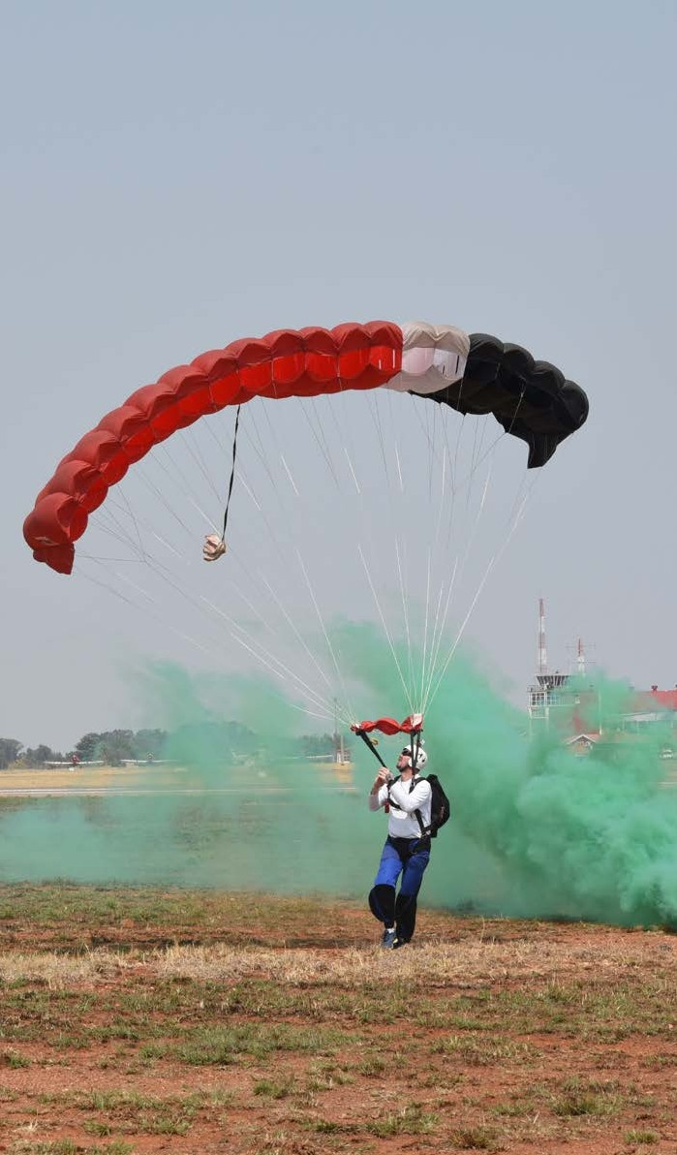















SPACE ONLY
OUR RATES
(min 36m²)
All prices exclude VAT @ 15%
OVER 100M²
1
2
3
For the first 100m² - between 36m² & 100 m²
For the second 100m² or part thereof - the part over 100m² but below 200m²
for the remaining area over 200m²
EARLY BIRD DISCOUNT RATE
Valid from:
1 March 2021
to 30 Sept 2021
R 2 024.00/m²
R 1 676.00/m²
R 1 577.00/m²
R 2 105.00/m
2
R 1 743.00/m
2
R 1 640.00/m
2
R 2 210.00/m²
R 1 830.00/m²
R 1 722.00/m²
DOUBLE STOREY STAND
STANDARD
RATE
Valid from:
1 October 2021
to 30 April 2022
The upper level of the stand will be subject to a charge for the area utilised including the means of access at 50% of the indoor floor space rate.
R 929.00/m²
R 966.00/m²
R 1 015.00/m²
LATE BOOKING
FEE RATE
Valid from: 1 May 2022
CHALET
Single module 75m2 inddor + 75m2 outdoor area
Includes the structure, marques, flooring, carpets, lighting and power as well as picket fencing for the outside area.
The Chalet is supplied as a shell & has no interior fittings.
R 218 559.00
Per chalet
R 227 301.00
Per chalet
R 238 666.00
Per chalet
ALL PATHS LEAD TO THE AFRICA AEROSPACE AND DEFENCE EXPO. AFRICA AWAITS! 11
ALL PATHS LEAD TO THE AFRICA AEROSPACE AND DEFENCE EXPO. AFRICA AWAITS!

Slide 13
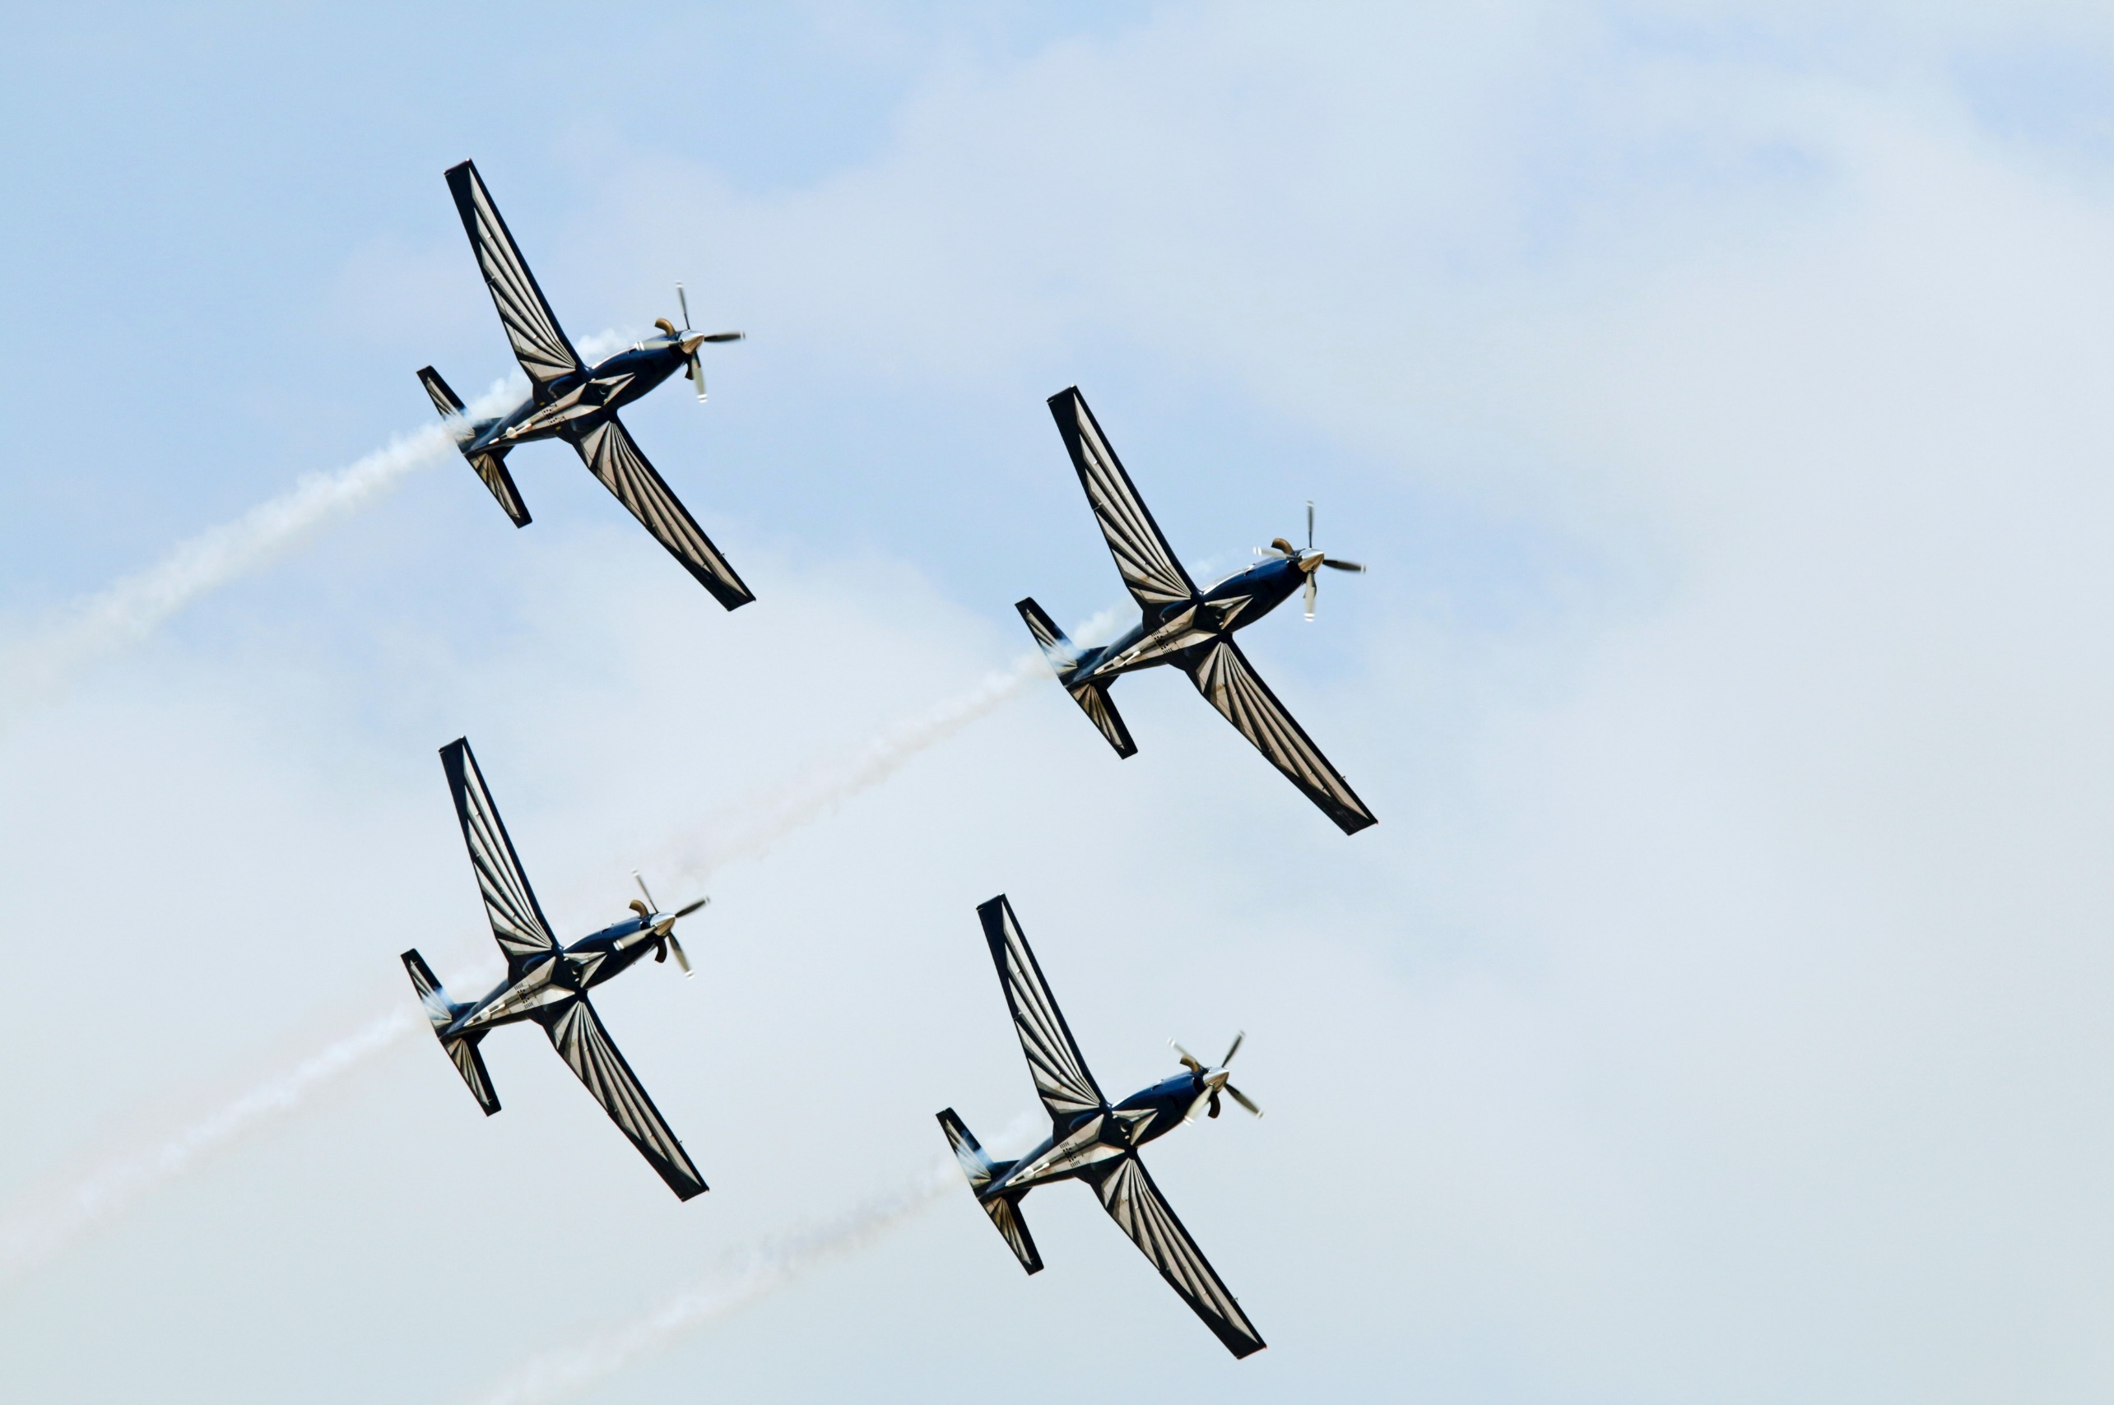

EXHIBITION DIRECTOR
Michelle Nxumalo
Cell: +27 84 840 3215
Email: expodir@aadexpo.co.za
SPACE BOOKING
Busi Nhlanhla
Cell: +27 84 840 3215
Email: sales@aadexpo.co.za
MARKETING & COMMUNICATIONS MANAGER
Nakedi Phasha Cell: +27 82 544 3339
Email: marketingcomms@aadexpo.co.za
FINANCE MANAGER
Portia Ngobeni Cell: +27 72 567 6095
Email: finance@aadexpo.co.za
WWW.AADEXPO.CO.ZA
Facebook: @africaaerospaceanddefence Twitter: @aadexpo | Instagram: @aadexpo
PARTNERS

