Slide 1
Discovery in the Era of Computation
The Future of Computation at the University of Chicago and Argonne National Laboratory

Slide 2
Computation is Poised to Drive the Solutions to Complex Problems
Computation provides a new way to attack complex problems of fundamental importance, such as climate change, food security, energy supply, and disease.
Notes:
Talking Points:
By opening up new lines of inquiry and reducing the time to discovery, computation provides a new way to attack complex problems of fundamental importance, such as climate change, food security, energy supply, and disease.

Slide 3
Basic Research as the Engine of Discovery
Basic research is often the first stepping stone in the entrepreneurial pipeline that drives breakthroughs: from fundamental research in computer science to the size of the iPhone in your pocket.
Notes:
Innovation is becoming a ubiquitous term, with every startup, firm, nonprofit and even bureaucracies claiming to hold the key to innovation.
However, universities approach innovation differently.
One unique element is that we focus on basic research as the engine of discovery. Basic research can be the base of the entrepreneurial pipeline, which supports breakthroughs in other areas and industries: from fundamental research in computer science to the size of the iPhone in your pocket

Slide 4
University of Chicago
UChicago research has had an impact around the globe, leading to such breakthroughs as discovering the link between cancer and genetics, establishing revolutionary theories of economics and developing tools to produce excellent urban schooling.
At a glance:
5,724 undergraduate students, 9,588 graduate students
2,205 full-time faculty
89 Nobel Prize winners, including 6 current faculty
Manager of Argonne National Laboratory and Fermi National Accelerator Laboratory; affiliated with Marine Biological Laboratory
Notes:
One of the world's premier academic and research institutions, the University of Chicago has driven new ways of thinking since our 1890 founding. Today, UChicago is an intellectual destination that draws inspired scholars to our Hyde Park and international campuses, keeping UChicago at the nexus of ideas that challenge and change the world.

Slide 5
Computational Discovery at the University of Chicago
Areas of Excellence in Computation
Cyberinfrastructure technologies
Data Science
Computational Biology
Mathematics and statistics
Education and Training
Notes:
In recent years, the University has made it a strategic priority to build on its core strengths in computation by incubating computational research and education initiatives that go beyond traditional disciplinary boundaries.
Traditional Areas of Excellence in Computation:
Cyberinfrastructure technologies: The University has become a pioneer in cyberinfrastructure technologies, including supercomputers, distributed systems, specialized data clouds, and national-scale data services used by tens of thousands of researchers;
Data Science;
Computational Biology;
Mathematics and statistics;
Education & training.
ing a unifying feature of methodological and disciplinary development and will
be the key to solving many of the world’s most pressing problems. The University has great strengths
in computation, including computational scholars and students in every division and school,

Slide 6
UChicago: Emerging Areas of Strength
The application of computational models to energy and climate policy
.
The generation of solutions to urban issues through computational social sciences
Personalized medicine
Engineering and computer science
Notes:
In addition to the University’s well established strengths, it has burgeoning capacities to lead in multiple facets of computation such as:
The application of computational models to energy and climate policy;
The generation of solutions to urban issues through computational social sciences (Urban Labs);
Personalized Medicine (e.g. Genomic Data Commons);
Engineering and Computer Science (IME, expansion of Computer Science Department).
Strategic Investments in Computation
University is making strategic investments in computer science (e.g. recruitment of new chair of computer science department Mike Franklin), along with computation and applied research that will directly impact innovation in Chicago and beyond.
Training the next generation of computational students: new education and training programs to produce a broad array of talent.

Slide 7
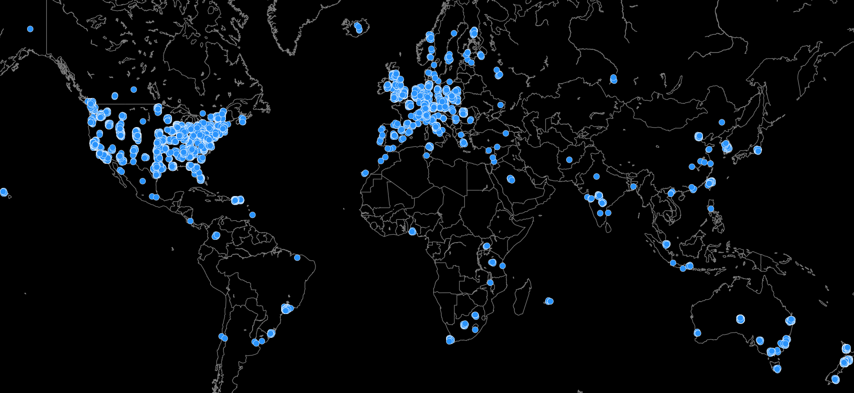
National and International Cyberinfrastructure
Globus endpoints
Notes:
In addition to the University’s well established strengths, it has burgeoning capacities to lead in multiple facets of computation such as:
The application of computational models to energy and climate policy;
The generation of solutions to urban issues through computational social sciences (Urban Labs);
Personalized Medicine (e.g. Genomic Data Commons);
Engineering and Computer Science (IME, expansion of Computer Science Department).
Strategic Investments in Computation
University is making strategic investments in computer science (e.g. recruitment of new chair of computer science department Mike Franklin), along with computation and applied research that will directly impact innovation in Chicago and beyond.
Training the next generation of computational students: new education and training programs to produce a broad array of talent.

Slide 8
Computational Powerhouse: Argonne National Laboratory
World-class capabilities in advanced computing technologies and applications:
Leadership computing facility that advance the scale and pace of discovery (e.g., Mira, the next generation of supercomputer)
Transportation Research and Analysis Computing Center (TRACC)
Advanced Computer Science, Visualization, and Data
Advanced Photon Source, one of the world’s biggest sources of scientific data
Notes:
Computational Powerhouse: University’s partnership with Argonne National Laboratory
Argonne National Laboratory provides world-class capabilities in advanced computing technologies and applications. Argonne leads in the conception, design, construction, and operation of world-class scientific user facilities. These internationally renowned facilities provide the ability to make groundbreaking discoveries that would otherwise not be possible.
Leadership computing facility that advance the scale and pace of discovery (e.g. Mira, the next generation of supercomputer);
Transportation Research and Analysis Computing Center (TRACC)
Advanced Computer Science, Visualization, and Data.

Slide 9
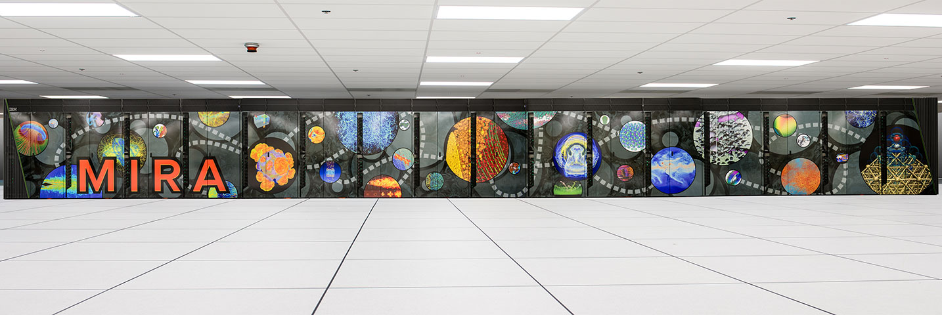
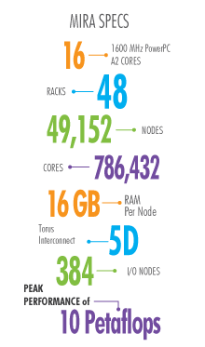
Supercomputers at the Argonne Leadership Computing Facility
Mira is one of the fastest and most energy efficient supercomputers in the world
Capable of 10 quadrillion calculations per second; 180 quadrillion op/sec by 2018.
A stepping stone to exascale, where computers will operate 1000x faster than today’s top machines.
Notes:
IME MIRA
One of the fastest and most energy efficient supercomputers in the world.
Capable of 10 quadrillion calculations per second, Mira can do in one day what it would take an average personal computer 20 years to achieve.
In addition to being one of the fastest computers in the world, Mira is also among the most energy efficient. The supercomputer saves considerable energy through innovative chip designs and a unique water-cooling system.
Beyond enabling scientific discoveries in a sustainable way, Mira itself is a stepping stone toward the next great goal of supercomputing: exascale speed, where computers will operate a thousand times faster than today’s top machines.

Slide 10
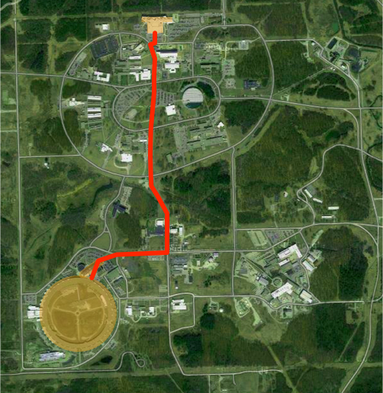
Co-location of world-leading X-ray source and supercomputer → unique new Exascope facility
ALCF-4: 10¹⁸ ops/s
(2023)
We are creating a new facility capable of transformative science
Tight coupling of detectors, data store & computation enables:
Theory for hypothesis testing in advance of experiments
Automated, model- and data-driven steering of experiments
Analysis of combined datasets too large for human understanding
1 Tb/s
~1 km
(5 usec)
(2024)
APS-U: 10²² std units

Slide 11
Chicago Innovation Exchange

Slide 12
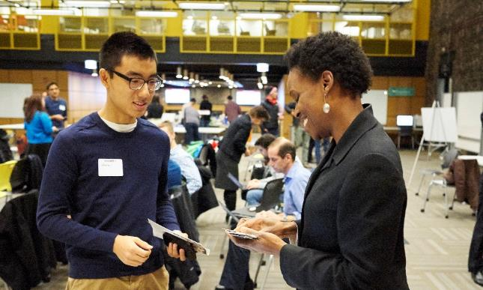
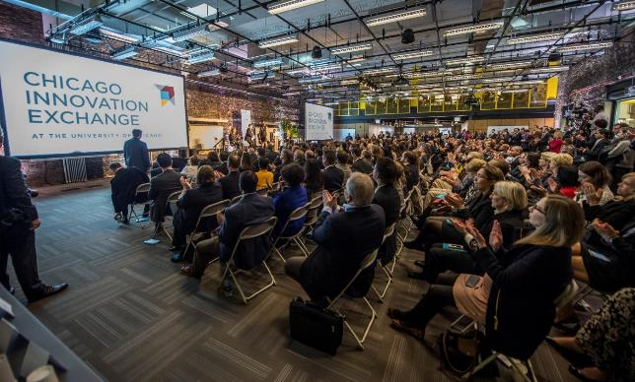
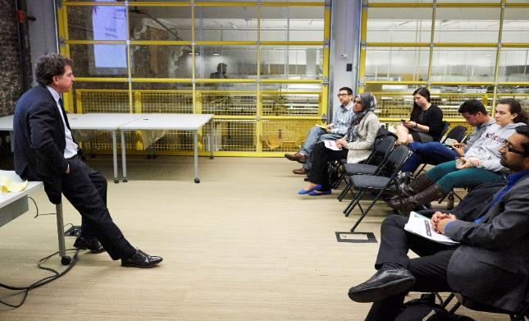
What is the Chicago Innovation Exchange?
The University of Chicago and South Side innovation campus
34,000 square feet of co-working, incubator, and conference space for start-ups
A gateway to corporate and ecosystem connections with access to mentors and programming
A hub for multidisciplinary collaboration between UChicago divisions and affiliates
Notes:
Talking points:
The Chicago Innovation Exchange was created to become a destination for innovation on the University of Chicago campus and within the Mid-South Side of Chicago
Our campus consists of 34,000 square feet of flexible space, including co-working, incubator, conference and event space within 3 buildings:
Our main primary space is the space you’re currently sitting in – nearly 20,000 square feet of conference and meeting rooms, event space, classrooms, incubator and co-working space
We also have additional event and conference space on the CIE Skydeck, which is a block east in the University of Chicago’s office building
And, across the street, we’re building another 7,000 square feet of incubator and office space, as well as a fabrication lab for rapid prototyping, so teams can build models or mock-ups of their ideas and improve and refine their products
3. The CIE is also a gateway to the broader ecosystem of innovation and entrepreneurship across the UChicago campus and throughout the city of Chicago and its surrounding region
We work closely with
The Polsky Center for Entrepreneurship and Innovation, which has close ties to the Booth School of Business
Our colleagues at the University’s technology commercialization office, UChicagoTech.
Two national laboratories, Argonne and Fermilab,
Organizations around the city, like the Chicago Innovation Mentors, which is a consortium of mentors who help researchers commercialize technology, and World Business Chicago.
We also work closely with corporations like
JPMorgan Chase, who is sponsoring a series of workshops we’re offering
Cisco, with whom we conducted an Innovation Challenge for Internet of Things, Analytics and Big Data
And we have a partnership with the College of Engineering at the University of Illinois at Urbana-Champaign, to help connect Booth students with their engineering students and support commercialization and entrepreneurships in the region

Slide 13
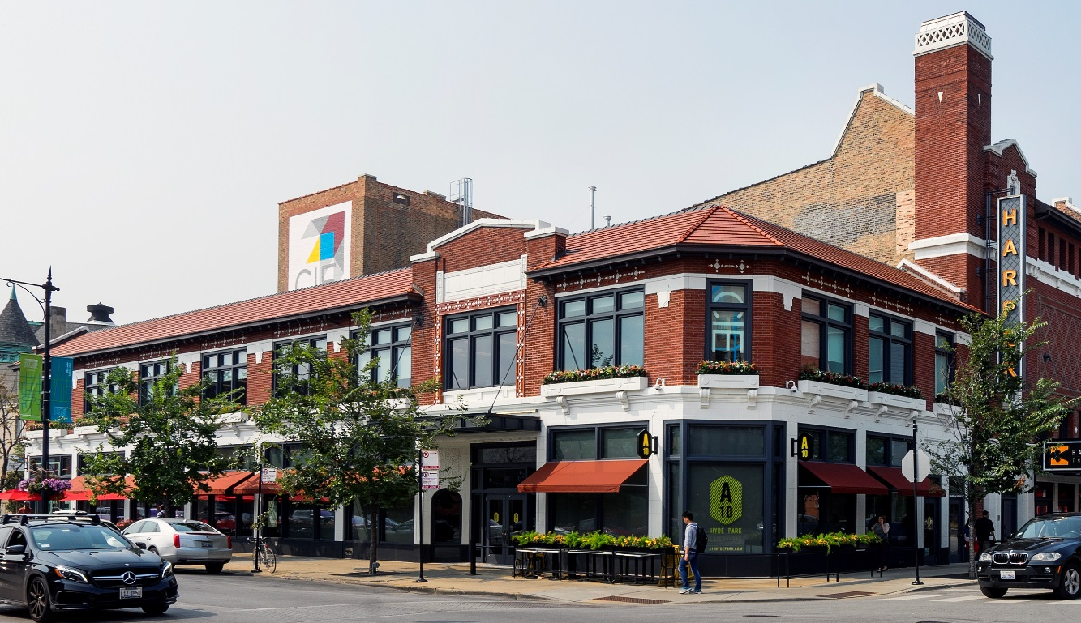
Chicago Innovation Exchange Goals
Helping entrepreneurs launch new ventures, and commercialize novel technologies and products that impact society
Collaborate with Illinois research institutions and corporations to leverage common resources
Elevate Chicago and the greater Midwest region as a global destination for entrepreneurship & innovation talent
Notes:
Talking Points:
The goals of the Chicago Innovation Exchange include helping entrepreneurs launch new ventures, and commercialize novel technologies and products.
We are open to innovation of all kinds, but we’re particularly focused on using science, innovation and entrepreneurship to develop solutions to a variety of societal challenges including improvements in the way we generate and store energy, conserve and treat water, compute and analyze data, provide healthcare, educate our youth and maximize our economy.
As I mentioned, we’re collaborating with Illinois research institutions to leverage common resources
One of our main goals is to really help elevate Chicago and the Midwest region as a global destination for entrepreneurship and innovation talent

Slide 14
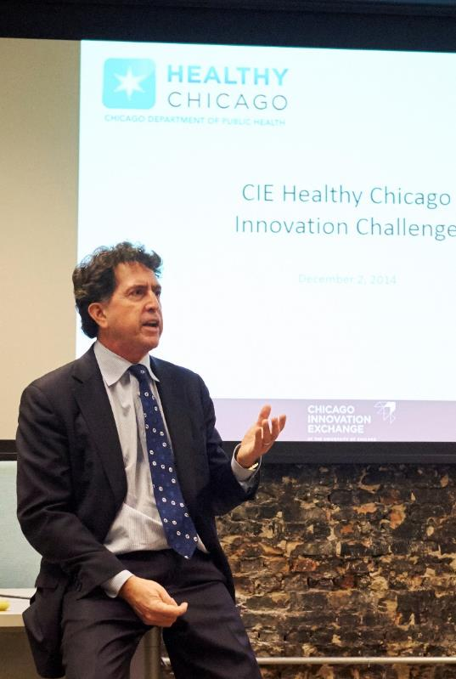
Enabling Entrepreneurs Through Resources
Incubator, co-working and accelerator space for faculty, student, and community start-ups housing more than 2,000 current members (and counting)
Expert-In-Residence programs
Early connections to partners
Fab Lab for prototyping
$20M Innovation Fund to invest in projects that otherwise could fall into the “Valley of Death”
Notes:
Talking Points:
The Chicago Innovation Exchange offers a wide range of resources:
Incubator, co-working and accelerator space – since we opened 2 months ago, we’ve accepted more than 320 members and are preparing to accept our next cohort for the business incubator, which will bring us up to a dozen companies with more than 40 people working on those businesses
Connection to experts-in-residence, mentors who offer their time and advice to help our entrepreneurs reach the next milestone
Opportunities through our partners, like the Chicago Public Health Department, who we’ve partnered with to create the CIE Healthy Chicago Innovation Challenge – which invites students to propose solutions to Urban Health challenge
And our $20 million Innovation Fund, which helps companies bridge the “Valley of Death” between basic research funded by the government and venture investment from outside investors which I will touch on later

Slide 15
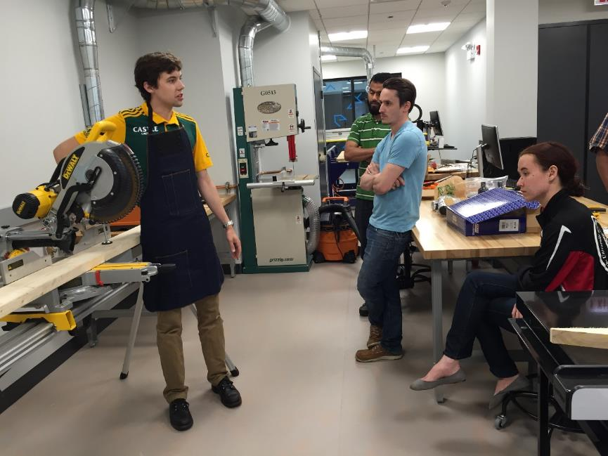
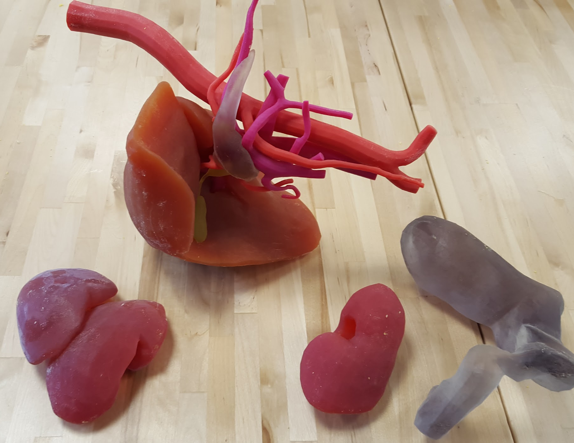
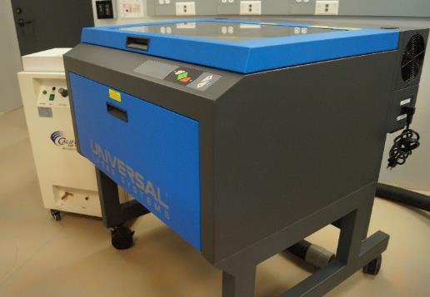
Fab Lab: Prototyping New Products
Computer-numerical controlled (CNC) mills, 3D printers, spray booths, and other tools are available in the lab
Notes:
Talking points:
Our digital fabrication lab provides CIE members the tools they need to translate between digital and physical design.
Entrepreneurs can create models or prototypes, turning their idea into physical objects that they can share, test, and perfect.
We have several of our Incubator companies using the Fab Lab, including Anansi, a physical safety device that is prototyping their wearable in the Fab Lab and about to compete in Polsky Center’s New Venture Challenge finals.
SonicLQ, a company working out of Argonne National Labs that uses sound waves to discover where cold and hot air is spilling from buildings, prototyped their handheld device in our Fab Lab that was used in the Clean Energy Trust Challenge.
We’ve also seen the Fab Lab of interest to UChicago medicine, which is what you see pictured above with a 3D digital model of a cancer of the head of the pancreas.

Slide 16
CIE by the Numbers
600+
Office Hours
600+
Office Hours
$14M
Raised by CIE startups
2,200
Members
750+
Events
30,000
Visitors
750+
Events
Notes:
Talking Points:
Stress that these numbers have happened just over the past 18 months, and they are growing every day.

Slide 17
CIE Diversity
Latino 3%
Multiracial 12%
“We’ve been to almost 50 centers like the CIE, and this is by far the most diverse.”
Demetria Gallagher, Senior Advisor for Policy and Inclusive Innovation, Office of the National Director
U.S. DEPARTMENT OF COMMERCE
Asian American
20%
African American
22%
White
43%
Notes:
Talking points:
We also have an extremely diverse membership base with only 43% of our population white and 22% African American, 20% Asian, 12% Multiracial, and 3% Latino.
Also 9 of our 20 incubator companies have women leaders.
We recently had Demetria from the U.S. Department of Commerce, Minority Business Development Agency, tour the CIE and said that she has been to almost 50 centers similar to ours, and we are by far the most diverse.

Slide 18
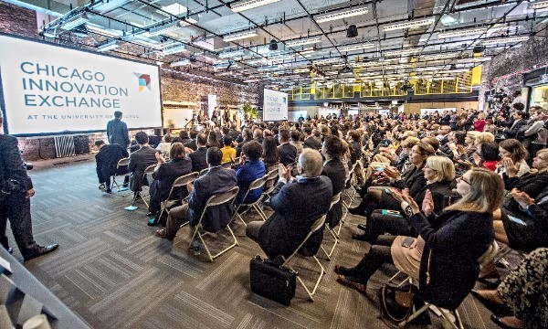
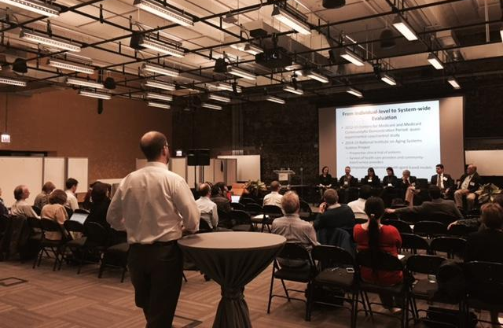
CIE Event Highlights
Megan Smith, CTO of the United States, lead a roundtable discussion with CIE startups and community leaders about diversity in tech
University of Chicago Convening on Urban Data Science brought together academic, research, and industry leaders to discuss the integration of social science, data ethics, and urban data science
Elizabeth Scott, previously Chief Media and Digital Officer at Lincoln Center for the Performing Arts, brought over 100 people as part of our Arts and Innovation series with Logan Center for the Arts
Obama Foundation reception, welcoming Michael Strautmanis as new VP of Civic Engagement, brought an elite crowd of over 200 community and UChicago members
The Polsky Center i-Corps Program, funded by NSF, led its 6th cohort at CIE. The program has trained 60 projects from across campus, including BSD, PSD, UCMC, Booth, ANL, and CI
18
Notes:
Talking points:
One of the exciting things about our diversity is it is what attracted Megan Smith, the CTO of the United States to come to the CIE while in town. She toured the CIE and lead a roundtable discussion on the importance of diversity in tech, sharing her experience and insights to a room full of community partners and startups.
We also recently hosted events such as the University of Chicago Convening on Urban Data Science and Obama Foundation’s announcement of Michael Strautmanis. Both brought leadership from all over to the CIE.

Slide 19
University of Chicago Innovation Fund
$50-250K
Proof-of-concept funding for each company
$20M
Total fundraise
for the Innovation Fund
21
Multidisciplinary Innovation Fund associates
2-5
Companies funded each round
Notes:
Talking points:
The University of Chicago Innovation Fund is a $20M fund that invests in early business development and proof-of-concept work for ventures created by faculty, students, and staff.
The fund is managed by CIE in partnership with UChicagoTech and Polsky Center for Entrepreneurship.
The fund focuses on commercializing early stage research and supporting emerging companies at the University and its affiliates, Argonne National Laboratory, Fermi National Accelerator Laboratory, and the Marine Biological Laboratory. The fund supports projects with high potential for societal and commercial impact, helping to bridge the gap between basic research funding and commercial investment.

Slide 20
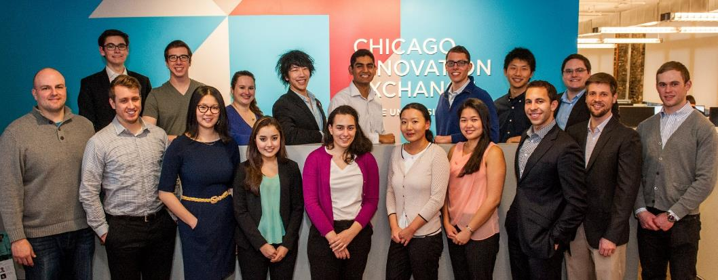
Innovation Fund Student Associates
Innovation Fund Associates (IFA) act as venture capital associates, assisting with assessing and selecting Innovation Fund projects
Multidisciplinary teams of students include Chicago Booth MBA candidates, PhD & Post-Doc students in the sciences, Harris School students, Law School students, and students from The College
Students receive robust training in diligence, presentation skills, market analysis, and commercialization paths
Notes:
Talking Points:
The Innovation Fund Associates are a group of students that act as venture capital associates and run diligence on the Innovation Fund companies. They:
Generate market-based feedback
Assess IP/concept and potential financial returns
Identify critical issues
Validate the path to market
Co-develop technical, business, funding, and talent plans
2. The teams come together from schools across campus including Chicago Booth, PhD & Post-Doc students, Harris School, Law School, and students from the College
3. The students receive robust training

Slide 21
Fall 2015 Innovation Fund Winners
RiMO Therapeutics - $250,000 to help study its proprietary high-precision cancer treatment in humans. Their scalable solution, which uses nanotechnology to deliver low dose X-ray treatment, is highly effective in eradicating solid tumors.
Praedictus Climate Solutions - $125,000 to validate their system with additional crops and in new geographies. Praedictus has developed new software tools that provides more accurate and timely projections of crop yields than current approaches. The Innovation Fund awarded the team
Navipoint Genomics, LLC - $175,000 to support the development of the team’s advanced genomics analysis platform. The innovative technology allows them to transfer and analyze full human genomes 50- to 100-times faster than competitive solutions, and speed up the time for large scale analysis from months to days.
Notes:
Talking Points:
RiMO Therapeutics was the first startup to receive our UCGo! Startup License, which is an optional, standardized license agreement that was created in partnership with UChicagoTech, to increase entrepreneurship at the University.
The license agreement streamlines and simplifies the process for licensing University intellectual property and shortens the timeline for companies to have the ability to launch and minimizes legal costs.

Slide 22
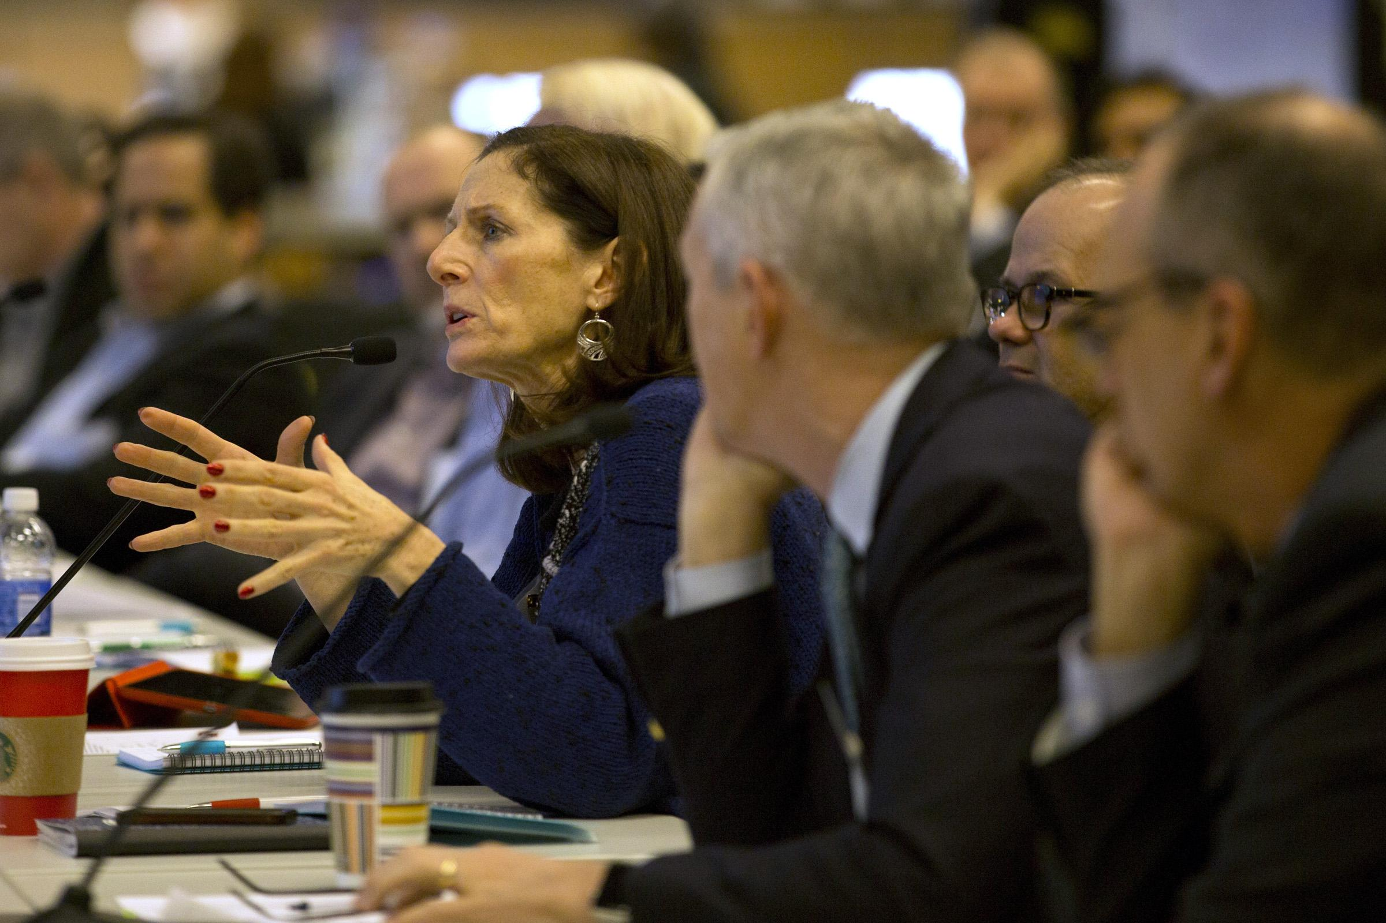
Spring 2016 Finals on June 1
Our five finalists will compete for a portion of the $20M fund
Technologies range from DNA Replication, voting, cancer treatment, obesity, and language, all with huge potential for societal impact.
Teams come from multiple disciplines and across campus, including Argonne National Labs
Notes:
Talking Points:
Twice per year we hold our finals, and our Spring 2016 Finals will be held June 1 at the CIE.
Our Five Finalists will compete for a portion of our fund. This is only the second year we’ve opened it to the public, and this year we have the Inc. Editor in Chief as the keynote.
Note: these are very simplified notes on the teams, but if you plan to really touch on them, I can give more details. This is given more for potential questions.
BallotReady (online voting guide) - Harris School
Beige Therapeutics (therapeutic treatment for obesity) - UChicago Medicine and Illinois Institute for Technology
Infrared Polymerase Chain Reaction (formerly Nucleic acid detection - developing cheap, highly mobile, and low energy methods for precise detection and rapid diagnosis of new contagions) - Physical Sciences Division
Minimally Invasive Electron Radiation Therapy (irradicate cancers that are difficult to treat with x-rays, such as bone metastasis, tumors near the spine, and inoperable tumors) - Argonne National Laboratory
Rzhetsky Language Science (“text” filter” technology that uses a mathematical representation of a significant body of text that captures the native relationships between words and can help users tune their writing to more accurately reflect their intentions) - UChicago Medicine and UChicagoTech EIR

Slide 23
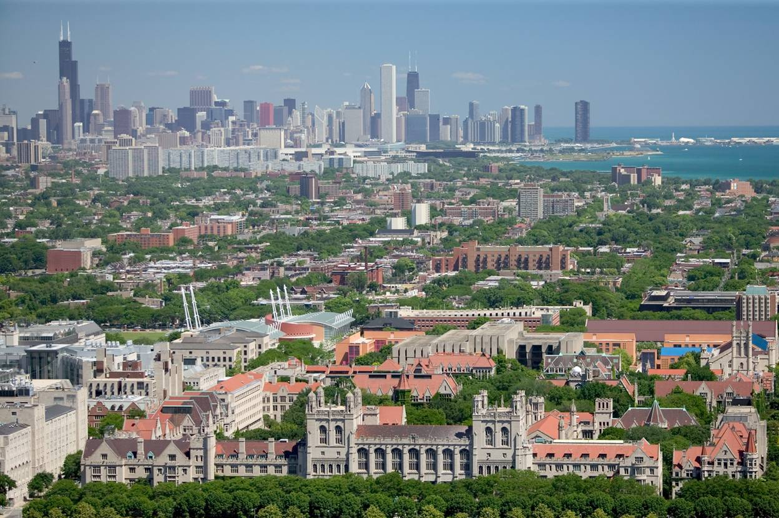
Q&A

