Slide 1
Mitas: North American production basis- agro tire production facility
Chicago,IL May 2016
Vladimír Dušánek –VicePresident, CFO/treasurer, US-project director

Slide 2
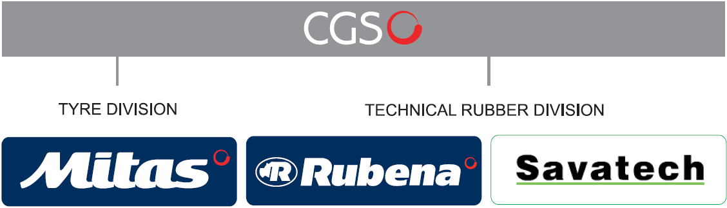
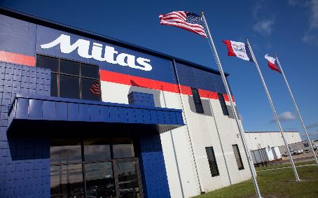
Mitas belongs to Ceská gumárenská společnost a.s. …. .
CGS revenues in 2015 16,2 mld CZK
Mitas Tires North America,Inc.
Notes:
Source: Hana Černá CGS.

Slide 3
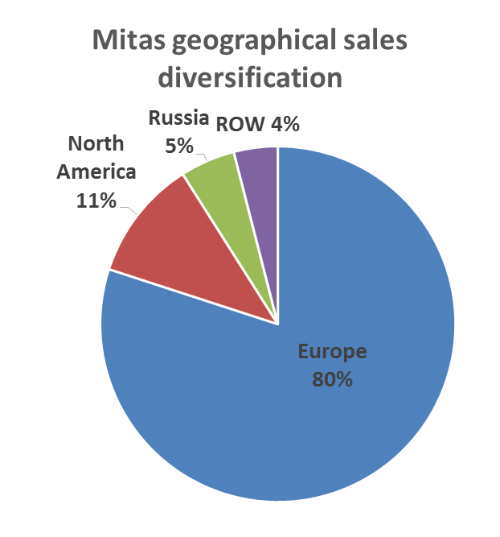
Mitas Tyre Division key facts….
80 years of experience manufacturing tyres
Oriented in production of radial farm tyres
No. 1 in sales of combine tyres in EU
No. 1 market share in Germany
No. 3 in Europe + North America markets (according to market share)
every 3. agricultural tyre sold in EU by European manufacturers is produced by Mitas company cluster

Slide 4
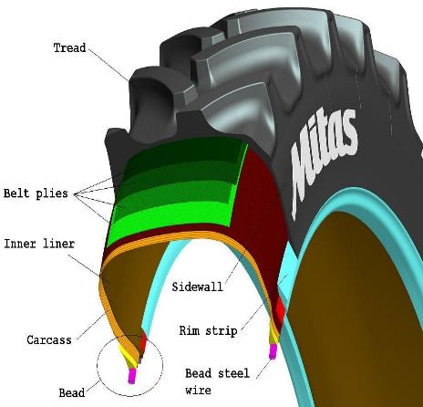
modern contruction….
Carcass: The plies of cord fabric extend from bead to bead and are the reinforcing parts of the tire. The plies are turned up around the bead, thereby locking the bead into the tire carcass.
Beads: The beads are composed of high – tensile steel wire formed into inextensible hoops. The bead functions to anchor the plies and to hold the assembly on the rim of the wheel.

Slide 5
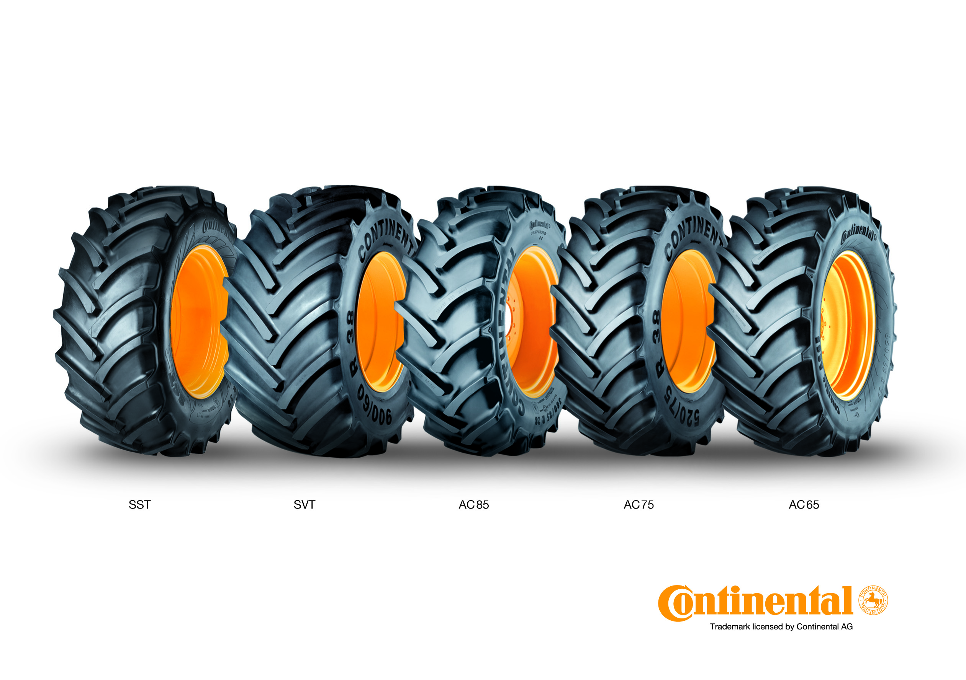
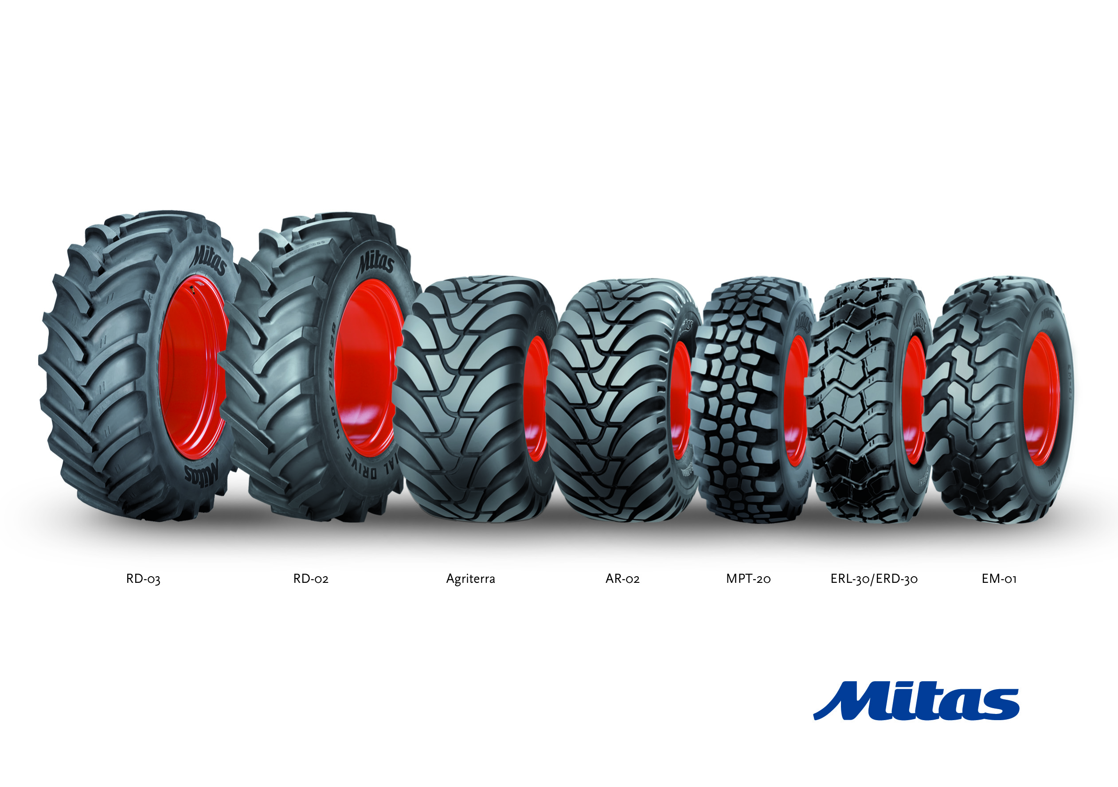
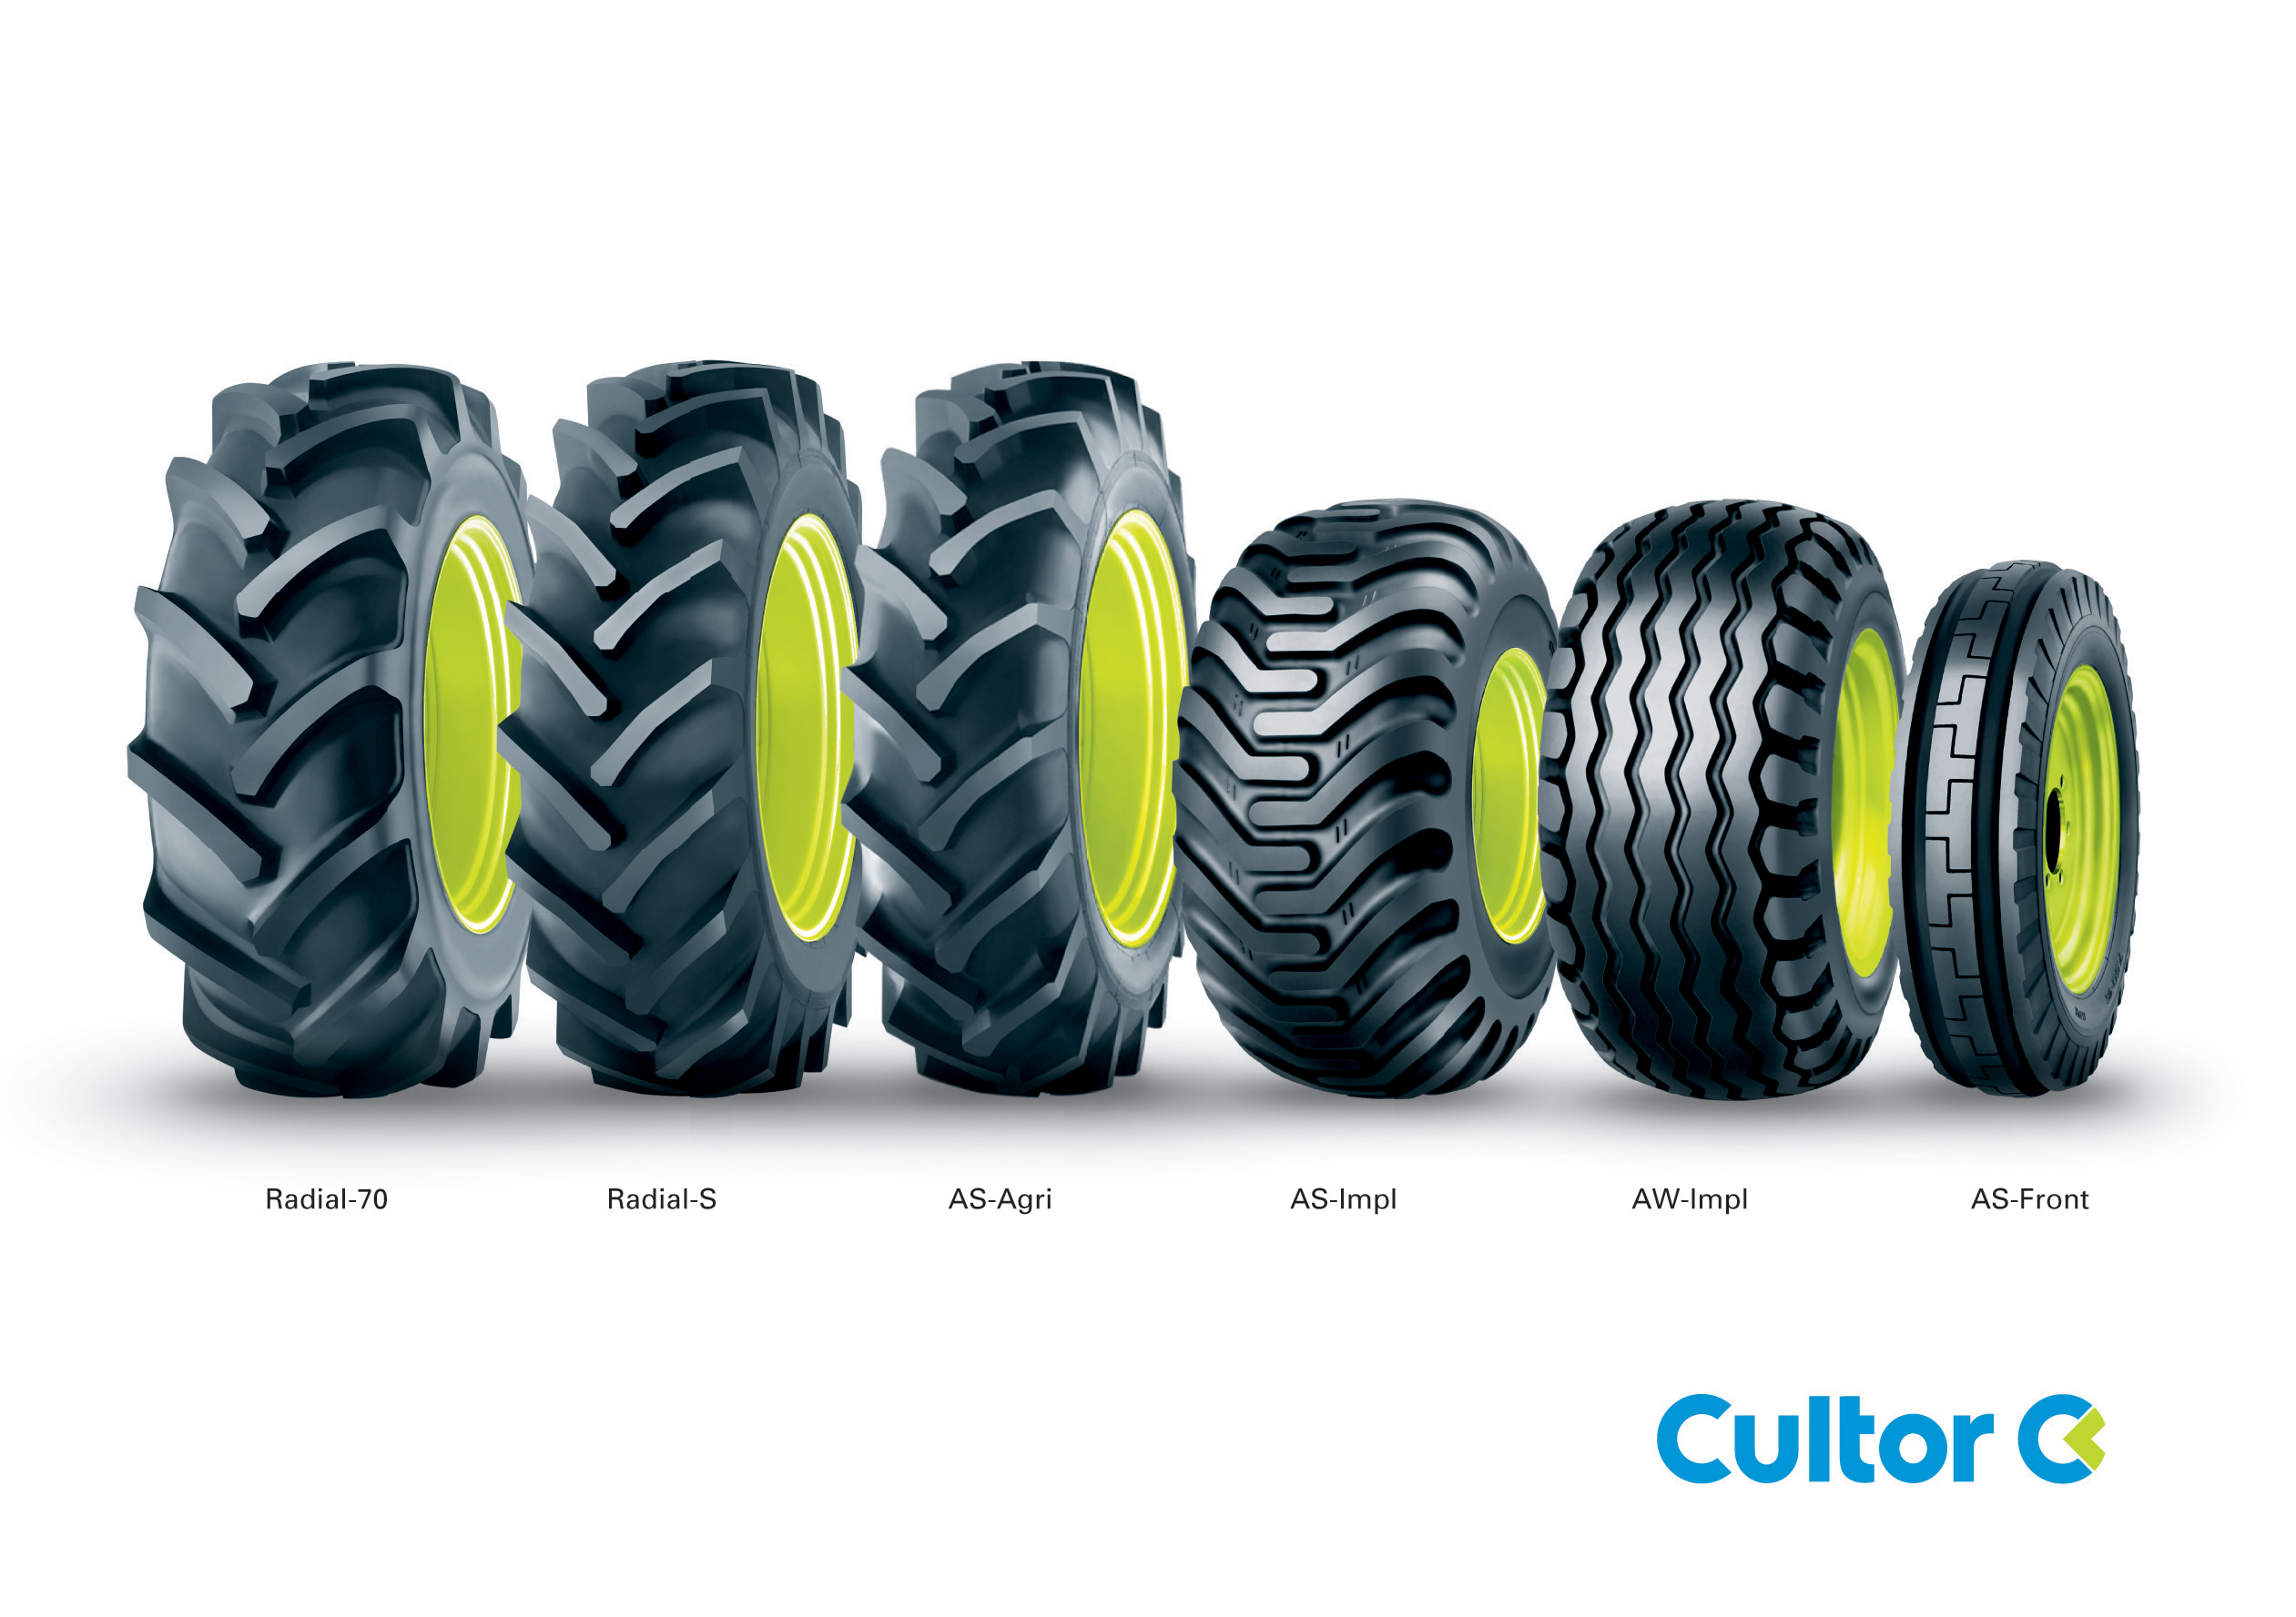
Mitas –brand policy…..
= licensed brand
own brands

Slide 6
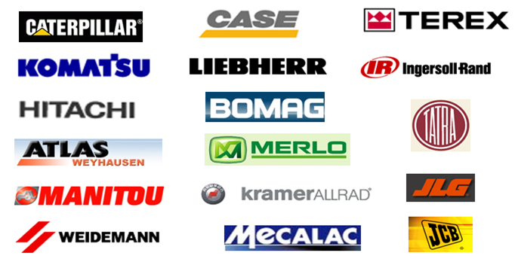
MITAS-industrial tires referencies…

Slide 7
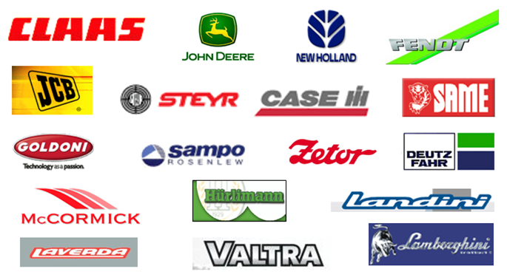
Mitas-agricultural tires referencies…

Slide 8



4. MITAS TIRES NORTH AMERICA INC.: production basis
MITAS: North American production basis- tire production facility project….
Original Investment = 52 Mio USD, current value = 66 Mio USD
Production = max 14 000 mtonne
Created jobs = current 147 +12
Assortment = 397 items (tires 78 = tires, 41 compl. wheels, 278 imports)

Slide 9
why to be in just USA as a producer ……?
Rear Radial market in USA and Canada is steadily growing (by 25% from 2007) . Rear Agro Ratio 2009 - Bias 65% Radial Tires 35%
High perception of Mitas by European tractor OEM considered as an advantage in development of supply partnership with US OEM (John Deere, CNH, Claas, AGCO, Kubota,..).
Significant market position in USA can be taken only by local manufacturers (very high logistic costs and fx rate fluctuation are natural protection).
Mitas Tires North America, Inc. (formerly named CGS Tires US, Inc.) is active on the US market since 2000 and represented there with its own subsidiary in Charlotte, NC. Our share of market in 2016 in North America is about 11%
Incentives package for „made in U.S.A“ producers was interesting, the chance take advantage of current economical circumstances (low production facility prices,etc)

Slide 10
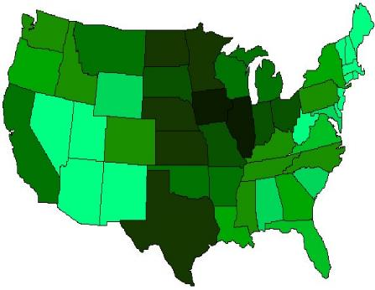
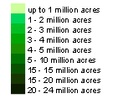
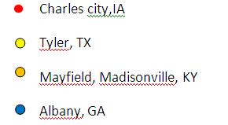
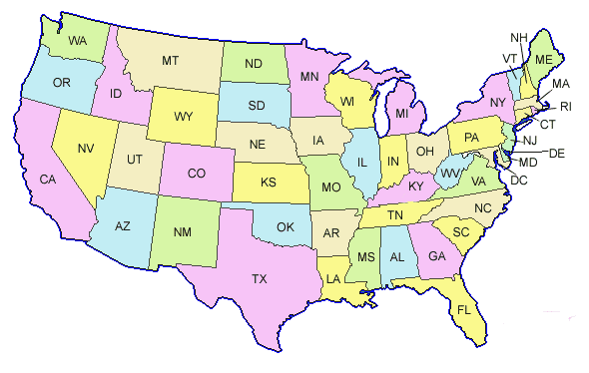
location…..
Crop yield map of USA
Originaly considered facilities in USA

Slide 11
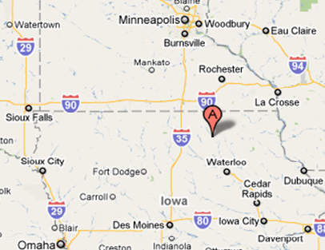
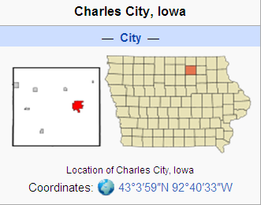
location – finally selected area…. .

Slide 12
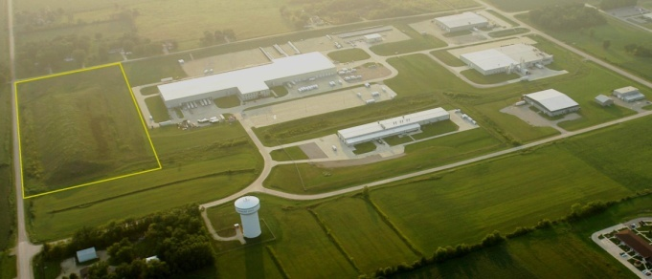
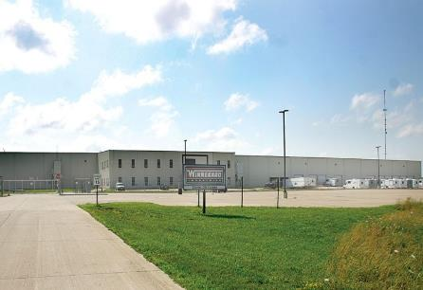
facility….
Mitas Tires North America, Inc.
1200 Rove Avenue
Charles City, IA 50616
U.S.A
area for further possible expansion…. .
former Winnebago production plant, Charles City, Iowa

Slide 13



4. MITAS TIRES NORTH AMERICA INC.: production basis
project partners….
The main project partners 1:
1) Iowa Department for Economic Developement
2) Charles city Area Development corporation
3) Citi bank Czech republic
4) Export Guarantee and Insurance Corporation (EGAP)
incentives
IOWA life | changing®
incentives
Area Development
Corporation
external financing
external financing

Slide 14






The main project partners 2:
5) University of Northern Iowa (IWRC)
6) North Iowa Community College
7) city of Charles City
8) MidAmerican ENERGY
9) Tebodin + Point Builders +
permits
workforce
municipality
energy sources
construction management

Slide 15
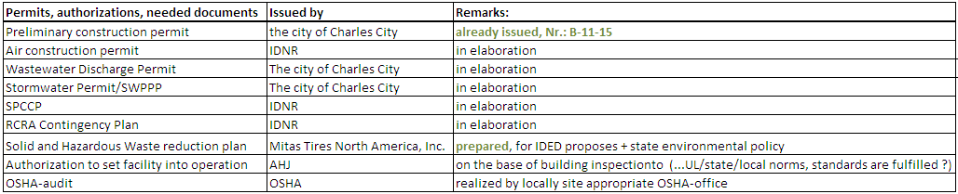
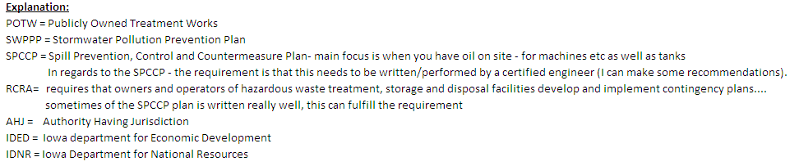
permits, authorizations, needed documents….

Slide 16
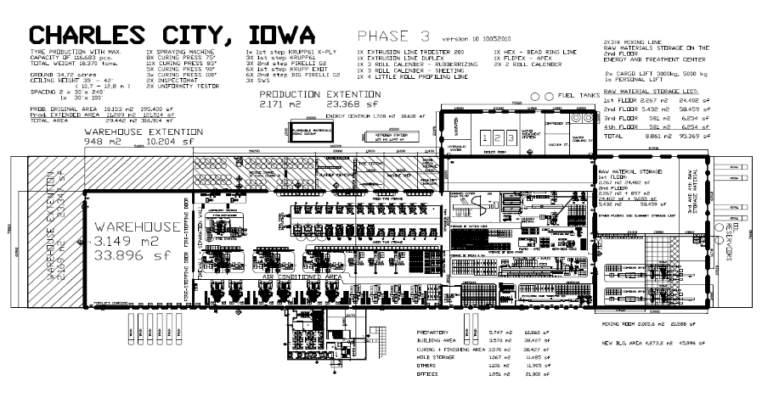
facility….
phase 1 = basic remodeling for tire production + construction of new energy centre
= phase 2 (warehouse+production extension)
= phase 3 (own mixing capacities)
former Winnebago production plant, Charles City, Iowa

Slide 17
result: most modern manufacturing agro tire plant in North America…. .
….used project method: IPD-Integrated Project Delivery method / crystal / „scrum“
2007 2008 2009 2010 2011 2012 2013 2014
1. 2010,July/August:
Investment Incentive Program presentation (IEDA)
Agreement signed with State of Iowa
2. 2011, April:
start of construction
3. 2011, October:
installation of production technology
4. 2012, April,26:
inauguration of the plant and start of production
Production programme to date April,26 2014
Tractor radial tires | 18 units curing presses | 14 000 tons/y

Slide 18
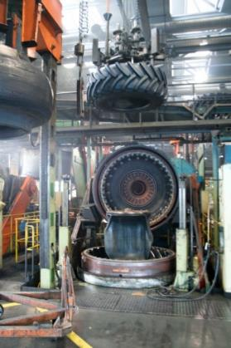
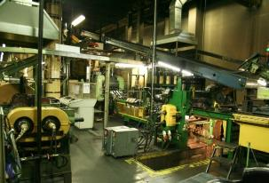
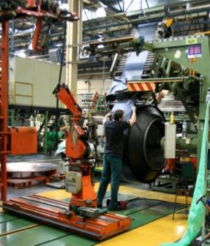
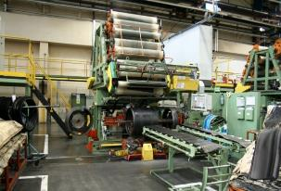
really heavy industry……

Slide 19
Thank you for your attention…

