Slide 1

AMD
PRESENTATION
RSA – CZECH REPUBLIC WEBINAR
11 MAY 2022
VIRTUAL VIA MS TEAMS

Slide 2

SADI
Industry Vision- Rationale
Aerospace and Defence is the Apex Ecosystem to ensure a smooth and successful transition to the fourth economic wave (4IR).
Digital tech (and ICT) is the means by which the apex ecosystem and all others are supported- like electricity in the 3rd Industrial wave, it is the means to transition, not the end.
Without the technology developed by the industry, we will not transition optimally through the interregnum between the 3rd and 4th waves.
  We will become technology takers (and price takers)
  We will be vulnerable to sovereign pressure
  We will not diffuse competitive technology throughout South Africa industry;
  Our citizens will not benefit as they must, from the Fourth Economy Wave – inequality and poverty will increase and;
  We will be less able to protect ourselves
Source: A&D Master Plan, 2020

Slide 3
AMD/SAAMDEC INTRODUCTION
AMD represents the South African Industries (SADI):
AMD/SAAMDEC Members
As an Industry Funded Association, serving the common interest of its members;
Recognised as such by Government and the broader aerospace and defence industry;
Governed by an elected Board of Directors comprising CEO’s of SADI Companies
The South African Aerospace, Maritime and Defence Export Council (SAAMDEC) is the only government recognised and supported Export Council for the Defence and Aerospace Sector Established jointly by the dtic and AMD
AMD/SAAMDEC Introduction
Growing
Export Volume and Value
Growing
Export Base
Diversifying
Export Base
Diversifying
Export Markets
AMD, The Representative Voice of the Defence Industry, as recognised by:

Slide 4

























































AMD/SAAMDEC Members
SADI Members
AMD/SAAMDEC Members
120

Slide 5
AMD/SAAMDEC Capabilities
LOGISTICS
TRAINING
AEROSPACE
DESIGN
SHIPBUILDING
MISSILES
RADARS
MANUFACTURING
C4ISR
AMMUNITION
R&D
CONSULTING
ARMOURED VEHICLES
MINE PROTECTED VEHICLES
OPERATING
UPGRADING
EVALUATION
MRO
UAV’S
TESTING
ENGINEERING

Slide 6
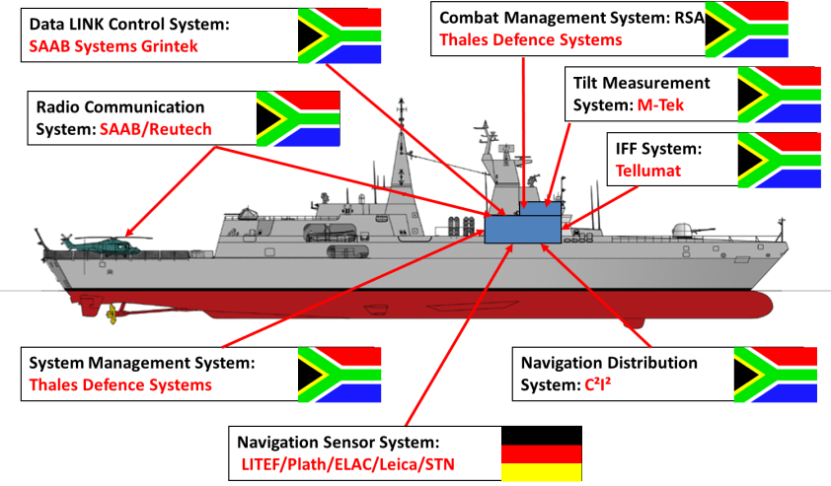
SADI Capabilities (2)

Slide 7
SADI Exports
AMD/SAAMDEC Members
AMD/SAAMDEC Introduction

Slide 8


SADI: Supplier to International Customers
AMD/SAAMDEC Members
Products:
Artillery Target Acquisition
Artillery Systems (G5 / G6)
APC / ISV / IFV
C³I² Systems (Radios Incl)
EW Systems
Mi-24 Upgrade
Mine Protected vehicles
(RG31, RG32M, RG12)
Mirage F1AZ Upgrade
Seeker UAV System
Sensors
Surface-to-Air and Air-to-Air Missiles
Training Systems
Vulture UAV System
Cyber Security Solutions
Customers:
Algeria
China
Canada
Finland
Jordan
Oman
Kuwait
Malaysia
Saudi Arabia
Slovakia
Sweden
Turkey
UAE
USA
AU and UN
35 African Defence Forces
European OEMS
(UK, France, Germany,
and Sweden)
AMD/SAAMDEC Introduction
SADI: GROWING SUPPLIER IN EXPORT MARKET

Slide 9
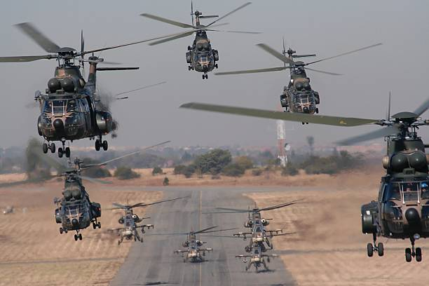

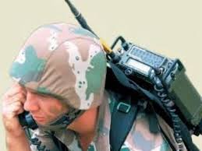
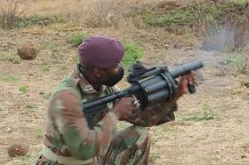
Opportunities in SADI environment
AVIATION & MISSILE
  Airframe structure
  Rotors & rotor systems
  Sensors & seekers
  Guidance, navigations, and control
  Propulsion
  Counter – UAS
  Visualization
  Anti-access/area denial
  Missile defence
ARMY RESEARCH LABORATORY
  Extramural Basic Research
  Computational Sciences
  Materials Research
  Sciences-for-Maneuver
  Information Sciences
  Sciences for Lethality and Protection
  Human Sciences
  Assessment & Analysis
  Advanced Computing & Big Data
  Agile Manufacturing
  Synthetic Biology
ICT, command & control, intelligence, surveillance and reconnaissance
  Mission command
  Tactical and deployed power
  Tactical cyberspace operations
  Electronic warfare
  Intelligence, surveillance, reconnaissance and targeting
  Network
  Prioritize position navigation and timing
ARMAMENTS
  Munitions systems & technologies
  Integrated weapon systems
  Energentics, warheads & manufacturing
  Guidance, navigations & control
  Fuze & precision armanate technology
  Cross domain fires
09

Slide 10
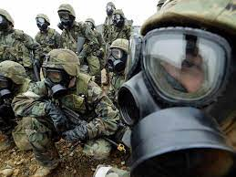
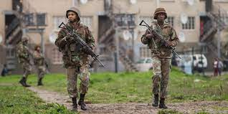
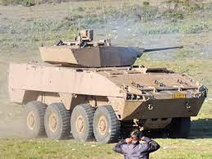
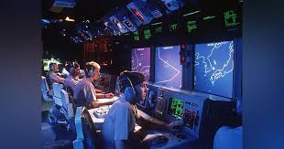
Opportunities in SADI environment
CHEMICAL & BIOLOGICAL
  Chemistry and Biological Sciences
  CB Agent Handling and Surety
  CB Materiel Acquisition
  CB Analysis and Testing
  CB Munitions and Field Operations
SOLDIER CENTRE
  Advanced/ Multifunctional Materials
  Biomechanics
  Cognitive & Behavioural Sciences
  Food Science
  Geographic/ Precision Guided Systems
  Soldier Performance Optimization
  Biological Technology
  Neuro-cognition
GROUND VEHICLES SYSTEMS
  Ground Vehicle Survivability
  Autonomy-Enabled Systems
  Vehicle Electronic Architecture
  Ground System Software
  Ground Vehicle Power& Mobility
  Robotics/Autonomous Systems
  Combat Vehicles
  Advanced Protection Systems
DATA & ANALYSIS
  Certified Item Level Performance Data
  Models, Simulations, & Tools
  Life-Cycle Systems Analysis
  Vulnerability / Lethality Technical Analysis
  Soldier-Centered Performance Design Analysis
09

Slide 11
Why Partner with the SADI?
South Africa remains the gateway to Africa – SSA.
Availability of expertise and know-how.
Well established sector – and value chain.
Trusted (and resilient) companies within the defence community, globally.
IP portfolio (in government and private sector) of products ready for commercialisation.
South Africa is a global leader in key sectors and has historically developed ground-breaking world class products which were international “firsts” such as:
    Frequency agile radios
    Long range artillery (G5 and G6)
    Mine-protected and mine detection vehicles.
    Missiles
    Rooivalk

Slide 12
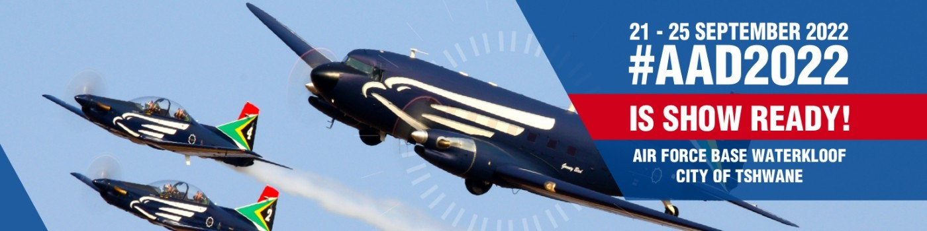
Upcoming events

Slide 13
CONTACT DETAILS
AMD/SAAMDEC Members
Mr Sandile Ndlovu
Chief Executive Director: SA AMD Export Council
Cell: +27 79 891 9111
Tel: +27 12 752 5880/2
Email: sandilen@saamdec.org.za
Website: www.saamdec.co.za
www.amd.org.za
AMD/SAAMDEC Introduction

Slide 14
Q&A
PRETORIA

