Slide 1
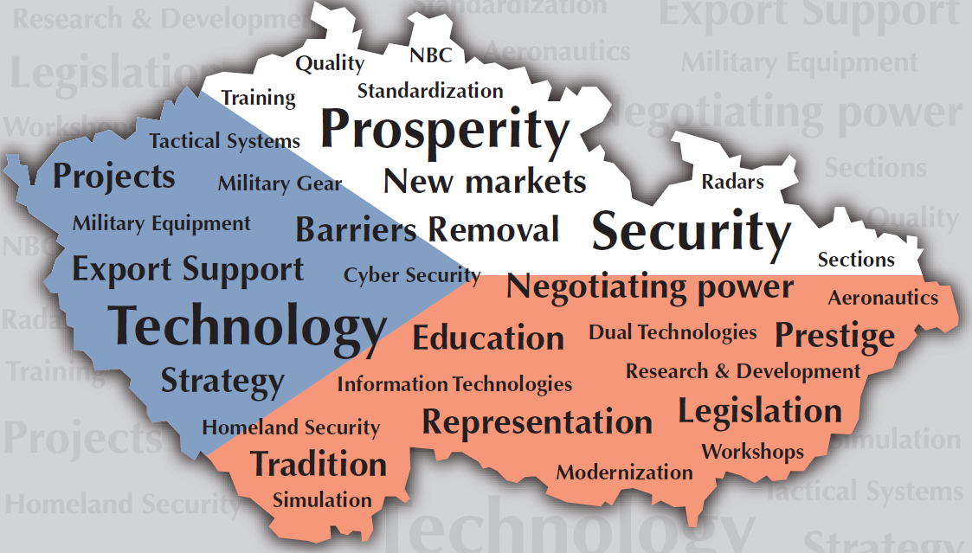
Defence and Security Industry of Czechia
Dušan Švarc
Defence and Security Industry Association of the Czech Republic

Slide 2
About DSIA
CZ DSIA Established in 1997 (transformation, privatization)
130 members (private, 5 state, dual production, SMEs)
https://www.aobp.cz/clenove/?lang=en
Total turnover – about 1,9 billion EUR (civil, dual use, military)
Value added more than 630 million EUR
Number of employees – more than 20 000
University educated– about 4 000
Export oriented industry
DSIA is a member or cooperates with:
ASD (AeroSpace and Defense Industries Association of Europe)
NIAG (NATO Industrial Advisory Group)
EDA (European Defense Agency)

Slide 3
DSIA Tasks
Represents its members´ interests towards Government, Parliament and other institutions
Provides export services (exhibitions, product promotions etc.)
Assists manufacturers and suppliers from abroad to establish contacts with Czech partners
Helps Czech companies to find contacts with primes or sub-contractors abroad
Helps to identify and develop marketing opportunities in the Czech Republic for members and informs about export-oriented programs
Provides PR support for its members

Slide 4
EDF, EDIDP
Promotion
DSIA
Ministry of Defence
Ministry of Foreign Affairs
European projects
Ministry of Industry and Trade
Ministry of Interior
Education
Economic diplomacy
Knowledge sharing
International cooperation
Exhibitions
Industrial cooperation

Slide 5
Czech Companies
Aviation and associated equipment
Systems of command and equipment
Navigation and radiolocation
Armoured and other vehicles
Weapons, fire control systems, ammunition
Engineering, chemical and health equipment
Research, development, repair and training
Equipment and appliances for security services
Trade and other activities

Slide 6
Sectoral Structure of Export

Slide 7
Czech exhibitions
2022
https://www.natodays.cz/
http://www.natoexhibition.com
2023
https://www.bvv.cz/en/idet/

Slide 8
Future Forces Exhibition
INTERNATIONAL EXHIBITION | EXPERT PANELS | NETWORKING
19 – 21 October 2022, Prague
Official delegations from more than 35 countries already confirmed (at the level of the Ministers of Defence, Chiefs of Defence, Land Forces Commanders, Air Force Commanders, Project Managers, etc.)
3 exhibition halls full of latest technologies and solutions in defence and security
Official sessions of 3 NATO working groups (approx. 300 experts)
More than 15 expert panels, conferences and workshops
YOU ARE CORDIALLY WELCOME TO FUTURE FORCES

Slide 9
Future Forces Exhibition
MAIN FOCUS & TOPICS OF THE EXHIBITION AND EXPERT PANELS
Future Air Force
Future Land Forces
Dismounted Soldier Systems
Emerging & Disruptive Technologies
Cyber Security & Defence
Crisis & Military Medicine
Modelling & Simulation
ABOUT
www.future-forces-forum.org
www.NATOexhibition.org

Slide 10
More Details on DSIA Companies
www.dsia.cz
Go to: DSIA Members
Click on Specific Company
Or download the DSIA Catalogue
Virtual library: https://dsia.publi.cz/en

Slide 11
Thank you for your attention!
AOBP, Washingtonova 25, Prague 1
Tel.: +420 224 235 320
info@aobp.cz
www.aobp.cz
www.dsia.cz

