Slide 1
Czechia Insight into the country profile

Slide 2
Contents (for internal use)
Location in the Heart of the Europe
Quick Facts About Czechia
Historical Background
Important Player in a Global Arena
Investment Environment
Czech Economy at a Glance
Foreign Trade
Highly Developed and Innovative Czech Industry
Education
R&D
Competitive Advantages – Czechia
Regions
Infrastructure
Socially Responsible Country
Environmentally Considerate Country
Czechia – A Good Place to Live
Tourism
Representation of Czechia Worldwide
Bilateral Relations
Useful Links

Slide 3
Location in the Heart of the Europe

Slide 4
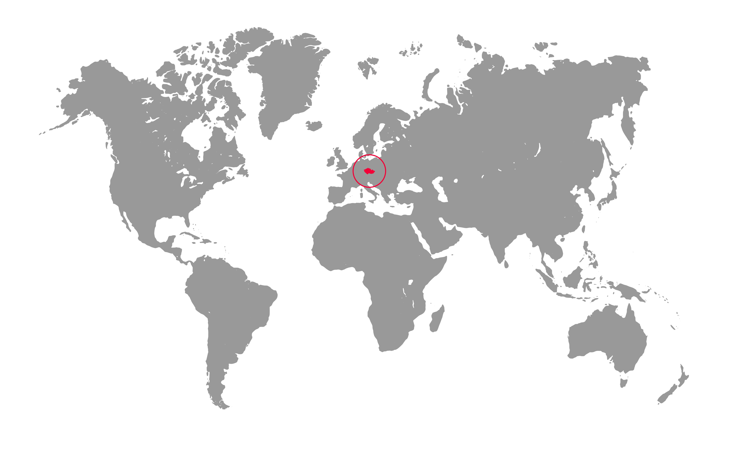
Czechia in the World

Slide 5
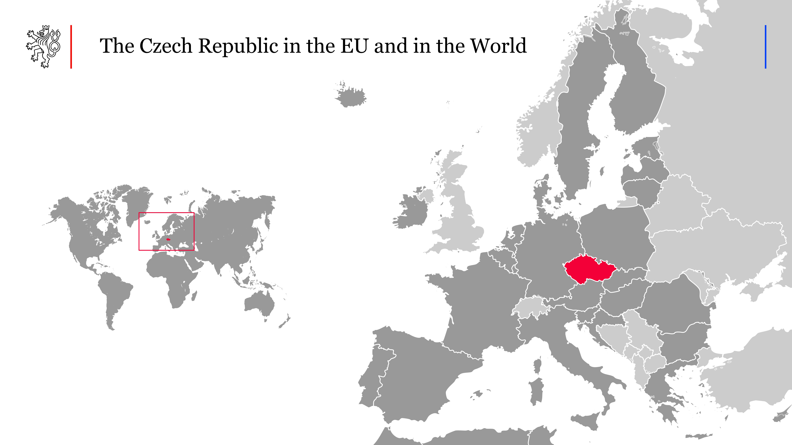

Czechia in the EU and in the World

Slide 6
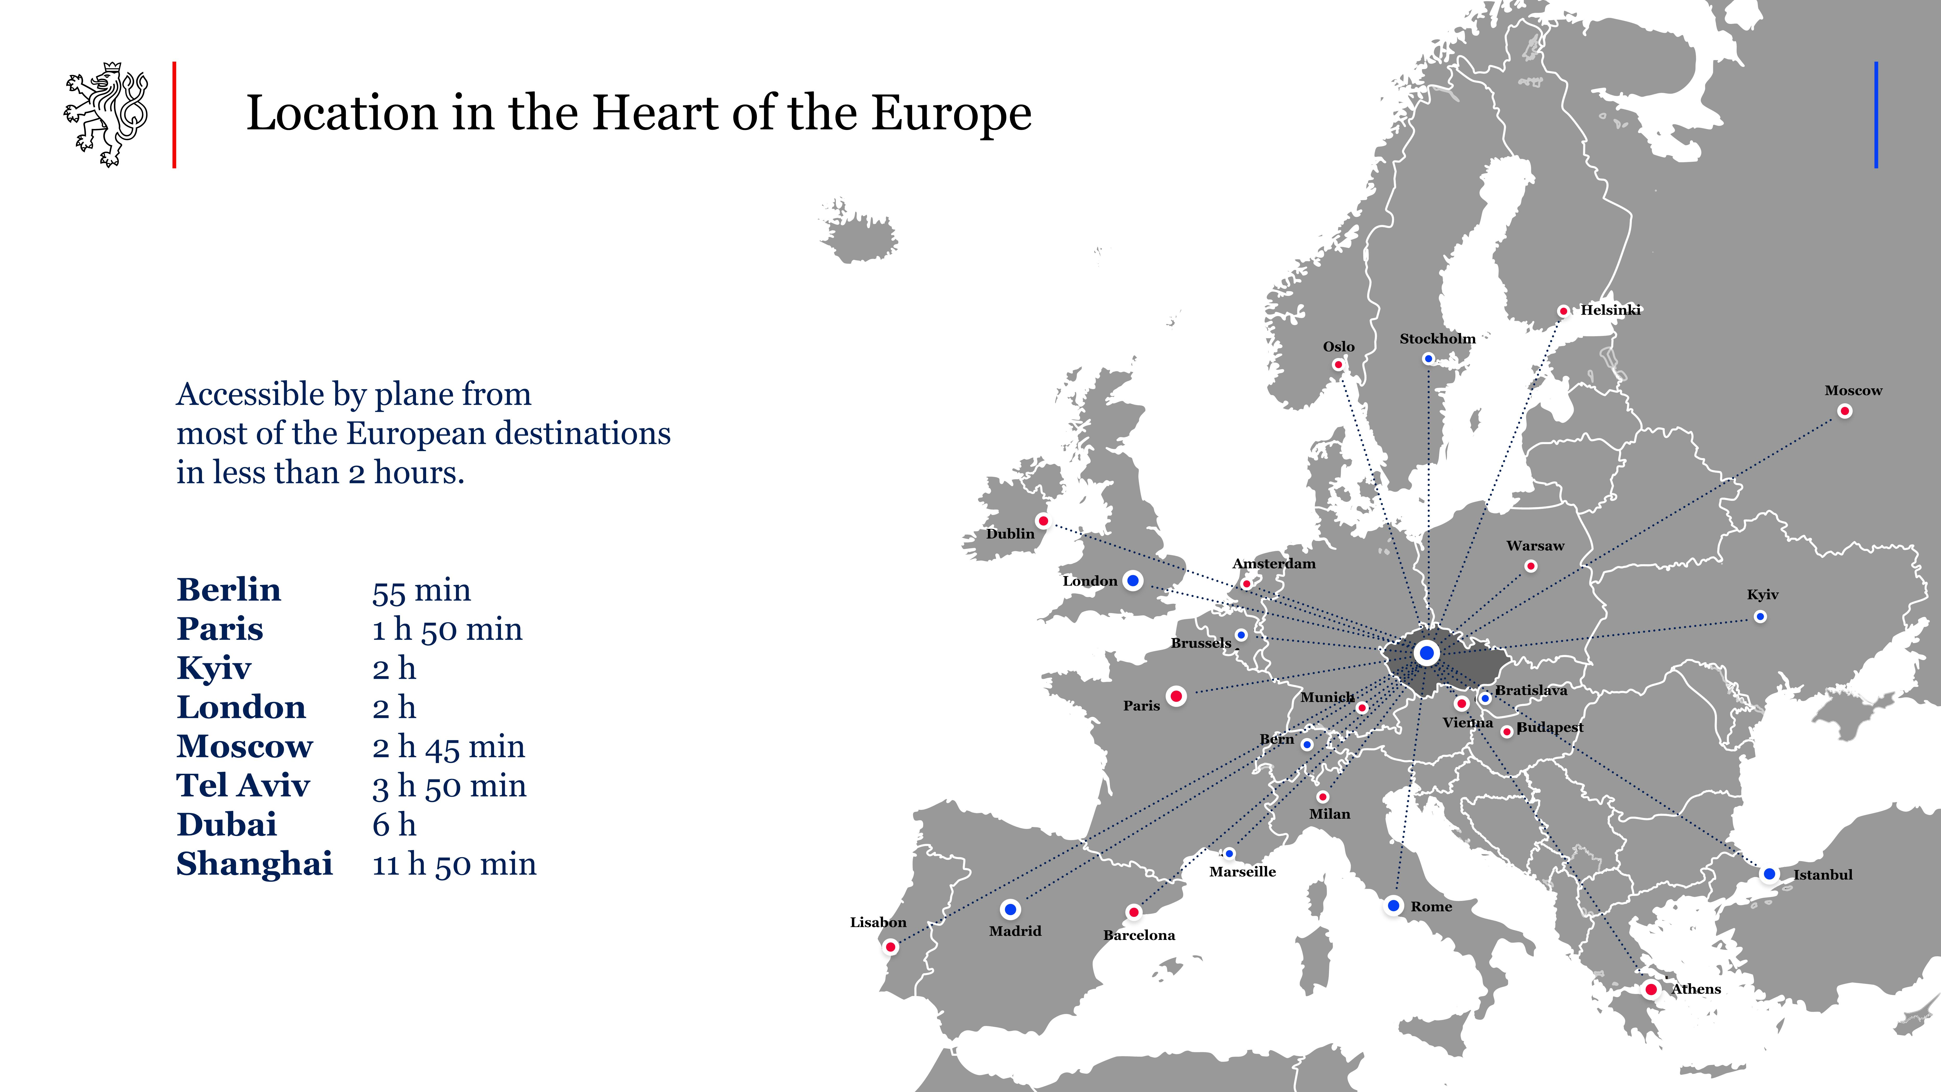
Location in the Heart of Europe
Location in the Heart of the Europe
Accessible by plane from most of the European destinations in less than 2 hours
Berlin 55 min
Paris 1 h 55 min
Kyiv 2 h
London 2 h
Moscow 2 h 45 min
TelAviv 3 h 50 min
Dubai 6 h
Shanghai 11 h 50 min
Notes:
Dále v prezentaci je ještě detailnější mapka s leteckou a dopravní dostupností, tento slide je cílen úvodně

Slide 7
Quick Facts About Czechia

Slide 8

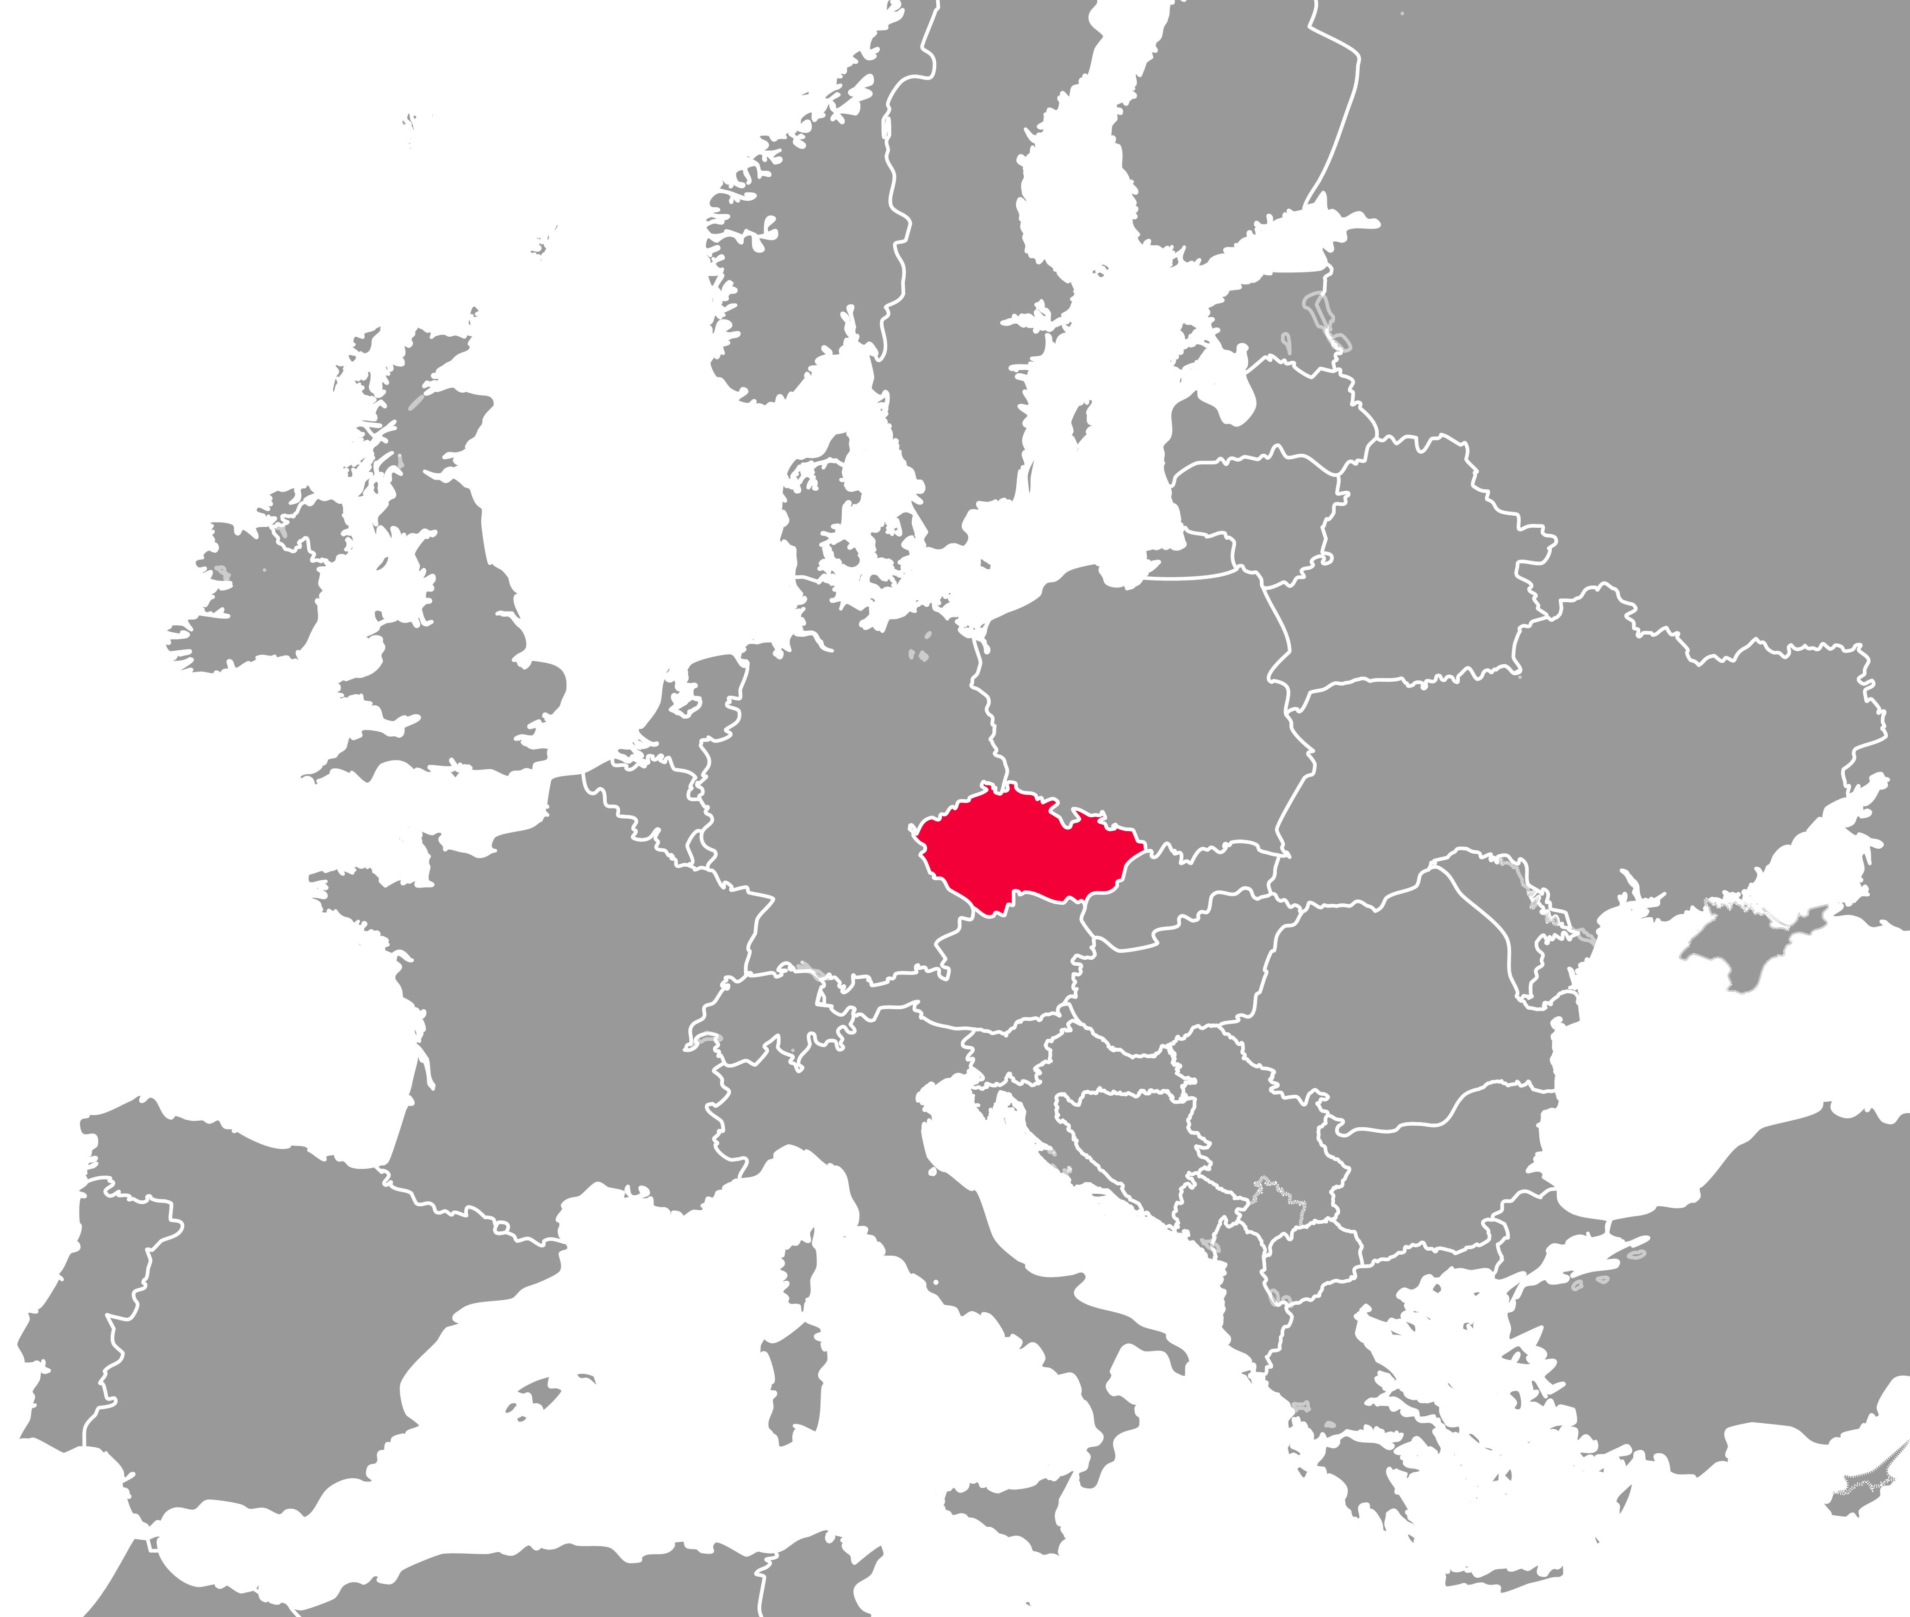
Czechia – General Information
Population: 10.90 mil (CZSO, 12/2023)
Area: 78.866 km²
Language: Czech
GDP per person: 56 400 $ (ppp 2024)
Currency: Czech Crown (CZK)
Capital: Prague
Other large cities: Brno, Pilsen, Ostrava
Neighbouring countries: Germany, Poland, Slovakia, Austria
Administrative division: 14 regions
Political System: Parliamentary Democracy
Notes:
GDP source: EIU

Slide 9
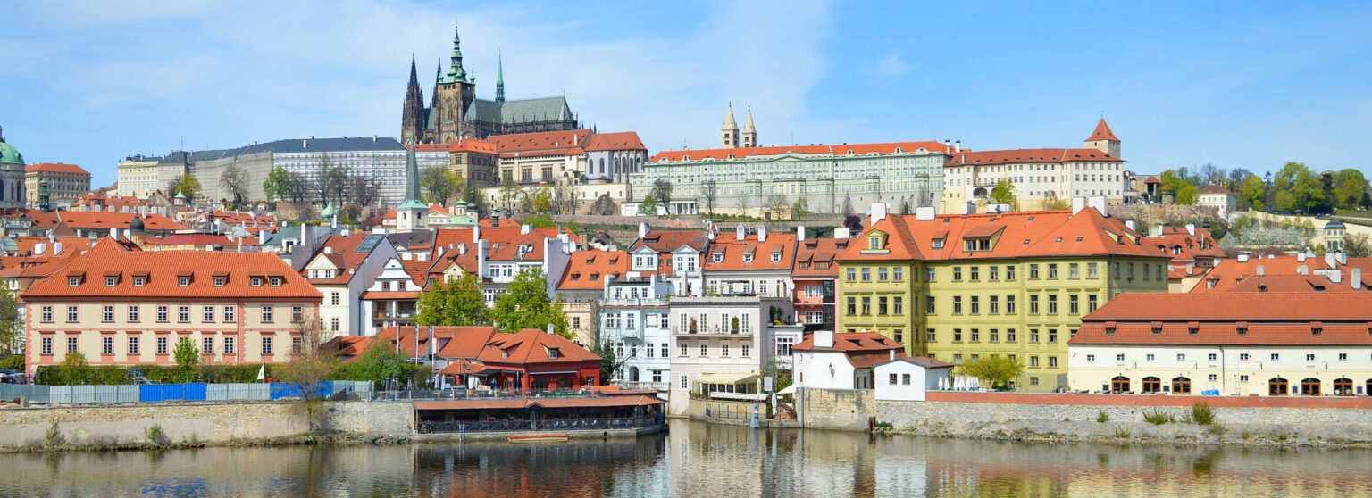
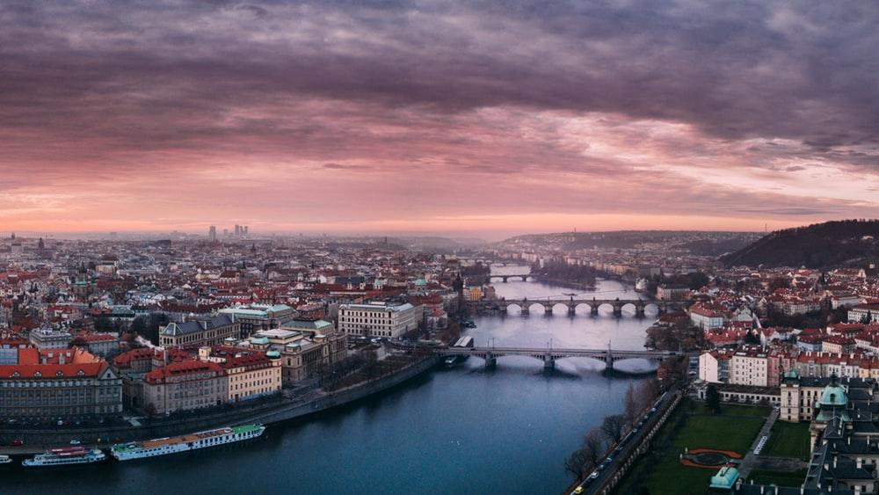
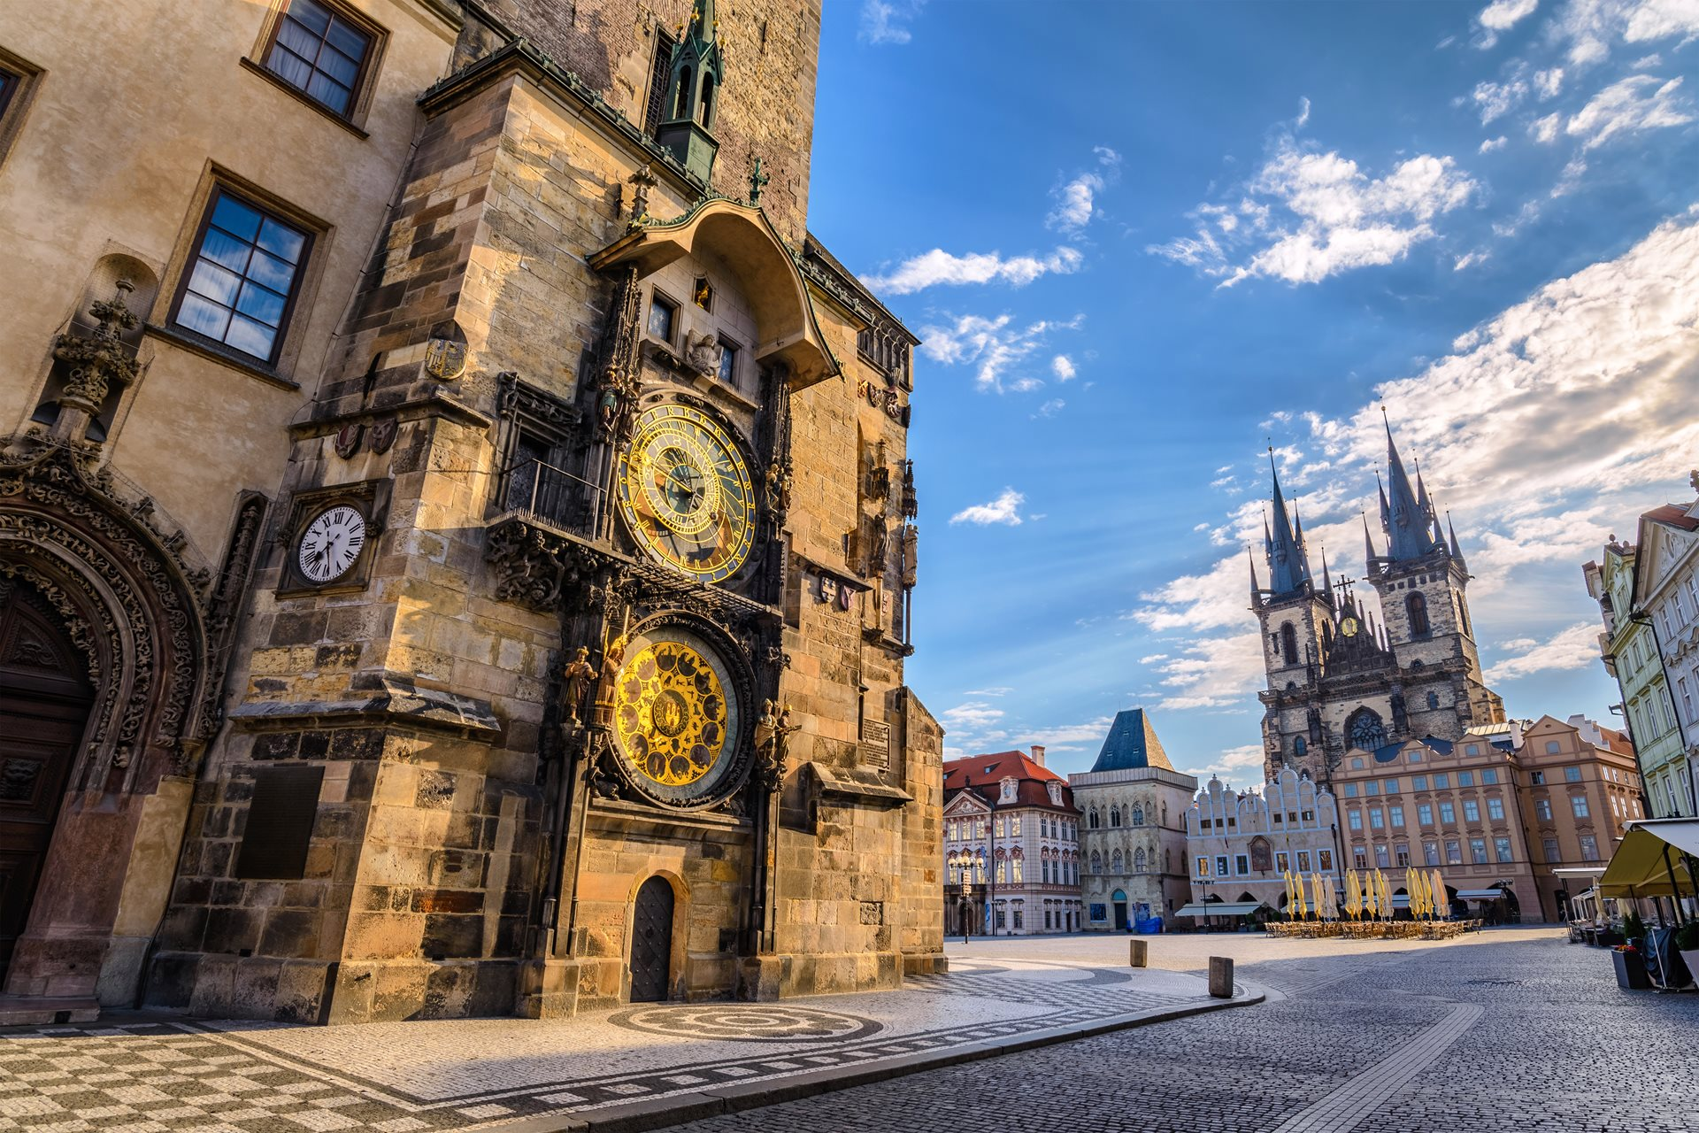
Prague – The Capital
The largest city in Czechia
Population: 1.4 million
27 % of the national GDP is created in Prague
(Prague = 13 % of Czech population) (CZSO, 2023)
2nd place in the Small European Region of the Future - overall ranking, in Top 10 Major European Cities of the Future in 3 categories (fDi 2-3/2023)
3rd richest region of the European Union (2021)
Famous for its architectural heritage, museums, theaters, cinemas, galleries, and cafés
Notes:
fDi: fDi_0223_ECOF.pdf
Richest region: Regional GDP per capita ranged from 32% to 260% of the EU average in 2019 - Products Eurostat News - Eurostat (europa.eu)
Newest data:
file:///D:/User_Data/epacesov/Downloads/FDI_170222%20ECOF.pdf
file:///D:/User_Data/epacesov/Downloads/FDI_170222%20ECOF.pdf

Slide 10
Historical Background

Slide 11




Recent History
1918
Independent Czechoslovakia
Independent & democratic Czechoslovakia was established
1948
Communist regime
Communist coup resulted in four decades of Communist rule in the country
1989
Velvet Revolution
Fall of the Communist regime (series of non-violent demonstrations led by Václav Havel)
1993
Velvet Divorce
Division of Federal Czechoslovakia into Czechia and Slovakia
1999
NATO Accession
Czechia became a NATO member
2004
EU Accession
Czechia joined the European Union

Slide 12
Important Player in a Global Arena

Slide 13





Membership in International Organizations
Czechia and the EU
Membership since May 1, 2004
Emphasis on common values, including democracy, rule of law, and respect for human rights and human dignity
July – December 2022 – Czech Presidency of the EU
Czechia and NATO
Membership since March 12, 1999
One of the first former Warsaw Pact members to join NATO
Visegrad Group (V4)
Since 1991
V4 is an alliance
of four Central European
countries – Czechia,
Hungary, Poland, Slovakia
Other organizations
WTO
UN
UNESCO
OECD
In 1995, Czechia became the first post-Communist state in Central Europe to be admitted to the Organization for Economic Co-operation and Development (OECD)

Slide 14




Priorities of Czech Foreign Policy
To promote respect for human rights and democracy worldwide
To enhance Czechia’s positive image and perception abroad
To foster good relations with neighbouring countries and strengthen regional cooperation
To strengthen the European integration of Eastern and South-Eastern Europe
To support a well-functioning, politically and economically strong European Union
To maintain and strengthen the transatlantic link
To maintain and strengthen good relations with Indo-Pacific and African countries
To promote Czechia’s economic and trade interests abroad, including energy security
To strengthen the security of Czechia, analyze threats and counter them

Slide 15
Investment Environment

Slide 16
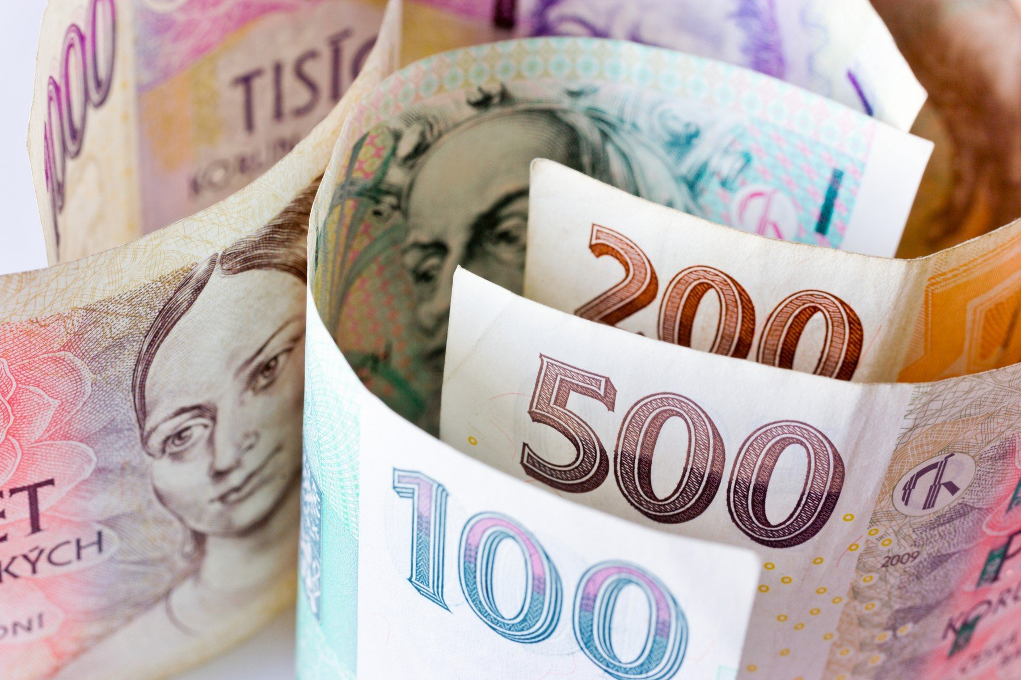

Czechia – A Great Place for Your Investment
Open investment climate
Effective legal environment
Healthy banking system
Stable political environment
High investment ranking with a stable and positive outlook
Moody‘s rating – Aa3, 4th highest (level of Belgium)
Fitch rating – AA-, 4th highest
S&P rating – AA-, 4th highest
The national currency koruna (Czech Crown, CZK) is fully convertible and extremely stable
Financial Support for Investment
Transparent system of investment incentives
Strong focus on R&D
Investment Protection
Czechia is a member of the Multilateral Investment Guarantee Agency (MIGA)
Notes:
Investment ranking source: ČNB https://www.cnb.cz/cs/o_cnb/mezinarodni-vztahy/srovnavaci-tabulka/

Slide 17


Investment Climate in Czechia
OECD member
Czechia hosts almost 100,000 foreign companies
such as ABB, Barclays, Bosch, Continental, Danone, Ford, GE, Nestlé, DHL, Astra Zeneca, Rockwell, Procter & Gamble, Siemens, Honeywell, Amazon, Toyota, Oracle, Sap, Exxon Mobil, Pfizer, Asahi, Imber

Slide 18
Czech Economy at a Glance

Slide 19

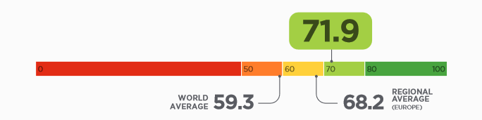
Open and Competitive Economy
Developed country with a market economy
Among the thirty most advanced countries in the World (World Bank)
The most stable and prosperous economy of all post-communist states
The 12th most advanced economy in the EU (Prosperity Index, 2023)
21st freest economy in the World
(According to the Heritage Economic Freedom Index, 2023)
Open and export oriented economy
Trade oriented (the main driver of growth – equals to the amount of 80% of GDP)
Stable and strong domestic consumption
Strong business and ownership relations with the European Union
The most industrialized country within the European Union
Economic Freedom Score
Source: The Heritage Foundation, 2023

Slide 20
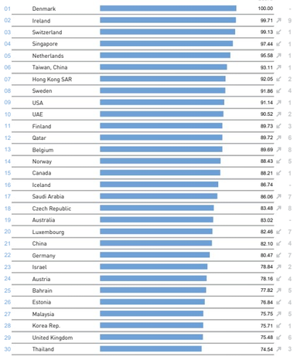

Open and Competitive Economy
The IMD World Competitiveness Ranking (2023)
Improving competitiveness
Czechia (18th place) is at the top of the CEE countries
According to the World Competitiveness Ranking
Ease of doing business ranking
Czechia is ranked 41st
Among 190 countries according to the World Bank (2020)
Netherlands 42nd, Belgium 46th, Italy 58th
Source: IMD, 2023

Slide 21
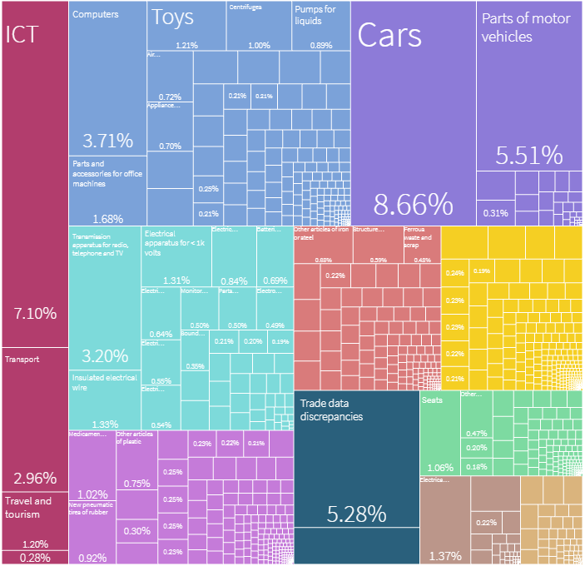
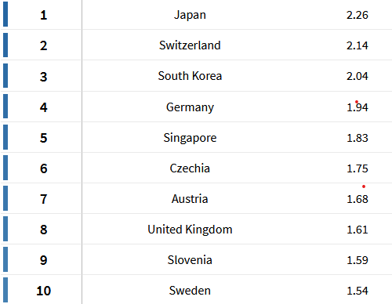
Economic Complexity
The Czech economy is the 6th most complex in the world (2021)
Wide variety of exports and high sophistication
Czechia´s largest goods exports are in high and moderate complexity products
Economic Complexity Ranking
Czech Export Complexity
Source: The Atlas of Economic Complexity, 2021
Source: The Atlas of Economic Complexity, 2021
Notes:
What are the world's most complex economies? | World Economic Forum (weforum.org)
Taken from: The Atlas of Economic Complexity (harvard.edu)
Newest – Economic complexity ranking table of content – taken from:
https://atlas.cid.harvard.edu/rankings
The Atlas of Economic Complexity, 2021:
The Atlas of Economic Complexity (harvard.edu)

Slide 22

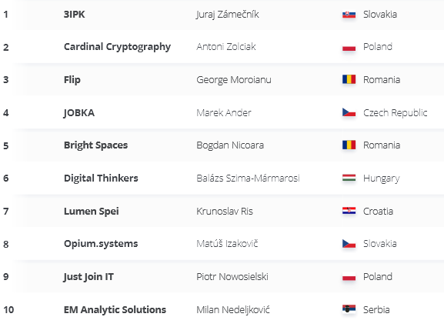
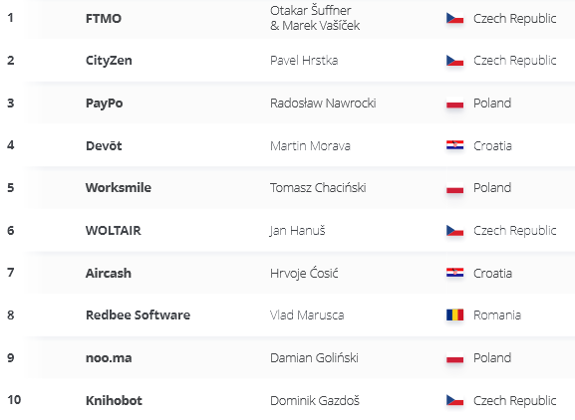
Raising Companies
Technology Fast 50 winner
(Ranking of the fastest growing technology companies in CE)
Growth Stars
(Ranking of the companies that show great potential but are too new to meet the minimum of four years in operation criterion for the main Fast 50 category – „Companies to Watch“ category)
Source: Deloitte Central Europe Technology Fast 50 ranking, 2023
Notes:
For 2022: ce-technology-fast-50-report-2022.pdf (deloitte.com)
For 2023: https://www2.deloitte.com/ce/en/pages/about-deloitte/topics/technology-fast-50.html
https://www2.deloitte.com/content/dam/Deloitte/ce/Documents/fast50/ce-technology-fast-50-report-2023.pdf

Slide 23
GDP per capita of Czechia is at the Level of South Korea
Sources: EIU, 05/2024
Notes:
GDP per capita (thousands $, PPP) 2010 – 2025

Slide 24
The Lowest Unemployment Rate of all EU27
Despite the negative consequences of the Covid-19 pandemic and the Russian aggression in Ukraine, the Czech Republic has maintained the lowest unemployment rate in the EU.
EU27: 6.0 % (03/2024)
Czechia: 2,9 % (03/2024)
Source: 2020-2025 EIU forecast

Slide 25

Favourable Macroeconomic Stability
Low debt to GDP ratio – 44,8 % (2023)
9th lowest within the EU
Favourable Macroeconomic Stability
Score 100/100 according to the WE Forum Global Competitiveness Index 2019
Sources: EIU, 2023-2025 forecast EIU (05/2024)
Source: WE Forum Global Competitiveness Index 2019
Notes:
WE Forum 2019: WEF_TheGlobalCompetitivenessReport2019.pdf (weforum.org)

Slide 26
Favourable Macroeconomic Stability - Czechia
Macroeconomic Indicators | 2019 | 2020 | 2021 | 2022 | 2023 | 2024* | 2025*
GDP growth (per head % pa) | 2,9 | -5,5 | 3,7 | 2,5 | -0,2 | 1,1 | 2,7
GDP per head (US$, PPP) | 45454 | 44631 | 48381 | 52567 | 54356 | 56400 | 59060
Inflation (%) | 2,8 | 3,2 | 3,8 | 15,1 | 10,6 | 2,1 | 2,8
Unemployment (%) | 2 | 2,6 | 2,8 | 2,2 | 2,6 | 2,7 | 2,8
Current-account balance (% of GDP) | 0,3 | 2 | -2,7 | -5,9 | 0,4 | -0,5 | -0,5
Exports of goods & services (% growth) | 1,3 | -6,3 | 6,9 | 5,9 | 2,1 | 3,6 | 4,2
Source: EIU, 2024,2025* forecast (05/2024)
The same positive trend in GDP per head (PPP) growth as EU27
GDP decrease is on par with the EU27 average, mainly caused by the Russian agression in Ukraine

Slide 27
Origin of GDP
Source: EIU, 05/2024

Slide 28
Foreign Trade

Slide 29
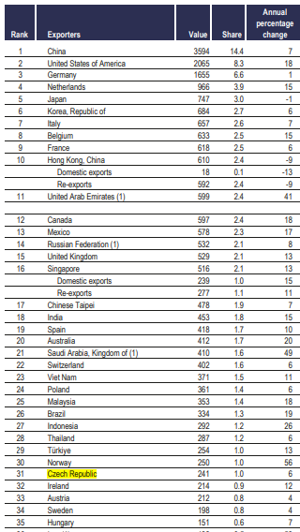
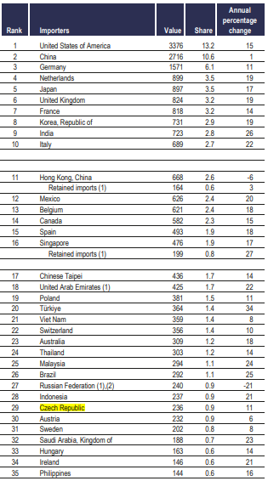
Czechia ranked as the 31th largest exporter and the 29th largest importer worldwide
Leading Exporters and Importers in world merchandise trade, 2022
Source: WTO, World Trade Statistical Review 2023
Notes:
World Trade Statistical Review 2023 (wto.org)

Slide 30

Foreign Trade
Growing exports of goods & services in the long term
The contribution of exports equals to 80% of the GDP
The most important export partners: Germany, Slovakia, Poland
The most important import partners: Germany, Poland, China
Strong connection to the EU27 internal market
80% of all exports

Slide 31
Czech Exports by Continents
Source: ČSÚ, 2024

Slide 32




Czech Export Sectors
Automotive industry
More than 20% of both Czech manufacturing output and Czech exports
Engineering industry
Czechia exports 90% of its engineering production
Electronics and electrical engineering
14% of Czech manufacturing output
Medical equipment
Czechia is a significant producer of electron microscopes
Czechia offers complete solutions
Such as Hospitals or Modular Hospitals
Chemical and pharmaceutical industry
Glass and ceramic industry

Slide 33
Highly Developed and Innovative Czech Industry

Slide 34
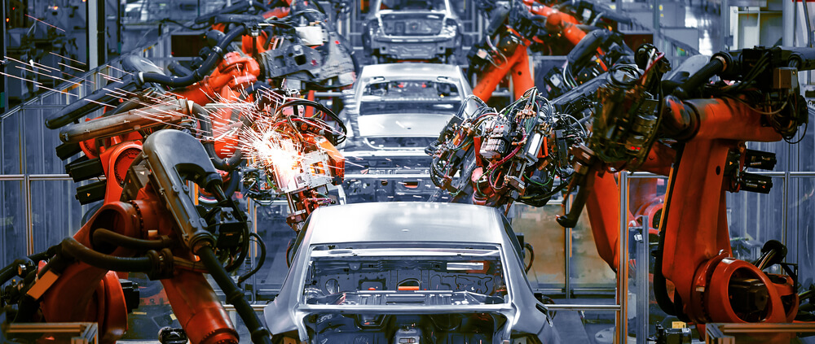
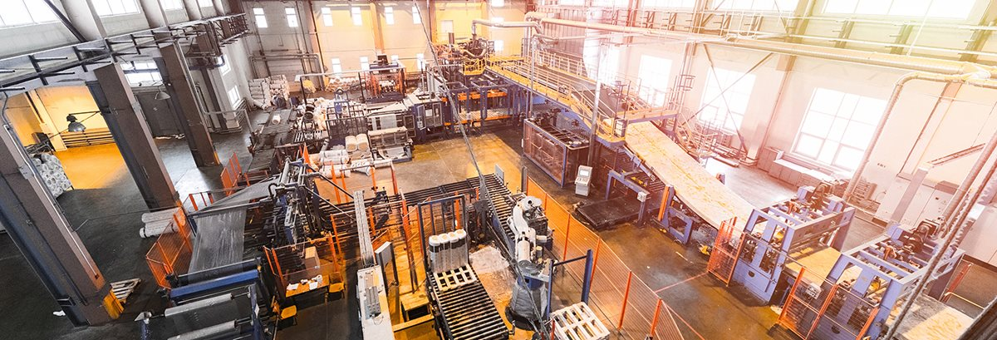
Where We Are Now
Czechia is the most industrialized country in the EU
A country with long tradition in production and manufacturing industry of all kinds
Gross added value of the Czech industry is 30,76% - 2nd in the EU after Ireland – 37,95% (Index Mundi, 2020)
Germany 26,53%
Poland 27,68%
More than half of Czech industrial production is exported

Slide 35


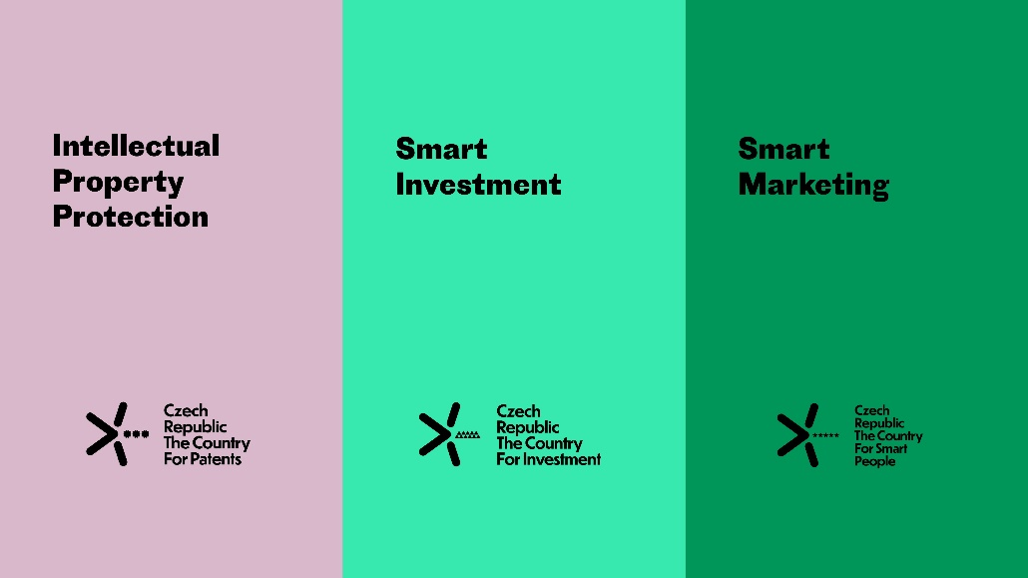
Where We Want To Be in 2030
Innovation Strategy of Czechia 2019 – 2030
Long-term focus on technologies, R&D and commercial applications, human capital and innovative opportunities

Slide 36

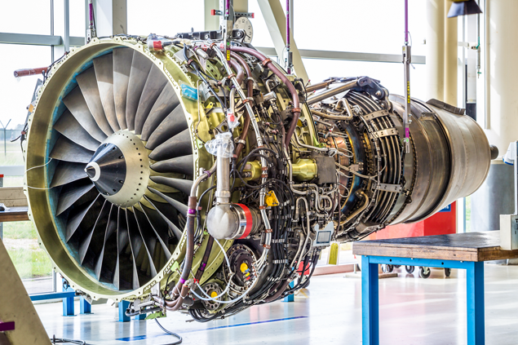
Czech Industry
Some of the Czech high tech sectors are:
Important sectors are mechanical-engineering, metals, chemicals and food sector
As well as energy, construction, consumer-goods industries and many more
Czechia is one of the 7 countries in the world that develop aircraft engines
Pharma
Electronics
Aerospace
Defense
Engineering

Slide 37
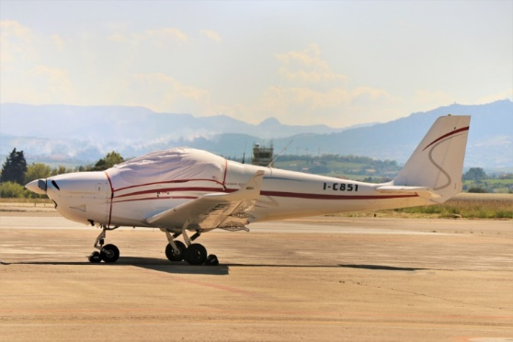






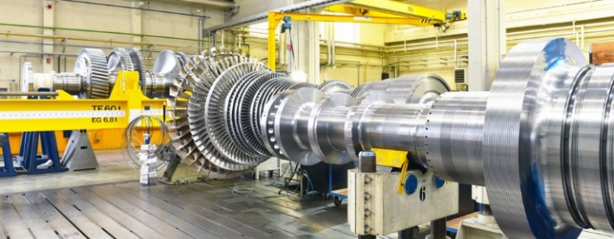




Czech production is wide and complex among various industries

Slide 38
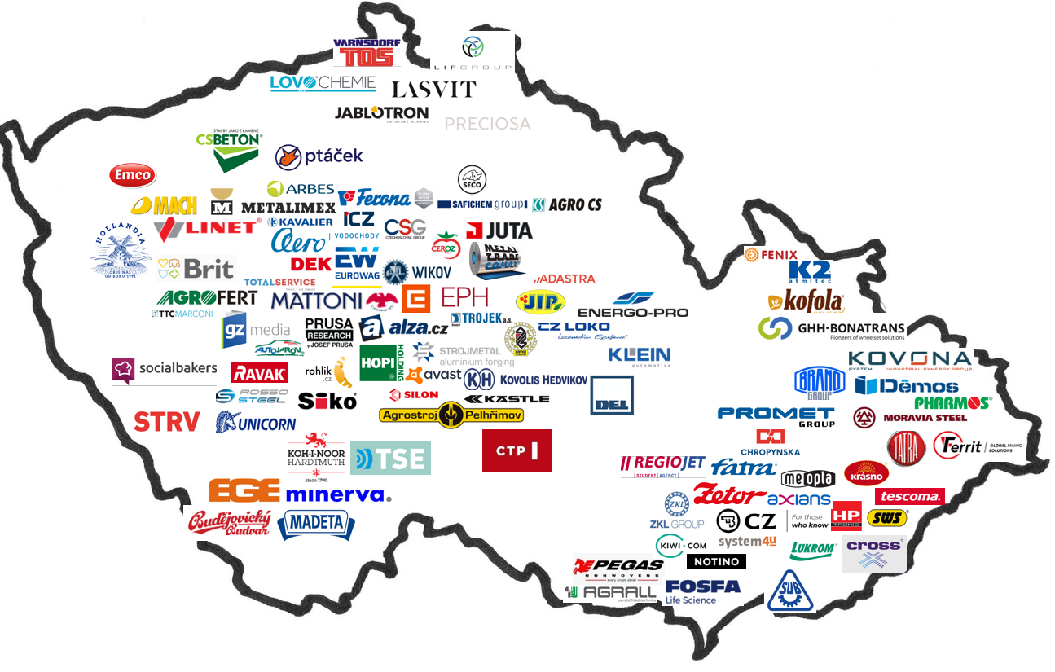
Czech Industry & Services

Slide 39

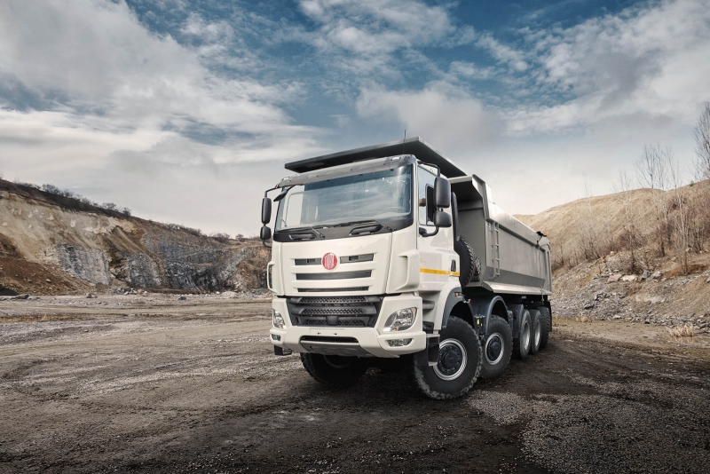
Automotive Industry
The most important branch of Czech industry is vehicle manufacturing
Accounts for almost 10% of GDP, 26% of total industrial production and 24% of Czech exports
Production has more than doubled in the past decade
Czechia is the 2nd largest producer of cars per capita in the World (after Slovakia)
with 133 cars per 1000 inhabitants – overtaking automotive giants such as Japan, the USA or Germany
One of the oldest car producers in the World
Peugeot – 1810, Tatra – 1850, Opel – 1862, Mercedes – 1886, Škoda – 1895

Slide 40
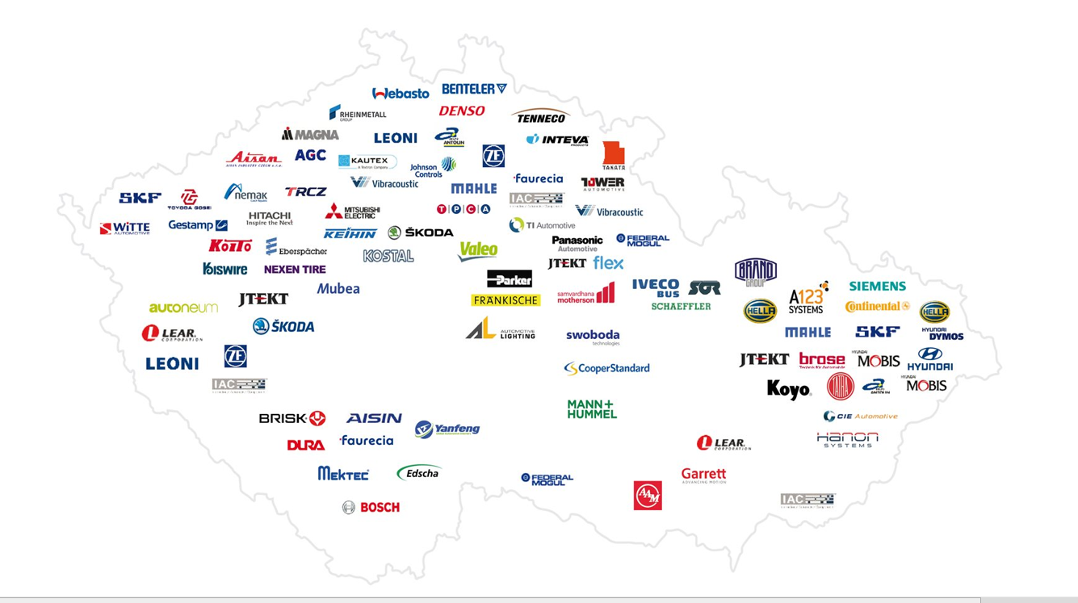
Automotive Industry – Key Players
Source: CzechInvest

Slide 41
Education

Slide 42

Educated and Skilled Workforce
Strong technological potential of the country due to pool of well-educated science workers and its skilled workforce
Rise of industries such as biotechnology, software development, etc.
project Tour for the Future - sparking interests in technological branches
The largest share of people who have attained upper secondary education within OECD countries
72% of Czechs have knowledge of at least one foreign language
Dominantly English or German
Czechia ranks 26th among the 100 countries with a high degree of proficiency in English
(According to the EF EPI English Proficiency Index 2023)

Slide 43

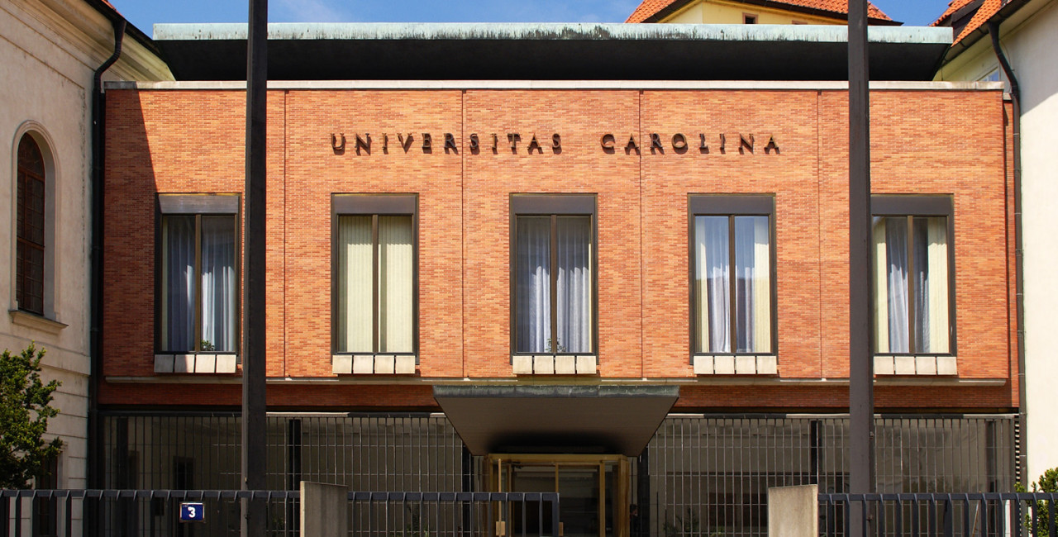
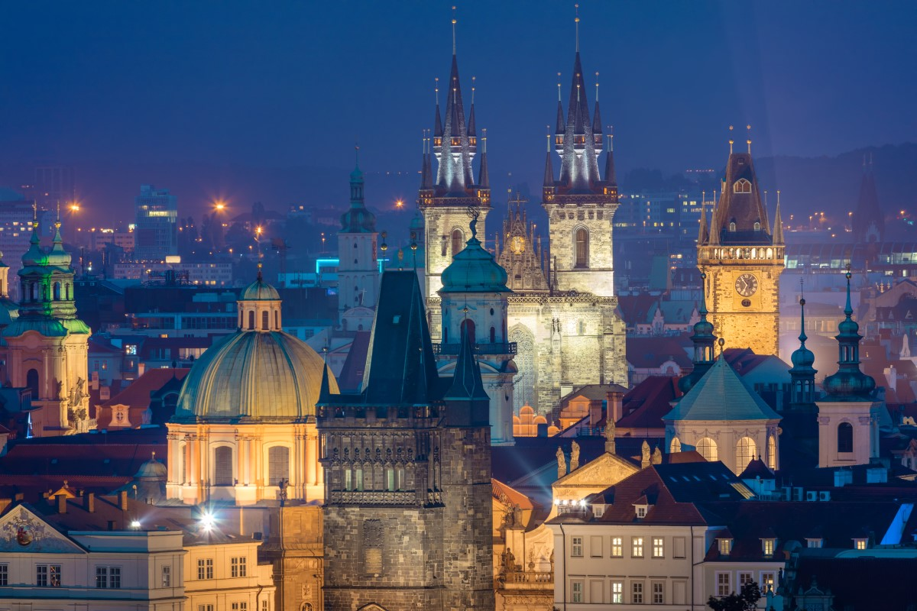
Education
67 universities
More than 200 000 students enrolled (2021/2022 academic year)
1/3 of the students study economics and finance, and 1/3 are enrolled in technical programs
Charles University was established in 1348
One of the oldest universities in the world
Prague, ranked in the top 10 best cities in the world for students (7th place)

Slide 44
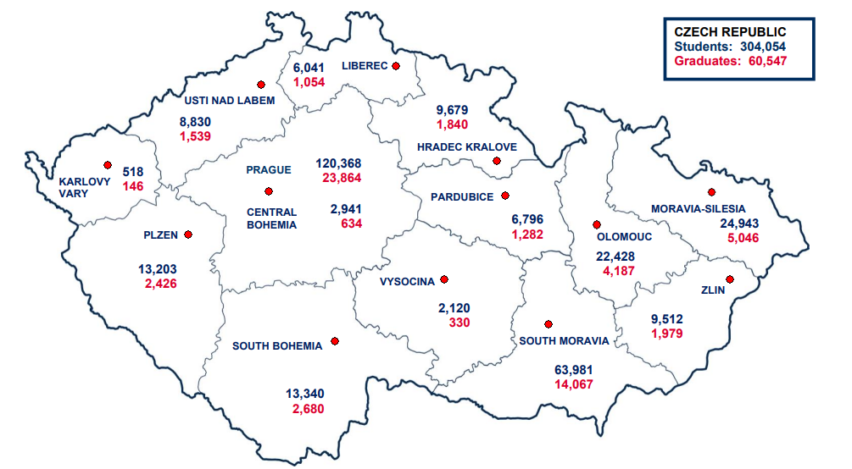
Number of Students and Graduates at Universities
Academic year 2021/2022
Source: Ministry of Education, Youth and Sport, 2022

Slide 45
R&D

Slide 46

R&D in Czechia
Rising R&D investment
Czechia spends the most in the CEE region
Gross expenditure on R&D - share of GDP (2005-2022, %)
Total expenditure on R&D (2005-2022, mil. EUR)
Source: CZSO
Source: CZSO, Eurostat

Slide 47
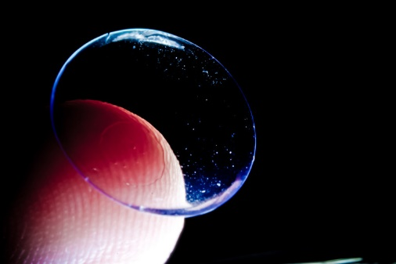

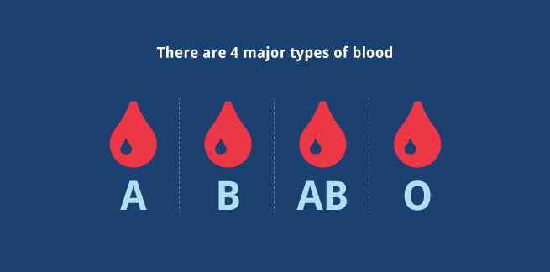
Czech Inventions (the best of)
Contact lenses
Invented by Czech chemist Otto Wichterle in 1961
Propeller
The first optimal prototype was invented by Czech constructor Josef Ressel in 1826
Blood Types
In 1907, Jan Jánský found out that human blood could be classified into four distinct groups

Slide 48

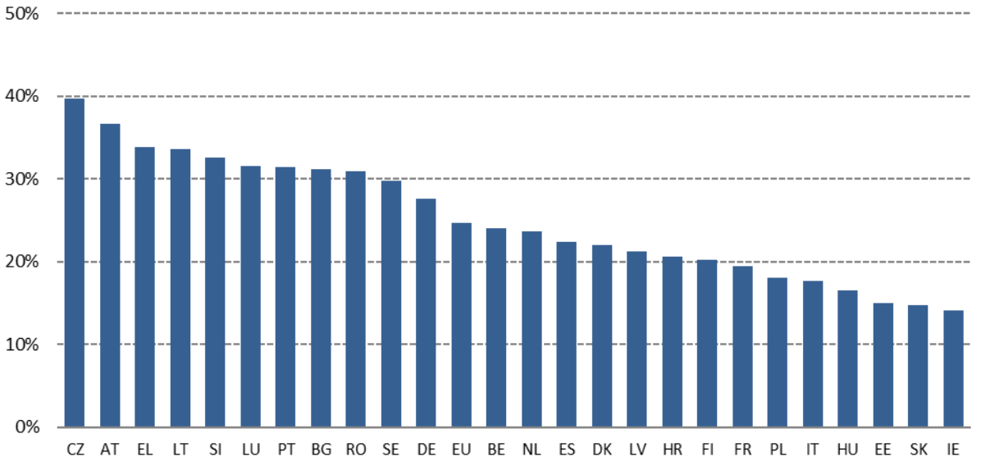
The leading role of artificial intelligence (AI)
Czechia has the highest percentage (40%) of enterprises using two or more AI technologies
According to the European Commission’s Digital Economy and Society Index (DESI)
Czechia has the highest percentage of enterprises using two or more AI technologies
Enterprises using at least two AI technologies (% of enterprises), 2020
Source: Digital Economy and Society Index, 2021

Slide 49

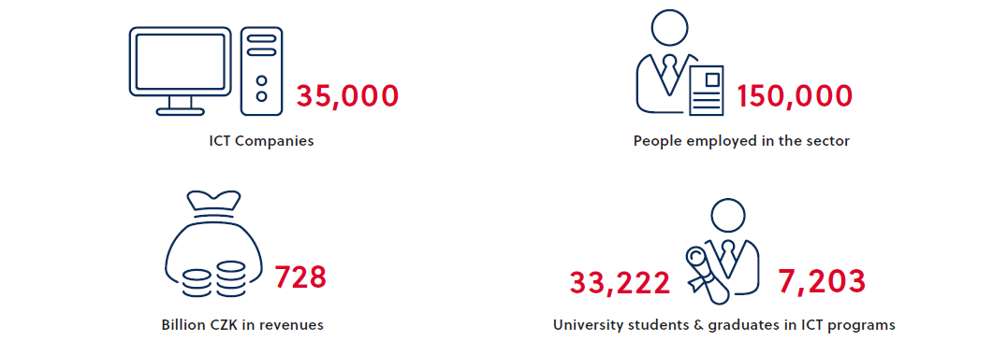

ICT
Strong inflow of high-value-added projects of the world´s top ICT companies
Successful investors in the country include Microsoft, Skype, Tieto, Red Hat, SolarWinds, IBM, Cisco, Oracle, H2O.ai and MSD IT
It is home to several top-level research centers that have achieved outstanding results and won awards in the area of ICT
Czechia= e-commerce centre of the Europe
Expertise in Blockchain, 1st bitcoin café in the World

Slide 50
Competitive Advantages - Czechia

Slide 51
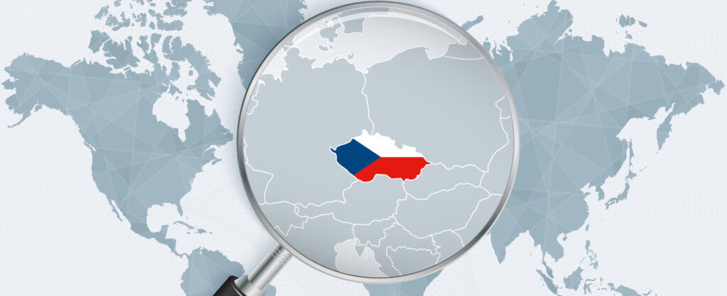



Competitive Advantages - Czechia
Strategic geographical location
Stable political and economic environment
Long-established industrial tradition
Well-developed infrastructure
Skilled and educated labour force
Good level of language skills
Attractive living environment

Slide 52
Regions

Slide 53
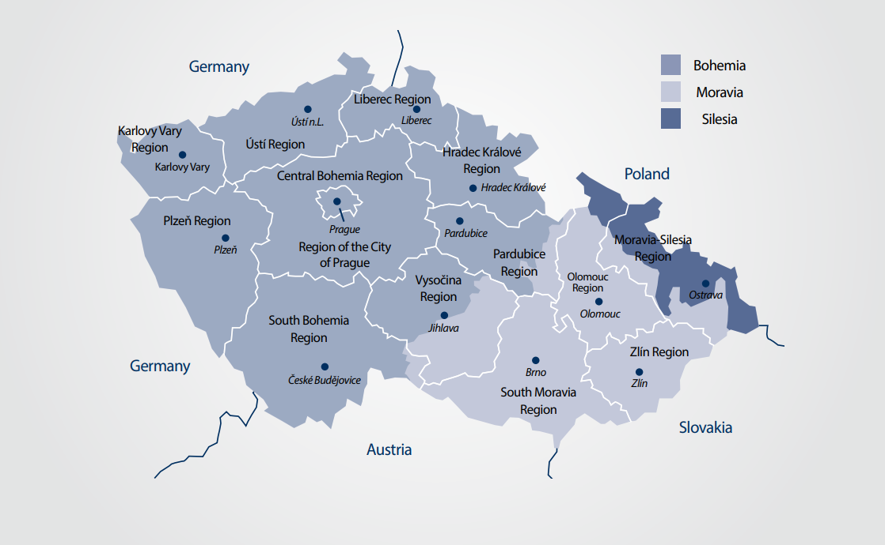
Regions in Czechia
Source: AFI Business Guidebook 2022

Slide 54
Infrastructure

Slide 55
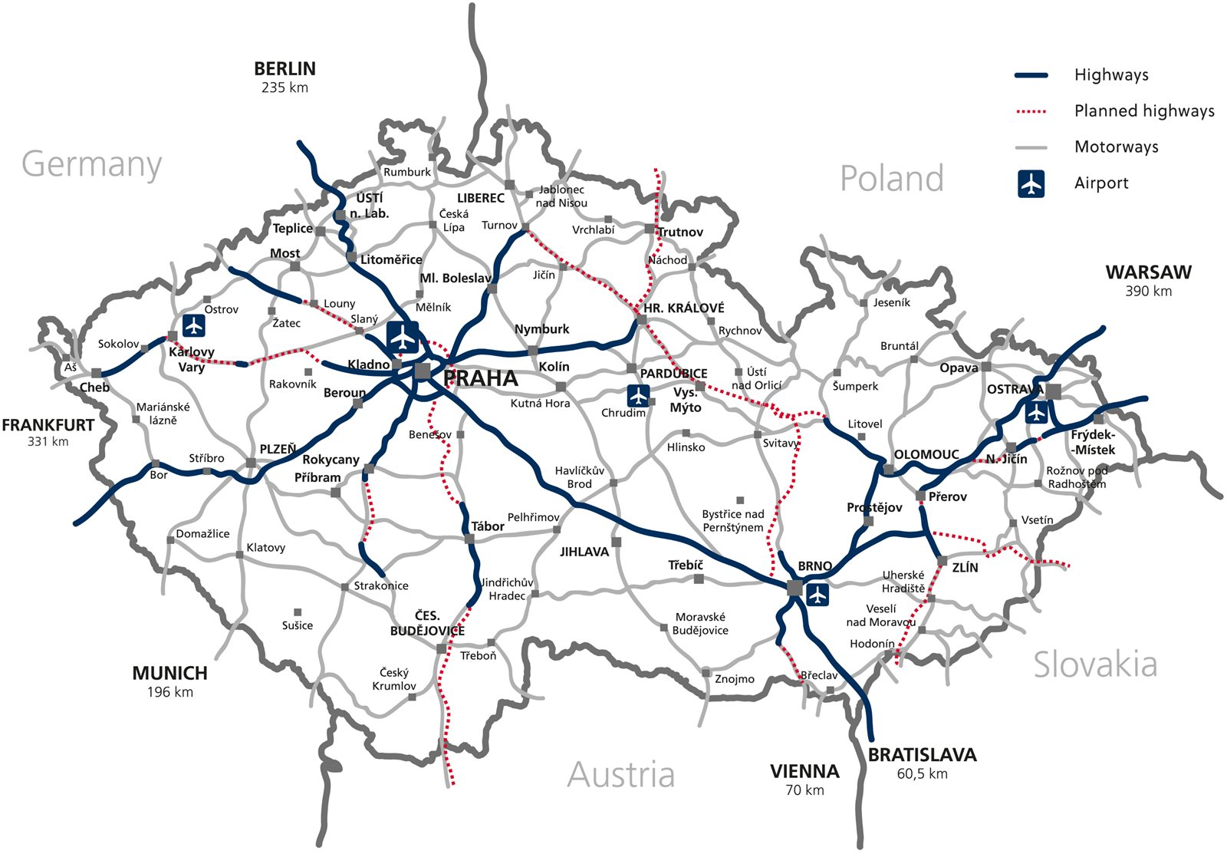
Well-developed Infrastructure
Infrastructure is among the best among CEE countries
Location at the very center of Europe makes it a natural crossroads for major transit corridors
Czechia has a rapidly modernizing communications infrastructure
Transport Infrastructure in Czechia (2016)
Source: CzechInvest, 2018

Slide 56
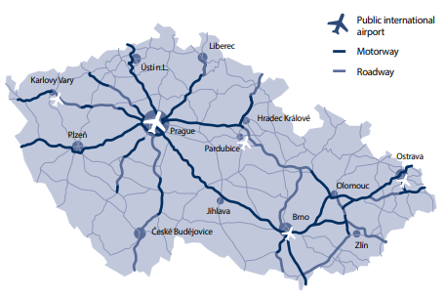
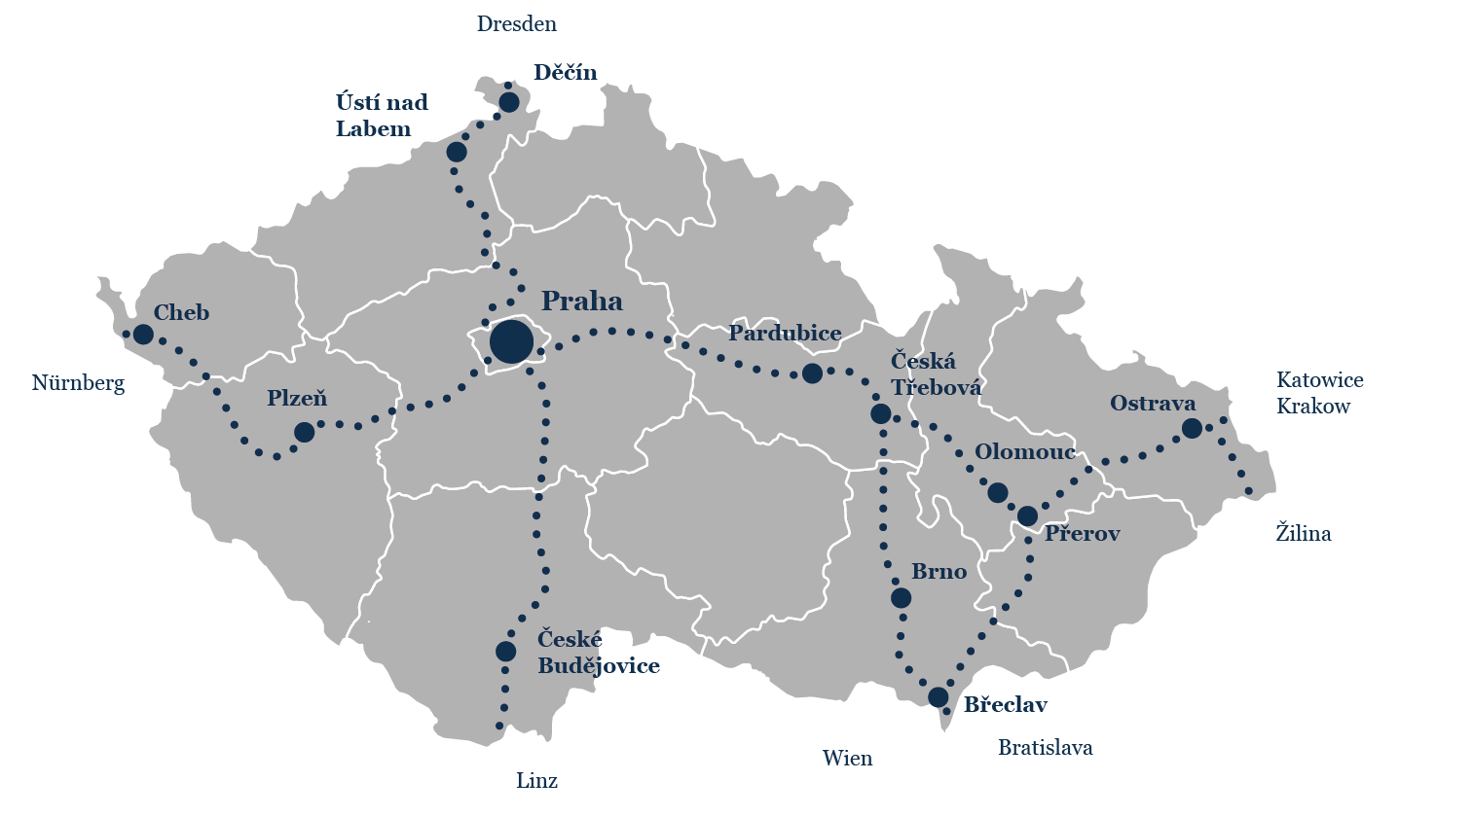

Transportation
Motorway network
Well-developed network of motorways
International airports all around the country
One of the densest railway networks in the World
9580 km of railways
0,12 km/km2 (USA 0,01; Japan 0,06)
České Dráhy is the main railway operator in the country
Source: Road and Motorway Directorate of the Czech Republic, 2021
Railway transit corridors
Source: AFI Business Guidebook, 2019

Slide 57

Airports
Václav Havel Airport Prague (PRG)
The biggest airport among the new EU members
Handles almost 18 mil passengers annually (excluding Covid-19)
Direct flights to 89 destinations around the world
Brno Airport (BRQ), Ostrava Airport (OSR), Karlovy Vary Airport (KLV), Pardubice Airport (PED)

Slide 58
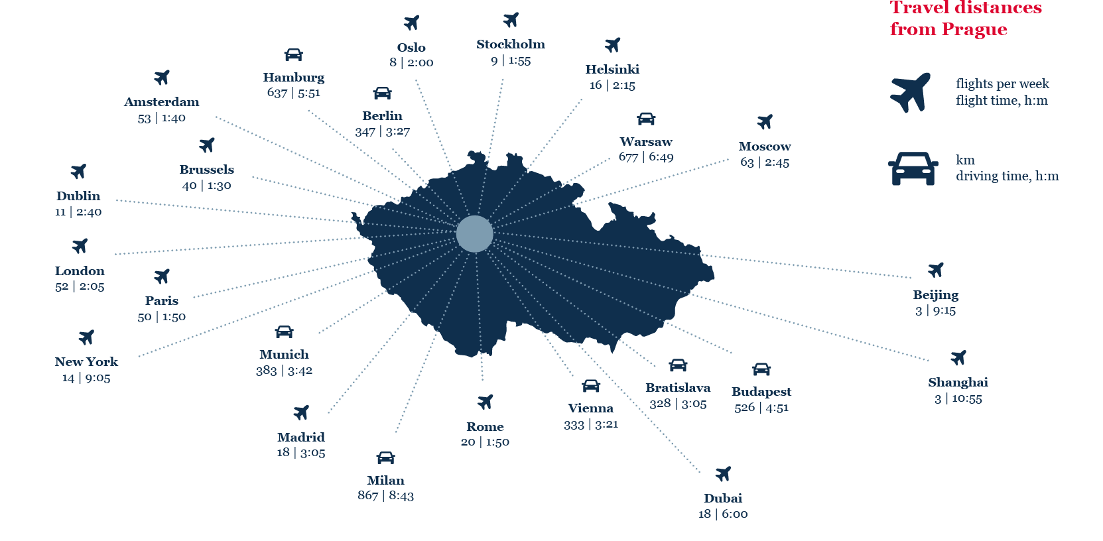
Perfect Connection All Around Europe and beyond
Source: AFI Business Guidebook 2020

Slide 59
Socially Responsible Country

Slide 60
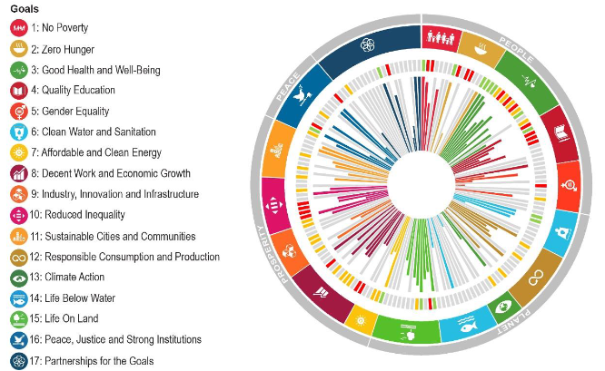

Socially Responsible Country
Czechia ranked as the world’s 12th most developed country in a new UN report
Among the 166 countries evaluated in the Sustainable Development Index (2022)
No decreasing trends - on the contrary most of the indicators are moderately improving or on track to be achieved
SDGs achieved:
No poverty
Clean water and sanitation
Decent work and economic growth
Major challenges:
Climate action
Partnerships for the goals
Humanitarian Aid
For 2022 Czech Ministry of Foreign Affairs allocated 10,2 mil USD
The Czech Ministry of Foreign Affairs supported the release of funds for Ukraine and for refugees from Ukraine
Czechia´s current level of achievement on each of 100 SDG targets
Source: OECD, 2022
Notes:
SDG_Governance_Review_Czech Republic_Institutional_Scan_2020.pdf (oecd.org)

Slide 61

Foreign Development Cooperation
Aiming at reducing poverty, improving quality of life and supporting sustainable development
Based on bilateral development projects, B2B programs, and small local projects
The Development Cooperation Strategy of Czechia 2018–2030 sets out six priority partner countries:
Bosnia and Herzegovina, Cambodia, Ethiopia, Georgia, Moldova, Zambia
+ specific and phase-out countries: Palestine, Ukraine, Kosovo, Mongolia, Serbia

Slide 62
Environmentally Considerate Country

Slide 63


Environmentally Considerate Country
Czechia is reducing its dependence on highly polluting low-grade brown coal as a source of energy
Nuclear power currently covers roughly 30% of the country’s total energy needs
Significant focus on green energy
17.7% of renewable energy (Eurostat,2021)
Mainly on wind energy, photovoltaics, hydropower plants, biomass, etc.
Notes:
Country facts - EUROSTAT (europa.eu)

Slide 64
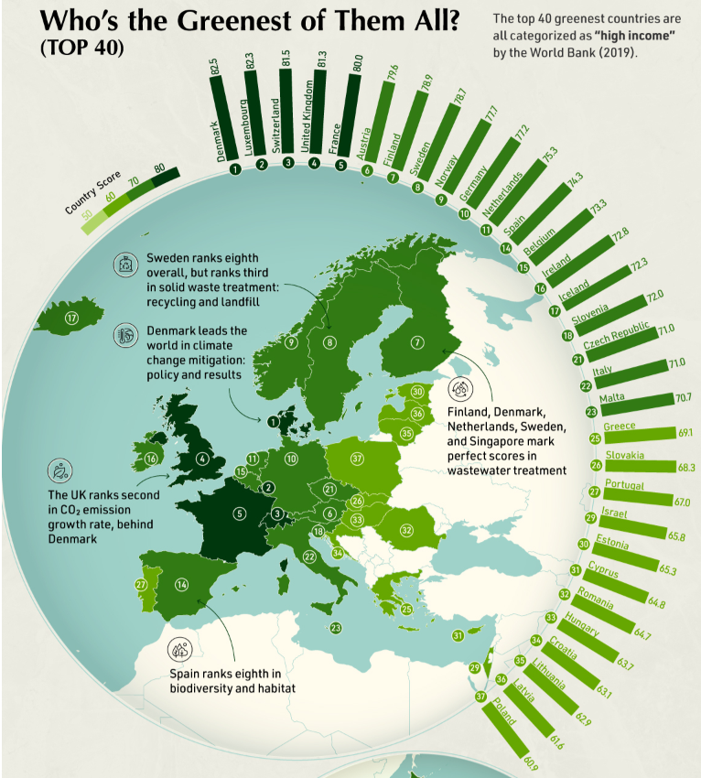

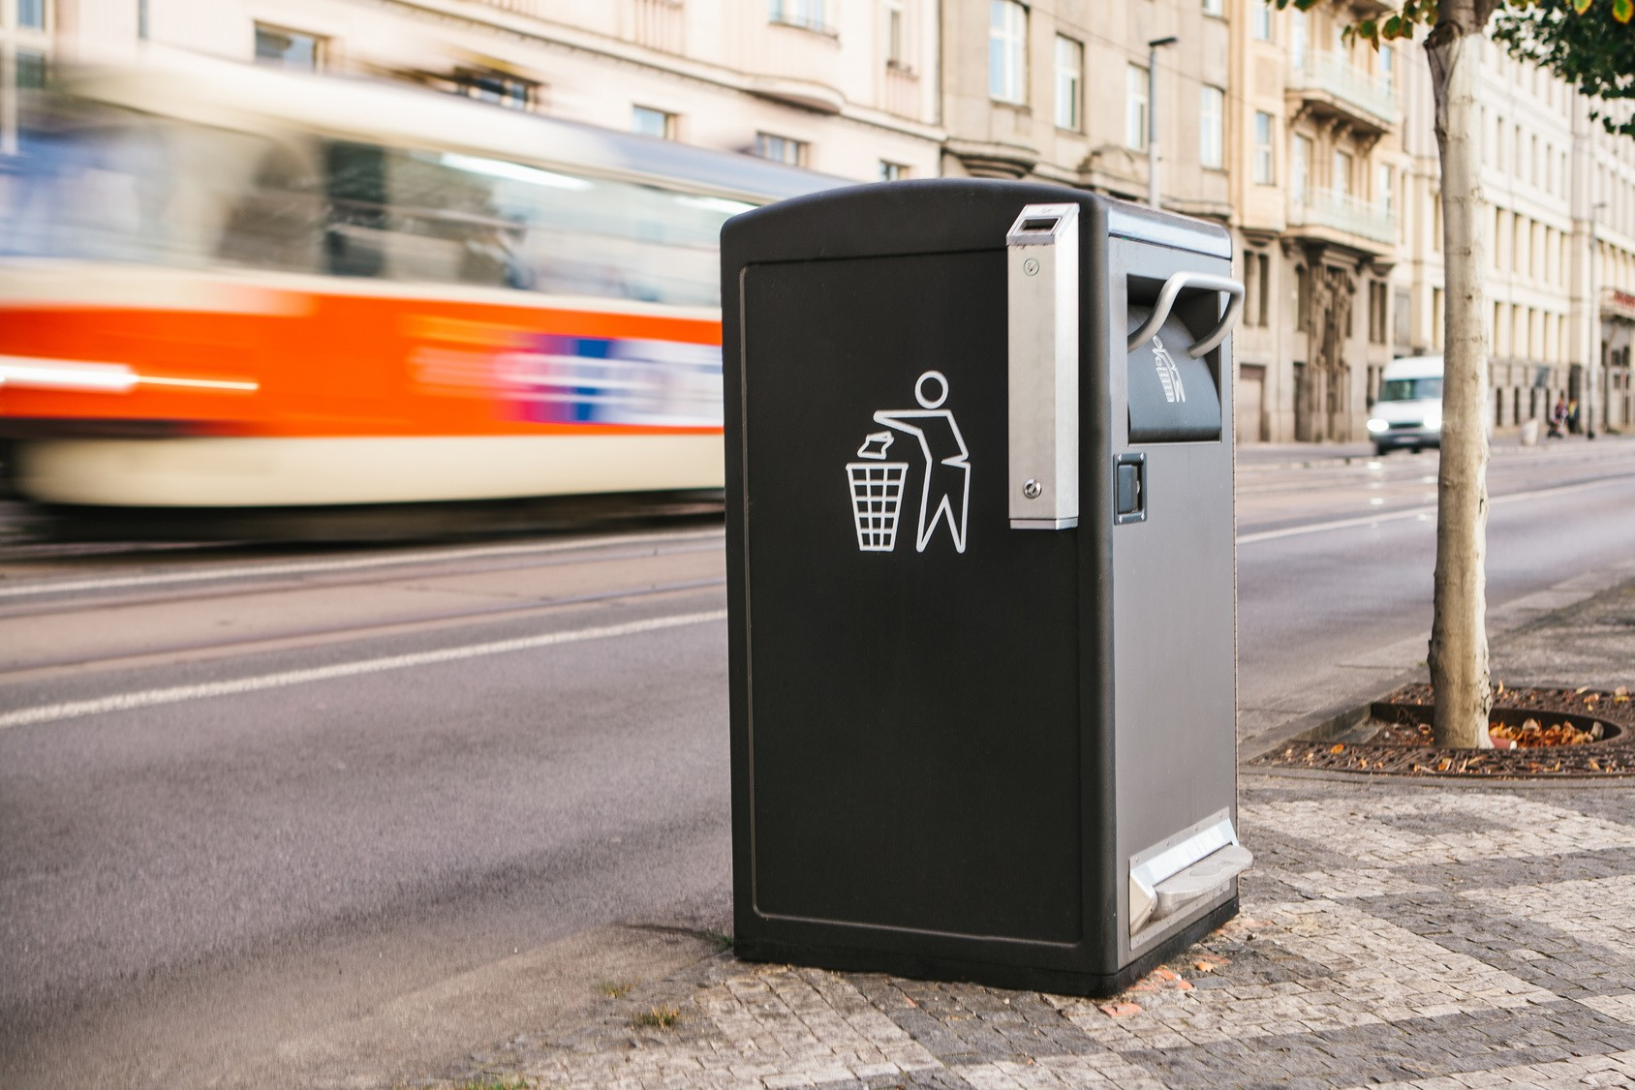
Environmentally Considerate Country
The 19th country with the best environmental performance
(According to the Environmental Performance Index, 2022)
The 13th most sustainable and developed country in the world
(According to the Sustainable and Development Report, 2022)
Source: World Bank, 2019

Slide 65


Environmentally Considerate Country
Prague ranks as one of the world’s greenest cities
In 2021 there were 1525 public chargers for e-cars
Czechs become one of the EU leaders in plastic recycling
98% of the population has a chance to recycle, and 73% actually participate

Slide 66
Czechia – A Good Place to Live

Slide 67
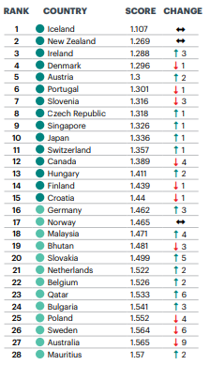
Quality of Life in Czechia
Global Peace Index (2022)
8th most peaceful country in the world
(According to the Institute of Economics and Peace)
6th safest destination out of 163 countries in the world
The highest quality of life amongst new EU members
Higher quality of life than in the USA
(According to the Deloitte 2019 Quality of Life Index)
Czechia rates 24th out of 149 countries, USA ranks 26th
14th best healthcare system in the EU
Czechia ranked higher than the UK or Ireland
Prague has been ranked among the 100 cities with the best hospital care in the World
Source: IEP, 2022

Slide 68
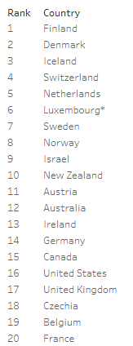

Quality of Life in Czechia
The World Happiness Index (2022)
18th happiest country in the world
(According to World Happiness Index 2019-2021 rankings)
Czechia is the 12th most attractive country and the 2nd best-country for expats to work in
6th fastest public transport in the World is in Prague
Source: World Happiness Report, 2022
Notes:
Zdroje:
https://news.expats.cz/prague-relocation/czech-republic-ranked-worlds-12th-best-country-to-achieve-the-american-dream-usa-88th/.
https://news.expats.cz/prague-relocation/czech-republic-ranked-second-best-country-for-expats-to-work-in/.
https://worldhappiness.report/ed/2021/happiness-trust-and-deaths-under-covid-19/.
https://news.expats.cz/prague-public-transport/pragues-public-transport-rated-6th-fastest-in-the-world-in-new-study/.

Slide 69
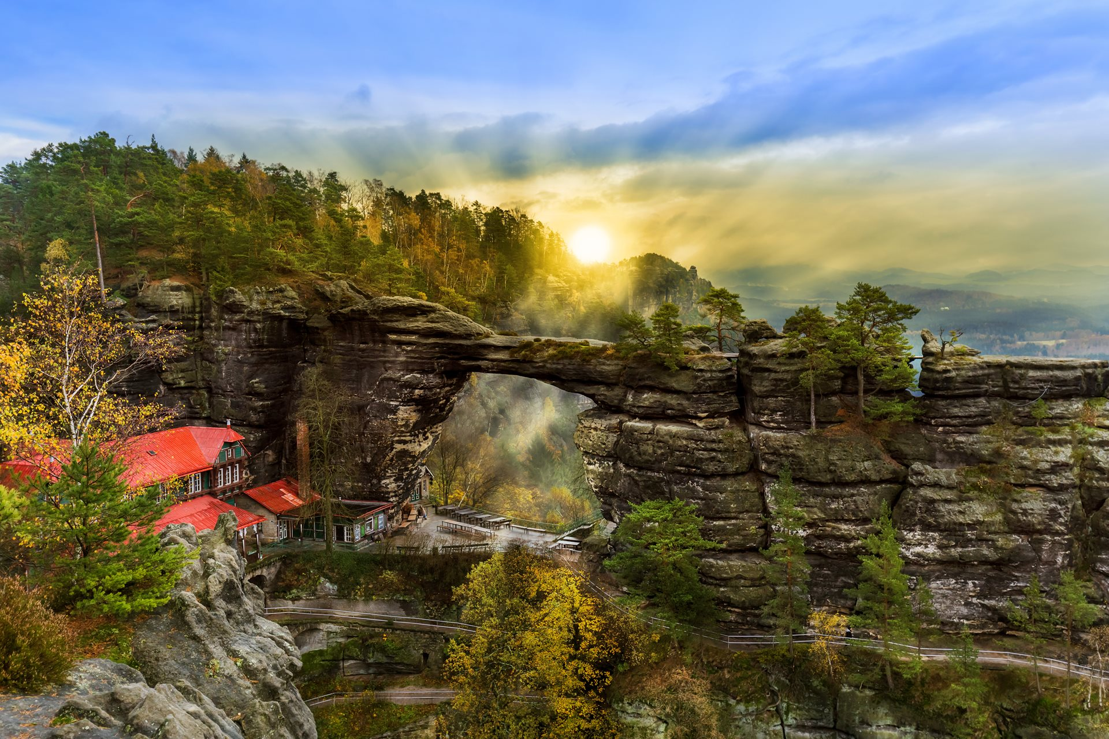
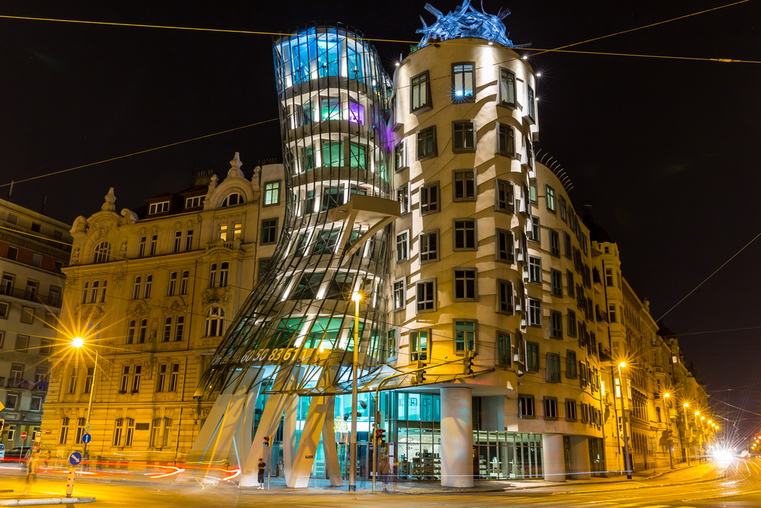
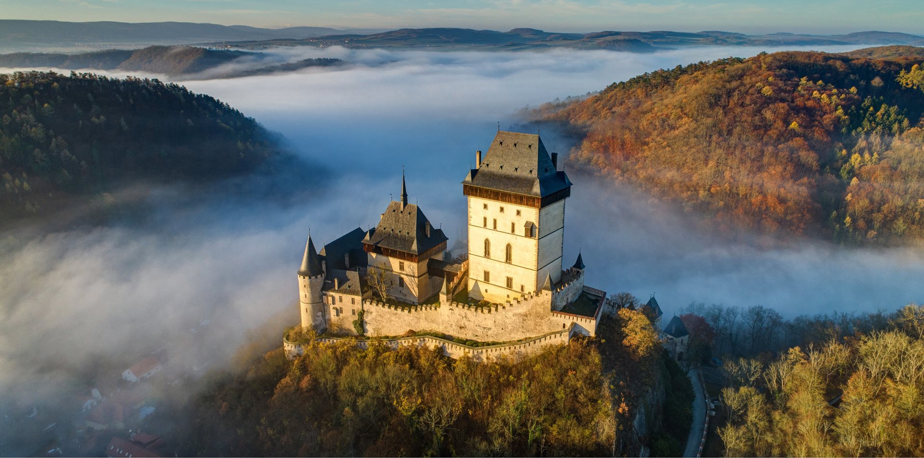
Czechia – A Good Place to Live
National parks
Castlex and Chateaux
Historical Centres
Spas
Modern Buildings

Slide 70
Tourism

Slide 71


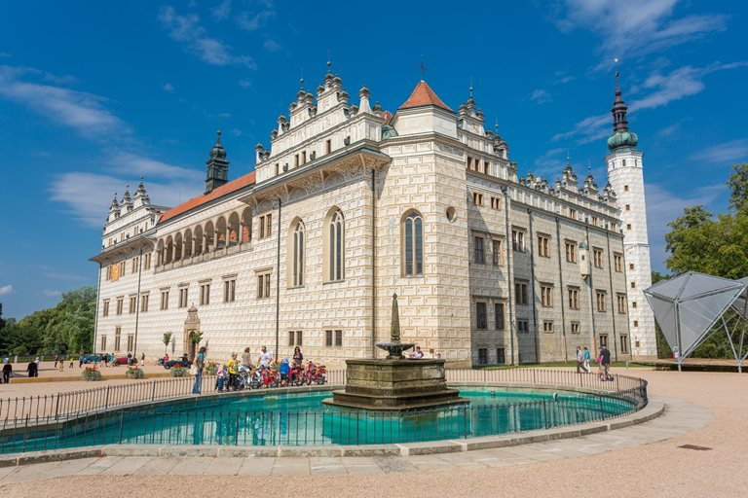
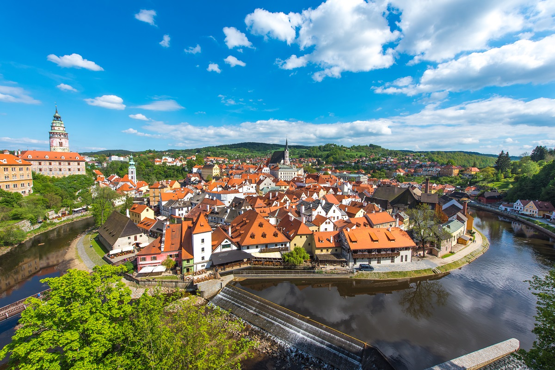


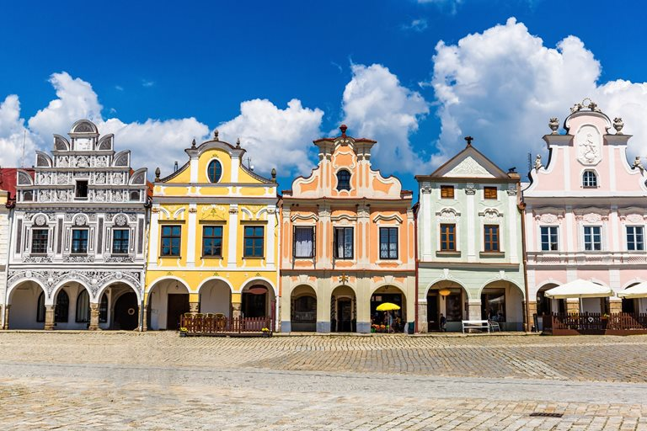


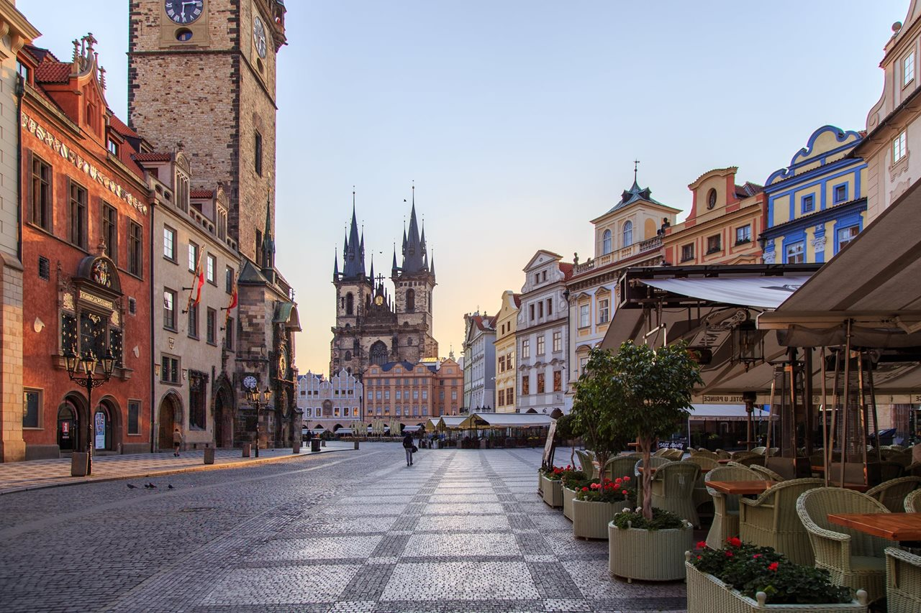
UNESCO Sights in Czechia
Notes:
Gardens and Castle at Kroměříž (a town in Moravia)
The Castle and Gardens are some of the most beautiful in Europe. You can see a labyrinth of green walls, original floral and sculptural decoration and historical greenhouses.
2. Litomyšl Castle
Visitors can find the Brewery within the castle complex, the birthplace of Bedřich Smetana, the Czech famous composer.
3. Historic Centre of Český Krumlov
Its historic centre was added to the UNESCO List in 1992. The city is most famous for its castle complex built in the 13th century.
4. Lednice-Valtice Complex
Visitors can find a unique park full of rare tree species, romantic little buildings, fishponds and beautiful little corners.
Known as the Garden of Europe.
5. Jizera Mountain Beech Forest (Jizerskohorské bučiny)
First natural site on the List of World Heritage Sites in Czechia.
These forests are one of the very last mountain beech forests in Europe almost untouched by people.
6. Historic Centre of Telč
7. Czech puppetry (intangible cultural heritage)
8. Holy Trinity Column in Olomouc
It is the most outstanding example of the Moravian Baroque style which developed in the 18th century in Central Europe.
9. Historic Centre of Prague

Slide 72



Mineral Spa Towns
World leader in spa and rehabilitation treatment
The west Bohemian Spa Triangle was granted UNESCO World Heritage Status
Karlovy Vary (Carlsbad)
More than 80 hot springs
The warmest (73°C) of them, the Vřidlo spring, emerges as a geyser, spurting up to 12 meters into the air
Mariánské Lázně (Marienbad)
Františkovy Lázně
Jáchymov Spa
The oldest radon spa in the world

Slide 73





Tourism
Prague is the top tourist destination in Czechia
Recognized as one of the most beautiful capitals in the world, the city boasts an exquisitely preserved historical centre
Czech Beer, Moravian wine

Slide 74






Enjoy Czechia
Cycling trails
Over 44,000 km
Walking trails
Over 40,782 km
Cross-country ski trails
Over 3,540 km
Ski slopes
Over 480 km

Slide 75
Representation of Czechia Worldwide

Slide 76

Representation of Czechia Worldwide
The foreign network is composed of:
Czech Embassies
Offices of CzechTrade
Offices of CzechInvest
Offices of CzechTourism
Czech Centers
159 offices covering 93 countries

Slide 77
Bilateral Relations CA – CZ (modifikovat dle potřeby)

Slide 78

Bilateral Relations
Source: ČSÚ

Slide 79

Potential for Further Cooperation Between CA and CZ
(vychází z mapy MOP)
Civil aviation industry
Strategic industry because of high investment into innovation and R&D
Opportunities in the supply of airplane components and production cooperation
Mining and oil
Projects in bitumen mining and construction of pipelines
Possible cooperation within competitive mining and mining technologies, equipment, accessories and other innovative items
Agricultural and food industry
Brewing technology, drones, smart agriculture
Possible cooperation within new agriculture and brewing technologies
Health and pharmaceutical industry
Experience with Czech exports of medical equipment to Canada
Possible cooperation within hospital beds and other hospital equipment

Slide 80
Useful Links (modifikovat dle potřeby)

Slide 81





Useful Links
Ministry of Foreign Affairs
www.mzv.cz
Embassy of Czechia in Canada (Ottawa)
www.mzv.cz/ottawa
Trade promotion in Canada (Calgary)
www.czechtradeoffices.com/en/ca
Investment and business support
www.czechinvest.org
Promotion of tourism #VisitCzechRepublic
www.visitczechrepublic.com
CzechTourism – tourist information
www.czechtourism.cz

Slide 82

Thank you for your attention
Jmeno_Prijmeni@mzv.cz

