Slide 1
Agricultural Research for the Development of
the Cerrado region
Fernando Souza Rocha
International Coordinator
Embrapa Cerrados
Brasília, January 2025

Slide 2
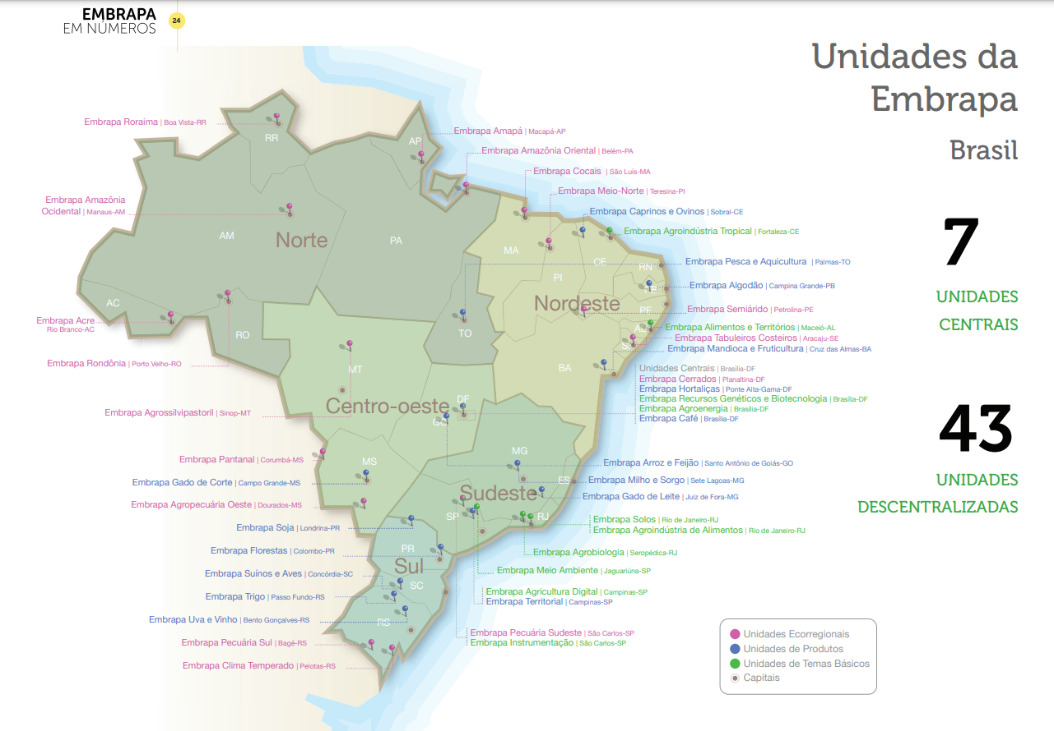

Slide 3
Embrapa Cerrados
Total area = 3,474 ha
65,000 m² main plant
1,300 ha arable land
96 ha PPA
650 ha Legal Reserve
Foundation: 1975

Slide 4
Embrapa Cerrados
369 employees
99 Research Scientists
59 analysts
53 technicians
158 research assistants

Slide 5
The Cerrado Region
RR
AP
AM
MA
CE
PA
RN
PI
PB
PE
AC
RO
TO
SE
AL
MT
BA
GO
Total Area :
DF
207 MHa
MS
MG
Arable land :
ES
139 MHa
Annual Crops:
33 MHa
Pastures:
60.6 MHa
Native vegetation
50%
SP
RJ
Cerrado
PR
SC
RS
Source: TerraClass Cerrado, 2020

Slide 6
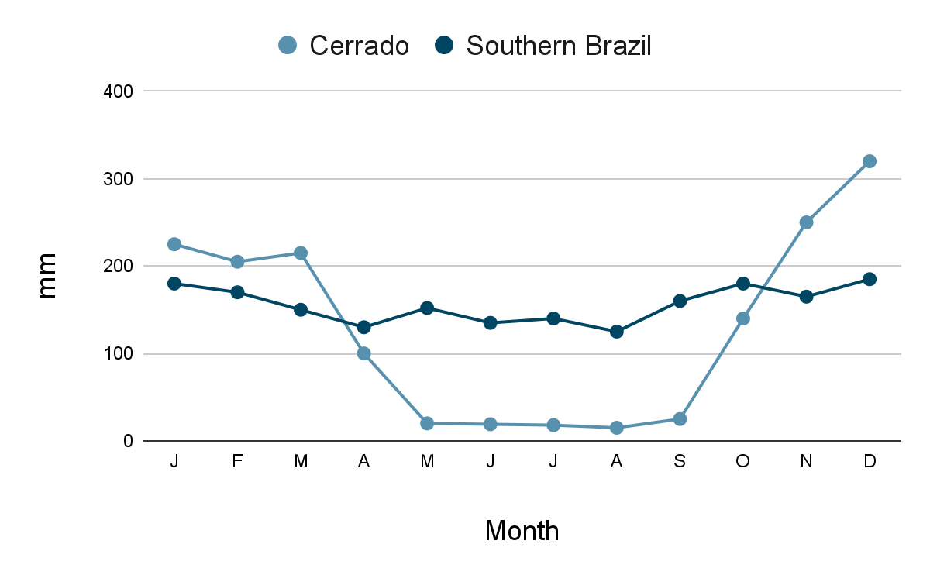
Rainfall distribution in the Cerrado:
two well defined season

Slide 8
Dominant land use in the Cerrado: extensive cattle raising of the native grass and bush lands
A little bit of history: The 70’s
Cerrado was regarded as unfit for farming: “the Brazilian wasteland”

Slide 9
Main agricultural problems in the Cerrado
1975
Limited knowledge about natural resources
Long dry season with irregular rain distribution in the rainy season (dry spells)
Low natural soil fertility

Slide 10
Inappropriate farming systems
Main agricultural problems in the Cerrado
1975
The absence of sound technology to overcome these constraints

Slide 11
01
Availability of arable land
Incorporation of the Cerrado in agricultural production
02
Investment in the development of agricultural technologies
03
Public policy

Slide 12
The first place in the world where modern agriculture was developed in soils with low fertility and in a region with a six-month raining season

Slide 13
The 1st revolution
Transformation of acidic, poor soils into fertile land
“Tropicalization” of crops and animal production systems
Development of a platform of sustainable practices
No-tillage + double cropping (1990’s)
The 2nd revolution

Slide 14
With limel
Addition of lime
Without lime
Development of Tropical Agriculture in Brazil
Soil fertility built
fertility built
Natural soil

Slide 15
Public R&D
Main limitations removed by public R&D in Brazil

Slide 16
Brazil has become a major food producer and exporter
Major exporter of:
Soybean
Corn
Coffee
Sugar
Orange juice
Sugarcane ethanol
Beef
Chicken meat

Slide 17
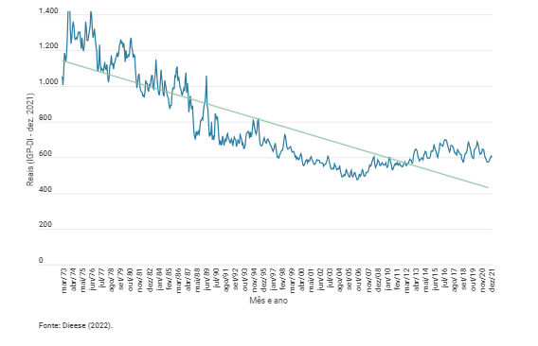
Agriculture and its social importance
Employment and income generation
Food security
Consistent reduction in food costs

Slide 18
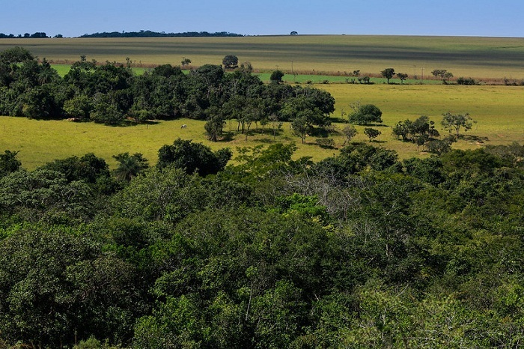
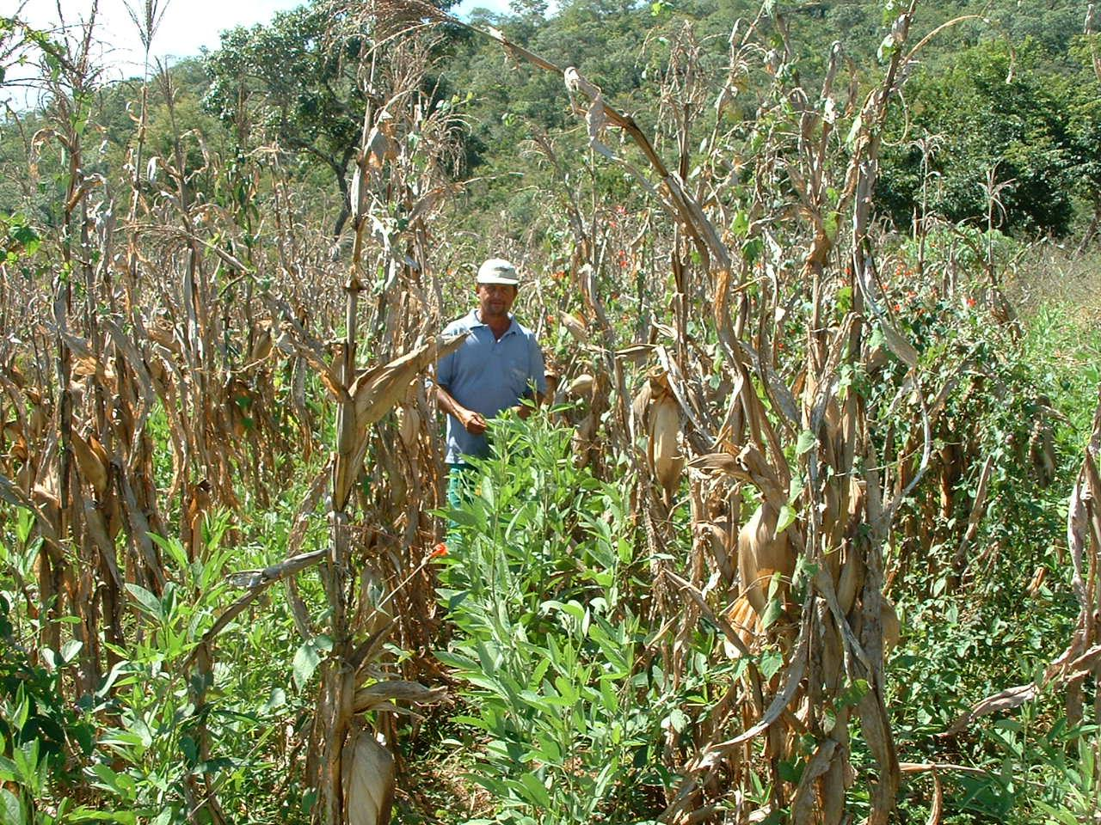
Embrapa Cerrados today
Management and Conservation of Natural Resources
Crop Production
Animal Production

Slide 19
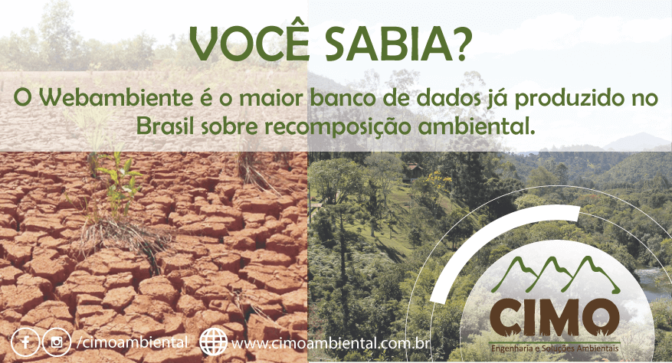
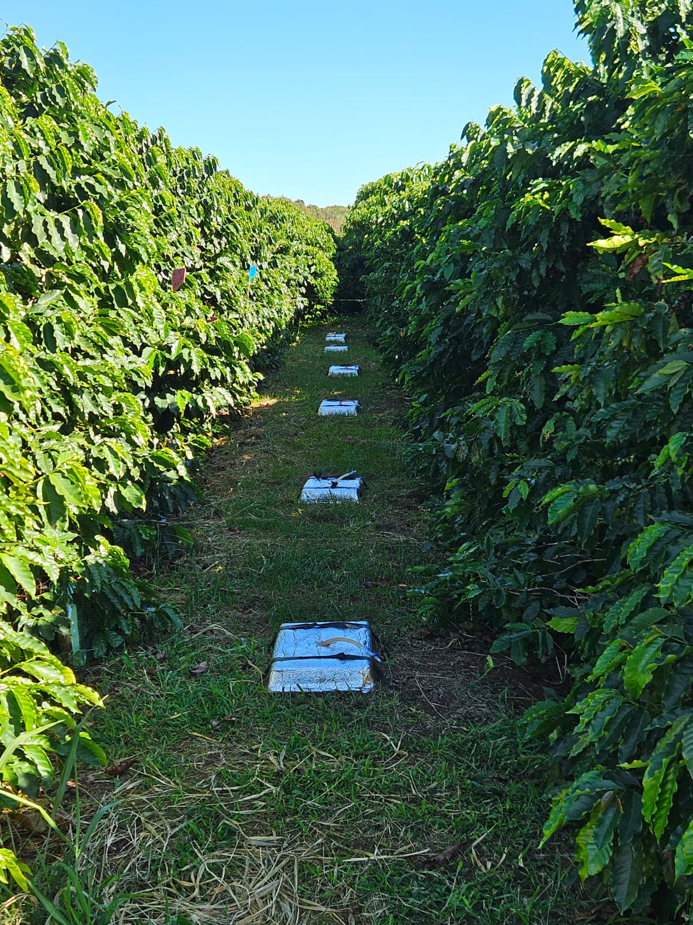
Management and Conservation of Natural Resources
Restoration of natural landscapes
Native Fruits
Greenhouse Gases

Slide 20
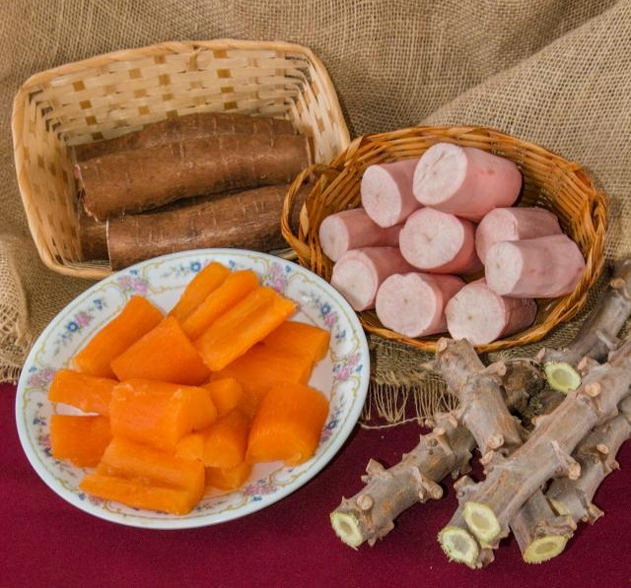
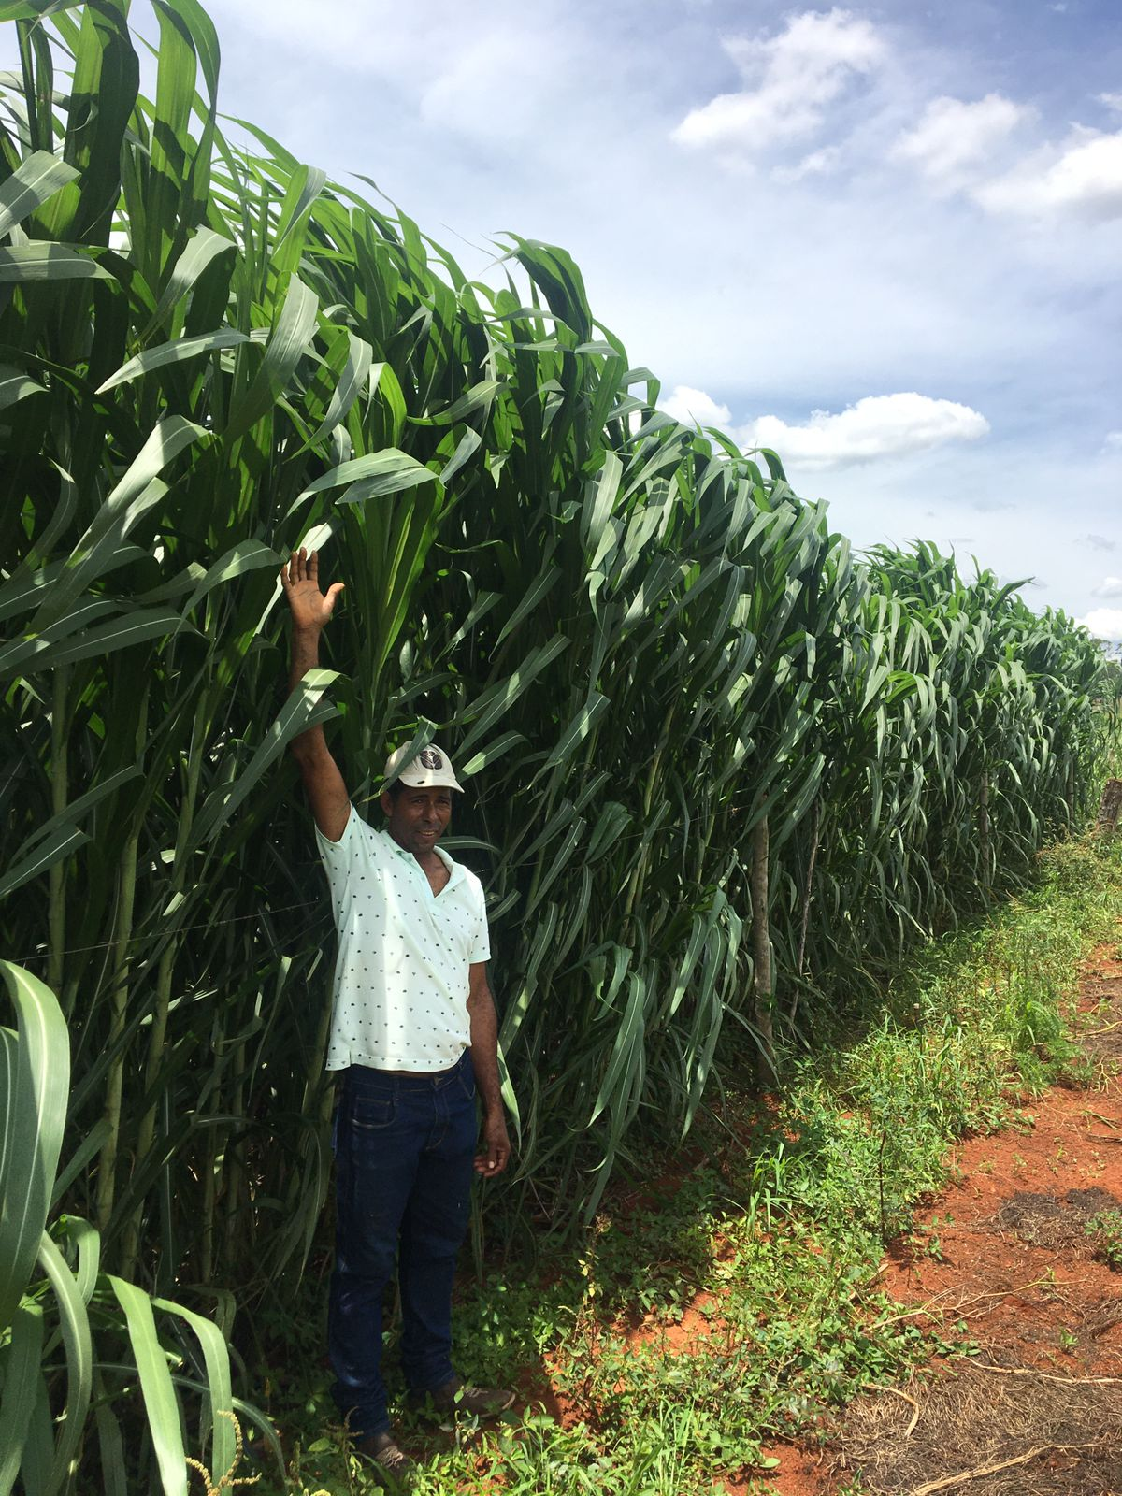
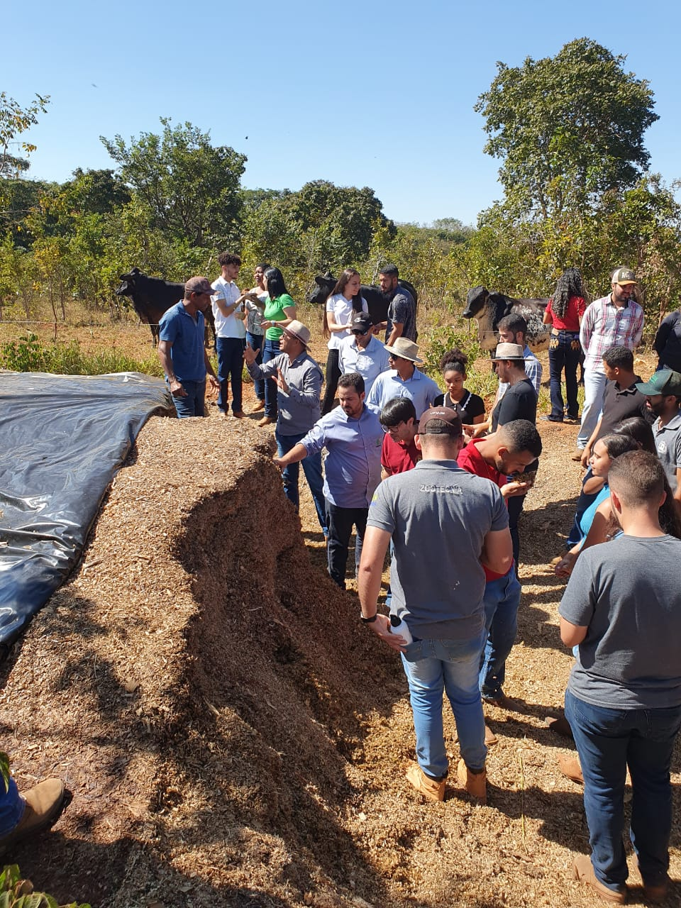
Crop Production
Crop Breeding
Family Farming
Crop Systems

Slide 21
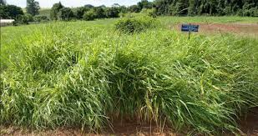
Animal Production
Integrated agricultural systems
Forage Breeding
Animal genetics

Slide 22
Obrigado!
cpac.chpd@embrapa.br
fernando.rocha@embrapa.br

