Slide 1

Sub-Saharan Africa:
Investors' final frontier
René Awambeng, Head of Global Corporates
Dr Edward George, Head of Group Research
Prague, December 2015
Notes:
Clients:
Precision & heavy machinery
Power generation
Transport
Infrastructure
Water management
Refineries
Food processing

Slide 2
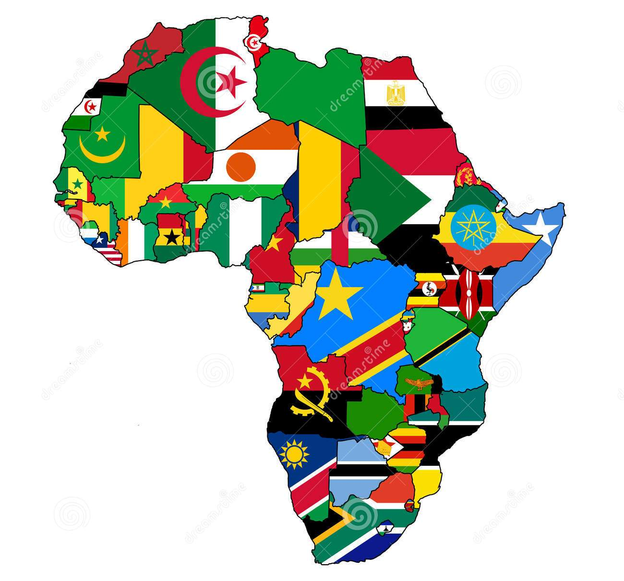
Africa is not a country – it’s 55 countries
Source: Dreamstime.
© Ecobank 2015 | Sub-Saharan Africa: Investors' final frontier | René Awambeng & Edward George | December 2015
²
Notes:
Add in
The first is the language barrier – which is bigger than you might think
There are dozens of languages spoken across West Africa, most them belonging to the Yoruba and Bantu language families
West Africans get round this by using former colonial languages, and English has become the undisputed language for international business
The problem is that this division between language zones – French in blue, English in pink – has created business silos, isolated from neighbouring markets
It’s common to find experts on Ghana’s cocoa sector, who know nothing about Cote d’ivoire – or vice versa
Despite the fact that the two countries’ cocoa zones border with each other – and there is plenty of informal trade between them
Countries like Cameroon have the added complication of being both Anglophone and Francophone – if you’ve ever tried speaking French with a Cameroonian Anglophone, you’ll know what I mean
But it’s not just outsiders who struggle – Anglophone Africans struggle in Francophone markets, and vice versa
Few Anglophones speak French (esp. Nigerians and Ghanaians), and although most Francophones speak some English, it is often rudimentary.
It is very common for Ghanaians never to have travelled to CDI, or Nigerians to Niger
Moreover, this language barrier between the CFA Franc Zone and WAMZ serves as a proxy for a whole host of other barriers to doing business
Different currencies & central banks – in the Franc Zone, one currency pegged to the Euro, in WAMZ multiple currencies and monetary policies
Different legal systems – in WAMZ systems based on English law, in the CFA Franc Zone, OHADA, drawn from the Code Napoleon
And then the crux to doing business anywhere: profoundly different ways of thinking
As an Englishman I am baffled by the way the Francophones make everything so complicated, hyper rational and bureaucratic
From their side, I’m sure they are frustrated by our seemingly random approach to strategy – we prefer to run a host of pilots rather a single, centralised project – our disdain for regulation and subservience to market forces
All of these have factors have resulted in two separate economies in West Africa – which makes no sense
But it does mean that if you speak both English and French, you are in a unique position to act as a bridge between the two – which opens a whole array of business opportunities

Slide 3
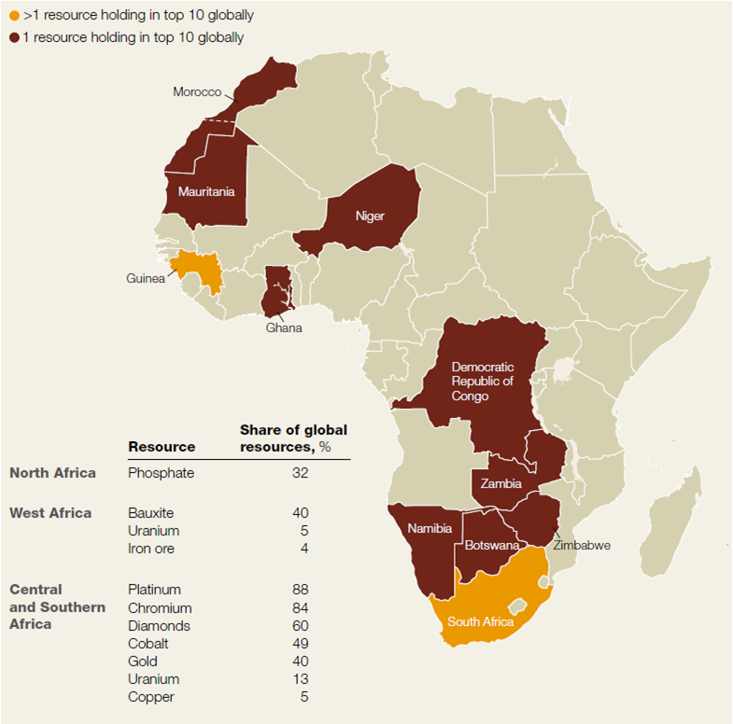
Africa has a wealth of natural resources
Africa’s resource holding companies Africa’s leading oil producers, mn bpd, 2014
Sources: McKinsey, Ecobank Research.
© Ecobank 2015 | Sub-Saharan Africa: Investors' final frontier | René Awambeng & Edward George | December 2015
³
Notes:
First – a quick tally of West Africa’s natural resources
If you look at this map by McKinsey – the dark brown countries are those with at least one resource holding company in the world’s Top 10, and the two orange countries – at least two
South Africa dominates commodity reserves, from platinum group metals to diamonds and coal
But West Africa is a mining hub in its own right
There are huge deposits of gold in Ghana, Mali and Burkina Faso, and bauxite reserves across the region
The potential for iron ore is only starting to be exploited – the Mount Nimba range, which straddles several West Africa countries, is made almost entirely of pure iron ore, the highest quality in the world
Uranium is mined in Niger for exclusive use in France’s nuclear reactors
And West Africa sits on at least 10% of the world’s hydrocarbons
These are focused on Nigeria and Angola, with 3.7mn bpd of production between them in 2013
New producers are emerging, such as Ghana, and there is huge potential to develop West Africa’s pre-salt offshore
On top of this, West Africa is a major producer of soft commodities
Cash crops like cocoa, coffee and cashews, and food crops like maize and palm oil
All of these make West Africa a very attractive proposition for investors
And yet we find, time and again, that Anglophone investors from the UK, North America & Australia focus on countries like Ghana and Nigeria, while Francophone investors focus exclusively on the CFA Franc Zone
In my view, there are two key reasons for this

Slide 4
Despite the global environment, Africa is still growing
Real GDP growth, annual % change
• African growth is holding up well, outpacing all other regions, bar Developing Asia.
• In 2000-13 Africa’s CAGR reached 12%, only marginally behind Asia and the BRICS.
• Although growth has slowed, it will still average around 4% over the next two years.
Source: IMF
© Ecobank 2015 | Sub-Saharan Africa: Investors' final frontier | René Awambeng & Edward George | December 2015
Notes:
Update chart with 2018 forecast

Slide 5
The largest economies are driving high growth rates
Top Performers in 2015
Ethiopia 8.7%
DRC 8.4%
Côte d’Ivoire 8.2%
Mozambique 7.0%
Kenya 6.5%
Senegal 5.1%
Angola 3.5%
Nigeria 4.0%
Ghana 3.5%
Top Performers in 2016
Mozambique 8.2%
Ethiopia 8.1%
Côte d’Ivoire 7.6%
DRC 7.3%
Kenya 6.8%
Senegal 5.9%
Ghana 5.7%
Nigeria 4.3%
Angola 3.5%
Source: IMF
© Ecobank 2015 | Sub-Saharan Africa: Investors' final frontier | René Awambeng & Edward George | December 2015
Notes:
Although growth has slowed in key markets such as Ghana and Nigeria, we still expect robust growth rates in other large economies in SSA such as Ethiopia, DRC, Mozambique and Cote d’Ivoire. Growth will continue to be driven by strong infrastructure development backed by still robust government spending (albeit weaker than previous years) and activity in consumer goods and services sectors.

Slide 6
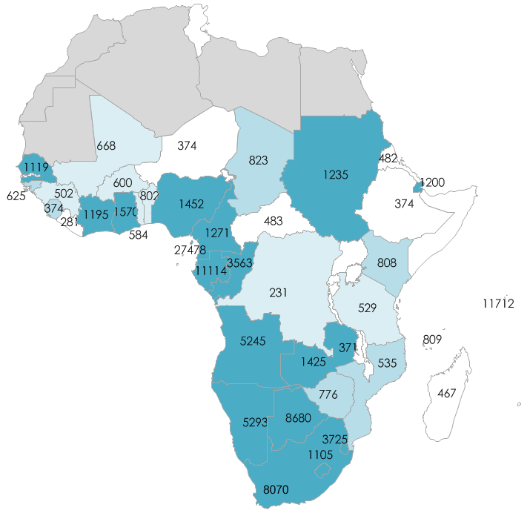
Purchasing power is rising, forging a consumer class
2025 likelihood of reaching middle income status
Sub-Saharan Africa’s population by income bracket percentage
Global (>$25,000)
Middle Income ($5,000-$25,000)
Basic needs ($1,000-$5,000)
Destitute (<$1,000)
Already
2005
2015
projection
Likely
Source: McKinsey
Possible
Unlikely
GDP per capita
Source: Devarajan & Fager “Is Africa’s growth sustainable, 2012”.
© Ecobank 2015 | Sub-Saharan Africa: Investors' final frontier | René Awambeng & Edward George | December 2015
6
Notes:
One consequence of high growth rates and rising urbanisation has been the emergence of a new consumer class
These figures from McKinsey are striking
McKinsey projects that those earning between US$1,000 and US$5,000 per year, will surge from 39% of the population in 2005, to 55% in 2015
Moreover, those with incomes in the US$5,000-25,000 bracket will rise to 9% of the population
These households will, for the first time, have income that is truly disposable – rather than living day-to-day subsistence
The map on the right shows how already half of Africa’s countries are Middle Income – the level you need to reach to become an EM
And only the most landlocked will have failed to graduate to Middle Income status by 2025
But we should not get carried away
When the WB and the press talk about the emergence of an African Middle Class, they are not MC by Western standards
And by that I mean the amount of disposable income can be tiny – McKinsey describes those earning US$1,000-5,000 as ‘Basic needs’, not middle class
Moreover, the number of middle class households appears to have been overestimated – wildly
Two years ago the AfDB estimated there were 350mn middle class African households
A recent report by Standard Bank puts the figure at 15mn households, less than 5% of the original estimate
And for many households, their emergence into this category is precarious
Many are earning just above US$2.50/day; it only takes a bad crop, a lost job, a fire or a robbery to plunge them back into poverty
But there is nonetheless a profound change going on, one which is forcing multinationals to reassess the market for their goods and services across SSA

Slide 7
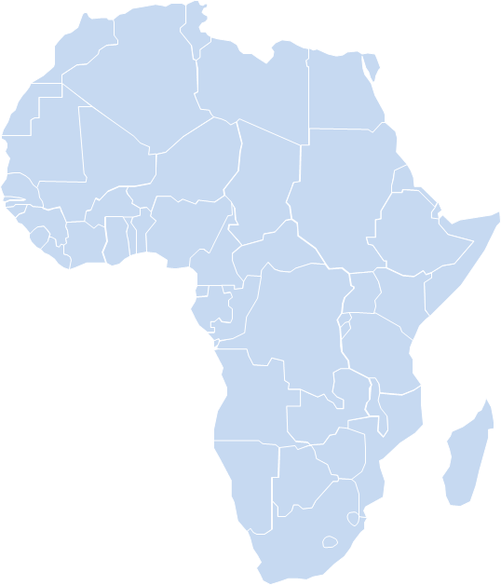
Opportunities - Pipelines
Huge future pipeline capex awaits the region
There are over 25,000 kilometres of oil, natural gas and petroleum product pipelines in West Africa. Gas carrying capacity is less than 5 billion cubic feet per day.
Nigeria dominates, accounting for 73% of installed pipelines in the region but needs to develop almost 7,000 km of new capacity.
Key pipelines:
  West Africa Gas Pipeline
  Abidjan – Yamoussoukro products pipeline
  Cote d’Ivoire – Ghana pipeline (planned)
  Trans Sahara Gas Pipeline (planned)
  Chad- Cameroon oil pipeline
  Niger – Chad oil pipeline (planned)
  Foxtrot gas pipeline
The West Africa region requires investments of over $1.5bn annually in various pipelines.
Yamoussoukro CIV
Lagos Nigeria
Abidjan CIV
Tema, Ghana
Foxtrot gas field CIV
Existing Gas Pipeline
Planned Gas Pipeline
Existing Oil Pipeline
Planned Oil Pipeline
Existing Products Pipeline
Planned Products Pipeline
© Ecobank 2015 | Sub-Saharan Africa: Investors' final frontier | René Awambeng & Edward George | December 2015
⁷
Notes:
Add this first:
Oil & gas infrastructure on ground is likely to be inadequate for expected increase in production:
Over 25,000 kilometres of oil, gas and petroleum product pipelines
Estimated gas processing capacity for 2.5 trillion cubic feet
40 FPSOs
92 Rigs offshore West Africa in November
3 LNG plants with capacity for 28 million metric tonnes
Investment in new infrastructure could see these segments expand:
10 new FPSOs
Rig dynamics are shifting from predominance of Jackup to Semisubmersible as companies move offshore
Jackup incidents have been common in the region.
EG LNG train 2 and NLNG train 7?
Floating Regasification Unit offshore Benin/Togo
Factors likely to drive new infrastructure:
Licensing rounds and renewal of deep-water licenses
Cameroon, Gabon & Congo
The presence of marginal offshore fields, stranded gas
Changing dynamics of trade in the Atlantic basin
There are over 25,000 kilometres of oil, natural gas and petroleum product pipelines in West Africa.
Nigeria accounts for around ¾ of installed pipelines, but at least another 7,000 km are needed in the short term to meet rising demand
Long-standing pipelines include the Foxtrot and Abidjan-to-Yamoussoukro pipelines in Côte d’Ivoire
More recently, the Chad to Cameroon pipeline has enabled Chad to become a significant oil producer, with exports of over 100,000 barrels/day via this pipeline
The most ambitious project under development is the West Africa Gas Pipeline
This is intended to carry gas from Nigeria through Benin and Togo to Ghana, with a possible extension to Côte d’Ivoire. But currently it just transports gas from Nigeria to Ghana
Niger wants to export 80,000 barrels/day via a new connection to the Chad-Cameroon pipeline
And there are several ambitious projects to build pipelines from Angola to Zambia, and the Trans Sahara Gas Pipeline, which are still in the planning stages
Altogether, West Africa will need US$1.5bn per year in investment to develop these projects
The West African Gas Pipeline was supposed to ship 120mmscfd but ranged between 20mmscfd and 80mmscfd since 2012

Slide 8
Key Mid-stream Infrastructure - Refineries
Nigeria to drive refinery development in the region
Existing Refineries in West Africa
Active Refinery
Planned Refinery
About 820 kbpd of capacity to be augmented with over 1800 kbpd of new capacity in next five years
Refinery developments are difficult in Africa due to issues with regulation, feedstock, off-take and funding. Hence less than half of planned refineries are expected to be constructed
Planned Refineries in West Africa
© Ecobank 2015 | Sub-Saharan Africa: Investors' final frontier | René Awambeng & Edward George | December 2015
⁸

Slide 9
Key Mid-stream Infrastructure - Storage
Storage Capacity in West Africa, by liquid, cubic metres
West Africa has nearly 19 million cubic metres of liquids storage; most of which is concentrated in Nigeria (53%), Cote d’Ivoire (21%), Ghana (9%), Angola (4%) and Cameroon (3%).
82% of existing storage capacity is for petroleum products – mostly gasoline due to Nigeria followed by diesel. But tanks are often used interchangeably in some cases.
Total products storage of 15.6 million cubic metres represents about 130 days of storage on the average with very wide disparity across countries.
Growth rate in fuel consumption is estimated at over 4% in SSA over the next few years. This could increase demand for storage considerably in several countries – Ghana, Cameroon, Nigeria and Zambia
LPG storage is really low at 2% of storage capacity despite rising LPG consumption. LPG consumption across the region has risen 11% in the past five years
Breakdown of West Africa storage capacity by fuel, %
© Ecobank 2015 | Sub-Saharan Africa: Investors' final frontier | René Awambeng & Edward George | December 2015
⁹
Notes:
Add:
Most countries have storage concentrated in key coastal cities and require significant amount of fuel movement with storage depots further inland. Most of these is still done via trucks and is partly responsible for the level of diesel demand across the region.
Storage is concentrated around refineries, airports and major ports in WAF.

Slide 10
The power sector needs sustained investment
  Electricity Consumption (kWh per capita)
  Access to Electricity (% population)
Source: World Bank
• SSA, with a population of 800 million people, generates roughly the same amount of power as Spain, which has a population of 47 million people.
• Around 600 million people in Africa have no or very limited levels of electricity supply.
• There are huge opportunities to develop large-scale generation & distribution networks, as well as off-grid & renewable generation (especially for remote rural areas).
© Ecobank 2015 | Sub-Saharan Africa: Investors' final frontier | René Awambeng & Edward George | December 2015
¹⁰
Notes:
But there is a huge fly in the ointment to all this exuberance – the power network
Put bluntly, the provision of power is woefully inadequate, and is holding back economic growth
Nigeria produces the same amount of power as the Greater London area – but has a population at least 20 times the size
It is common for households in Lagos to have three generators – a main one, a back-up, and a back-up for the back-up – so unreliable is the power network
In some countries power shortages are the result of underinvestment and incompetence – Ghana is a case in point, where Accra residents have been getting an average of 2 days of power per week since the start of this year
But shortages also reflect economic growth – notably in South Africa where demand has far outstripped efforts to expand capacity, which his already high for Africa
This is the single greatest opportunity for investors in Africa – as the pent up demand is almost limitless
And it’s not as if SSA doesn’t have sufficient oil, gas or coal reserves to feed power stations
Major investments are on the drawing board – and in fact, Ecobank’s advisory team has been working on a project for Vitol to identify power opportunities in West Africa
The Vice-President, Namadi Sambo, Thursday disclosed that Nigeria’s power generation level would increase to a capacity of 20,000 megawatts even though the country currently generates about 5,500 megawatts. He spoke at the inauguration of the Niger Delta Power Holding Company/NIPP 330/132/33 KV Transmission Substation at Apir in Makurdi, the Benue State capital. He said: “The Niger Delta Power Holding Company, NDPHC, has effectively pursued its mandate of implementing robust power projects across the country under the National Integrated Power Power Project (NIPP). “Under the first phased of its project mandate, the company has completed several thermal generating plants in the country. “Today we are proud that the NDPHC has 265 out of a total of 296 distribution injection substations located nationwide and several other power projects across the country.
Installed capacity 10.4 MW, but only produces 5.5 MW. Demand is what?
Add is issue of poor gas distribution, poor investment in pipelines, pricing mismatch, means supplies are inadequate, Dangote switch to coal
The West African Gas Pipeline was supposed to ship 120mmscfd but ranged between 20mmscfd and 80mmscfd since 2012
Across all 3 countries, collection of payments from both residential, govt. ministries, depts & agencies (MDA) is problematic
Over 50% of Nigeria's power demand is thus off-grid...that is a huge market estimated at over 20,000MW

Slide 11
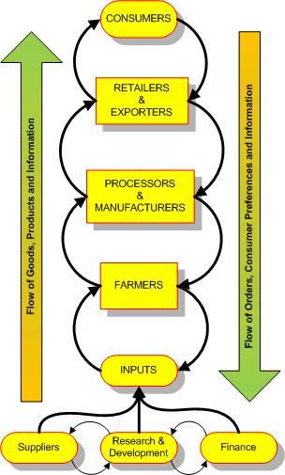
Financing the value chain: from farm to fork
The key to a successful agricultural sector is knitting the value chain together:
• Inputs
Seed, fertiliser & pesticide
• Farmers & cooperatives
Training, financing, market for goods
• Agri-processors
Financing (working capital & capital investment)
• Logistics
Warehousing, ports, roads, railways, border crossing
• Traders & retailers
Financing
• Exporters & offtakers
Financing
© Ecobank 2015 | Sub-Saharan Africa: Investors' final frontier | René Awambeng & Edward George | December 2015
11
Notes:
Ultimately, the key opportunity is to link all of these flows together into one coherent value chain
This not only ensures the most efficient operations, but also that investors extract value at each phase of the chain, capturing it before the commodities are exported to the global market
The value chain ties together producers, traders, processers and offtakers
When the flows of commodities and money between these players are linked together
It creates a seamless flow from fark to fork, seed to shelf, or pit to port.
A vertically integrated value chain is much easier to finance, as all of its parts and credit risks are known
When properly managed, this can allow considerable flexibility with payments, which in the commodities sector are mostly short-term
In a well managed value chain, it is also easier to ensure that each participant gets their fair share, especially at the farmgate
But putting such a chain together requires expertise, local knowledge and enormous patience
And it will be local producers, processers and traders who drive this process.
Major investment in domestic processing capacity is under way, but the long-term viability of many projects is in question

Slide 12
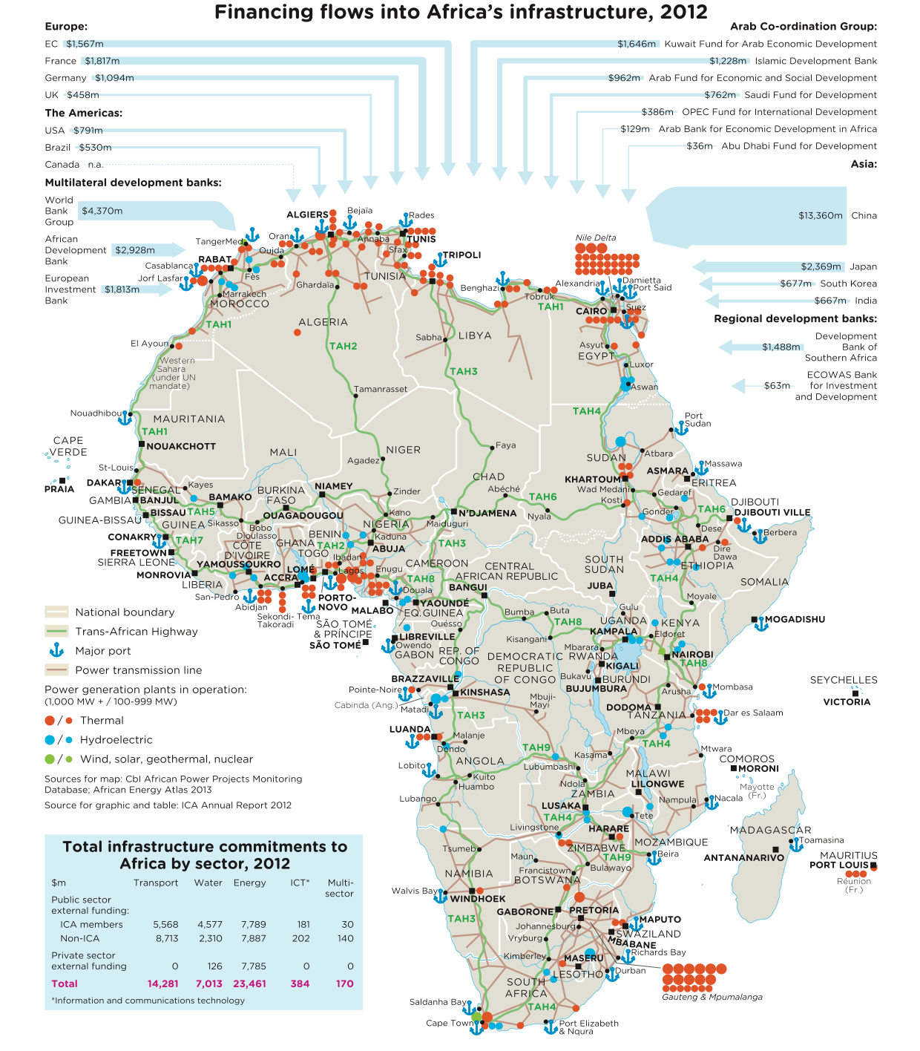
• In 2012 an estimated US$45bn was invested in Africa’s infrastructure.
• The key sectors were energy (52%), transport (32%) and water (15%).
• China was the largest investor, with total flows of US$13.4bn (1/3 of the total).
• Development banks invested US$9.5bn, more than Europe & the Americas combined (US$6.3bn).
• The total invested falls well short of the estimated US$110bn that is required every year for the next decade to close the deficit.
Sources: Cbi, ICA.
© Ecobank 2015 | Sub-Saharan Africa: Investors' final frontier | René Awambeng & Edward George | December 2015
¹²
Notes:
Which isn’t too say there hasn’t been investment in Africa’s infrastructure
Quite the opposite – as this graphic by Cross Border Information and The Infrastructure Consortium for Africa shows
In 2012 a total of US$45bn was invested in Africa’s infrastructure.
Around half of this went into energy projects – from power generation to fuel refining & storage, and 1/3 into transport
Unsurprisingly, China led the field with US$13.4bn of investment, 1/3 of the total
Development banks were also strong, disbursing almost US$11bn between them
But investment from other regions was miserly – just US$6.3bn from Europe and the Americas combined, US$5bn from the Arab states
If you bear in mind that Africa needs an estimated US$93bn of investment – every year, for the next decade – in order to close its infrastructure deficit, you can see the scale of the problem
The other key constraint facing businesses in West Africa is the logistics infrastructure
This map shows that infrastructure is highly developed in places – for example, the port complexes in Lagos, Dakar and Tema
But all of these ports operate above their capacity, and delays are common
The expansion in capacity that has occurred has, for the most part, been piecemeal and in fits and starts
This partly reflects the difficulty of coordinating projects across different countries, especially between Francophone and Anglophone West Africa
An ambitious project to construct a six-lane highway running from Dakar along the coast to Lagos has never got off the drawing board
Warehousing is woefully inadequate, particularly up-country in the agricultural heartlands where crop losses are typically 40% of outtturn
And intra-regional air connections are poor
Other regions of Africa have developed international hubs - Egyptair in Cairo, Royal Air Maroc in Casablanca, Ethiopian Airlines in Addis Ababa, Kenya Airways in Nairobi and South African Airways in Johannesburg
But West Africa’s air network is highly fragmented, with multiple carriers and poor connections between Anglophone & Francophone markets
If West Africa is to fulfil its promise, it must address these woeful infrastructure gaps
This will require a mix of public and private funding and management, drawing on the experience of seasoned value chain managers in the region
Only then will this infrastructure enable new industries to grow out from the commodity flows and foster trade between the different economic zones
Thank you

Slide 13
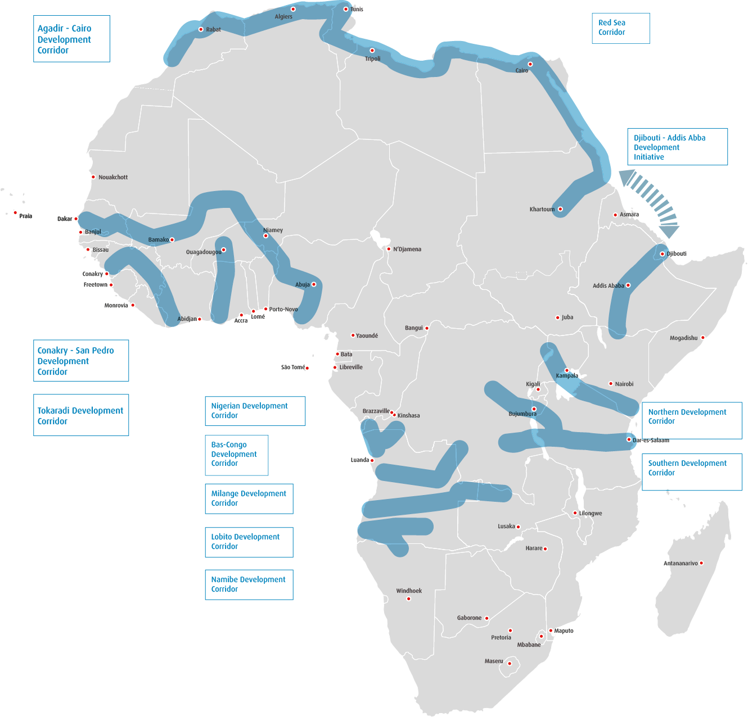
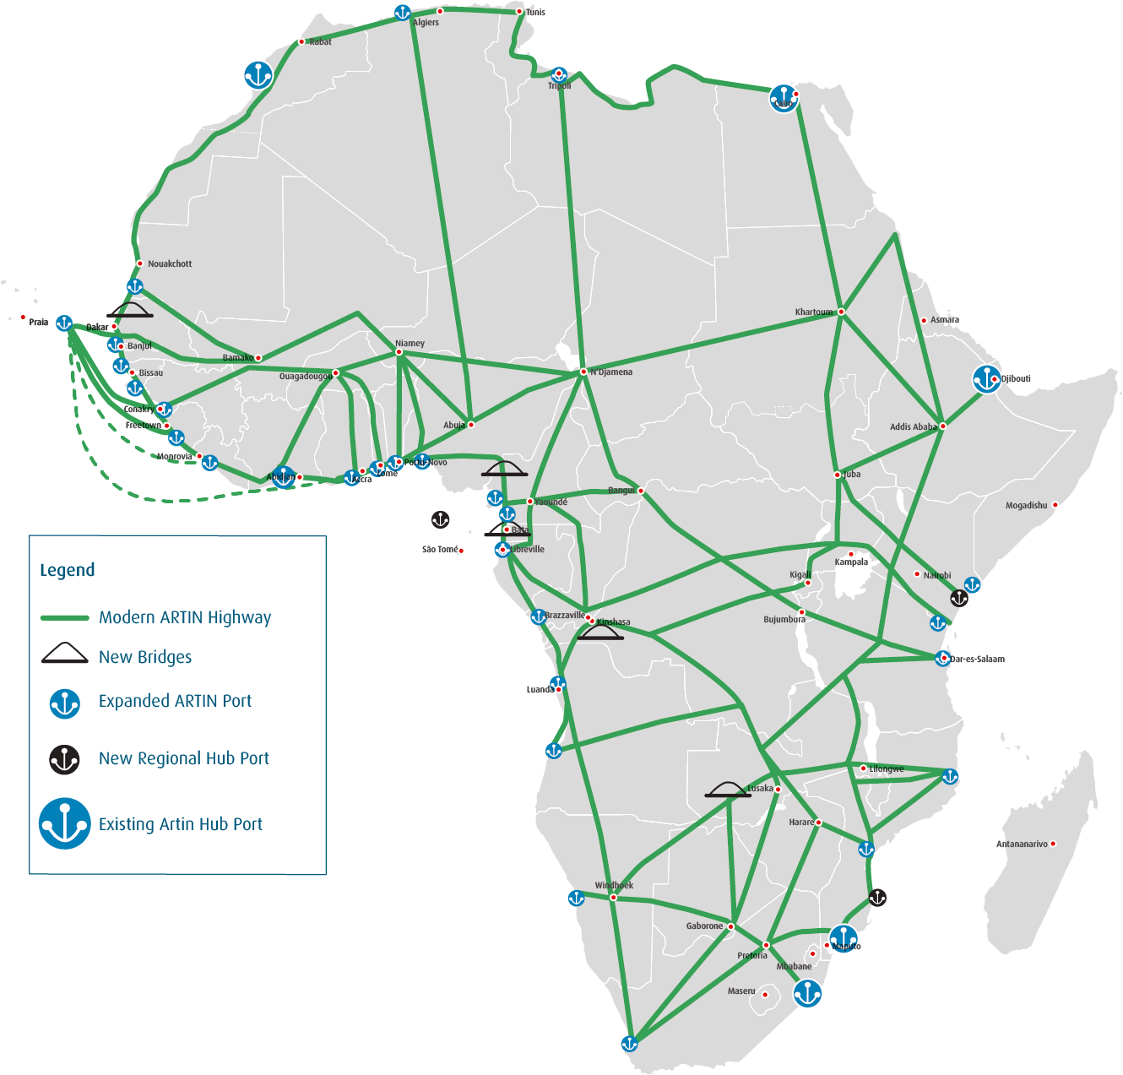
New trade corridors could unlock intra-regional trade
Proposed regional/coastal corridors One-stop border posts planned by 2040
Source: Ecobank Research.
© Ecobank 2015 | Sub-Saharan Africa: Investors' final frontier | René Awambeng & Edward George | December 2015
13
Notes:
For me, the solution is to develop Africa’s trade corridors, both existing and planned
Long-standing trade routes exist along the East African sea board, with the ports of Maputo, Beira, Dar-es-Salaam, Mombasa, Mogadishu and Kismayo acting as entry and exit points for goods into East & Southern Africa
But the connections from these ports to the interior are piecemeal and heavily congested
In order to unblock these infrastructure bottlenecks, governments are developing regional trade corridors
A successful example is the Maputo Development Corridor, linking South Africa’s Gauteng province to the port of Maputo
Perhaps the most ambitious is the LAPSSET project, which aims to build a port at Lamu on the Kenyan coast, with a road, railway and pipelines running to Ethiopia and South Sudan, and possibly into Central Africa and beyond
Many other trade corridors have been proposed
There is the corridor from Khartoum in Sudan across the southern Mediterranean to Agadir in Morocco
A proposed railway and road from Somaliland to Ethiopia – being developed by Welshman I met last year
And a project to build a railway and road from Ethiopia to the port of Djibouti
These new corridors could become the arteries of Africa’s intra-regional trade
And they could unlock its potential
Not just for trade within Africa, but also with its partners in the Gulf
A properly integrated network of trade corridors could provide the basis for developing value chains that link the Gulf with East Africa
These could not only create genuine value adding industries in both regions, but in the process integrate both region’s economies

Slide 14

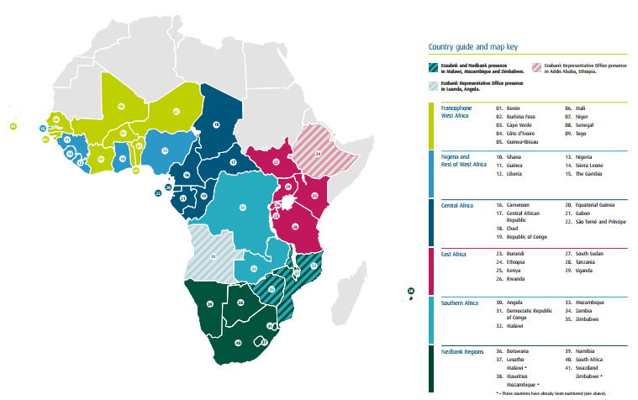
Ecobank is the ideal pan-African partner
Africa-Asia trade flows
© Ecobank 2015 | Sub-Saharan Africa: Investors' final frontier | René Awambeng & Edward George | December 2015
Notes:
Before I start, I’d like to take couple of minutes to tell you about Ecobank
We are a bank with long-standing African roots, but are relatively new players in East Africa
Many clients who deal with Ecobank in East Africa do not realize that we are a pan-African bank
Our headquarters is in Lome, Togo, and there are 34 subsidiaries spread across Middle Africa, all operating as one single bank
The area we focus on is what we call: Middle Africa
If you subtract North Africa, which is its own geographical, cultural and economic region, and the Rand Zone to the South
Everything else, the cheese in the sandwich, is Middle Africa
This is where the opportunity of Africa lies – in the world’s fastest growing and developing economies, and its most unbanked and unserved clients
Ecobank is divided into five operating clusters –
Anglophone and Francophone West Africa, Central Africa, SADC
In essence, Ecobank was created to further regional integration, which means intra-regional trade
To succeed in this region you need local knowledge, and a presence on the ground
Ecobank is in Middle Africa to stay, and if you need a local partner, chances are we already bank them, and know them well
I heard the research team of 9 analysts based across the region
If you would like to receive our reports, please give me your business card at the end: there’s no charge
And if you are interested in expanding your operations in Africa – or just dipping your toe in the market – come and see me afterwards

Slide 15
Any questions?
Notes:
Thank you

