Slide 1
Expanding your business in the united states
SelectUSA

Slide 2
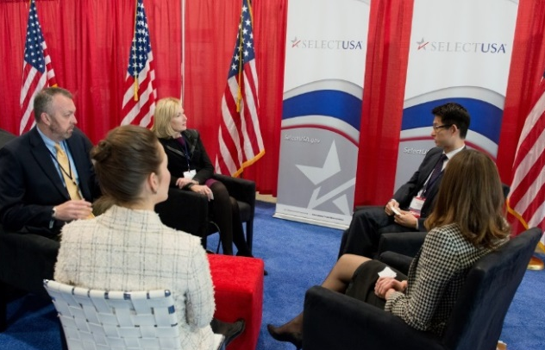
About SelectUSA
OUR MISSION
SelectUSA’s mission is to promote and facilitate business investment in the United States. We are the single point of contact at the national level for international and domestic companies to invest in the United States.
OUR CLIENTS
Existing and Potential Business Investors
U.S. Economic Development Organizations (EDOs)
OUR IMPACT
To date, SelectUSA has directly assisted in attracting more than $23 billion in client- verified investments to the United States.

Slide 3
Who We Are
OUR TEAM
U.S. Department of Commerce – International Trade Administration
SelectUSA HQ: http://www.selectusa.gov/our-team
U.S. and Foreign Commercial Service
100+ Domestic Offices
70+ International Offices
OUR NETWORK
InterAgency Investment Working Group (IIWG)
U.S. State Department, Embassy & Consulate Personnel

Slide 4
Global fdi trends
The United States is the Largest Recipient of FDI in the World
Source: United Nations Conference on Trade and Development http://unctadstat.unctad.org/

Slide 5
Largest and fastest growing Sources of FDI
Largest Sources of FDI in the United States
(by UBO)
Fastest-Growing Sources of FDI in the United States (by UBO)
Rank | Market | 2015 Position (USD millions) | Share of Total
1 | United Kingdom | $568,948 | 18.2%
2 | Japan | $414,007 | 13.2%
3 | Canada | $391,948 | 10.9%
4 | Germany | $318,988 | 10.2%
5 | France | $251,375 | 8.0%
6 | Ireland | $200,502 | 6.4%
7 | Switzerland | $143,534 | 4.6%
8 | The Netherlands | $137,406 | 4.4%
9 | Spain | $61,378 | 2.0%
10 | Sweden | $50,875 | 1.6%
11 | Italy | $47,049 | 1.5%
12 | Australia | $44,925 | 1.4%
13 | Belgium | $43,335 | 1.4%
14 | South Korea | $38,174 | 1.2%
15 | Mexico | $35,516 | 1.1%
Rank | Market | 2015 Position (USD millions) | CAGR (2010-15)
1 | Argentina | $3,771 | 38.9%
2 | Chile | $2,475 | 36.9%
3 | China | $20,765 | 30.8%
4 | Malaysia | $1,613 | 20.5%
5 | South Korea | $38,174 | 17.3%
6 | Norway | $29,600 | 14.9%
7 | United Arab Emirates | $27,480 | 14.2%
8 | Colombia | $2,468 | 14.0%
9 | India | $11,345 | 13.6%
10 | Ireland | $200,502 | 12.8%
11 | Bermuda | $27,585 | 11.7%
12 | Brazil | $23,685 | 11.7%
13 | Hong Kong | $14,525 | 11.4%
14 | Japan | $414,007 | 9.8%
15 | Finland | $13,278 | 9.8%
Source: Bureau of Economic Analysis. UBO refers to Ultimate Beneficial Owner. CAGR refers to Compound Annual Growth Rate. Fastest-Growing Sources of FDI ranks markets with 2015 FDI stock in the United States greater than $1 billion.

Slide 6
Fdi in the united states by industry
2015 FDI in the United States
Breakout of $3.1 Trillion Inward Position
2004 FDI in the United States

Slide 7
Open investment policy
The United States’ open investment policy
is a commitment to treat all investors
in a fair and equitable manner.
Upheld by administrations throughout U.S. history.
Core obligation in bilateral investment treaties (BITs).
Ensures investors and investments receive treatment no less favorable than a country affords to its own investors and investments.

Slide 8
Why invest in the united states?
World’s most attractive consumer market
$18 trillion annual GDP
Population of more than 325 million
Competitive export platform
Free trade agreements with 20 markets
Fast export procedures
Transparent, fair and stable business environment
Unparalleled climate for innovation
Global leader in research & development (R&D)
Strong intellectual property protection
Highly educated and productive workforce
Abundant natural resources
Low-cost, stable energy supply

Slide 9
Motivations of Foreign Firms
Why do firms choose the United States?
Canada 4
Source: fDimarkets.com
Source: www.FDIMarkets.com
Notes:
Since 2003, fDimarkets.com reports 9,766 global companies have announced investment projects in the United States. If completed at announced levels, they represent more than $656.02 billion in capital investment and creation of 1,436,826 jobs.
Motive---% of Projects
Proximity to markets or customers 44.5
Domestic Market Growth Potential 37.2
Industry Cluster / Critical Mass 20
Skilled workforce availability 9.9
Technology or Innovation 8.6
Regulations or business climate 4.8
Attractiveness / Quality of Life 3.8
Presence of Suppliers or JV Partners 3.3
Facilities Site or Real Estate 2.3
Infrastructure and logistics 2
Other Motive 5.8

Slide 10
SelectUSA Services for Foreign Firms
Information, Research & Strategic Counseling: We provide companies with information to support their decision-making process, including industry information and analysis
Connections: Through direct introductions and SelectUSA events, international firms can meet U.S. state and local representatives
Assistance: We help companies navigate the federal system and provide information about federal regulations and programs
Notes:
Understand Valuable Opportunities
SelectUSA is often the initial point of contact for a foreign company seeking information or assistance to invest in the United States. While there is great interest among companies to establish operations in the United States, the prospect of entering the U.S. market may seem daunting. SelectUSA’s goal is to facilitate business investment by providing valuable information, tools, and connections. We work one-on-one with investors to demystify federal rules and regulations and link businesses with partners and resources. Many of our services are free of charge.
Get the Information You Need to Make Decisions
Our investment specialists provide the credible, unbiased, detailed data and analytics that managers need to make critical decisions about their investments.
Connect to the Right People at the Local Level
Through direct introductions and SelectUSA events, international firms can meet U.S. state and local representatives. These contacts help move investment forward, and are fundamental to success.
Navigate the Federal Regulatory System
The United States is recognized for its ease of doing business. By working with SelectUSA, businesses can develop a better understanding of the U.S. regulatory environment. Our team works with firms on a case-by-case basis to address issues or questions involving federal regulations or programs related to investments.

Slide 11
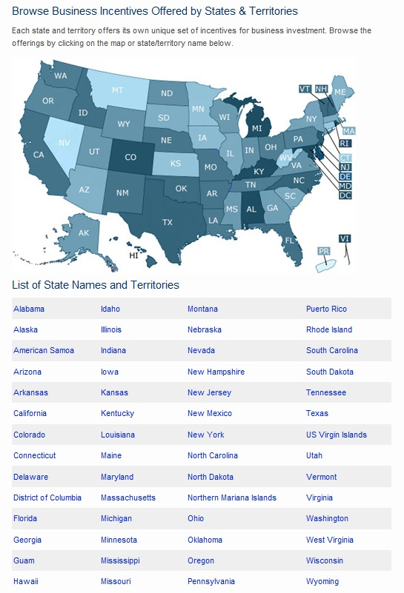
State Business Incentives
INVESTOR services: INFORMATION & COUNSELING
U.S. states and territories offer financial and other incentives to foreign investors.
To easily browse state investment promotion agencies and learn more about available incentives, simply visit http://selectusa.commerce.gov/.

Slide 12
Selectusa investment summit
The SelectUSA Investment Summit is the highest-profile event dedicated to promoting FDI in the United States. This signature event provides an unparalleled opportunity to bring together companies from all over the world, economic development organizations from every corner of the nation, and other parties working to facilitate business investment in the United States.
The Summit's theme – "Grow with US" – will highlight the innovative business climate in the United States and feature investment opportunities from every corner of the country.
www.SelectUSAsummit.us
Notes:
If your company is pursuing opportunities to invest in the United States as part of your international growth strategy, we encourage you to participate in the SelectUSA Investment Summit, the premier investment event showcasing inbound investment opportunities throughout the United States. The 2017 Summit will take place June 18-20 at the Gaylord Hotel, National Harbor, MD and is expected to draw an audience of more than 2,500 participants, including executives of foreign companies interested in investing in the US market, representatives of economic development organizations from across the United States, and senior US government representatives. The SelectUSA Summit attracts serious investors. According to data from fDi Markets, 2013-2016 SelectUSA Investment Summit participants have announced more than $20.6 billion in greenfield FDI into the United States. The Commercial Service at the U.S. Embassy in Lima will be leading recruitment of leading Peruvian firms.

Slide 13
www.selectusa.gov
www.selectusasummit.us
@SelectUSA on Twitter

