Slide 1
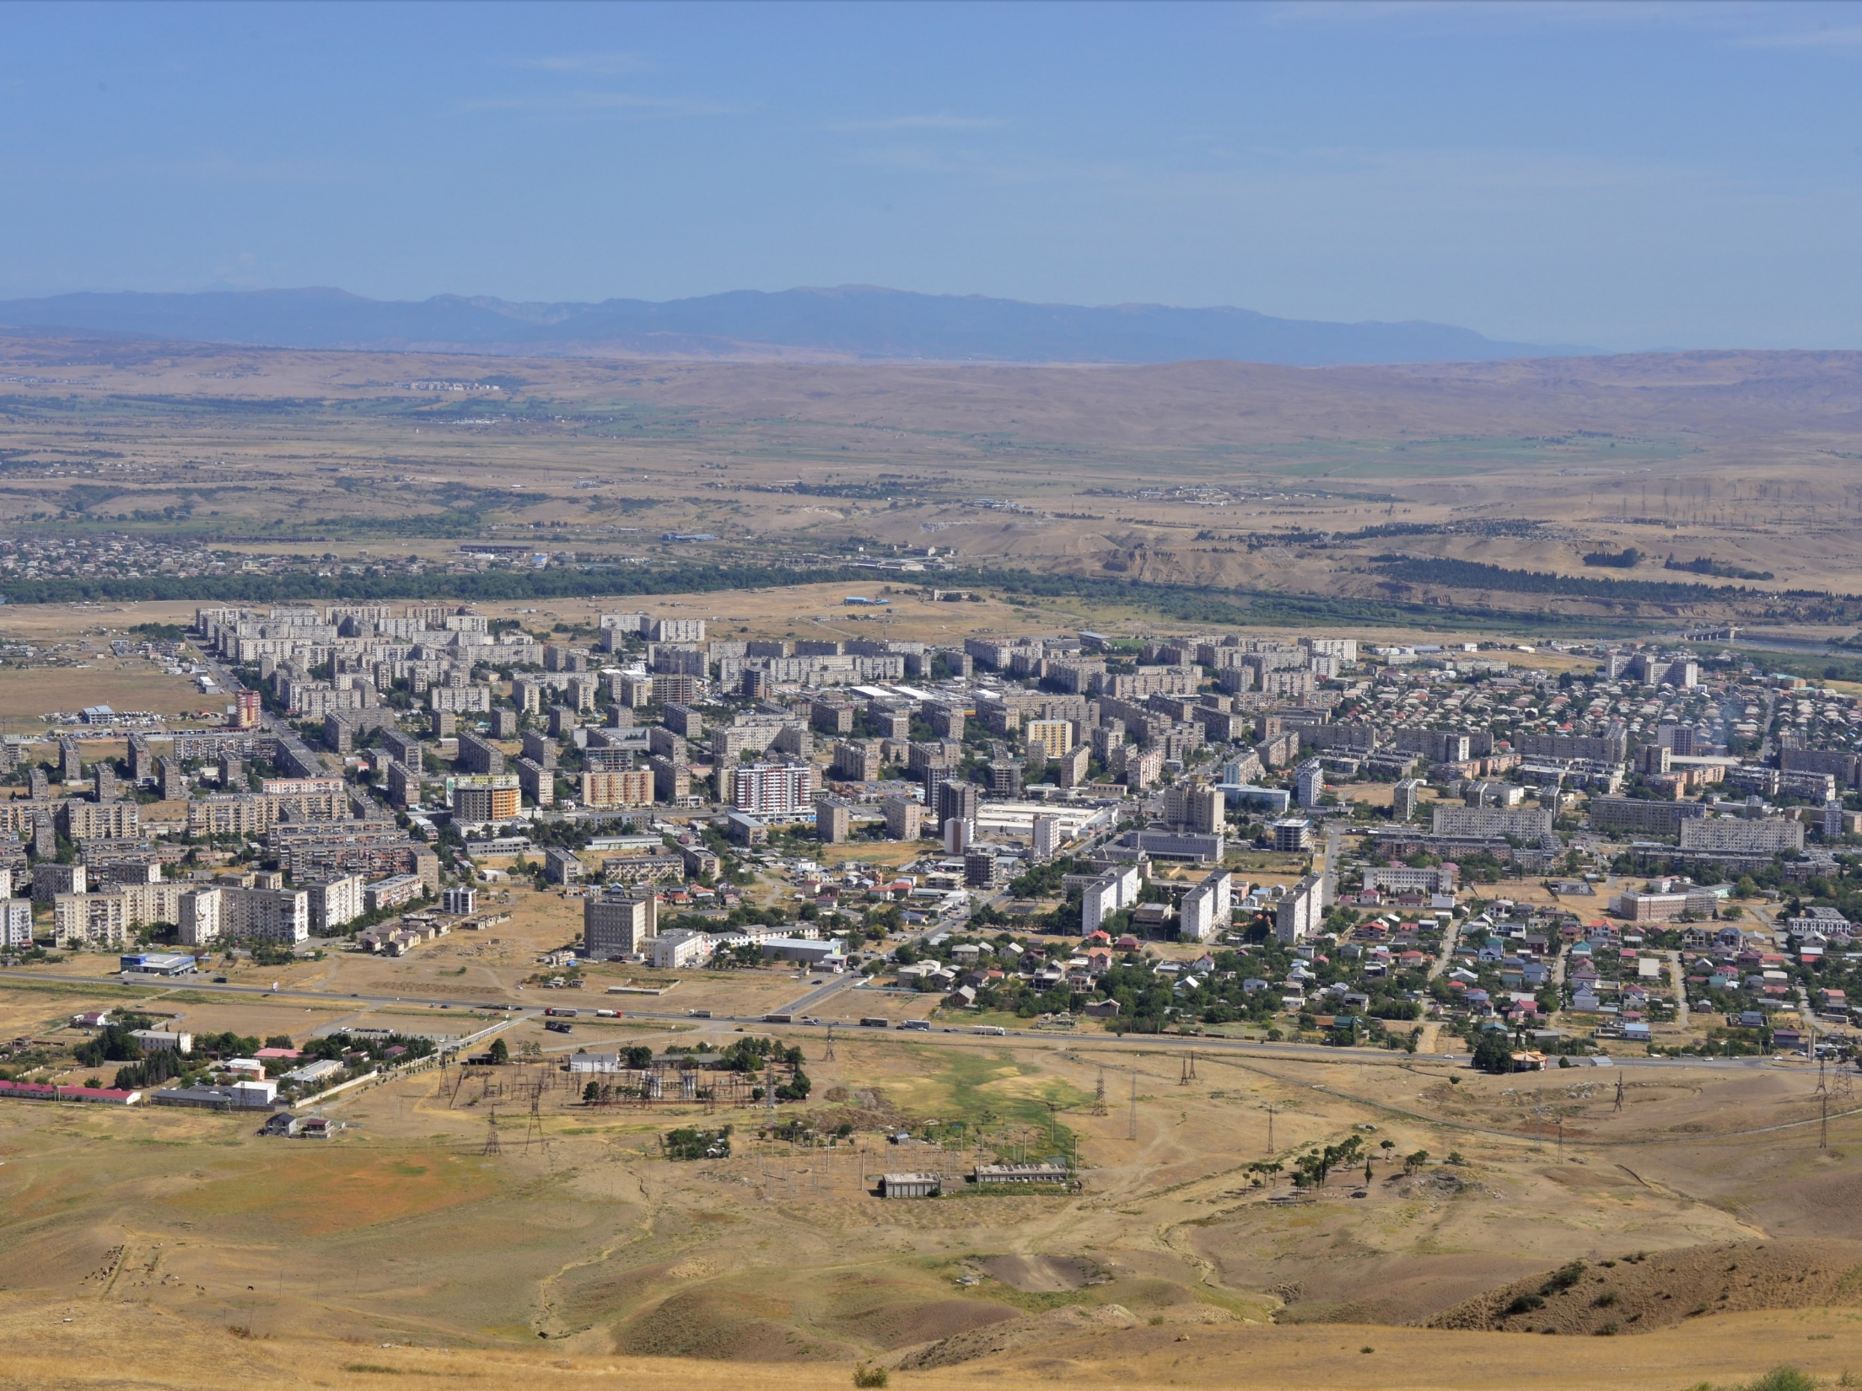
Expert assessment of green spaces in Rustavi and recommendations for the Rustavi Urban Development Plan
Alena Švandelíková, Milan Svoboda
October 2022

Slide 2
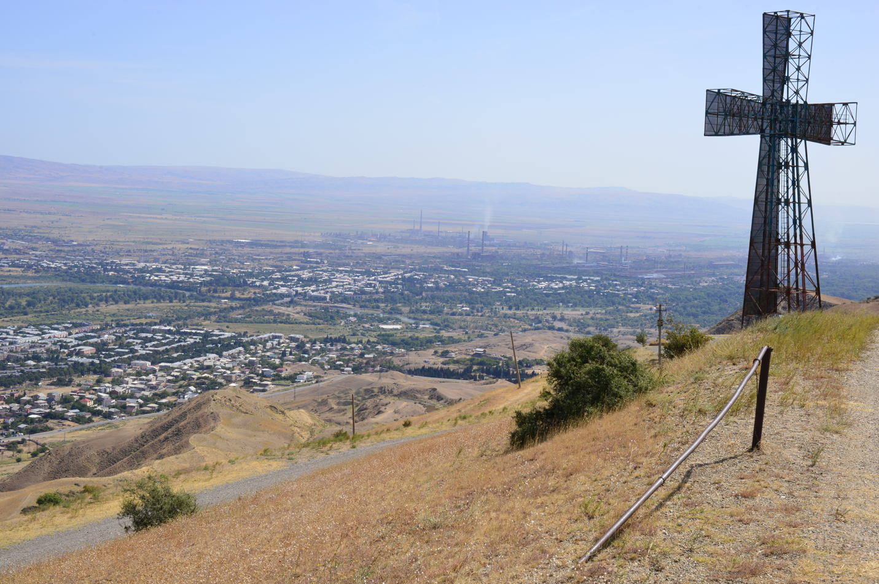
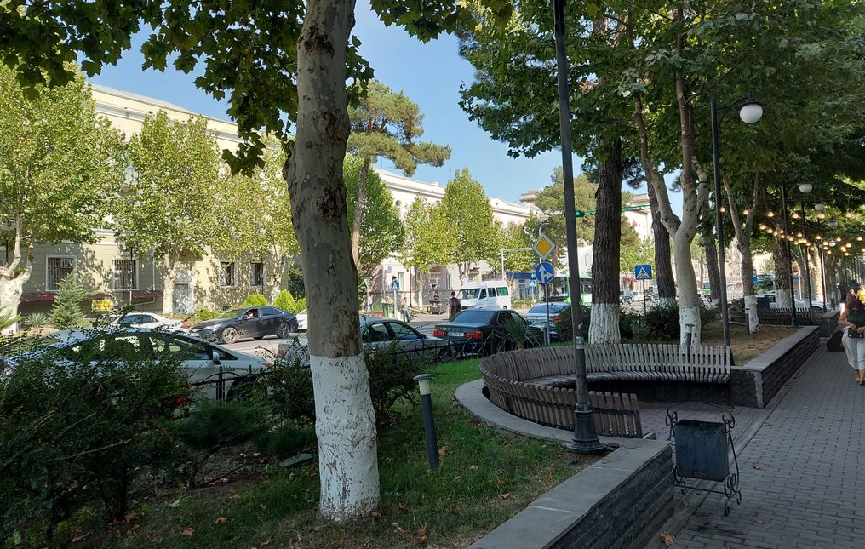
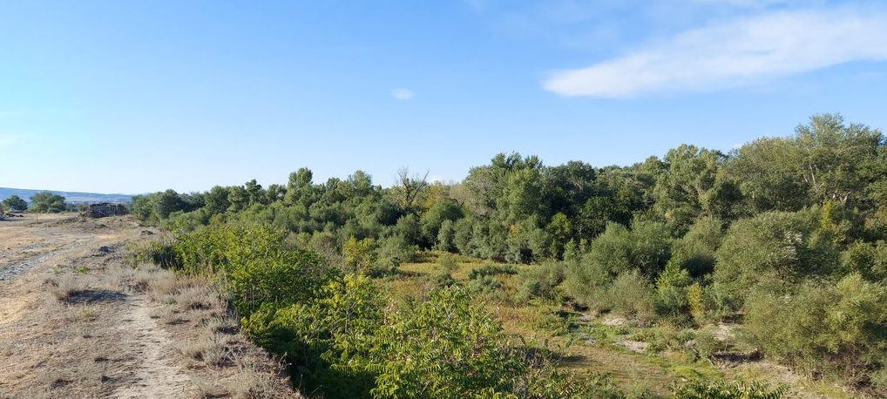
INTRODUCTION
Project description
Evaluation of the existing green spaces in Rustavi Municipality and recommendations for its further use in the process of creating a Rustavi Urban Development Plan.
Based on experience from the Czech Republic and other EU countries, document contains recommendations for:
supplementing the urban green system in the Rustavi Urban Development Plan,
application of green infrastructure principles,
solution of some types of secondary areas of residential greenery.

Slide 3
METHODOLOGY
Green spaces assessment
The urban green system is based on the main green spaces (so-called green spaces in the prime function), which are parks, park-style squares and boulevards and smaller publicly accessible green spaces. These spaces are defined in the Rustavi General Plan and are primarily intended for recreational, aesthetic, health and ecological functions for the city's residents. The fulfilment of these functions must be subordinated to all handling of main green spaces.
The current state of the main green spaces according to the Rustavi General Plan was evaluated in detail during field surveys conducted on 05/07/2022 (basic survey) and 09/12-17/2022 (detailed survey).

Slide 4
METHODOLOGY
Green spaces assessment
Main green spaces in Rustavi General Plan – assessed
main green spaces in Rustavi General Plan
main green spaces added beyond Rustavi General Plan
partly bulit up green space
Main green spaces in Rustavi General Plan – assessed
built up area
physically inaccessible or poorly accesible space
sport area
closed or restricted area
green space in secondary function

Slide 5
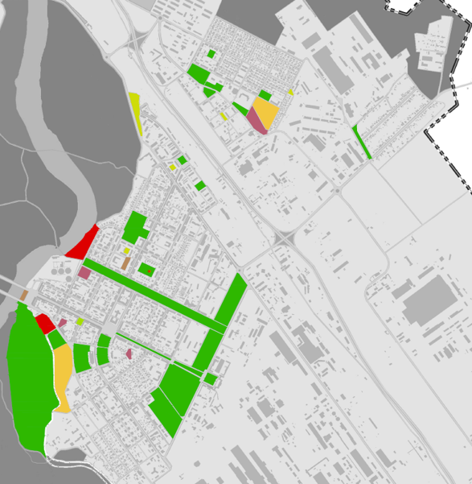
METHODOLOGY
Old Rustavi

Slide 6
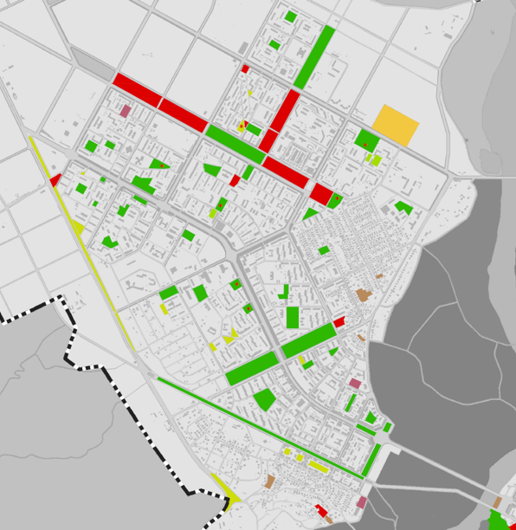
METHODOLOGY
New Rustavi

Slide 7
METHODOLOGY
Detailed green spaces assessment
The methodological basis of the assessment is the methodology for the processing of territorial studies of residential greenery in the Czech Republic. The expert assessment of the condition of main green areas takes into account:
spatial structure of vegetation elements (trees, shrubs, flowers)
species composition of woody vegetation elements (trees, shrubs)
age structure of woody vegetation elements
health and growth status of woody vegetation elements
suitability of furniture and equipment
qualitative state of furniture and equipment

Slide 8
GREEN SPACES ASSESSMENT
Detailed green spaces assessment
1 – the space is stable, fully functional, without the need for measures.
2 - the space is stable, sufficiently functional, without the need for fundamental measures
3 - the space is unstable in the longer term, functionally limited, with a future need for fundamental measures
4 – the space is unstable, almost non-functional, with an urgent need for measures
5 - the space is unstable, non-functional, with an urgent need for restoration or a new modification
0 – unassessed green space, currently in proces of greenery implementation

Slide 9
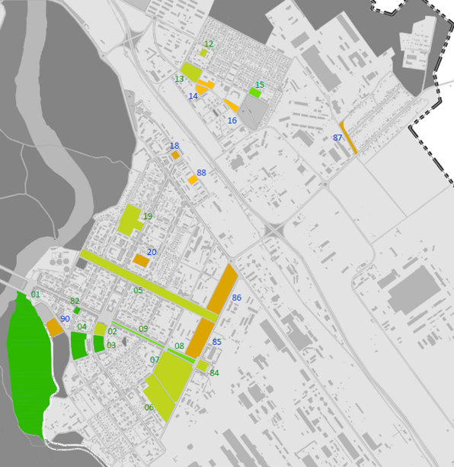
GREEN SPACES ASSESSMENT
Old Rustavi

Slide 10
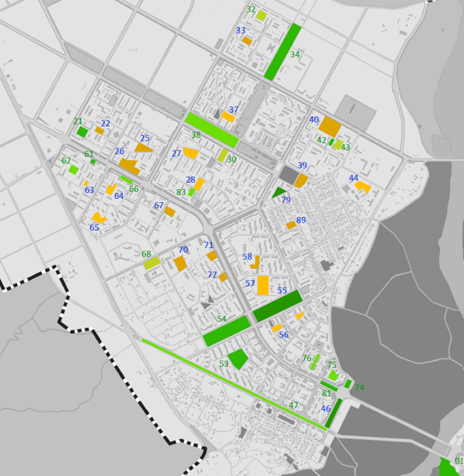
GREEN SPACES ASSESSMENT
New Rustavi

Slide 11
GREEN SPACES ASSESSMENT
Detail assessment cards are processed for all main functional green spaces
Number, name of the location eventually
Location - designation in the drawing of Rustavi General Plan
Category according to Rustavi General Plan
Brief description
Assessment – an overview of the assessment of the area according to the individual indicators listed in chap. B.1.2.
Recommendations
Photodocumentation.
An example of detail assessment card is shown on next slides.

Slide 12
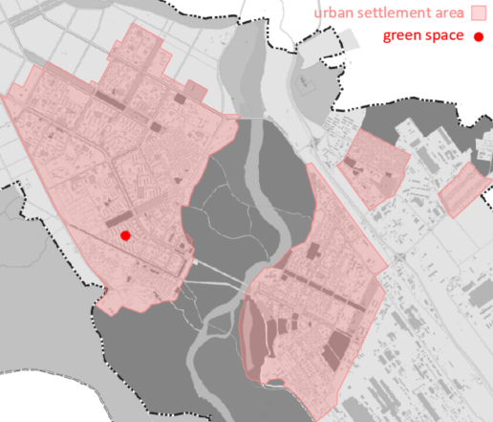
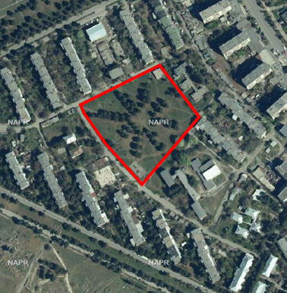
GREEN SPACES ASSESSMENT
GREEN SPACE No. 53 | Momenatre park
Location

Slide 13
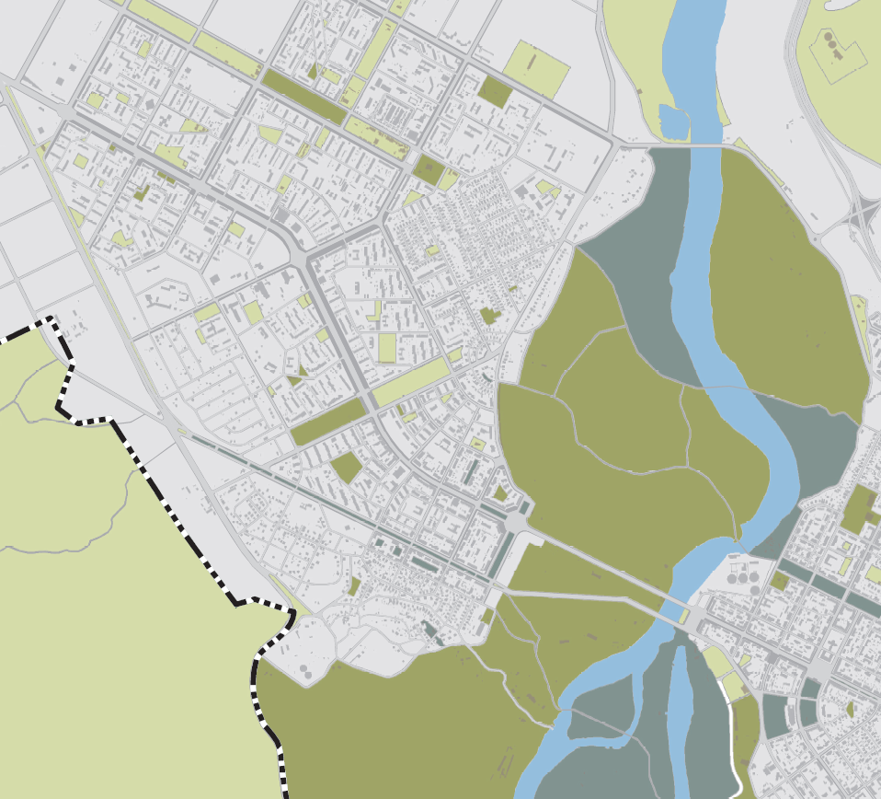
GREEN SPACES ASSESSMENT
GREEN SPACE No. 53 | Momenatre park
Category according to Rustavi General Plan
partly green space

Slide 14
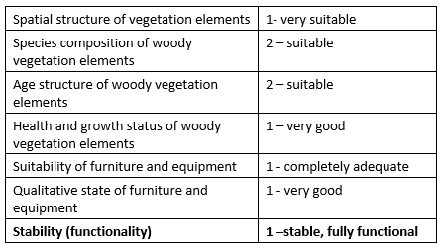
GREEN SPACES ASSESSMENT
GREEN SPACE No. 53 | Momenatre park
Brief description
A revitalized park with complete equipment.
The only park with a distinctive composition of plantings in Rustavi.
The trees are vital, additions of new plantings have been made.
Assessment
Recommendations
No measures recommended.

Slide 15
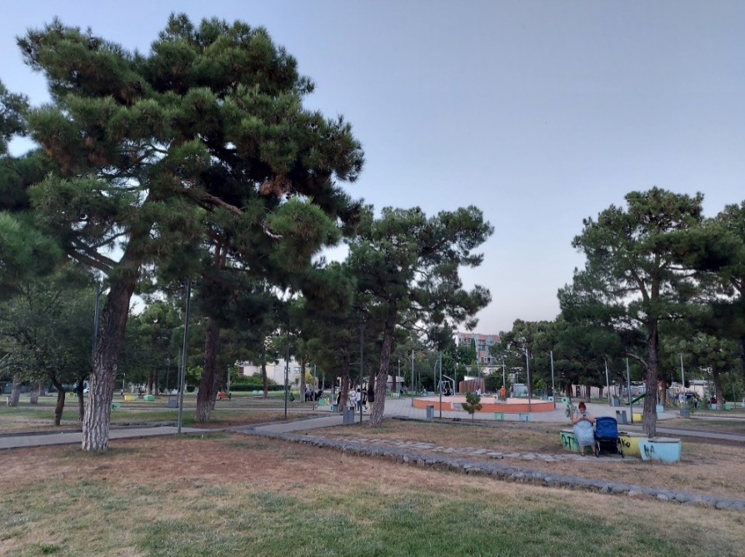
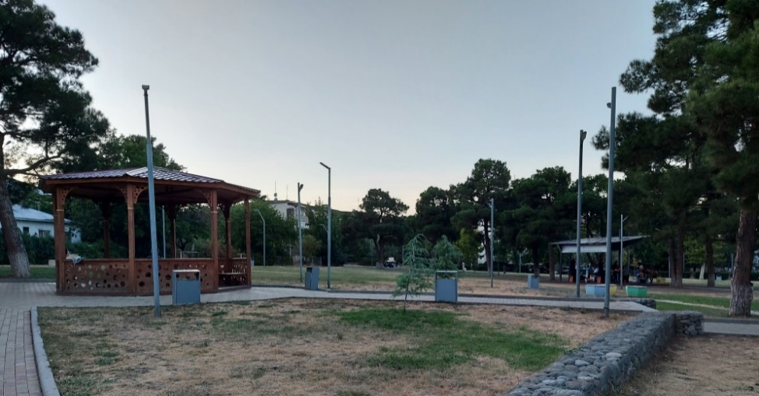
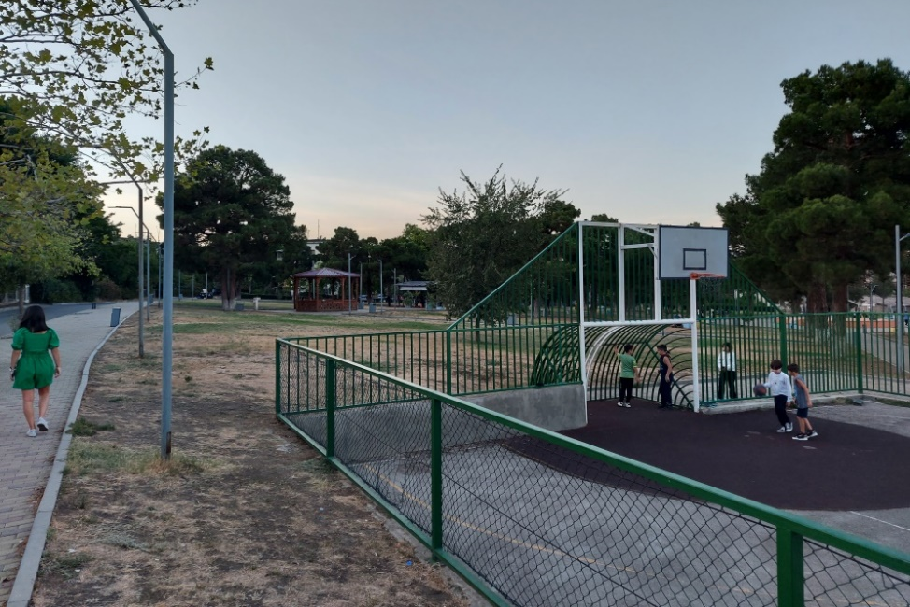
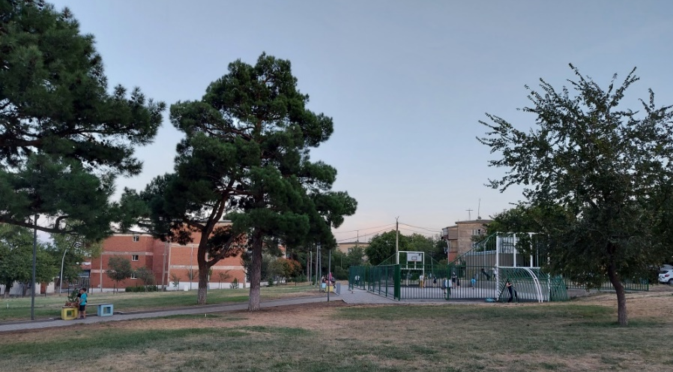
GREEN SPACES ASSESSMENT
GREEN SPACE No. 53 | Momenatre park
Photodocumentation

Slide 16
GREEN SPACES ASSESSMENT
General recommendations for main non functional green spaces
Characteristics of non-functional green spaces
Forms of ensuring the implementation and maintenance of green spaces
- in the classic, still used way, i.e. as an investment by the municipality of Rustavi
- an alternative form of ensuring implementation and maintenance.
Alternative forms of architectural solutions
Increasing interest of people in the quality of the environment

Slide 17
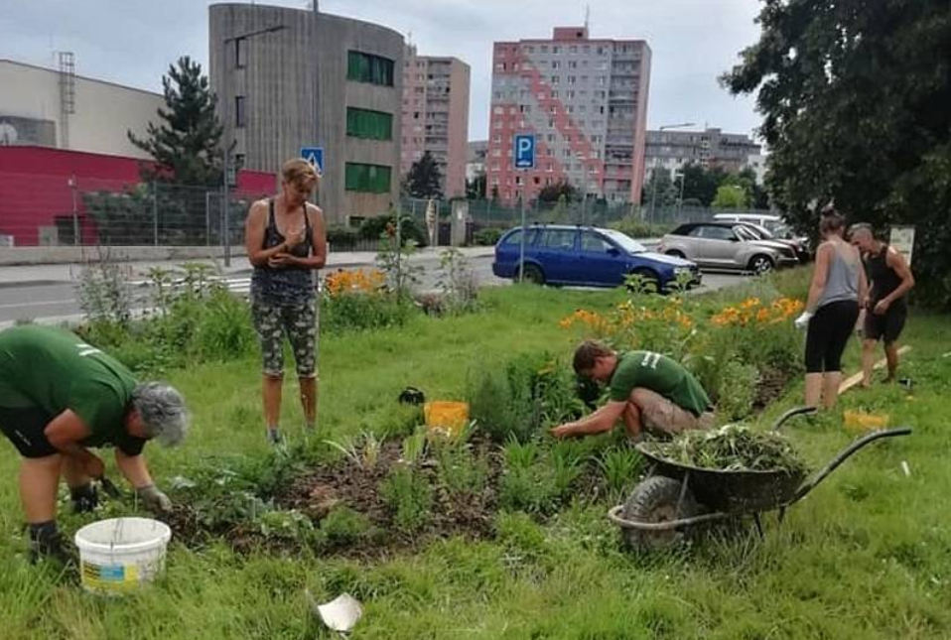
GREEN SPACES ASSESSMENT
General recommendations for main non functional green spaces
Implementation of a community park in Beroun, Czech Republic

Slide 18
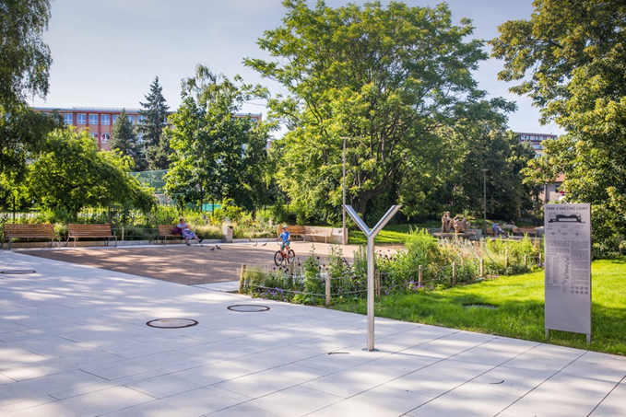
GREEN SPACES ASSESSMENT
General recommendations for main non functional green spaces
Nature like vegetation elements in a park in Prague, Czech Republic

Slide 19
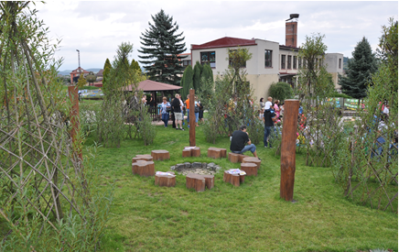
GREEN SPACES ASSESSMENT
General recommendations for main non functional green spaces
The nature garden of the kindergarten in Švihov, Czech Republic

Slide 20
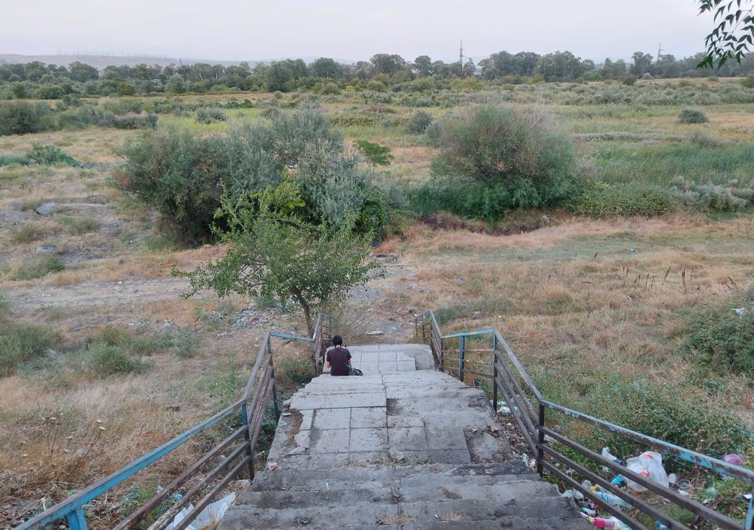
LANDSCAPE GREEN AREAS
Kura flood plain
In the Rustavi Urban Development Plan,it is desirable to define the floodplain of the Kura river as a specific area of the suburban park
Recreational use
Agricultural use
Support of biodiversity
Improvement of the water regime and flood protection

Slide 21
LANDSCAPE GREEN AREAS
Kura flood plain
Inspiration
IBA Emscher Park
For the suburban park in Rustavi, the most inspiring part is a process based on:
comprehensive planning framework,
involvement of stakeholders and consultations with them
creating relational networks
organizing processes with an open outcome, i.e. with the possibility of revising decisions
Prague Confluence (Praha Soutok)
Recently, an international architectural competition was announced, the aim of which is to select a team who can design the future form of this river landscape and its long-term development in the form of a suburban park.

Slide 22
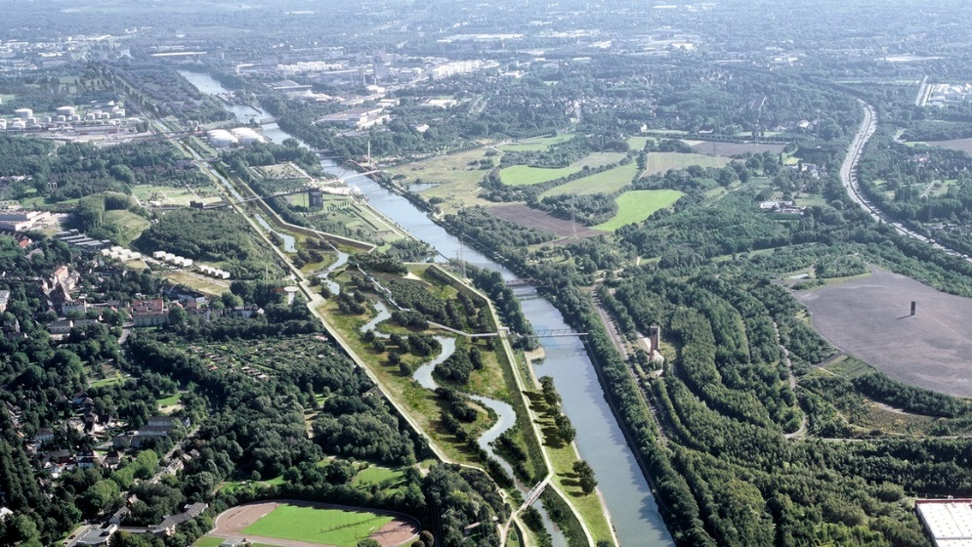
LANDSCAPE GREEN AREAS
Kura flood plain - inspiration
IBA Emscher Park

Slide 23
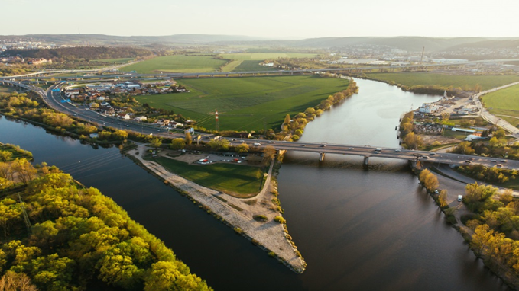
LANDSCAPE GREEN AREAS
Kura flood plain - inspiration
Prague Confluence (Praha Soutok)

Slide 24
RECOMMENDATION FOR SOLVING URBAN GREEN SYSTEM IN THE NEW RUSTAVI URBAN DEVELOPMENT PLAN
For the creation of a new development plan and specifically the implementation of the green system in land use, it is necessary to emphasize the following important principles:
main green areas must always be separately defined in order to ensure their protection within the urban structure of the city
main green areas, which are evaluated as non-functional but suitable for the future development of the residential green system, must also be defined separately, even in cases where their implementation is not expected in the long term – addition of green spaces without prior protection of suitable areas is usually impossible (especially if these areas are built up, which is an irreversible process)
for minor green spaces it is necessary to establish specific conditions to ensure the protection of a minimum proportion of greenery, e.g.

Slide 25
RECOMMENDATION FOR SOLVING URBAN GREEN SYSTEM IN THE NEW RUSTAVI URBAN DEVELOPMENT PLAN
For the New Rustavi development plan the main assumptions are:
protection and further development of the Park for Culture and Leisure as a good example of greenery development along the river
strengthening and quality improvement of pedestrian links to the parks and other green spaces
protection of established public green spaces and their better interconnections
definition of the boundary of buildings and recreational / agricultural / natural areas along the river Kura
determination of the concept of river area development (see chapter D)
exploiting the potential of the recreational connection towards Tbilisi
creation of basic conceptual principles of development of the system of residential greenery, recreational and sports areas within the future development

Slide 26
RECOMMENDATION FOR SOLVING URBAN GREEN SYSTEM IN THE NEW RUSTAVI URBAN DEVELOPMENT PLAN
Implementation of urban greenery
Urban green system
Specific conditions
The urban green system = connected system of green spaces and other elements.

Slide 27
RECOMMENDATION FOR SOLVING URBAN GREEN SYSTEM IN THE NEW RUSTAVI URBAN DEVELOPMENT PLAN
Urban green system | example - Pardubice City Masterplan
General schema of the main concept of urban green system

Slide 28
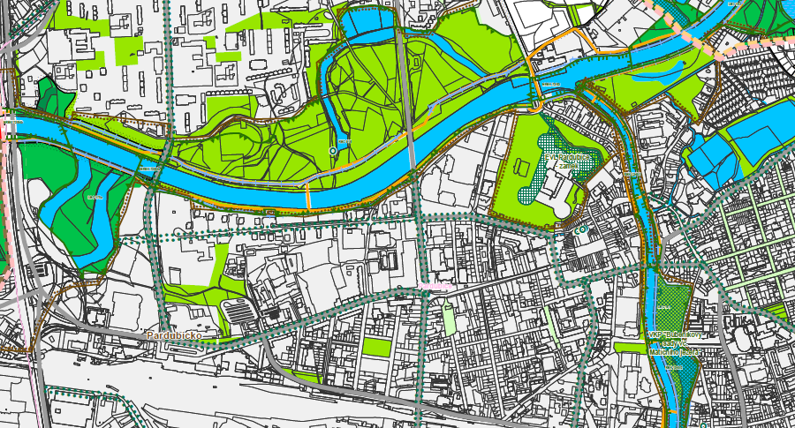
RECOMMENDATION FOR SOLVING URBAN GREEN SYSTEM IN THE NEW RUSTAVI URBAN DEVELOPMENT PLAN
Urban green system | example - Pardubice City Masterplan
Complex landscape proposal including green spaces in urbanized areas

Slide 29
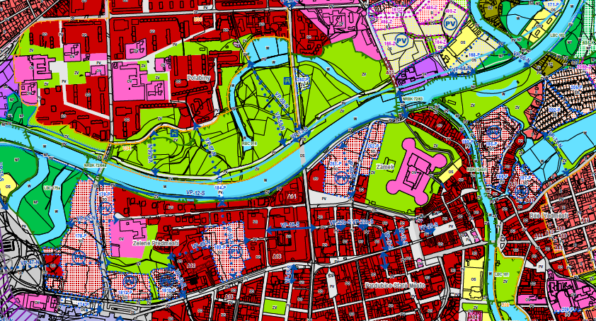
RECOMMENDATION FOR SOLVING URBAN GREEN SYSTEM IN THE NEW RUSTAVI URBAN DEVELOPMENT PLAN
Urban green system | example - Pardubice City Masterplan
Detailed land use plan showing projection of green spaces into land use plan

Slide 30
RECOMMENDATION FOR SOLVING URBAN GREEN SYSTEM IN THE NEW RUSTAVI URBAN DEVELOPMENT PLAN
Specific conditions relating to urban greenery
The minimum size of public spaces in the new proposed areas for housing, recreation and public amenities – 1000 m² per 2 ha
The minimum ratio of greenery on a property
The minimum number of trees for parking lots - 1 tree per 5 car parking places
Notes:
Besides planning the urban greenery concept we use several conditions for urban greenery in the text part of Master plans. These conditions are relevant for the spatial parameters of greenery.
I will go through them.

Slide 31
RECOMMENDATION FOR SOLVING URBAN GREEN SYSTEM IN THE NEW RUSTAVI URBAN DEVELOPMENT PLAN
Specific conditions relating to urban greenery
The minimum size of public spaces in the new proposed areas for housing, recreation and public amenities – 1000 m² per 2 ha
0,1 ha
2 ha
Notes:
According to the legislation we have to design for every 2 ha of newly proposed areas for housing, recreation and public amenities public space or green place with minimum size of 1000 sqm.

Slide 32
RECOMMENDATION FOR SOLVING URBAN GREEN SYSTEM IN THE NEW RUSTAVI URBAN DEVELOPMENT PLAN
Specific conditions relating to urban greenery
The minimum ratio of greenery on a property
Gray surface
-
parking
pavements
Building
Greenery
Notes:
The next condition is minimum ratio of greenery
This obligatory regulation means the percentage of property which must be used for greenery. It is not set generally and depends on the city and also on the architect.
We usually define 40-50 % for housing areas, 50-60 % for recreational areas and about 20 % for industrial areas.

Slide 33
RECOMMENDATION FOR SOLVING URBAN GREEN SYSTEM IN THE NEW RUSTAVI URBAN DEVELOPMENT PLAN
Specific conditions relating to urban greenery
The minimum number of trees for parking lots - 1 tree per 5 car parking places
Notes:
When I worked for The Pilsen Urban Planning Institution, we applied the condition of the minimum number of trees in parking lots. We used the condition that for every 5 parking places must be 1 tree.
It has also been applied in Prague and other cities.

Slide 34
RECOMMENDATION FOR SOLVING URBAN GREEN SYSTEM IN THE NEW RUSTAVI URBAN DEVELOPMENT PLAN
The spatial distribution of green areas ensuring accessibility
The maximum distance of green areas of minimum size 0,5 – 1 ha is 300 m from housing areas
300 m
Notes:
The last condition I want to mention is focused on the accessibility of green areas. There is the rule, that green area of minimum size up to 1 ha should be accessible within 300 m from housing areas .

Slide 35
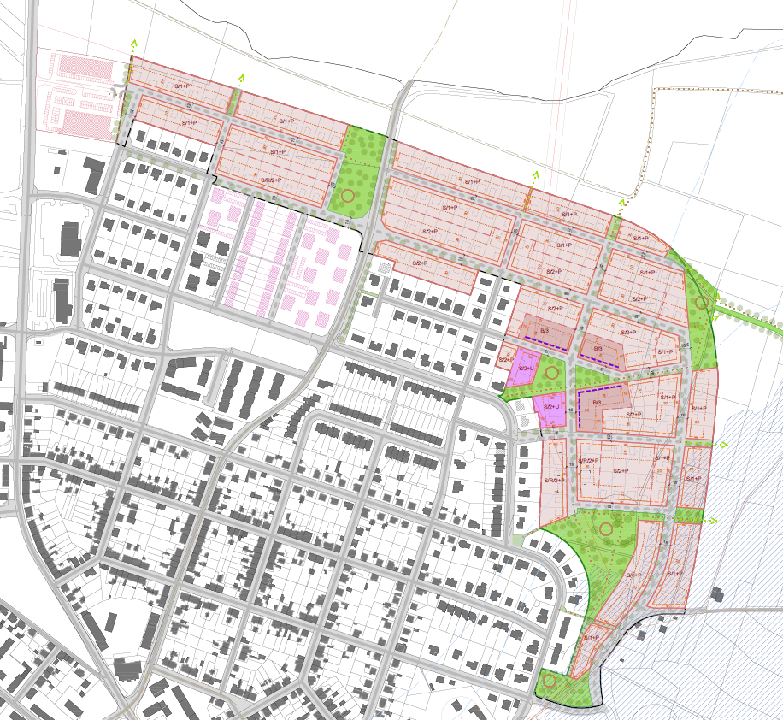
RECOMMENDATION FOR SOLVING URBAN GREEN SYSTEM IN THE NEW RUSTAVI URBAN DEVELOPMENT PLAN
The spatial distribution of green areas ensuring accessibility
The regulatory plan for new residential area in the Town of Přeštice
Notes:
The last condition I want to mention is focused on the accessibility of green areas. There is the rule, that green area of minimum size up to 1 ha should be accessible within 300 m from housing areas .

Slide 36
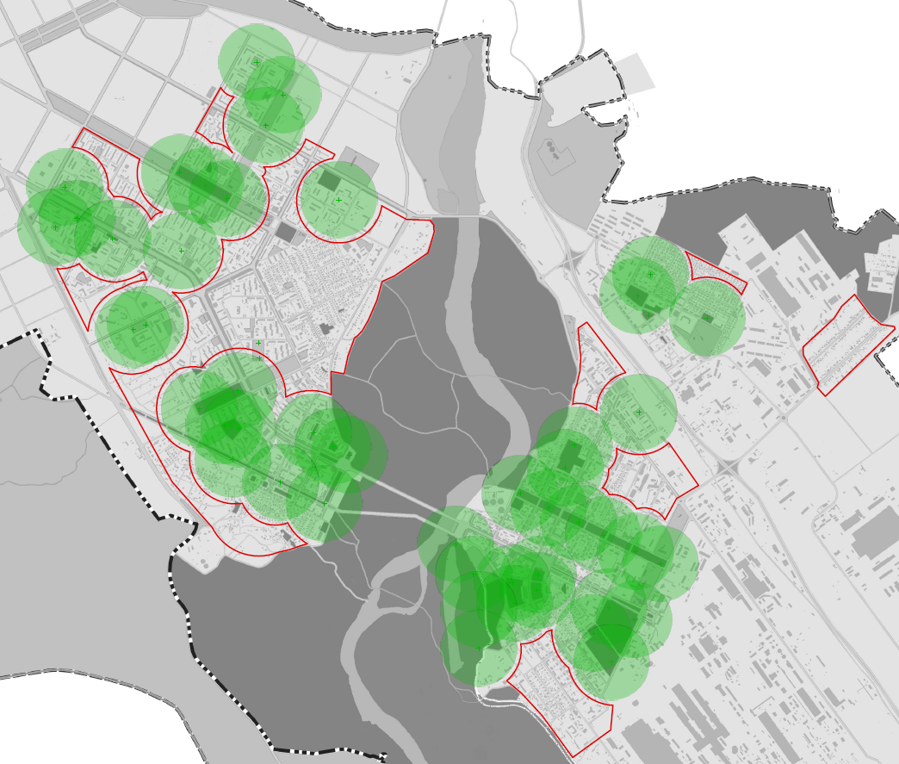
RECOMMENDATION FOR SOLVING URBAN GREEN SYSTEM IN THE NEW RUSTAVI URBAN DEVELOPMENT PLAN
The spatial distribution of green areas ensuring accessibility
accessibility of fuctional green spaces – 300 m distance
insufficient accessibility of green spaces from urban residential areas

Slide 37
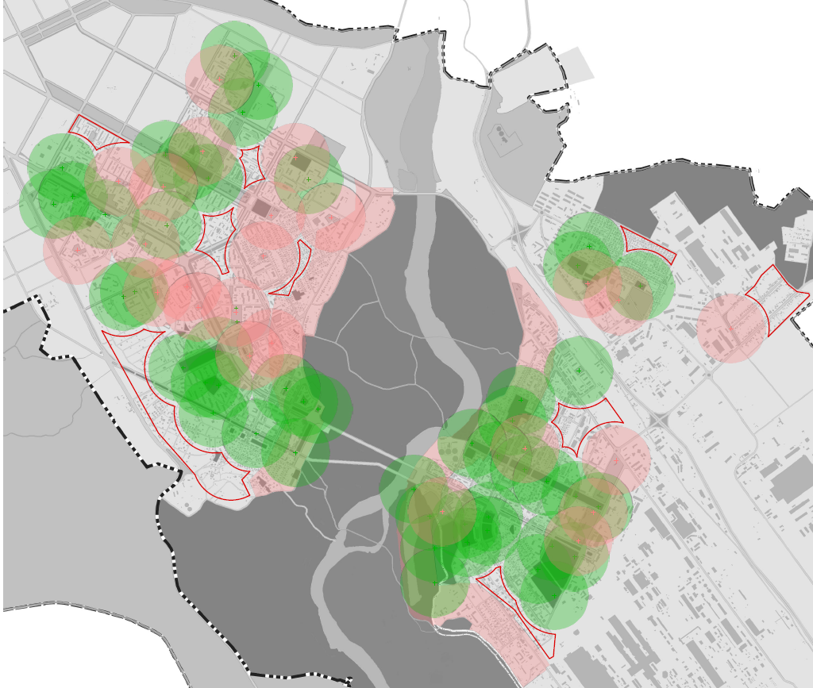
RECOMMENDATION FOR SOLVING URBAN GREEN SYSTEM IN THE NEW RUSTAVI URBAN DEVELOPMENT PLAN
The spatial distribution of green areas ensuring accessibility
accessibility of fuctional green spaces – 300 m distance
accessibility of potential green spaces – 300 m distance
insufficient accessibility of green spaces from urban residential areas
Notes:
The last condition I want to mention is focused on the accessibility of green areas. There is the rule, that green area of minimum size up to 1 ha should be accessible within 300 m from housing areas .

Slide 38
GREEN INFRASTRUCTURE
Framework for the implementation of green infrastructure in Rustavi Urban Development Plan
Analysis and protection of existing valuable biotopes and the occurrence of rare species of plants and animals
Consideration of possible synergies of the urban green system with other requirements for improving the water regime of the landscape and supporting biodiversity.
Creation of a suburban park in the floodplain of the Kura river.
Determination of conditions for managing rainwater in buildings and public spaces.
Determination of the conditions for the share of greenery on the plot and possible substitution of greenery on the ground for greenery on structures, e.g. roof gardens.
Determination of conditions for greening of streets incl. infiltration beds.
Notes:
Here you have summary of the normative Framework before the break.

Slide 39
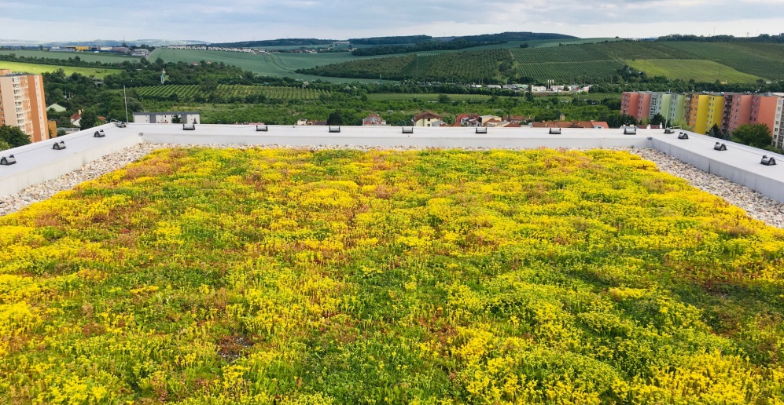
GREEN INFRASTRUCTURE
Examples of application of the principles of green infrastructure in the field of urban green system
Green roof on a panel house in Brno, Czech Republic
Notes:
Here you have summary of the normative Framework before the break.

Slide 40
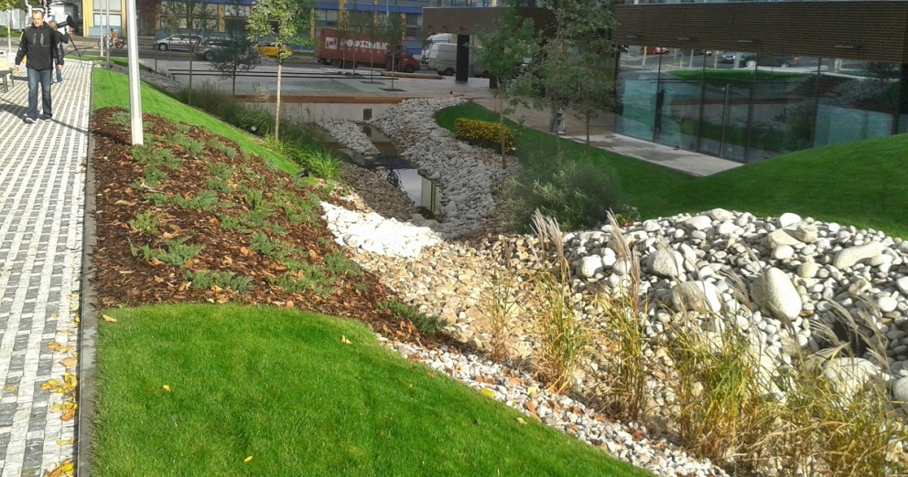
GREEN INFRASTRUCTURE
Examples of application of the principles of green infrastructure in the field of urban green system
„Dry creek“ enabling surface water retention

Slide 41
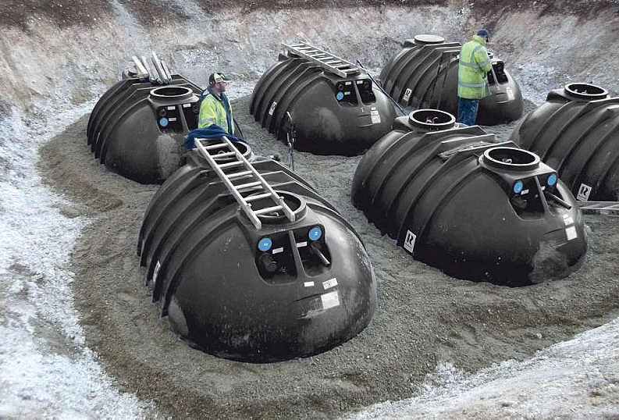
GREEN INFRASTRUCTURE
Examples of application of the principles of green infrastructure in the field of urban green system
Water retention tanks

Slide 42
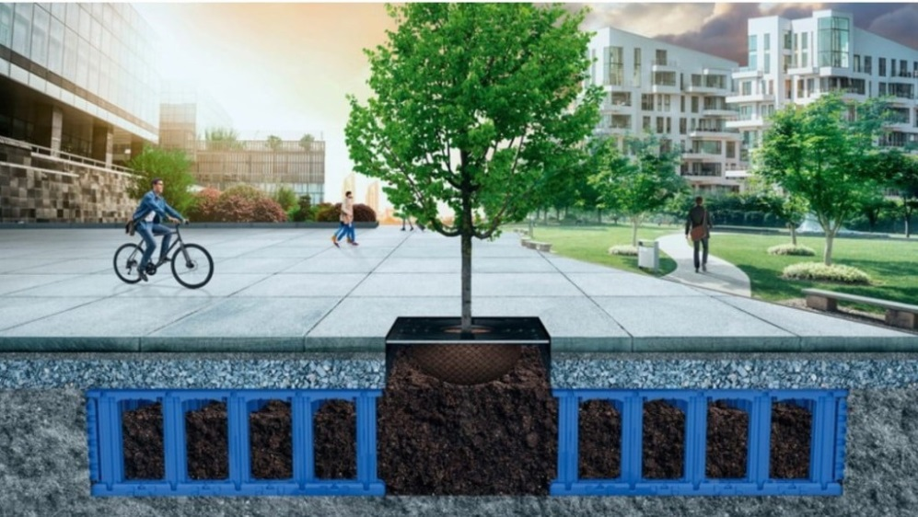
GREEN INFRASTRUCTURE
Examples of application of the principles of green infrastructure in the field of urban green system
Scheme of measures to improve the environment for tree roots

Slide 43
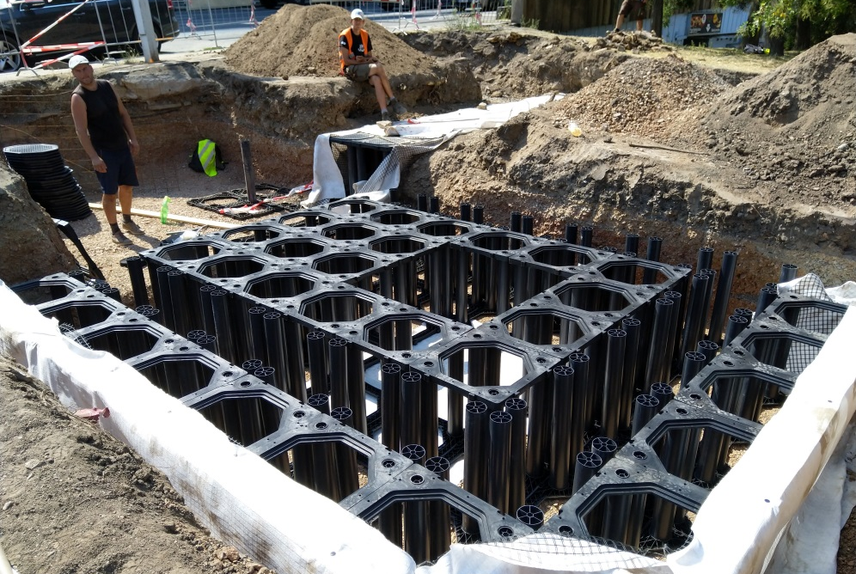
GREEN INFRASTRUCTURE
Examples of application of the principles of green infrastructure in the field of urban green system
The use of constructions to improve conditions for tree roots at the National Museum in Prague

Slide 44
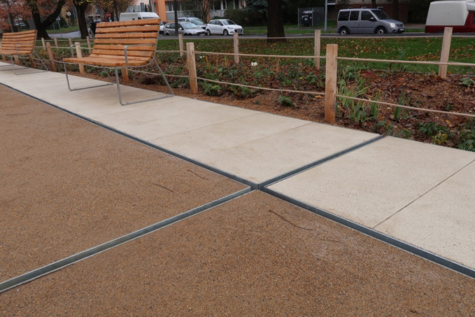
GREEN INFRASTRUCTURE
Examples of application of the principles of green infrastructure in the field of urban green system
Drainage of water into the rain bed from the path (revitalized park in Prague)

