Slide 1
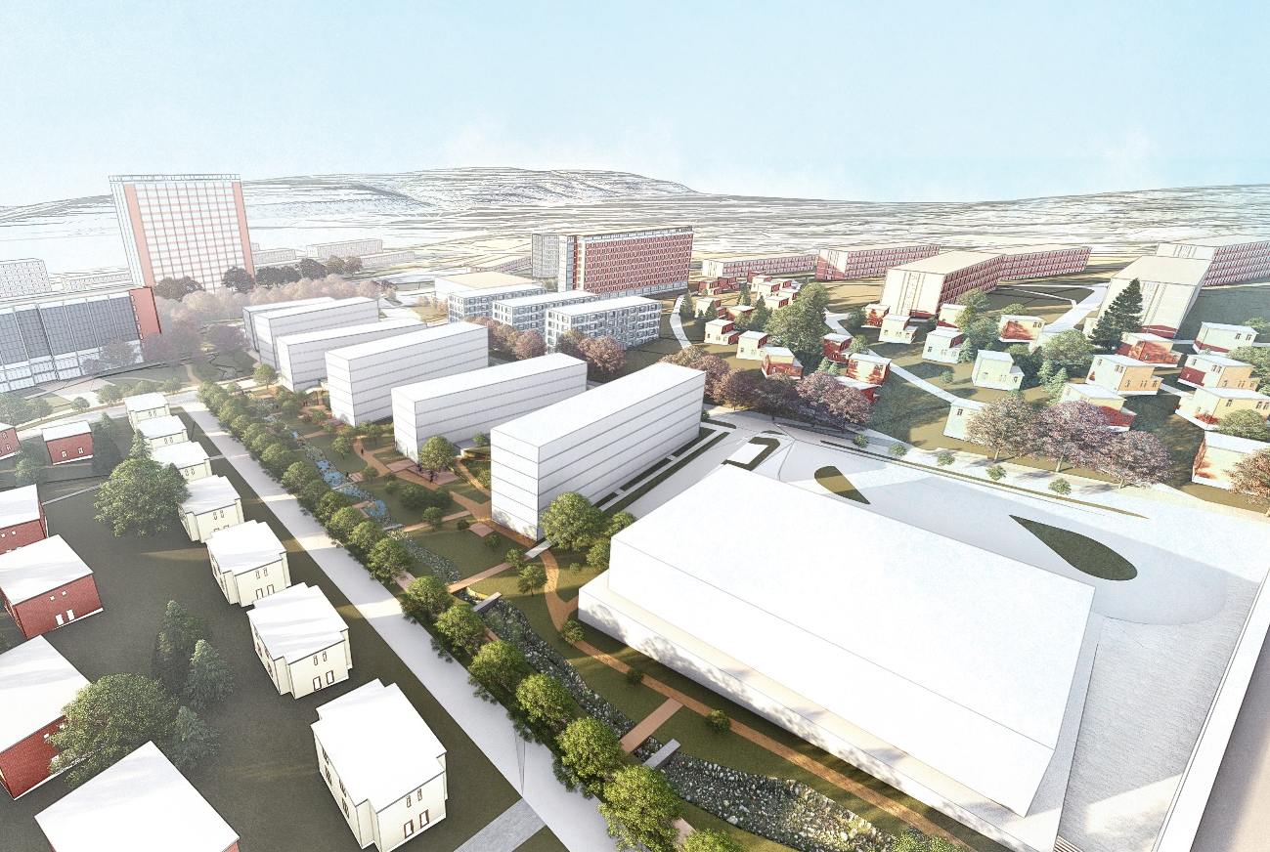
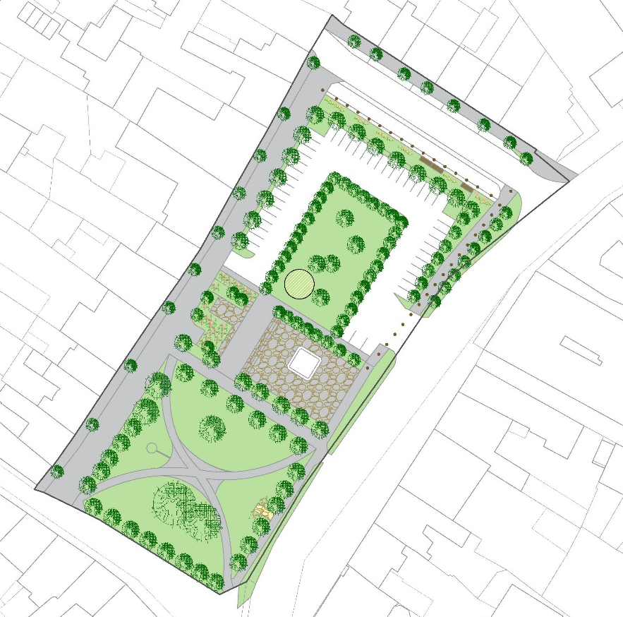
URBAN GREENERY AS A PART OF URBAN PLANNING
IN THE CZECH REPUBLIC
PRACTICE
GREEN CITIES AND URBAN PLANNING MILAN SVOBODA
TBILISI, JUNE 16, 2021 milan.svoboda@ateliercs.cz
Notes:
Ladies and Gentlemen,
Welcome back to the presentation.

Slide 2
PRACTICE
CONTENT
1 Territorial study of urban greenery
2 Green infrastructure
Notes:
I will talk about two more practical topics now.
I will describe the territorial study of urban greenery on the pracitcla , which are comprehensive documents from our point of view.
The second part will be focused on the green infrastructure concept we are trying to implement into the Czech building legislation.

Slide 3
1 │ TERRITORIAL STUDIES OF URBAN GREENERY
The impacts on the Master plans and on the management of public greenery
Evaluation of quality of the green areas
Proposal of the system of urban greenery
Proposal of new green areas and other green elements such as alleys
Proposal of necessary measures for improving quality of existing green areas
Territorial studies of urban greenery are the base for the Master plans
and for their changes
Notes:
Territorial studies of urban greenery are generally the very relevant documents in the field of our interest. They have impacts on the Master plans and their changes and also on the management of public greenery
I´d like to present the territorial study of urban greenery for a small town nearby Pilsen called Přeštice as a case study.

Slide 4
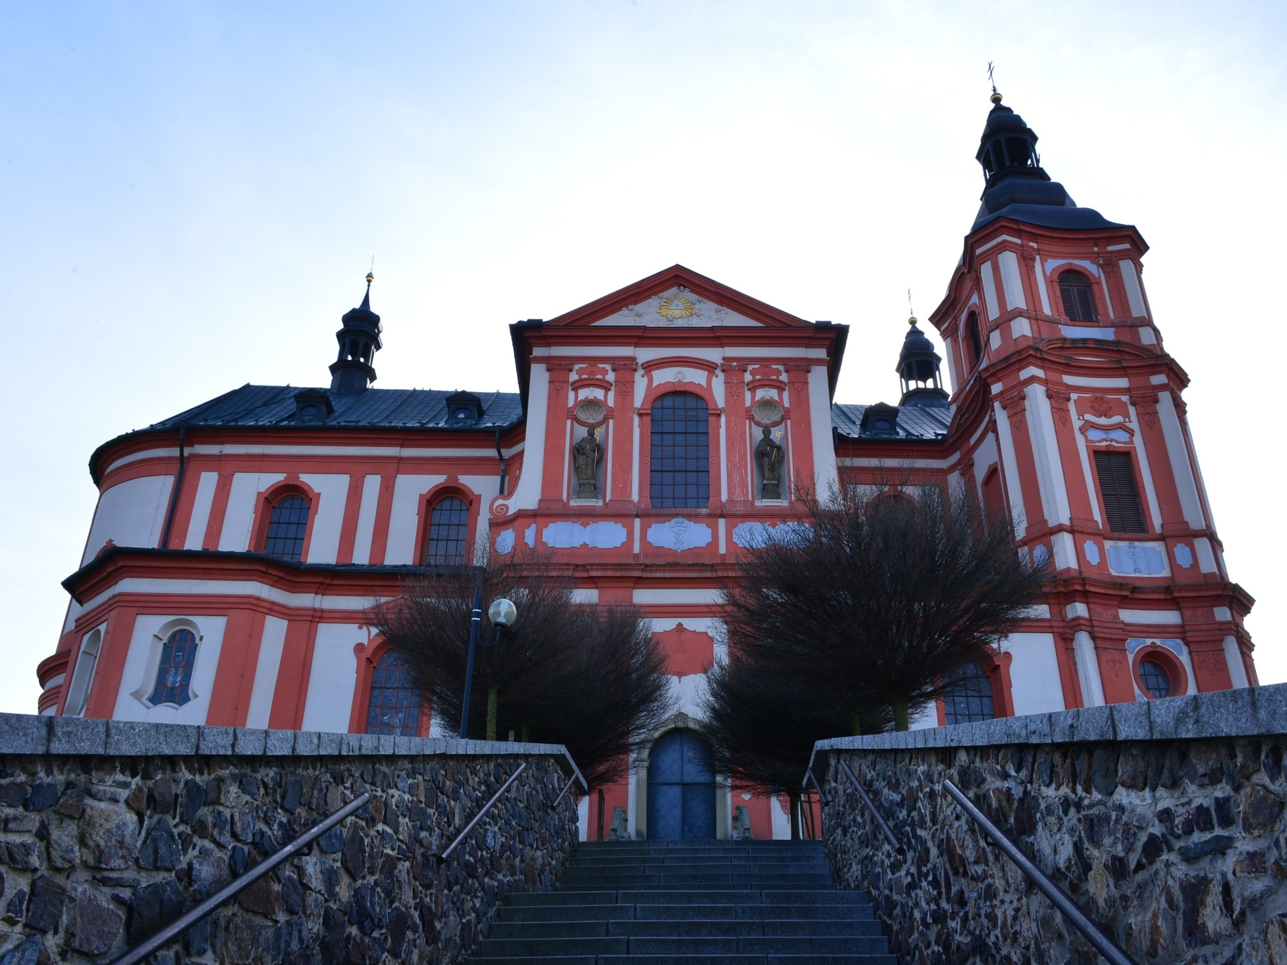
Notes:
Meet the town first. Přeštice boasts this famous baroque church which belongs to the top Czech Baroque Countryside Monuments.

Slide 5
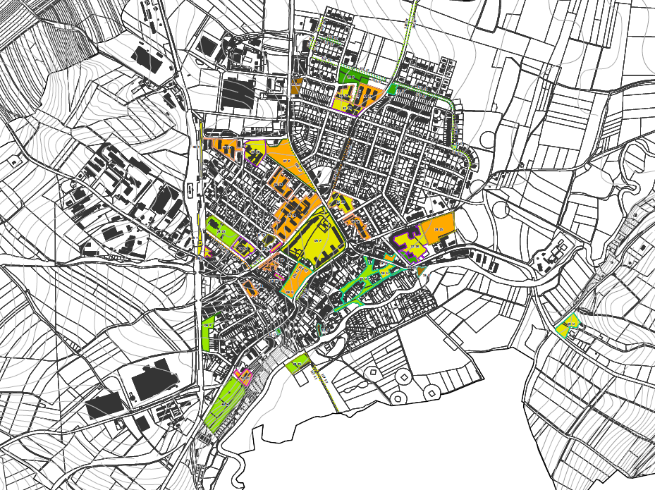
Notes:
But lets continue with the study. Look at this map of the town.
Here is the central square, the church is here.
This part is the housing area with panel houses and this area is the main residential area with family houses.
The very northern part has been developed for housing since the 1990s, and the western part has been developed for industry.
This map contains the analysis of existing public green areas and alleys in the town. Different colours express the quality of green areas and elements evaluated with criteria such as the state of the trees and shrubs, the quality of the maintenance and the suitability of the park furniture.

Slide 6
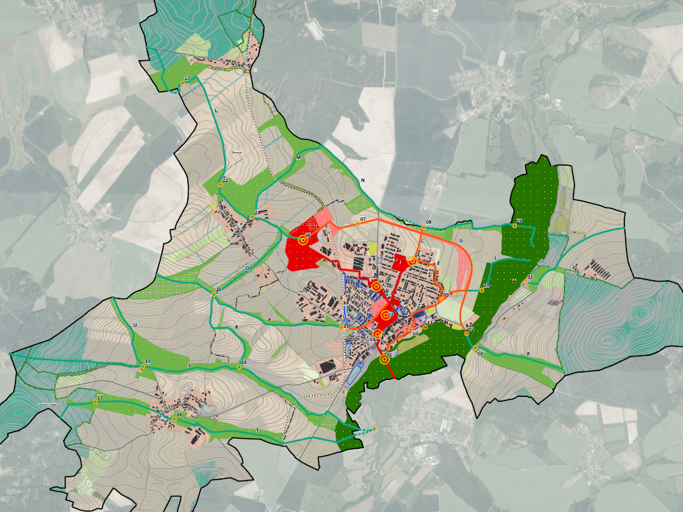
Notes:
The proposal of greenery has two levels.
This map includes the green system on the level of the whole area of the town.
You can see the main urban green areas in red colour and also main green spaces in the surrounding landscape in green. These areas are connected with existing or proposed green axes. These are for instance alleys and greenery along paths and small streams.
The proposal on this level also solves connections between urban area and the landscape and the ecological network.
A very important part of the green system are forests and a flat valley of the river Úslava covered by meadows.

Slide 7
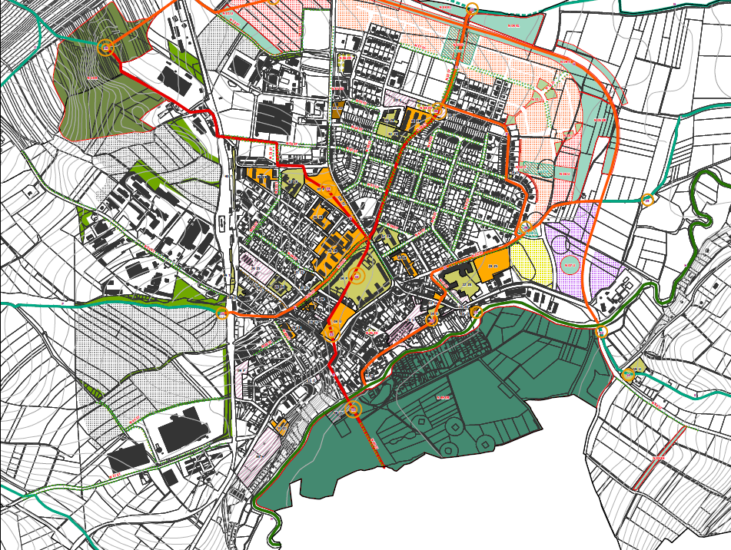
Notes:
This is a map of the detailed proposal of the green system. It includes several kinds of measures.
The necessity of intervention in the existing green areas and alleys is expressed by different yellow shades.
We proposed landscape park near the river. It is not classic urban park. We only proposed slight changes in the landscape such as pedestrian and cycling paths and benches.
This green area on the opposite side of the town is a former mining area in which we proposed an adventure park.
In the industrial area we defined existing greenery which must be protected.

Slide 8
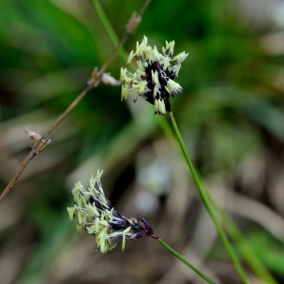
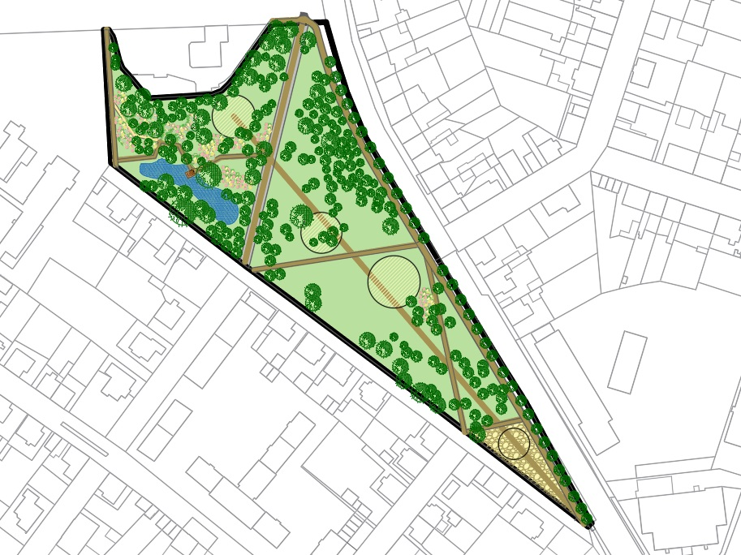
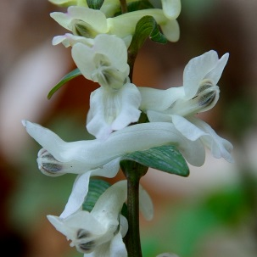
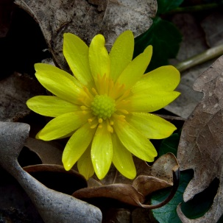
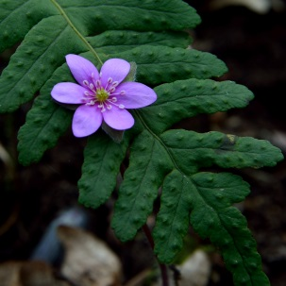
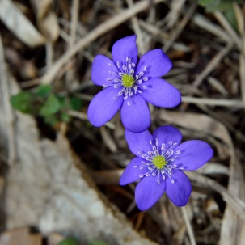
Notes:
We also prepared ideas for redesigning existing green areas such as this main town park.
In this proposal we used several principles of green infrastructure. I would like to emphasise this wetland using rain water from the roofs of the kinder garden located close to the park and also this undergrowth formed by natural perennials.

Slide 9
2 │ GREEN INFRASTUCTURE
New holistic approach to the planning of greenery
Benefits for the people and for also the nature
So called ecosystem services are taken into account
One ot the measures for an adaptation on the climate changes
Green infrastructure is a new perspective on urban and landscape greenery
Notes:
This slide introduces the last topic of my presentation. We try to implement so called green infrastructure into our urban planning system and also into building legislation.
I suppose you know the green infrastructure concept.
This concept has been developed in the USA since the 1960s.
The EU adopted green infrastructure as a tool for the support of the biodiversity in 2013.
There are a lot of very complicated and sophisticated definitions of green infrastructure. In my opinion green infrastructure is just a „new perspective on urban and landscape greenery “.
The difference between classic approach to greenery and green infrastructure lies in the benefits we expect from green areas.
Aside from the benefits for people, such as recreational potential, aesthetic and health effects, we should take into account the benefits for nature itself – for instance a water regime and biodiversity. You certainly know, that everything is related with everything in the environment, therefore benefits for nature are definitely also benefits for people.

Slide 10
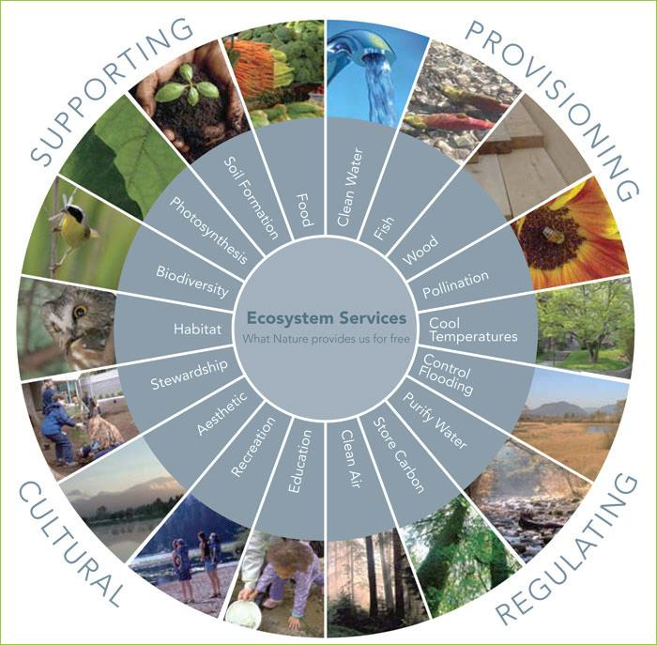
2 │ GREEN INFRASTUCTURE
Ecosystem services
Notes:
Understanding of the benefits of greenery is based on the theory of ecosystem services.
Main principle of this theory is that nature gives human beings plenty of benefits and we are able value these benefits.
The picture explains a division of the ecosystem services into four groups.
Provisioning services are connected with supporting people with food, water and materials.
Regulating services related to quality of air, water regime etc.
Cultural services mean for instance legacy, community activities, tourism and sport
Supporting services aimed at nature and biodiversity.

Slide 11
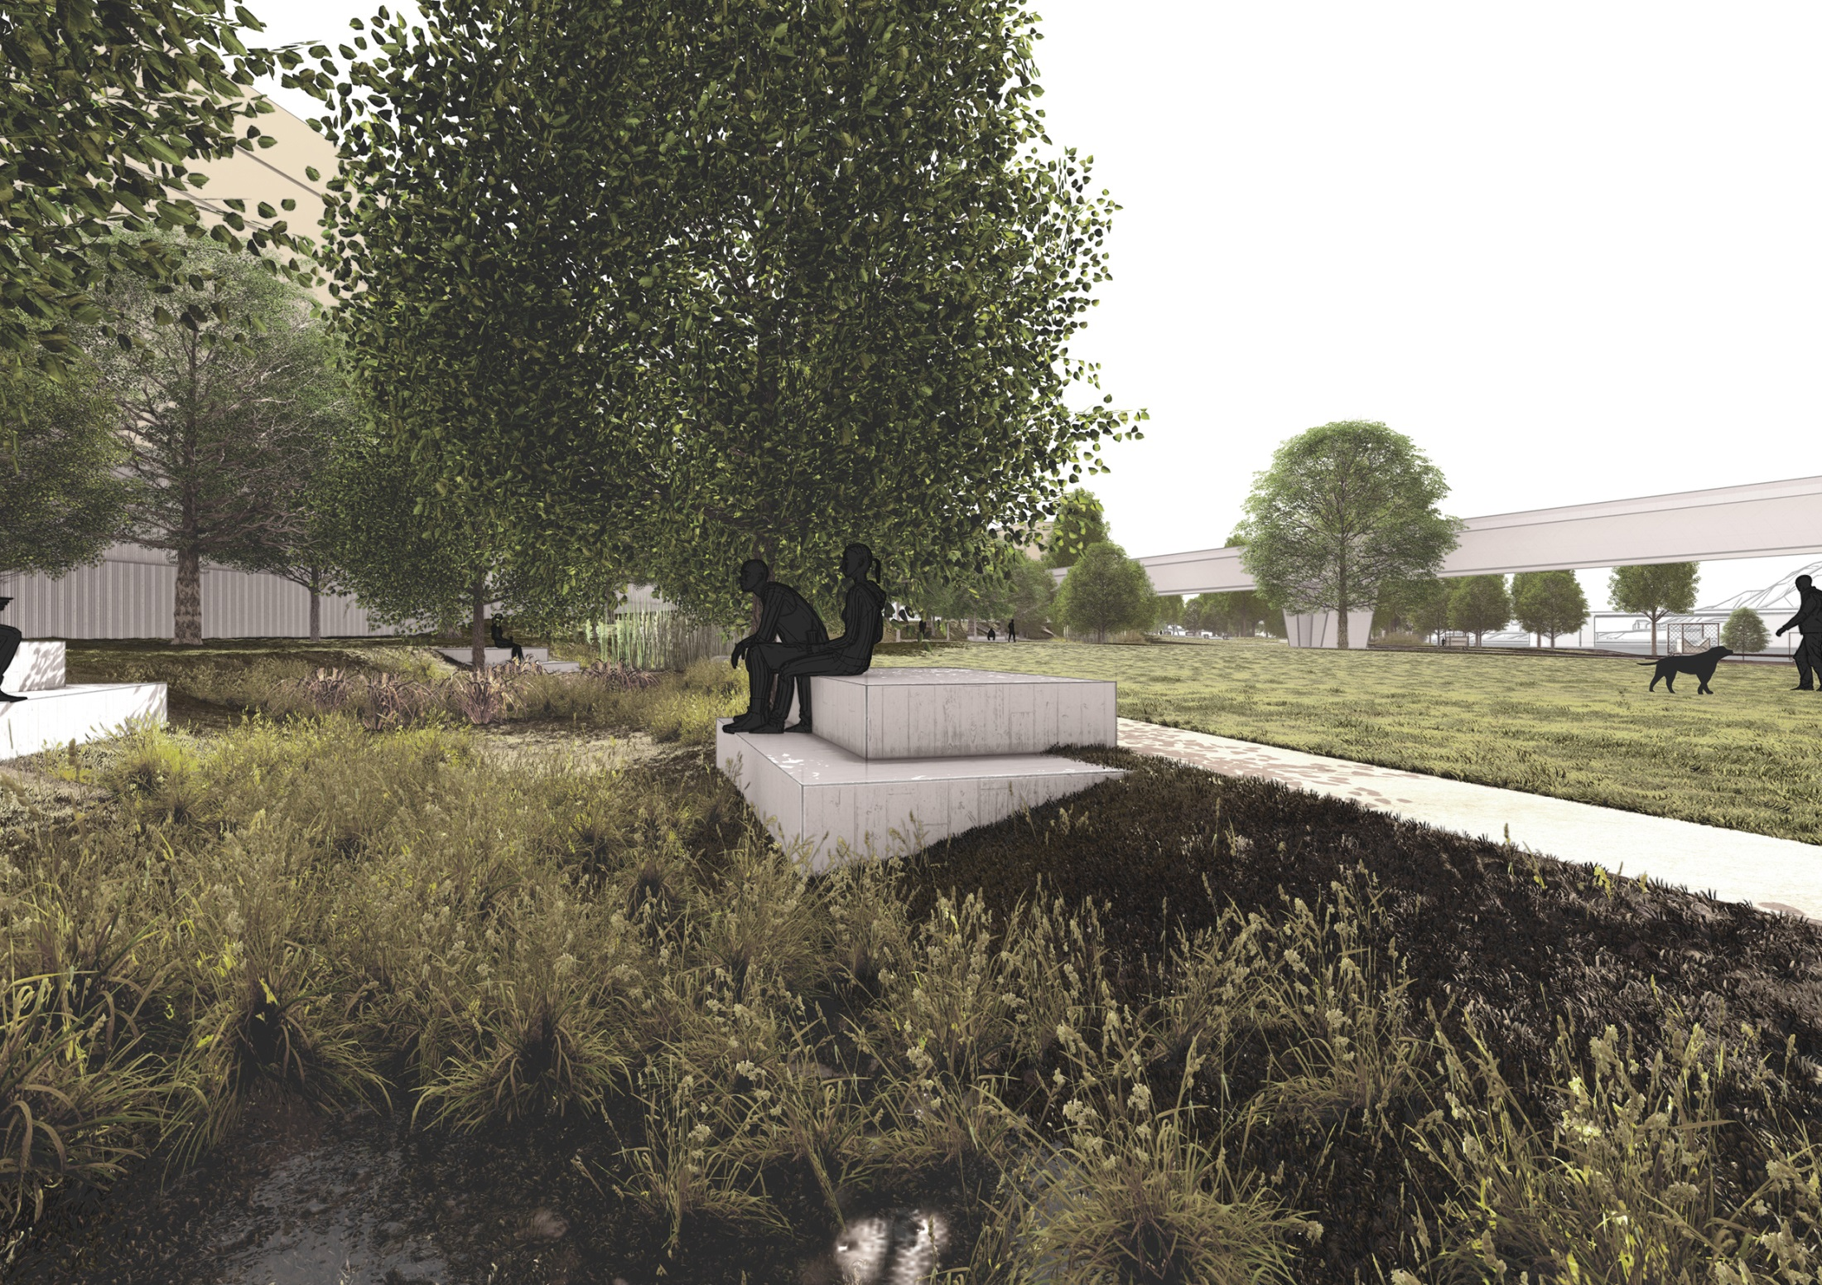
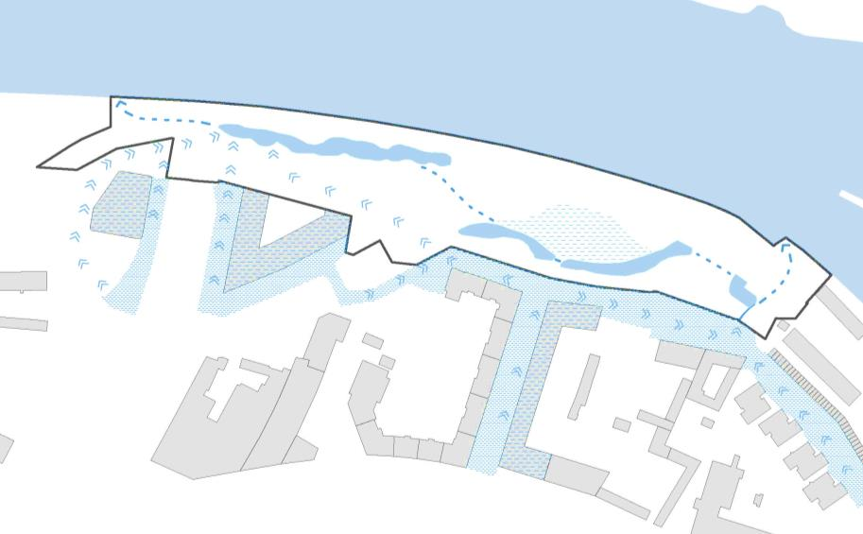
Notes:
This slide shows the implementation of green infrastructure principles in a proposal for an architectural competition. The aim of this competition was to design a new park next to the river Vltava in Prague.
Among other things we proposed to bring rain water from the roofs of the buildings near the future park and also from the streets around and use the water in small nature-like pools with vegetation similar to the wetland ecosystems along the river Vltava.

Slide 12
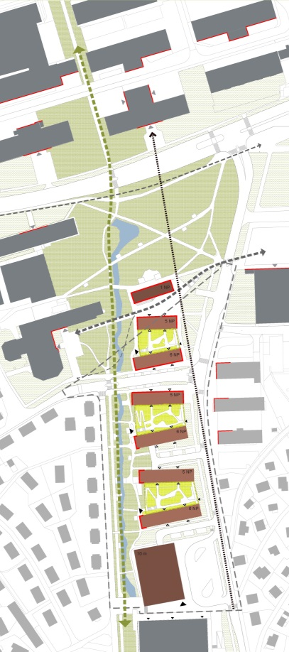
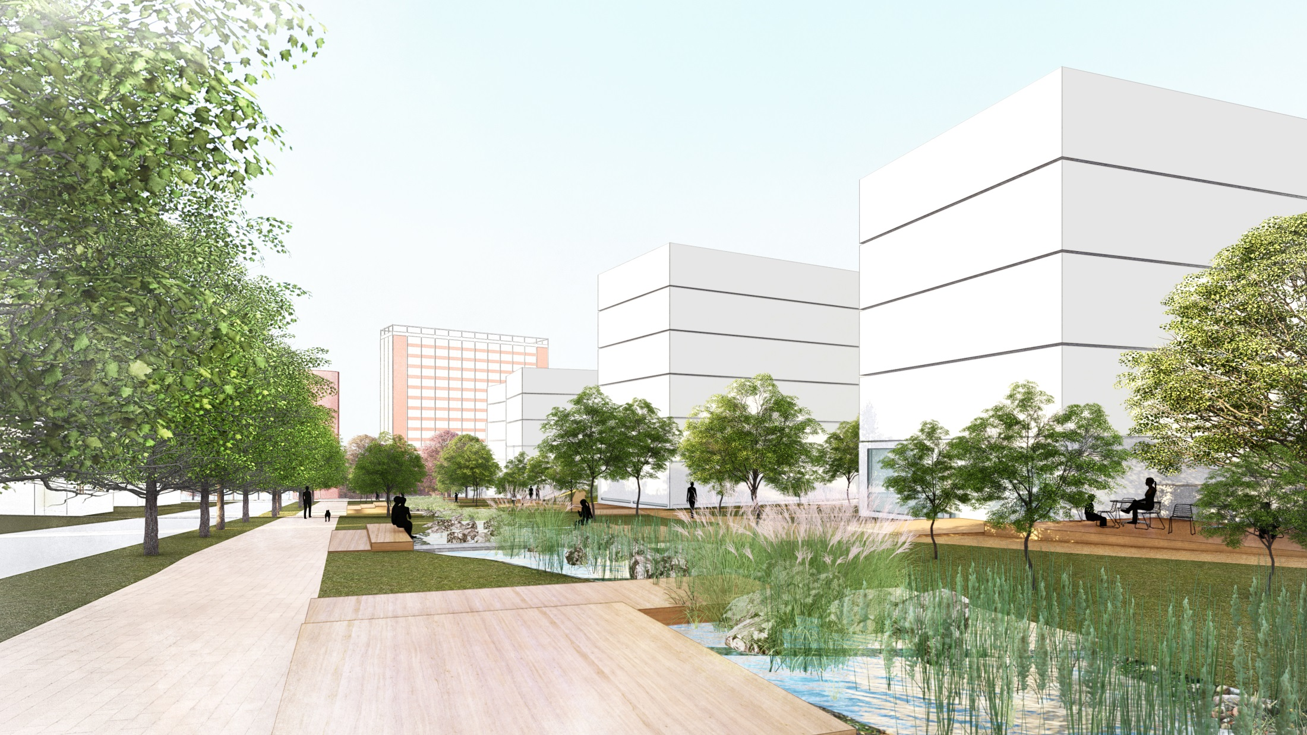
Notes:
We used a similar idea for another competition proposal of the urbanisation of a part of the city of Zlín.
A comment: Zlín is the city in which Baťa Brand shoes were originally produced.
We proposed the new urban quarter which includes a new sports hall, six blocks of flats and a community centre near an existing park. We planned a stream with wetland vegetation along the urban quarter.
This proposed element of green infrastructure is a reference to a destroyed brook which was in this area in the olden days. We also took into account benefits for relax and community activities, for the water regime, for the microclimate and for nature.

Slide 13
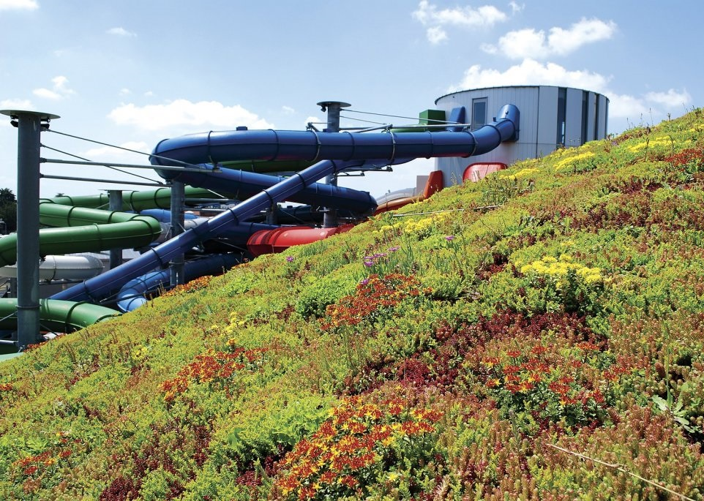
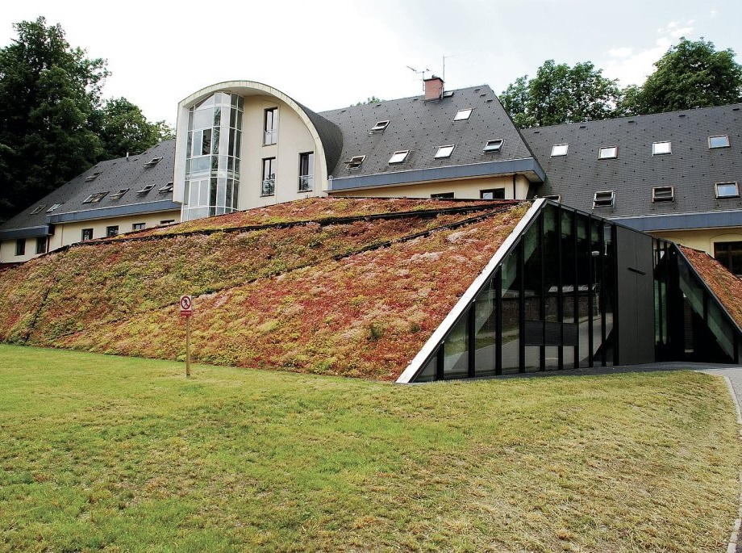
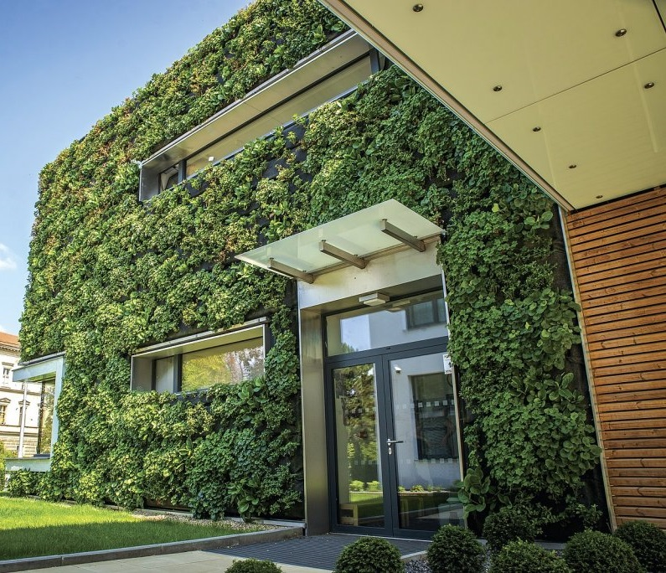
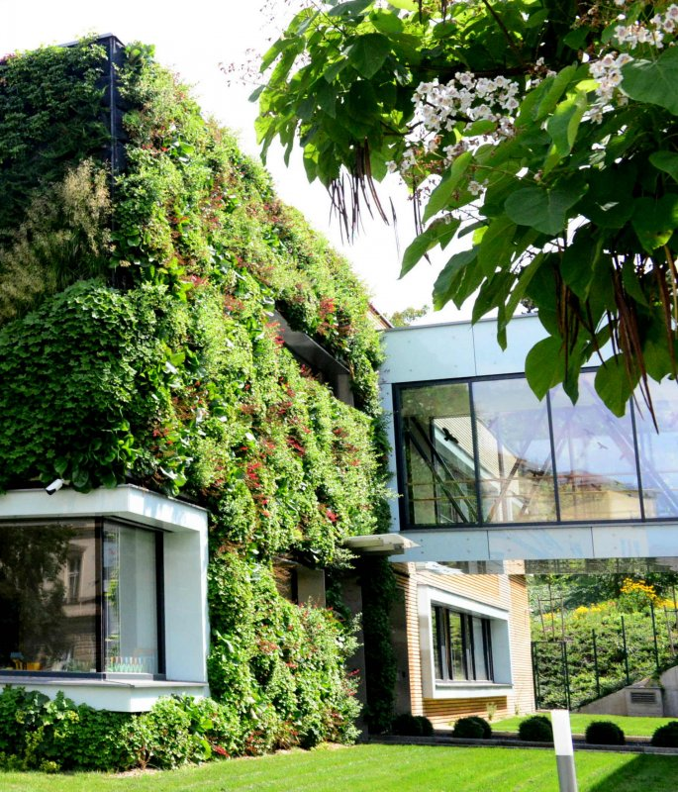
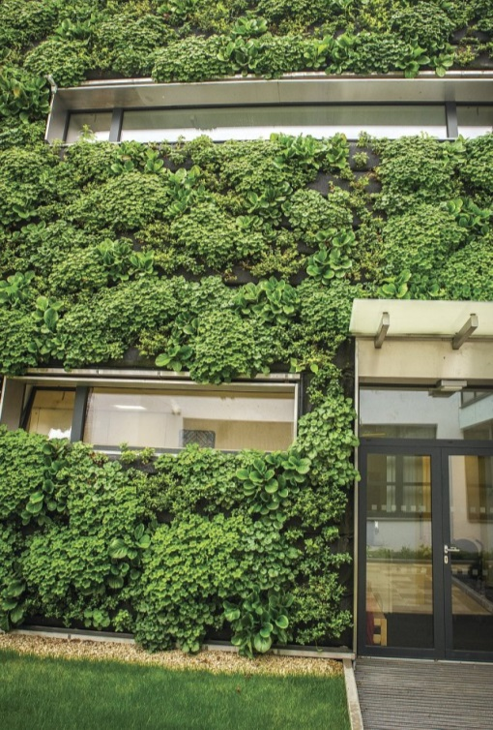
Notes:
The last slide shows several existing buildings with green roofs and green facades.
These elements of green infrastructure are connected directly with buildings and bring a lot of benefits such as water retention, slowing down the outflow of water, cooling and humidifying the microclimate and supporting biodiversity.
Although these green elements are demanding in terms of the quality of the construction, technology, plants and water system, I hope they will be used to a greater extent and make our cities more liveable.
Thank you for your attention!

Slide 14
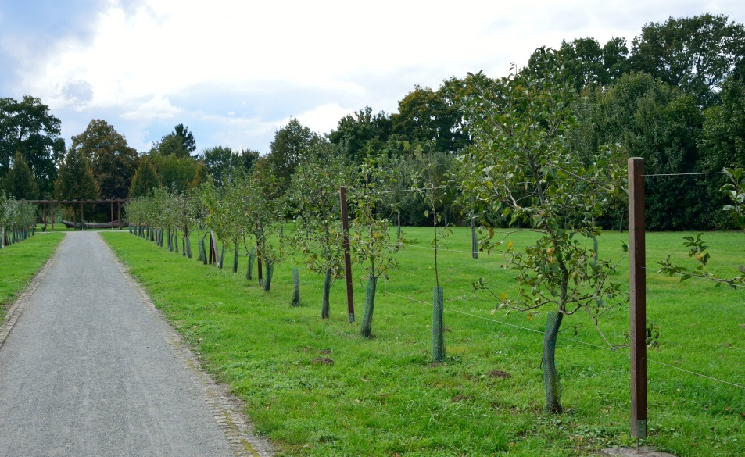
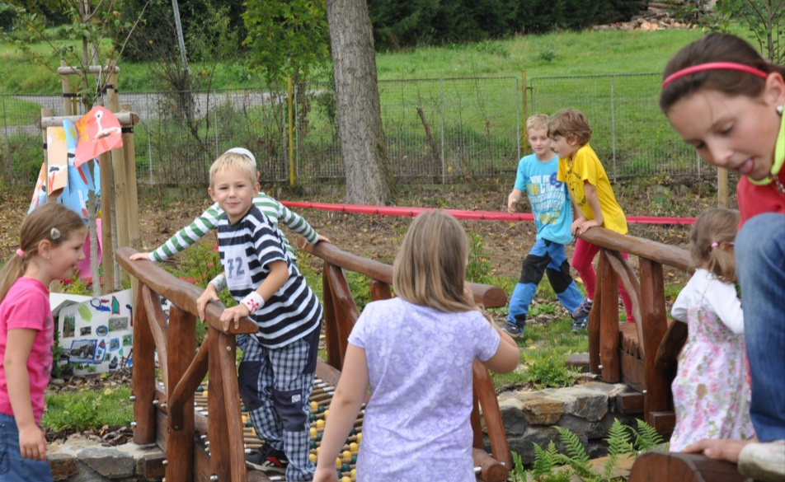
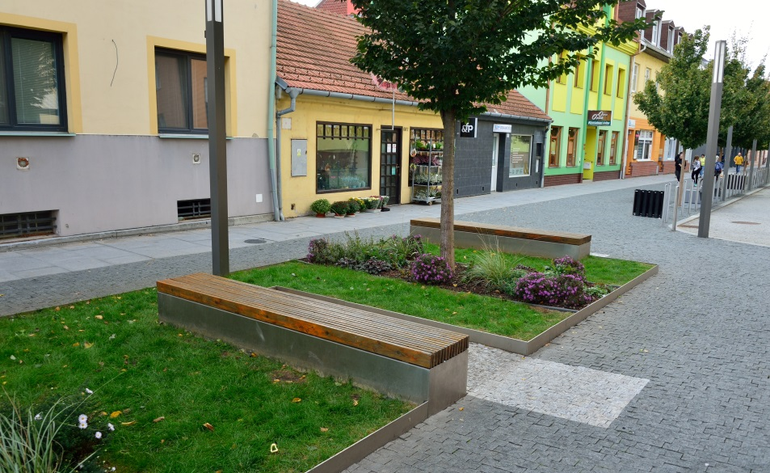
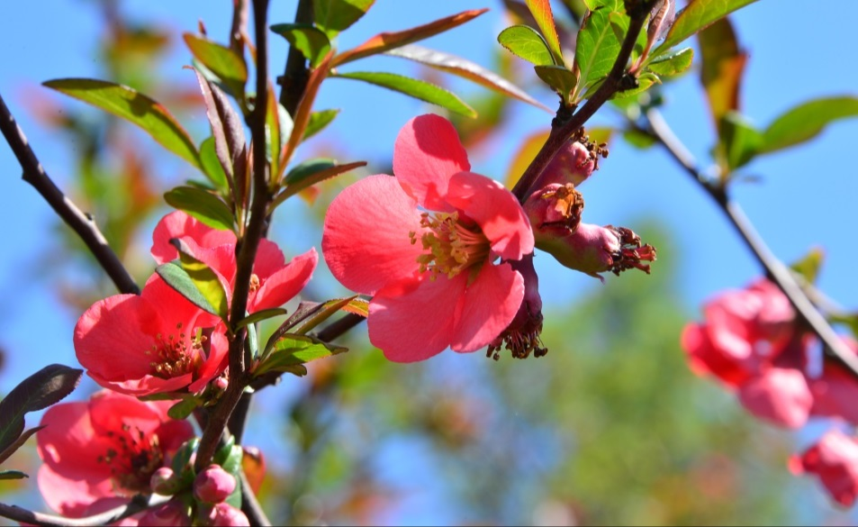
Thank you for your attention

