Slide 1
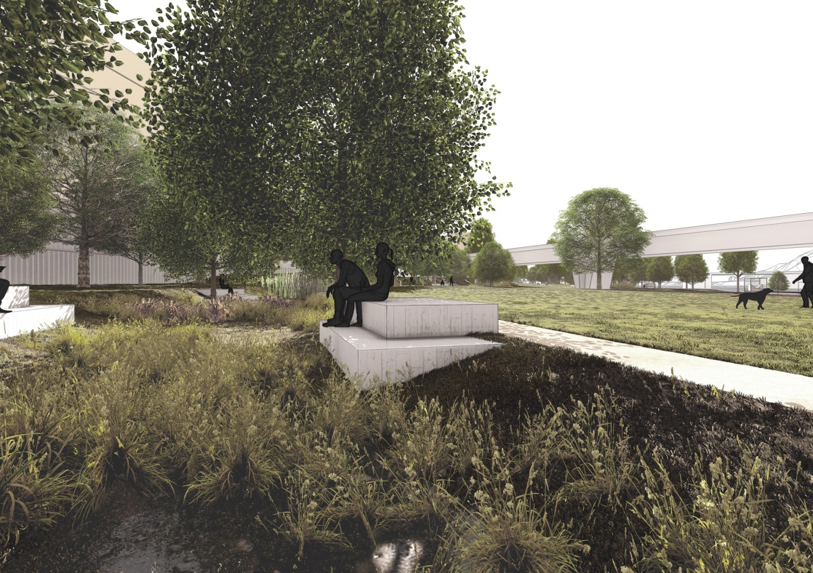
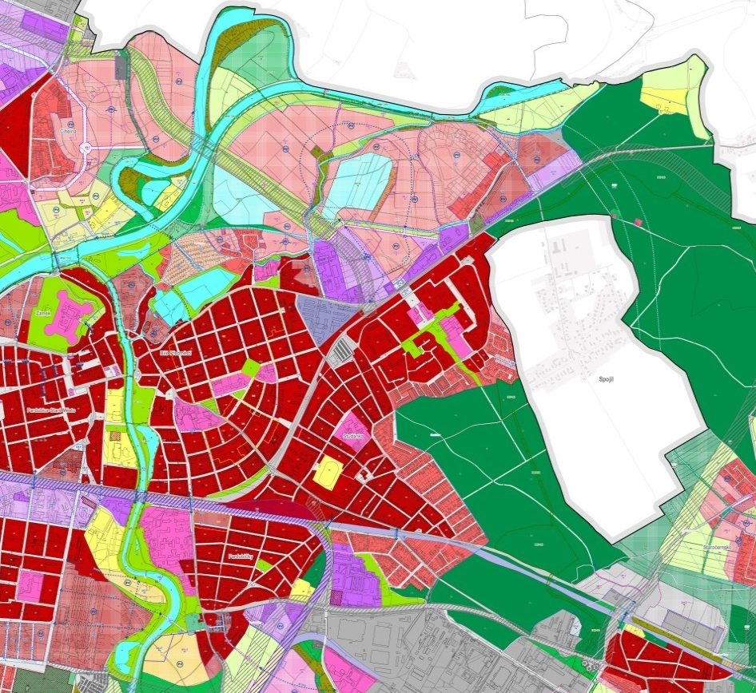
URBAN GREENERY AS A PART OF URBAN PLANNING IN THE CZECH REPUBLIC
NORMATIVE FRAMEWORK OF URBAN PLANNING
GREEN CITIES AND URBAN PLANNING MILAN SVOBODA
TBILISI, JUNE 16, 2021 milan.svoboda@ateliercs.cz
Notes:
Good afternoon Ladies and Gentlemen,
I am glad to be here in your beautiful city. This is my second time here. I first visited Tbilisi almost 40 years ago with my schoolmates from university.
Let me briefly introduce myself. Although I studied landscape ecology and nature protection, my professional life is connected with urbanism and landscape architecture. I worked as a city planner in the Urban planning institute of the city of Pilsen. I hope you know Pilsen, it is the 4th biggest city in the Czech Republic and also the capital of beer.
I have worked as an urbanist and landscape architect since 2007, in 2019 I established my own company.
I also work for the Czech Chamber of Architects, I am responsible for architectural contests.
I have been asked to present how we implement the system of urban greenery into our urban plans. I am persuaded that greenery is an important topic for all countries due to the climate changes , so I am thankful for the opportunity to discuss and exchange the experiences in this area.

Slide 2
NORMATIVE FRAMEWORK OF URBAN PLANNING CONTENT
1 Urban planning in the Czech Republic
2 The Urban Greenery Concept as a part of Master plans
3 Specific conditions relating to urban greenery
Notes:
You can see the content of my first presentation on this slide. It will be focused on normative framework.
First of all I would like to briefly explain our system of urban planning.
Then the next slides will show the urban greenery concept and the specific conditions we use in our urban plans.

Slide 3
1 │ URBAN PLANNING IN THE CZECH REPUBLIC
Czech legislation in the field of urban planning
Act No. 183 from 2006
New Building Act
The new Building Act probably won´t bring anything new in the field of urban planning
Notes:
Short introduction to the legislation
Dating back to the 1880s the urban planning in Czechia has always been connected with building legislation. We´ve never had a special act neither for urban planning nor for spatial planning.
Now we use The Building Act which has been in force since 2007.
The Czech parliament is currently discussing a new building law. Due to the large number of amendments, the situation around this law is confused and I am curious to see the result.
But I think that the new building law doesn´t elminite the weaknesses we see in the the current building act in the field of urban planning. The most problematic are a disconnection from strategic planning and a reduction of the role of local governments.

Slide 4
1 │ URBAN PLANNING IN THE CZECH REPUBLIC
Urban planning tools according to the Czech Building Act
National level: The Spatial Development Policy
The Spatial Development Plan
Regional level : Principles of Regional Development
Local level: Master plan
Regulatory plan
Notes:
According to the current Building Act we have five obligatory tools in the Czech Republic on national, regional and local level.
Let me introduce them briefly.

Slide 5
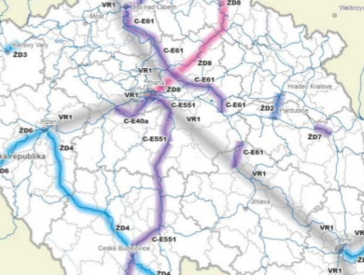
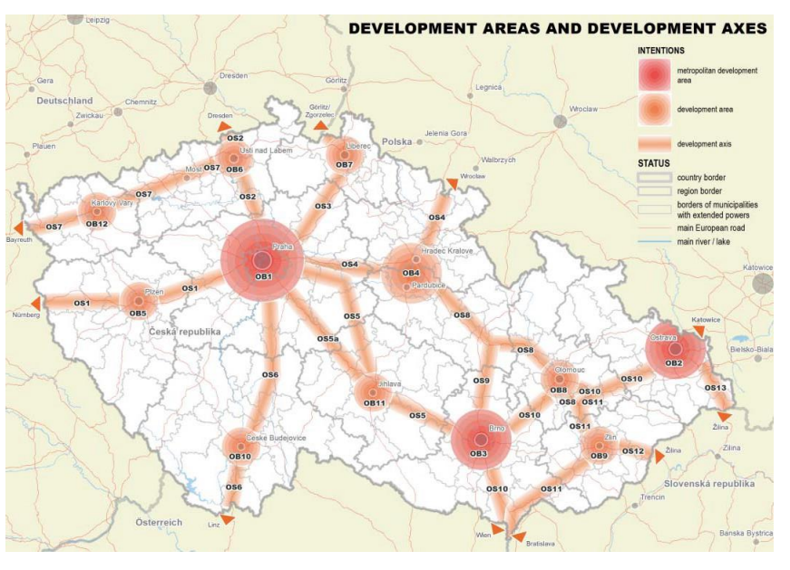
1 │ URBAN PLANNING IN THE CZECH REPUBLIC
National level
The Spatial Development Policy since 2008
The Spatial Development Plan (currently being prepared)
Notes:
The most general tool is The Spatial Development Policy which defines the principles of sustainable urban planning and the main development areas, development axes and specific areas.
The Spatial Development Policy also includes important infrastructure measures on the national level, for instance highways, railways, main power lines and dams.
The example on the left side is the scheme of the development areas a development axes. On the right side you can see the part of the railways concept scheme.
The national level of tools will be complemented by The Spatial Development Plan which has already been prepared.

Slide 6
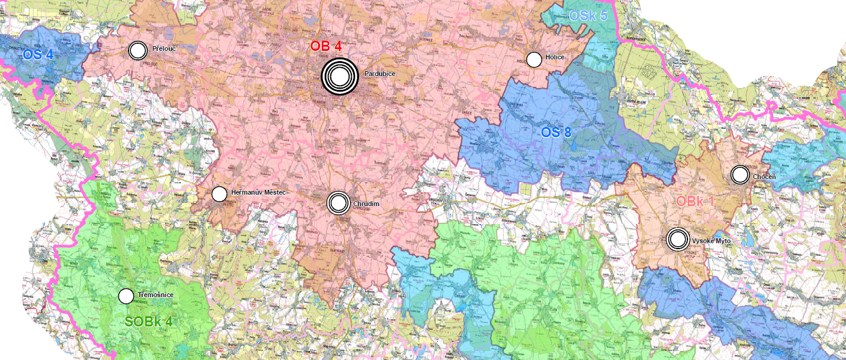
1 │ URBAN PLANNING IN THE CZECH REPUBLIC
Regional level
Principles of Regional Development
Notes:
We use The Principles of Regional Development for regions. These documents define principles of urban planning on a regional level and divide regions into development areas, specific areas and development axes as it is shown on the example.
Regional principles also propose measures in the field of infrastructure. Moreover they are focused on the ecological network and the quality of landscapes according to the European Landscape Convention.

Slide 7
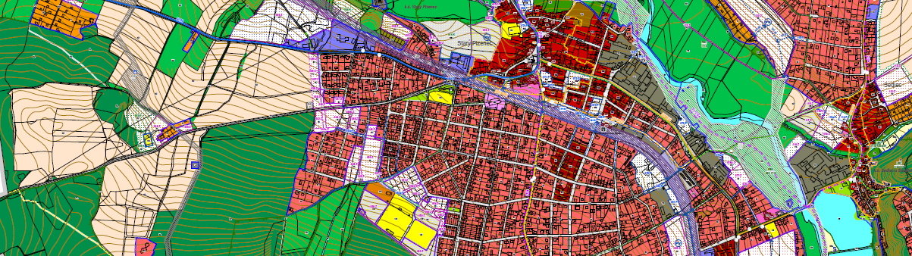
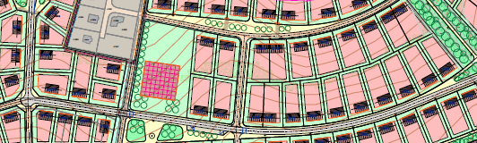
1 │ URBAN PLANNING IN THE CZECH REPUBLIC
Local level
Master plan
Regulatory plan
The Master Plan is the most important tool regarding urban greenery
Notes:
From our point of view The Master Plan is the most important tool, which comprises the solutions of urban greenery. Master plans are prepared for cities, towns and villages.
Regulatory plans solve more detailed regulations. They are used for the parts of cities, especially for new proposed building areas and for transformation areas.

Slide 8
1 │ URBAN PLANNING IN THE CZECH REPUBLIC
Master plan
Land use plan
Urban structure plan
Landscape plan
Plan of public infrastructure
Plan of the measures in the public interest
Text part including the specific rules
Notes:
The Master plan is a complex document including component plans such as
Land use plan
Urban structure plan
Landscape plan
Plan of public infrastructure
Plan of the measures in the public interest
A text document with specific rules is also a part of the Master plan .
Unfortunately we don´t have time to deal with the Master plan in detail. But I will talk about some parts which are relevant for urban greenery in the next slides.

Slide 9
1 │ URBAN PLANNING IN THE CZECH REPUBLIC
Implementation of urban greenery in the Master plans
Urban greenery concept
Specific conditions
Notes:
The main question of my presentation is how we implement urban greenery into our urban planning, especially into the Master plan.
We use two measures. The firest one i the proposal of the urban greenery concept.
We also define the specific conditions for greenery in the text part of the Master plan.

Slide 10
2 │ URBAN GREENERY CONCEPT IN THE MASTER PLANS
The urban greenery concept = connected system of green areas and other elements
It includes
The main green areas such as parks, green squares, public greenery in the housing areas, cemeteries, botanical gardens etc.
The additional green elements such as private gardens, school gardens, hospital gardens, alleys, trees on parking lots etc.
Connection to the landscape and the ecological network
The urban greenery concept is the obligatory part of the Master plans
Notes:
The Urban greenery concept represents the connected system of the main green areas such as parks and also the additional greenery, e.g. small gardens and alleys.
The urban greenery concept doesn´t have any special plan. This concept is mainly reflected in the land use plan and the landscape plan.
I will show you it using examples from the Master of the city of Pardubice, which is currently being prepared.

Slide 11
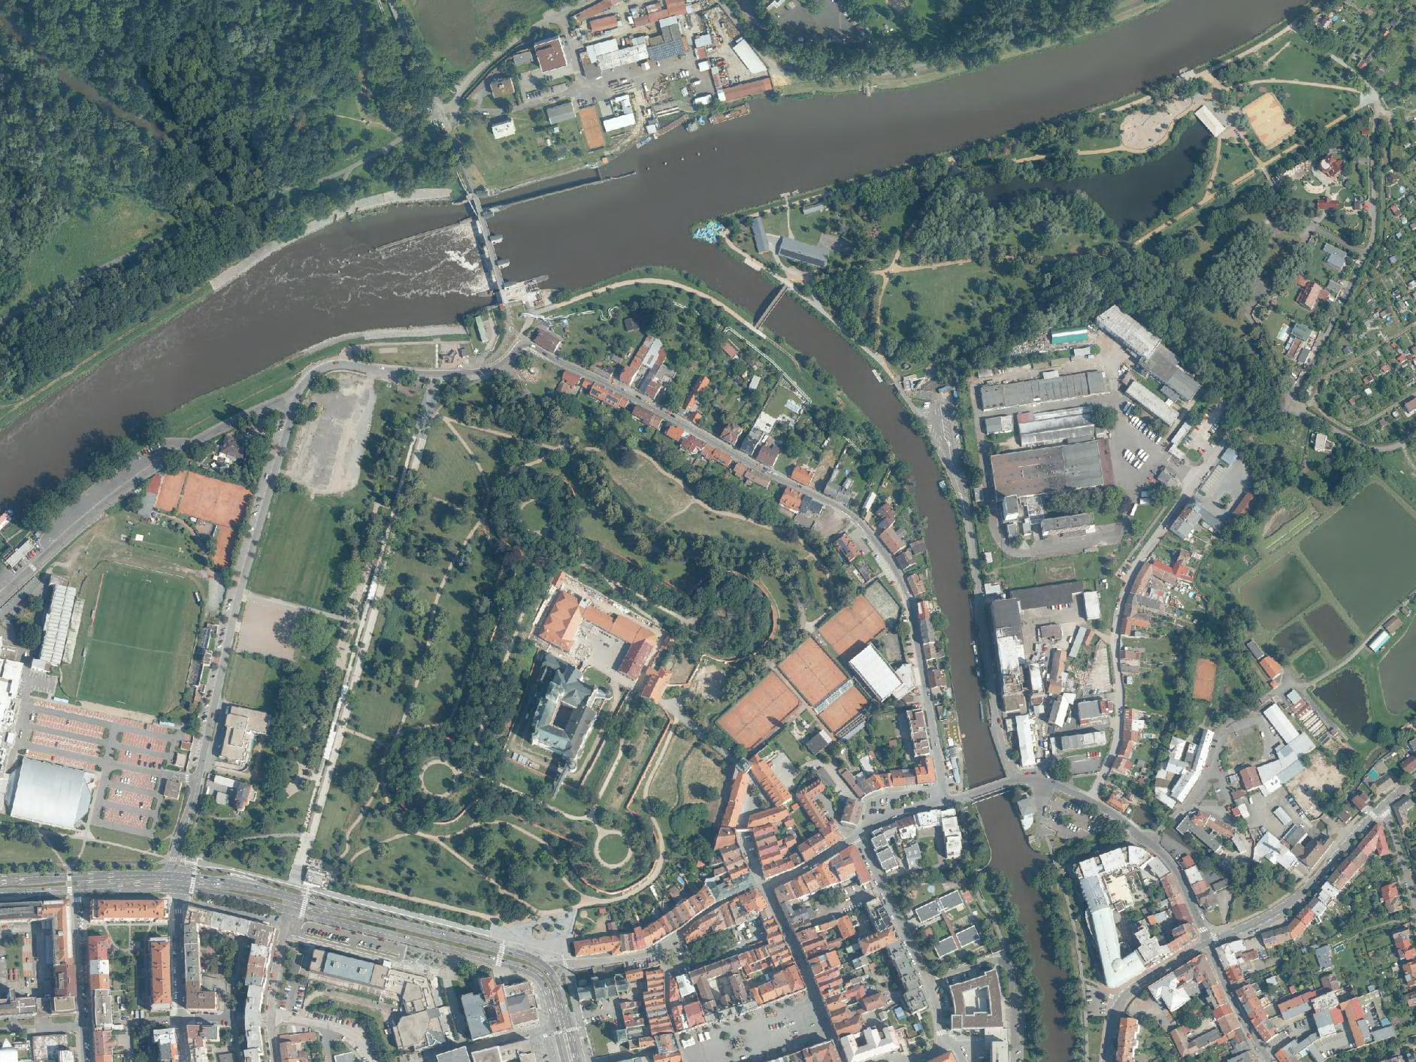
PARDUBICE
Elbe
River landscape park
Park „At the Peak“
Chrudimka
Chateau park
Fish
ponds
Castle
Main square
Notes:
On this aerial view of the centre of Pardubice you can see the confluence of two rivers – Elbe and Chrudimka, Pardubice Castle surrounded by a recently reconstructed park, another recently reconstructed park next to the confluence, fish ponds, proposed landscape park near Elbe and the historical quarter with the main square.

Slide 12
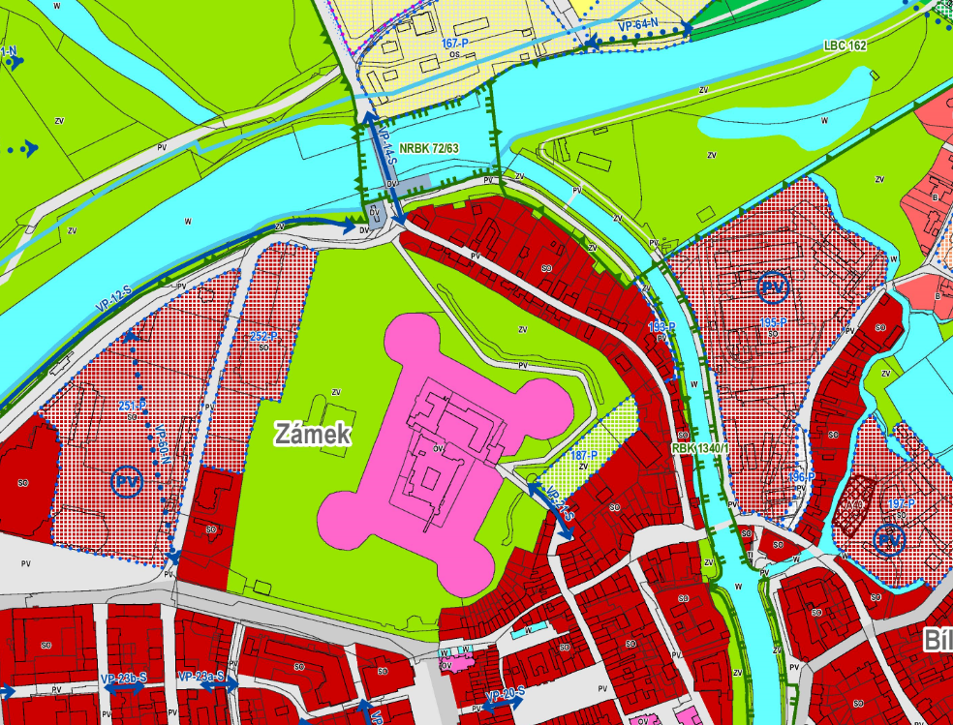
PARDUBICE
Elbe
River landscape park
Park „At the Peak“
Chrudimka
Chateau park
Fish
ponds
Castle
Main square
Notes:
And here you can see the same area on the Land use plan.
The land use plan defines areas according to their specific kind of use - for instance housing, civic amenities, industry, sport and leisure and, of course, greenery.
You can see a lot of existing residential areas in red solid colour fill. You can also see several proposed transformation areas for housing - red pattern fill.
These small circles with the letters PV are relevant from the perspective of our task, I will return to them in a moment.
The jagged green lines define the ecological network. Explaining the prinicples od ecological network would be the topic of another presentation. But briefly – it is a net of nature-like places connected by nature-like corridors. We define it to support the biodiversity.

Slide 13
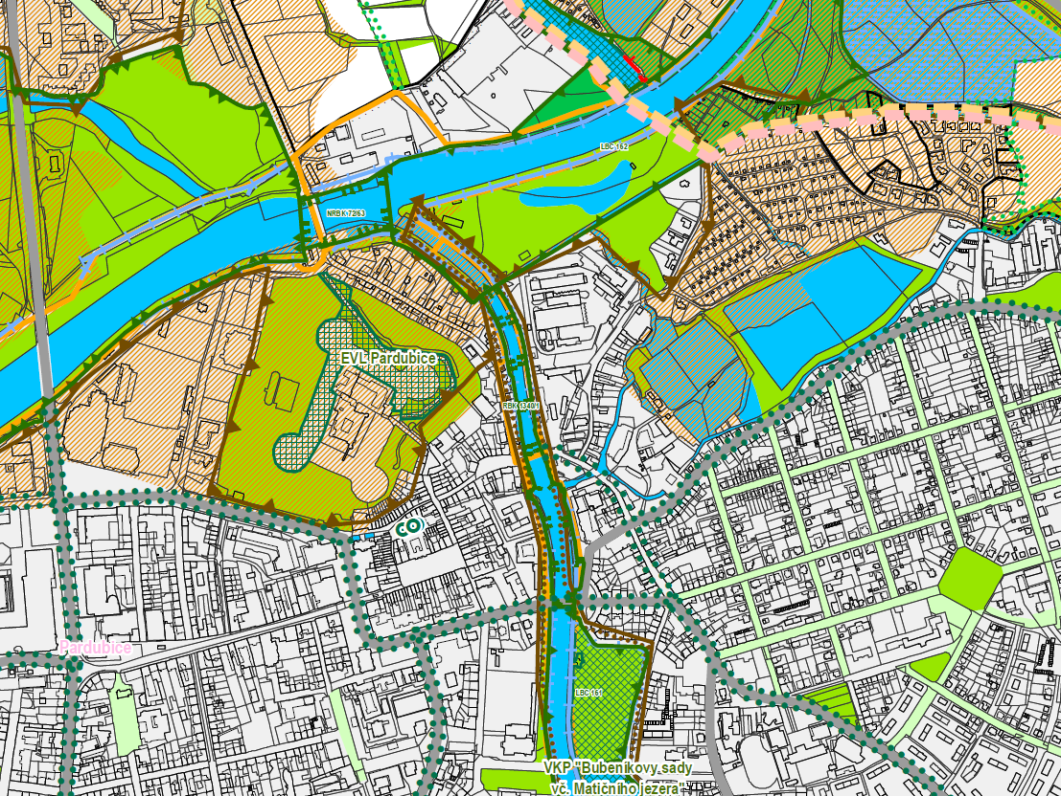
PARDUBICE
Park „At the Peak“
Elbe
River landscape park
Fish
ponds
Castle
Chateau park
Main square
Notes:
This picture displays the same area on the Landscape plan. The landscape plan is not obligatory but is usually included in the Master plans of big cities.
The urban greenery concept in this case is based on the chateau park and rivers with parks on their banks, as we saw before.
The landscape plan is more detailed and contains other green elements - alleys, „green“ streets and small green segments.

Slide 14
3 │ SPECIFIC CONDITIONS RELATING TO URBAN GREENERY
The minimum size of public spaces in the new proposed areas for housing, recreation and public amenities – 1000 m² per 2 ha
The minimum ratio of greenery on a property
The minimum number of trees for parking lots - 1 tree per 5 car parking places
The maximum distance of green areas of minimum size 0,5 – 1 ha is 300 m from housing areas
Notes:
Besides planning the urban greenery concept we use several conditions for urban greenery in the text part of Master plans. These conditions are relevant for the spatial parameters of greenery.
I will go through them.

Slide 15
3 │ SPECIFIC CONDITIONS RELATING TO URBAN GREENERY
The minimum size of public spaces in the new proposed areas for housing, recreation and public amenities – 1000 m² per 2 ha
0,1 ha
2 ha
Notes:
I hope you remember the circles with the letters PV I mentioned before.
What do they mean?
According to the legislation we have to propose for every 2 ha of newly proposed areas for housing, recreation and public amenities 1000 sqm of public space, ideally greenery.

Slide 16
3 │ SPECIFIC CONDITIONS RELATING TO URBAN GREENERY
The minimum ratio of greenery on a property
Gray surface
-
parking
pavements
Building
Greenery
Notes:
The next condition is minimum ratio of greenery
It is an obligatory regulation and means the percentage of property which must be used for greenery. We usually define 40-50 % for housing areas, 50-60 % for recreational areas and about 20 % for industrial areas.
But it is not defined generally and depends on the city and also on the architect.

Slide 17
3 │ SPECIFIC CONDITIONS RELATING TO URBAN GREENERY
The minimum number of trees for parking lots - 1 tree per 5 car parking places
Notes:
When I worked for The Pilsen Urban Planning Institution, we applied the condition of the minimum number of trees in parking lots. We used the condition that there must by 1 tree for every 5 parking places.
It has also been applied in Prague and other cities.

Slide 18
3 │ SPECIFIC CONDITIONS RELATING TO URBAN GREENERY
The maximum distance of green areas of minimum size 0,5 – 1 ha is 300 m from housing areas
300 m
Notes:
The last condition, I want to mention, is focused on the accessibility of green areas. There is the rule, that green area of minimum size up to 1 ha should be accessible within 300 m from housing areas .

Slide 19
NORMATIVE FRAMEWORK OF URBAN PLANNING
SUMMARY
Urban greenery is solved in the Master Plans
Urban greenery is defined as a specific kind of use in the land use plan
The urban greenery concept is specified in the text part of the Master plans
The Landscape plan is the most relevant plan for definition of the urban greenery concept
Notes:
Here you have summary of the normative Framework before the break.

Slide 20
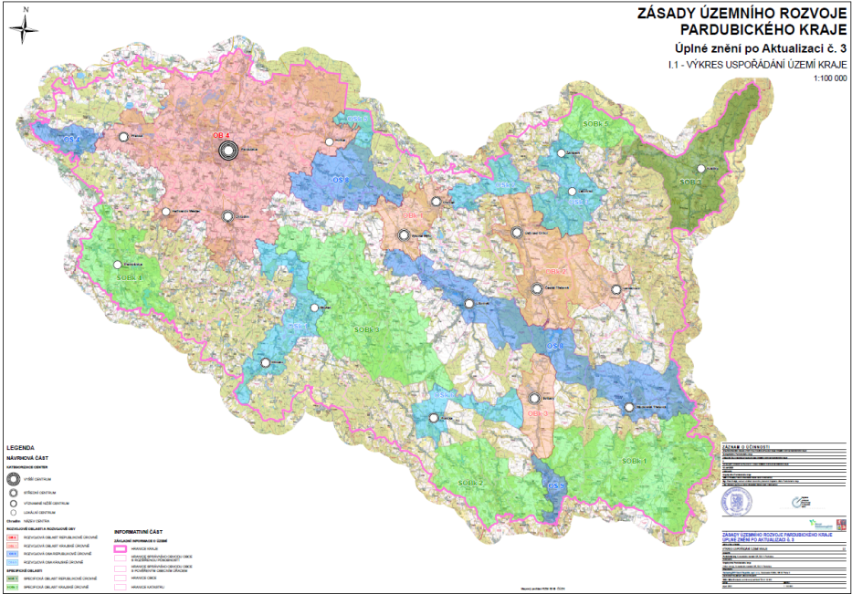
SEE YOU AFTER THE BREAK

