Slide 1



1
United Kingdom of Great Britain and Northern Ireland – Export Opportunities

Aleš OPATRNÝ
Economic diplomat
Embassy of the Czech Republic in London
Monday 15th April 2019

Slide 2

2
Outline
  British Economy
  Foreign Trade
  Industrial Strategy
  Business opportunities
  How to do business in the UK
  How can Embassy help
  Brexit


Slide 3
3
British Economy: in brief
  5th largest economy globally, 2nd in the EU
  9th largest industrial producer in the world
  9th in „Ease of doing business“ WB score (CZ: 35th…)
  GDP growth: 2018 - 1,4% HDP 2019 - 1,2% (estimate)
  Unemployment – only 3,9 % (lowest since 1975)
  Services form 80% of UK economy, industry 11%, construction 6%
  PMI in Q1 2019: 48,9% services, 55,1% manufacturing (stockpiling for brexit)


Slide 4
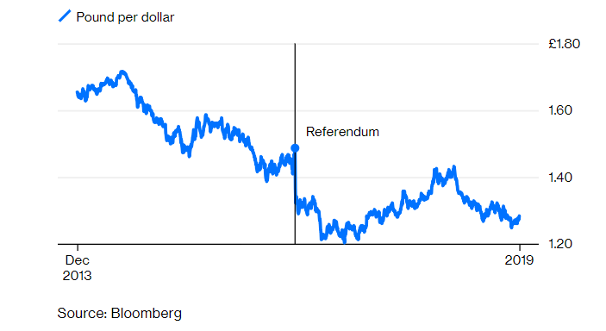
4
British Economy: Pound Exchange rate


Slide 5
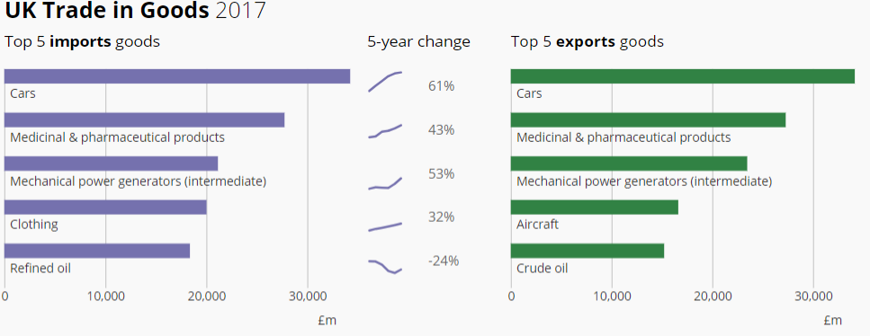
5
UK Trade with the EU
UK exports to the EU:
  54% of exports of goods
  39% of exports of services

Comparison:
  Exports to EU form 15% of UK GDP
  Exports to UK form only 5% of EU27 GDP
Notes:
Výrazný deficit
nicméně s ohledem na velikost vnitřního trhu je EU pro UK vzájemný volný obchod relativně důležitější, než pro EU – zatímco pro UK tvoří export do EU 15% domácího HDP, zbytek EU vděčí exportu do UK jen za 5% svého HDP.
USA nejdůležitější exportní země; obchodní přebytek UK

Slide 6
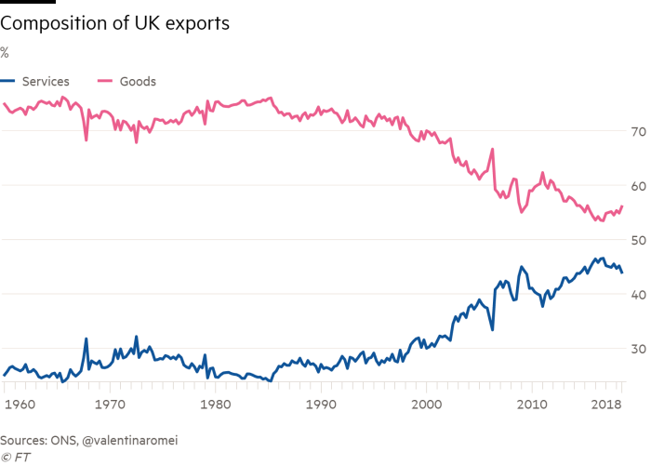
6
Changing structure of UK exports

Notes:
Výrazný deficit
nicméně s ohledem na velikost vnitřního trhu je EU pro UK vzájemný volný obchod relativně důležitější, než pro EU – zatímco pro UK tvoří export do EU 15% domácího HDP, zbytek EU vděčí exportu do UK jen za 5% svého HDP.
USA nejdůležitější exportní země; obchodní přebytek UK

Slide 7
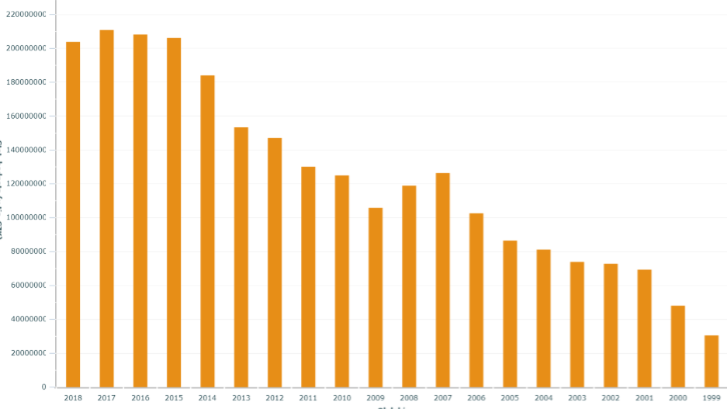
7
Bilateral trade CZ - UK
  UK is 5th most important export territory for Czech companies
  UK is 7th largest trade partner of the Czech Republic
  CZ among the top 20 importers to the UK
  CZ export to UK: 1999: 30 bil. CZK, 2018: 203 bil. CZK

Notes:
Výrazný deficit
nicméně s ohledem na velikost vnitřního trhu je EU pro UK vzájemný volný obchod relativně důležitější, než pro EU – zatímco pro UK tvoří export do EU 15% domácího HDP, zbytek EU vděčí exportu do UK jen za 5% svého HDP.
USA nejdůležitější exportní země; obchodní přebytek UK

Slide 8
8
CZ Exports to UK – TOP 10 Commodities
    Road vehicles 31 % (177 thousands car/year = 8,1% UK car imports)
    Office machinery and equipment for cars 9 %
    Electrical equipment and appliances 8 %
    Other products 7 %
    Equipment for telecommunications, sound 7,3 %
    Industrial machinery and equipment 5,7 %
    Power generating machinery and equipment 4,0 %
    Metal products 3,6 %
    Rubber products 2,1 %
    Iron and Steel 2,0 %

Notes:
Výrazný deficit
nicméně s ohledem na velikost vnitřního trhu je EU pro UK vzájemný volný obchod relativně důležitější, než pro EU – zatímco pro UK tvoří export do EU 15% domácího HDP, zbytek EU vděčí exportu do UK jen za 5% svého HDP.
USA nejdůležitější exportní země; obchodní přebytek UK

Slide 9


9
  Future business opportunities in the UK
UK Industrial Strategy - global future trends:
Artificial Intelligence and data
Ageing society
Clean growth
Future of mobility
Industry Sector Deals:
Aerospace
Artificial Intelligence
Automotive
Construction
Creative Industries
Life Sciences
Nuclear
Offshore wind
Rail


Slide 10

10
Export opportunities for Czech Companies in the UK

Notes:
Výrazný deficit
nicméně s ohledem na velikost vnitřního trhu je EU pro UK vzájemný volný obchod relativně důležitější, než pro EU – zatímco pro UK tvoří export do EU 15% domácího HDP, zbytek EU vděčí exportu do UK jen za 5% svého HDP.
USA nejdůležitější exportní země; obchodní přebytek UK

Slide 11

11
Export opportunities: Automotive
  Leading sector of British manufacturing and exports, 18 of 20 TOP carmakers in the UK
  Large share of components originating in the EU, only 41% British national content
  Risk: Brexit = decline in investments 50%, risk of 10% tax under WTO Framework
  City clean air zones (London, Cambridge, Birmingham, Leeds, Edinburgh, Glasgow…)
  Demand for:
    selfdriving technologies (57% UK carmakers develop)
    ultra low emission and electric cars technologies (64% UK carmakers develop)
    3D printing
    advanced materials
  Melrose Industries / GNK to invest 250 mil. GBP in electric cars parts production

Notes:
Výrazný deficit
nicméně s ohledem na velikost vnitřního trhu je EU pro UK vzájemný volný obchod relativně důležitější, než pro EU – zatímco pro UK tvoří export do EU 15% domácího HDP, zbytek EU vděčí exportu do UK jen za 5% svého HDP.
USA nejdůležitější exportní země; obchodní přebytek UK

Slide 12


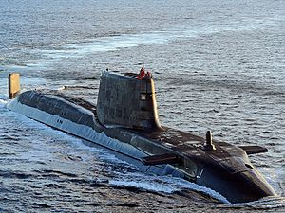
12
Export opportunities: Defence & Aerospace
  UK has the 2nd largest military budget in NATO
  Planned: new battleships and aircraft carrier, 4 nuclear submarines (31 billion pounds)
  Project Tempest - 6th Generation Fighter (BAE Systems, Rolls - Royce, Leonardo and MBDA)
  Civil Aviation - Airbus, Boeing, Bombardier and Rolls Royce, 90% of sector turnover is export
  Growing satellite technology sector - Britain has 7% market share globally
  In the next 5 years, global demand for orbiting will be up to 2600 small satellites (up to 50 kg)
  Plan to build the first UK vertical launch spaceport in the north of Scotland (Sutherland coast)
  Plan for 3 horizontal launch spaceports in Cornwall (Newquay airport from 2021, Virgin Orbit), Glasgow and Snowdonia, to launch satellites up to 500 kg (conventional aircraft)
  Demand for: steel structures, machine processed components, advanced materials, composites
  Poss.: decommissioning of nuclear submarines (future estimated costs: 7,5 bil GBP)

Notes:
Výrazný deficit
nicméně s ohledem na velikost vnitřního trhu je EU pro UK vzájemný volný obchod relativně důležitější, než pro EU – zatímco pro UK tvoří export do EU 15% domácího HDP, zbytek EU vděčí exportu do UK jen za 5% svého HDP.
USA nejdůležitější exportní země; obchodní přebytek UK

Slide 13
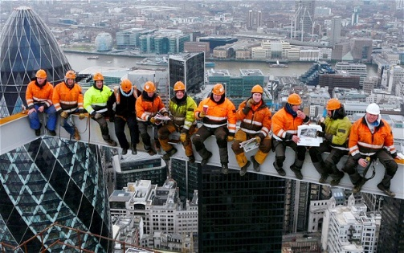
13
Export opportunities: Construction Industry
A new £ 23 billion fund for "innovation and infrastructure"
High Speed Rail (HS2) North England - 335 miles long high-speed corridor links London, Birmingham, Manchester, Sheffield and Leeds (by 2032)
Crossrail project in progress - modernization and completion of the railway in London
Missing 1 million apartments, the government's goal to build up to 2020
The government will release £ 44bn to build 300,000 home annually
Slowdown expected in commercial buildings sector, but in London 200 new skyscrapers planned
Planned expansion of Heathrow, Stanstead and Gatwick airports
Government will not open any new PPP projects (after Carillion, the 2nd largest construction company and service supplier to public sector went into liquidation in 2018)
Czech companies PPF, HB Reavis - Projects in London
SIPRAL

Notes:
Výrazný deficit
nicméně s ohledem na velikost vnitřního trhu je EU pro UK vzájemný volný obchod relativně důležitější, než pro EU – zatímco pro UK tvoří export do EU 15% domácího HDP, zbytek EU vděčí exportu do UK jen za 5% svého HDP.
USA nejdůležitější exportní země; obchodní přebytek UK

Slide 14
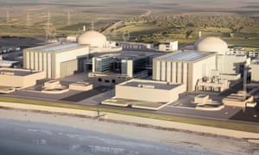
14
Sector opportunities: energy industry
25% of British power plants should be decommissioned in the next 10 years
all lignite power plants must be phased out by 2025
7 nuclear blocks to be phase out by 2030 = new opportunities in decommissioning (VHM)
Up to 6 nuclear sources were planned (Hinkley Point C, Sizewell, Oldbury, Bradwell, Moorside, Wylfa). 2019: 3 nuclear projects abandoned: Moorside (Toshiba), Wylfa and Oldbury (Hitachi)
Poss. Energy strategy update? Possible feed-in tariffs for pumped storage hydro power plants?
Renewables - wind, waves, water, biomass and sun = 7% of British electricity; the share is expected to increase to 20-25% by 2020; declining feed-in tariffs, sector already competitive
Extraction of oil and gas in the North Sea: recovery + decommissioning
Test drilling of shale gas (25-year)
Czech companies in the UK energy:
EPH - Langage and South Humber Bank, Lynemouth (+ Eggborough)
Sev.en Energy: 50% in InterGen (Natural Gas Power Plants: Rocksavage, Coryton, Spalding)
Hydro power plants (Hydropol, Cink, Hydrohrom), waste2energy (Hedviga), tidal (Wikov)

Notes:
Výrazný deficit
nicméně s ohledem na velikost vnitřního trhu je EU pro UK vzájemný volný obchod relativně důležitější, než pro EU – zatímco pro UK tvoří export do EU 15% domácího HDP, zbytek EU vděčí exportu do UK jen za 5% svého HDP.
USA nejdůležitější exportní země; obchodní přebytek UK

Slide 15
15
Export opportunities: other sectors
  Glass and ceramics industry - architectural projects for the world (Lasvit, Preciosa)
  ICT, artificial intelligence - UK most patents in Europe in the AI area after Germany
  Medical and Pharmaceutical Industry - 2nd most important export manufacturing sector Opportunities: sub-supplies of substances and components for the chemical, pharmaceutical and medical industries, including laboratory equipment, supplies of complete medical devices and equipment
  Agricultural and food industry - not only beer, but also malt (whiskey production), increasing consumption (and production) of wine in the UK

Notes:
Výrazný deficit
nicméně s ohledem na velikost vnitřního trhu je EU pro UK vzájemný volný obchod relativně důležitější, než pro EU – zatímco pro UK tvoří export do EU 15% domácího HDP, zbytek EU vděčí exportu do UK jen za 5% svého HDP.
USA nejdůležitější exportní země; obchodní přebytek UK

Slide 16

16
Specifics of doing business in the UK
  Relatively easy to set-up business, but…
  High operational costs – employees, office / business space hire, energies, business services
  „Business rates“ – special tax on the occupation of non-domestic property, expensive in cities
  High competion, to suceed it requires:
    Clear vision, „unique selling points“
    Excelllent presentation of company/products
    Excellent marketing materials, domain on „.co.uk“ or „.com“
    Establish local branch or find local partner / distributor / sales representative
    Detailed preparation for business meetings („time is money“), technical details
    Importance of a long-term approach, respect of British values of privacy and politeness
    References
    Price is important, „the business of Britain in business“
    Follow-up is a must
    Always look for a shared interests

Notes:
Výrazný deficit
nicméně s ohledem na velikost vnitřního trhu je EU pro UK vzájemný volný obchod relativně důležitější, než pro EU – zatímco pro UK tvoří export do EU 15% domácího HDP, zbytek EU vděčí exportu do UK jen za 5% svého HDP.
USA nejdůležitější exportní země; obchodní přebytek UK

Slide 17






17
Czech Economic Team in the UK

+ new office „in the North“ – Consulat General in Manchester since 2019

Slide 18







18
Czech Export events in the UK in 2019
Czech Official Pavilions:
Automechanika (Birmingham, 4.-6.6.)
DSEI (Londýn, 10.-13. 9.)
Economic Diplomacy Projects, CzechTrade, CzechInvest events:
Mise Embraer do ČR (Praha, Pardubice, Brno, Kunovice, 11.-15.2.)
Doing business in the Czech Republic (London, 14.5)
Czech Wine Day (London, 21.5.)
Central European Investment Forum (London, 12.6.)
Czech Beer Day (London, 19.6.)
CEE Start-ups Day (Londýn, 1.10.)
London Design Fair (19.-22.9.)
Advanced Engineering (Birmingham, 30.-31.10. )

Slide 19
19
Export opportunities: information sources
  Web page of the Embassy in London: https://www.mzv.cz/london/cz/obchod_a_ekonomika/index.html
  Business opportunities, list of export events in the UK: https://www.businessinfo.cz/cs/zahranicni-obchod-eu/teritorialni-informace-zeme/velka-britanie.html
  List of the most important business fairs in the UK:
https://www.mzv.cz/london/cz/obchod_a_ekonomika/zpravodajstvi/vyznamne_mezinarodni_veletrhy_v_uk.html
Database of governmental tenders:
https://www.gov.uk/contracts-finder
Tenders in the defence & Security area:
https://www.contracts.mod.uk/

Notes:
Výrazný deficit
nicméně s ohledem na velikost vnitřního trhu je EU pro UK vzájemný volný obchod relativně důležitější, než pro EU – zatímco pro UK tvoří export do EU 15% domácího HDP, zbytek EU vděčí exportu do UK jen za 5% svého HDP.
USA nejdůležitější exportní země; obchodní přebytek UK

Slide 20

20


Slide 21
21
  BREXIT
  Current state of play:
  The EU and UK have agreed a further delay to Brexit until 31 October, at the latest.
  The UK could leave earlier if a withdrawal agreement has been ratified by MPs.
  UK must vote in the European Parliament elections on 23 May - if it did not the UK would have to leave the EU on 1 June without a deal.
  UK Governement now talks to opposition regarding non-legally binding political declaration which sets out parameters for the long-term future relationship.
  Next possible scenarios:
  UK leaves the EU with the „withrawal agreement“
  UK leaves the EU with „No deal“
  Other options: another referendum, renegotiation of withdrawal agreement (EU refuses), general elections in the UK, No Brexit (UK gov. Revokes Arcitle 50),


Slide 22
22
  Option 1/ No-deal Brexit
  Politicaly:
  Default Brexit option – happens on:
    1st June 2019 – if the UK does not take part in the European elections on 23 May
    31st October 2019 – if the Westminster Parliament can't reach any agreement
  Trade aspects:
  UK becomes 3rd country to the EU
  Customs declarations will be needed on UK-EU trade (MRN or an EORI number)
  UK temporary tariff regime – NO import tariffs on majority (87%) of goods, except 25 cathegories (cars, aluminium, meat, textiles, etc. full list here) for up to 12 months.
  Harmonised standards: UK will continue to recognise conformity assessment by EU notified bodies, goods meeting EU CE marking can still be sold in the UK
  Cars – type aprovals: manufacturers with valid EC type-approval will NOT need to do duplicate testing in the UK (VCA), but will need to prove compliance to VCA


Slide 23
23
  No-deal Brexit – guidance & info
  Czech Governement: https://www.brexitinfo.cz/
  Guidance for Czech businesses: https://www.businessinfo.cz/cs/clanky/special-brexit-ocima-exporteru-119098.html#!&chapter=1
  Guidance for Czech citizens in the UK: https://www.mzv.cz/london/cz/konzularni_a_vizove_informace/brexit/index.html
  European Commission: https://ec.europa.eu/info/brexit/brexit-preparedness_en
  UK Governement: www.Gov.uk/euexit
  UK Gov. Preparadnes notices – no deal: https://www.gov.uk/government/collections/how-to-prepare-if-the-uk-leaves-the-eu-with-no-deal
  Detailed presentations of UK governement on border procedures:
  https://www.businessinfo.cz/app/content/files/dokumenty/industry-day-prezentace-1.pdf, https://www.businessinfo.cz/app/content/files/dokumenty/industry-day-prezentace-2.pdf
  Inquiries on UK border procedures: queriesattheborder.fr@hmrc.gsi.gov.uk


Slide 24
24
  Option 2/ Brexit with withrawal agreement
  Politicaly:
  If the Westminster Parliament ratifies the negotiated „withrawal agreement“, UK leaves the EU at the beginning of the following month.
  Transition period starts, which will last till the end of 2020.
  In the meanwhile, UK and the EU will negotiate new comprehensive trade agreement.
  Trade aspects:
  During the transition period, trade continues under current terms.


Slide 25
25

  Thank you for your attention
  ales_opatrny@mzv.cz

