Slide 1



Institute for Nanomaterials, Advanced Technologies and Innovation - CxI
Adam Blazek
Director of Industry Relations
… where NANOSPIDERTM was born …
Studentská 1402/2 | 461 17 Liberec 1 | tel.: +420 485 353 006 | cxi.tul.cz

Slide 2
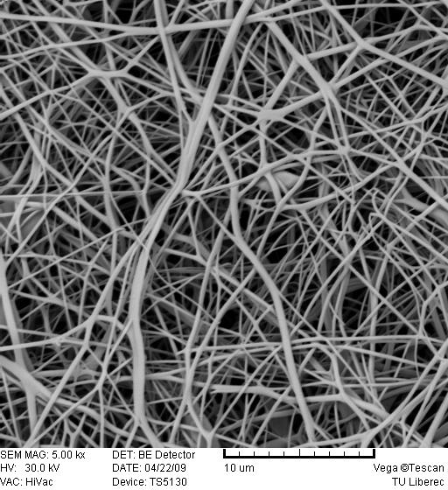
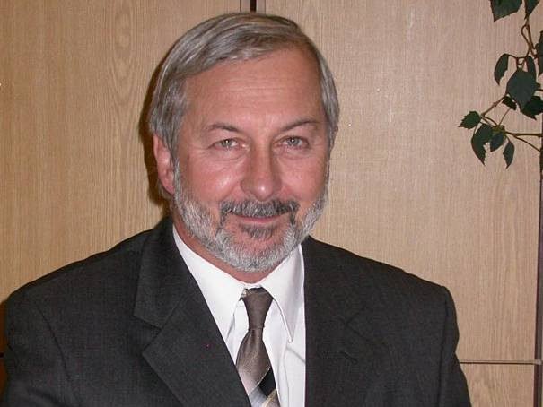
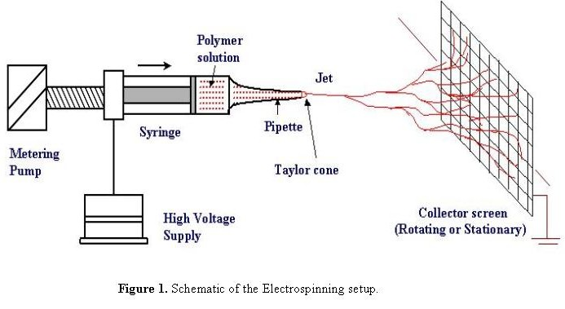
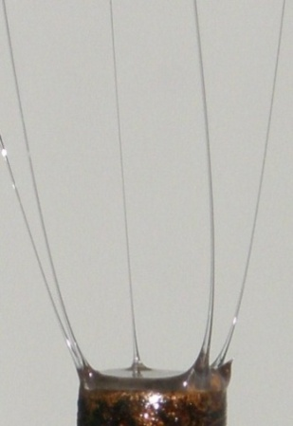
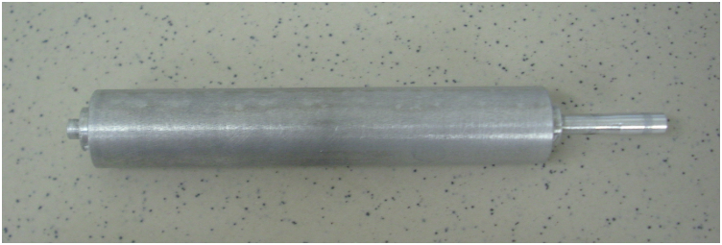
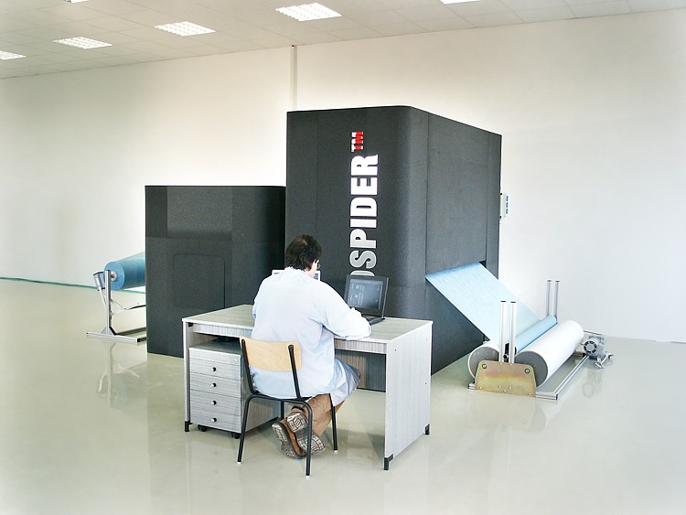
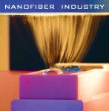
Short history of nano-oriented research at TUL
2000: First experiments with electrospinning
2004: world-wide patent → Elmarco
2015: AC electrospinning
→
→
→
→
→

Slide 3
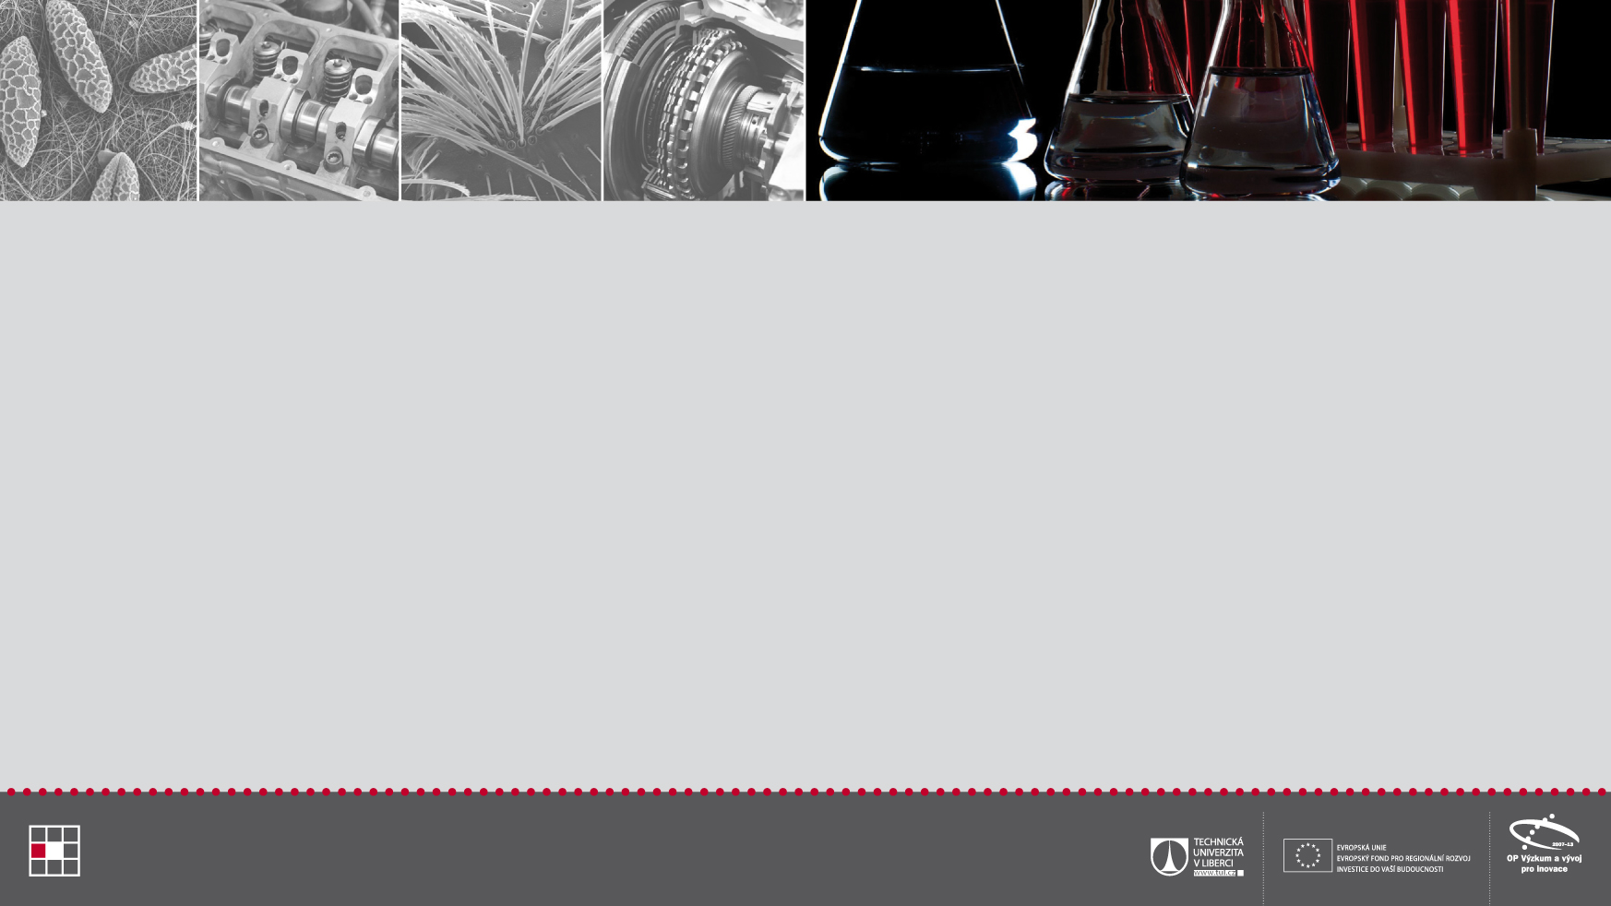
Genesis and history of CxI
The CxI Center
  Nanofibre production → nanoresearch at TUL
  was established in 2009 and financed from European fund for regional development (ERDF) and a state budget of the Czech Republic through Operational program: Research and Development for innovation (VaVpl) (till 2013)
  focuses on preparation and application of new materials, mainly nanomaterials and advanced industrial designs and technologies
  nowadays in the sustainability phase (till 2018)
Institute for Nanomaterials, Advanced Technologies and Innovation

Slide 4

Laboratories and Departments – see booklet
Department of Nanostructure
Preparation and Analysis
20 laboratories
Department of Machinery Construction
Department of Physical
Measurements
Department of Vehicles and Engines
Department of Nanomaterials
in Natural Science
Department of
Industrial Technology
Department of Nanotechnology
and Informatics
Department of Robotic Systems
And Mechatronic Systems
Laboratory of Metamaterials
Institute for Nanomaterials, Advanced Technologies and Innovation

Slide 5
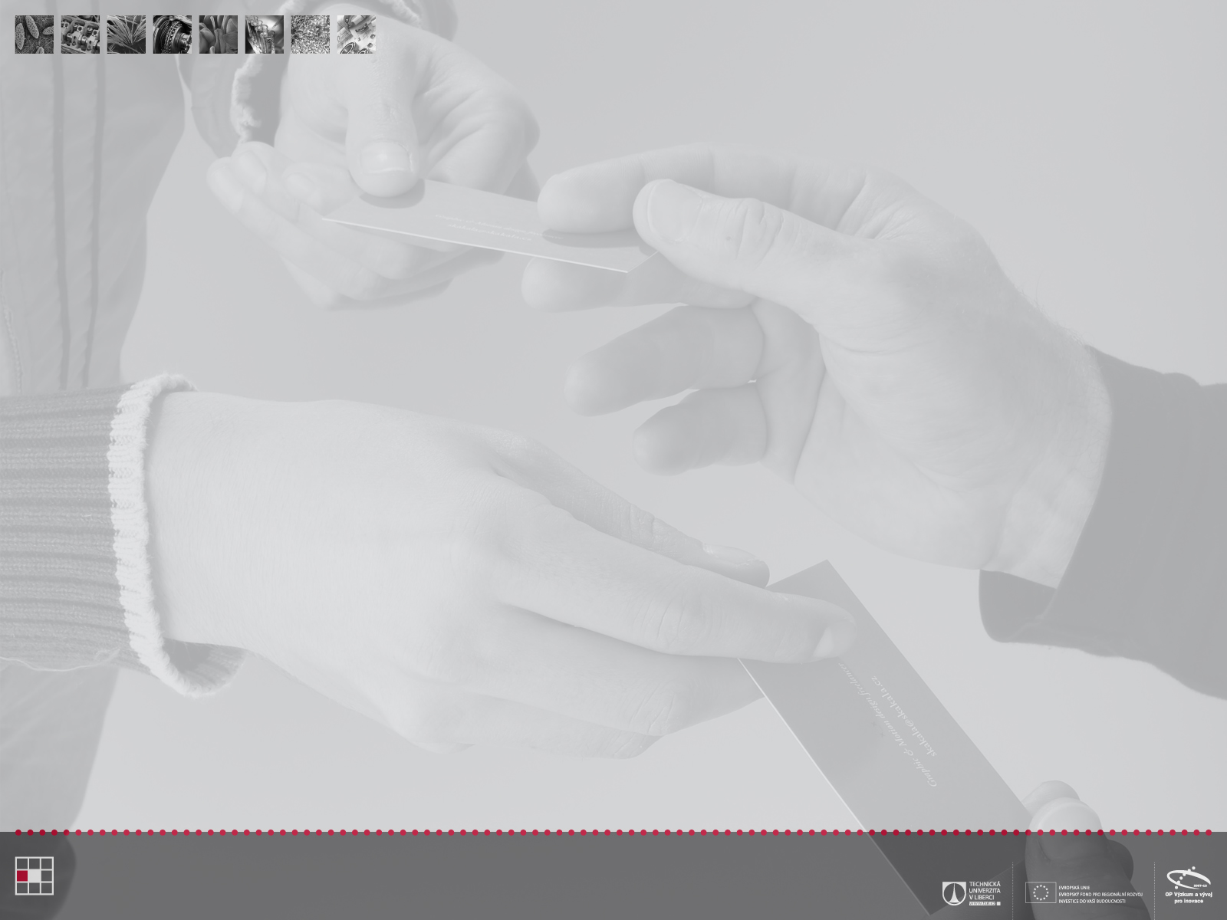
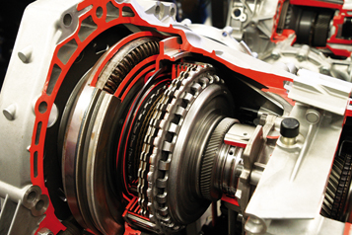
Types of cooperation
Individual short-term contracts
Long-term collaboration
(framework agreement, collaboration agreement, NDA)
– series of subsequent contracts
Applied research
and development
Exclusive relations
Partnership within grant
projects
Association
(„consortium“, „active network“)
Non-exclusive
relations
Basic / searching
research
Institute for Nanomaterials, Advanced Technologies and Innovation

Slide 6




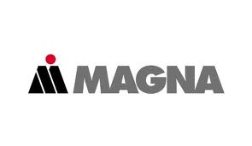


Contractual Research
Institute for Nanomaterials, Advanced Technologies and Innovation

Slide 7
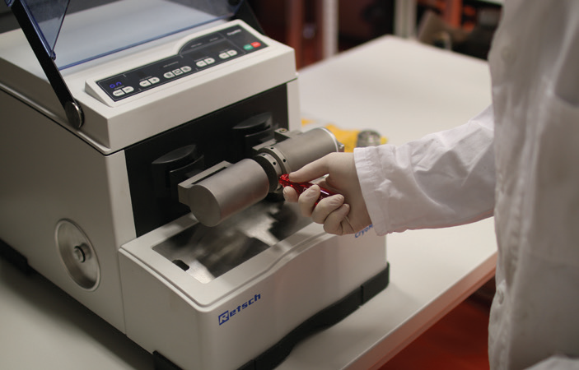
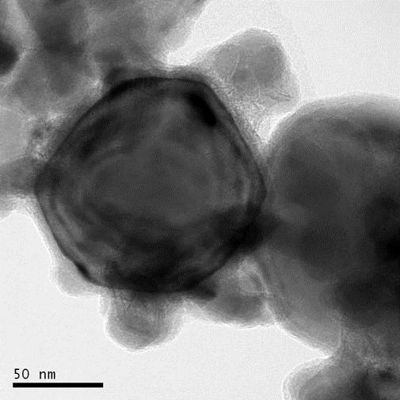
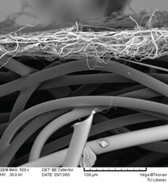
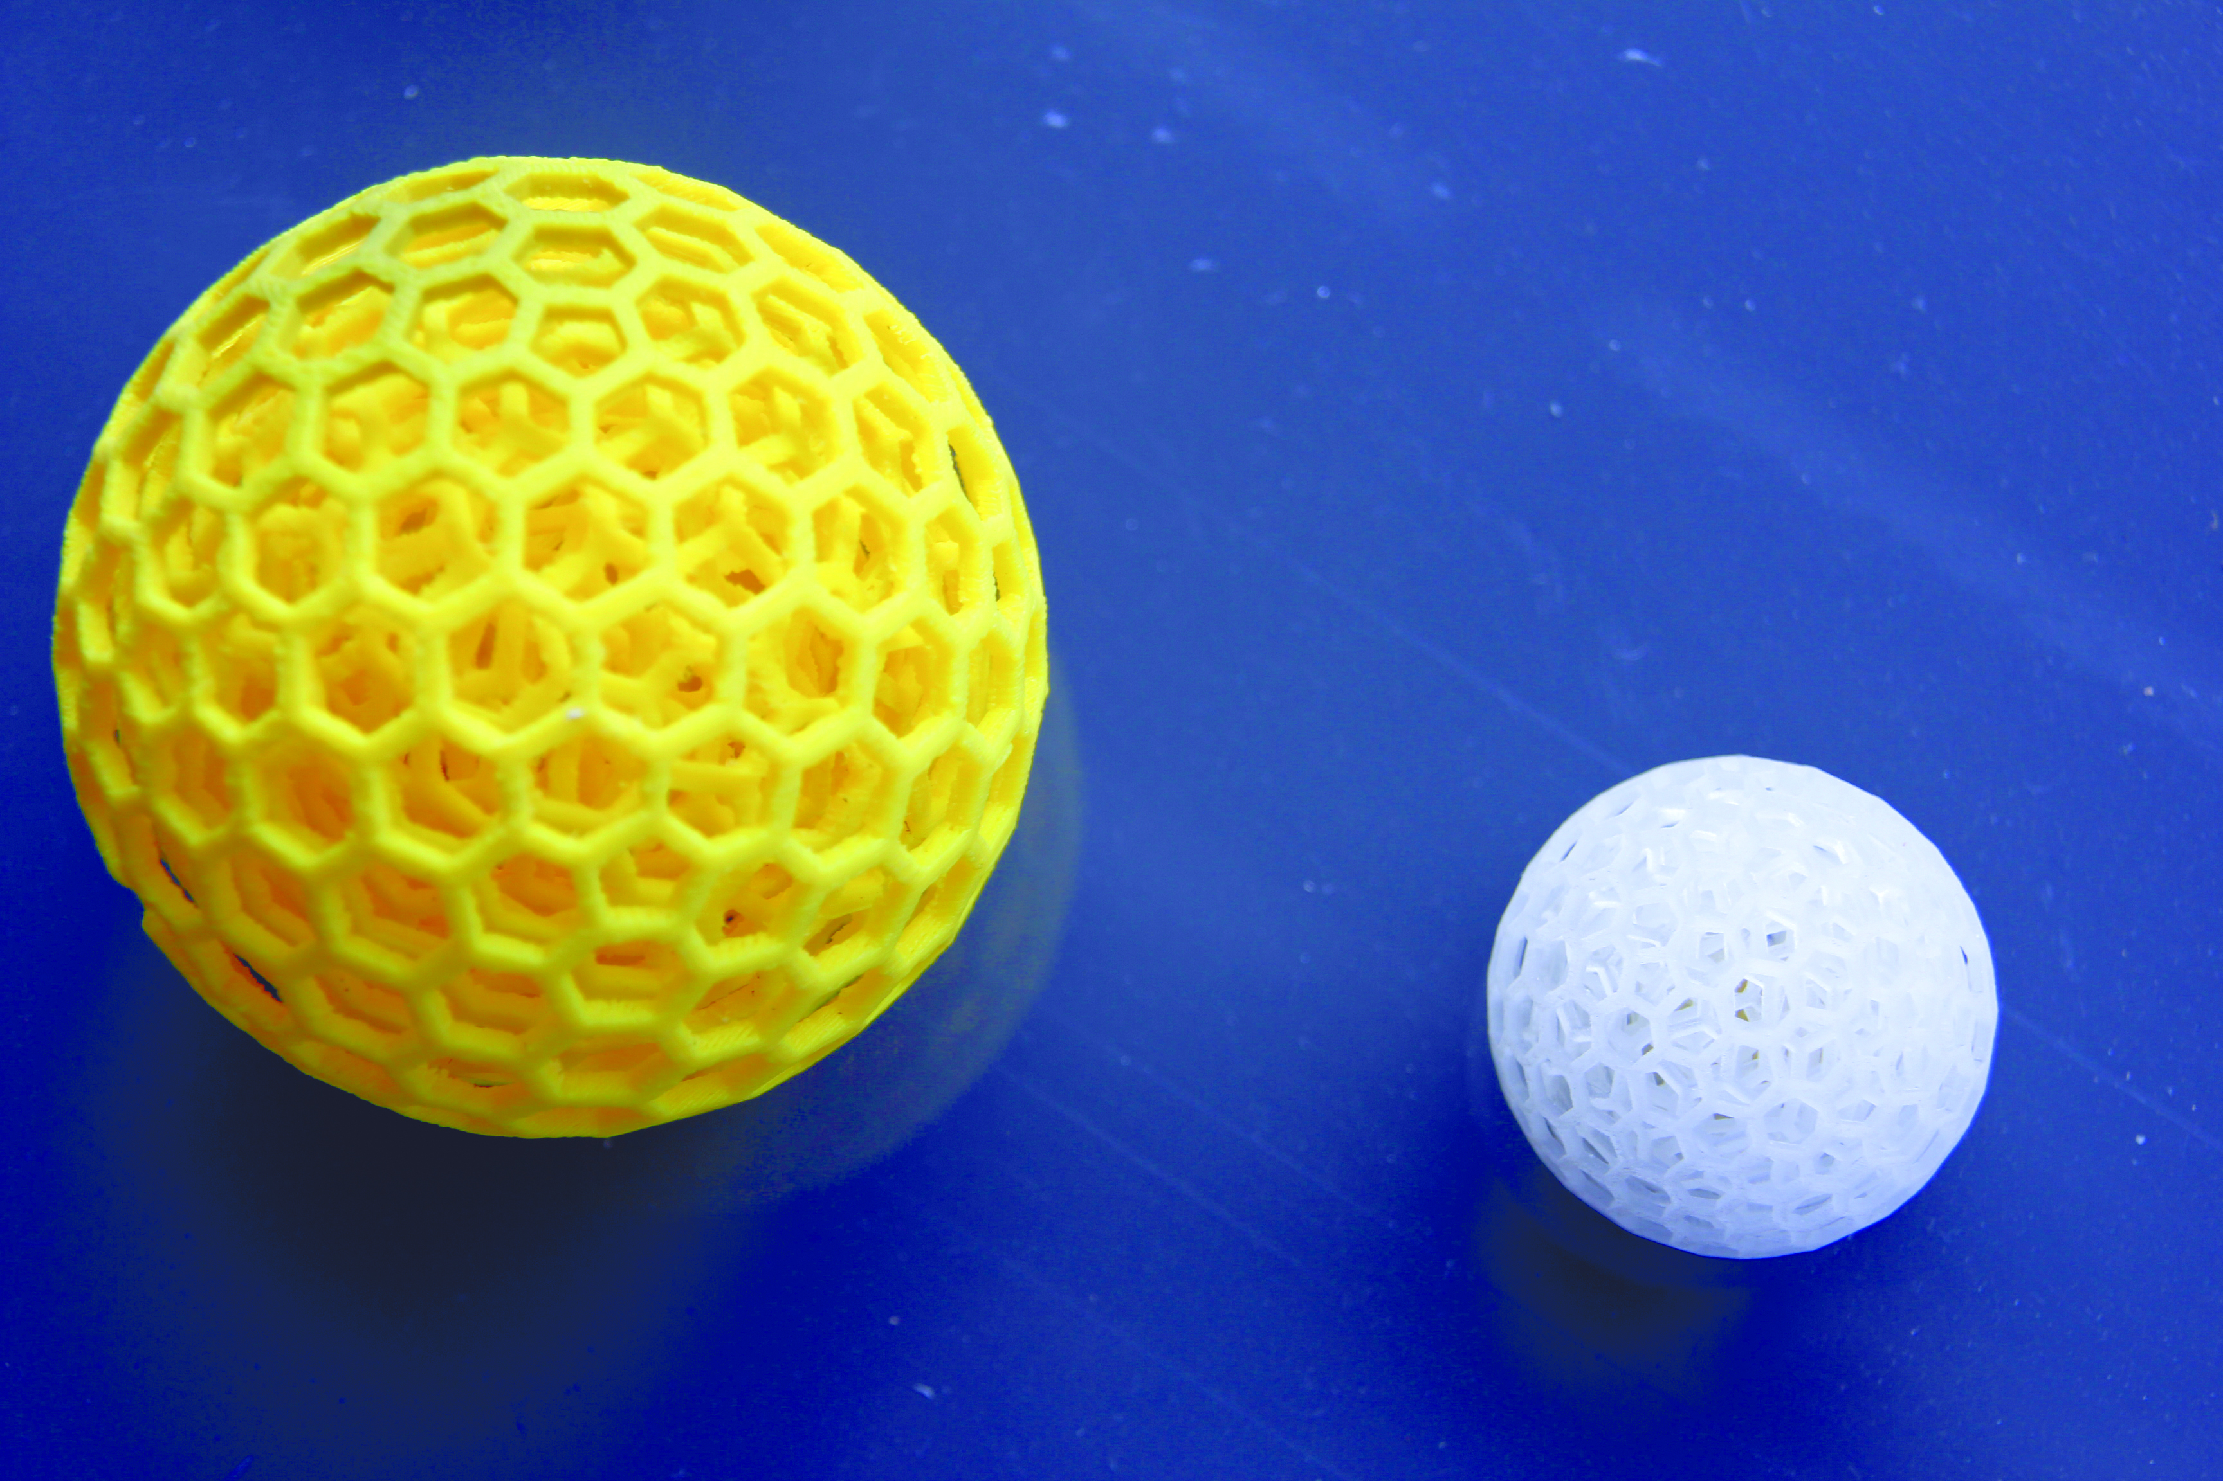
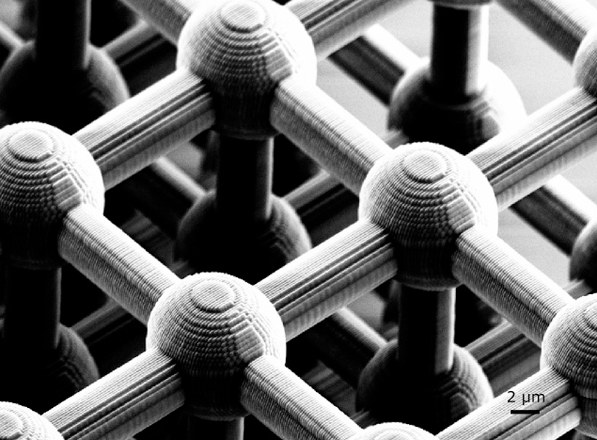
Departments in nano-oriented research
Preparation and analysis of nanostructures - nanolayers, nanocomposites (e.g. PIKATEC).
Nanomaterials in natural science – remediation, nano Fe, risk of nanomaterials.
Nanotechnologies and Informatics - nanofibrous applications, tissue engineering
New Laboratory of metamaterials - multiscaled structure-tuned materials
Institute for Nanomaterials, Advanced technologies and Innovation

Slide 8
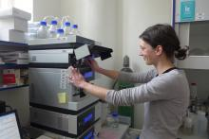
Nanomaterials in natural science
Chemical Remediation Processes
Development of new methods for remediation of contaminated groundwater, surface water, wastewater and industrial water based on chemical action on selected contaminants.
  Application of new methods for water treatment and remediation, the application of nanomaterials in remediation technologies and study of the potential hazards of nanomaterials.
  Research of zero-valent nanoiron improvement, combined oxidation, reduction and biological remediation methods and materials for transmission of electrical energy and heat in geological structures.
Project Nanomaterials for water remediation
(cooperation of TUL, Aquatest, Institute for Soil Science, Chinese Academy of Science, Jiangsu DDBS Environmental Remediation Co.,Ltd.)
The main objective of the project is to develop and put into practice new materials and processes for water remediation. Two main activities will be implemented.
Water treatment using nano/micro iron particles (reductive and oxidative mechanisms). Synergic effect of cleaning biological processes using surface modification by biological activator will be implemented.
Water treatment using membranes and nanomaterial filters with biocidal modification. This applied research and optimization to the specific conditions will lead to a significant cost reduction in remediation methods.
Institute for Nanomaterials, Advanced technologies and Innovation
Notes:
We are looking for industrial partners as well as research organisations to joint projects in area of water remediation.

Slide 9
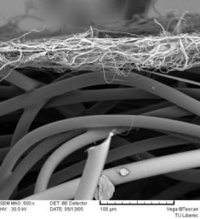
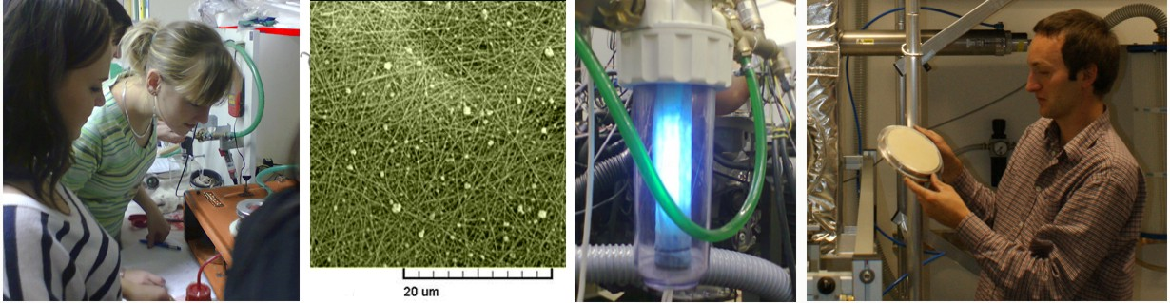
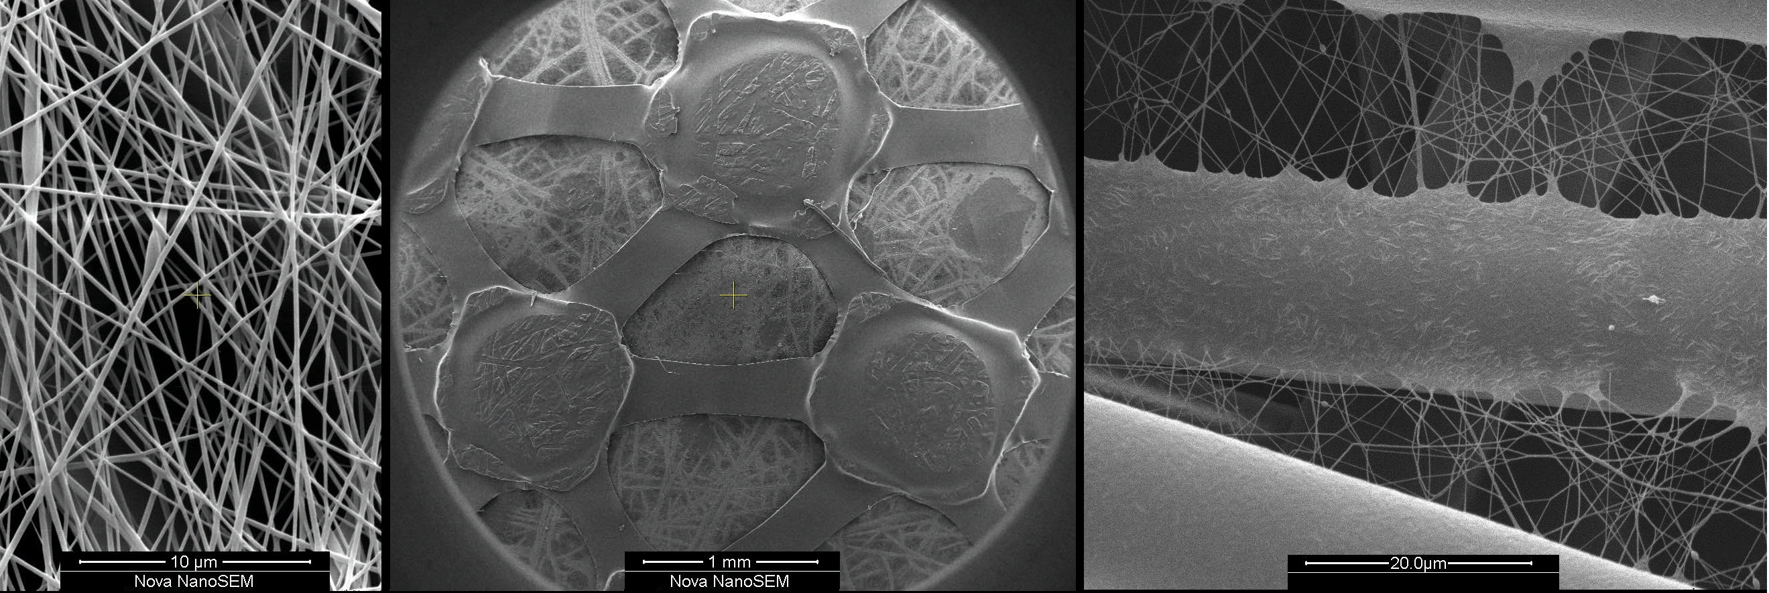
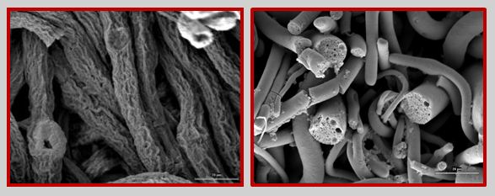
Nanotechnology and Informatics
Nanomaterial Applications
Acoustics
Construction (panels, foam, wool, fleece, fasteners), Engineering (soundproofing material of fridges, washing machines)
Automotive (noise and vibration control of cabs and engines), Phonics (soundproofing of halls, rooms, headphones, speakers)
Functional decoration (paintings, carpets, wall decorations)
Filtration
Filtration of hot combustion products - elimination of solid polluting substances and
Filtration of atmospheric air - dust filtration and elimination of hazardous gasses and microorganisms
Filtration of liquids - elimination of specific substances from drinking or industrial water
Membranes
Sterile Filtration Membranes
Breathable & Hydrophobic Membranes
Nanofibre Adhesion
- used in pharmaceutical, food and special chemistry industry
Biodegradable Materials
Filtration Materials
Hygiene Materials
Tissue Engineering Materials
Institute for Nanomaterials, Advanced technologies and Innovation

Slide 10
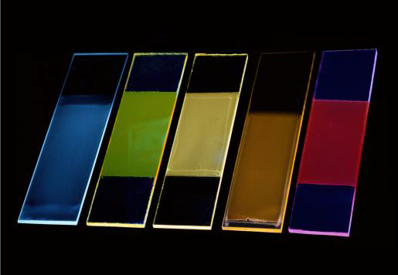
Why CxI is ready for
nano-oriented industry
Centre is established and in full operation (all criteria satisfied)
Relevant research team
Balanced budget – sustainable state
Well-defined research areas, international relevance
International cooperation established (11 projects)
Intensive cooperation with industry (190 contracts, over 1,5 mil €)
New multifunctional nanoparticles
Member of European Research platforms - MERGE
|Institute for nanomaterials, Advanced technologies and Innovation

Slide 11

Studentská 1402/2 | 461 17 Liberec 1 | tel.: +420 485 353 006 | e-mail: cxi@tul.cz cxi.tul.cz
Research on the Top
Institute for Nanomaterials, Advanced technologies and Innovation

