Slide 1





CZECH NANO DAY
LONDON
June 12th 2017
Jan Buk _ COO Pardam s.r.o.

Slide 2

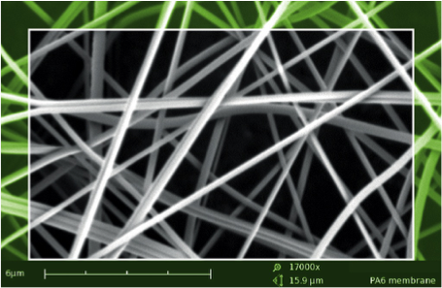
PARDAM – what do we do??
NANOFIBERS
MADE BY PARDAM
ELECTROSPINNING
CENTRIFUGAL SPINNING
SOLUTION SPINNING
R&D
&
small production of ~ 100nm fibers
O N L Y
SOLUTION
SPINNING
Fibers ~ 250-800nm
MELT
SPINNING
Fibers ~ 250-800nm
PRODUCTION
DEVELOPMENT
OTHER SERVICES
CUSTOM MADE - INORGANIC NANOFIBERS
XRD
CUSTOM MADE - POLYMERIC NANOFIBERS
SEM
CONTRACTUAL
PRODUCTION
PRODUCTS &
APPLICATIONS
BET
TECHNOLOGY
RESEARCH STUDIES

Slide 3

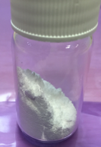
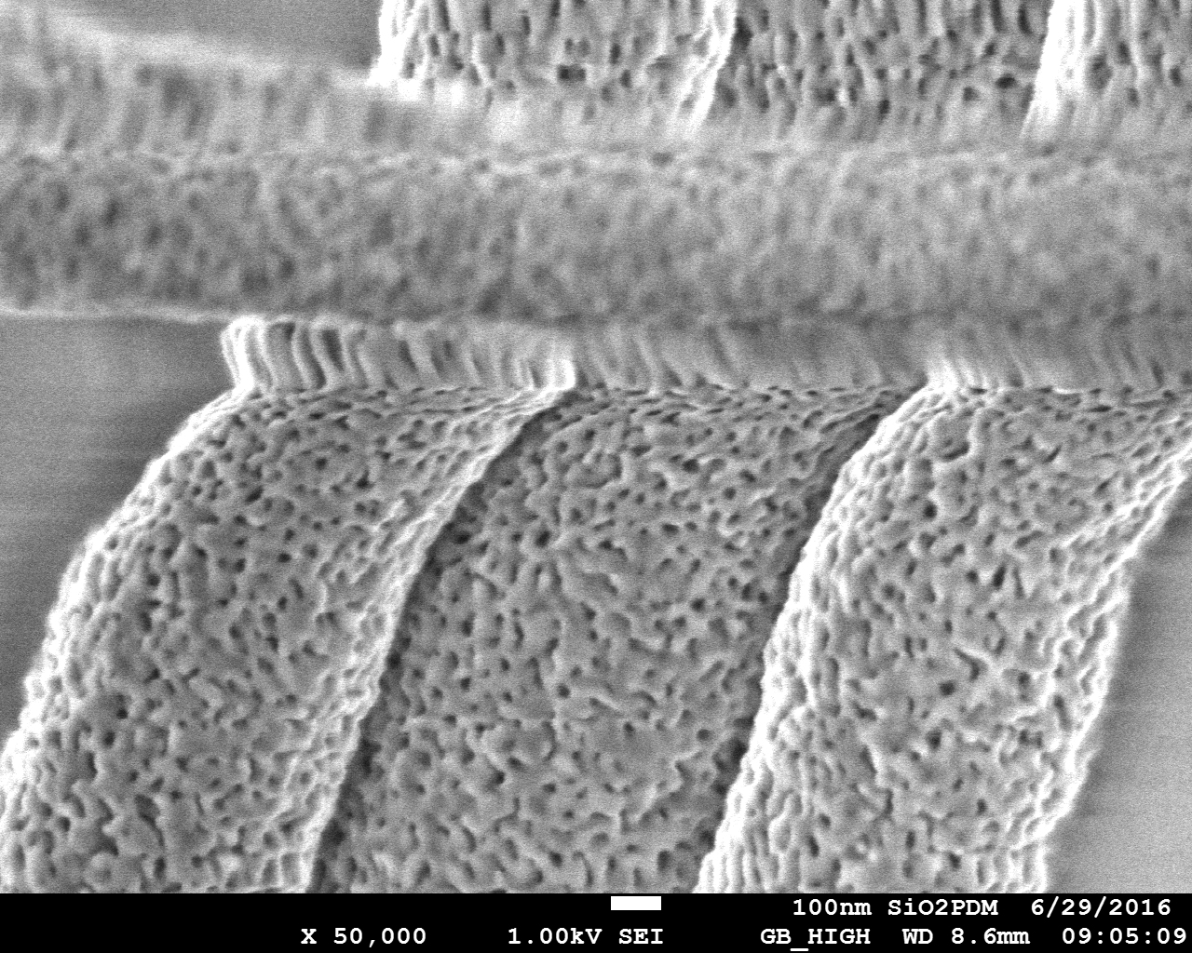

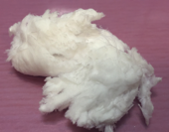


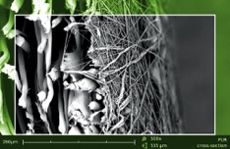
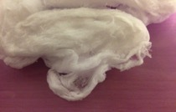
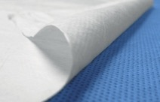
SERVICES _ Production _ Centrifugal Spinning Technology
Development and Industrial production of Inorganic nanofibers (powders and 3D structures)
TiO₂, SiO₂, ZrO₂, CeZrO₂, LTO, BTO, SBTO, Al₂O₃,, …
Catalyst / Filtration
Energy storage
Sorbents / Dehumidifiers
Composites
………….
Development and Industrial production of Polymer nanofibers - membranes and 3D structures
PA6, PUR, PVB, PCL, PAN, PVDF, PVA, special polymers…
Air / Liquid filtration
Sorbents
Wounds/Scaffolds
Composites
……………..

Slide 4
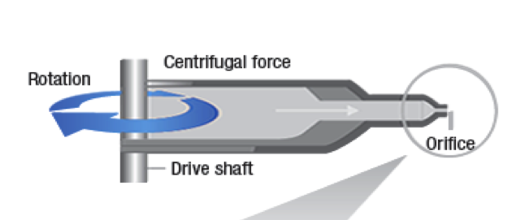
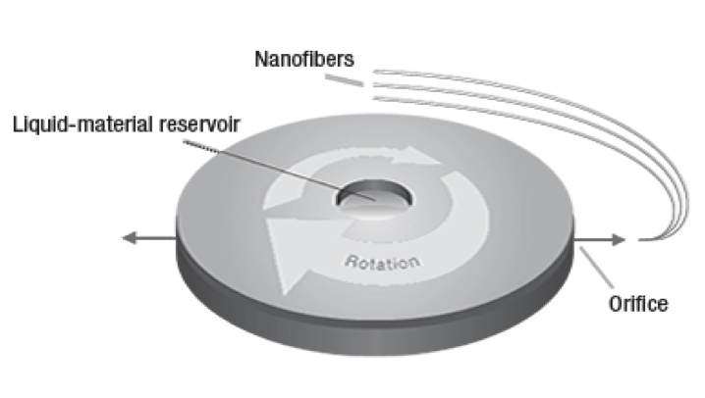
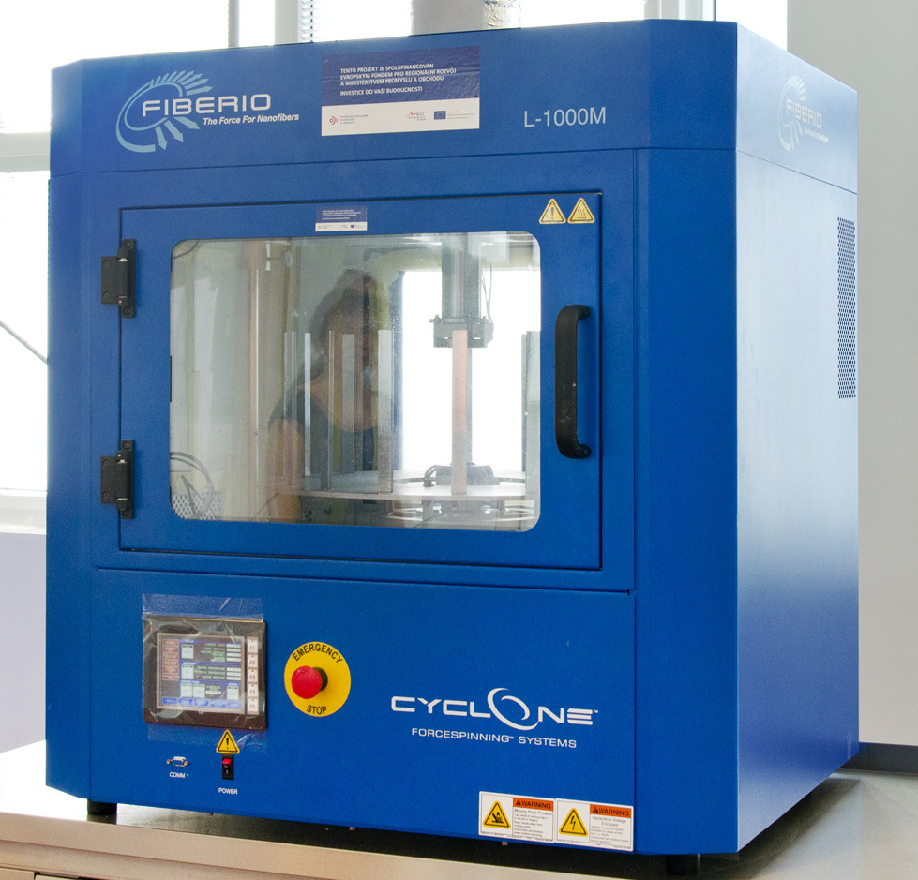
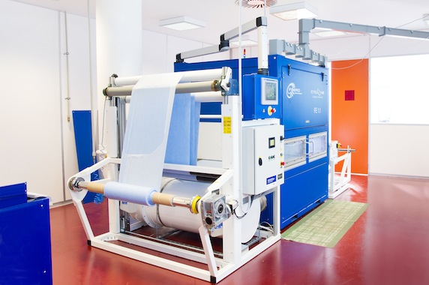
Centrifugal forces spinning technology

Slide 5
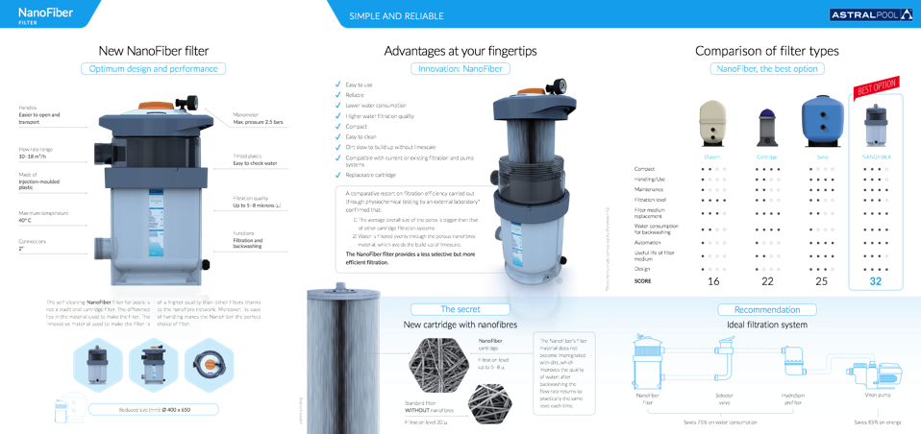
NnF MBRANE for SWIMMING POOL WATER PURIFICATION
New generation of Nanofiber swimming pool filters available on the market in April 2016
PARDAM in cooperation with LEITAT and SACOPA developed and successfully up scaled
the production of nanofibrous materials for this unique and new designed filter

Slide 6
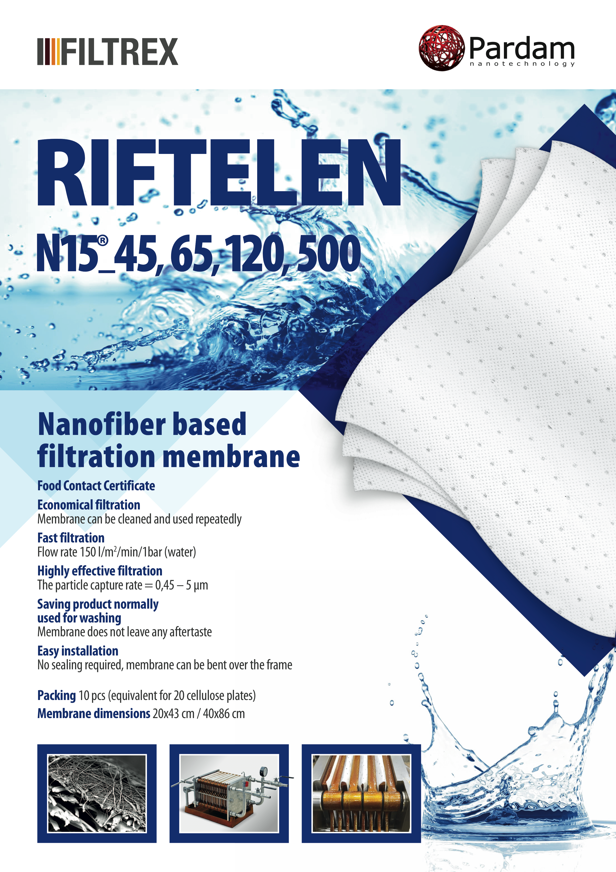
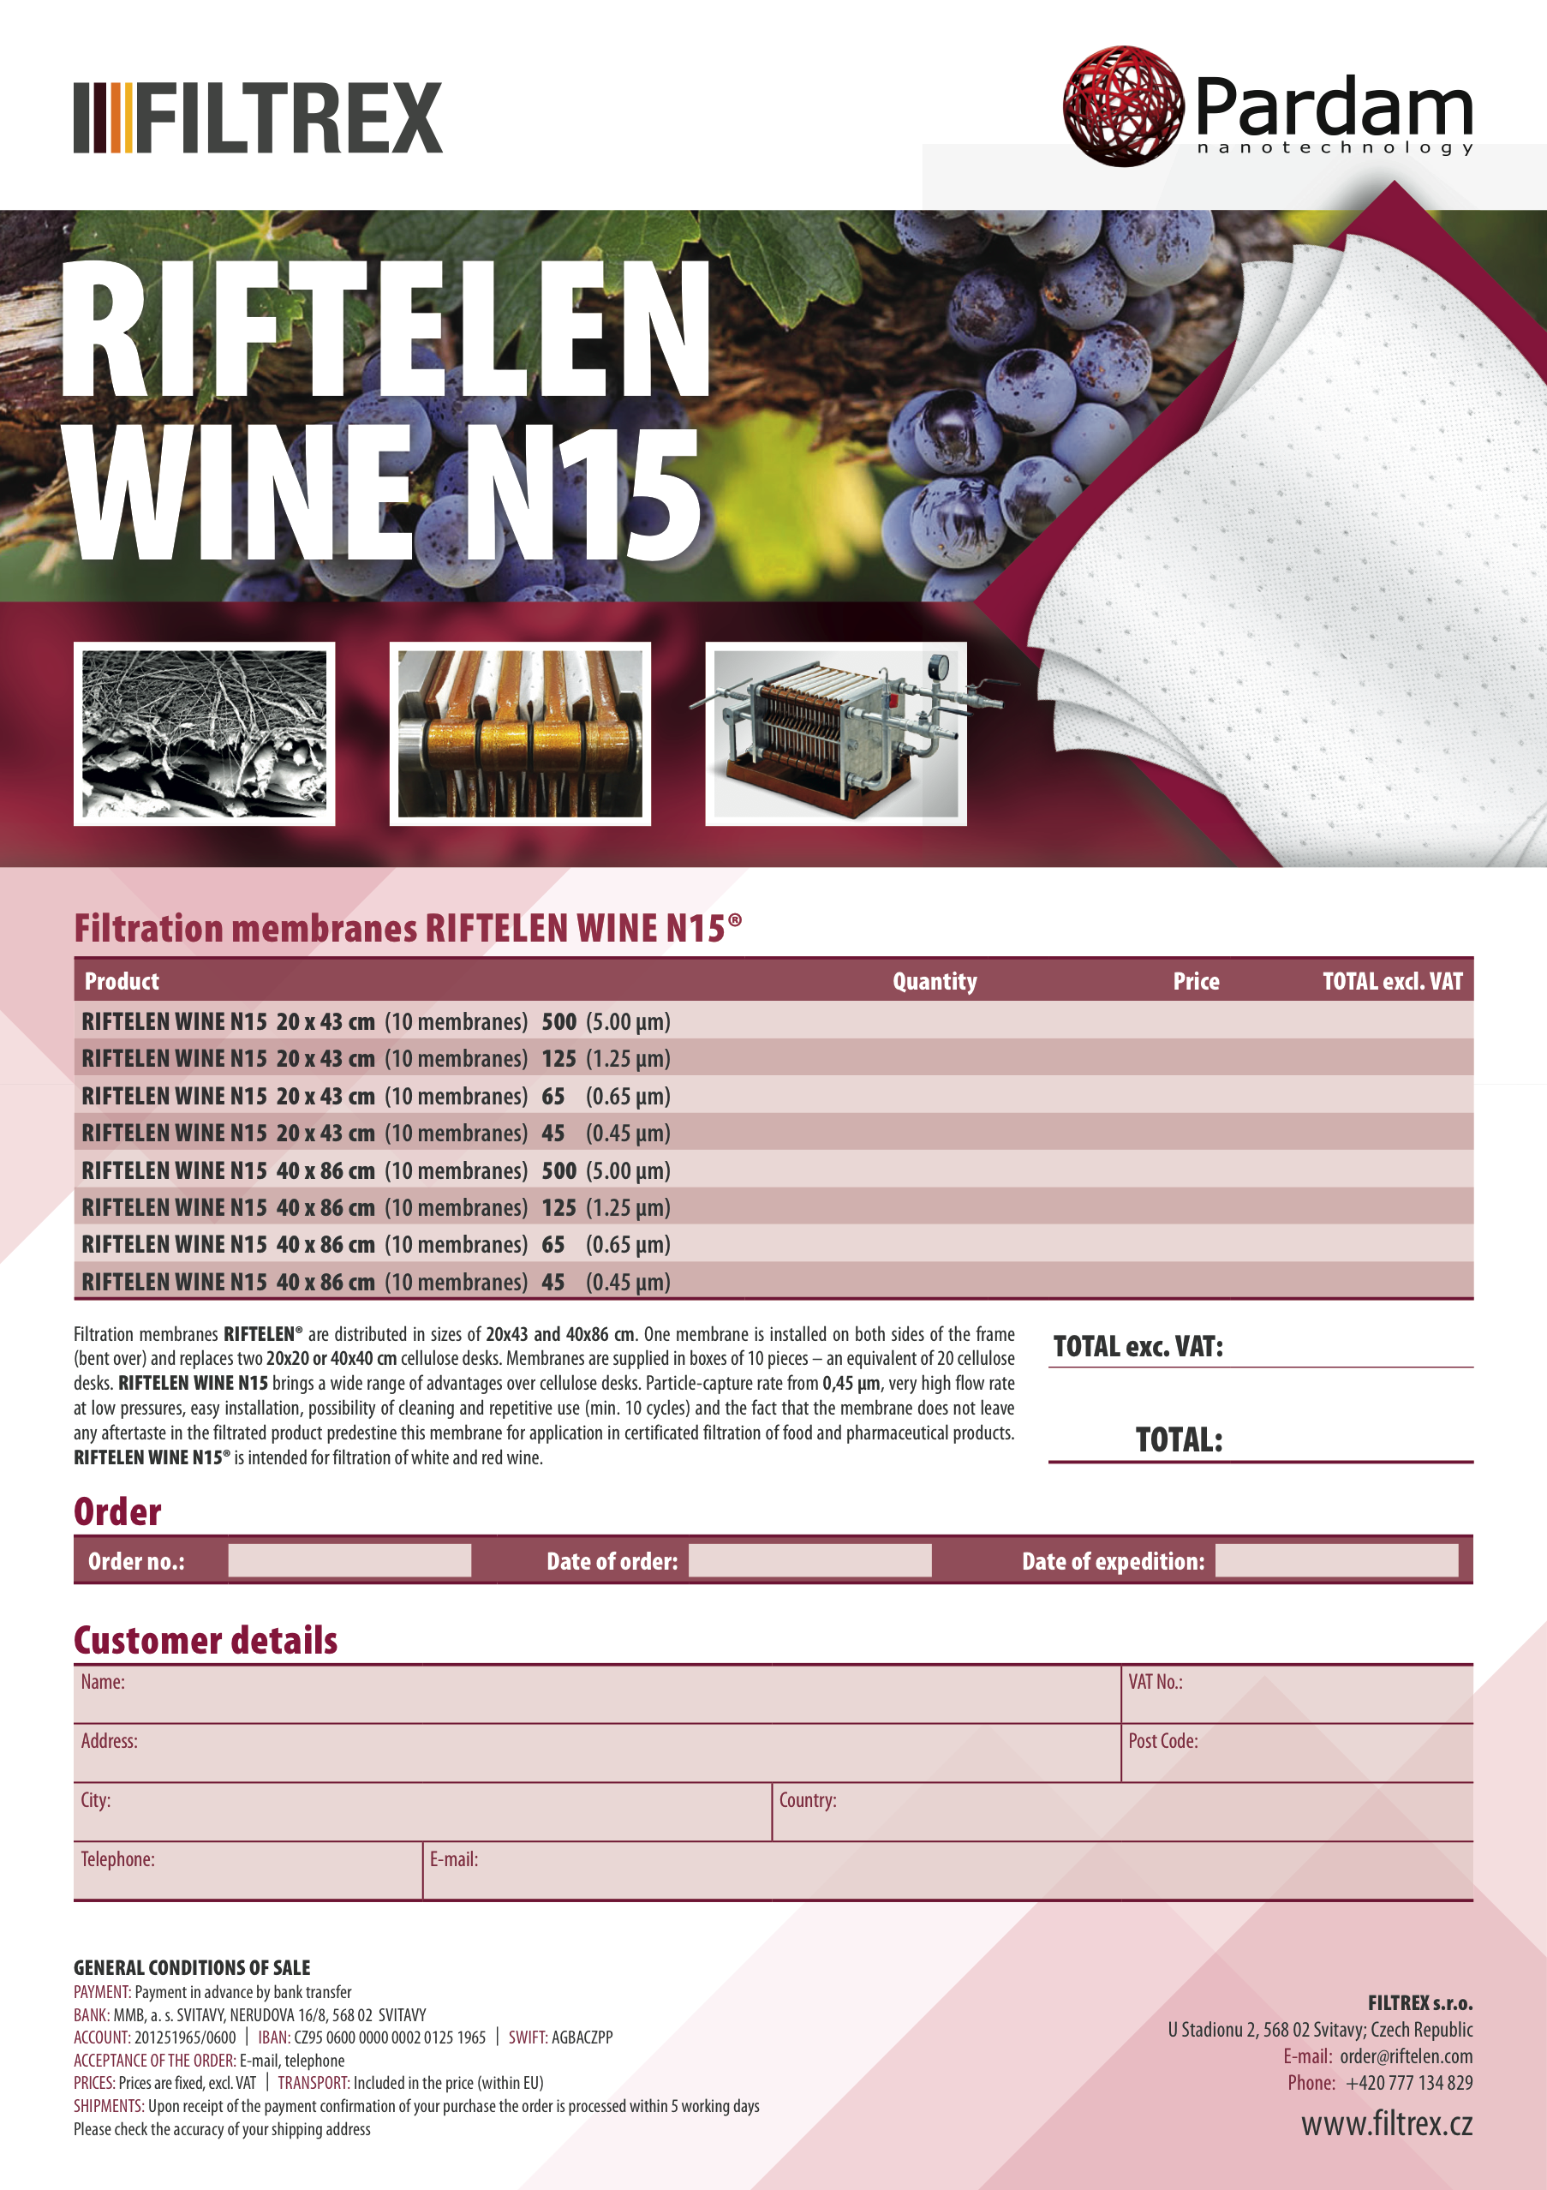
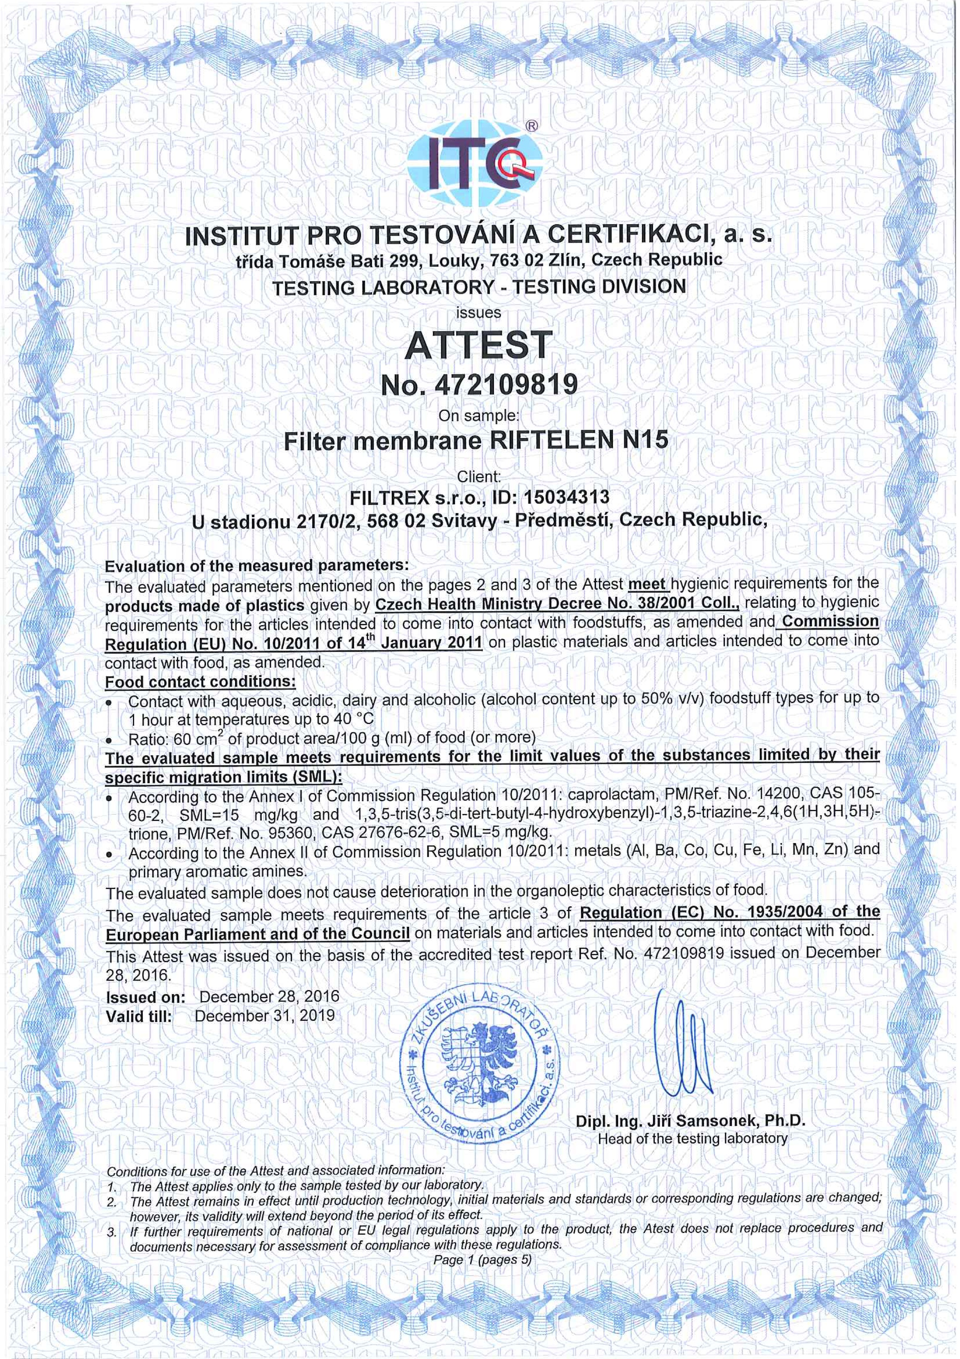
NnF MBRANE for FOOD PRODUCT PURIFICATION (protected by utility model)
VIDEOS: https://www.youtube.com/channel/UC0BFWhl6FrebfZI5AICEPxQ

Slide 7

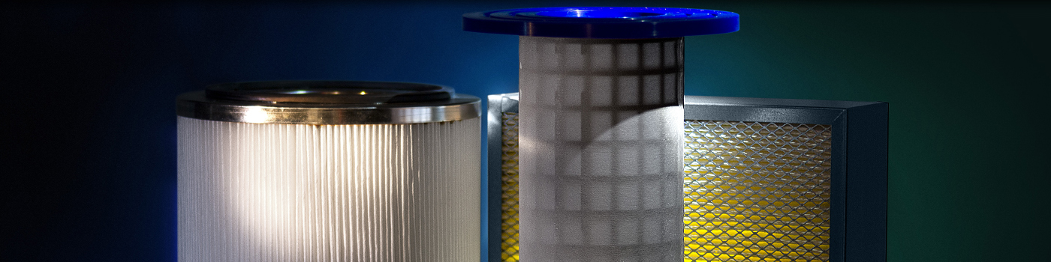
NnF MBRANE for anti micro bacterial – AIR PURIFICATION
Antibacterial (_{up to} H13) HEPA filters for chirurgical rooms and hospitals
Antibacterial RESPIRATORS
Replacing Glass fiber HEPA FILTERS
Lower pressure drop
Antibacterial surface – killing collected bacteria (no need of additional disinfection)
Possible to dope with aromatic essences for improving the air environment
Tailored design and filter construction
Combination with active coal textile – to add anti odour function

Slide 8
More information on our
Materials, Services and Products
can be found at our web
www.pardam.cz
Please feel free to contact us
for farther information
because
WE MAKE NANOFIBERS!
Head Office:
Jahnova 8
530 02 Pardubice
Czech Republic
Production Facility:
Žižkova 2494
413 01 Roudnice nad Labem
Czech Republic
info@pardam.cz

