Slide 1
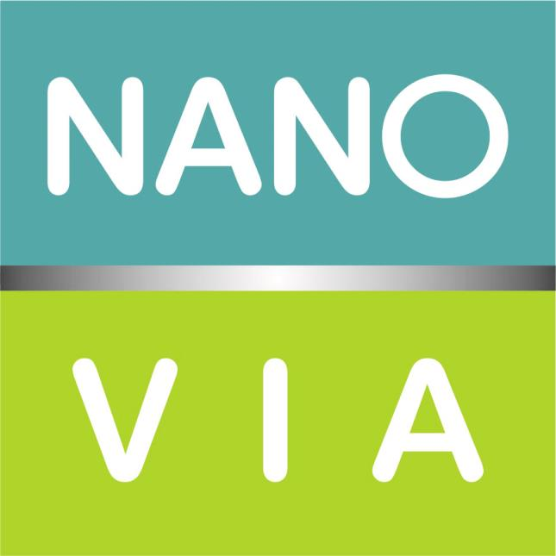
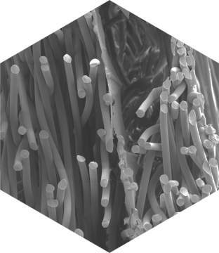
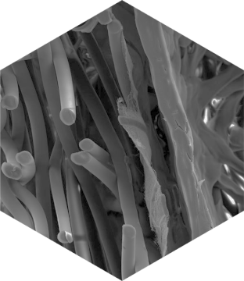
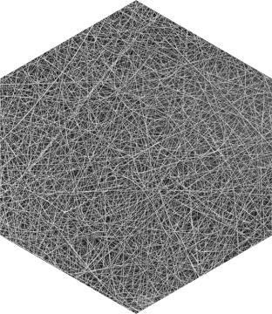
The world of nanofibers PRODUCT AND SERVICE

Slide 2
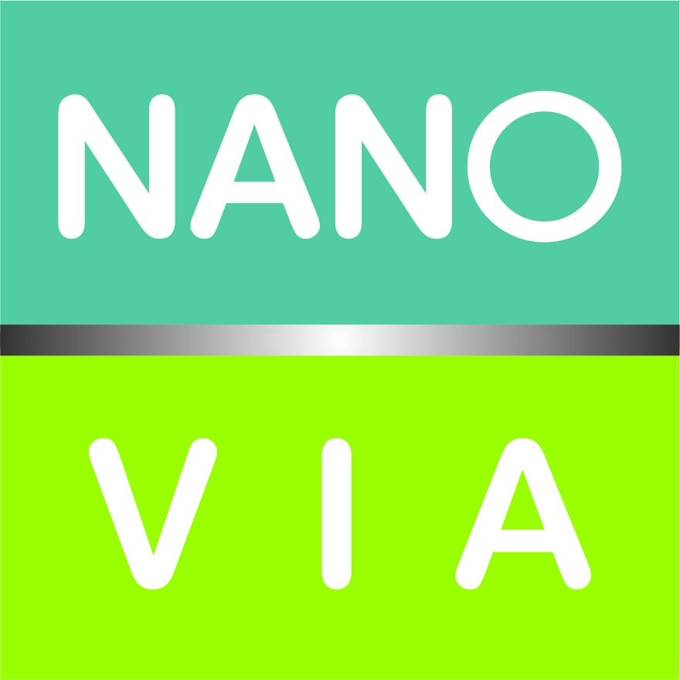
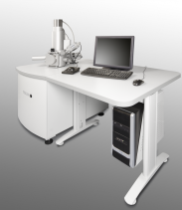
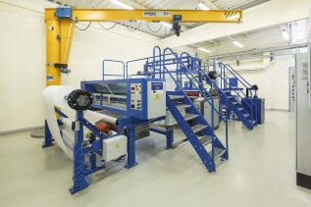
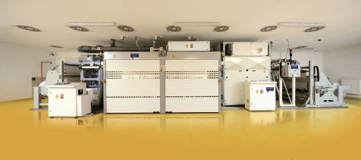
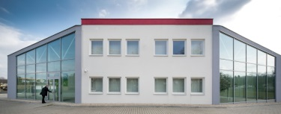
Nanovia history
Activities in nanofiber industry started at 2010
building purchasing x repair started (2010 -2011)
start of applications development (2010)
First investment stage 2011-2013
development laboratory put into operation (2011)
first production line A width 1,6 m installed (2012)
laminating machine width 1,6 m installed (2012)
marketing and trade activities started (2012)
second production line B width 1,6 m installed (2013)
2010
2011
2015
2012
2013
2014
Second investment stage 2014-2015
purchased cutting machine (2014)
production line C width 1,6 m installed (2015)

Slide 3
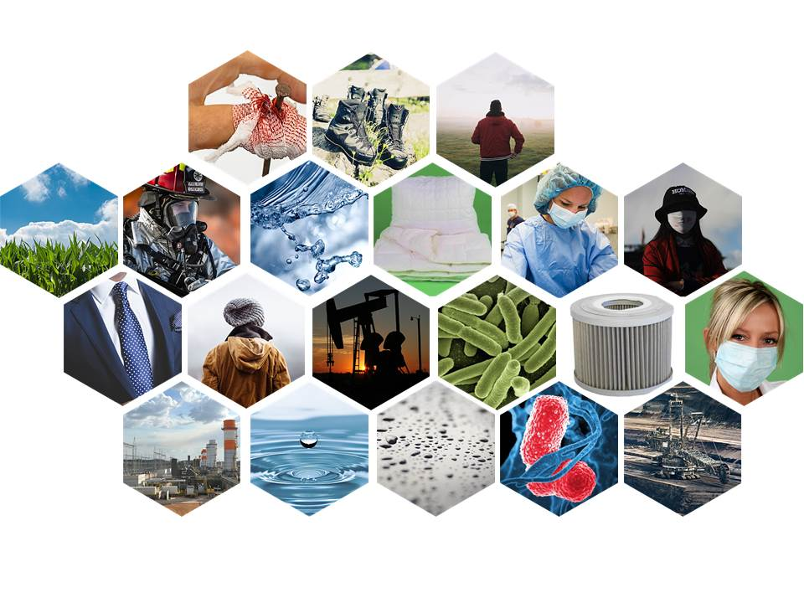
Nanovia Focused Industries
Filtration - air or liquid
Automotive applications
Technical or apparel fabrics
Barrier fabrics

Slide 4
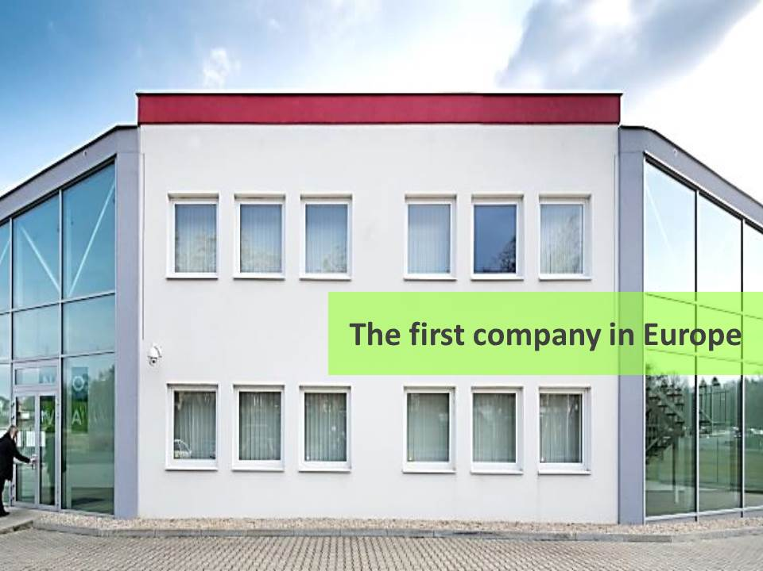
About company Nanovia
The production capacity is used for:
custom-made nanofibers materials for different applications and final products)
Filtration
Membranes
Technical textiles
Acoustic products
manufacturing of barrier fabrics launched under own brand names:
Nanovia AntiAllergy fabrics
Nanovia face mask and respiratory fabrics
Nanovia Clean Air fabrics

Slide 5
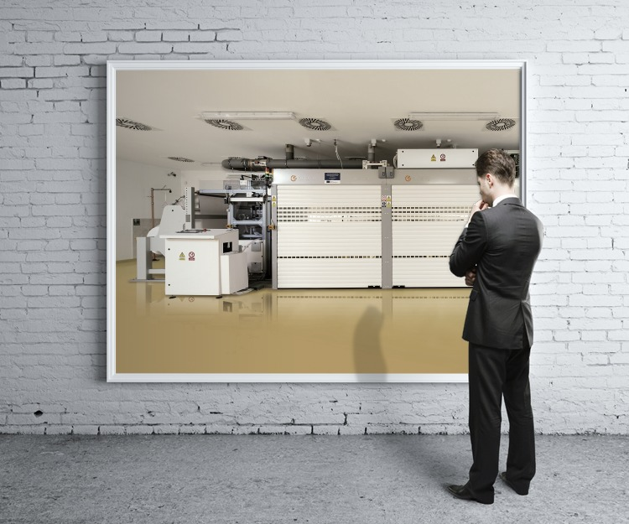
Production plant Nanovia Litvínov
ISO certification
EN ISO 9001:2009
OHSAS 18001:2008
EN ISO 14001:2005
Nanofibers production capacity
(depends on the nanolayer thickness) production capacity end of 2015 – ca. 10,5 mil.m² /year
Capacity of the lamination
(depends on the speed) production capacity end of 2013 ca. 4,0 - 7,0 mil.m²/year

Slide 6
Customer Service
Development of new products
Production
Analytical services

Slide 7
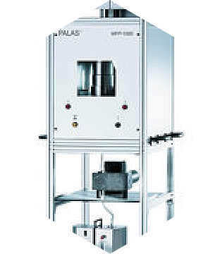
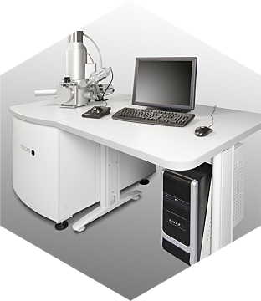
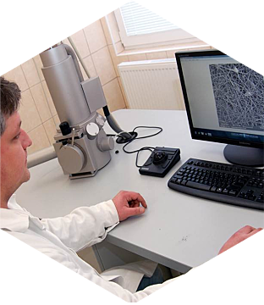
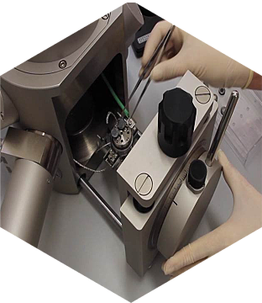
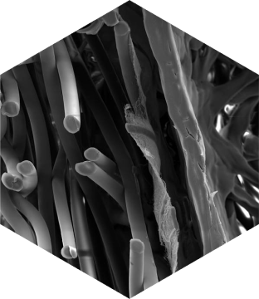
Nanovia Service - Development
Development support
know-how of polymer solution recipe
know-how of nanofibers production
know-how to ensure adhesionof adhesion, lamination
development on laboratory or industrial technology NanospiderTM
well equipped laboratory
the possibility of industrial lines capacity utilization for product development
professional staff
professional approach for customer
transfer of results from development into production

Slide 8
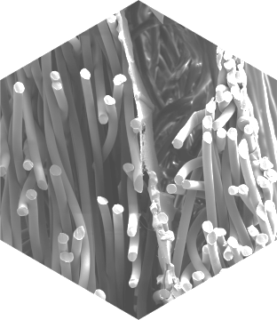
Nanovia Service - Production
Custom production
three industrial line NanospiderTM – width 1600 mm
air - conditioned production halls
continuous quality control by pressure drop measuring - Textest FX 3500
adhesive applying before nanocoating
glue application before nanocoating, lamination in next step
laminates with contain of nanofibrous layer preparation 2L or 3L systém
longitudinal cutting of laminated fabrics into strip

Slide 9
Manufacturing of barrier textiles
Nanovia AntiAllergy
Nanovia Face Mask
Nanovia Repspirator
Nanovia Clean Air
Nanovia Pure Liquid

Slide 10
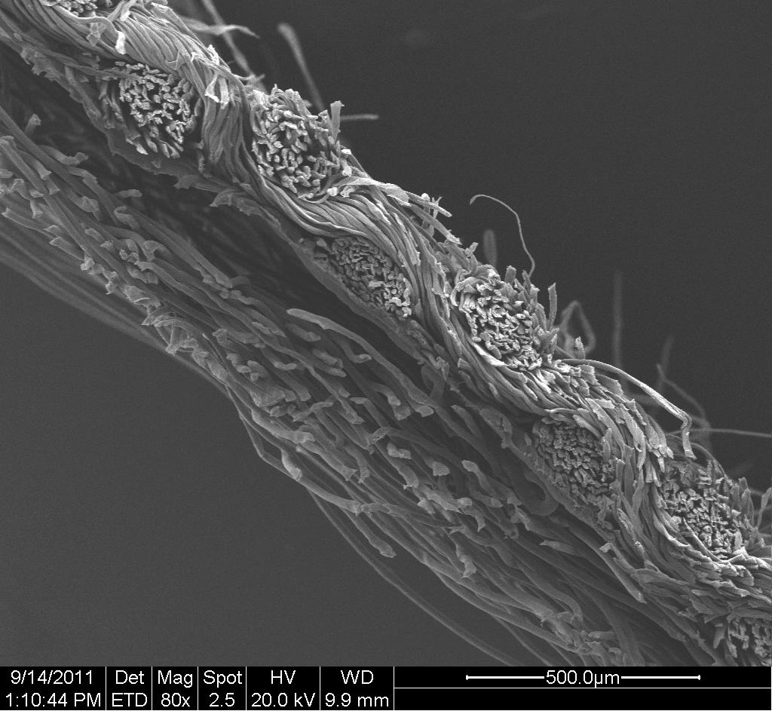
Barrier textile laminates
with nanofibers
Barrier fabrics structure
Nanovia AntiAllergy
Nanovia Face Mask
Nanovia Respirator
Nanovia Clean Air
Three-layerd or multi-layerd textile laminates - outside textile are common nonwoven materials (spunbond, meltblown, spunlace) and the layer which is closed between is a layer of nanofibers.
The mechanical connection of three-layerd textile laminates or two-layerd filtration media is build on the principle of applying adhesive solution on the substrate before covering by nanofibers, or one side or two side connection by powder adhezive.

Slide 11
Barrier textile laminates
with nanofibers
NANOVIA ANTIALLERGY
Barrier textiles Nanovia AntiAllergy were developed in order to prevent the penetration of alergens by the ubiquitous dust mites. Exept the excellent barrier properties of materials offers very good breathability and moisture permeability.
Therefore, it is convinient to use the material for example for production of mattresses and bedding covers also as the part of blankets and pillow cases which protect against their colonization of dust mites.

Slide 12
Barrier textile laminates
with nanofibers
NANOVIA FACE MASK
Materials Nanovia Face mask have been developed for the purpose of preventing the penetration of microorganisms (bacteria and viruses) or dust particles into the respiratory organs.
Most of the materials fulfill the standard EN 14683:2005.

Slide 13
Barrier textile laminates
with nanofibers
NANOVIA RESPIRATOR
Materials Nanovia Respirators are intended for the production of respirators according to standard EN 149:2001.
In the offer is material achieving the class of the efficiency FFP2, FFP3.

Slide 14
Barrier textile laminates
with nanofibers
NANOVIA CLEAN AIR
Materials Nanovia Clean Air are designed for air purification.
This are textile laminates intended for industrial air filtration according to EN 779:2012, the class of the efficiency of the F8-F9 and according to EN 1822:2009, class efficiency E10-E12.
Nanovia developed also laminate suitable for installation into window or other ventilation matter in flats, family houses or offices.
In this product group are also included materials for bags production into vacuum cleaners.

Slide 15
Intellectual Property
Barrier Fabrics - patents
CZ 305 230
EP 2 517 607 B1 (Barrier Fabric)
Russian Federation 2011125637
US 8,980,772 B2
Filters – utility models
PUV 2013 – 28614
PUV 2014 - 30160

Slide 16
Nanovia team 2015

Slide 17
Thank you for your attention
Nanovia – right partner for your nanofiber products

