Slide 1
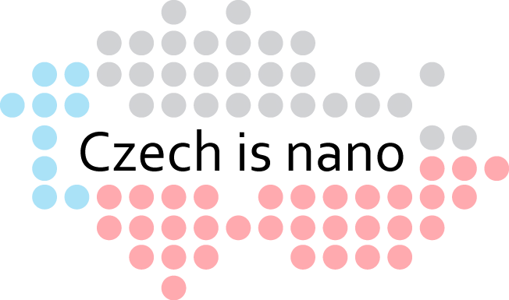
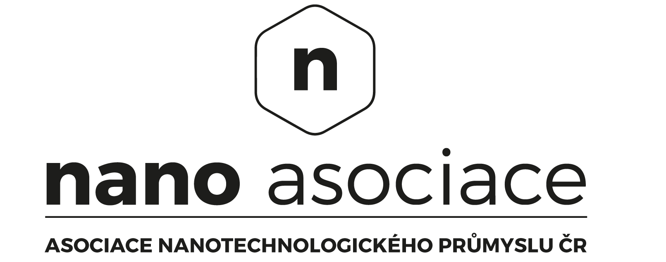
JIŘÍ KŮS Czech Nanotechnology Industries Association

Slide 2
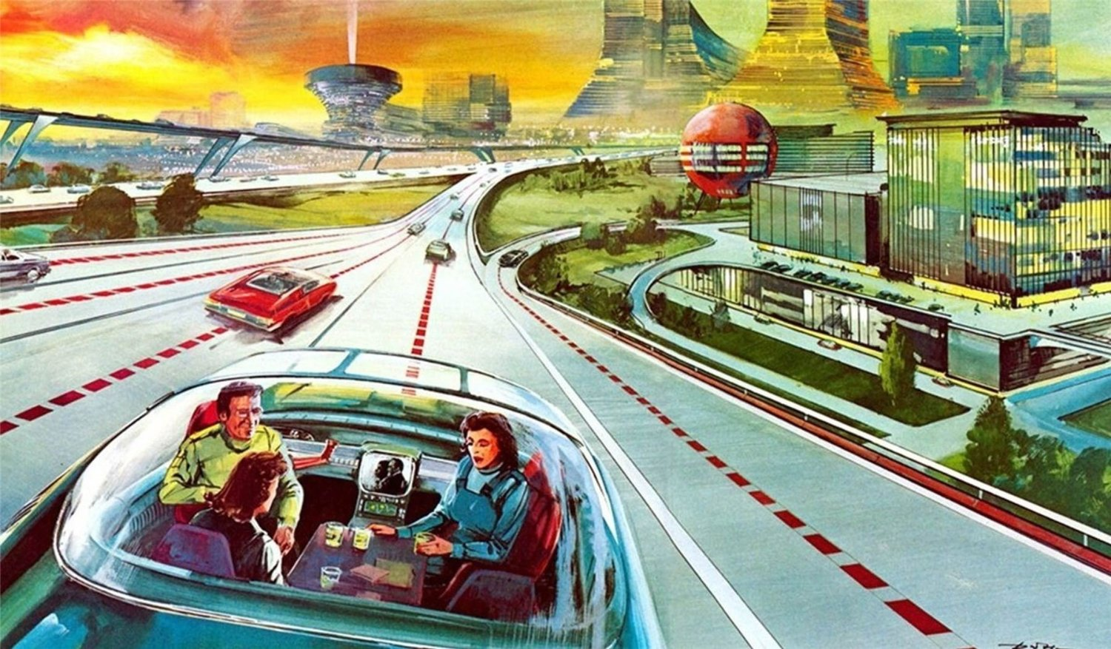
We stand on the threshold of a new
industrial revolution

Slide 3
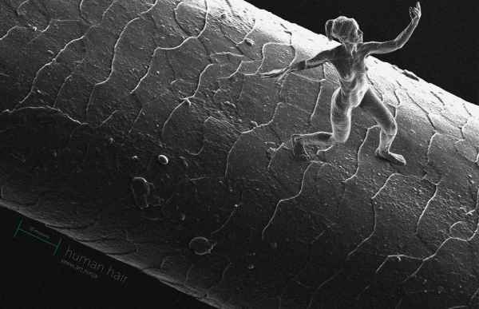
1959 Richard Feynman
1981 Scanning tunneling microscope STM
1986 Atomic force microscope AFM
1986 Eric Drexler Engines of Creation
1991 Carbon nanotubes
1997 First nano company Zyvex in USA
2000 Start of commercial applications of nanotechnology, NNI
2004 Czech nanospider technology for industrial nanofibres production

Slide 4
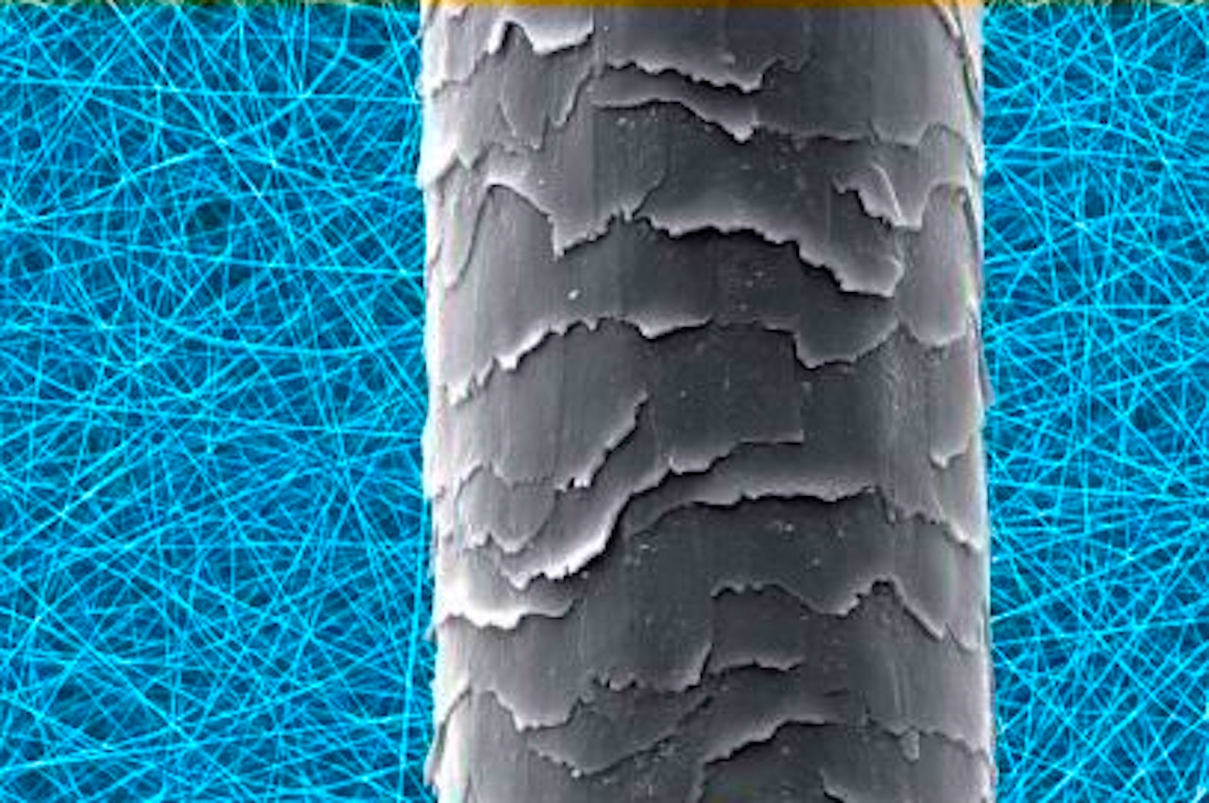
Nanofiber is thousand times thinner than a human hair

Slide 5
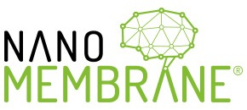

Slide 6
DRINKING WATER
FOR ASTRONAUTS
Czech nanotechnologies can produce drinking water even from faeces and urine of astronauts on long space missions.
But also help on earth with water purification from radioactivity or Ebola virus.

Slide 7
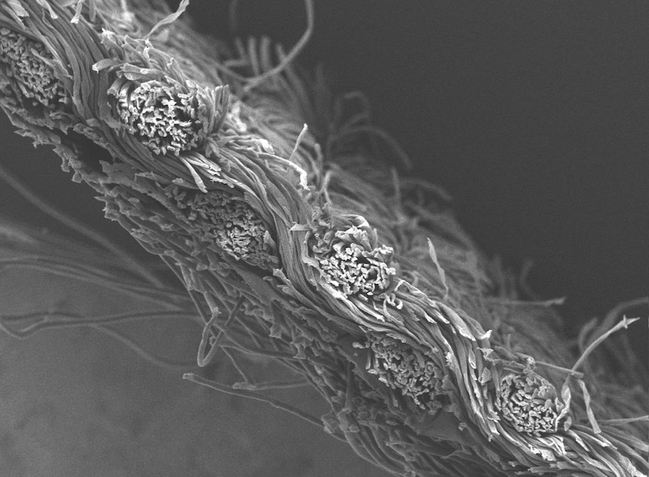
NANOTECHNOLOGY HELPS ALLERGIC PERSONS
The first concept
in the world of hypoallergenic
interior based on nanotechnology.
Nanofibre barrier bedding is an innovative way
how to protect against dust mites and their allergens.

Slide 8
NANOPARTICLES PURIFY THE AIR
Titanium dioxide nanoparticles in a clever photocatalyst coating purify the air from all organic contaminants, including viruses and bacteria.
Smart coating also prevents dirt depositing on the facade
and it keeps looking like new one.

Slide 9
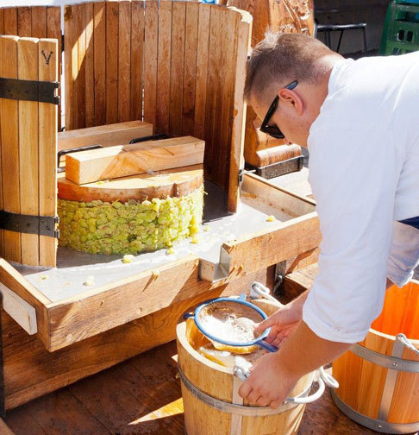
NANOFILTRATION FOR WINEMAKERS
The nanofiber membrane has a lower pressure drop, can be regenerated, no need to flush before filtration, improves filter performance. Financial savings for cellulose plates.
In the near future, the use will be extended to oil, beer or spirits filters.

Slide 10
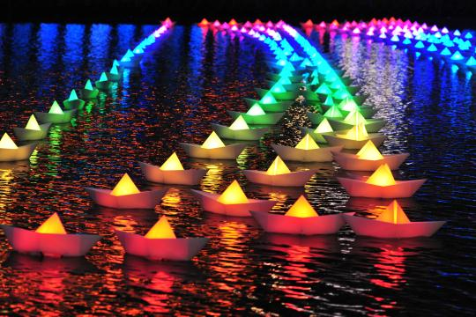
NANOOPTICS IS SHAPING THE LIGHT
New flat plastic lenses for lighting of supermarkets street lights, cars, offices and homes have outstanding properties due to the complex nanostructures inside and on the surface of the plastic.

Slide 11
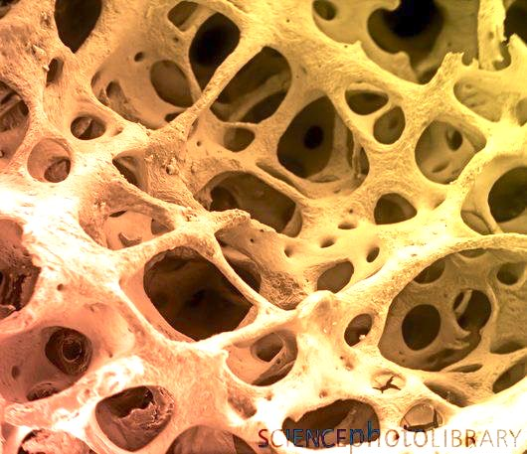
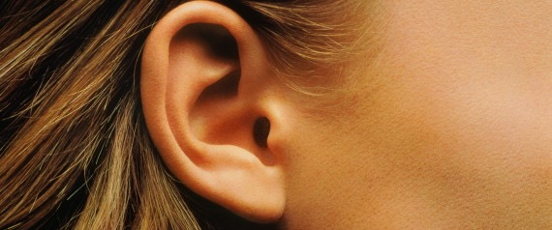
REPLACEMENT HUMAN
ORGANS
Czech nano3D printer builds an artificial scaffold around which the stem cells in the laboratory complete the human organ.
Innovative bone fillings that can fully recover your bone tissue.
The recovered bone tissue is indistinguishable from your original tissue and the recovery process is much faster.

Slide 12
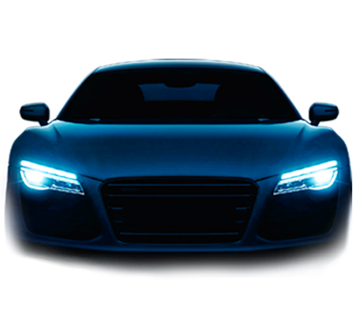
STORAGE OF RENEWABLE ENERGY
3D nano battery is 100% safe. It can fast recharge and discharge. It can be perfect reservoir of rapidly available energy for distribution network and electromobility.

Slide 13
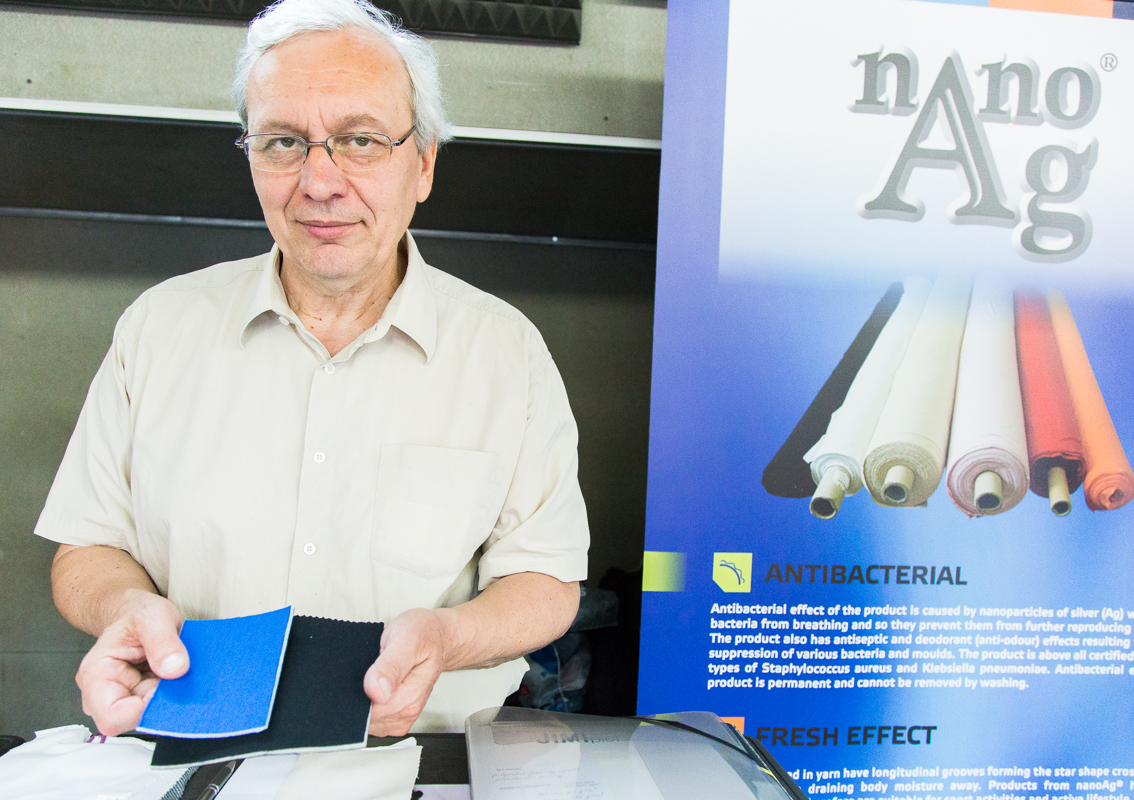
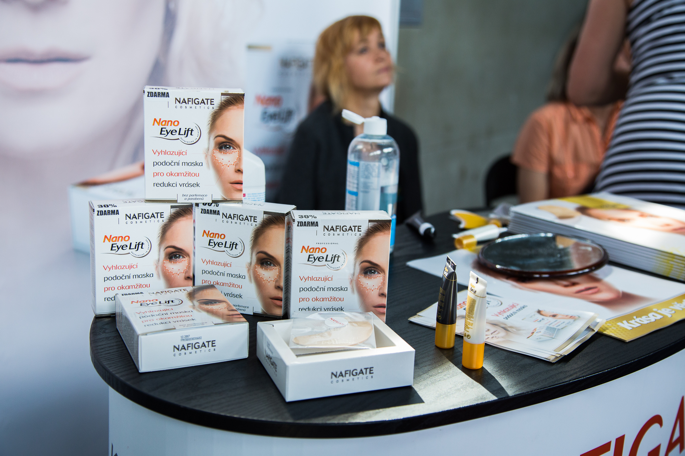
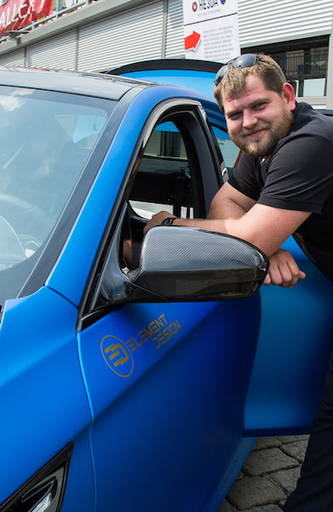
NANOTECHNOLOGY FOR EVERY DAY

Slide 14
NANOTECHNOLOGY FOR EVERY DAY

Slide 15
Czech is nano!

