Slide 1
This is Peab - the Nordic Community Builder

Slide 2
Our business concept
Peab is a construction and civil engineering company, whose ultimate guiding principle is total quality in all stages of the construction process.
Through a combination of innovation and sound professional skills, we aim to make our clients’ interest our own and thereby build at all times for the future.

Slide 3
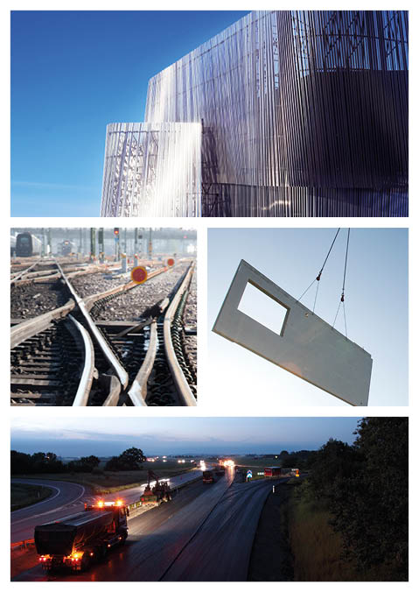
Our business
Four business areas
Construction
Civil Engineering
Industry
Property Development
Notes:
With a view to creating a platform for continued growth in order to develop our customer offering, rationalise the organisation and clarify the control structure, as of 1 January 2012 the business was divided into four Nordic business areas: Construction, Civil Engineering, Industry and Property Development.

Slide 4
Construction
Product range
Residential properties
Schools, sports facilities, stadia, hospitals, etc.
Commercial properties such as offices, hotels, department stores, etc.
Industrial properties
Construction service
Notes:
^{MORE DETAILED INFORMATION}
Contracts for external clients and develop our own production.
Everything from new production to renovation and construction services.
^{Three market segments:}
^{Residential properties}
^{Construction service}
^{Buildings and industry}

Slide 5
Civil Engineering
Product range
Infrastructure
Land and civil engineering
Operation and maintenance
Notes:
^{MORE DETAILED INFORMATION}
Infrastructure: Roads, railways, bridges, tunnels, harbours, industrial installations.
^{Customers:} National transport authorities, larger municipalities, industrial companies.
Land and civil engineering: Development areas, foundations for buildings, development and renewal of urban environments, water and drainage installations, cabling and pipeline works, energy installations.
Customers: municipalities, Peab Construction, local trade and industry, energy companies.
Operation and maintenance: Operation of national road network, operation and maintenance of municipal installations (roads, parks, water and sewage systems), external property maintenance.
Customers: transport authorities, municipalities, property owners.

Slide 6
Industry
Product range
Foundations
Gravel and rock
Ready-mixed concrete
Manufacture and laying of asphalt
Transport and machine services
Leasing of machines, cranes, lifts and temporary power
Street lighting contracts
Electricity distribution networks
Prefabricated concrete panels
Construction systems for apartment blocks
Notes:
MORE DETAILED INFORMATION
Consists of three complementary businesses: machines, products and services. All focusing on the
Nordic construction and civil engineering market.

Slide 7
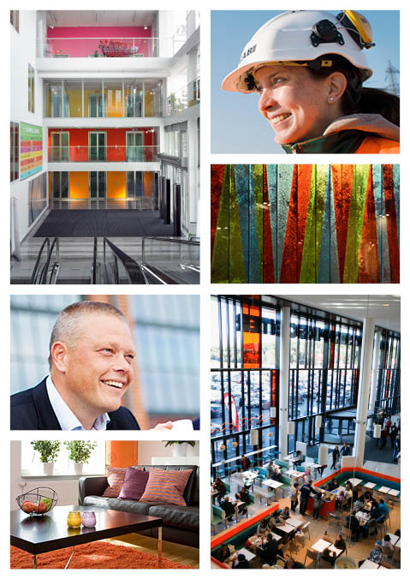
Property Development
Product range
Development of commercial properties from land acquisition to finished projects
Shops, offices, industrial properties and homes with rights of tenancy.
Notes:
^{MORE DETAILED INFORMATION}
New business area as from 1 January, 2012
Development of commercial properties from land acquisition to finished projects.
Generates assignments for construction areas of Peab's business.
Includes projects such as shops, offices, industrial properties and homes with rights of tenancy.
Collaborate with property owners, at the same time developing our competence and experience in order to become an even better partner for our customers.
Our ambition is to become the leader in the Nordic region in the acquisition, development and sale of both commercial properties and residential properties with rights of tenancy.

Slide 8
Our customers
• Public sector
• Trade and industry
• Property companies
• Private individuals
Notes:
^{MORE DETAILED INFORMATION}
• All-purpose builder with national coverage.
• Customers in private and public sectors.
• Growing strongly as home-builder (projects run in-house).
• Private customers therefore an expanding customer segment.
• Construction service – private customers.

Slide 9
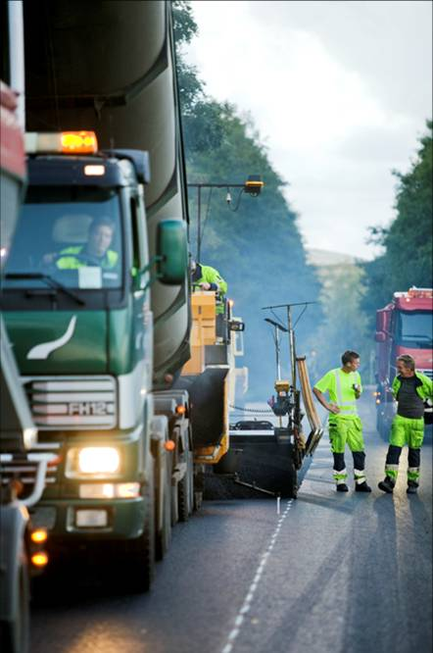
A strong partner
Customer focus
Cost awareness
One-stop supplier
Resource-efficient and climate-smart
Quality
Decentralised organisation with short decision-making paths
Efficient processes
Purchasing and logistics
A learning organisation
Notes:
^{MORE DETAILED INFORMATION}

Slide 10
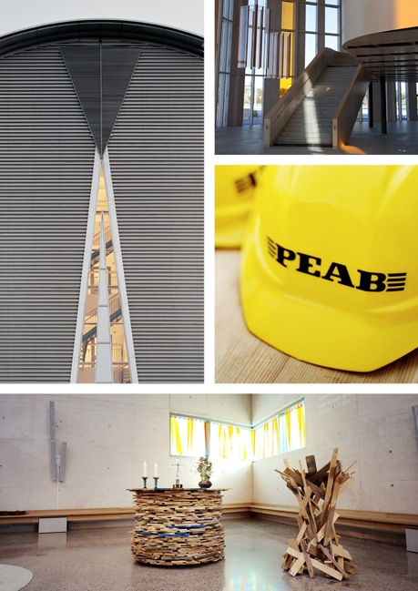
Our offering
KULTURHUSET SPIRA
Jönköping
• Collaboration on the customer’s terms
• All kinds of contracts
• Different payment options
ASTRA ZENECA
Mölndal
TUREBERG CHURCH
Sollentuna
Notes:
^{MORE DETAILED INFORMATION}
It is important for us to be able to offer customised solutions. That is why we work with different forms of collaboration (Peab's Trust-Based Contract and Peab Partnership), all kinds of contracts and different payment options.
• Collaboration: Everything is based on all parties involved working closely together from an early stage. All of the experience within the project is collected, and competence can be shared across specialist borders. Having common targets, activities and financial incentives creates the best conditions for a successful project. In Peab's Trust-Based Contracts and Peab's Partnership, we work together using a well-defined, structured toolbox. The difference between the options is how involved you want to be in the construction process. In a trust-based contract you pass on more responsibility to us and you are not as involved as in a partnership.
• Contracts: We have extensive, solid experience of working with turnkey contracts, general contracts and coordinated general contracts.
• Payment: Depending on your needs and the nature of the project, we work on the basis of a fixed price, a unit price or a flexible price (with or without index-linking, bonuses and incentives).

Slide 11
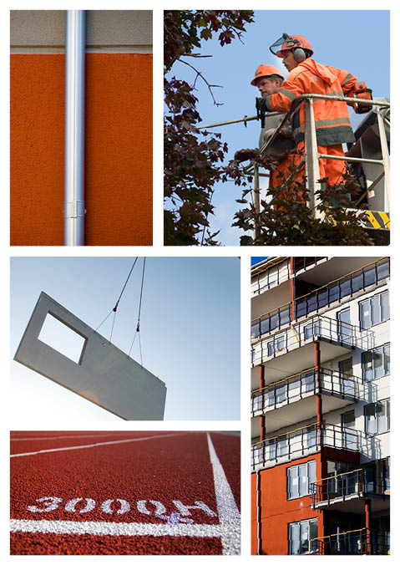
Our resources – the whole chain
From development and land acquisition, through materials, logistics and execution of construction and civil engineering, to operation and maintenance of completed projects.
Guaranteed capacity and cost of project.
Tremendous flexibility.
Option of one-step solution.

Slide 12
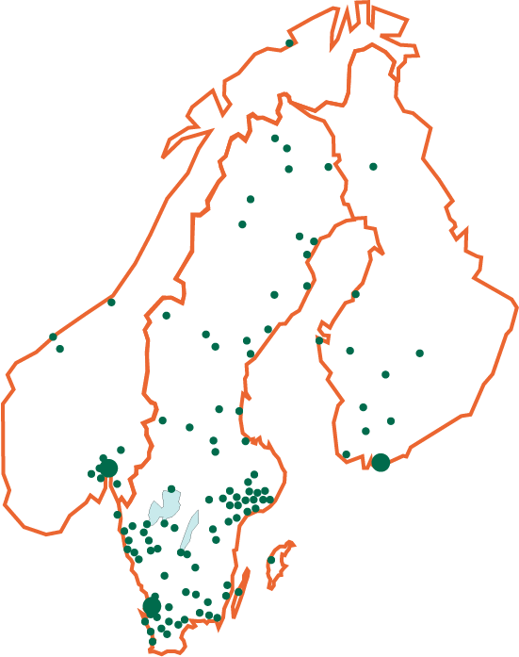
Peab – a Nordic company
Sales: Exceeding SEK 46 billion
Employees: More than14,000
Shareholders: 33,000
Publicly listed at Nasdaq Stockholm
Peab Group
Business area
Construction
Business area
Civil Engineering
Business area
Property Development
Business area
Industry
Notes:
PLEASE NOTE!
The key figures shown here are updated as required in connection with the interim reports four times a year. Sales figures and the number of employees do fluctuate; these figures may be treated as approximate figures, sometimes higher/lower.

Slide 13
Peab’s development, 1996-2015
MSEK
MSEK
Operative net sales and operative operating profit are reported according to percentage of completion method corresponding segment reporting.

Slide 14
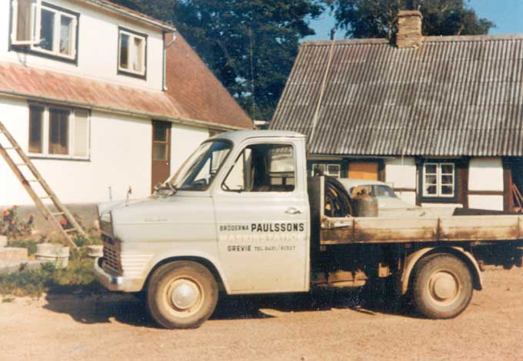
It all started in Skåne in 1959
Notes:
^{MORE DETAILED INFORMATION}
^{A quick} ^{look back – how} ^{did} ^{Peab's} ^{journey start?}
It's more than fifty years since two teenage lads snapped up a contract that their father didn't want. It was to be the start on an amazing success story...
Success stories often have some clear common denominators - in this case a large slice of entrepreneurship, innovation and respect for handshakes between people that runs like a common thread throughout the entire history of Peab. This is also why the handshake is the symbol of our core values, of how we work at Peab.

Slide 15
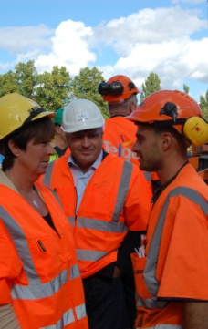
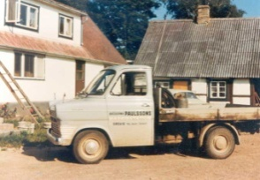
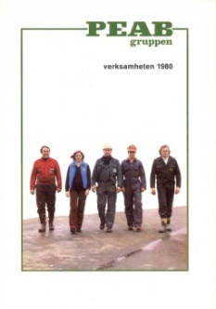
More than 50 years of growth
Healthy growth for the Group through organic growth and further acquisitions
Four business areas are formed
The business is established and developed
Peab starts to grow through acquisitions
1960
1980
1990
2000
2010
2012
2013
1970
Action plan for greater profitability
Peab starts the construction dept.
The journey to become the Nordic Community Builder begins
Peab is launched on the Stock Exchange and gains national coverage through further acquisitions
Notes:
^{FÖRDJUPAD INFORMATION}
Under de senaste 50 åren har Peab har utvecklats från ett litet bolag drivet av entreprenörer, till ett av Sveriges största byggföretag:
^{Under 60–talet}
^{etablerades verksamheten}
^{På 70-talet}
startade Peab en byggavdelning som uppförde monteringsfärdiga hus
80-talet - verksamheten expanderade
Peab AB förvärvade (nämn några)
^{- Wihlborgbyggen AB}
^{- Diös Södra Bygg AB}
^{ett antal bolag i Halmstad/Hjo}
^{SBB, inom anläggning}
90-talet - Börsnotering genom att gå samman med det OTC-noterade bygg- och anläggningsföretaget Hallströms & Nisses AB – blev en börsnoterad rikstäckande storkoncern inom bygg- och anläggning.
(Ytterligare förvärv; nämn några)
- Peab blev huvudägare i fastighetsbolaget Wihlborg & Son
^{- BPAs byggproduktion.}
Kungsfiskaren Bygg & Fastighets AB, verksam inom Stockholms stad, primärt inom husbyggande och ROT.
Fagbygg A/S ett av de större byggbolagen i Osloregionen
^{Swerock}
^{NORgruppen}
^{Stockholm Entreprenad)}
^{2000-talet} Kraftig organisk tillväxt och fortsatta förvärv Brinova Fastigheter AB delades ut till aktieägarna. Detta som ett led i Peabs strategi att inte äga färdigförädlade förvaltningsfastigheter.
^{Expansion i Finland inleddes}
[Peab Industri börsnoterades och delades ut till Peabs aktieägare 2007, återköptes sedan under 2008.]
²⁰¹⁰
Resan fram till idag har skapat ett marknadsvärde på idag över 9 miljarder kronor
Under 2010 arbetade vi fram en ny strategi för att bli Nordens samhällsbyggare
²⁰¹²
^{Fyra affärsområden bildas}
²⁰¹³
Ett omfattande åtgärdsprogram för ökad lönsamhet genomförs.

Slide 16
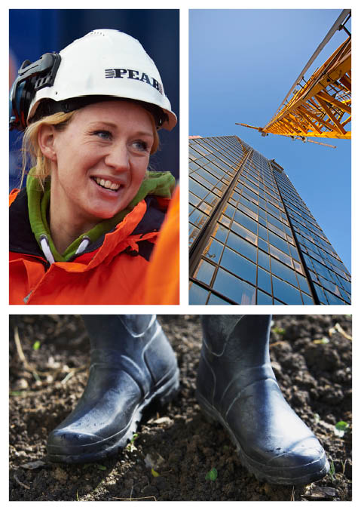
Our core values
• Down to earth
• Developmental
• Personal
• Reliable
Notes:
^{MORE DETAILED INFORMATION}
^{• Our most important values.}
• Strongly embedded in the corporate culture.
• Part of our corporate policy.
• Management programme to bring our core values to life.
• All new staff are introduced to the core values.
• Helps to act in a manner that strengthens the brand.
• Down to earth - we want to work close to our customers. Before taking on an assignment we need to be sure that we have access to the resources required to do a good job. We must be recognised for our down-to-earth way of working with short decision-making paths, and be sensitive to ^{our customers' interests.}
• Developmental - we must be innovative, flexible and constantly improving ourselves. We must appreciate our employees’ competence and offer good opportunities for development, training, promotion and preventive healthcare. We want our employees to be dedicated and involved in the business, and to contribute to our positive growth. At Peab we must have an opportunity to influence our work situation.
• Personal – We must be the personal company. By means of an honest, trusting dialogue with our customers and suppliers, we must create and maintain good, long-term relations. We must strive to ensure that the work we do is compatible with family life and leisure interests. We want good communication, a good atmosphere and respect for the individual to prevail at Peab.
• Reliable – our customers must feel secure when engaging Peab. This means that we must always apply good business ethics, competence and professional expertise. We must plan well, get it right from the outset, eliminate risks and meet promised deadlines. We must comply with laws and requirements, choose the best possible techniques, prioritise renewable resources and avoid environmentally harmful substances.

Slide 17
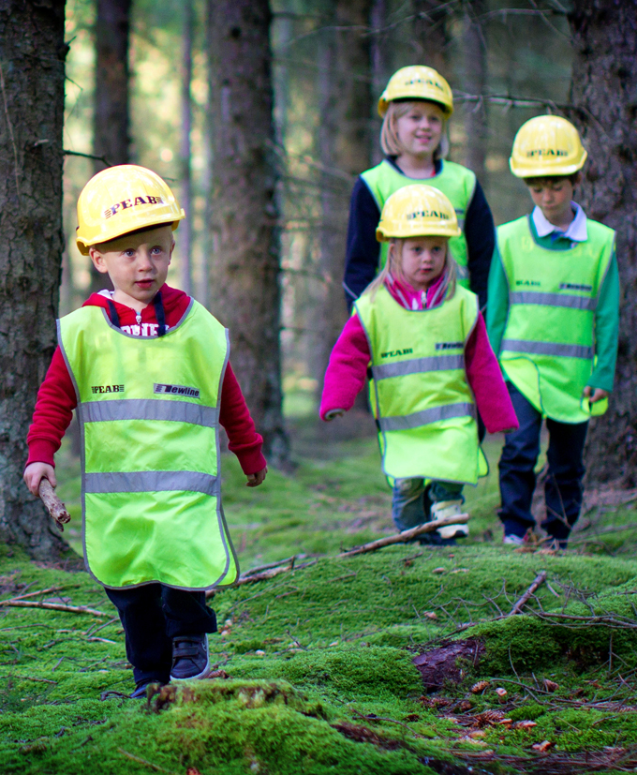
Our vision - The Nordic Community Builder
Peab builds the sustainable communities of the
Peab is the Nordic company
Peab is a magnet for skilled people
We work across borders to exceed our customers’ expectations.
CHILDREN
Notes:
^{MORE DETAILED INFORMATION}
Peab builds the sustainable society of the future.
We are the obvious partner for building society in the Nordic region. We create concepts, seize the initiative and are pioneers. We use resources efficiently and our climate-smart solutions are at the cutting edge. What we do is sustainable throughout the entire life cycle.
^{Peab is the Nordic company.} We work across borders to exceed our customers’ expectations. At Peab we are close to our customers, whether they are local, national or global. Satisfied customers contribute towards our success throughout the Nordic region.
Peab is a magnet for highly skilled people. We are the number one employer in the Nordic region. Our values are simple and clear. Our employees are deeply committed and our managers are driven by a desire to develop people. When our employees grow, so does Peab.
We shall be the community builder for the whole Nordic region
As the Community Builder, we assume a broad responsibility – social, economic and environmental. We listen to social issues and build communities in which people want to settle and live. We create opportunities for young people to be involved in building communities through our involvement in the Peab College and in the TelgePeab integration project, to name just a couple. We create modern residential concepts for pensioners, allowing them to decide for themselves how they want to live. It is through initiatives such as these that we contribute towards society as a whole.

Slide 18
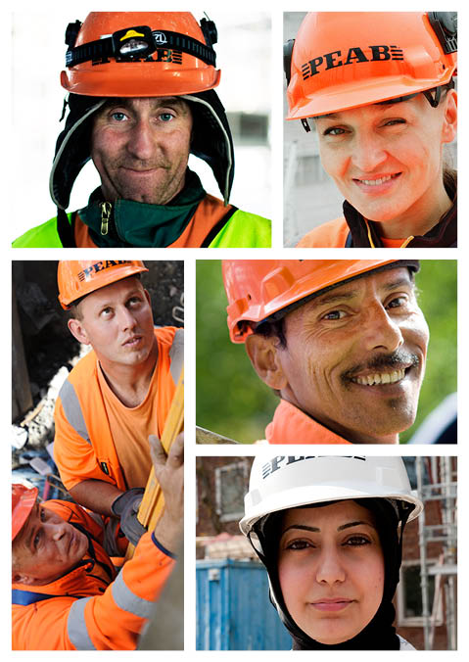
We want to do the best we can for our employees
Good opportunities for development
Good management
Healthy working environment
Modern work organisation
Secure employment and the right terms of employment
Strong brand and culture
Notes:
^{MORE DETAILED INFORMATION}
A magnet for skilled employees.
A key factor for success: being able to attract committed employees, and to create a climate that people are happy in and that encourages them to stay with the company.
The means of achieving this is through simple, clear values (core values) and using managers who have a burning desire to help people develop and grow. When our employees grow, so does Peab.

Slide 19
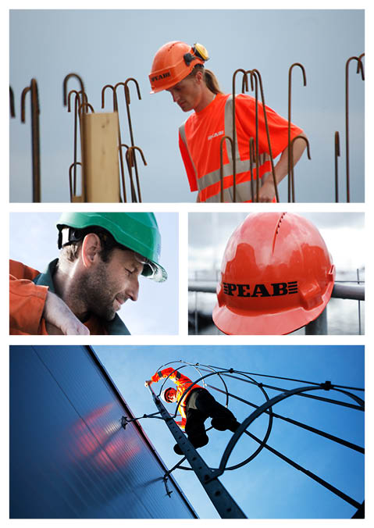
One important challenge – a safer working environment
• Always have the working environment on the agenda
• Workplace introduction for everyone
• Report accident and incidents
• Encourage a safe behaviour
• Change attitudes
Notes:
^{MORE DETAILED INFORMATION}
Group management took a decision that the working environment is a prioritised, predefined item on the agenda at all meetings at all levels of the organisation (during 2012).
Everyone at a workplace - employees, subcontractors, secondary contractor and suppliers - must be introduced with a focus on the working environment, Peab's Order and Safety Rules, introductory film.
Reporting of accidents and incidents: forms the basis of conveying knowledge of what has happened within the Peab Group in order to avoid repeats and to prevent new accidents and incidents. Learn lessons.
It is important to adopt a long-term approach to change attitudes and to change "incorrect" behaviour that has become ingrained, often over a long period of time.

Slide 20
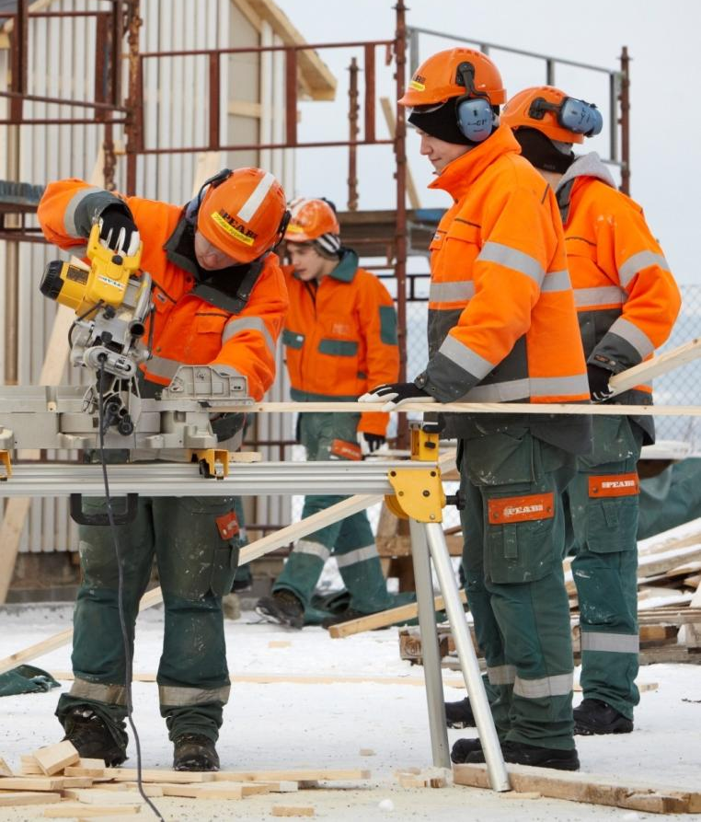
A college based on self-belief
The Peab College is an upper secondary course in construction and civil engineering.
Gives large numbers of young people the opportunity for vocational training and real jobs.
450 students in Ängelholm, Solna, Upplands Väsby, Malmö and Gothenburg.
Notes:
^{MORE DETAILED INFORMATION}
The Peab College is an upper secondary course in construction and civil engineering that has existed since 2006.
Why does the Peab College exist?
There are upturns and downturns in the economy, but the industry will need a lot of people in the next few years. not least in view of the high number of people retiring. Peab also needs to employ skilled construction and ^{civil engineering workers.} In order to develop more competent construction and civil engineering employees, Peab launched the Peab College within the framework of the Upper Secondary Construction Programme.
All of Peab's colleges are based on the same principle and the same teaching model. They are small colleges where all students are able to be seen and to feel that they are making a difference. Every college works in an integrated process, which means that theory is integrated into the practical part of the course in a natural way.
There are around 100 students at each Peab College, divided into Years 1-3.
The Peab College's teaching model
Tuition at the Peab College is characterised by four fundamental principles: collaboration with trade & industry, individualised teaching, a cross-functional work method and active work on the value base.
Collaboration with trade and industry involves each of the students doing all of their workplace-based learning at Peab's workplaces.
Individualised teaching means that all educational activities are based on the student's situation and needs. We are all different
and reach our goals in different ways. Support for those who need it, challenges for those who want them.
Examples of a cross-functional work method involve, for example, having English lessons in the building hall,
sports lessons being integrated into teaching of ergonomics in the construction profession, or the maths teacher using yardsticks and building plans
as key educational aids. At the Peab College they strive to make use of a student's strengths to combat any weaknesses. Put simply, it's all part of the big picture.
Work on the value base is ever-present and forms the basis of the student's development as a member of society.
450 students, at more locations in the country, hopefully in Norway and Finland in due course.

Slide 21
A sustainable future
A holistic approach to sustainability throughout the whole life cycle.
Environmental issues
Social issues
Financial issues
How we treat customers and each other, how we minimise the environmental impact in our processes, how we contribute to the communities where we operate.
Notes:
^{MORE DETAILED INFORMATION}
Issues relating to sustainability play a central role in Peab's vision to be The Nordic Community Builder. We want to lead the way and contribute to a sustainable society. To succeed in this, openness and clear communication are a prerequisite.
A holistic approach to sustainability
Peab's strategy includes a holistic approach to issues relating to sustainability. This means that we focus not only on issues relating to sustainability, but also social and financial issues throughout the whole life cycle. Our efforts to include the sustainability perspective must pervade everything we do, from how we treat both customers and one another at the workplace to how we minimise the impact on the environment from our processes and contribute to the communities where we operate.

Slide 22
Some of our projects

Slide 23
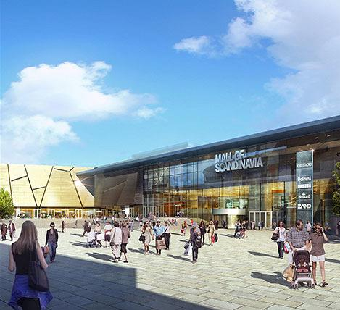
Arenastaden in Solna
A unique whole in a totally new district
Homes, hotel, shopping centre, stadium, offices.
Making use of industrial land.
Environment-friendly materials, minimised energy and water consumption.
Needs-based, healthy indoor environments.
Major expansion in public transport.
Notes:
^{MORE DETAILED INFORMATION}
Together with the City of Solna, Fabege, Jernhusen and the Swedish Football Association, Peab is involved in developing all parts of Arenastaden.
Client: Arenabolaget in Solna, with a contract sum of SEK 2.2 billion. Turnkey contract, construction started in June 2009. Friends Arena officially opened in October 2012.
^{Record}
The roof construction of the Friends Arena contains just as much steel as there is iron in the Eiffel Tower. The span of the great beams is the same as the height of the Kaknäs Tower. Homes and offices at the heart of events An attractive location with good communications. Peab's five apartment blocks, with 143 apartments in each building, are in the western part of the district and have a design that aims to create the feel of a local suburb. One of many companies that have already chosen Arenastaden is Vattenfall, who recently moved into the climate-smart head office that Peab has built for them. More big brands have also chosen Arenastaden: Carlsberg, Apoteket, Adidas, Esprit, Olympus, Egmont, Nike, Nordisk Film and the Swedish Football Association. World-class experiences and shopping Sweden's new national stadium, Friends Arena, is Sweden's biggest, most flexible stadium. It plays host to world-class concerts, sporting events and shows all year round. Just next door is the 19-story hotel and the Mall of Scandinavia with its 250 shops. This will be the biggest shopping centre in the Nordic region. ^{Developing the infrastructure} The area, which used to be a run-down industrial area, rests on a recent seabed with a lot of clay, which called for a high degree of engineering expertise. In addition to a number of temporary installations during the construction period, at the moment a road bridge and a footbridge are being built over the neighbouring track area. Communications will also be expanded. The Tvärbanan line is being extended to Solna station in Arenastaden, and the commuter line to Arlanda Airport. At the same time there will be new slip roads and exits on the E4 and E18.
The site now being used was originally little-used industrial land.
Environment-friendly materials.
Energy and water consumption in the area will be minimised by means of ground source heating and cooling, solar heating and other kinds of renewable energy.
Needs-based, healthy indoor environments.
Major expansion in public transport.

Slide 24
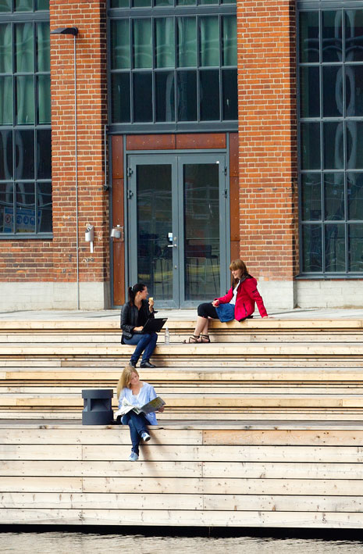
Varvsstaden, a sustainable district of Malmö
A town within the city
2/3 homes, 1/3 commercial premises.
Historical and modern environments combined.
The district has a labyrinthine feel, with meeting places and pocket parks created between the buildings.
Environmental certification in accordance with BREEAM.
Notes:
^{MORE DETAILED INFORMATION}
^{VISION FOR VARVSSTADEN}
Innovative urban environment incorporating its historical heritage.
Varvsstaden is a town within the city. Green areas, footpaths and cycle paths, proximity to local and global communication options just around the corner.
Living in Varvsstaden is different. The district has structures that create a labyrinthine feel, with meeting places and pocket parks created between the buildings. Historical environments combine with innovative architecture. The development involves a high level of ambition in the field of sustainable urban development.
^{Media Evolution City (MEC)} MEC moved into the property on Stora Varvsgatan in spring 2012. The building houses both small and large media companies. This is the first stage in the creation of a physical media centre in Malmö and Southern Sweden, as a hub for media developments in Sweden and Europe.
^{SVT first tenant.} The new SVT building has 5,000 square metres on three floors. The studio covers 200 square metres, and the Sydnytt programme broadcasts from a base covering 100 square metres. SVT in Malmö produces programmes such as Sydnytt, Antiques Show, Amigo, Landfall, Stars in the Castle and Fridays in the Garden.
Development area for homes and commercial premises.
^{Land area approx. 19 hectares.}
The original Kockums shipyard development.
^{2/3 homes,} ^{1/3 commercial premises}
285,000 sq.m. future development rights.
Environmental certification in accordance with BREEAM
Covers social, ecological and financial sustainability.
Certification covers eight areas, including climate and energy, social planning and biodiversity.

Slide 25
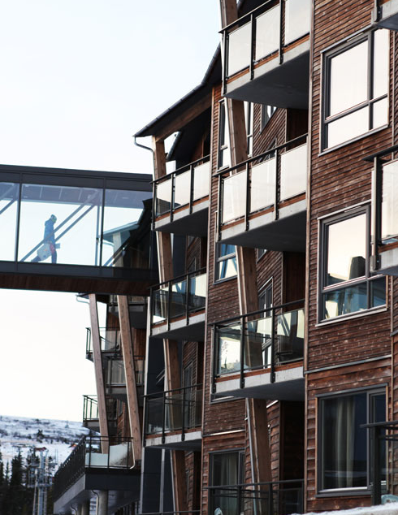
Trysil, tourism hub in Norway
Innovation breathed new life into stalled project
Hotel instead of time-share properties.
Increased capacity for Trysil.
65,000 bookings for first season.
Notes:
^{MORE DETAILED INFORMATION}
Trysil is Norway's biggest skiing region and a hub for tourism. The local community relies on visitors and the ski centre. The number of visitors is growing every year, and Trysil was facing the challenge of coping with the increase in interest by building time-share properties. A project that stalled when the former contractor was declared bankrupt. Peab stepped in and took over responsibility for completing the project. The solution involved a totally new way of thinking. The project plan was torn up and changed from time-share properties to a hotel, which was better in providing Trysil with the increased capacity they needed. In the first season alone, the hotel received 65,000 bookings.

Slide 26
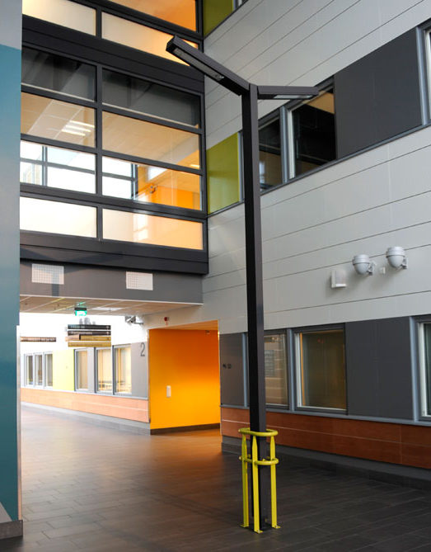
Western Finland’s biggest hospital in Seinäjoki
Smaller units combine to create a bigger hospital in Finland.
Seinäjoki:
Specialist healthcare for more than 200,000 people in 25 municipalities.
Healthcare students can study close to the actual hospital environment.
Development in partnership with medical staff.
Notes:
^{MORE DETAILED INFORMATION}
Healthcare in Finland is under development. The aim is to combine smaller units to create bigger hospitals, so that more doctors can work side by side and provide patients with better specialist healthcare under one roof.
In Seinäjoki, Peab has extended the local hospital to create Western Finland's biggest and most important hospital.
The development of the hospital's capacity also means that the local healthcare education system has new opportunities to arrange for students to study close to the actual hospital environment.
When work started, it was the third largest construction project in Finland. Developments took place at all times in collaboration with medical staff in order to find the right solutions that can allow the hospital to continue to develop in the long term.

Slide 27
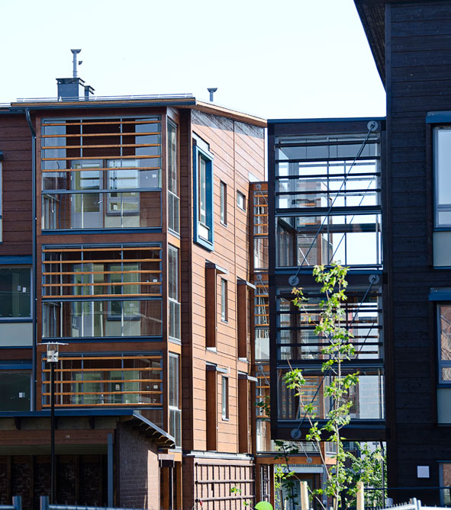
Ecological construction in Viikki, Helsinki
Finland’s biggest wooden multi-storey building in Viikki.
Environment-friendly
Quick construction
Modular
Easy to develop and adapt over time.
More timber projects are planned in Finland.
Notes:
Helsinki is developing rapidly and has a long-term plan, with a focus on ecological construction. Within the framework of this work, Peab is building one of the city's symbolic projects - a new residential area with Finland's biggest wooden multi-storey building.
Finland has a proud timber and paper industry, and there have long been discussions about the importance of making more out of timber as a raw material.
Viikki is a traditional area of Helsinki, but one that is still growing and developing. Here young families live alongside university students, and the area has a definite environmental profile. It's no coincidence that this initiative is taking place here.
At the same time more projects using timber are being planned all over Finland, and the benefits are obvious. As well as being environment-friendly, it can be built quickly and in modules. The result is easier to develop and adapt over time.

Slide 28
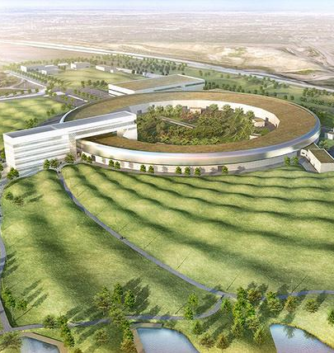
MAX IV in Lund - a world-leading research facility
Sweden’s biggest-ever infrastructure project for research
Energy solutions based on recycling and renewable energy.
Vibration requirements at nanometre level.
Innovative solutions to dampen vibrations: wave pattern with hills made from recycled earth.
Seeds from local nature reserve create unique flora.
Notes:
Peab creates MAX IV in Lund - a world-leading research facility.
Peab is building Sweden's biggest-ever infrastructure project for research in North-eastern Lund. Here Peab is building a gigantic super-microscope, and next to the new facility a new area is being developed at the same time in which science and recreation are being combined.
The new MAX IV research facility in Lund will use so-called synchrotron light to investigate really small objects, which may result in, among other things, better batteries and solar cells or new, more effective medicines. The facility will be a world leader in the field of synchrotron light and will put Lund and the Öresund region on the international research map. MAX IV is also expected to attract thousands of researchers from all over the world every year. Bigger than the Colosseum and very sensitive to vibrations MAX IV will have a circumference of no less than 528 metres, one metre bigger than the Colosseum in Rome. One of the biggest challenges facing the project was the extremely strict vibration requirements. The research facility is extremely sensitive, as synchron light has a width that is just one quarter of that of a human hair. The vibration requirements are defined down to nanometre level, which is a real challenge bearing in mind the heavy traffic on the E22 motorway just by the area. In collaboration with professors from Lund University and the Snøhetta firm of architects, Peab has developed a number of innovative solutions to dampen the vibrations. Among other things, the surrounding landscape has been given a functional wave pattern, with hills that contribute to absorbing energy and vibrations in the ground. ^{Research for the future} The sustainability requirements for such major project are also a challenge. Vast areas of agricultural land are being used for the construction work. All earth excavated is being taken and reused to create the hills in the surrounding landscape. The nearby Kungsmarken nature reserve has unique flora, and seeds were taken from there to be planted. The plan is for there to be grazing sheep on the grass-covered hills. The area will be a recreational space for the general public, where people can walk, have picnics, jog and study the research facilities. The wave patterns in the landscape will become a symbol of MAX IV and will even be visible on Google Map. It will be a visitor destination that enhances the area's drawing power to attract the best researchers, as well as being a new, exciting district for the general public. The project is a European role model for sustainable construction. MAX IV has energy solutions based on recycling and renewable energy. The facility has been designed so that energy consumption is minimised and surplus heat generated in the facility - equivalent to 1,800 houses in the Lund area - is used and recycled.

Slide 29
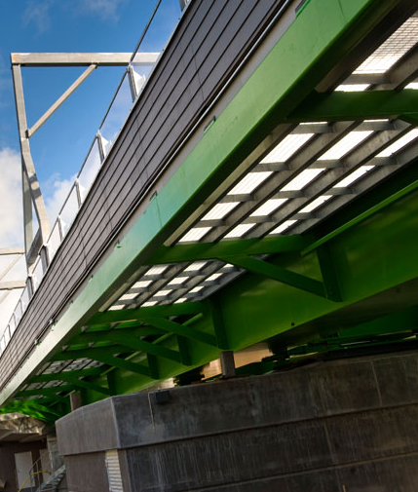
Tracks and bridges for transport solutions of the future, Motala - Mjölby
Increase capacity for climate-smart transport solutions from north to south
Four bridges in the centre of Motala.
Sweden’s first swing bridge for a double-track railway.
Construction alongside existing railway and ongoing boat and road traffic.
Least possible impact on existing transport operations.
Notes:
From Motala to Mjölby - Peab develops tracks and bridges for the transport solutions of the future.
Demand for climate-smart, cost-efficient transport solutions is on the increase, and the pressure on the Swedish rail network is tough. The goods traffic corridor from north to south and onward into Europe will need increased capacity within a few years. With advanced railway bridges and double tracks, Peab is working together with the Swedish Transport Administration to create opportunities for the transport solutions of the future.
Work is under way at the moment in Motala on Sweden's first swing bridge for a double-track railway. Construction of double tracks on the section between Motala and Mjölby has been under way since 2007, and Peab has carried out most of the land and bridge works on the section. Along the whole section between Motala and Mjölby, double tracks are replacing single tracks in order to meet the capacity required and to provide the facility for smooth goods transport operations throughout the whole country. Millimetre precision and advanced hydraulics Peab has built four bridges in the centre of Motala. The opening swing bridge over the Göta Canal is notable for being Sweden's first swing bridge for a double-track railway. Step by step, with millimetre precision, the 163-tonne, 35 metre long railway bridge was installed over the Göta Canal. The double-track swing bridge rotates 88 degrees in less than 80 seconds, standing parallel to the Göta Canal when goods or leisure boat traffic has to pass. During the high season the bridge will be opened about 15 times a day. Advanced technology and precise measurements were required for all four railway bridges, and the challenges include the varying ground conditions. Rock, clay and not least of all rapidly flowing water in the Motala River made laying the foundations difficult and required specialist expertise. In a small space and in a short time, construction took place alongside the existing railway and ongoing boat and road traffic. Despite the scope and size of the project, careful planning made it possible to focus on ensuring the least possible impact on ongoing transport operations. Building in parallel with tracks and roads in use places strict demands on safety. Against the background of Sweden's need for increased capacity for climate-smart transport solutions, Peab has contributed to enhanced opportunities for the traffic of the future.

Slide 30
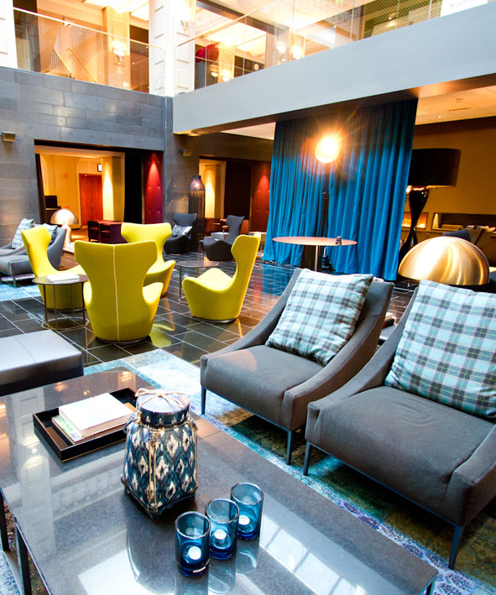
From Central Post Office to first-class hotel in Gothenburg
Centrally situated, famous old post office in Gothenburg was converted into a hotel
500 rooms, 17 conference rooms, restaurant and bar, and a spa covering approx. 1,200 sq.m.
Peab turnkey contractor in partnership with client Home Properties
Logistics a major challenge due to the central location
Notes:
^{MORE DETAILED INFORMATION}
From famous old Central Post Office to first-class hotel.
On 26 January the Clarion Hotel Post opened, built by Peab for Home Properties. This famous old Post Office in the heart of Gothenburg has been converted into a hotel and merged together with a newly built 13-storey hotel property.
In its finished state the hotel will have about 500 rooms, 3 of them suites, one with its own terrace and swimming pool, 17 conference rooms, one of which holds almost 1,000 people, a restaurant and bar, and a spa covering approx. 1,200 sq.m.
The project has been carried out with Peab as turnkey contractor in partnership with Home Properties, with the planning coordinated by Peab. This means that architects and other planners were involved from the beginning of the project, and large parts of the planning process took place at Peab's project office on site at the Central Post Office.
The location, by Drottningtorget in the centre of Gothenburg, with a very limited development area, small to virtually non-existent storage areas and deliveries on average every 18 minutes during the entire construction period, placed major demands on planning logistics. The well-planned logistical work, with timed slots in which all goods transport providers had a pre-booked time for unloading, was a decisive factor.

