Slide 1
Ministry of Transport
Luděk Sosna
Director of Strategy department
PLANNING OF RAILWAY INFRASTRUCTURE IN THE CZECH REPUBLIC
27.3.2017, Stockholm

Slide 2
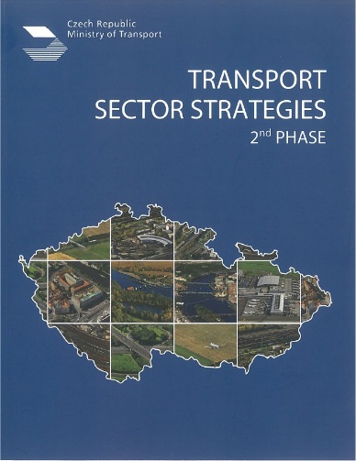
Ministry of Transport
STRATEGIC FRAMEWORK
Roadmap to a Single European Transport Area
Towards a competitive and resource efficient transport system

Slide 3
Ministry of Transport
TRANS EUROPEAN TRANSPORT NETWORK (TEN-T),
CORE NETWORK CORRIDORS

Slide 4
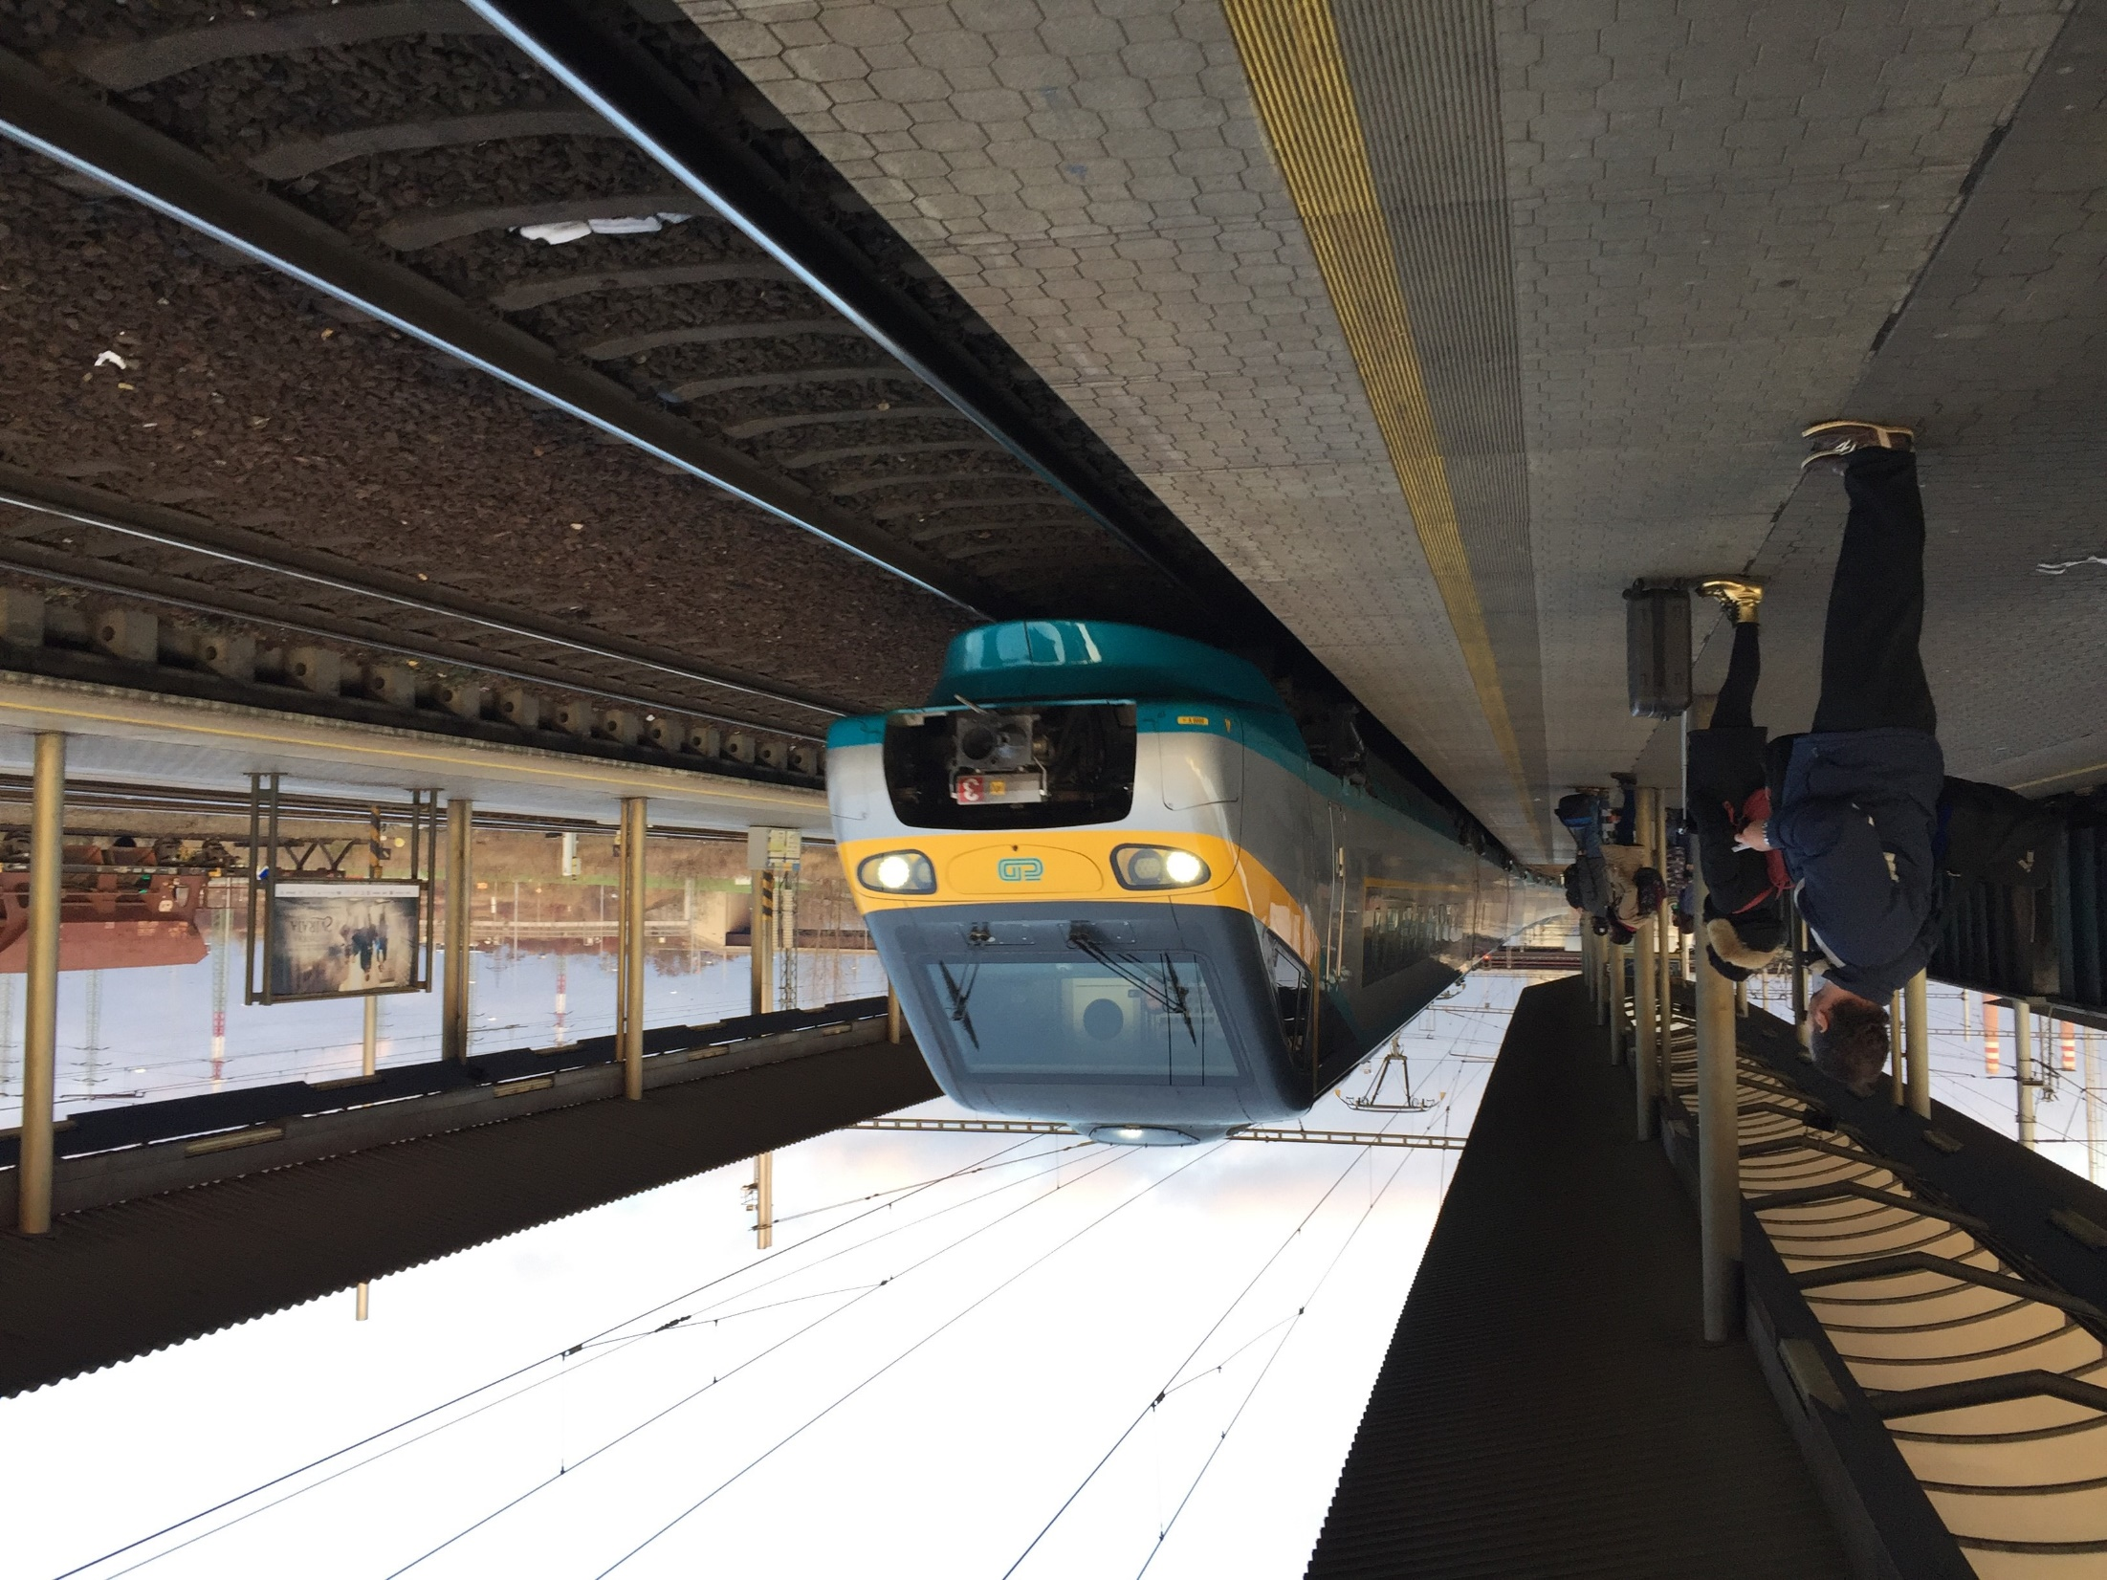
Ministry of Transport
FINANCING: MAIN RESOURCES
State Fund for Infrastructure (national budget)
2 billion EUR for 2017
Operational Programme Transport 2014-2020 (EU co-financing 4,7 billion EUR: Cohesion Fund + European Fund for Regional Development)
CEF: Connecting Europe Facility (Regulation (EU) No. 1316/2013)

Slide 5
Ministry of Transport
PLANNED TEN-T RAILWAY PROJECTS

Slide 6
Ministry of Transport
CHALLENGES IN PROJECT PREPARATION
Feasibility Studies (high requirements vs. CBA analysis)
CZ specific legal processes:
Environmental Impact Assessment (EIA)
protection of strategic corridors in Regional Master Plans
Land Purchase (in future, the topic for the implementation of HSR/RS in CZ)

Slide 7
Ministry of Transport
Thank you for your attention!
www.mdcr.cz

