Slide 1
Ministry of Transport
Luděk Sosna
Director of Strategy department
PLANNING OF HIGHWAY INFRASTRUCTURE IN THE CZECH REPUBLIC
27.3.2017, Stockholm

Slide 2
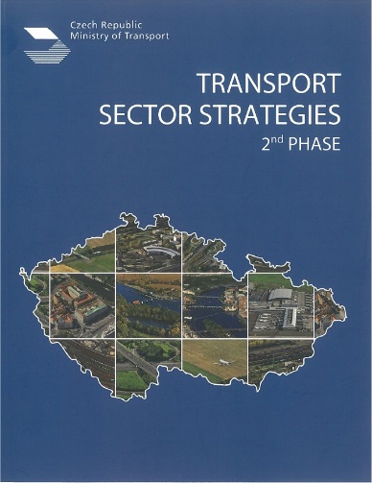
Ministry of Transport
STRATEGIC FRAMEWORK
Roadmap to a Single European Transport Area
Towards a competitive and resource efficient transport system

Slide 3
Ministry of Transport
TRANS EUROPEAN TRANSPORT NETWORK (TEN-T),
CORE NETWORK CORRIDORS

Slide 4
Ministry of Transport
FINANCING: MAIN RESOURCES
State Fund for Infrastructure (national budget)
2 billion EUR for 2017
Operational Programme Transport 2014-2020 (EU co-financing 4,7 billion EUR: CF+EFRD), marginally CEF (Connecting Europe Facility)
Pilot PPP Project: Public – Private financing (Expressway D4 connecting Prague with South Bohemia, not on TEN-T)

Slide 5
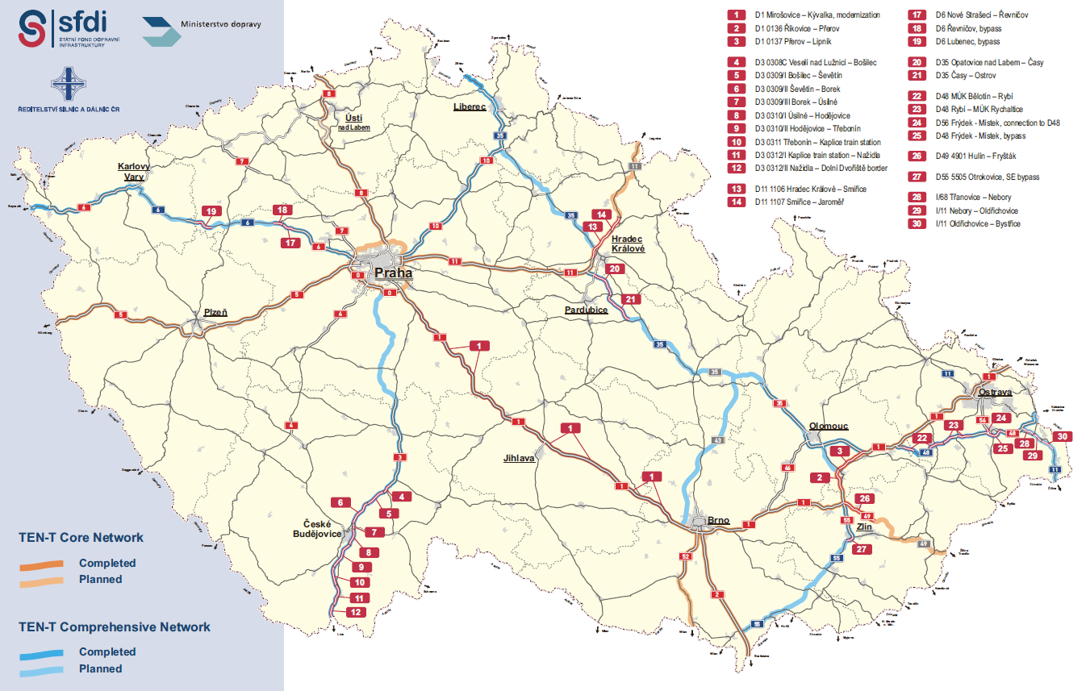
Ministry of Transport
PLANNED TEN-T ROAD PROJECTS

Slide 6
Ministry of Transport
CHALLENGES IN PROJECT PREPARATION
Feasibility Studies (high requirements vs. CBA analysis)
CZ specific legal processes:
Environmental Impact Assessment (EIA), Permitting Procedures overall,
Procurement of Regional Master Plans
Land Purchase

Slide 7
Ministry of Transport
Thank you for your attention!
www.mdcr.cz

