Slide 1


Welcome to Czechia

Slide 2

Contents
SLIDE
Basic Facts about Czechia 3 - 10
Driving Regulations 11 - 12
Useful Links 13 - 15
Foreign Policy and International Cooperation 16 - 25
Economy 30 - 64
Tourism 65 - 71
Traditional Czech Brands 72 - 78
History 79 - 86
Important Personalities 87 - 91
Geography 93
Population 94
Infrastructure 95 - 96
Agriculture 97
Environment 98

Slide 3
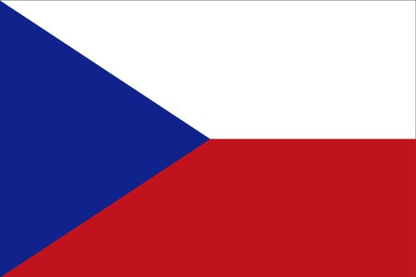
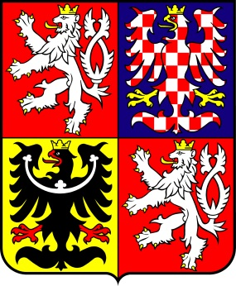

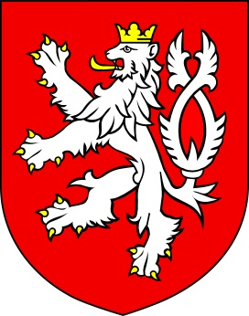

Basic Facts about the Czechia
Flag of Czechia Czech State Emblem
Flag of the President Small State Emblem State Seal

Slide 4
Basic Facts about the Czechia
Area: 78,867 km²
Population: est. 10,5 mil.
Official language: Czech
Political system: Parliamentary republic
Head of State: President
Currency: 1 Czech crown (CZK)
Capital: Prague
Administrative division: 14 regions
Member of organizations: EU, NATO, IMF, WB,
WTO, OECD, OSCE

Slide 5
Basic Facts about Czechia
Time zone: GMT + 1
Average temperatures: Summer: +20°C / 68°F
Winter: -5°C / 23°F
Country calling code: +420
(calling abroad from Czechia: 00 + country code + number)
TV / video system: DVB-T / DVB-T2
Voltage: 120/230V, 50Hz/AC

Slide 6









Basic Facts about Czechia
System of weights and measures:
  Metric system (kilometre, metre, kilogram, gram)
Payment system:
  International credit cards are accepted (Eurocard/MasterCard, American Express, VISA, Diner’s Club, Japan Credit Bureau, Access and Carte Blanche)
Mobile telephone operators:
  GSM system
  O2, T-Mobile, Vodafone

Slide 7


Basic Facts about Czechia
Healthcare services for foreigners:
Whether you arrive in Czechia as a tourist, student, or
you are going to stay here temporarily or settle down here for
good, you need a “card” that will prove that you have health
insurance. If you need urgent medical care
and do not have the insurance card with you,
you will still receive medical care, of course!

Slide 8
Basic Facts about Czechia
You can find information about the precise procedure
for health insurance here:
www.justlanded.com/english/Czech-Republic/Czech-Republic-Guide/Health/Health-insurance
For more information about social security visit
the following websites:
Responsibilities of MoLSA (mpsv.cz)

Slide 9
Basic Facts about Czechia
Opening hours of shops and other services:
Shops: 9 a.m. – 8 p.m. on weekdays
9 a.m. – 1 p.m. on Saturdays
Shopping centres are also open on Sundays
Banks: 8. a.m. – 6 p.m. on weekdays
Pharmacies: the same as shops; larger (regional) towns have pharmacies with non-stop operation

Slide 10



Basic Facts about Czechia
Important contacts:
Integrated Rescue System:
112 – Single European emergency number
  150 – Czech fire brigade
  155 – Paramedic service
  158 – Czech police

Slide 11



Driving Regulations
Zero alcohol tolerance;
Ban on holding telephones and other
communication devices while driving;
Mandatory use of seat belts;
Mandatory use of headlights at all times;
Children up to 36kg or 150cm must use a children’s car seat;
Mandatory use of helmets by cyclists and motorcyclists

Slide 12
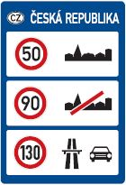
Driving Regulations
Speed limits:
In-town speed limit: 50 km/h
Roads: 90 km/h
Motorways: 130 km/h
Motorcycles: 90 km/h
Trucks over 3.5t: 80km/h
Fees for vehicles under 3.5t:
Yearly / monthly / 10-day
Motorway stickers can be purchased on-line
Electronic Vignette - eDalnice

Slide 13

Useful Links
Ministry of Foreign Affairs www.mzv.cz
The official Czechia website
www.czechia.eu, www.czechia.cz
Trade promotion www.czechtrade.cz
Investment and business support www.czechinvest.cz

Slide 14




Useful Links
CzechTourism – tourist information www.czechtourism.cz
Czech Centres – cultural activities abroad
www.czechcentres.cz
Government of Czechia
www.vlada.cz
Chamber of Deputies of the Parliament www.psp.cz
Senate of the Parliament www.senat.cz

Slide 15

Useful Links
Business intelligence
Consultancy on available financial support for investment projects
Identification of green/brownfield sites, production facilities and offices
Identification of potential acquisition, joint venture and supply partners
Individually adapted visits to Czechia
Liaising with government bodies
Aftercare services
All CzechInvest services are free of charge

Slide 16
Foreign Policy of Czechia
The basic upcoming priorities of Czech foreign policy are:
to strengthen the security of Czechia, analyse threats and counter them;
to promote Czechia’s economic and trade interests abroad, including energy security;
to enhance Czechia’s positive image and perception abroad;
to foster good relations with neighbouring countries and strengthen regional cooperation;

Slide 17
Foreign Policy of Czechia
to support a well-functioning, politically and economically strong European Union;
to maintain and strengthen the transatlantic link;
to promote respect for human rights and democracy worldwide (using transition and development cooperation instruments);
to strengthen the European integration of Eastern and South-Eastern Europe.

Slide 18




Foreign Policy of Czechia
Security and Defence Policy
NATO collective defence system – basic pillar of Czechia’s security;
Support of the development of an effective and responsive EU Common Security and Defence Policy while taking into account our NATO commitments. Both organisations need to complement each other. Cooperation with the United States is essential;
Active military and civilian involvement in NATO, EU and UN missions to manage crises and consolidate post-conflict situations.

Slide 19











Foreign Policy of Czechia
Czech troops have served e.g. in:
  Afghanistan (ISAF - Czech Provincial Reconstruction Team in Logar, Field Hospital and Chemical Detachment; Enduring Freedom - Special Forces),
  countries of former Yugoslavia (UNPROFOR, IFOR, SFOR, SFOR II, KFOR, EUFOR Althea),
  Kuwait and Iraq (NATO Training Mission, Military Police, Field Hospital, Chemical, Biological and Radiological Protection Unit)
  -Mali (EUTM, MINUSMA)
  -Sinai (MFO)

Slide 20
Foreign Policy of Czechia
Czechia and NATO
NATO member since 12th March 1999
One of the first former Warsaw Pact members to join NATO
NATO Military Committee was chaired by a Czech General, Petr Pavel from 2015 to 2018
General Pavel was the first Military Committee chairman from the former Eastern Bloc and is the current president of Czechia

Slide 21
Foreign Policy of Czechia
Czechia and NATO
Defence expenditure stands at about 1,4% of GDP (in contrast to the 2% defence expenditure level agreed under the Washington Treaty).
Most recently, NATO and its role was the subject of a public debate in connection with the plan to deploy a US long-range missile defence system in Central Europe.

Slide 22

Foreign Policy of Czechia
Czechia and the European Union
Czechia is a medium-sized member of the EU (2.1% of the population and 1.2% of the EU’s GDP);
Functioning European market and energy security are the key interests for our open and export-oriented economy;
The Common Foreign and Security Policy (CFSP), alongside with the Common Commercial Policy and the EU’s thematic and territorial financial instruments, is an essential vehicle for enabling the Member States to influence important processes in the international community and for the handling of global problems;

Slide 23
Foreign Policy of Czechia
Emphasis on common values, including democracy, rule of law, freedom, and respect for human rights and human dignity as the cornerstone of the EU’s external action;
Emphasis on the effectiveness of the EU’s institutional projects – such as EU enlargement, the European Neighbourhood Policy, and, in particular, the Eastern Partnership and related financial instruments − in promoting stability and prosperity in
the vicinity of the EU, including the Western Balkans, Eastern Europe, the Southern Caucasus and the Middle East.

Slide 24

Foreign Policy of Czechia
Visegrad Group
The Visegrad Group (V4) is an alliance of four Central European countries – Czech Republic, Hungary, Poland and Slovakia.
The V4 was established to further the European integration of its participants and to encourage their military, economic and energy cooperation.
The V4 was founded at a summit meeting of Czechoslovak, Hungarian and Polish leaders at Visegrad, Hungary, on 15 February 1991.

Slide 25
Foreign Policy of Czechia
Visegrad Group
All V4 countries are high-income economies with very high Human Development Indexes, benefiting from over a century of more or less steady economic growth.
Counted as a single whole, the V4 would rank as the fifth largest economy in Europe and the twelfth largest in the world.
The only formal V4 institution is the International Visegrad Fund (IVF) established in 1999.
The IVF supports individuals and NGOs from the V4, Western Balkans and Eastern Partnership regions as well as from other countries.

Slide 26
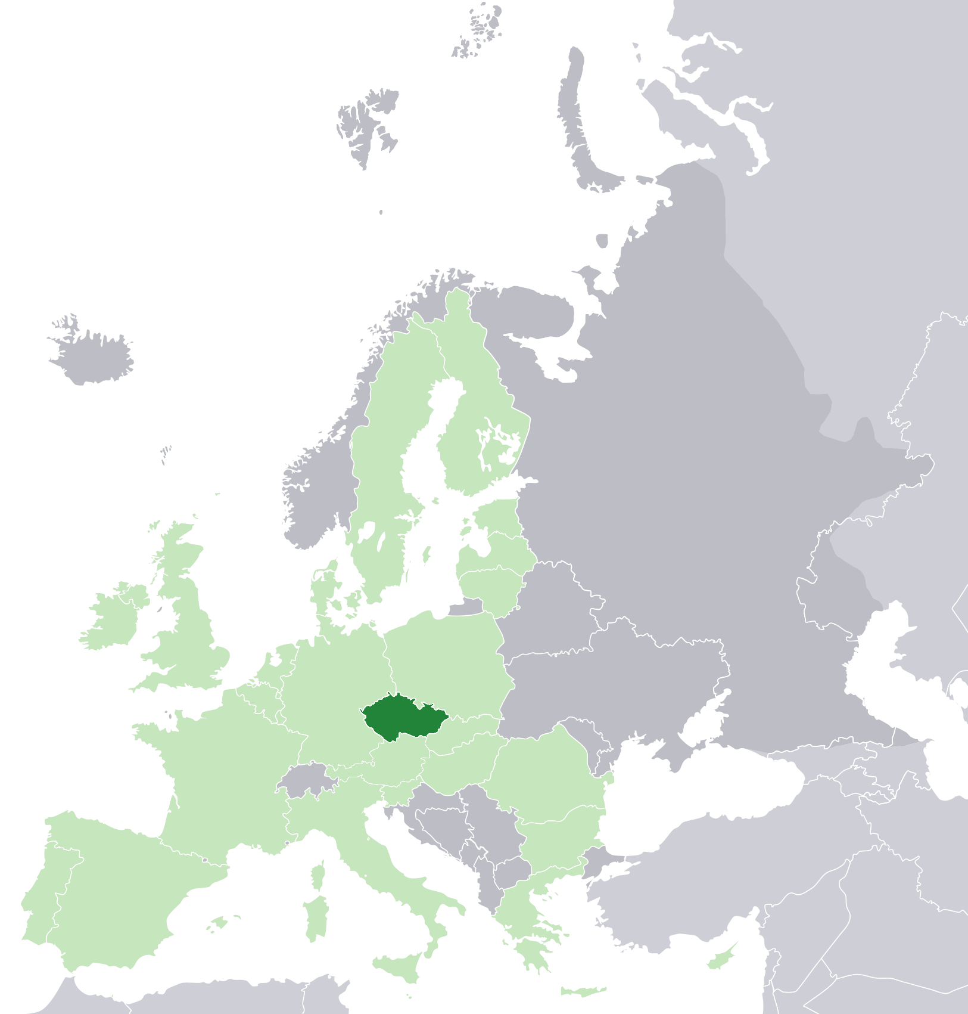
Foreign Policy of Czechia
Czechia in the EU
Timeline:
1996 – Request for EU membership
June 2003 – Referendum on EU accession (77% Czechs in favour)
1 May 2004 – Czechia joins the EU
December 2007 – Czechia joins the Schengen Area
January - June 2009 – Czech Presidency of the EU
July – December 2022 – Czech Presidency of the EU

Slide 27

Foreign Policy of Czechia
Promoting Democracy and Human Rights
Drawing on the specific experience of Czechia gained in its own process of social transition and nonviolent resistance to a totalitarian regime;
Focus on universal support for civil society and human rights defenders, independent media and free access to information, strengthening the rule of law as well as good and democratic governance;
Czechia’s Transition Assistance Programme - basis for an active financial support for NGO projects;
Advocacy of human rights and democracy at international fora, including the EU (facilitating the best possible use of the EU’s financial instruments);
Czechia served as an elected member on the UN Human Rights Council (June 2011 – June 2014).

Slide 28

Foreign Policy of Czechia
Development Cooperation
Czechia is able to rely on its own transition experience and offer sustainable solutions;
Basic principles: respect for development objectives and needs of partner countries, long-term commitments and mutual accountability, promotion of civil society, good governance and transparent institutions; human rights and gender equality, protection of environment and climate.

Slide 29
Foreign Policy of Czechia
Six priority countries with bilateral development programs:
- Bosnia and Herzegovina,
- Cambodia,
- Ethiopia,
- Georgia
- Moldova,
- Zambia
Specific countries and regions with stabilisation programs: - Africa (Horn of Africa, Sahel),
- MENA Region (Iraq, Syria, Yemen),
- Ukraine (+ refugees in Moldova)
Sectoral focus on agriculture and rural development, social development (health, education), water and sanitation, disaster risk reduction and climate resilience, and economic growth (energy).

Slide 30
Economy
Rating of Czechia
Agency | Rating | Outlook | Date
Moody's | Aa3 | stable | Oct 04 2019
Fitch | AA- | stable | Aug 03 2018
Moody's | A1 | positive | Apr 20 2018

Slide 31
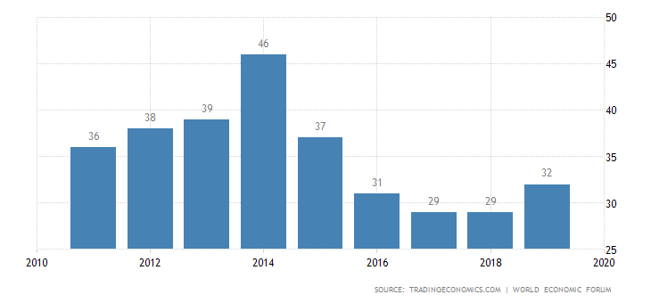

Economy
Global competitivness index rating

Slide 32

Economy
CZECHIA – COMPETITIVE ECONOMY
According to the 2019 Global Competitiveness Report published by the World Economic Forum, the Czech Republic ranks 32nd among 141 world economies in terms of competitiveness.
Competitive Advantages (Rank)
Inflation (1)
Debt dynamics (1)
Credit gap (1)
Electricity access (2)
Railroad density (3)
Electrification rate (3)
Trade tariffs (7)
Insolvency regulatory framework (9)
Active labour market policies (11)
Worker´s rights (14)
Mean years of schooling (15)
Flexibility of wage determination 15)
Imports (15)
Road connectivity (17)
Energy efficiency regulation (18)
Reliability of water supply (19)
School life years (19)
Quality of land administration (20)
Notes:
Author/Update: CzechInvest 2014

Slide 33
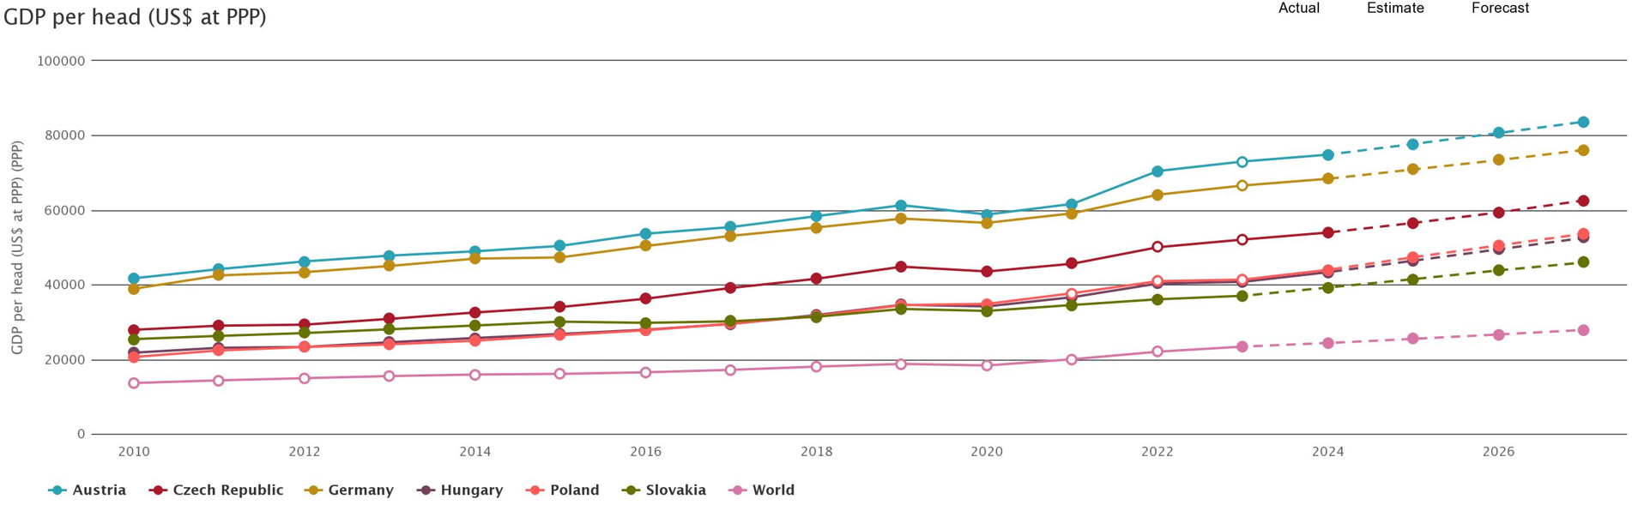
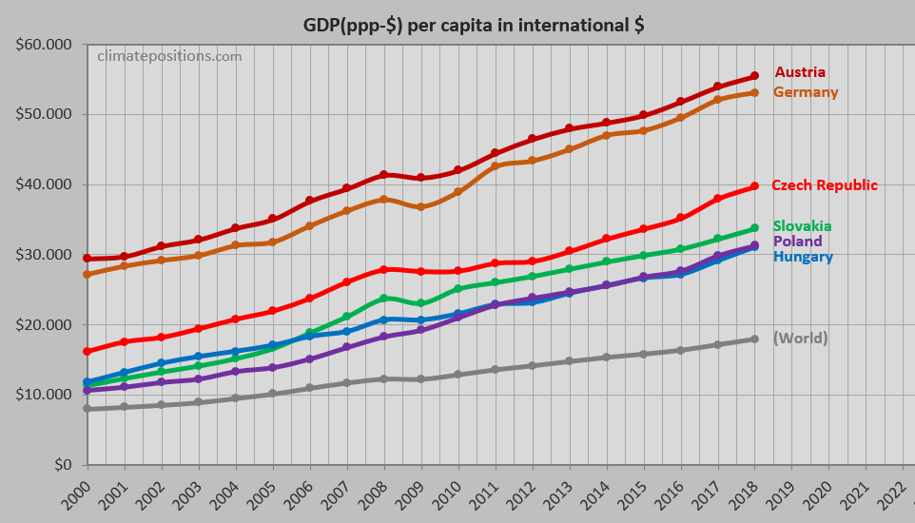
Economy
GDP of Central European Countries

Slide 34
Economy
Gross Domestic Product per capita in EUR

Slide 35
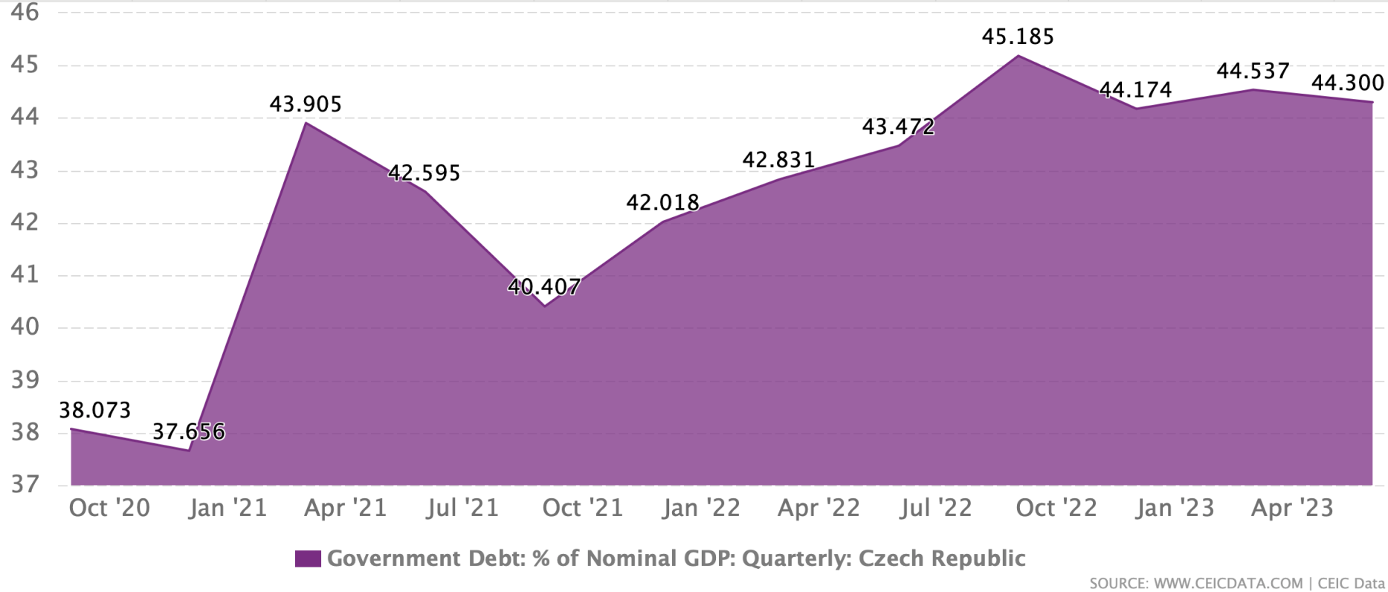
Economy
Czech Government's Debt

Slide 36
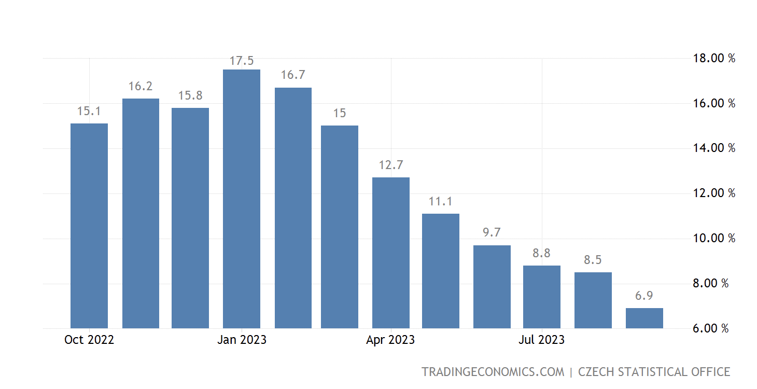
Economy
Czechia inflation rate

Slide 37
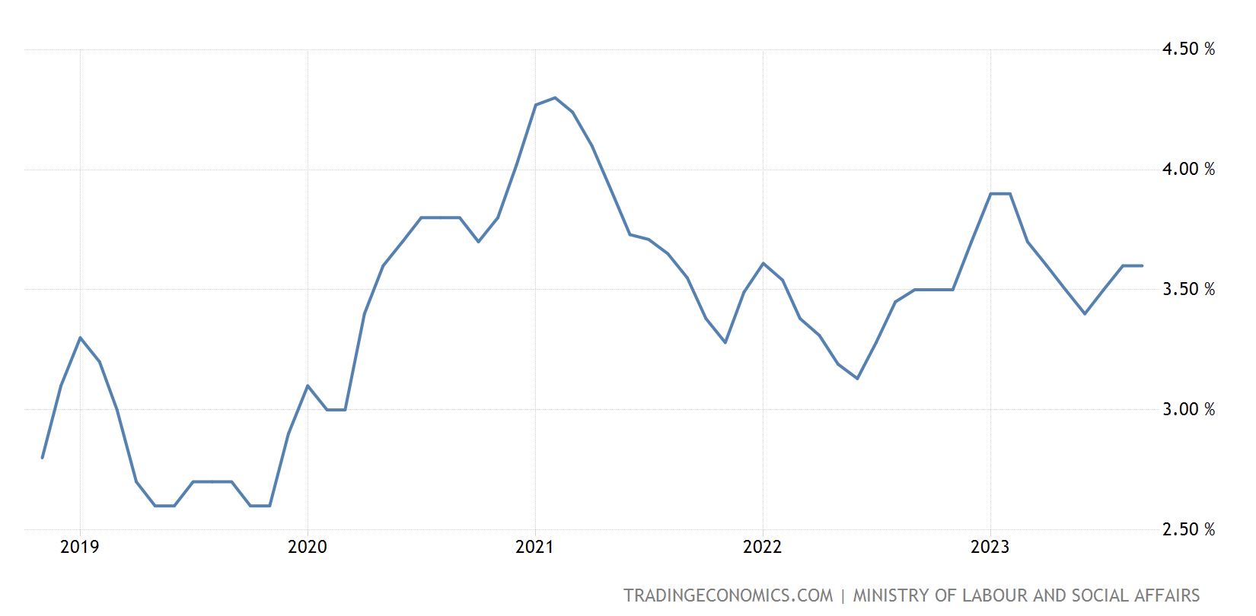
Economy
Unemployment rate

Slide 38
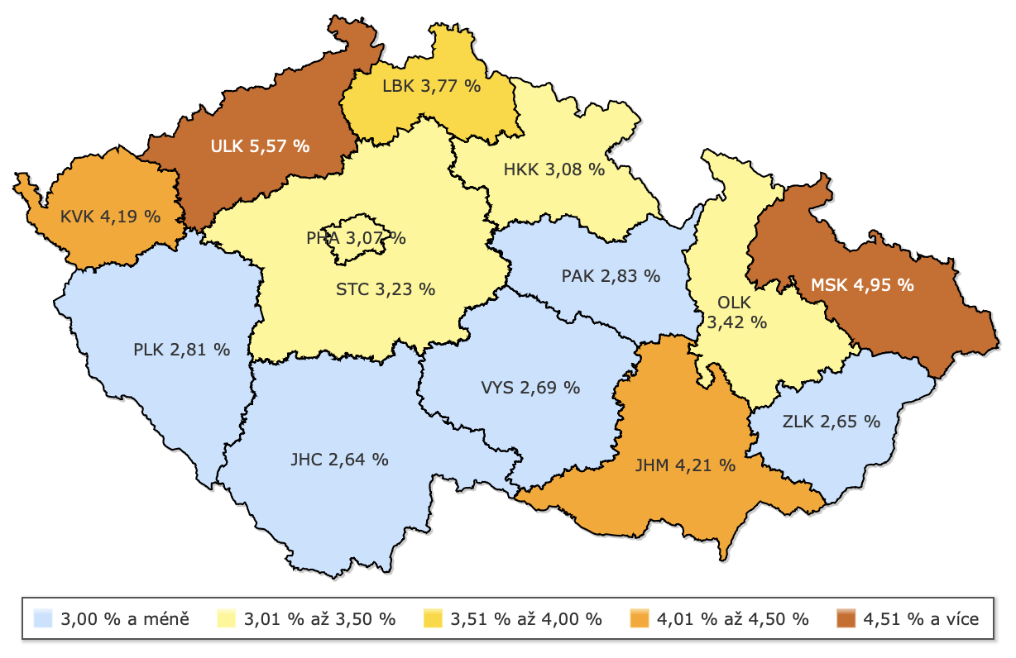
Economy
Unemployment by regions 2023

Slide 39
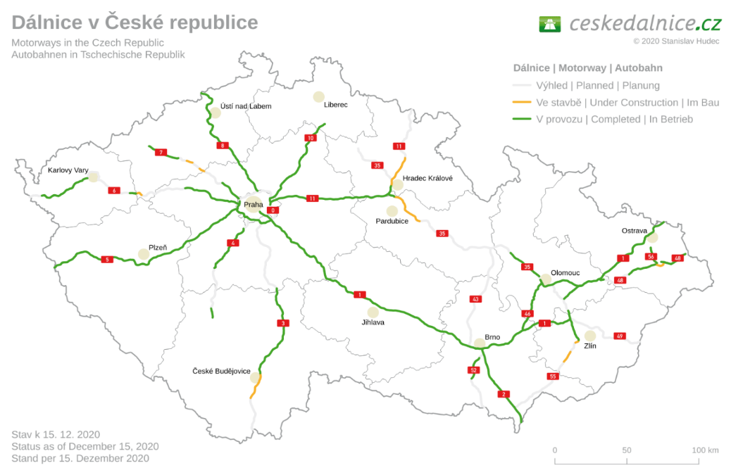
Economy
Motorways in Czechia

Slide 40
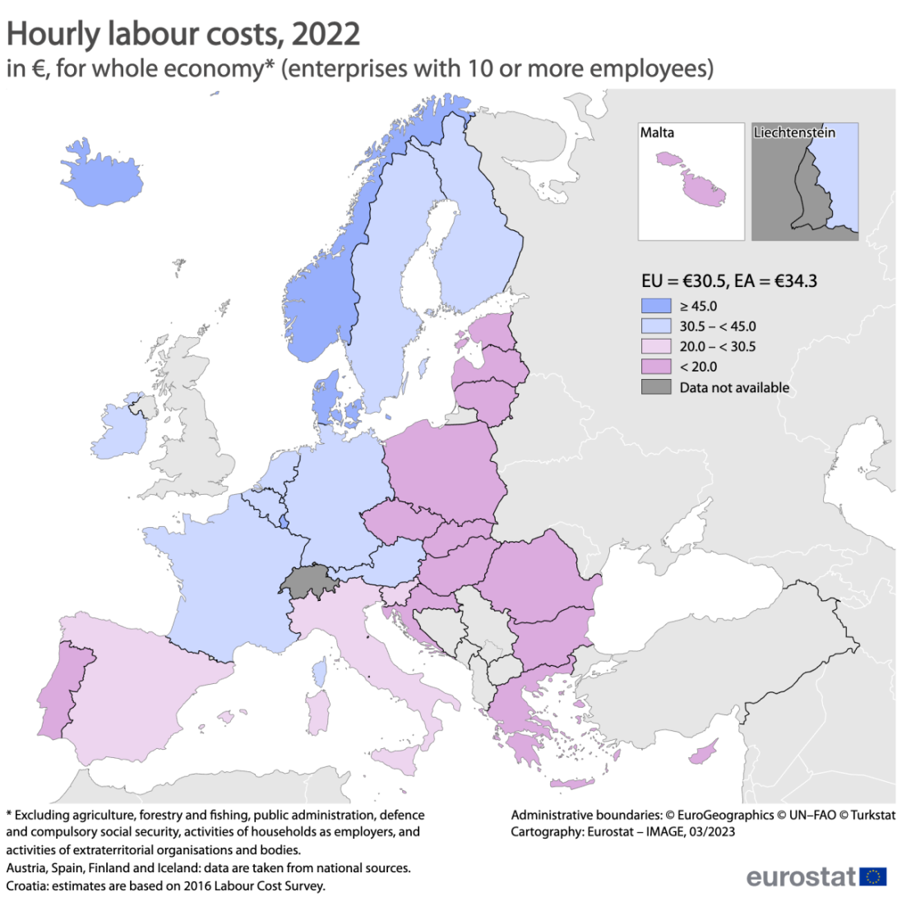
Economy
Labour costs per hour in Euro

Slide 41
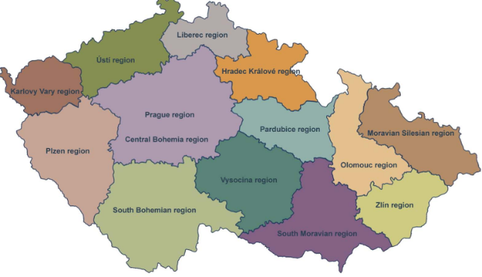

Economy
Wages in Czechia
Region | Average wages 2Q 2023 in CZK
Prague | 52 833
Central Bohemia region | 45 477
South Moravia region | 39 279
Plzeň region | 40 986
Ústí region | 39 589
Hradec Králové region | 41 249
Liberec region | 39 143
Vysočina region | 39 382
South Bohemia region | 41 912
Moravian Silesian region | 39 108
Olomouc region | 38 488
Pardubice region | 38 275
Zlín region | 39 019
Karlovy Vary region | 37 072

Slide 42

Economy
TAXATION IN THE CZECH REPUBLIC
Corporate income tax 21%
Personal income tax 15% (23 % progressive tax rate from 36x of average wage)
Withholding tax 15%
Value-added tax 21% (standard rate) or 12% (reduced tax rate)
Real estate tax rates vary by type, location and purpose of use; and inflation coefficient
Real estate transfer tax 15% from profit (FO possible tax exemption)
Road tax on vehicles from 12 tonnes only; rates vary by engine capacity (passenger cars) or weight and number of axles (other commercial vehicles)
Excise tax on petrol, alcohol and tobacco only
Energy tax on electricity, natural and other gases, and solid fuels
Source: PricewaterhouseCoopers, 2016 – updated based on tax package 2024
Notes:
Real estate transfer tax – FO exemption: time test, previous occupacy, use of funds (acquired form sale) for own housing needs

Slide 43
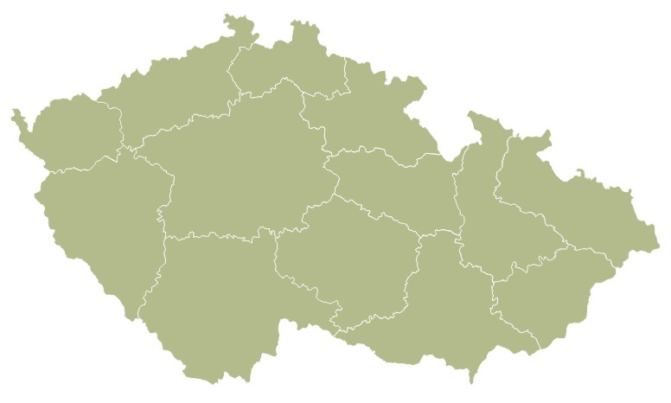
Economy
Main Universities 2022
CZECH REPUBLIC
Students:
304,518
Graduates: 82,324
Jan Evangelista Purkyně Univesity
Ústí nad Labem
Students: 10,884
Graduates: 1,983
Technical University Liberec
Students: 6,140
Graduates: 970
University
of Hradec Králové
Students: 6,193
Graduates: 1,145
University of Life Sciences, Prague
Students: 20,809
Graduates: 3,938
Charles University Prague
Students: 50,663
Graduates: 15,162
University of Economics Prague
Students: 14,472
Graduates: 4,798
University of Ostrava
Students: 8,962
Graduates: 2,028
Czech Technical University Prague
Students: 17,268
Graduates: 3,905
University of Pardubice
Students: 6,598
Graduates: 982
University of West Bohemia Plzeň
Students: 11,071
Graduates: 3,305
VŠB-Technical University Ostrava
Students: 11,215
Graduates: 2,134
Palacký University Olomouc
Students: 22,716
Graduates: 3,897
Tomáš Baťa
University Zlín
Students: 9,001
Graduates: 1,349
University of South Bohemia České Budějovice
Students: 10,354
Graduates: 1,714
Brno University of technology
Students: 17,426
Graduates: 4,251
Masaryk University Brno
Students: 36,475
Graduates: 12,682
Source: Ministry of Education, Youth and Sports

Slide 44
Economy
SOCIAL AND HEALTH INSURANCE CONTRIBUTIONS
Source: CzechInvest
 | Employer-payable | Employee-payable
Health insurance | 9.0% | 4.5%
Social insurance | 25.0% | 6.5%
pension fund | 21.5% | 6.5%
sickness insurance | 2.3% | 0%
unemployment fund | 1.2% | 0%
Total | 34.0% | 11.0%

Slide 45
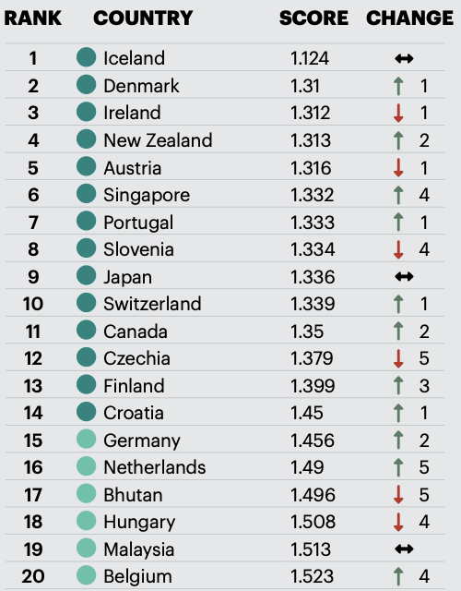
Economy
Czechia
Global peace index 2023
Source: Institute of Economics and Peace, 2023

Slide 46
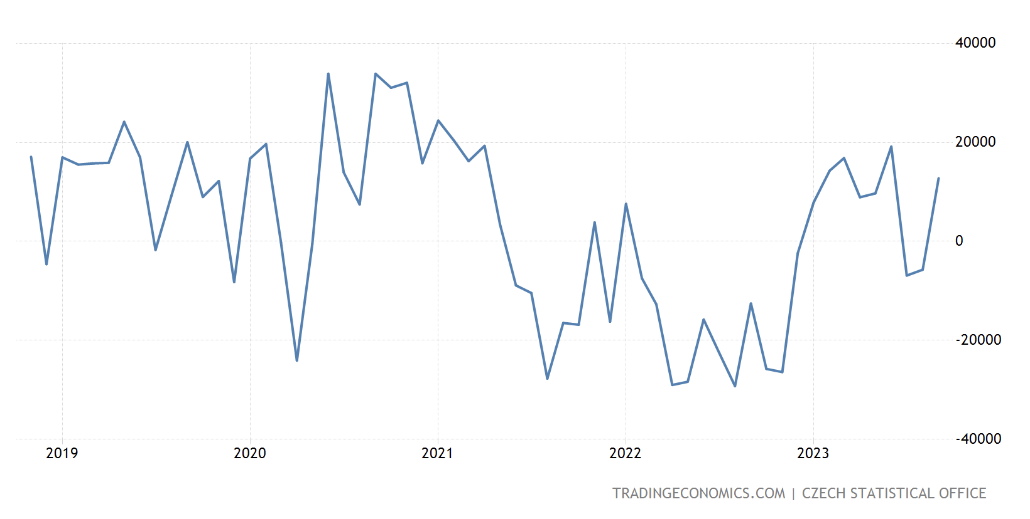
Economy
Balance of External Trade - Czechia
(in Millions of CZK)

Slide 47
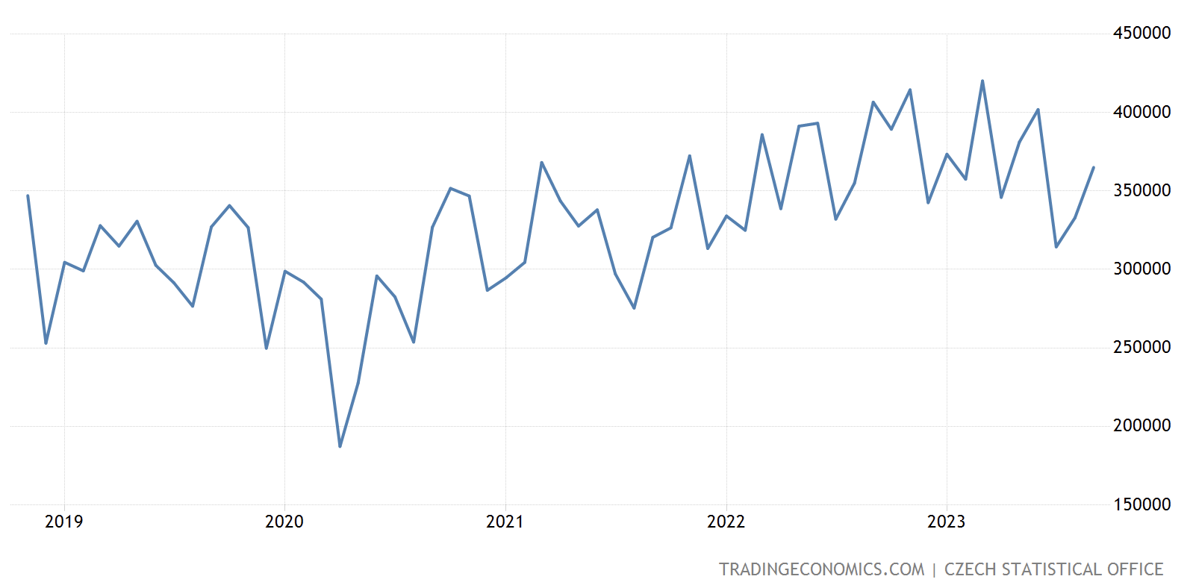
Economy
Exports of Czechia
(in Millions of CZK)

Slide 48
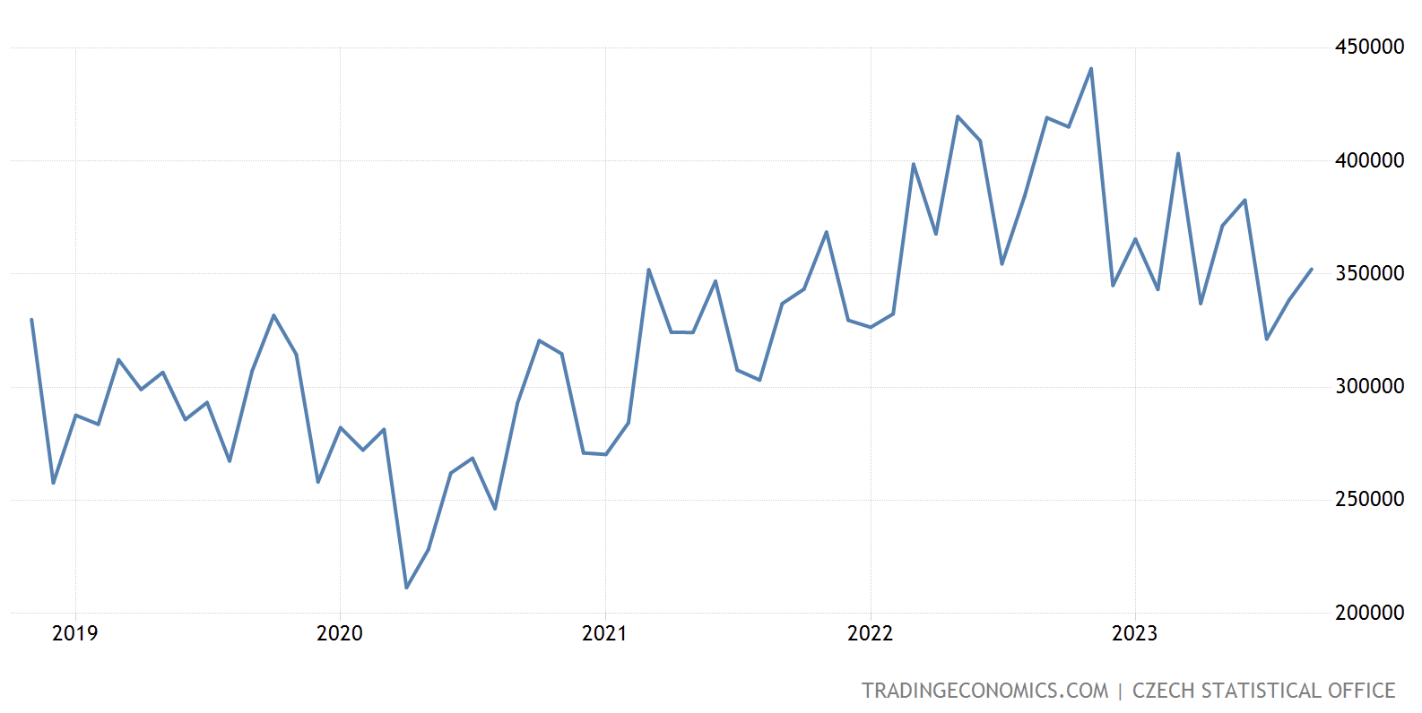
Economy
Imports of Czechia
(in Millions of CZK)

Slide 49
Economy
External Trade – Top 15 Export Countries (2022)
Czechia Exports By Country | Value | Year
Germany | $79.22B | 2022
Slovakia | $20.30B | 2022
Poland | $17.04B | 2022
France | $11.23B | 2022
Austria | $10.73B | 2022
United Kingdom | $8.62B | 2022
Netherlands | $8.73B | 2022
Italy | $9.85B | 2022
Hungary | $8.24B | 2022
Spain | $6.32B | 2022
United States | $8.62B | 2022
Russia | $1.56B | 2022
Belgium | $5.28B | 2022
Sweden | $3.95B | 2022
Switzerland | $3.49B | 2022
Romania | $3.76B | 2022
China | $2.72B | 2022
Turkey | $2.67B | 2022
Denmark | $2.28B | 2022
Ukraine | $1.51B | 2022
Ireland | $1.55B | 2022
Bulgaria | $1.34B | 2022
Japan | $1.28B | 2022
Finland | $1.22B | 2022
Slovenia | $1.21B | 2022

Slide 50
Economy
External Trade – Top 15 Import Countries (2022)
Czechia Imports By Country | Value | Year
Germany | $46.82B | 2022
China | $44.36B | 2022
Poland | $18.93B | 2022
Russia | $11.37B | 2022
Slovakia | $9.83B | 2022
Italy | $9.09B | 2022
Netherlands | $6.51B | 2022
France | $6.49B | 2022
Austria | $6.31B | 2022
United States | $6.14B | 2022
Hungary | $5.39B | 2022
South Korea | $4.51B | 2022
Japan | $3.98B | 2022
Spain | $3.82B | 2022
Belgium | $3.73B | 2022
United Kingdom | $3.65B | 2022
Romania | $2.80B | 2022
Turkey | $2.74B | 2022
Vietnam | $2.27B | 2022
Switzerland | $2.14B | 2022
India | $2.09B | 2022
Norway | $2.07B | 2022
Malaysia | $2.04B | 2022
Sweden | $1.80B | 2022
Thailand | $1.69B | 2022

Slide 51
Economy
External Trade – Czech exports by category (2022)
Czechia Exports By Category | Value | Year
Electrical, electronic equipment | $48.14B | 2022
Machinery, nuclear reactors, boilers | $42.85B | 2022
Vehicles other than railway, tramway | $42.50B | 2022
Mineral fuels, oils, distillation products | $8.55B | 2022
Plastics | $8.55B | 2022
Articles of iron or steel | $8.38B | 2022
Iron and steel | $6.01B | 2022
Furniture, lightning signs, prefabricated buildings | $5.74B | 2022
Optical, photo, technical, medical apparatus | $5.18B | 2022
Rubbers | $4.45B | 2022
Toys, games, sport requisites | $4.33B | 2022
Pharmaceutical products | $3.71B | 2022
Wood and articles of wood, wood charcoal | $3.71B | 2022
Aluminium | $2.80B | 2022
Paper and paperboard, articles of pulp, paper and board | $2.45B | 2022
Glass and glassware | $2.37B | 2022
Essential oils, perfumes, cosmetics, toileteries | $2.25B | 2022
Miscellaneous chemical products | $1.94B | 2022
Miscellaneous manufactured articles | $1.70B | 2022
Miscellaneous articles of base metal | $1.64B | 2022
Articles of apparel, knit or crocheted | $1.47B | 2022
Articles of apparel, not knit or crocheted | $1.41B | 2022
Organic chemicals | $1.39B | 2022
Dairy products, eggs, honey, edible products | $1.28B | 2022
Railway, tramway locomotives, rolling stock, equipment | $1.21B | 2022

Slide 52
Economy
External Trade – Czech imports by category (2022)
Czechia Imports By Category | Value | Year
Electrical, electronic equipment | $51.19B | 2022
Machinery, nuclear reactors, boilers | $35.41B | 2022
Mineral fuels, oils, distillation products | $22.12B | 2022
Vehicles other than railway, tramway | $19.84B | 2022
Plastics | $11.47B | 2022
Iron and steel | $9.18B | 2022
Pharmaceutical products | $7.04B | 2022
Articles of iron or steel | $5.90B | 2022
Optical, photo, technical, medical apparatus | $4.93B | 2022
Furniture, lighting signs, prefabricated buildings | $4.07B | 2022
Aluminium | $4.05B | 2022
Miscellaneous chemical products | $3.21B | 2022
Rubbers | $3.06B | 2022
Paper and paperboard, articles of pulp, paper and board | $2.98B | 2022
Essential oils, perfumes, cosmetics, toileteries | $2.41B | 2022
Articles of apparel, knit or crocheted | $2.31B | 2022
Toys, games, sports requisites | $2.22B | 2022
Inorganic chemicals, precious metal compound, isotope | $1.98B | 2022
Copper | $1.94B | 2022
Articles of apparel, not knit or crocheted | $1.89B | 2022
Pearls, precious stones, metals, coins | $1.29B | 2022
Organic chemicals | $1.79B | 2022
Wood and articles of wood, wood charcoal | $1.58B | 2022
Footwear, gaiters and the like | $1.56B | 2022
Meat and edible meat offal | $1.53B | 2022

Slide 53
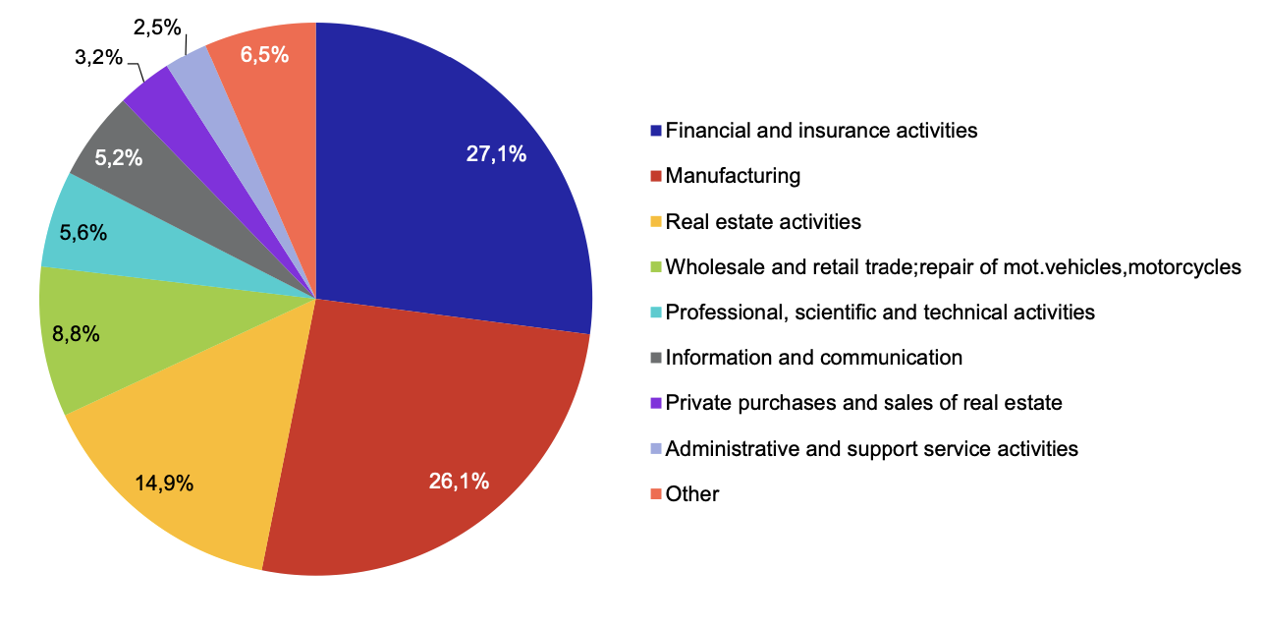
Economy
FDI by sectors 1993-2021
Total EUR: 177 billion
Total USD: 200.5 billion
Source: Czech National Bank, 2021

Slide 54
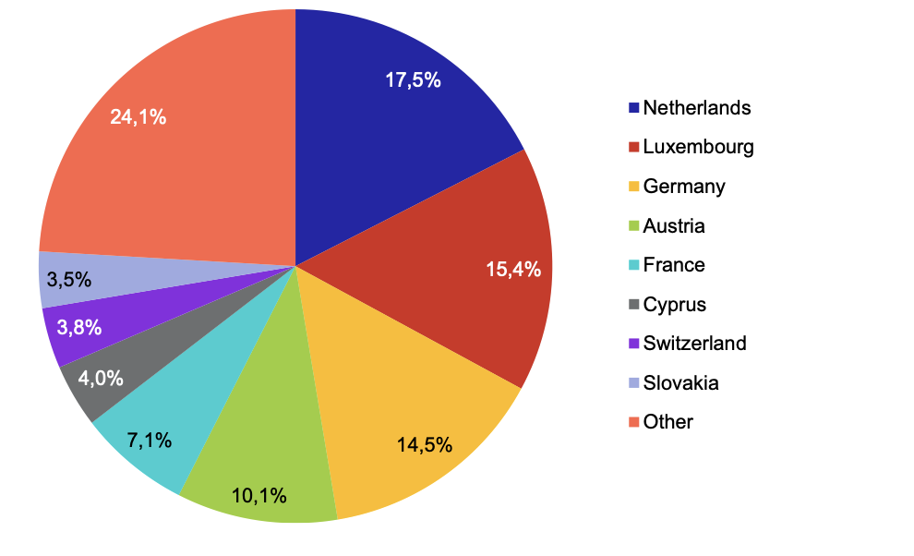
Economy
FDI by states 1993-2021
Total EUR: 177 billion
Total USD: 200.5 billion
Source: Czech National Bank, 2021

Slide 55
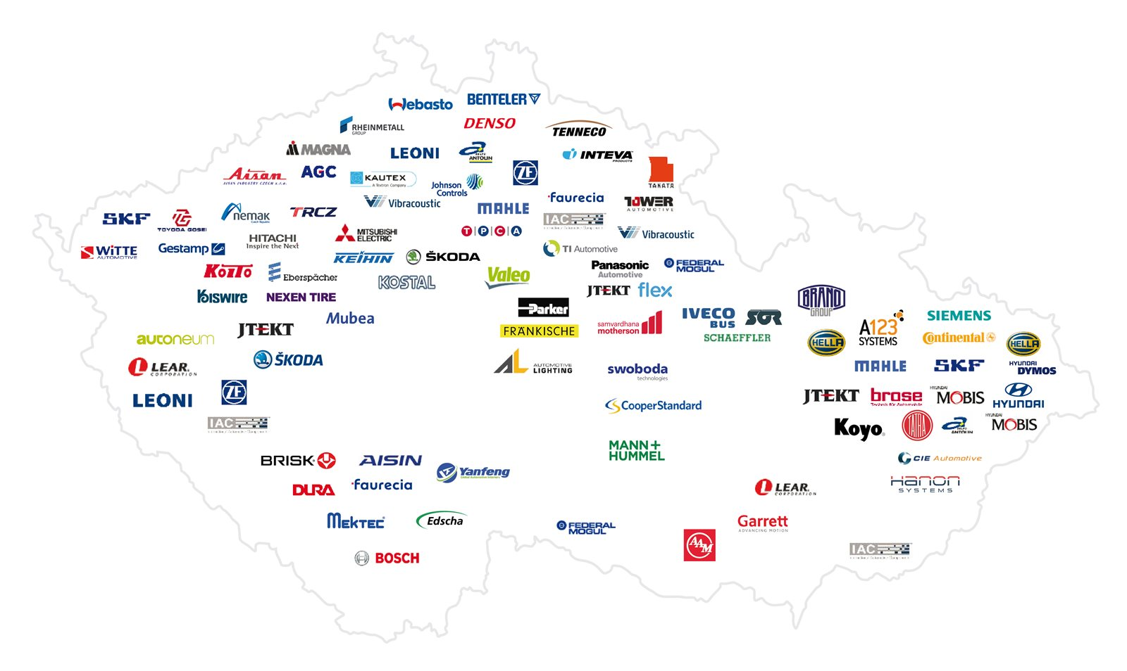
Economy
Automotive industry
in Czechia
key players

Slide 56
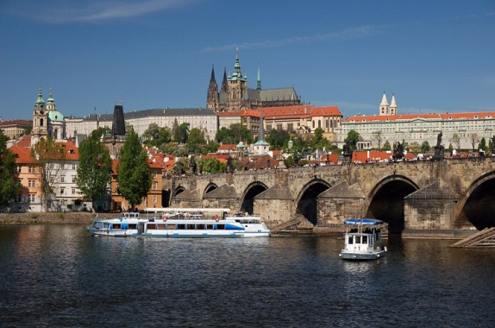
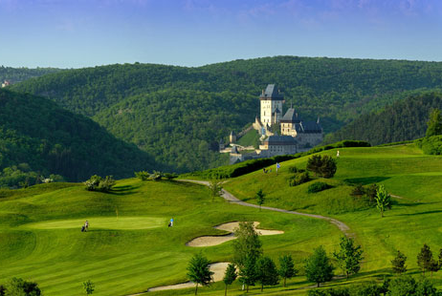
Economy
SUMMARY – INVESTMENT BENEFITS
Outstanding geographical location
Advanced transport infrastructure
Transparent investment incentives
Highly skilled and educated labour force
Good level of language skills
Well-developed supplier base
Attractive living environment

Slide 57

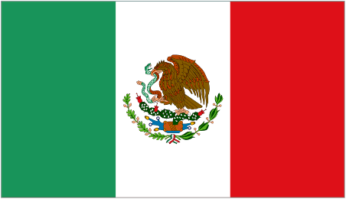

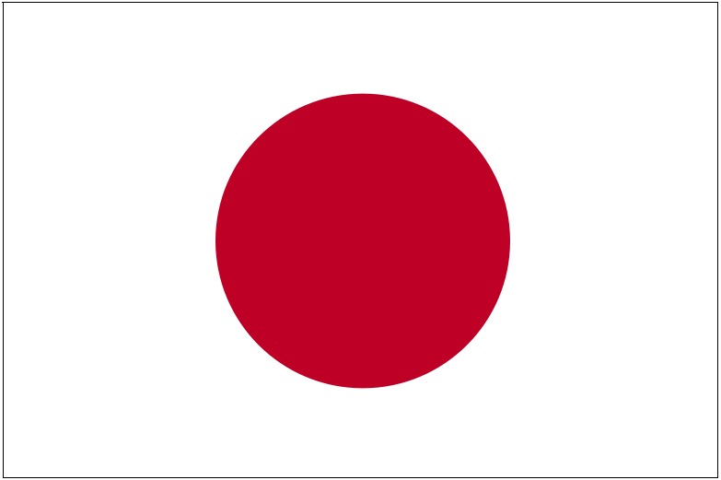



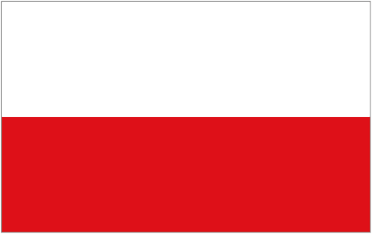



Economy
MAJOR INVESTORS – Manufacturing
      ABB (eng.+el.) NEMAK (aut.)
      BOSCH (aut.) PANASONIC (el.)
      CATERPILLAR (eng.) SAINT GOBAIN (build.)
        CONTINENTAL (aut.) SHIMANO (eng.)
      DAIKIN (eng.+el.) SIEMENS (el.+aut.)
      DENSO (aut.) SYNTHOS (chem.)
      FOXCONN (el.) TEVA (phar.)
      HONEYWELL (eng.) TORAY (tex.)
      HYUNDAI (aut.) TOYOTA+PEUGEOT+CITROËN
      JOHNSON CONTROLS (aut.) TRW (aut.)
      KIMBERLY CLARK (med.) VOLKSWAGEN (aut.)
      MAGNA (aut.)

Slide 58




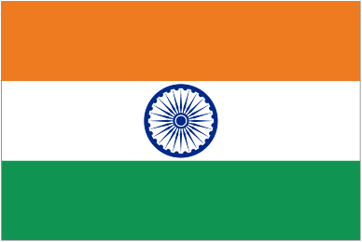
Economy
MAJOR INVESTORS – IT & Software Development
ACISION O RACLE
      ADOBE PIXMANIA
      AVG TECHNOLOGIES RED HAT
      BOHEMIA INTERACTIVE SKYPE
      COMPUTER ASSOCIATES SOLARWINDS
      DEUTSCHE BÖRSE STORA ENSO
      DHL SUSE LINUX
      HEWLETT PACKARD IBM TELOGIC
      INFOSYS TERADATA
      MICROSOFT TIETO
      NESS TECHNOLOGIES Source: CzechInvest

Slide 59

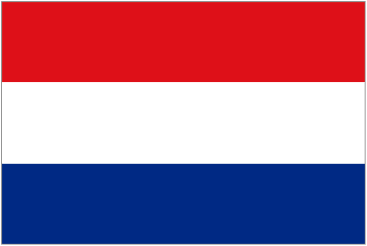

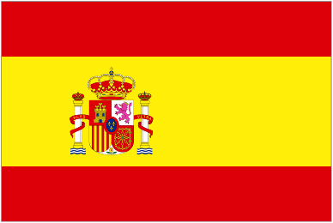
Economy
MAJOR INVESTORS – Business Support Services
      ACCENTURE (ss) INBEV (ss)
      ADP (bpo) JOHNSON&JOHNSON (ss+cc)
      BANK AUSTRIA CREDIT. (ss) LUFTHANSA (cc)
      COVIDIEN (ss) MONSTER (ss+cc)
      DSG INTERNATIONAL (ss+cc) MOTOROLA (ss)
      EBAY (ss) REGUS (ss)
      EXL SERVICE (ss) SAP (ss)
      EXXONMOBIL (ss) SIEMENS (ss)
      GARDNER DENVER SITA (ss)
      GE MONEY BANK (cc) ORACLE (ss)
      GRUPO ATENTO (cc) TESCO STORES (ss)
      IBM (bpo) Source: CzechInvest, 2014
      bpo = business process outsourcing cc = call centres, ss = shared services

Slide 60


Economy
MAJOR INVESTORS – Technology Centres
      BANG & OLUFSEN (el.) OLYMPUS (med.)
      ROBERT BOSCH (aut.) ON SEMICONDUCTOR (el.)
      DENSO (aut.) PANASONIC (el.)
      EMERSON (el.) PROCTER&GAMBLE (chem.)
      GE AVIATION (aero.) R ICARDO (aut.)
      HONEYWELL (el.) RIETER
      INGERSOLL RAND SIEMENS (el.)
      LATÉCOÈRE (aero.) VARROC LIGHTING (aut.)
      LONZA (bio) VOLKSWAGEN (aut.)
      MERCEDES-BENZ (aut.) VISTEON (aut.)
      Source: CzechInvest

Slide 61

Economy and Tourism
Czech Film Industry
Czech film industry is centred around Barrandov Studios.
Barrandov Studios is the largest film production hub in the country and one of the largest in Europe.
Noted director Roman Polanski praises Barrandov Studios as one of the finest in the world.
Barrandov Studios has been involved in the production of several Oscar-winning films.
Since 2010, Barrandov Studios has been the location of choice for about fifty international films.

Slide 62
Economy and Tourism
Czech Film Industry
Barrandov Studios is recognized as the "European Hollywood" and "Hollywood of the East" thanks to the increasing interest of producers from Western Europe and beyond (Mission Impossible, The Bourne Identity, Casino Royale, Prince Caspian, and many other films)
Barrandov Studios annually awards its own prize - the Golden Trilobite.
The Karlovy Vary International Film Festival takes place in Karlovy Vary every July.
The Karlovy Vary Festival is one of the oldest in the world and has become the leading film event in Central and Eastern Europe.

Slide 63
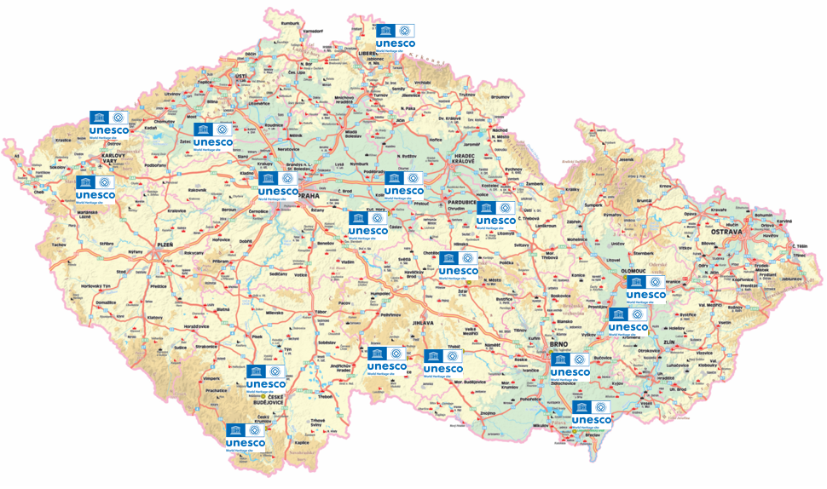

Tourism
Tourism in Czechia
Located at the crossroads of cultures in the heart of Europe, Czechia has countless cultural and historical points of interest. Czechia is a country of great historical and cultural traditions. A country rich in historic sites, including entire towns, inscribed on the World Heritage List.

Slide 64
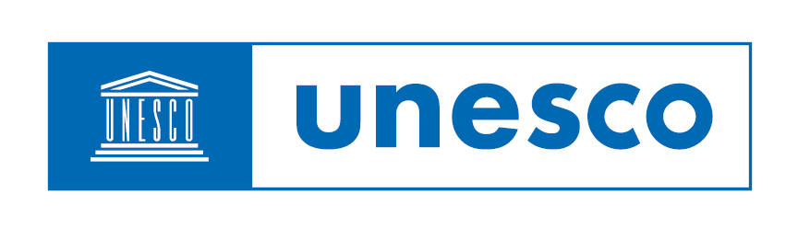
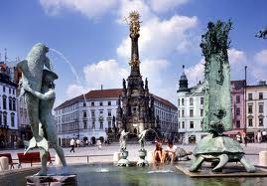
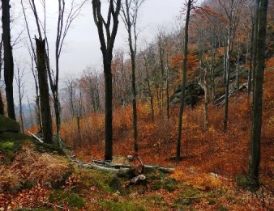
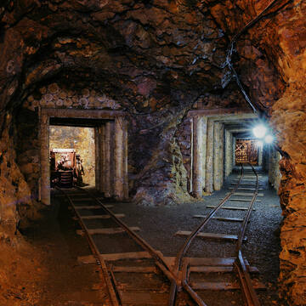
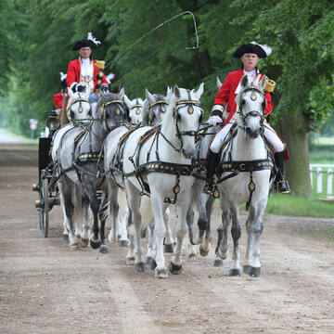
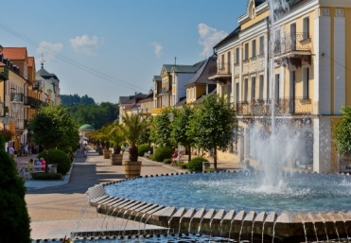
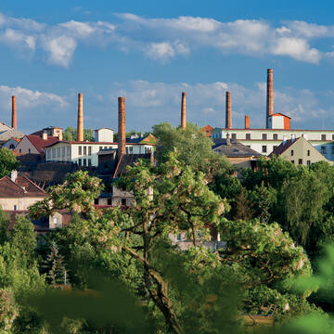
Tourism
World Heritage Sights in Czechia

Slide 65

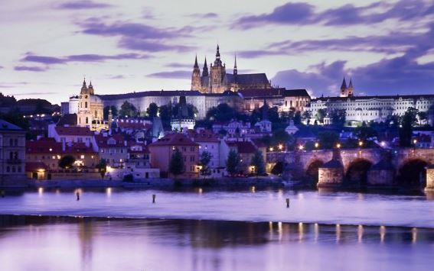
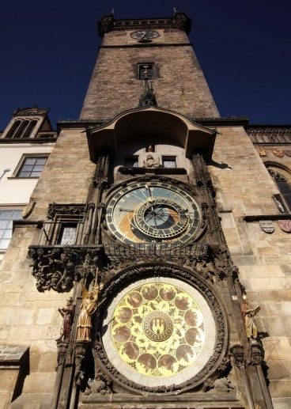
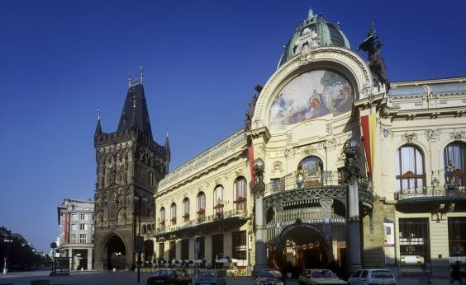
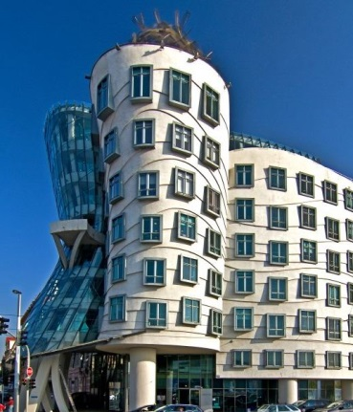
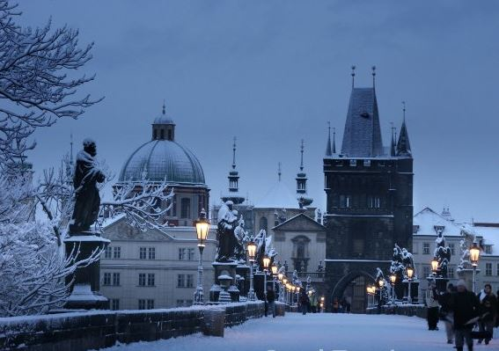
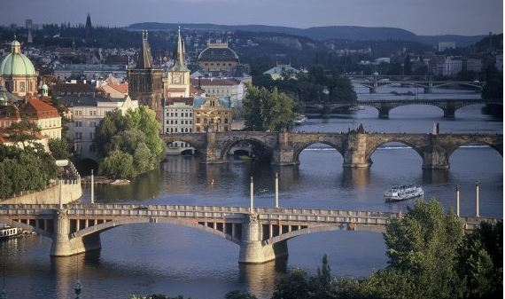
Tourism
Prague is the top tourist destination
in Czechia. Recognized as one of the most beautiful capitals in the world, the city boasts an exquisitely preserved historical centre.

Slide 66
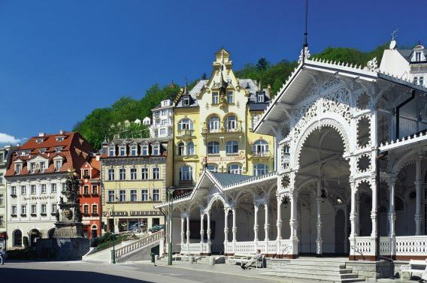
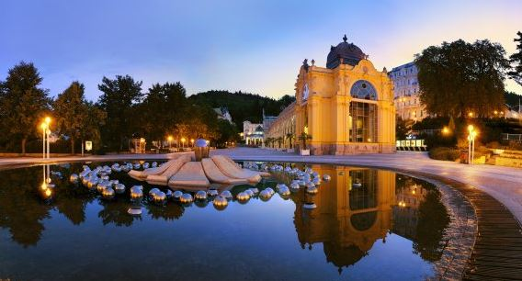
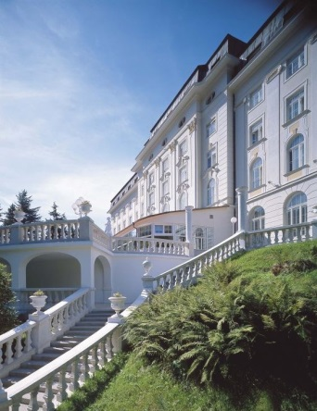

Tourism
Mineral spa towns in Czechia are very popular tourist destinations.
Spa towns like Karlovy Vary (Karlsbad) and Mariánské Lázně (Marienbad) have a very long history of international recognition and success.
The spa town of Jáchymov is renowned for its rare
radioactive springs.

Slide 67

Tourism
Beer and beer baths
Czech beer is a national symbol, enjoying the Protected Geographical Indication status since 2008. The annual production
of nearly 20 million hectolitres places the Czech Republic 15th in the world
(the biggest producer is the USA, followed by China and Germany).
A beer bath is an extremely popular wellness procedure. It combines the curative effects of mineral water, beer and ingredients used in beer production. The benefits of beer baths have been known since the Middle Ages. Medieval doctors, herbalists and bonesetters recommended bathing in yeasty beer as a curative as well as preventive therapy.
For more information please visit:
http://www.czech.cz/en/Business/Czech-companies/Beer-Nation-–-Czech-Republic

Slide 68
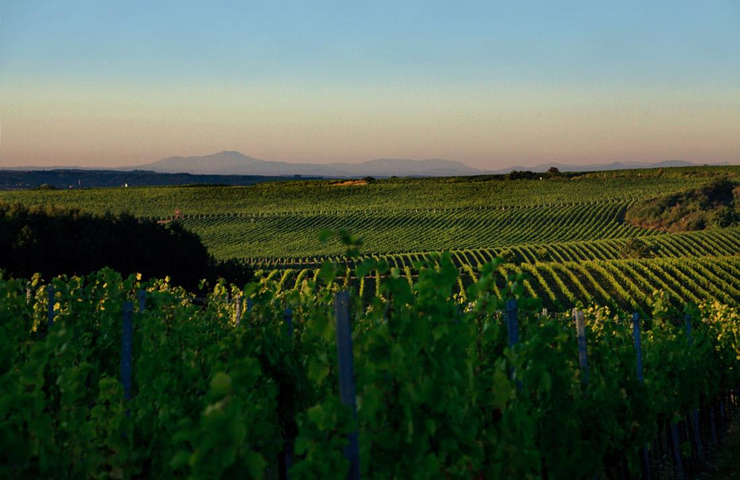
Tourism
Wine and winemaking in Czechia
Moravian white wines are recognized worldwide. They have won many international awards and are well received even in major wine-growing countries such as France and Germany.
Czechia is divided into two main wine-producing regions, Bohemia and Moravia, each with several subregions.
The country’s wine producing tradition is very long, going back to the 3rd century when the Romans planted the first grape vines in the territory of the present Czechia. The area taken up by vineyards was largest in the seventeenth century, on the eve of the Thirty Years' War. Today there are 19,000 hectares of vineyards, mostly situated in Moravia.
For more information please visit:
http://www.czech.cz/en/98915-wine-and-viniculture-regions-in-the-czech-republic

Slide 69
Tourism
Wine & Tourism
The diversity of the Moravia wine producing region, stretching across several terroirs with different climatic factors, gives Moravian wines their distinctive character.
The area between Znojmo and Uherské Hradiště, with its diversity of vineyards, wine growing traditions, grape varieties and wine producing technologies has a unique genius loci.
More than 1,200 kilometres of signposted cycling trails known as the Moravian Wine Route run through Moravia. The trails zigzag the wine growing region, guiding you to vantage points, down alleys lined with wine cellars, and through many famous wine-growing villages. A cycling tour along the Wine Route is a good way to see the picturesque Moravian landscape with its historical landmarks and wonderful wines.
For more information please visit:
http://www.wineofczechrepublic.cz/en/wine-tourism.html

Slide 70

Traditional Czech Brands
Barum Continental, spol. s r.o.
Barum Continental, spol. s r. o. is the largest Czech tire manufacturer. Since
1999 has been the largest European manufacturer of passenger car tires. In
1993, Barum Continental merged with Continental AG, one of the
world's leading companies in its field. Barum has achieved success
by combining modern development trends, technology, business
strategy and experience based on a long tradition of tire manufacturing in the
Zlín region, where the first tires were produced in the 1930s by the Bata
Company.
www.conti-online.cz
www.barum-online.cz

Slide 71

Traditional Czech Brands
Budějovický Budvar, n.p.
The history of beer brewing in České Budějovice began in 1265 when King Přemysl II Otakar founded the town and granted it brewing rights. The 19th century industrial revolution brought new brewing technologies (bottom fermentation) and new machinery; large industrial breweries began to emerge . The world-famous original premium lager from Budějovický Budvar brewery is exported to 50 countries (the largest markets include Germany, the United Kingdom, Slovakia, Austria and Russia). Ninety-day aging, an original recipe and 700 years of brewing tradition are guarantees of the inimitable flavour and outstanding quality of this lager. "Budweiser Beer " and "České Budějovice Beer" are EU Protected Geographical Indication. This status is granted only to products with an excellent international reputation and long tradition.
www.budvar.cz

Slide 72

Traditional Czech Brands
Moser, a.s.
The Moser company was founded in Karlovy Vary in 1857 by Ludwig Moser, a
gifted merchant and talented engraver. Products of Moser
masters received awards at numerous international exhibitions. Moser became a distinguished supplier to royal courts and presidential palaces. Fine, handmade lead-free glass, refined through many traditional decorative processes, sets the products of the Moser glassworks apart from others on the market. The blown, cut, gently etched and richly gilded Paula and Splendid stemware remains just as attractive today as when it was designed back at the turn of the 20th century. Visitors to the glassworks can admire the fine craftsmanship and premium quality of Moser glass, and the company’s products are available for purchase at Moser retail shops in Karlovy Vary, Prague, Brno and Český Krumlov.
www.moser-glass.cz

Slide 73

Traditional Czech Brands
Koh-i-noor Hardmuth, a.s.
KOH-I-NOOR HARDMUTH, a.s. is currently one of the largest global
producers and distributors of high-quality art, school and office supplies. The
company was founded by Josef Hardmuth in Vienna in 1790; in 1848 the
production of graphite cores was moved to České Budějovice. In addition to an extensive product range developed over many years, the company offers custom services at its manufacturing facilities in Czechia and abroad including, for example, the production of extrusion blow moulds and printing on moulded plastics.
www.koh-i-noor.eu

Slide 74

Traditional Czech Brands
Plzeňský Prazdroj, a.s.
Plzeňský Prazdroj holds a dominant position among Central and East European beer companies. Its products (Pilsner Urquell, Gambrinus, Radegast and Velkopopovický Kozel beers) can be purchased in nearly 50 countries around the world. Plzeňský Prazdroj is part of the SABMiller plc international group, the second largest beer company in the world. Beer brewing has a long tradition in Plzeň (Pilsen), dating back to the founding of the city at the end of the 13th century. The "Pilsen Beer" trademark was registered with the Plzeň Chamber of Commerce and Trade in 1859; the new "Prazdroj Urquell" trademark dates back to 1898. The Plzeňský Prazdroj joint-stock company was established in the 1990s and in 1999 it became part of South African Breweries plc. Its merger with Radegast and Velké Popovice breweries was approved in the same year and completed in 2002.
www.prazdroj.cz

Slide 75

Traditional Czech Brands
Škoda Auto Mladá Boleslav, a.s.
Established in 1895, the family firm Laurin & Klement in Mladá Boleslav produced bicycles, motorcycles and, starting in 1905, automobiles. In 1925 it merged with Škoda Plzeň engineering company. The firm continued to grow rapidly, producing cars with great attention to fine details and successfully competing at international races. In 1991, Škoda Auto returned to the international market under the wings of the Volkswagen Group. Today the company enjoys a prominent standing on the market and sells over 550,000 of its Fabia, Octavia, Superb and Roomster models each year. Over 80% of these cars are exported to more than 90 countries around the world, and Škoda Auto remains the country's largest exporter.
www.skoda-auto.cz

Slide 76

Traditional Czech Brands
Baťa, a.s.
The name Baťa is inextricably tied to the city of Zlín, where Tomáš Baťa and his
siblings started a footwear business in 1894. Thanks to the skill of the founder,
the name Baťa has become known throughout the world. After an
absence of over fifty years, Baťa returned to the country in 1992. Today the Baťa
joint-stock company has a sales division in Zlín and a production division in Dolní Němčí. The company’s products are sold in a network of 80 retail shops across the Czech Republic. The largest Baťa store in Europe is on Wenceslas Square in Prague. Baťa is a leading global brand; the company sells its products in over 4,700 of its own shops in 68 countries around the world and employs over 50,000 people at 75 production facilities and at its retail locations.
www.bata.cz

Slide 77
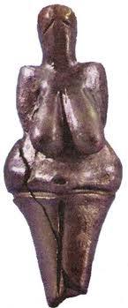

Ancient History (up to the 9th century)
Evidence of settlement in the territory of today's Czech state dates back up to 25,000 years. First farmers appeared in the Stone Age, and during the 4th and 3rd centuries BC a great variety of cultures met and clashed in the area. The first known inhabitants in this period were the Boii Celts (from whom the name of Bohemia is derived); Germanic Marcomanni and Quadi arrived in the 1st century BC. Slavs arrived from the Carpathian region at the peak of the Migration Period and joined forces in the “Samo Kingdom” around the year 630 to fight the Avars and later the Franks.

Slide 78


Early Christianity (9th and 10th centuries)
Great Moravia, formed in 830, was the first state in the area of the Czech Lands (the picture shows jewellery from the Staré Město archaeological site). Its rulers adopted Christianity from the West, but attempts at independence from the western Church climaxed around 863 in the Byzantine mission of Cyril and Methodius, who created the Slavic (Glagolitic) alphabet. The land of Bohemia broke away already before the end of the Great Moravian state in 907. The Přemyslid family gained control over Bohemia, moved to Prague and completed the unification of Bohemia by exterminating the rival Slavník family.

Slide 79



Přemyslid Dynasty (11th to 13th century)
Between the 10th and 12th centuries the Přemyslid family consolidated its power and brought prosperity to the country. Vratislav II became the first Bohemian king in 1085 − the Vyšehrad Codex, a richly illuminated gospel, was created for his coronation (see picture). During the reigns of Přemysl Otakar I (1197-1230) and Wenceslas I (1230-1253) in the first half of the 13th century, the submontane regions were colonized, trades developed, and numerous towns were founded. Silver was mined, castles, monasteries and churches were built in the Gothic style. However, with the murder of King Wenceslas III in Olomouc in 1306, the Přemyslid dynasty died out in the male line.

Slide 80

Luxembourg Dynasty (14th and 15th centuries)
The marriage of 14-year-old John of Luxembourg and 18-year-old Přemyslid princess Elizabeth brought the Luxembourg Dynasty to the Bohemian throne. During this era the Bohemian state was at the height of its power. John's first-born and highly educated son Charles IV became the most famous king in the Czech history (1346-1378). During his reign Charles IV expanded the state to include additional lands, founded Prague's New Town and the university (1348) and, after being crowned the Holy Roman Emperor, he commissioned the construction of the stone bridge in Prague (1357) bearing his name (the picture shows Charles Bridge from 1606). His son Wenceslas IV was deposed from the German throne (1400) and the country fell into crisis.

Slide 81

Habsburgs (1526 to 1611)
The Habsburgs assumed the Czech throne in 1526 and Ferdinand I gained hereditary succession rights for his family. The reign of his successor, Maximilian II, brought unprecedented religious freedom. Rudolph II (1576-1611) transferred his seat to Bohemia and Prague which became not only the capital city of the empire, but also the centre of European science and the arts. His court hosted the greatest astronomers of the period, including the Italian Giordano Bruno, the Dane Tycho Brahe, the German Johannes Kepler and the Bohemian-born Tadeáš Hájek. The picture shows Arcimboldo's famous portrait of Rudolph II.

Slide 82

The Thirty Years’ War and Germanization – 17th and 18th centuries
The strengthening of absolutist tendencies and Catholic expansion climaxed after Matthias took the throne (1611) and Czech was declared the official state language (1615). Disputes between the sovereign and the Czech nobility provoked the Uprising of the Estates (1618), which marked the beginning of the Thirty Years War. The defeat of the Protestants at the Battle of White Mountain (1620) led not only to the execution of 27 rebellious leaders (see picture) but also economic decline and the end of Czech independence. The period of Germanization brought the first census (1754), the introduction of compulsory general school attendance (1774), the cancellation of serfdom (1781), the unification of Moravia and Silesia into a single administrative unit (1782), and the abolition of lifelong military service (1802).

Slide 83

National Revival (19th century)
The ideals of freedom and civil society spread through the Czech lands from the end of the 18th century. A new class of Czech intellectuals started a National Revival (renaissance of the Czech language and culture), and developed modern arts and sciences. In 1883 a public collection was launched to build the National Theatre (pictured in 1888). A group of radicals and liberals entered the political scene for the first time in the tumultuous year of 1848; these individuals were later replaced by leaders of political parties pursuing universal suffrage rights (1907). Progress was interrupted by the First World War, after which the first independent Czechoslovak Republic was established on October 28, 1918, with Tomáš Garrigue Masaryk (1850-1938) as president.

Slide 84

Modern History (20th and 21st centuries)
The battle for political control following the end of the Second World War was won by the Communist Party in February 1948. Years of totalitarian power and economic troubles climaxed in the Prague Spring of 1968 and the invasion of the Warsaw Pact troops. The Communist government regained control during the 1970s ("normalisation period"). The country returned to democracy after the Velvet Revolution of 1989 when Václav Havel was elected president. The transformation of society and the economy followed; state enterprises were privatised and laws were changed. After the peaceful separation of Czechoslovakia into two independent states on January 1, 1993, the Czech Republic joined NATO in 1999 and became a member of the European Union in 2004.

Slide 85



Famous Personalities
Jan Amos Komenský 1592 – 1670
- Pedagogue, philosopher, theologian, minister, writer, and education reformer
Bedřich Smetana 1824 – 1884
Composer
Most famous works: the opera The Bartered Bride, Má vlast (My Fatherland) symphonic cycle, and the First String Quartet (From My Life).
Antonín Dvořák 1841 – 1904
Composer
Most famous works: New World Symphony, Slavonic Dances, “American” String Quartet, the opera Rusalka, Cello Concerto in B minor, choral works (Stabat Mater, Requiem, Te Deum).

Slide 86



Famous Personalities
Alfons Mucha 1860 – 1939
Painter and printmaker
His paintings, illustrations and designs (furniture, jewellery) represent Art Nouveau at its best.
Franz Kafka 1883 – 1924
Writer of German-Jewish origin, born in Prague
Author of absurd existentialist stories (The Metamorphosis, The Judgment) and novels (America, The Trial, The Castle)
Karel Čapek 1890 – 1938
- Writer, playwright, journalist, translator, and philosopher
- He invented the word “robot” for his play R.U.R.

Slide 87



Famous Personalities
Jaroslav Heyrovský 1890 - 1967
Physical chemist, Nobel Prize for chemistry (1959)
Father of polarography, inventor of the polarograph (1924)
Founder of the Czechoslovak Polarographic Institute
Jaroslav Seifert 1901 – 1986
Poet, recipient of the Nobel Prize for literature (1984)
A leading representative of pre-war Czechoslovak avant-garde
Otto Wichterle 1913 - 1998
- Chemist, inventor of gel contact lenses and of the first Czechoslovak synthetic fibre “silon”
- Founder of the Institute of Macromolecular Chemistry in Prague

Slide 88



Famous Personalities
Emil Zátopek 1922 - 2000
Athlete
Four-time Olympic gold medal winner, declared World’s Greatest Athlete in 1949, 1951 and 1952
Milan Kundera *1929
Writer, poet, playwright and translator
Most famous novels: The Unbearable Lightness of Being (1982) and Immortality (1988)
Miloš Forman 1932 - 2018
Director, screenwriter and actor
Most famous films: One Flew Over the Cuckoo’s Nest, Amadeus, Hair, Goya’s Ghosts, etc.

Slide 89



Famous Personalities
Václav Havel 1936-2011
Politician, playwright, poet, essayist and dissident
Last president of Czechoslovakia and the first president
of the Czech Republic
Renowned human rights defender
Martina Navrátilová *1956
- Czech American tennis player
- Open era record for most singles titles (167) and doubles titles (177), including 18 Grand Slam singles titles, 9 singles titles at Wimbledon (an all-time record)
Jaromír Jágr *1972
Ice-hockey player, winner of the Stanley Cup (1991, 1992), the World Championships (2005, 2010), and the Olympic gold medal (1998), all-time leader among European trained players in scored goals, assists and points in NHL history

Slide 90

Geography
Location: Central Europe
Area: 78,866 km²
Distance North/South: 278 km; West/East: 493 km
Bordering on (length of border): Germany (646 km)
Austria (362 km)
Poland (658 km)
Slovakia (215 km)
Lowest point: Elbe River – 115 m
Highest point: Sněžka – 1,602 m
Average temperatures: summer + 20°C / 68°F, winter -5°C / 23°F
Land use: arable land 39%; permanent crops 3%; forests 34%; other 24%

Slide 91

Population
Total: est. 10,5 mil.
Age structure Median age
0-14 years: 15.8% Total: 43.2 years
15-64 years: 63.4% Male: 40 years
65+ years: 20.8% Female: 42.6 years
Birth rate Death rate
9.51 births / 1,000 population 10.867 deaths / 1,000 popul.
Population growth rate Urbanization
0.18% 74.5% of total population

Slide 92


Infrastructure
LOCATION AND INFRASTRUCTURE
Czechia's geographical position makes it a natural crossroads for major transit corridors.
The significance of Czechia as a transit hub has grown since the country became a member of the EU Single Market covering the area of the 27 countries in Europe with 445 million consumers in total.
The flight time from most European destinations is less than two hours.
Czechia ranks among the world's most advanced countries in terms of transport network density.
Source: Road and Motorway Directorate of the Czech Republic,

Slide 93
Infrastructure
Motorways in Czechia

Slide 94

Infrastructure
Airports
Total: 122; 44 with paved runways; 5 international
Main International Airports in the Czech Republic:
Václav Havel Airport Prague (PRG)
– 11-12 million passengers per year
– connections to 130 destinations worldwide
– winner of the 2011 IATA Eagle Award
for the Most Deserving Airport
Brno Airport (BRQ), Ostrava Airport (OSR),
Karlovy Vary Airport (KLV), Pardubice Airport (PED)

Slide 95



Infrastructure
Roadways
Total: 55,500 km (paved)
1,178 km of motorways and highways
(2,180 km planned)
Railways
Total: 9,600 km in operation
3,000 km electrified tracks
Waterways
Total: 660 km (mainly Elbe, Vltava and Oder rivers)

Slide 96


Agriculture
Agricultural land: 4,269,000 ha
Arable land: 3,062,000 ha (40% of total area)
Organic cropland 220,000 ha
Share in overall GDP: 3.4%
Agricultural workers: 4% of population
Traditional agricultural crops:
- Grains (wheat, rye, barley, oats, corn)
- Rape - Sugar beet
- Hops - Mustard - Potatoes - Oil seeds

Slide 97






Environment
Number of protected areas: 2,170
National parks: Krkonoše (Giant Mountains)
Podyjí NP (Dyje River valley)
České Švýcarsko (“Bohemian Switzerland”)
Šumava NP
Area of national parks: 119,020 ha
Share of national parks in overall area: 15.09%
Forest land: 2,646,000 ha
  Share in overall area: 34%
Communal waste production per capita: 280 kg
CO₂ emissions in tonnes per capita: 11.27 t

Slide 98
Thank you for your attention

