Slide 1
INDIA – EXPORT OPPORTUNITIES FOR CZECH COMPANIES

Slide 2
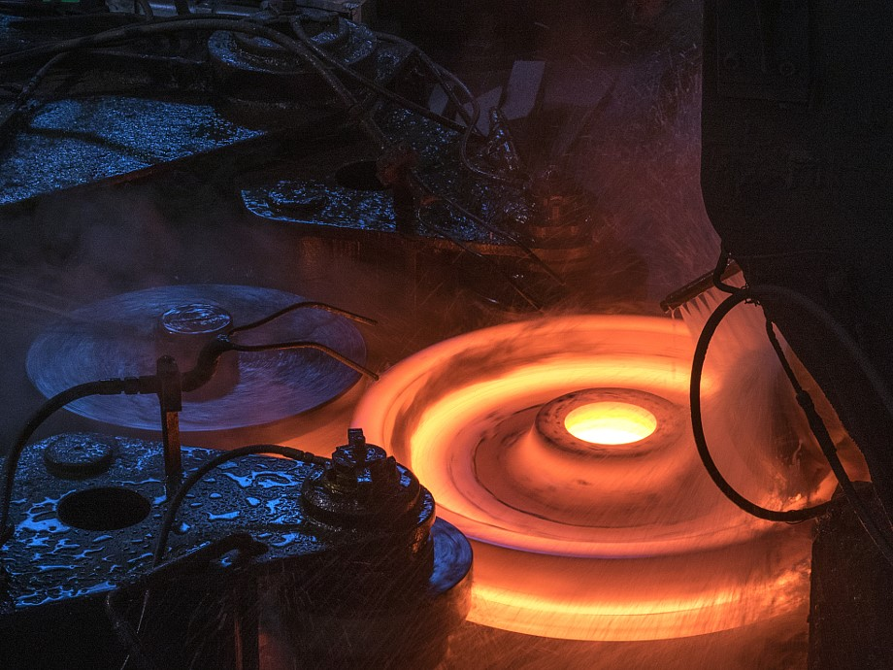
GHH-BONATRANS OVERVIEW

Slide 3
GHH-BONATRANS.
ONE GROUP.
SAME VALUES.
EXPERTISE
INNOVATION
POWER
QUALITY
PASSION

Slide 4
GLOBAL PRESENCE
BONATRANS GROUP
Engineering
Manufacturing
Sales & Service
Gutehoffnungshütte Radsatz
Engineering
Manufacturing
Sales & Service
Bonatrans India Pvt. Ltd.
Manufacturing
Sales & Service
Bonatrans Asia Limited
Sales & Service

Slide 5
MANUFACTURING PLANTS
Companies |  | BONATRANS GROUP Czech Republic | Bonatrans India India | GHH-Radsatz Germany
Sales and Employees 2015 |  | Sales : € 232 m Employees : 1 344 | Employees : 52 | Sales : € 85 m Employees : 284
Capacities per year | Wheels (incl. resilient) | 200 000 | 20 000 | 40 000
 | Axles | 50 000 | 5 000 | 7 000
 | Wheelsets | 30 000 | 5 000 | 6 000
Deliveries 2015 | Monobloc wheels | 157 000
 | Wheelsets monobloc | 26 000
 | Axles | 25 000
 | Resilient wheels | 4 000
 | Wheelsets resilient / Independent wheel axle | 3 000
 | Tyres | 27 000

Slide 6
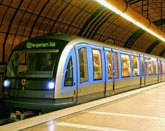
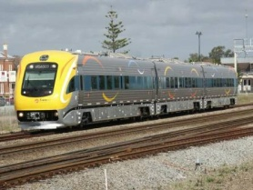
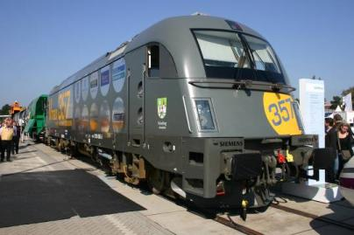
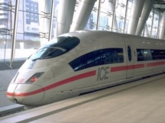
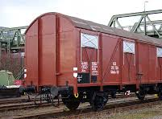
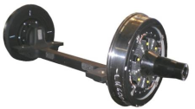
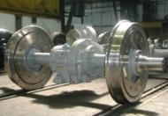
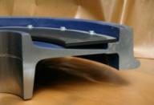
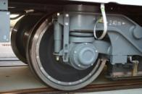
ONE STOP SHOP
Tramway
City train / Metro
Urban transport
Long distance train
High Speed train
Freight
Building machines
Low Floor /
Resilient W.
Passenger / Metro
EMU/DMU
Locomotive
+ Shunter
Very High Speed
Freight
Noise absorbers
Independent wheel axles and wheelsets with resilient wheels.
Covering all low floor applications
Power and trailer wheelsets
Complete with components and noise reducing applications
Power and trailer wheelsets and their parts for all types of EMU and DMU units
Complete locomotive wheelsets
Products for very high speeds above 250 km/h
Including induction hardening of axles for high fatigue strength
Stress optimized low-weight wheelsets
Fine-tuned wheel-mounted noise absorbers
Effective reduction of noise generated by wheel/rail contact

Slide 7
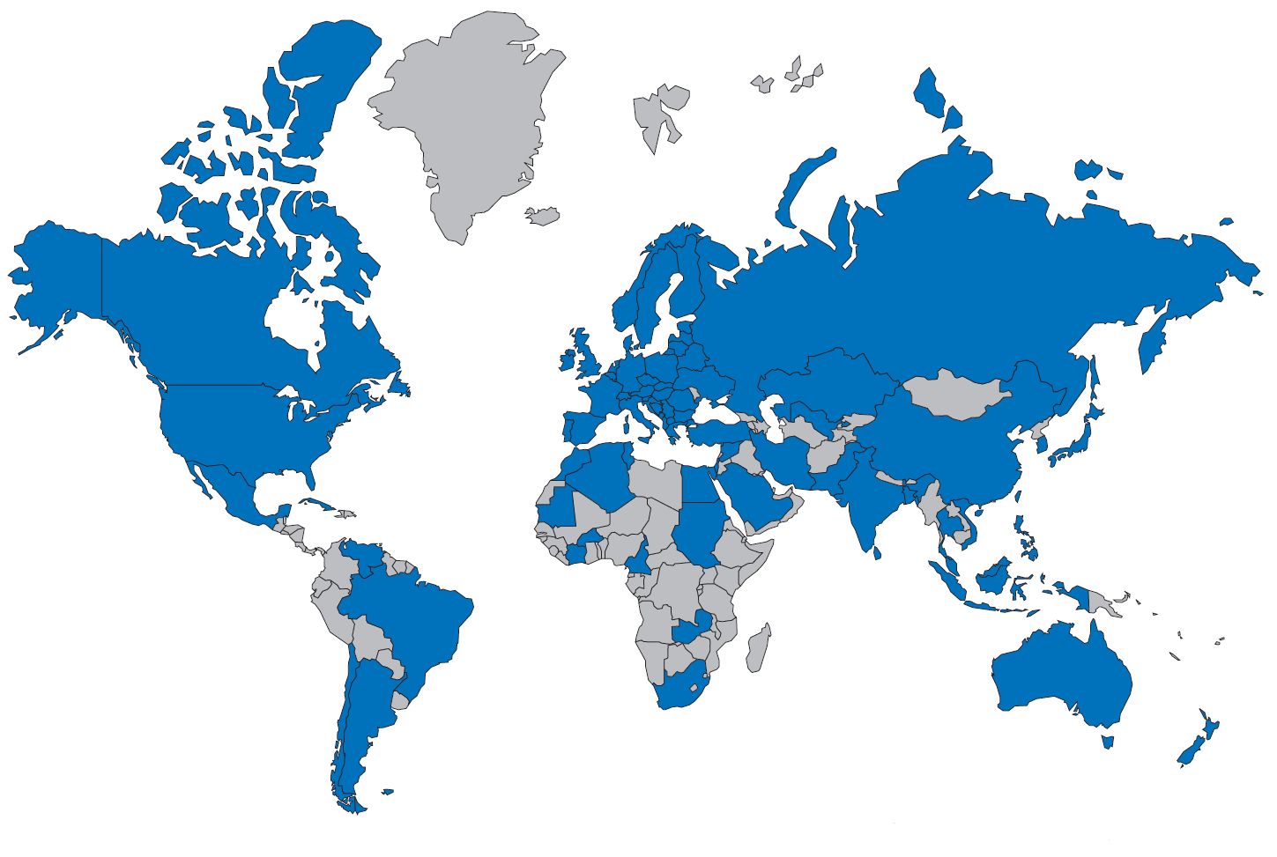
DELIVERED COUNTRIES

Slide 8
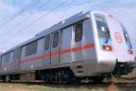
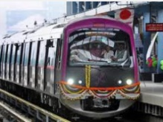
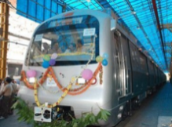
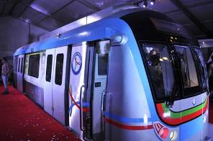
SELECTED DELIVERIES IN INDIA
Project |  | Design | Builder | End User | Country | Scope of Supply | Years of Supply
DMRC – Metro Delhi Phase I Phase III |  | Yes | Hyundai Rotem | DMRC | India | Wheels Power axles Trailer axles | 2002-2010
MOVIA Metro Delhi RS II |  | No | Bombardier | DMRC New Delhi | India | Power and trailer Wheelsets | 2008-2009
Bangalore Metro |  | Yes | Hyundai Rotem, BEML | BMRCL Bangalore | India | Wheels Power Axles Trailer Axles | 2010-2012
Jaipur Metro Green line |  | Yes | Voith Turbo, BEML | Jaipur Metro Rail Corp. | India | Wheels Trailer Wheelsets | 2011-2012
Hyderabad Metro |  | Yes | Hyundai Rotem | Hyderabad Metro Rail | India | Wheels Trailer Wheelsets | 2011-2012
Locomotive wheels FIAT bogie wheels | over 30k units over 25k units | No | Indian Railways |  | India | Wheels | 2000+

Slide 9
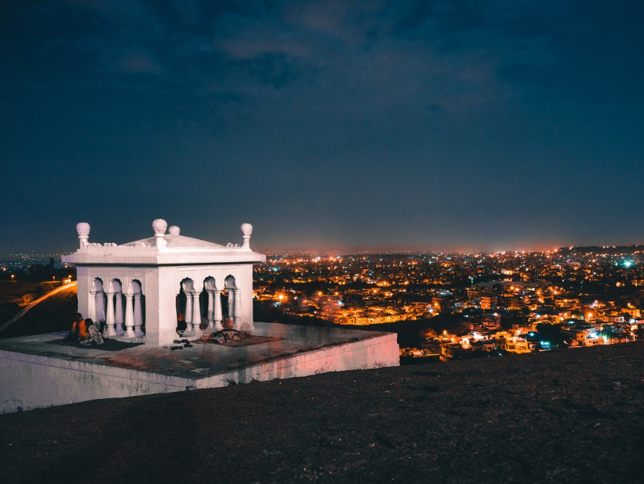
BONATRANS INDIA

Slide 10
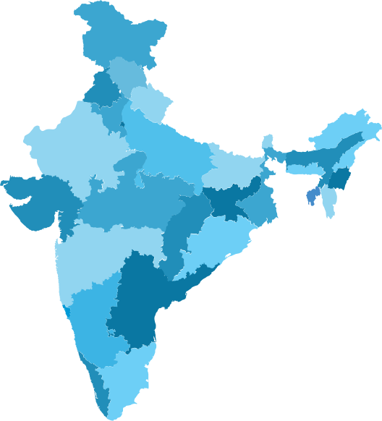
LOCATION
In the west Region
State of Maharashtra
45 Mins flight from Mumbai
480 kms from Mumbai port
Industrial area of State
Prestigious project of Central Government
Delhi Mumbai Industrial Corridor (DMIC)
◉
◉
Aurangabad
400 km
Mumbai port

Slide 11
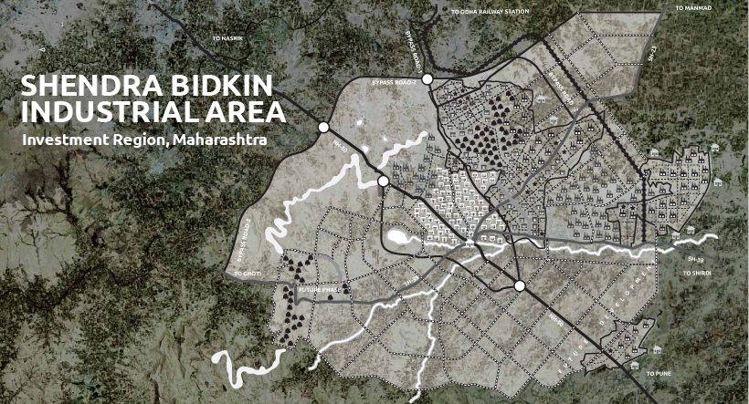
LOCATION
located at the SHENDRA BIDKIN INDUSTRIAL AREA
very large-scale industrial cluster
abundant land provisions for high growth industries
wide-ranging infrastructure services
convenient access
provisions to handle environmental waste with minimum impacts
proximity to the existing industrial areas, Aurangabad city and existing airport and railways
strong support for export-oriented businesses

Slide 12
MILESTONES
Decision about BIPL creation in 2012
Date of incorporation: February 8th, 2013
MIDC plot posession: September 25th, 2013
Ground breaking ceremony: January 24th, 2014
Civil works completed: February 8th, 2015
Project Complete with receipt of Land Lease Agreement from MIDC in Jan 2016
Proud to make first delivery to Kochi Metro RS1 Project ahead of Schedule
ISO 9001:2008 certification completed
Official opening on 19th Apr 2016

Slide 13
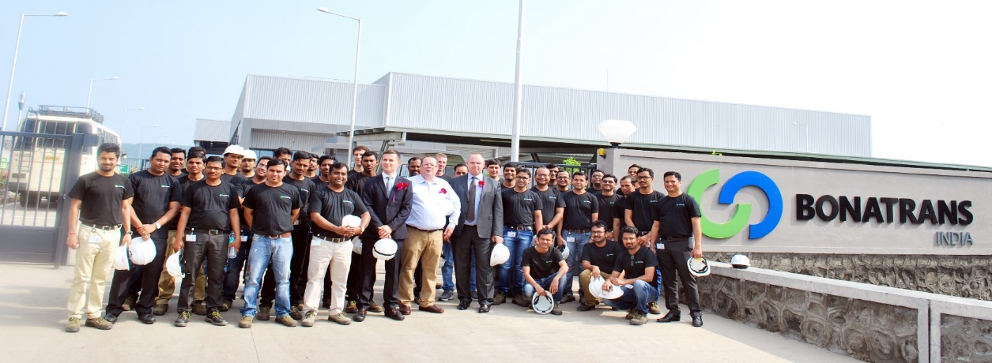
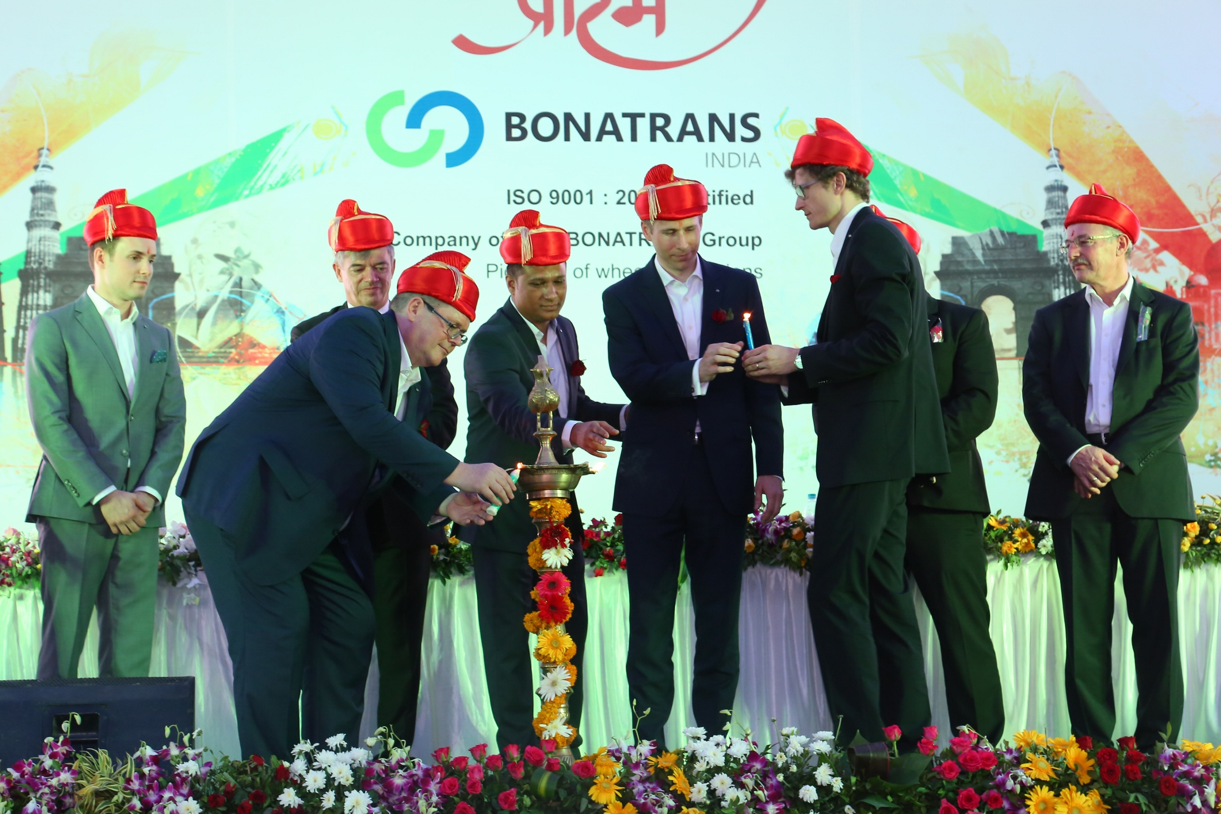
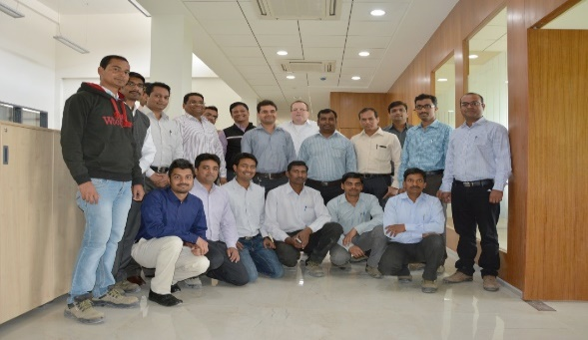
IT IS ABOUT PEOPLE

Slide 14
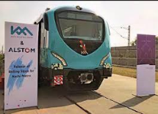
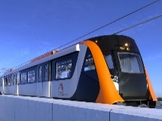
SELECTED DELIVERIES
Project |  | Design | Builder | End User | Country | Scope of Supply | Years of Supply
KMRL – Kochi Metro RS1 |  | No | Alstom | KMRL | India | Wheels | 2015 – On Rolling
North West Rail Link – Sydney Metro |  | No | Alstom | NWRL | Australia | Power Axles (Localized) | 2016 – On Rolling
DMRC – Metro Delhi RS13 |  | Yes | BEML | DMRC | India | Trailer Wheelsets | To Roll in Q2 2016

Slide 15
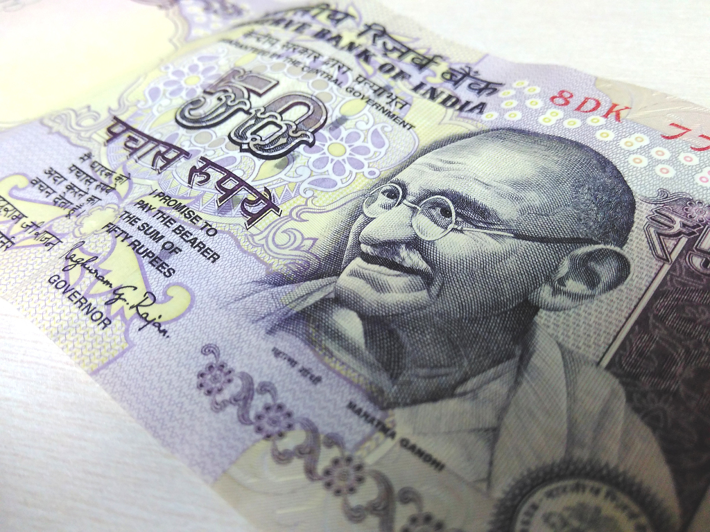
INVESTMENT IN INDIA

Slide 16
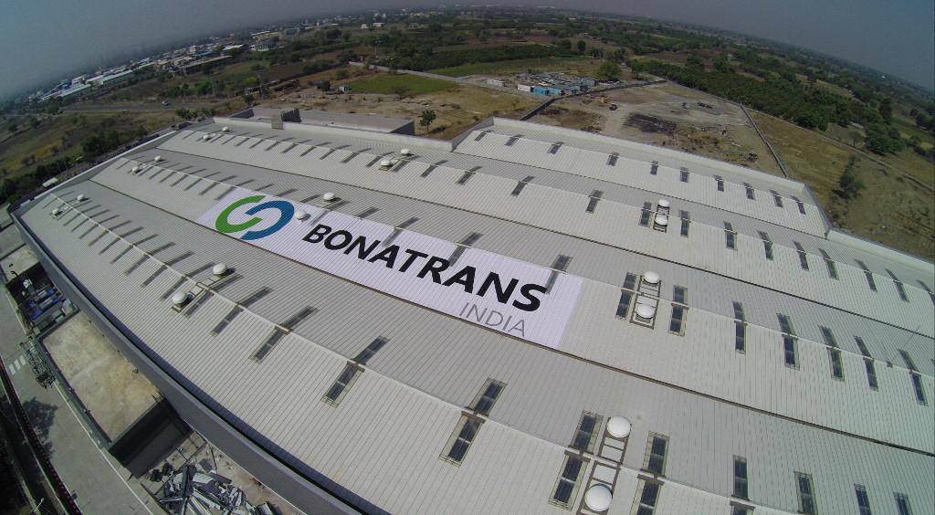
KEY CONSIDERATIONS
Strategy
Observing the economic and political environment in India from the perspective of the investment
Different approach between investment by Consumer good/brand maker, and industrial component manufacturer
Law
Exchange Control Laws
Corporate Laws
Sector Specific Laws
Tax
Domestic Taxation Laws
International Tax Treaties

Slide 17
MODES OF INVESTMENT
Foreign investor
Unincorporated entities
Generally requires approval (except for Project Office); subject to conditions
Incorporated entities
Generally permitted except for certain sectors
Partnerships
Government approval required
Liaison office
Joint venture
Unlimited partnership
Foreign investment recently allowed
Project office
Wholly owned subsidiary
Limited Liability Partnership
Branch office

Slide 18
TAX LANDSCAPE
GAMUT OF TAXES IN INDIA
Direct tax
Indirect tax
Income tax
Customs duty
Wealth tax
Service tax
Excise duty
Dividend distribution tax (DDT)
Central sales tax (CST)
Minimum Alternate Tax (MAT / Alternate Minimum Tax (AMT)
Federal Levy
Value added tax (VAT)/Octroi/Entry tax
Federal Levy
State Levy

Slide 19
„INDIA“ – WHAT COMES IN MIND?
Outsourcing
Population
I don’t know where India is on the world map
Mahatma Gandhi
Corruption
Bollywood
Slumdog Millionaire
Young population with so many ‘wants’
Everything seems to sell in India
Risk taking entrepreneurial spirit
Are people really making money there and how I can?
Where do I start…???

Slide 20
CULTURAL ASPECTS OF DOING BUSINESS
Land of different cultures – people from North India more aggressive, from South India more conservative, from West India more businesslike
Both strongly held traditional values and emerging modern business practices prevalent
Greet with a handshake or Namaste
Always use formal titles (Mr., Dr., Sir, Madam ) when greeting for first time
Punctuality – be prepared for delays in appointments, particularly in Government offices

Slide 21
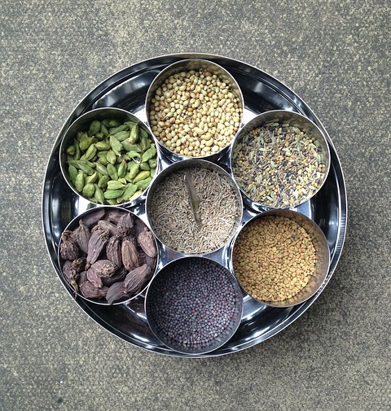
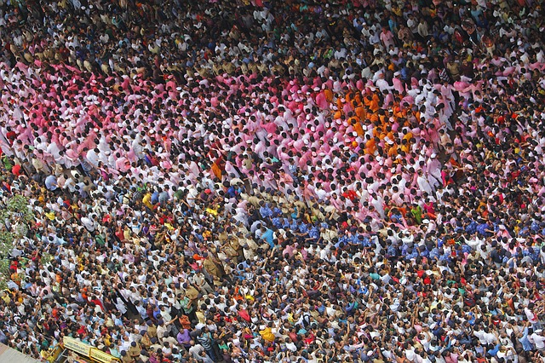
CULTURAL ASPECTS OF DOING BUSINESS
Most Indians are reluctant to say no directly - try and understand the message behind the words
Get to know your counterpart as a person and gain his trust
Be willing to share a cup of tea/coffee and indulge in small talk before getting down to the main business
Do not be offended at personal questions
Do not be too aggressive or forceful or confrontationist – try and use reasoned logic after understanding the other person’s problem

Slide 22
WHEN DEALING WITH AN INDIAN PARTNER
Check for
Reliability: Testimonials with Client verification
Ethical Practices
Commitment to work/doing business
Cooperation with partner
Fair and responsiveness to employees
Show that you have multiple options open
You are in the game for long time
Willingness to come to India
Build relationship

Slide 23
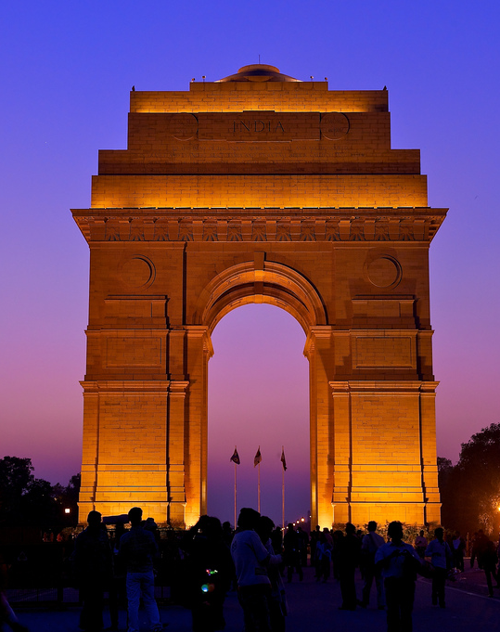
SUCCESS FACTORS
Time and patience
Right expectations
Well defined agreements
Clear strategy
An Indian on your side

Slide 24
FUTURE GROWTH ACCELERATORS
Fair, effective and consistent laws
Reducing bureaucracy, increasing legal certainty, e.g. land purchase
Introduction of Industry standards, environmental standards, building standards…
Development of Infrastructure (Utilities, Logistics, Industrial Parks)
Attract new technology by promoting collaboration between Industry and educational institutions

Slide 25
„MAKE IN INDIA“ – EFFECTS & BENEFITS
Zero import duties
No maritime transport
Zero currency risks
Shortens reaction time
European quality at your door-step

Slide 26
Q&A

Slide 27
CONTACT
Jakub Weimann, Managing Director – BONATRANS GROUP a.s.
Joachim Marreck, Managing Director – Bonatrans India Private Limited
CZECH REPUBLIC BONATRANS GROUP a.s. Revoluční 1234 735 94 Bohumín Tel.: +420 597 083 112 E-Mail: info_cz@ghh-bonatrans.com | GERMANY Gutehoffnungshütte Radsatz GmbH Gartenstrasse 40 D-46145 Oberhausen Tel.: +49 (0)208 - 7400 0 E-Mail: info_de@ghh-bonatrans.com | INDIA Bonatrans India Private Limited Plot No. A – 119 Shendra Five Star Industrial Area Shendra MIDC, Aurangabad 431 154 Tel.: +91240 7113900 E-Mail: info_in@ghh-bonatrans.com | HONG KONG Bonatrans Asia Limited Rooms 2103-4, 21/F., Wing On Centre 111 Connaught Road Central Tel.: +86 136 0132 7096 E-Mail: info_asia@ghh-bonatrans.com

