Slide 1
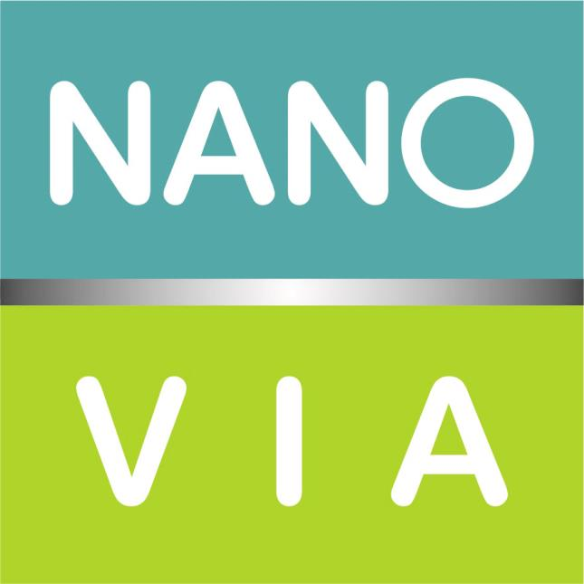
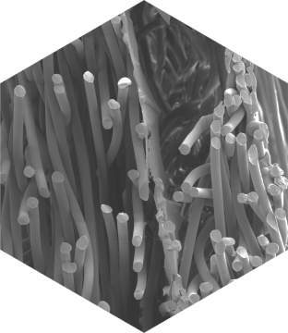
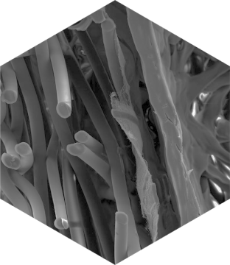
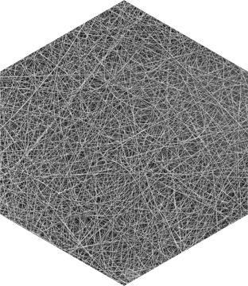
THE WORLD OF NANOFIBERS

Slide 2
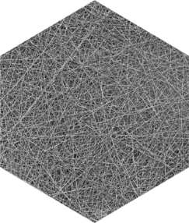
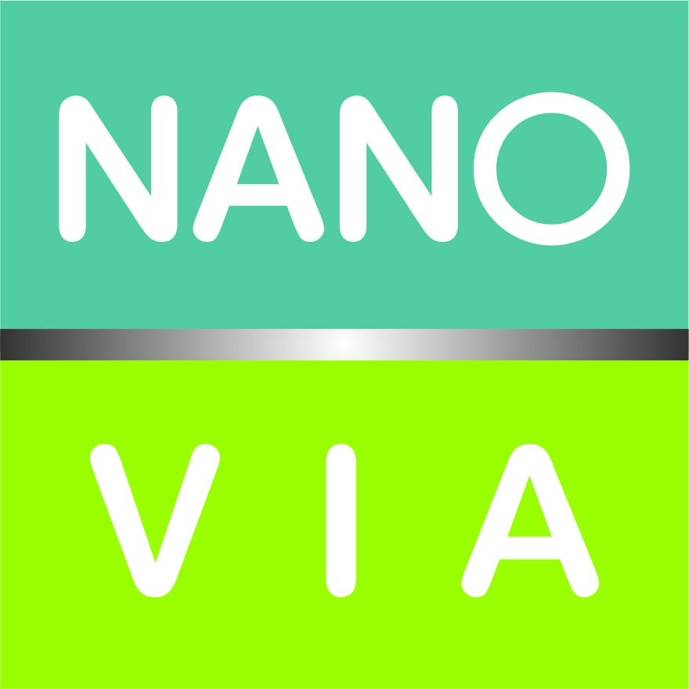
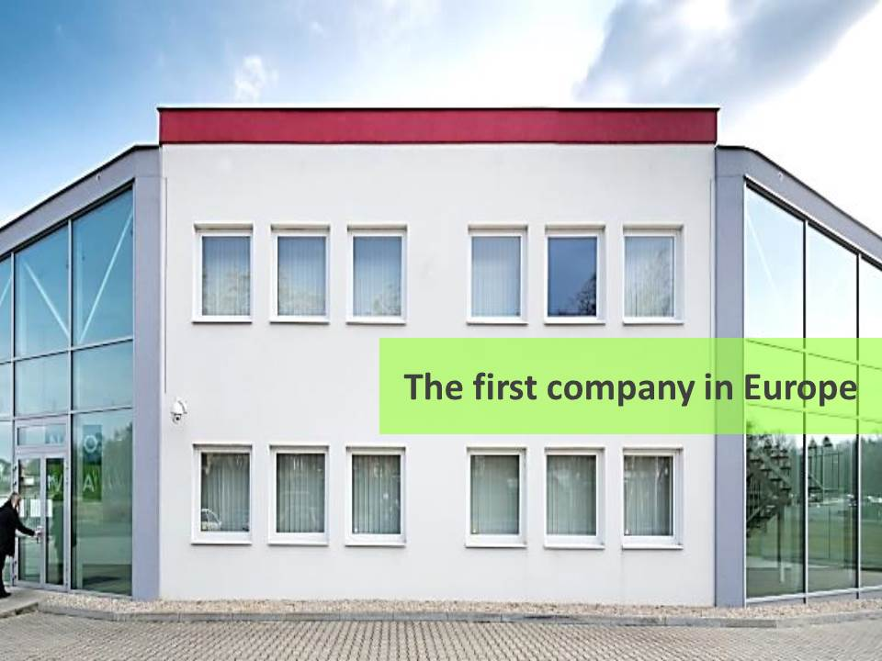
Company Nanovia
First company in Europe with capacity for industrial production of nanofibres for:
custom-made nanofibers materials for different applications and final products
manufacturing of laminated fabrics launched under own brand names Nanovia
2010-2015 Investment in Litvínov
construction of the factory
laboratory for development and quality control
Nanovia products development
installation of production lines for the production of nanofibers (3 lines)
instalation of laminating and cutting machines
2010
2011
2015
2012
2013
2014

Slide 3
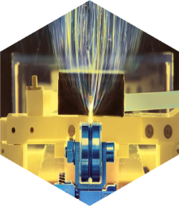
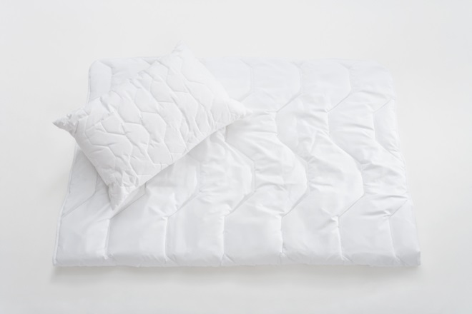
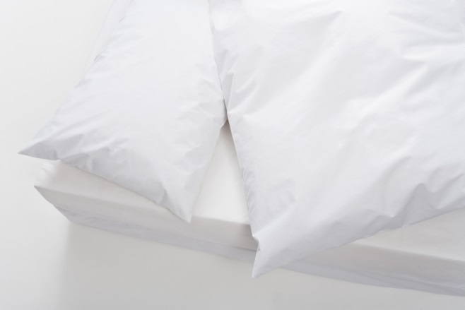
What we do / What we offer
Custom-made nanofibers production for different applications and final products
Filtration
Membranes
Technical textiles
ISO certification
EN ISO 9001:2009
OHSAS 18001:2008
EN ISO 14001:2005
Nanofibers production capacity
(depends on the nanolayer thickness) production capacity cca. 10,5 mil.m² /year
Barrier fabrics launched under own brand names:
Nanovia AntiAllergy fabrics
Nanovia face mask and respiratory fabrics
Nanovia Clean Air fabrics (filter media)

Slide 4
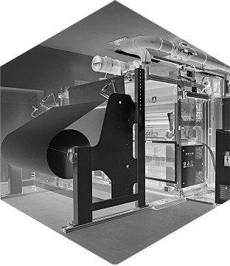
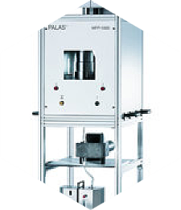
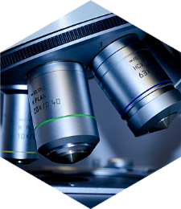
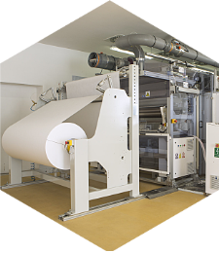
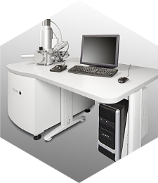
Possible cooperation with Austrian partners
Development of new application
cooperation with academic or industrial partners, joint ownership of IP
Custom production of nanofibres
cooperation with industrial partners - IP, final product, knowledge of the market, the distribution of material on the side of the customer
Processing of Nanovia materials to final products for Austrian or European market
cooperation with industrial partners – IP on the Nanovia side, knowledge of the market, the distribution of ready product on the side of the customer

Slide 5
Thank you for your attention
Nanovia – right partner for your nanofiber products
www.nanovia.cz

