Slide 1

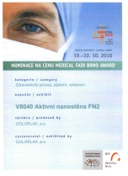

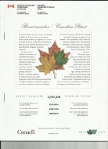

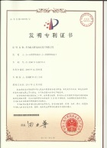

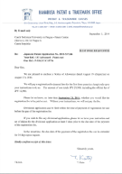
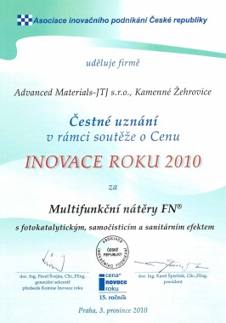
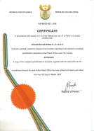
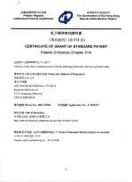
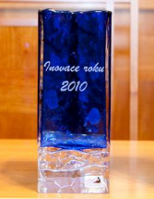




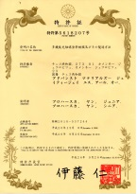



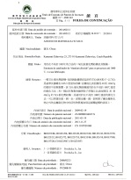
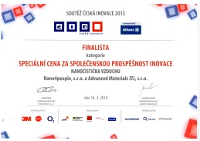

FN® Coating Technology
Creating healthy environments
Lithium batteries
Nano TiO₂ production
Nano-materials for Thermobarriers

Slide 2

Multifunctional TiO₂ coatings (FN® Coatings)
Nano TiO₂ production
Nano-materials for Thermobarriers
Lithium batteries
HE3DA TECHNOLOGIES
NAPOWER
Specialty nano-materials

Slide 3


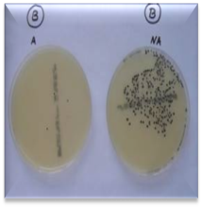

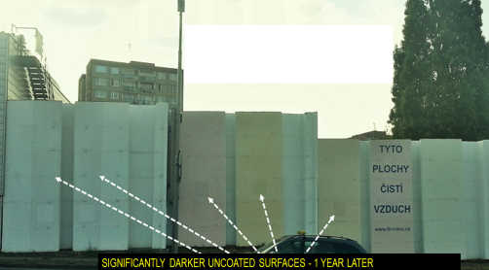
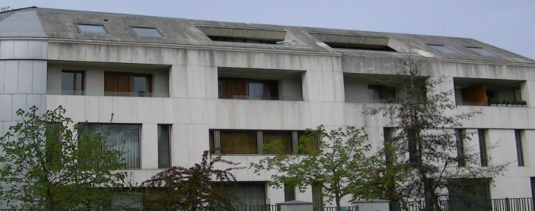
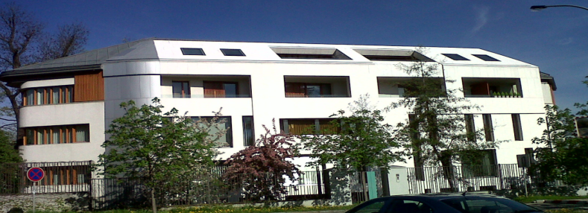

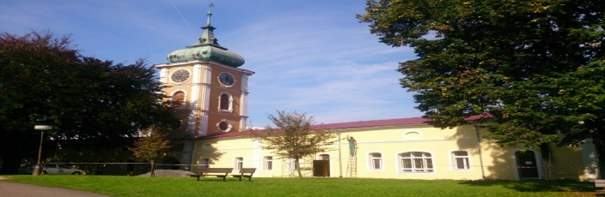
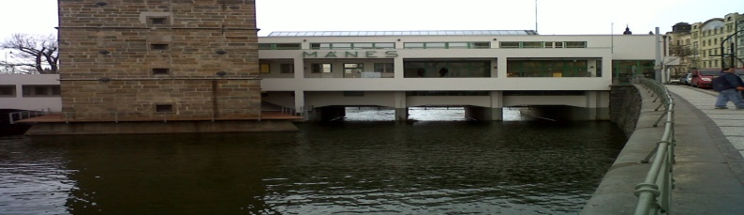
Multifunctional TiO₂ coatings (FN® Coatings) – AIR PURIFICATION TECHNOLOGY
INTERIOR
Clean and healthier environment
Lowering risk of infection
Protecting health
Eliminating viruses and bacteria
Preventing mold & mildew
Stopping mustiness
Liquidating allergens
Eliminating smoke
Ridding of unpleasant odors
AN END TO SICK BUILDING SYNDROME
Permanently clean buildings
BEFORE
AFTER
EXTERIOR

Slide 4
WHAT COMMERCIAL PARTNERS WE ARE LOOKING FOR?
PARTNERS TO APPROACH AND CAPTURE THE AUSTRIAN MARKET:
Protection of building facades
Creating healthy environment in public buildings (schools, preschools, airports, offices)
Air purification
Hospitals with low HAI (hospital acquired infections)
FN® Coatings
FN® Coatings:
Innovative and motivated application & distribution companies
Joint Venture partners
Progressive Architect Firms
Investors for commercialization of our other nanotechnologies

