Slide 1
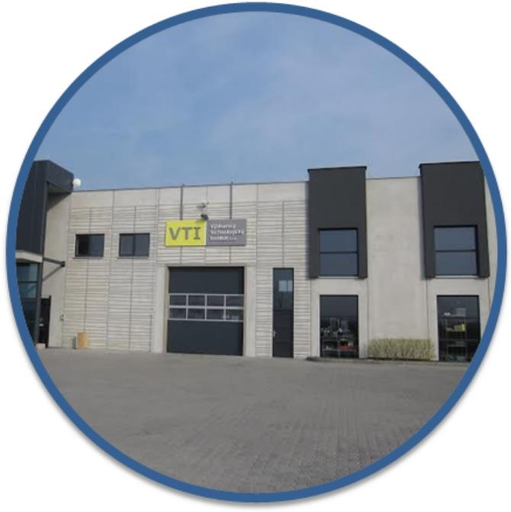
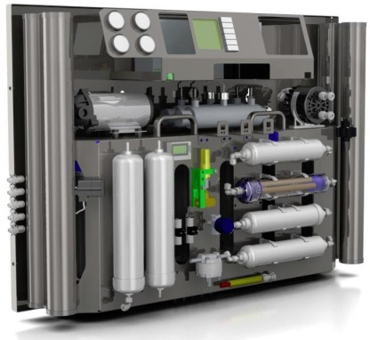
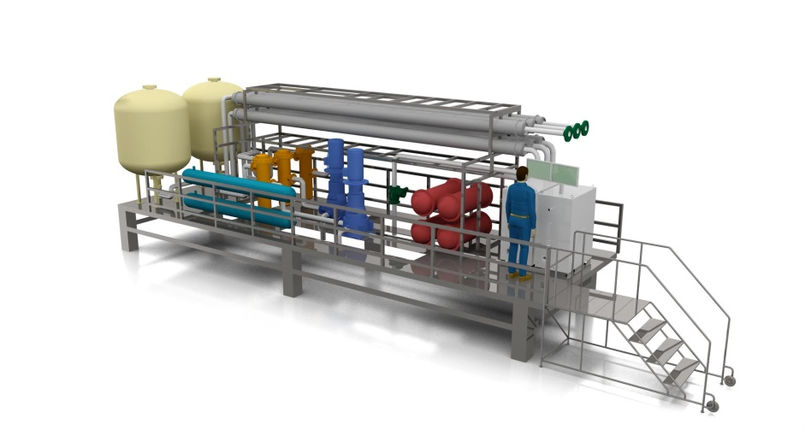
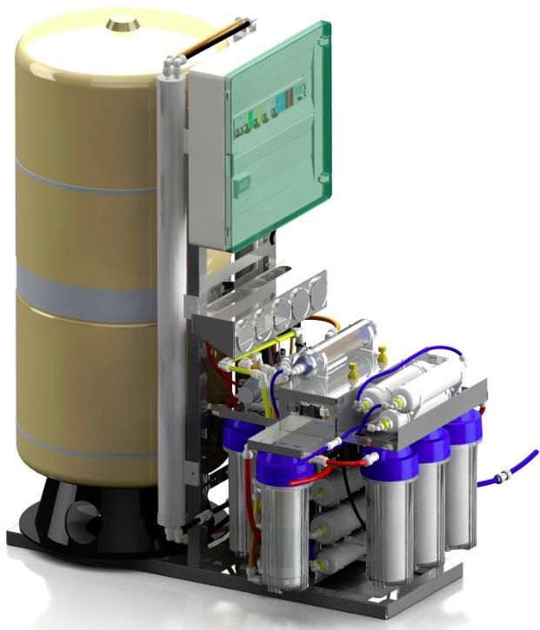
Michael Carvan
20. 4. 2016

Slide 2
Technology
Processing of any water source
Only physical and no chemical process
Nano filtration combined with other technologies
Low pressure technology = low power consumption
Operation on solar power

Slide 3
Technology of Hybrid Asymmetric Selective Membrane Separation
Low power consumption
Extremely low maintenance cost
Self-cleaning system
Flexibility
Higher efficiency
Lower volume of retenate (waste water)
Amazing Purity
Regardless of the water source
0,06 to 0,14 kW per 1000 liters of water
Solar panels – no electric grid
No membrane exchange if regular maintenance
Any size of production
No impurities (even dead bacteria)

Slide 4
IMPURITIES AQ3 REMOVES
COMMUNITY WASTE WATER :
• Pathogens: giardia lamblia, salmonella, shigella, typhoid, yersinin enterocolitica, viral hepatitis , contraception, hormones, antibiotics & others
• Non-metallic contaminants: phosphates, nitrogen and others
• Synthetic organic contaminants: pharmaceutical drugs, chlorinated solvents, hydrocarbons & others
INDUSTRIAL WASTE WATER :
• Metallic contaminants: aluminum, arsenic, barium, cadmium, copper, chromium, iron, lead, lithium, manganese, mercury, molybdenum nickel,
silver, uranium, and zinc
• Non-metallic contaminants: acids, ammonia, nitrate, phosphates, boron, chloride, cyanide, fluoride, radium, selenium, sulfates and various radioactive isotopes
• Synthetic organic contaminants: pesticides, chlorinated solvents, hydrocarbons and polychlorinated bi-phenols (PCBs) and others
FILTHY RIVER :
• Combination of all contaminants: pathogens, metallic contaminants,
non-metallic contaminants, synthetic organic contaminants from community, industrial and agricultural waste water

Slide 5
AQ3 Family
AQ3 Mini
No electricity needed
Daily production 100 liters
AQ3 Midi
Slightly larger, much more powerful
Daily output is about 300 liters
AQ3 Home (Plus)
Size of small refrigerator
up to 3,000 (7,000) liters per day

Slide 6
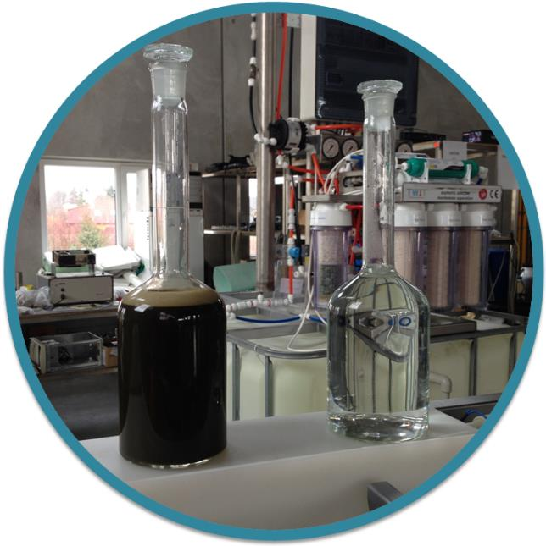
PIG SLUDGE to PURE WATER??

Slide 7
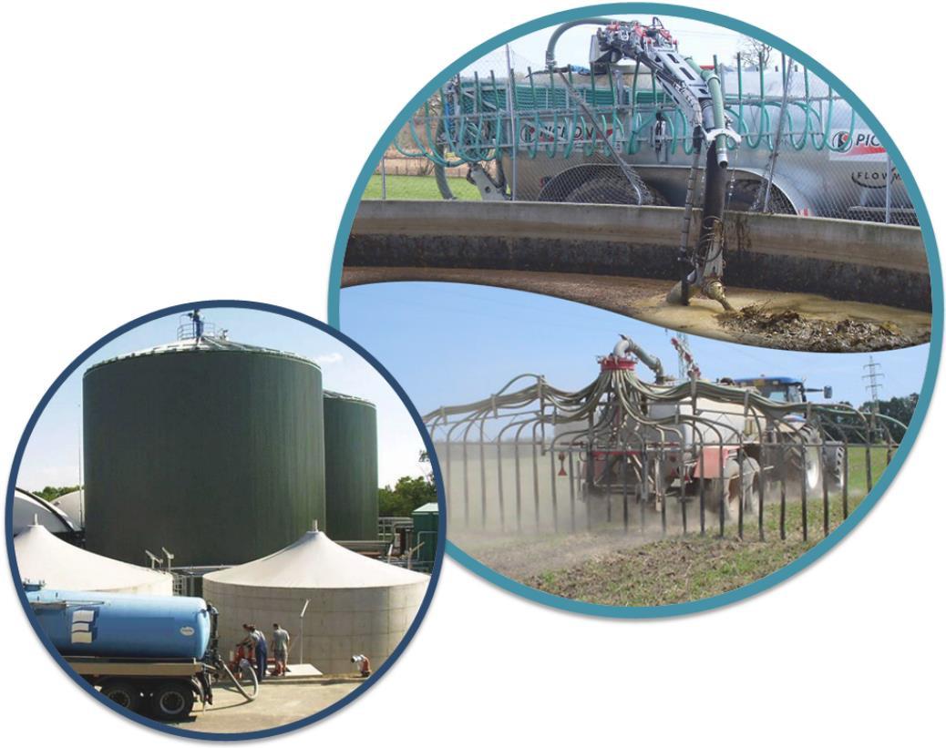
Water demand during 365 days
15 000 PIGS = 40 000 000 liters of water
112 000 litres of sludge per day

Slide 8
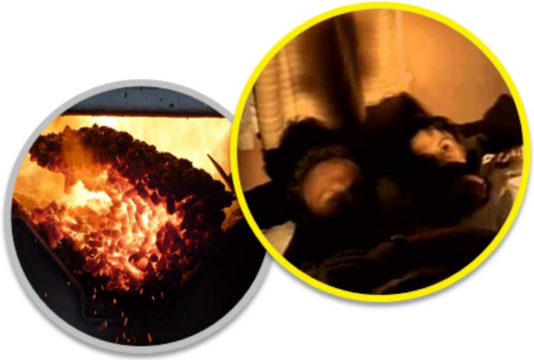
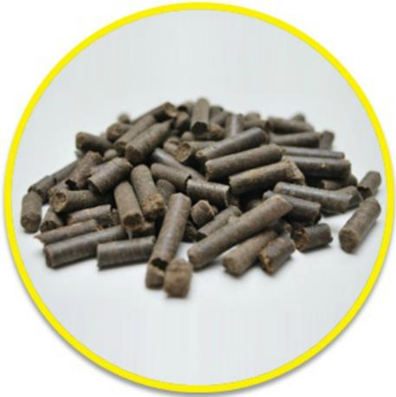
SOLUTION
digestate
Decanting centrifuge
pelletizing line
pellets
burning makes heat or energy

Slide 9
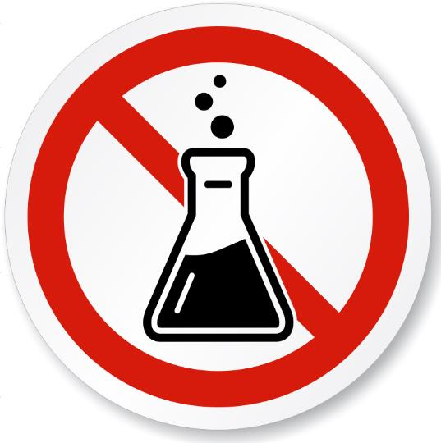
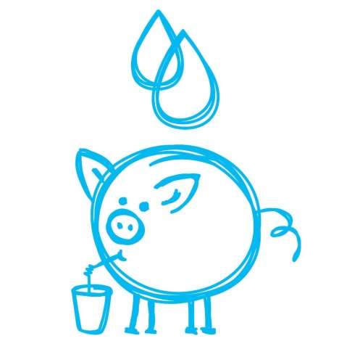
SOLUTION
fugate after centrifuge
AQ3 pure water technology
AQ3 water
NO CHEMICALS!!!

Slide 10
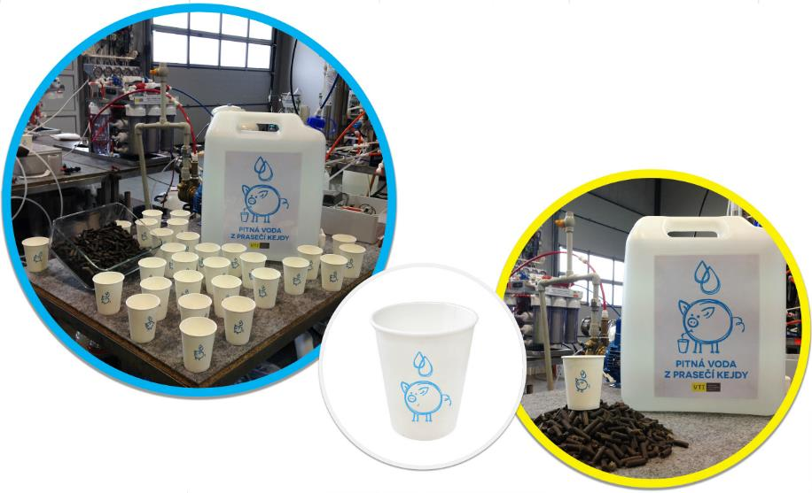
DRINKING WATER AND PELLETS FROM PIG SLUDGE

Slide 11
USAGE AND BENEFITS
Separator
Effective use of organic material after decomposition of enzymes
AQ3 water
Water purification technologies on physical principles without the use of chemicals
Water source
The use of rain water, pond water and treated sludge
Recirculation and regeneration of water
Healthy, minerals enriched no bacteria sterilized drinking water without chlorine!
Allows you to produce materials for resale
It is not necessary to continue with transporting organic material for further processing
Independent on public water system
Processed water is suitable for all processes (washing, the use of the entire distribution network, flush toilets, water heaters, ...); hot water without Legionella

Slide 12
USAGE AND BENEFITS
CLOSED SYSTEM
Almost 100% savings of water expense = decreasing costs
Technology does not burden the environment with dangerous substances = BIO
Possibility of another income from secondary product of separator = increased income
AQ3 clean water – healthy, no chemical treatment = higher quality of meat, generally livestock breeding
Increasing quality and scoring of whole livestock breeding
It is not necessary to continue with transporting organic material for further processing = decreasing costs

Slide 13
Michael Carvan
michael.carvan@vti-cz.com
+420 775 581 655

