Slide 1
European Union Emergency Trust Fund for stability and addressing root causes of irregular migration and displaced persons in Africa
Information Session
Ministry of Foreign Affairs, Czech Republic 06/04/2016

Slide 2
1
Overall Framework

Slide 3
Objectives of the Trust Fund
To address the crises in the regions of the Sahel and Lake Chad, the Horn of Africa, and North Africa.
To support all aspects of stability and contribute to better migration management as well as addressing the root causes of destabilisation, forced displacement and irregular migration, in particular by promoting resilience, economic and equal opportunities, security and development and addressing human rights abuses.

Slide 4
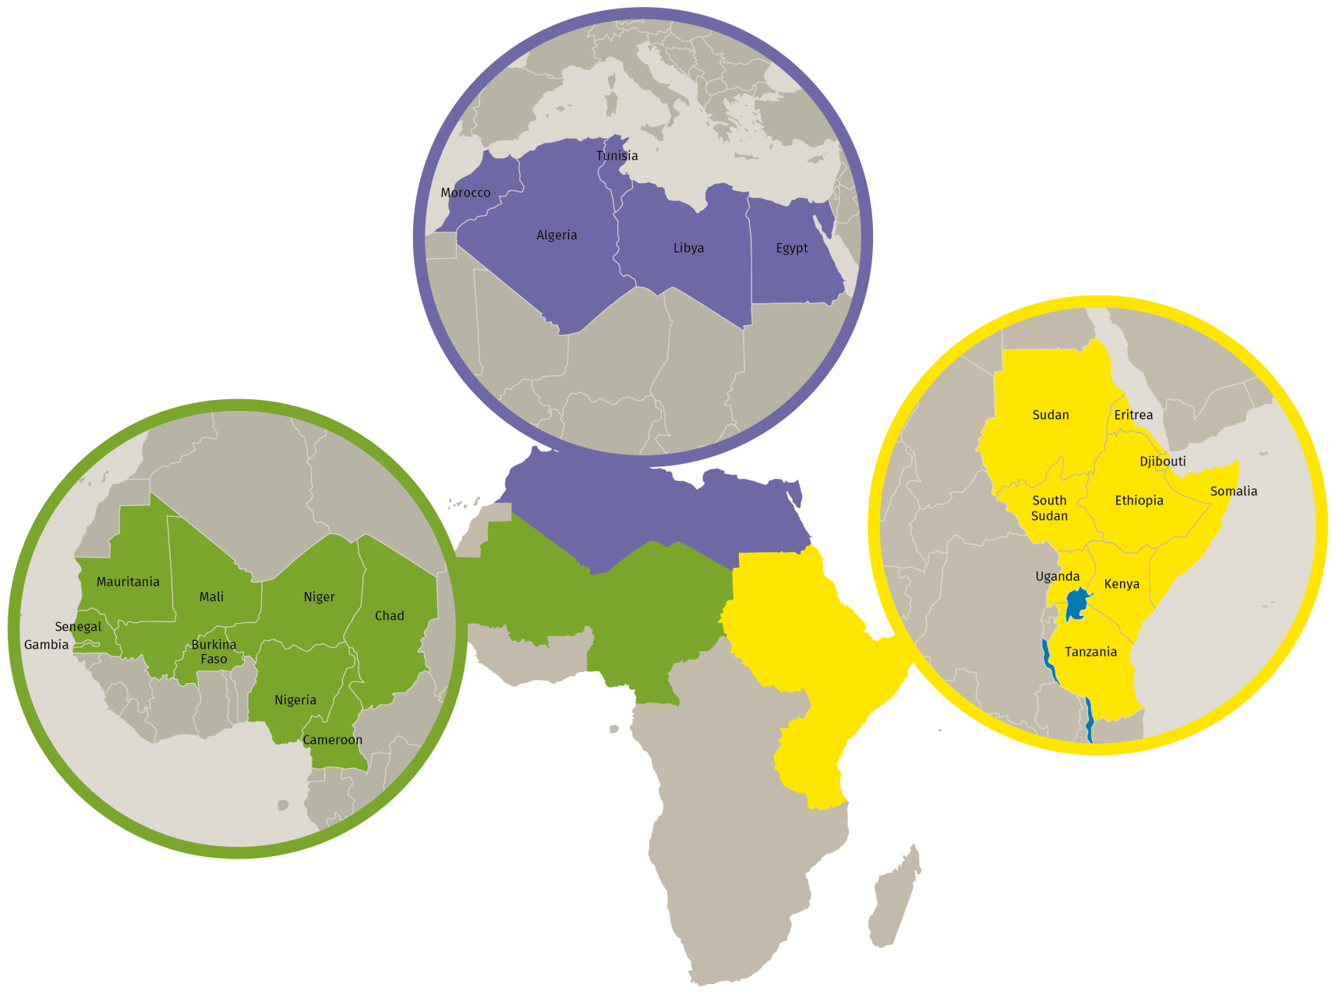
Who benefits from the Trust Fund?
23 eligible countries, in 3 operational windows: Sahel and Lake Chad, Horn of Africa, North Africa
Neighbouring countries can also benefit from Trust Fund projects, in order to address cross-regional migration flows.

Slide 5
What are the priority areas of intervention?
Greater economic and employment opportunities
Strengthening resilience of communities, in particular the most vulnerable
Improved migration management
Improved governance and conflict prevention

Slide 6
What are the principles of intervention?
Political dialogue
Local ownership
Evidence-based and targeted approach
Holistic and coordinated approach
Conflict sensitive approach
Principles of subsidiarity and complementarity

Slide 7
The added value of the Trust Fund
A EU collective response to the crisis;
An additional tool to help the most fragile and affected countries;
A swift and flexible instrument to deliver immediate and concrete results;
A platform for reinforced engagement with countries of origin and transit;
A more integrated and comprehensive approach based on greater research, data gathering and analysis.

Slide 8
High-Level Dialogues
NIPs, RIP, bilateral cooperation
Trust Fund
National and regional strategies
Valletta Action Plan

Slide 9
Contributions from the EU
Instruments | Commitments (EUR)
Reserve of the 11th EDF | 1,000,000,000
Regional Indicative Programme for West Africa – 11th EDF | 200,000,000
Regional Indicative Programme for Central Africa – 11th EDF | 10,000,000
Regional Indicative Programme for Eastern Africa, Southern Africa and the Indian Ocean – 11th EDF | 50,000,000
National Indicative Programmes for Horn of Africa 11th EDF | 30,000,000
Special Support Programme for South Sudan – 9th and previous EDFs | 86,400,000
Other EU financing | 423,600,000
Contribution from EU financing | 1,800,000,000
Contributions from European States | 81,714,389
Total | 1,881,714,389

Slide 10
Priorities of Horn of Africa Operational Framework
Migration and displacement:
Improving conditions for refugees and host communities
Moving towards durable solutions
Strengthening migration management in support of High-Level dialogues and the Khartoum process
Stabilisation:
Curbing the risk of potential future displacement
Conflict prevention and mitigation

Slide 11
Horn of Africa specific actions
Employment opportunities and resilience
Focus on peripheral/ cross-border areas
Regional Development & Protection Programmes
Support to Khartoum Process
Return and readmissions
Promote legal channels for migration
Governance and conflict prevention
High-level dialogues
Peacebuilding/ reconstruction efforts
Notes:
Employment opportunities and resilience – key to address root causes of migration, and which will be complemented with security and peace-building initiatives to promote community cohesion and protection of vulnerable groups
Governance and conflict prevention – here actions are with regard to conflicts & human rights violations that generate internal displacement or irregular migration – special focus will be given to Sudan, Somalia and South Sudan
RDPPs – with over 8 million people in protracted situations of forced displacement, providing durable solutions either for their integration into host communities or for their return to their areas of origin is v important. RDPPs will focus on: protection and development needs of refugees and displaced people, as well as the needs of the hosting communities
Khartoum process – regional dialogue to support the prevention and fight against irregular migration and trafficking & smuggling – e.g. adopting legislative frameworks, offering protection/assistance to victims
Return and readmissions & promoting legal migration channels – identified as priorities at Valletta, actions will include employment creation and fostering social cohesion in order to create more conducive conditions for return and reintegration

Slide 12
2
Participatory Governance

Slide 13
Legal framework
Financial Regulation – Article 187 "Union Trust Funds for external actions"
Commission decisions
establishing the Trust Fund
for the financing of the Trust Fund
Constitutive Agreement

Slide 14
How is the Trust Fund governed?
The fund is governed at two levels:
The Board, chaired by the EU, consisting of representatives of Donors, is responsible for the definition of a general strategy. Non-contributing EU MS are invited to act as observers.
The Operational Committees, chaired by the EU and constituted of representatives of Donors (>3M€) decide on the mobilisation of funds and the approval of projects.
National and regional authorities participate at both levels
Notes:
Board = composed of donors, EUMS that are not donors and relevant regional organisations as observers
Role = guide the overall strategy of the TF
Op Coms = donors who have contributed more than 3 million, and non-contributing MS, regional organisations, beneficiary countries' authorities as observers
Role = to approve actions and supervise their implementation

Slide 15
Operational Committees
Window A – Sahel Region & Lake Chad
1st OC held on 14/01/2016 with 10 projects approved for €101 million
Window B – Horn of Africa
1st OC held on 16/12/2015 with 10 projects approved for €253 million
Window C – North Africa
1st OC to be held in July 2016

Slide 16
HoA – 10 projects adopted totalling €253 million
Country | Title | Amount
Ethiopia | RESET II (Resilience Building and Creation of Economic Opportunities in Ethiopia) SINCE (Stemming Irregular Migration in Northern and Central Ethiopia) | €47M €20M
Somalia | RE-INTEG (Enhancing Somalia's responsiveness to the management and integration of mixed migration flows) | €50M
Uganda | Strengthening Social Cohesion and Stability in Slum Populations of Kampala SPRS-NU (Support Programme to the Refugee Settlements and Host Communities in Northern Uganda) | €4.3M €10M
South Sudan | Health Pool Fund II IMPACT - Improvement of delivery of basic education through improved management and teacher's training Support to stabilisation through improved resource, economic and financial management | €20M €45.6M €12M
Regional | Research and Evidence Facility Better Migration Management | €4.1M €40M

Slide 17
3
Methodology

Slide 18
Speed and flexibility
With the EU's financial decision already taken, the decision process is therefore much shorter
The Trust Fund is an emergency Trust Fund:
The financial regulation allows the use of the most effective and efficient implementation methods
Simplified procedures are applicable for the implementation of the actions

Slide 19
Identification and formulation
The Trust Fund follows the usual EC identification and formulation methodology.
To ensure partners' ownership of EU support, close consultation with the authorities of the partner country are ensured throughout identification and formulation.
The EC services are in charge of projects' identification and formulation. In case of projects related to one specific country, this is done by the relevant Delegation.
Notes:
Identification and formulation is done in close cooperation with partner country authorities and local stakeholders.
Regional projects are formulated at HQ level, individual country projects are formulated by Delegations and then under quality support in Brussels

Slide 20
Action fiches
The EC (Delegations, Managers) drafts action fiches
Donors can also submit action fiches to the Manager
Action fiches are approved by the Operational Committee once submitted by the Manager

Slide 21
Implementation
Commission rules, procedures and templates apply
The action fiche can identify procedures for how the partners will be selected: call for proposals, call for expression of interest, direct contract

Slide 22
4
How can you participate?

Slide 23
Work with us
It is not necessary to submit unsolicited funding requests / project proposals
Share with us your analysis of the priorities of the Trust Fund in your areas of expertise
Participate in consultation/information meetings
Participate in calls for expression of interest

Slide 24
Next steps?
- Second pipeline of bilateral/regional/cross-border programmes for the HoA window to be presented to Operational Committee at the end of the month
- Consultations led in EU Delegations and at Headquarters level with stakeholders

Slide 25
Keep in touch
Request to be included in our mailing list:
EuropeAid-EUTF-AFRICA@ec.europa.eu
Monitor the Trust Fund webpage and the EuropeAid calls for proposals page:
https://ec.europa.eu/europeaid/regions/africa/eu-emergency-trust-fund-africa_en
https://webgate.ec.europa.eu/europeaid/online-services/index.cfm?do=publi.welcome

