Slide 1

1
Trends in Economic Diplomacy in the Czech Republic

Martin TLAPA
Deputy Minister of Foreign Affairs
Ministry of Foreign Affairs of the Czech Republic
Prague, 16. 2. 2016

Slide 2
Export share on GDP
2
V4 countries are export oriented economies.

%
2014
2015
2015
EU average
Notes:
V4 countries are export oriented – we need to looking for trade and invesment opportunities.
(Note: trade movement in and through Schengen area)

Slide 3
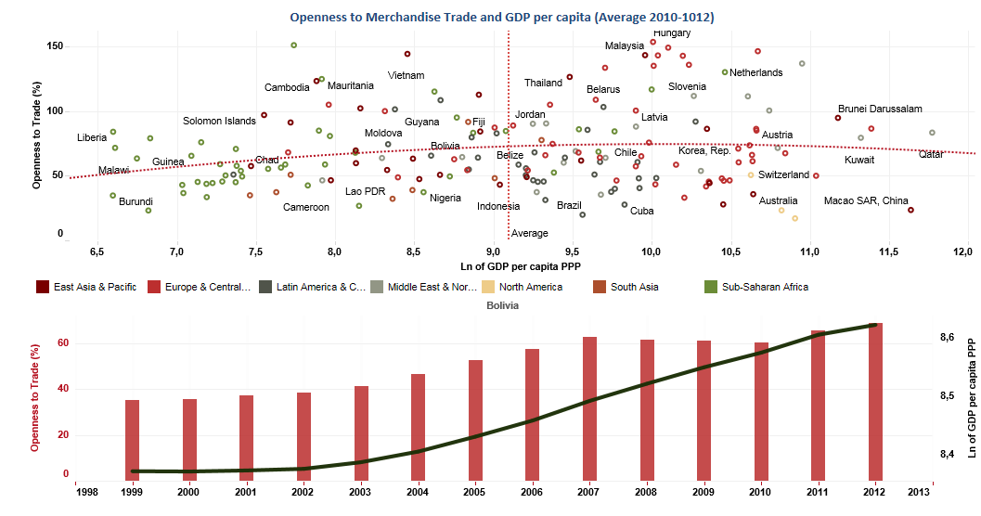
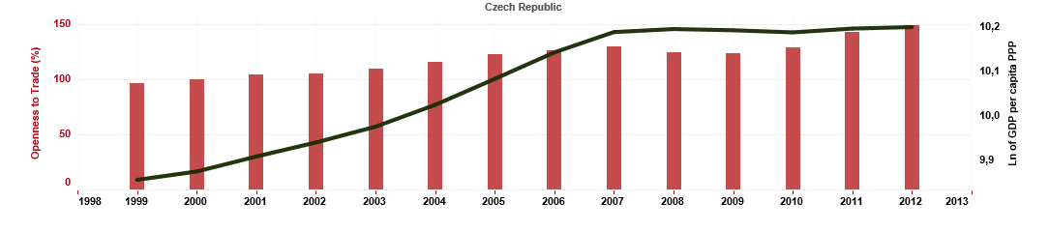
Openness to Merchandise Trade
3

Correlation between openness to merchandise trade and GDP per capita.
HU
SK
CZ
PL
2014
2015
2015
Notes:
Z ekonomických teorií je zřejmé, že existuje korelace mezi otevřeností obchodu se zbožím, kterou můžeme měřit jako podíl obratu obchodu na HDP, a velikostí HDP. Česká republika, jak již bylo naznačeno, patří z tohoto pohledu mezi velmi otevřené ekonomiky. Korelace mezi otevřeností obchodu a logaritmem HDP na obyvatele činí pro ČR je 91 %.

Slide 4
Multilateral Level and Trade for Growth
4

Trade is one of the sources of growth - 1 bill. EUR of foreign trade = 15 000 new working positions
Multilateral level
Trade agreements (TTIP, FTA with Japan, Investment agreement with China, FTAs with ASEAN countries)
Multilateral system (Implementing Bali package, modernization WTO)
EU (Completing Single marke, Schengen area, migration)
EU level
Czech Republic regards preventing restrictions on trade and movement of goods across the EU due to the current adverse and hopefully temporary measures as one of the major tasks of the current economic diplomacy, and appeals on maintaining this crucial and substantial pillar of what we call the European Union
Notes:
Together tasks on multilateral level

Slide 5

Economic Diplomacy Trends

Slide 6
6
Economic Diplomacy Trends

Current trends in economic diplomacy shows that ministries of foreign affairs play increasingly larger role in supporting export activities.
Denmark
Centralization of ED under MFA (Trade Council)
Paid services
Trade Council – employees from other resorts and private sector
Finland
Integration of support activities– Team Finland
Economic diplomats only in territories with business opportunities
Netherland
United Kingdom
9 priority sectors
Ireland
UKTI agency
Economic diplomats from MFA
Agricultural and scientific attaché
Coordinated by BIS and FCO
Business diplomats – company Enterprise Ireland
Project based cooperation
Notes:
Together tasks on multilateral level

Slide 7
7
Economic Diplomacy Trends

Association fi International Affairs
Trend | Belgium | Denmark | Finland | France | Ireland | Netherland | UK | Sweden
MFA exclusive jurisdiction in ED | X | X | X |  | X | X | X | X
MIT manages agency for supporting export |  |  | X | X | X | X | X
Export and investment agencies are unified | X | X | X | X |  |  | X | X
Private sector in decision making process | X | X |  | X | X |  | X | X
Outsourcing of services |  |  | X |  | X |  | X
Paid services |  | X | X | X | X | X | X | X
Evaluation of services quality | X | X | X | X | X | X | X | X
Sectoral approach |  | X | X | X | X | X | X | X
Notes:
Together tasks on multilateral level

Slide 8
8
Economic Diplomacy Trends

Conclusions
Competencies are usually divided between the Ministry of Foreign Affairs and other economic ministry and specialized agencies.
Strengthening element is an effort to invite private sector representative to decision-making process.
Also trend to coordinate embassies and agency offices is obvious.
In some countries, economic sections or agency to promote exports for their services charge fees (because of sustainability of number of services).
In economic diplomacy many countries focus on specific sectors in which their companies can offer value added.
Notes:
Together tasks on multilateral level

Slide 9

Czech experience - Changes in the Economic Diplomacy

Slide 10
Foreign policy concept and connection to economic diplomacy
10

Economic diplomacy is an integral part of Czech foreign policy
Economic diplomacy
Safety
Prosperity and sustainable development
Human dignity and human rights
Citizen assistance
Good reputation abroad
Security and strategic decisions, energetic safety and efficiency
Economic development - improvement of life conditions, innovation, environment protection, free trade
Support of economic sustainability, sharing of Czech experience , ODA and value chain management
Solving problems and protection of Czech subjects, foreign companies – visa, permits
Branding - quality products, services and innovations

Slide 11
Changes in the economic diplomacy - our vision and ambition
11

Economic diplomacy changes since 2013
Economic Agenda complements the security, development and political dimension of foreign ministries around the world.
2013/2014
2014/2015
2014
2015
2015/2016
Ministry of Foreign Opportunities
Ministry of Foreign Seized Opportunities
Ministry of Foreign Affairs

Slide 12
Changes in the economic diplomacy
12

Economic diplomacy changes since 2013
 | 2013/2014 | 2014/2015 | 2015/2016
1. | Fragmentation of foreign networks and conflict of competences | Unified foreign network and joint supply of services | Standard quality services supplied by the unified foreign network
2. | Incomprehensibility of the system for companies | Czech export center – unified contact point for entrepreneurs and the division of competences between CzechTrade and embassies (B2B, B2G, G2G) | More active communication with the corporate sector - feedback and joint projects
3. | Priority countries | Perspective field of export interest for each country | The countries divided by the field of export interest
4. | Unsystematic allocation of resources for economic diplomacy projects | Systematic allocation of resources for economic diplomacy projects and transparent project processing | Effective targeting of projects to seize opportunities abroad and increased funding
5. | Business missions as an "adventure tourism" | Coordination of business missions and active approach of companies | Controlling system for business mission outputs and small sectoral missions as follow-up
6. | Overlapping educational systems –MFA´s Diplomatic Academy and CzechTrade´s Export Academy | Unified training program for MFA, MIT and CzechTrade employees | Human resources and capacity building
7. | Absence of the evaluation system | Model of trade and economic activities for embassies | Evaluation system

Slide 13
Unified foreign network
13
Establish and increase provided service quality

Catalog of services offered by public sector
System of services offered by CzechTrade offices and representative offices
Definition of competences and elimination of duplicities between the Embassies and CzechTrade Offices (B2B / B2G / G2G).

Czech export centre
MFA employees are available 4 days in a week + regular consultations with MFA or MIT Deputy Ministers
Increasing number of provided services (from 1/10/2014 320 provided services)
More objective evaluation system
Capacity building– transformation of Economic Diplomacy Department
Services for Czech exporters (mostly B2G services)
Quality management, and output monitoring
Realization of client events in Czech republic (e.g. Export seminars), business missions and economic diplomacy projects
Quality and sustainability of services
Process formalization and standardization of outputs (Sinpro)
Notes:
Management kvality - budou nastaveny formalizované procesy sjednání, zadávání (work-flow) a postupy realizace hlavních typů služeb, včetně jejích standardizovaných výstupů. Bude probíhat dozor nad kvalitou u každého výstupu.

Slide 14
Newly opened offices abroad
14
Newly opened offices performing economic agenda

We are opening new offices in countries with export and investment potential.
✓
Nairobi, Kenya
✓
Dakar, Senegal
✓
Bogotá, Colombia
✓
Rangoon, Myanmar
✓
Erbil, Iraq
✓
Chengdu, China

Slide 15
Agriculture and technology diplomats
15
Synergy effect with Ministry of Industry and Trade (MIT), Ministry of Agriculture (MA), Government office (GO) and other partners

Memorandum of cooperation with MA – agricultural diplomats on agreed Embassies (China, Saudi Arabia and Serbia, Russia, eventually Ukraine). Agreement with PM´s office – technology diplomat in Israel with primary goal to strengthen cooperation in R&D and innovations.
✓
EMB Belgrade, Serbia
✓
EMB Riyadh, Saudi Arabia
✓
EMB Beijing, China
✓
EMB Moscow, Russia
✓
EMB Kiev, Ukraine
✓
EMB Tel Aviv, Israel

Slide 16
Network of Economic diplomats in 2016
16

We are strengthening CzechTrade agencies and offices with diplomats with economy agenda.
New 14 places of economic diplomats in 2016 – 12 embassies will be strengthened and 2 new CzechTrade offices will be opened.
✓
EMB Pretoria, JAR
✓
EMB Accra, Ghana
OFF Lagos, Nigeria
✓
CG Toronto, Canada
✓
EMB Delhi, India
✓
EMB Kuala Lumpur, Malaysia
✓
✓
EMB Manila, Philippines
✓
EMB Amman, Jordan
✓
CG Hong Kong, China
✓
EMB Tokyo, Japan
✓
Berlin, Germany
✓
CG Chicago and OFF Seattle, USA
✓
CECO Taipei

Slide 17
17
Map of global sectoral opportunities

Export and investment opportunities
Unique knowledge of export opportunities. We have know-how to define and verify opportunities.
Why sectoral approach
More efficient allocation of resources
Flexible reaction to current situation

Tool for exporters
First aid how to find possible market
Well evaluated by partners, stakeholders and even entrepreneurs
Online interactivity
From territorial to sectoral search
www.businessinfo.cz/mop

Slide 18
Map of global sectoral opportunities
18
Export and investment opportunities

Market dynamics
Export competences
Czech export potential

Slide 19
Map of global sectoral opportunities
19
Export and investment opportunities

1.
2.
3.
Statistical analysis
Verification by the embassies
Consultations with partners
4.
5.
Verification by the embassies
Finalization

Slide 20
20
Verification by the embassies

Verification of statistical results
Market insight
Verify proposals
Include justification
Include the information about „soft“ signals (planned government projects and investments, changes in customer preferences, economic structure, business behavior)
Outlook for 2-3 years time
Unique opportunity to use the experience from diplomats staying abroad


Slide 21
Cuba
Results
Sector | Opportunities
Agricultural and food industry | HS 8432 - Machine tools for agriculture forestry
 | HS 8438 - Machinery for the industrial food preparation
 | HS 8701 - Tractors
Automotive | HS 8702 - Motor vehicles for public transport and passenger
 | HS 8703 - Cars motor vehicles for the transport of persons
 | HS 8708 – Parts of motor vehicles
Railway industry | HS 8603 - Railway or tramway coaches, self-propelled
 | HS 8607 - Parts of railway or tramway locomotives or rolling stock
Infrastructure | CPA 42 - Engineering works and construction
 | CPA 49 - Land transport
Services | CPA 42 - Engineering works and construction
 | CPA 71 - Architectural and engineering services; technical testing and analysis
Automotive and transportation
New licenses for private taxi and transport services
New infrastructure of communications and public transportation
Problem – vehicle´s age
Agriculture and food industry
Agriculture intensification
Small private farms
Transfer know-how

Slide 22
Example: Agriculture industry
Results
HS4 classification | Potential regions
2203 Beer | Croatia, Italy, Japan, Republic of Korea. Hungary, Slovenia, the United Kingdom, Australia
0402 Milk, cream sweetened condensed | Lebanon, Nigeria, Serbia, Thailand, Tunisia
2201 Mineral water, soda water, unsweetened | South Korea, Lebanon, Russia, Thailand
1704 Confectionery without cocoa | Australia, Egypt, Croatia, Israel, Nigeria, Peru, Russia, United Kingdom
1107 Malt, roasted | Italy, Japan, Yemen, South Africa, Nigeria, the Netherlands, Peru, Slovakia
1701 Sugar, cane, beet | Tunisia, Italy, Slovenia, Nigeria, Israel
Saudi Arabia
SA imports more then 70 % of food from abroad, 12 % annual growth of food import
Strategic government decision – ensuring food needs by imports, stop agriculture funding

Slide 23
Did you know that…
23
Results example

Ethiopia
  Ethiopia plans to build 3,000 km of railway lines
Indonesia
  Indonesia modernizes air transport infrastructure and want to build 46 new airports
Zambia
  Zambia plans to build 8 000 km of new roads
Colombia
  In next 5 years Columbia wants to increase its electric power capacity by 4 000 MW

Slide 24
Economic Diplomacy Projects
24

Support for Czech exporters
Economic Diplomacy Projects (EDP) – way how to create new contacts, promote Czech products and services and even acquire new contracts.
Increased funding
51 projects were implemented in 2014 and 4,5 millions CZK were provided by MFA
87 projects were approved for implementation in 2015 with total support of 9 millions CZK

New methodology
Since 2014 new methodology is used – transparent processing of EDPs
System for processing EDPs was improved
More effective targeting of projects
Czech solutions in countries, where opportunities were identified
Better targeting of projects and synergy with Map of global and Sectoral Opportunities
Planning projects with partners
Planning projects with CzechTrade, MIT, Czech centers, CzechInvest, CzechTourism and other partners
Better communication with private sector
Notes:
Na rok 2016 je ve výběru téměř 200 projektů o celkovém rozsahu 900 tis. EUR.

Slide 25
Education of economic diplomats
25

Economic diplomacy needs diplomats with 21. century competencies
Agreement between MFA and MIT – together education of MFA, MIT and CzechTrade employees in economic diplomacy.
Competency building
Education program to train experts with required competences in economic diplomacy

Synergy
Institutional synergy – MFA´s Diplomatic academy and CzechTrade´s Export academy
Complex competences – economy and export courses, soft skills and diplomatic protocol
Cooperation with private sector
Expanding cooperation with private sector
Emphasizing of economic education
Capacity building
Better education for new diplomats – examination and evaluation system
Internships at the Economic Diplomacy Department for applicants
More competent economic diplomats

Slide 26
Czech development cooperation
26
Capacity building of the Czech Development Agency (CDA) and synergy between state, non-profit and private sector

Approved Czech development cooperation plan for 2016, increased budget at the medium term to 854 mil. CZK. Next tasks - raise public awareness of the development cooperation, use resources more efficiently and in LDCs, prevent irregular and forced migration, increase sustainability through effective global partnership
.
Involving the private sector
CzDA supported 17 business to business projects in 2015
Council for international development cooperation - sharing of information and experiences, policy coherence for development - PCD

Project management
Results based monitoring and evaluation – feedback and lessons learned
New sectoral programs, risk analysis, and efficient implementing partnerships
Future Czech development cooperation priorities
Agenda 2030 for Sustainable Development – global goals, targets, indicators and commitments
New bilateral development strategy after 2017 - Czech solutions for the development partner needs
Synergy between state, non-profit and private sector
Czech Development Agency - Strategic vision
Capacity building
Accreditation of CDA for European Commission programmes (delegated cooperation)

Slide 27

Economic Diplomacy - Topics

Slide 28
Cooperation of V4 countries – sharing the „best practices“ of Economic Diplomacy
28

Together capacity and competence building
Because V4 countries are trade open economies and their growth depends on global economy, they have to stimulate growth through the development of export-related activities.
To be efficient and not to compete on single markets, for V4 countries is better to cooperate.
From the point of view of economic diplomacy the Czech Republic considers very important to discuss our experiences and innovations on field of economic diplomacy and share them in the form of the best practices (how to develop of foreign networks and their services, look for sectoral opportunities or create synergy effects between private and public sector by economy projects)


Slide 29
Cooperation of V4 countries – shared sectoral competences
29

Together capacity and competence building
The world contains a whole host of export opportunities, and only a limited number can be explored because of scarce resources.
To seize the opportunities the Czech Republic considers as advantage cooperation with V4 countries especially on development markets (lake in Asia, Latin America or Sub-Saharan Africa).
It is possible to find sectoral investment or export opportunities in development country but to offer only part of capabilities or competencies or know how to seize the opportunities. In this case it would be appropriate to find a partner between V4 countries with complementary competencies and solve this business opportunity together – share the competencies. This also could lead to improve positions of V4 countries on global markets.


Slide 30
30
Thank you for your attention!

"Feedback, as well as showers, of course, is not permanent. It's something we should have periodically. „
- Zig Ziglar, entrepreneur and writer

