Slide 1
Czech Republic
Competitiveness and Trade
January 15, 2016
Martin Tlapa
Deputy Minister
Ministry of Foreign Affairs of the Czech Republic

Slide 2
National Competitivess
National competitiveness is a popular term widely used by politicians, business leaders, scholars and ordinary people around the globe nowadays.
Bill Clinton’s analogue that each nation is like “a big corporation competing in the global marketplace” (Krugman, 1997).
Annual publication of world competitiveness reports:
  World Economic Forum
  International Institute for Management Development
  World Bank
Notes:
The rationale behind this wide interest is that national competitiveness is seen as vital for the economic success of a country.
This interest is a result of the fact that in a globalized world driven by global competition in commerce and trade, there is a need for countries to improve their national competitiveness in order to survive and thrive.

Slide 3
Competitiveness: A dangerous obsession?
„competitiveness is a meaningless concept when applied to national economies“(Krugman, 1994)
  Justifications:
  uncompetitive corporations may go out of business, countries do not have such a bottom line and therefore the concept of national competitiveness is elusive.
  countries do not compete with each other the way corporations do because international trade is not a zero-sum game, meaning one country’s gain is not another’s loss.

Slide 4
Why a dangerous obsession?
competitiveness policies “lead, directly and indirectly, to bad economic policies on a wide range of issues, domestic and foreign, whether it be in health care or trade” (Krugman, 1994)
  Three reasons for a dangerous obsession:
    it could result in misallocation of resources in pursuit of improving national competitiveness;
    it could lead to protectionism and trade wars;
    It could result in bad public policy on a spectrum of important issues.

Slide 5
Competitiveness Definitions
Michael Porter (2004) “economic value is indirectly generated by nations through enterprises, therefore the role of the nations is to create an environment that promotes the activities of enterprises” and “the only meaningful concept of competitiveness at national level is national productivity”.
Garelli (IMD) “competitiveness is not an objective in itself but an economic tool. However a tool is linked and dependent on the objectives pursued by the various economic actors, which constitute a nation.”
WEF competitiveness is “the set of institutions, policies, and factors that make a nation remain productive over the longer term while ensuring social and environmental sustainability”
OECD “competitiveness is the degree to which a nation can, under free trade and fair market conditions, produce goods and services which meet the test of international markets, while simultaneously maintaining and expanding the real incomes of its people over the longterm.”
Notes:
Garelli (1) achieving efficiency, (2) making choices, (3) the utilization of disposable resources.

Slide 6
Competitiveness and Growth
Competitiveness seen as ability to earn or the economy´s everall results in macroeconomic terms (higher GDP or standart of living).
Source is seen in (or is even equivalent to) productivity (Porter, 1990)

Slide 7
What lies behind different growth paths?
(GDP per capita, PPP USD)

Slide 8
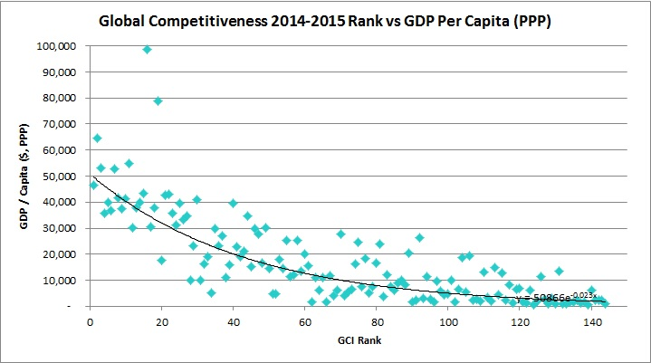
GDP per capita vs. GCI

Slide 9
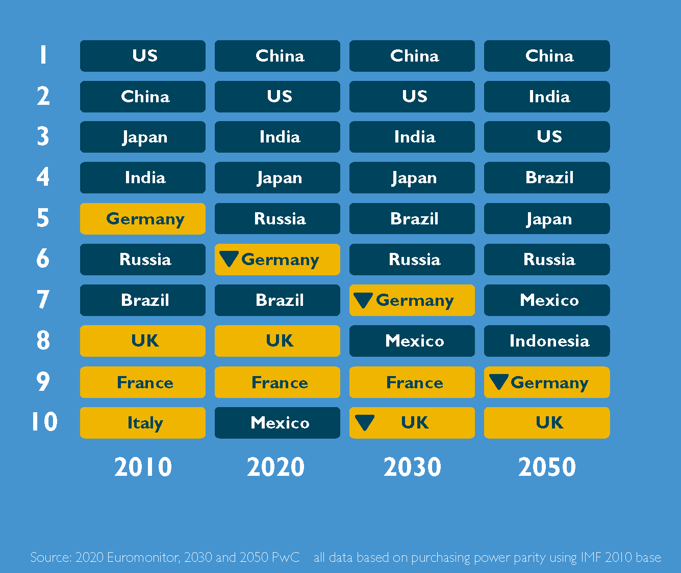
Does Europe have to change?
Notes:
If the current trends continue, the Europe may be pushed out from TOP 10 strongest economies of the world by 2050
Europe will be replaced in the competitiveness rankings by fast growing economies (China 7-8% annual growth, India 5-6%)

Slide 10
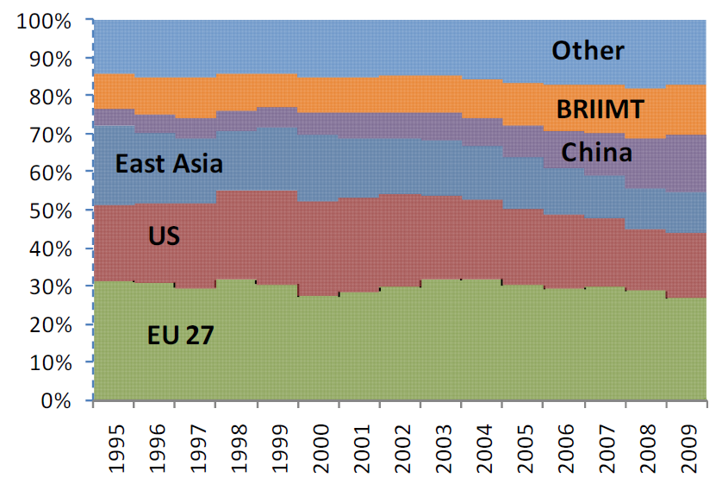
Share in Global Value Chain
Notes:
The EU27’s share in GVC income has remained stable between 1995 and 2009 at around 30% - i.e. even during the first financial crisis that started in 2007. East Asia’s share has also been stable, at round 25%, with China taking a larger share within East Asia (showing the relative decline of Japan).
The US’ share dropped from 20% to 15%. The share of the BRIIMT (Brazil, Russian Federation, India, Indonesia, Mexico and Turkey) has been around 10% between 1995 and 2009. All other countries have a less than 20% share in the Global Value Chain income.

Slide 11
GCR 2015-2016

Slide 12
The Czech Republic´s rank out of 144 economies
Notes:
GCI – 31
Innovation – 32
Efficiency enh. – 26
Basic req. – 31

Slide 13
Czech Rep. vs Switzerland
Source: WEF, 2015

Slide 14
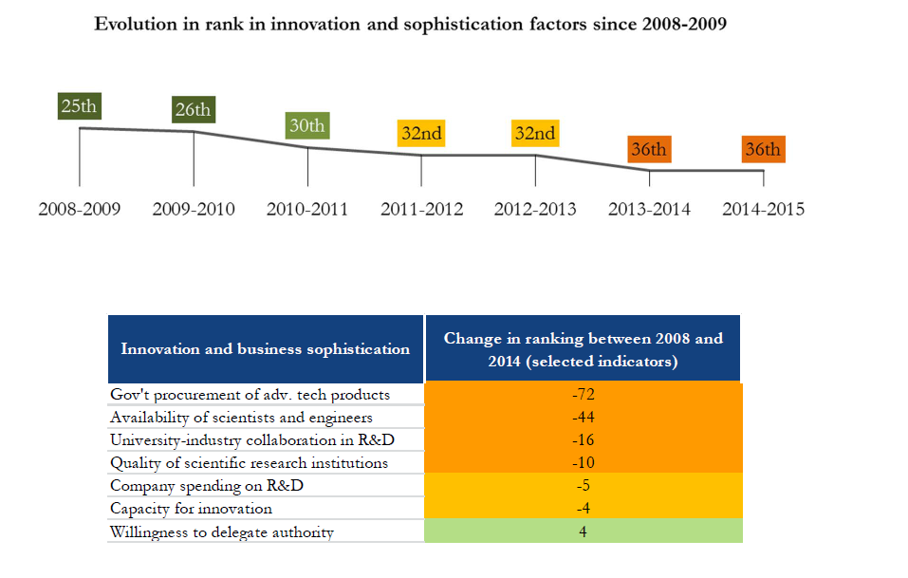
Focus on innovation
Notes:
32th in 2015 and 2016

Slide 15
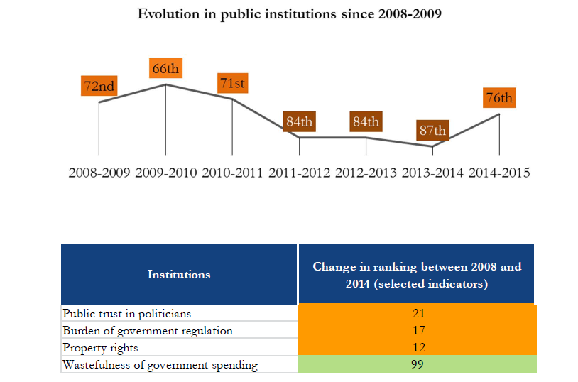
Focus on public institutions
Notes:
57th in 2015-2016

Slide 16

Strengthening growth for the long run?
What policy responses?

Slide 17
Vision and delivery
Long-term vision for turbulent times + address the necessary steps that can ensure the sustainable level of prosperity in years ahead.
Avoid inefficient and short-term perception of the problems and look for real and appropriate solutions.
Implement changes!

Slide 18
Thinking in global perspectives
Link discussions about future with analyses of global economic trends.
Building a system and developing capabilities for monitoring of world markets.

Slide 19
Trade for growth?
Trade is one of the sources of growth - 1 mld. EUR of foreign trade = 15 000 new working positions in EU
EU level:
  Trade agreements (TTIP, FTA with Japan, Investment agreement with China, FTAs with ASEAN countries)
  Multilateral system (Implementing Bali package, modernization WTO)
  Completing Single market
National level:
  Effectivity in promoting national interests abroad
  Information about opportunities abroad
  Open doors for investment projects home

Slide 20
Export share on GDP
83,6 %
Notes:
Česká republika je ekonomikou s relativně malým spotřebním trhem a je tedy nutné, aby byla exportně orientovanou zemí. Hospodářská prosperita České republiky je z velké míry závislá na vývoji světové ekonomiky. Objem českého exportu je na úrovni 83,6 % našeho HDP (WorldBank, 2014). Průměr EU činí 40 % HDP. České firmy, pokud chtějí růst, musí expandovat a hledat své exportní či investiční příležitosti v zahraničí.

Slide 21

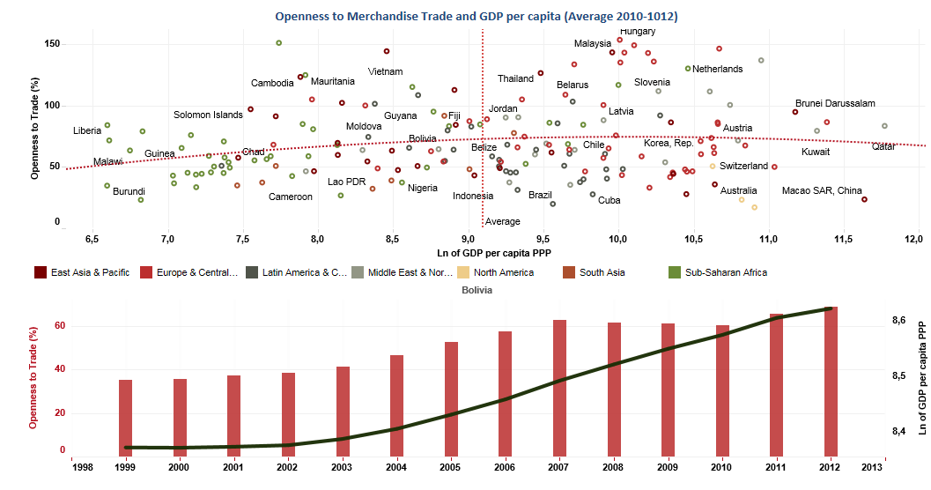
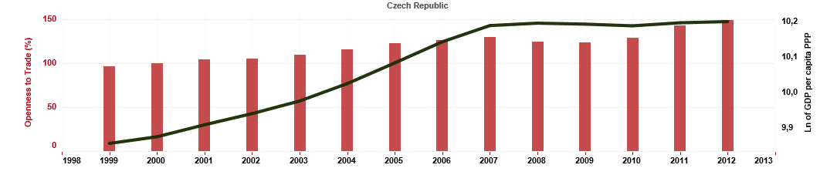
21

Openness to merchandise trade – trade as a percentage of GDP
We can find correlation between openness to merchandise trade and GDP
Czech Republic
2014
2015
2015
Notes:
Z ekonomických teorií je zřejmé, že existuje korelace mezi otevřeností obchodu se zbožím, kterou můžeme měřit jako podíl obratu obchodu na HDP, a velikostí HDP. Česká republika, jak již bylo naznačeno, patří z tohoto pohledu mezi velmi otevřené ekonomiky. Korelace mezi otevřeností obchodu a logaritmem HDP na obyvatele činí pro ČR je 91 %.

Slide 22
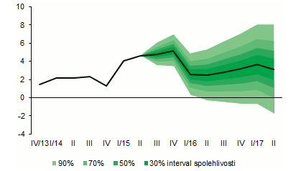
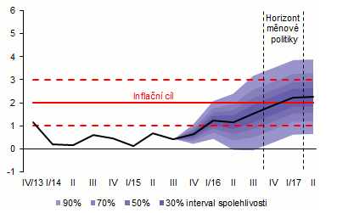
22

Czech Republic – Economy growth
Economic growth was reached with low unemployment rate
GDP growth
Inflation
Monetary policy
horizon
Inflation target
2015
2015
Confidence interval
Confidence interval
Prognosis of CNB, % | 2015 | 2016 | 2017
GDP growth | 4,7 | 2,8 | 2,9
Inflation | 0,5 | 1,4 | 2,2
Unemployment rate | 5,3 | 4,8 | 4,7

Slide 23
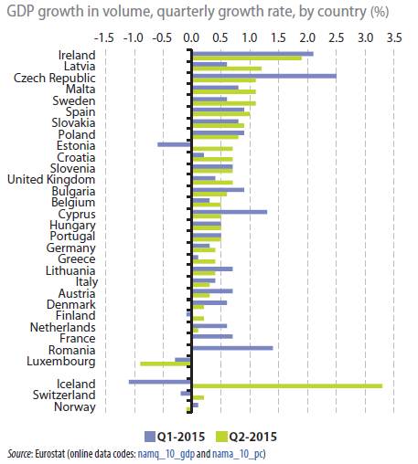
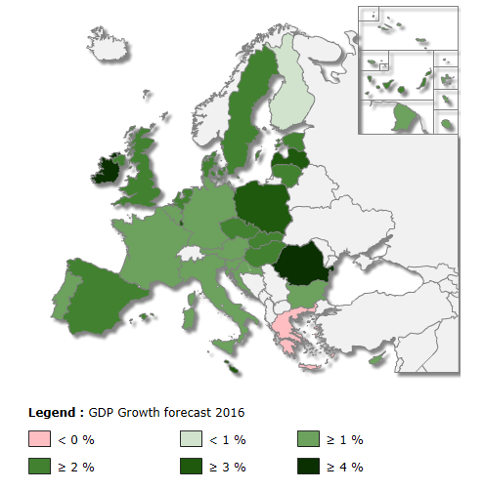
23

Czech Republic – Economy growth
Last year the Czech Republic had one of the highest GDP growths compared with EU countries.
2015
2015
Notes:
V posledním roce byla ČR jednou z nejrychleji rostoucích ekonomik EU, za celý rok dle odhadu ČNB dosáhla růstu HDP 4,7 %. I v příštím roce by si dle odhadů ČNB měla ČR udržet jeden z nejvyšších růstů HDP - 2,8 %.

Slide 24
Foreign trade of the Czech Republic
Trade balance reached 442.49 billion CZK surplus in 2014.
Exports grew by 13.9 % and imports by 12.4 % in 2014. Exports grew by 7 % and imports by 7,5 % in 2015 (December is not yet included).
Strong reliance on manufacturing (55.0 % share of machinery and transport equipment in 2014) and on exports to EU-28 (82.1 % of total exports in 2014). The same values are expected in 2015
Growing potential of developing countries (especially in Africa and Asia). The emerging markets are expected to become more important trade partners to Czech Republic in the future.
Notes:
From January to November 2015 trade balance was 424 bill. CZK
Exports grew by 7 % and imports by 7,5 % in 2015 (december is not yet calculated).

Slide 25
The importance of economic diplomacy for economic development
Effective enforcement of economic interests abroad = global trend of promoting economic growth.
Changes in the world trade:
  increased pressure on strengthening of the economic role of the ministries of foreign affairs and embassies.
  active approach of the states in field of foreign direct investment and removing barriers to market entry
Pillars of diplomacy: security, political realtions, economic realtions

Slide 26
Economic diplomacy in practice (1)
Market access- removing the barriers for entring the foreign markets
Doing business abroad – favorable conditions for the development of business activities
Searching opportunitiess – provide information about arising opportunities
Investment promotion - promoting the Czech Republic among potential foreign investors

Slide 27
Economic diplomacy in practice (2)
Export services – assisting the companies while dealing with official institutions and state enterprises
Public tenders - providing information about upcoming public procurement
Development funds - informing about the possibilities to participate in the projects financed development (or other) funds.

Slide 28
Economic diplomacy in practice (3)
Facilitating relations - contributing to building contacts between Czech and foreign partners
Problem solving - helping to solve the problems of Czech firms at foreign markets

Slide 29
Actors of Economic Diplomacy
Entities with competence abroad: Embassies and consulates of the country, their economic departments and diplomatic staff. Representatives of domestic government agencies to promote investment, trade etc., representatives of non-governmental agencies and representatives of multinational companies.
Entities operating in home country: Central government authorities – the Ministry of Foreign Affairs, Ministry of Industry and Trade, the Ministry for Regional Development. Business associations, chambers, associations and business sector entities, involved in international economic relations.

Slide 30
Tools of Czech economic diplomacy at MFA
Czech export centre
Projects of economic diplomacy
Sectorial business missions
Export promotion seminars and conferences
Regular meeting with ambassadors
Map of global sectoral opportunities

Slide 31

Czech export centre
Provides consulting services for exporters (specialists from MFA and Czechtrade)
Consulations with deputy ministers
Entry point for services of Single international network of Czech embassies and foreign offices of CzechTrade

Slide 32
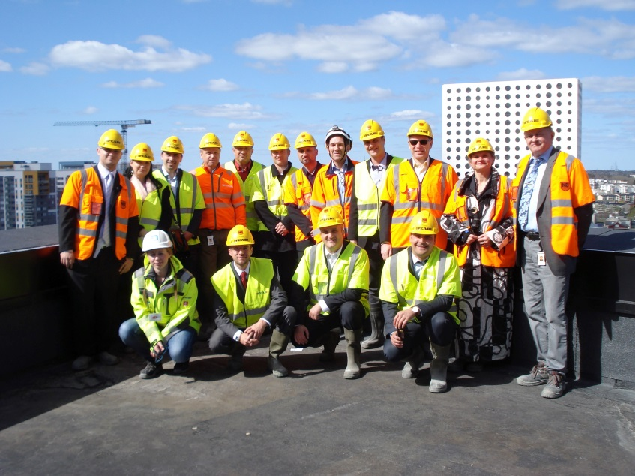
Projects of economic diplomacy
For 2015 was approved by a total of 87 projects supported by the Ministry of Foreign Affairs in excess of 10.3 miles. CZK.
Forms: seminars, presentations, participation in exhibitions and trade fairs, conferences, business missions, Czech Days and other similar industry-focused events

Slide 33

Sectorial business missions
Foreign missions led by the Deputy Minister tailor made for group of companies operating in the same sector or sectorial associations

Slide 34
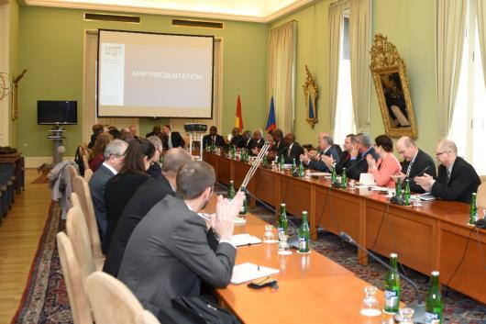
Export promotion seminars and conferences
Territorial or sectoral focus
Representatives of foreign chambers of commerce, businessmen and Czech companies that operate in the territory
Opportunity to gain new information and share experience with each other

Slide 35

Map of global sectoral opportunities
Unique instrument for furthering economic diplomacy through search sectoral opportunities for Czech exporters
Analysis that aims to identify promising possibilities of Czech companies in foreign markets
Overview of specific export opportunities in specific territories

Slide 36
Map of global sectoral opportunities
Sectoral approach: efficient resource allocation and planning activities to support the country's economic interests, flexible reaction to the current situation
Interactively on the web - data can be used both for territorial and industry-targeted searches

Slide 37
MSO: The process
1.
2.
4.
Input data – proposals of headquarters
Verify and supplement from the embassies
Consultations with entrepreneurs in the Czech Republic
5.
6.
Verify and supplement from the Ministry of Foreign Affairs
Finalizing and processing to printed and interactive form
3.
Processing into cards, adding data

Slide 38
Methodology?
Soft signals
Analytical data
Experience
Promising sectors for each country

Slide 39
Verification by the embassies
Verify proposals
Include justification
Include the information about „soft“ signals (planned government projects and investments, changes in customer preferences, economic structure, business behavior)
Outlook for 2-3 years time
Unique opportunity to use the experience from diplomats staying abroad

Slide 40
Which sectors?
Growth dynamics of the market
Export competences
Potential of CZ

Slide 41
Growth dynamics of the foreign market
First assumption for market selection
More then 10 % market growth in average for selected commodity (for last 3 periods)
Market is not saturated yet

Slide 42
Potential of the Czech Republic
Second assumption for market selection
Czech export partner´s market share is more than two times lower than Czech export world market share
Czech Rep.
World

Slide 43
Export competences
Third assumption for market selection
Revealed Czech comparative advantage for selected commodity
Revealed partner´s comparative disadvantage for selected commodity
Lafay index was used
Share of export of „A“ on overall turnover of „A“ is in given country higher than share of export on the turnover of foreign trade of given country
Share of export of „A“ on overall turnover of „A“ is in given country lower than share of export on the turnover of foreign trade of given country
Comparative disadvantage
Comparative advantage

Slide 44
Export competences – example
Comparative advantage of the Czech Republic
$$\frac{100−25}{100+25}>\frac{1000−600}{1000+600}$$
(100−25)/(100+25)>(1000−600)/(1000+600)
Comparative disadvantage of the partner
$$\frac{30−20}{30+20}<\frac{650−350}{650+350}$$
(30−20)/(30+20)<(650−350)/(650+350)

Slide 45
Where are we heading?
Priority countries
Prospective sectors in individual countries
Prospective countries for individual fields

Slide 46
Benefits for state and exporters
Exporters
  Quick overview of promising sectors
  Information about market dynamics and market outlook
  Deciding where to allocate their resources
Country
  Efficient allocation of resources and capacities of embassies and headquarters
  Strategic decisions and planning
  Industry-specific missions
  Economic diplomacy projects

Slide 47
Did you know that…
47

Results example
Ethiopia
  Ethiopia plans to build 3,000 km of railway lines
Indonesia
  Indonesia modernizes air transport infrastructure and want to build 46 new airports
New Zeeland
  Aging problems - In 2061 will be more than 25 % citizens older than 65
Hungary
  Metro modernization in Budapest
Zambia
  Zambia plans to build 8 000 km of new roads
Columbia
  In next 5 years Columbia wants to increase its electric power capacity by 4 000 MW

Slide 48
Example: Agriculture industry
HS4 classification | Potential regions
2203 Beer | Croatia, Italy, Japan, Republic of Korea. Hungary, Slovenia, the United Kingdom, Australia
0402 Milk, cream sweetened condensed | Lebanon, Nigeria, Serbia, Thailand, Tunisia
2201 Mineral water, soda water, unsweetened | South Korea, Lebanon, Russia, Thailand
1704 Confectionery without cocoa | Australia, Egypt, Croatia, Israel, Nigeria, Peru, Russia, United Kingdom
1107 Malt, roasted | Italy, Japan, Yemen, South Africa, Nigeria, the Netherlands, Peru, Slovakia
1701 Sugar, cane, beet | Tunisia, Italy, Slovenia, Nigeria, Israel
Saudi Arabia
SA imports more then 70 % of food from abroad, 12 % annual growth of food import
Strategic government decision – ensuring food needs by imports, stop agriculture funding

Slide 49
Cuba
Sector | Opportunities
Agricultural and food industry | HS 8432 - Machine tools for agriculture forestry
 | HS 8438 - Machinery for the industrial food preparation
 | HS 8701 - Tractors
Automotive | HS 8702 - Motor vehicles for public transport and passenger
 | HS 8703 - Cars motor vehicles for the transport of persons
 | HS 8708 – Parts of motor vehicles
Railway industry | HS 8603 - Railway or tramway coaches, self-propelled
 | HS 8607 - Parts of railway or tramway locomotives or rolling stock
Infrastructure | CPA 42 - Engineering works and construction
 | CPA 49 - Land transport
Services | CPA 42 - Engineering works and construction
 | CPA 71 - Architectural and engineering services; technical testing and analysis
Automotive and transportation
New licenses for private taxi and transport services
New infrastructure of communications and public transportation
Problem – vehicle´s age
Agriculture and food industry
Agriculture intensification
Small private farms
Transfer know-how

Slide 50
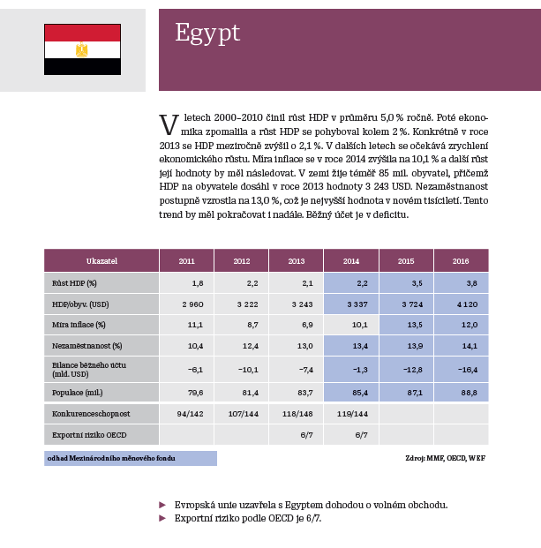
Example – Egypt (1)

Slide 51
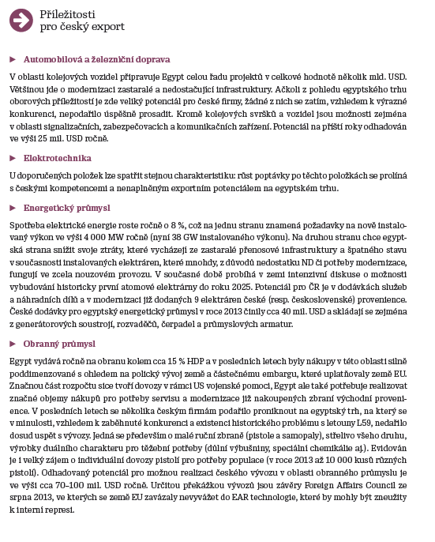
Example – Egypt (2)

Slide 52
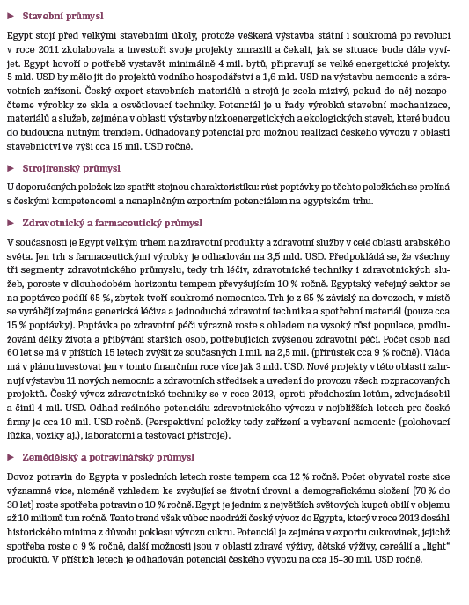
Example – Egypt (3)

Slide 53
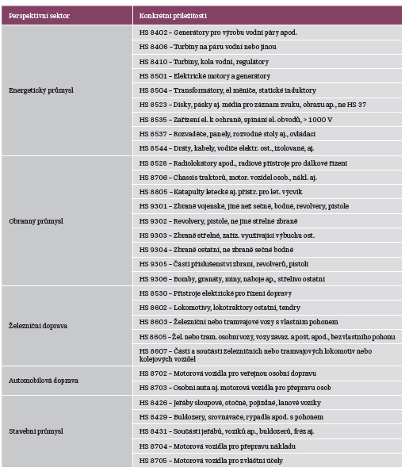
Example – Egypt (4)

Slide 54
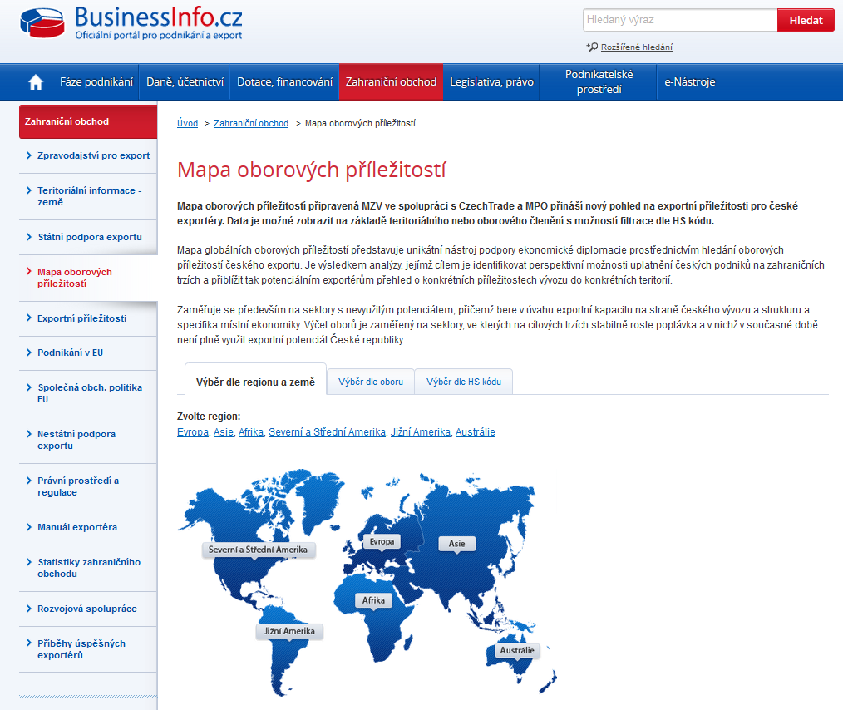
Available online
(filtration according to the countries or sectors)

Slide 55
Thank you for attention!

