Slide 1
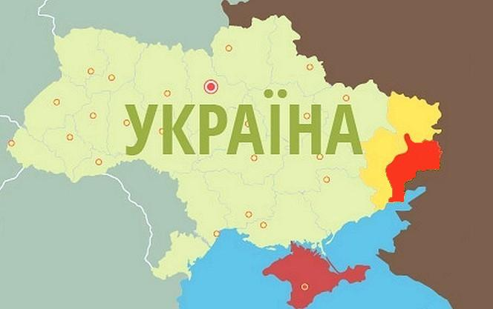
Population of Ukraine: 45 million people
Area: 603 628 km2
Occupied territories of Donetsk and Luhansk regions ~ 3, 5 mln
> 0,5 mln refugees
Crimea: 1,9 million people

Slide 2
NUMBER OF EMPLOYEES INVOLVED IN THE RESEARCH AND DEVELOPMENT SECTOR FOR THE PERIOD 1991 – 2013
Maksym Strikha
Notes:
Slide 12
123,2 (one hundred twenty three point two) thousand people were working at research institutions in 2013. Among them about 68,6 (sixty eight point six) thousand are researchers and about 20,5 (twenty point five) thousand of them have the degree of Doctors habilitatus or Ph.D.

Slide 3
FUNDING OF THE SCIENCE AND
TECHNOLOGY SECTOR
FOR THE PERIOD 2005-2013
% GDP
1,17
0,96
0,86
0,84
0,85
0,82
0,73
0,75
0,77
Maksym Strikha
Notes:
Slide 15
Regarding the funding issue of the science and technology sector in Ukraine I would like to admit that total funding in 2013 amounted to 0.77% (zero point seventy seven per cent) of GDP (Gross domestic product), of which 0.33% (zero point thirty three per cent) was from the budget funds and 0.44% (zero point forty four per cent) was from the non-State budget funds.

Slide 4
RESEARCH STRUCTURE BY SECTOR
UKRAINE

Slide 5
RESEARCH STRUCTURE BY SECTOR
USA

Slide 6
EVOLUTION OF IDEAS
What kind of entities should be responsible for the science, technology and innovation development?
Prime Minister Assistant/Advisor on Science and Technology?
Science Committee of Advisors on Science and Technology:
PM Assistant and 20+ best representatives from R&D including foreigners
Executive Committee:
President, PM, PM Assistant, Ministers and Executives from all Governmental branches and Agencies responsible for Science and Technology
National Council on Science and Technology
(National Assembly)

Slide 7
President
Parliament
Preparation of the Budget
(Committees)
Prime Minister
NATIONAL RESEARCH FUND
DIRECTOR
Fund for Fundamental Research
Fund for Applied Research
Fund for Innovative Programs
Fund for Start-ups Support
NATIONAL ASSEMBLY
Strategy for R&D
HEALTH
AGRICULTURE
INSTITUTES,
UNIVERSITIES,
LABORATORIES (GRANTS & CONTRACTS)
SECURITY
SPACE
ENERGY

Slide 8
INTERNATIONAL COOPERATION AGREEMENTS
TOTAL: 70 AGREEMENTS
Maksym Strikha
Notes:
Slide 22
In general, there are about 70 international agreements in the science and technology sector have been concluded between Ukraine and other countries. The biggest part of them was concluded with the European Union countries.
In the framework of this agreements Ukrainian scientists are successfully collaborating with scientists of foreign institutions.

Slide 9
COOPERATION WITH INTERNATIONAL ORGANIZATIONS AND FUNDS
Ukraine-EU
Ukraine-NATO
International European Innovation Scientific and Technical Program “EUREKA”
U.S. Civilian Research and Development Foundation (CRDF)
European Organization for Nuclear Research (CERN)
Joint Institute for Nuclear Research (JINR)
Organization of Black Sea Economical Cooperation (BSEC)
Science and Technology Center in Ukraine (STCU)
International Centre for Scientific and Technical Information (ICSTI)
Maksym Strikha
Notes:
Slide 23
Quite active is the science and technology cooperation of Ukrainian scientists with such international organizations as: EU, NATO, “EUREKA”, Civilian Research and Development Foundation (CRDF), European Organization for Nuclear Research (CERN) and other, you can see them on the slide.

Slide 10
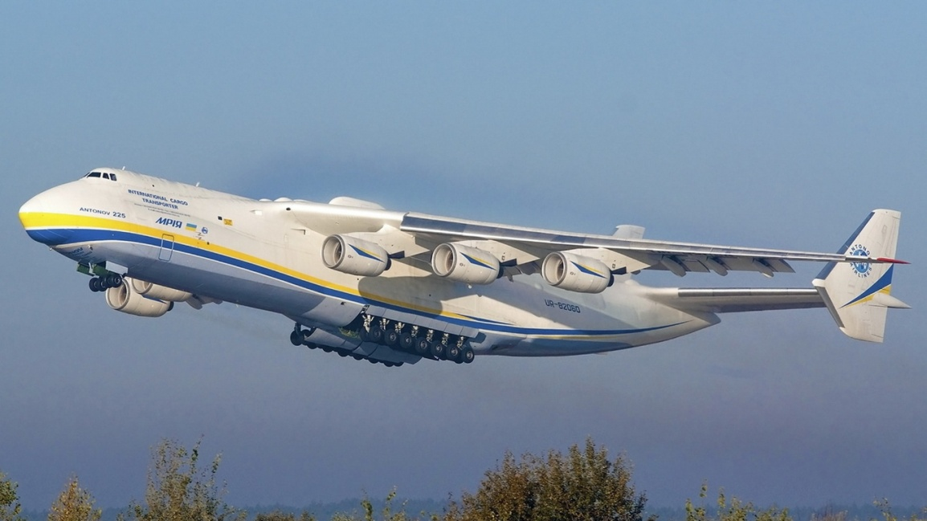
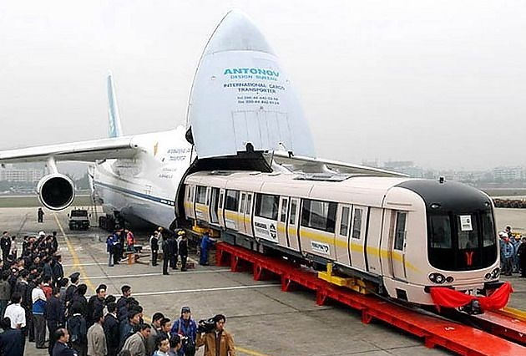
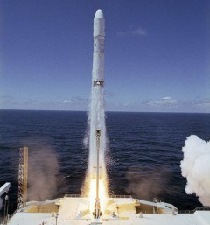

Slide 11
http://www.slideshare.net/YevgenSysoyev/ukraine-dealbook-201214

Slide 12
http://www.slideshare.net/YevgenSysoyev/ukraine-dealbook-201214

Slide 13
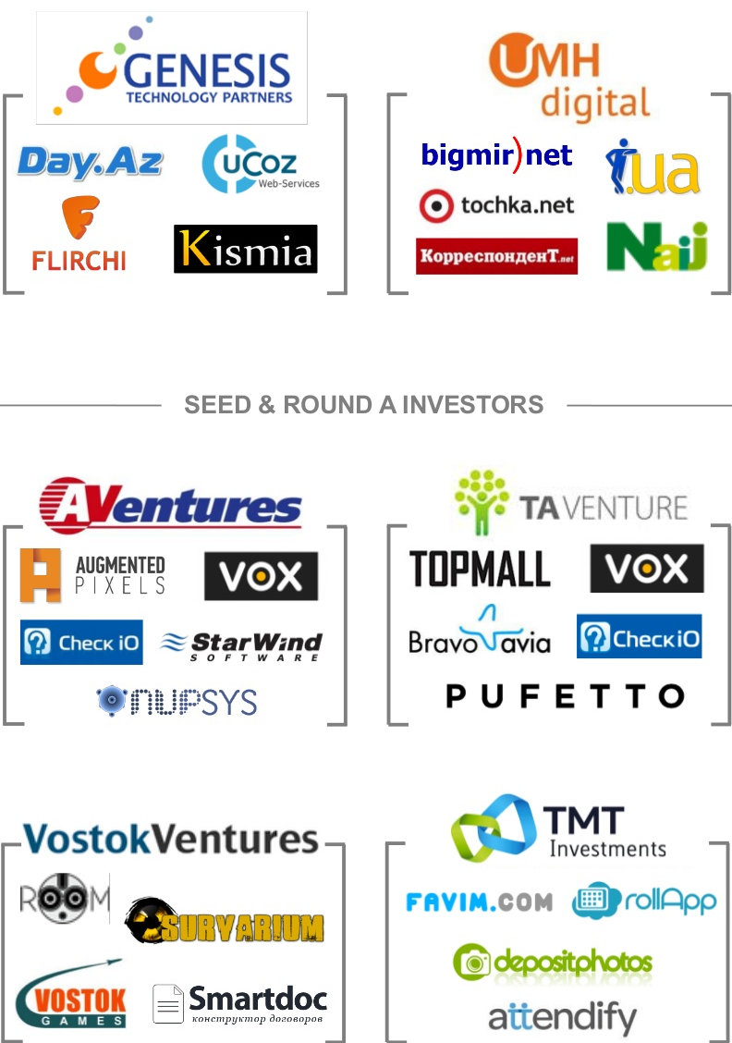
http://www.slideshare.net/YevgenSysoyev/ukraine-dealbook-201214

Slide 14
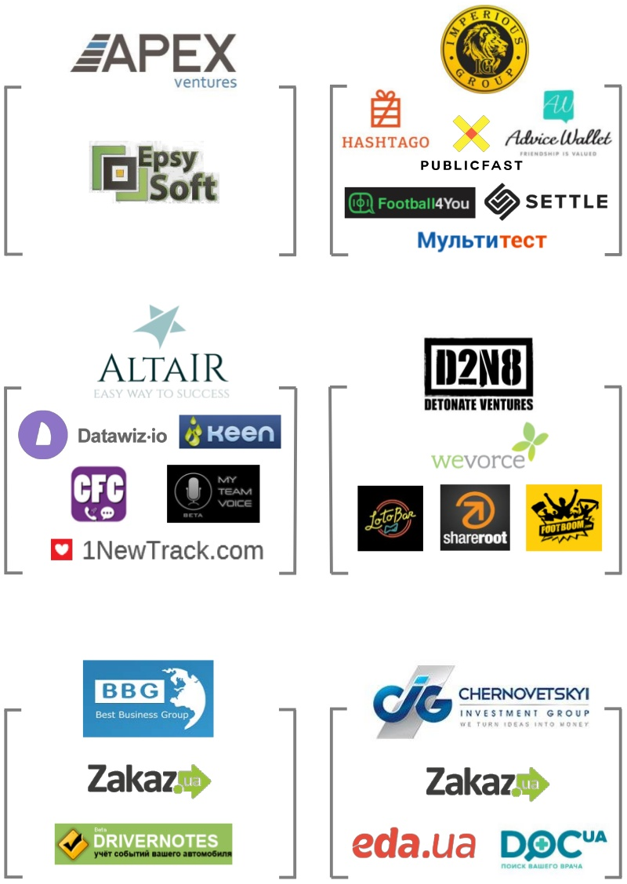
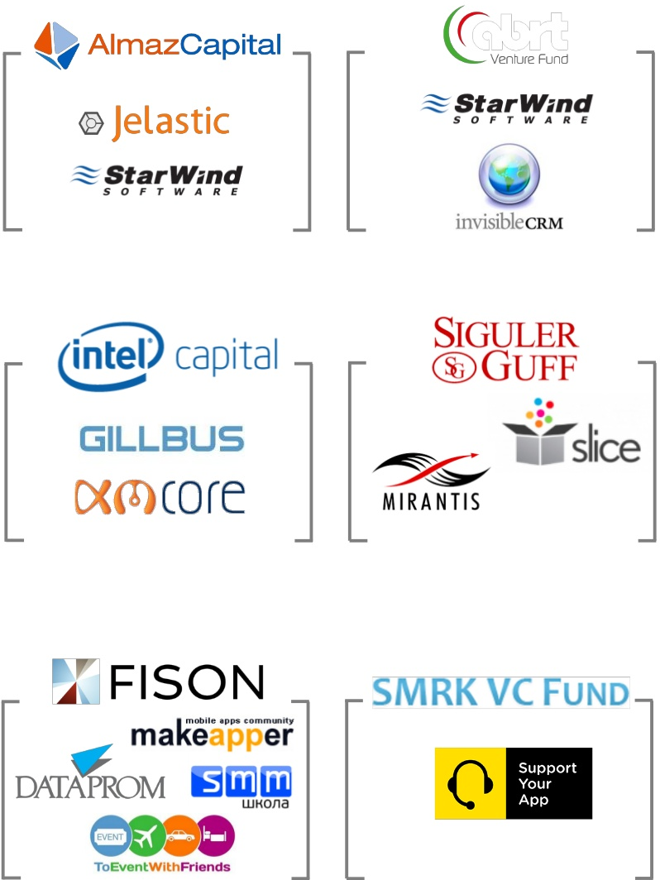
http://www.slideshare.net/YevgenSysoyev/ukraine-dealbook-201214

Slide 16
https://www.youtube.com/watch?v=RlFVx-grsqY

Slide 17
Thank you!

