Slide 1

Current approach to HE Financing in Poland
Data: 13\10 \2015
address: ul. Hoża 20 \ ul. Wspólna 1/3 \ 00-529 Warszawa \ phone: +48 (22) 529 27 18 \ fax: +48 (22) 628 09 22
www.nauka.gov.pl

Slide 2

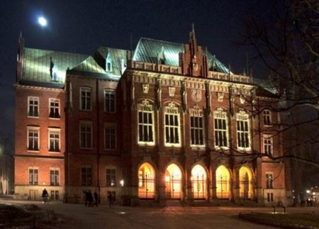

General overview
Number of HEIs – 428
  public – 132
  non-public – 296
Number of students – 1,5 mln
  in public HEI’s – 1,1 mln
  in non-public HEI’s – 360 ths
www.nauka.gov.pl

Slide 3
Students by sector (public/non-public)
www.nauka.gov.pl

Slide 4
HEIs by sector (public/non-public)
www.nauka.gov.pl

Slide 5

Public higher education institutions (HEIs)
Types of institution:
Universities (18)
Technical universities (18)
Economic universities (5)
Agricultural universities (7)
Medical universities (9)
Pedagogical schools (5)
Academies of physical education (6)
Art academies (19)
Maritime and military academies (7)
State professional schools (36)
School of Police and Central School of Fire Service
www.nauka.gov.pl

Slide 6

Supervisory authorities
Minister of National Defence – military academies,
Minister of Internal Affairs – academies of public services,
Minister of Culture – universities of artistic education,
Minister of Health – medical universities,
Minister of Maritime Economy – maritime academies,
Minister of Higher Education – other types of HEIs.
www.nauka.gov.pl

Slide 7

State expenditure on higher education
16 billion PLN
≈3,9 billion EUR
0,9% GDP
www.nauka.gov.pl

Slide 8
The structure of expenditures in higher education
Budget spendings 2015
www.nauka.gov.pl

Slide 9

Process of determining the amounts of grant for HEIs
Step 1
Index-linked way of determining the overall budget on Higher Education
Step 2
distribution of the funds among the individual HEIs with an allocation formula

Slide 10

Allocation formula
Allocation formula is based on :
the so-called transmission constant – responsible for allocation of 65% of the total grant
and 6 following criteria – responsible for allocation of 35% of the total grant:
  students and doctoral students - 35% (out of 35%),
  staff- 35%,
  proportional growth – 10%,
  research – 10%,
  authorization – 5%,
  international exchange - 5%.
www.nauka.gov.pl

Slide 11
Allocation algorithm
www.nauka.gov.pl

Slide 12

Allocation of the grant for financial support for students - parameters
total number of students,
number of students staying in dormitories,
number of students receiving a financial support in the previous year,
number of disabled students.

Slide 13

Student’s support
Grants
  a maintenance grant,
  a special grant for disabled persons,
  the Minister’s scholarship for outstanding learning achievements,
  the Rector’s scholarship for best students,
  assistance grants.
Loans
Other advantages (e.g. accommodation in a student dormitory of their higher education institution and for meals in a student cafeteria, reduction in urban public transport fares).
www.nauka.gov.pl

Slide 14
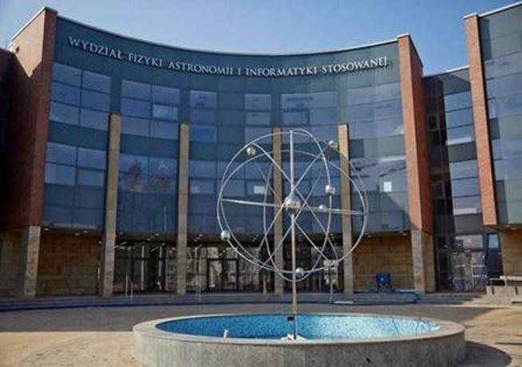


Investment
Allocation of funds for the investment projects is not based on standardized and quantified criteria.
Application is judged by a panel appointed by the minister, which takes into account in particular the importance of the planned investment for the development of the HEIs.
Signing the relevant agreement is required in order to receive funds.

Slide 15

Special grants intended for improving quality
leading national research centres
units which were assessed ‘with distinction’ by the State Accreditation Committee
units implementing national qualification frameworks
additional scholarship for 30% the best doctoral students

Slide 16

R&D
funds for statutory research and development activities,
projects obtaining in a competetive way (National Centre of Science, National Centre of Research and Development, european funds, international cooperation),
there are other players apart from HEIs (institutions of the Polish Academy of Science, research institutes, entrepreneurs),

Slide 17
Thank you for your attention
address: ul. Hoża 20 \ ul. Wspólna 1/3 \ 00-529 Warszawa \ phone: +48 (22) 529 27 18 \ fax: +48 (22) 628 09 22
www.nauka.gov.pl

