Slide 1
Higher Education Funding in the Czech Republic Higher Education Department Ministry of Education, Youth and Sports
Ministerstvo školství, mládeže a tělovýchovy
Karmelitská 7, 118 12 Praha 1 • tel.: +420 234 811 111
msmt@msmt.cz • www.msmt.cz

Slide 2
Czech Republic
- currently 71 higher education institutions:
26 public HEIs
43 private HEIs
2 state HEIs (University od Defense, Police Academy of the Czech Republic in Prague)
- 350,000 students and 88,000 graduates at higher education institutions in 2014 (90% at public, 10% at private, <1% at state)
- including 41,000 foreign students (12%) and 8,000 foreign graduates (10%)
- 15 072 academic staff (in 2014 - FTE); 40 721 total number of staff (in 2014 – FTE)

Slide 3
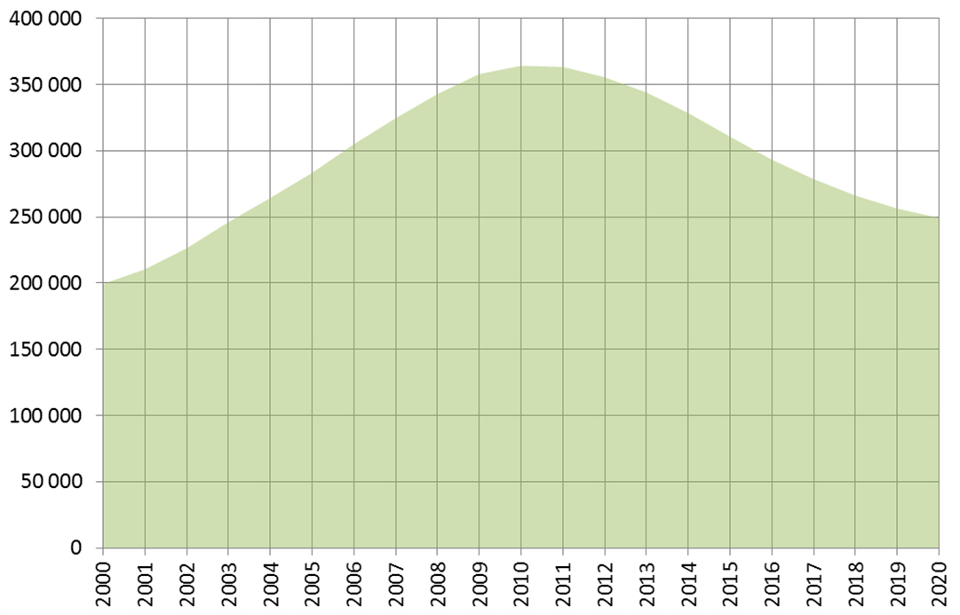
Prediction of the Number of Students at Public HEIs in 2020

Slide 4
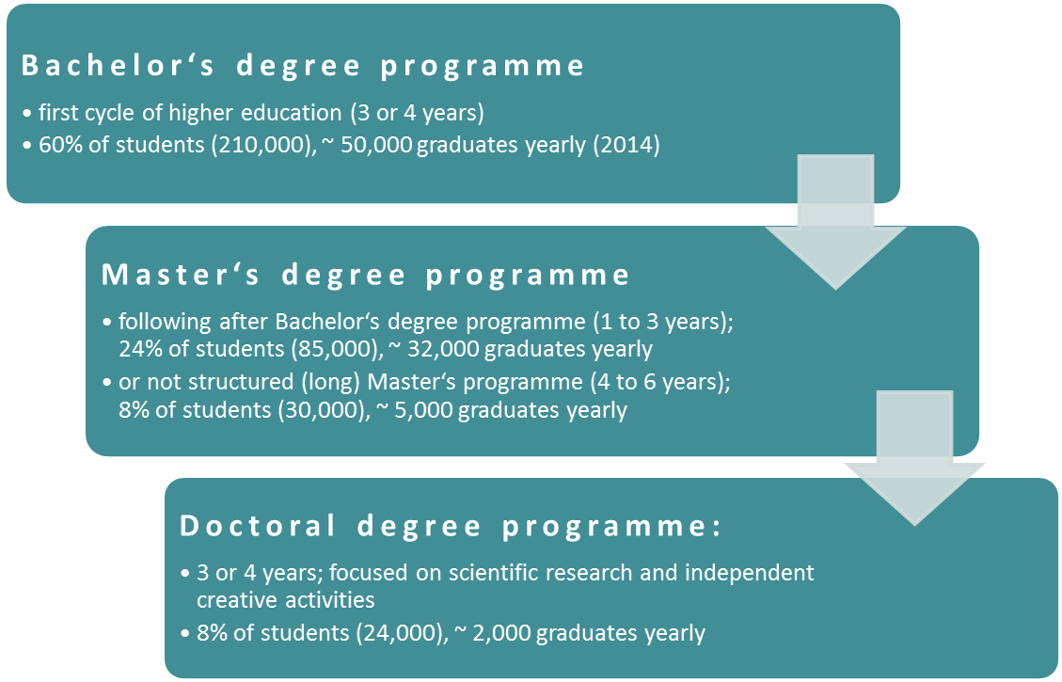
Division of study programmes

Slide 5
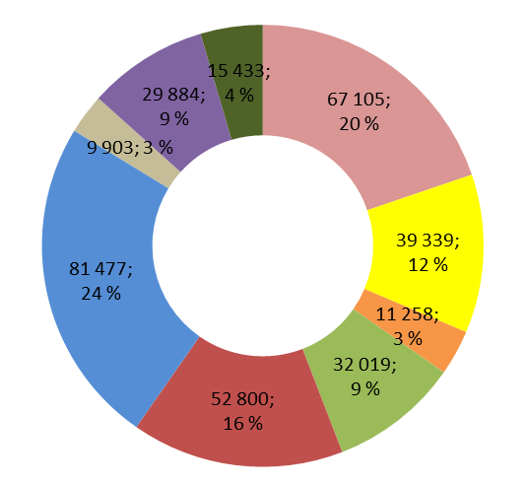
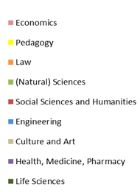
Study Conditions
Programmes in Czech language at public and state universities can be studied for free both by EU and non-EU citizens
Language of instruction: besides to Czech, more and more courses are offered in English as well as German, French, and Russian
Division of HE students in accordance with the fields of study:

Slide 6
Public funding of HE – final data of year 2014
Approx. 72 % of HEIs income from public sources
Total sum of MEYS´grant: 35 355 mil. CZK / 1 285, 6 mil. EUR
Educational grant : 21 667 mil. CZK / 787,89 mil. EUR
Research and Development: 13 688 mil. CZK / 497, 74 mil. EUR
Share HEIs funding/GDP 1,2 % (OECD 1,4%) in 2011

Slide 7
Planned funding in year 2015:
Total sum of MEYS grant: 38 718 mil. CZK/ 1 407 mil. EUR*)
Educational grant : 21 491 mil. CZK / 781,5 mil. EUR
Research and Development: 17 227 mil. CZK / 626,4 mil. EUR*)
*) Note: This includes R & D funding outside HEI funding

Slide 8
Background of current HE funding system
In 1990 only 7,2 % of population had completed HE, in 2001 it was 8,9%.
Widening access to HE had been set in 2001 as a primary goal of the HE system (however this process had already started before „spontaneously“: in 1995 only 10 % of 20-29 year olds had been enrolled in HE, in 2000 it was 15 %).
To meet this goal, the funding system had been focused exclusively on per capita funding in its institutional funding grant (80 % of the MEYS grant to HEIs).
In 2009 the number of newly enrolled students in HE has doubled in comparison with 2001 (and the proportion of 20-25 year olds enrolled in HE has become comparable to the average of OECD countries).

Slide 9
Background of current HE funding system
Rapid expansion became perceived as a threat to the quality of HE in the Czech republic. A new goal has been set: to promote quality of HE and to allow for its greater diversification.
Since 2010 the institutional funding grant of MEYS has been divided not only on the basis of per capita indicators (part “A“) but also according to the performance and quality of HEI’s activities (part „K“).

Slide 10
Structure of the MEYS educational grant
Institutional funding (80%) | Per capita, „A“ (61%)
 | Quality, „K“ (19%)
Social support (10%) | Ph.D. scholarships (5%)
 | Accommodation scholarships (3%)
 | Other (2%)
Performance agreements (6%)
Other (4%)

Slide 11
Institutional funding
Constitutes 80% of the MEYS grant.
Consists of two indicators:
Quantitative „A“, based on a number of students – in 2015 76 % of Institutional funding.
Number of students used for calculation has to be negotiated among MEYS and HEIs. Moreover, economic demand is taken into consideration by coefficient of economic demand (KEN) that is set in several categories:
1 Humanities (economy, law, philosophy)
1,2 Pedagogical branch of studies
1,65 Technical branch of studies, natural science
2,25 Technical branch of studies, natural science´; agricultural, environmental, forest ………..branch of studies,
2,8 Technical, medical and pharmaceutical branch of studies
3,5 Veterinary branches of studies, cultural and art science
5,9 Arts
Qualitative „K“, based on quality of HEI´s activities – in 2015 24 % of Institutional funding

Slide 12
Structure of indicator „K“ based on quality
Since the institution of „K“, its significance has been gradually increased
Part of MEYS grant distributed according to „K“ indicator is divided amongst the HEIs mainly based on their performance in R&D, inbound and outbound student mobility and on the unemployment of their graduates. These criteria are applied without exception.
Gradual increase of significance of this indicator has lead to a major interannual decrease in share of certain HEIs on MEYS grant: in 2014, there has been set a maximum limit of 5 % interannual decrease of a share of given HEI on the Institutional part of MEYS grant.

Slide 13
Structure of „K“ indicator (2015)
HEI Quality and Performance Indicators („K“ indicator) | 2015
„RIV Points“ (R&D performance) | 34,3 %
„RUV Points“ (Arts performance) | 3,5 %
Targeted R&D Funding | 4 %
Own Income | 4 %
Weighted number of professors and associate professors | 2,6 %
Graduates Unemployment | 16 %
Foreign students in the respective study programmes | 2,6 %
Paying Students in the respective study programmes | 4 %
Outbound mobilities | 14,5 %
Inbound mobilities | 14,5 %

Slide 14
Specific support
Internationalization 250 mil CZK/10.3 mil EUR
(ERASMUS etc.)
Students with specific needs 80 mil CZK/3 mil EUR
Teachers education 40 mil CZK/1.5 mil EUR

Slide 15
Performance-based funding
Performance based funding constitutes 6% educational grant
3 years project - 2016-2018
To fulfill strategic criteria of HEI and MEYS
Motivate to better performance of each HEI
Motivate to increase quality of HE institution

Slide 16
Transparency of funding process
Representative commission
Rules for funding and all calculations are discussed with representations of HEIs through “Representative commission“ (“RC”), which is an advisory body of the Deputy Minister and a platform for the negotiating procedure.
RC consist of 6 members nominated by the Czech Rectors Conference, 5 members form Council of the Higher Education Institutions, 4 members representing the HEI finance officers (“bursars”) and one representative of HEIs trade union.
Budget calculation is distributed to all HEIs before the MEYS approval
Official MEYS web page
Rules for funding and majority of calculation and are published on MEYS official web page http://www.msmt.cz/vzdelavani/vysoke-skolstvi/financovani-vysokych-skol-1

Slide 17
Future: Strategic Plan 2016 - 2020
Main priorities stated in Strategic plan 2016-2020
(the strategic document concerning funding of HE):
Increase significance of indicators based on outputs of HEIs (concerning possibly both the per capita indicators and the indicators of the quality of HEIs activities).
Institute multiannual elements of public funding to support HEI ability to plan (e. g. setting student number limits for longer period than one year).
Three year performance agreements (6% of MEYS HE grant) have been instituted to period 2016 – 2018
Enhance the diversification of the study programmes profiles with a financing mechanism

Slide 18
2016 – fixed allocation
2017- ?

Slide 19
Thank you for your attention.

