Slide 1
Czech IT Landscape
Michal Zalesak, MBA
Executive Director

Slide 2
Czech ICT Alliance – about us
Founded in 2005
180+ members: small to multinationals
Official ICT alliance of CzechTrade, national TPA
Czech presence at major Europe events (CeBIT, TechCrunch Disrupt)
Start-up promotion events in CR/ abroad
Facilitation of investments into start-ups (Microsoft Ventures Accelerator Berlin)
Active co-operation with Czech embassies (Berlin) –foreign co-operation

Slide 3
How we support CZ start-ups
Close co-operation with Silicon Valley
Czech suppliers and global customers
angel investor training
Mentoring bootcamps.
Co-operation with Microsoft on multiple start-up programs (students, start-ups)
Facilitated investments: 10+ start-ups
Regional start-up pitch events
Start-up promotion events USA/JPN/EU (TechCrunch Disrupt...)

Slide 4
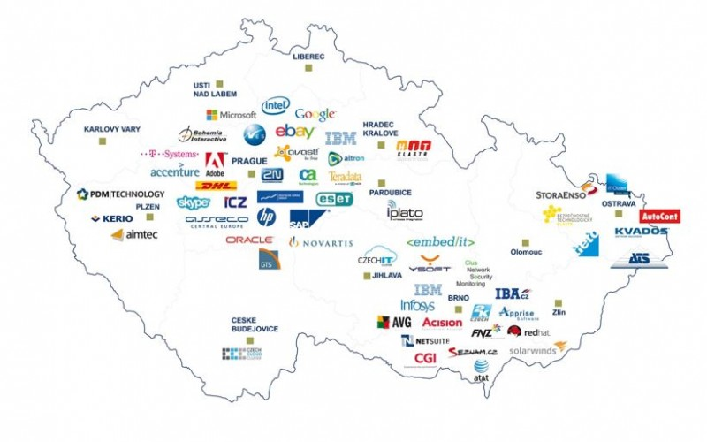
Czech IT: 140 000 jobs

Slide 5
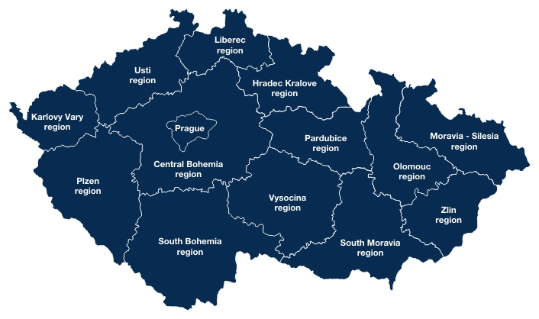
Regional map of IT salaries
Region | Regional Differences
 | 0%
Prague | 22%
Pilsen | -16%
Hradec Kralove | -25%
South-Moravia | 0%
Olomouc | -34%
Moravian-Silesia | -15%

Slide 6
Gross Average Salaries – IT jobs
Position | Min | Max | AVG
Programmer/Analyst (Graduate) | 982 EUR | 1 273 EUR | 1 091 EUR
Help Desk - 1st line | 1 018 EUR | 1 273 EUR | 1 055 EUR
Application Specialist - 2nd and 3rd line | 1 273 EUR | 2 036 EUR | 1 636 EUR
Systems analyst/QA | 1 273 EUR | 2 545 EUR | 1 636 EUR
Developer/Programmer - JAVA/.NET | 1 600 EUR | 3 455 EUR | 2 182 EUR
Administrator | 1 273 EUR | 2 182 EUR | 1 818 EUR
Business Analyst | 1 455 EUR | 3 091 EUR | 2 036 EUR
Technology/Business Consultant | 1 636 EUR | 3 091 EUR | 2 364 EUR
Project Manager | 2 000 EUR | 3 636 EUR | 2 727 EUR
IT Manager | 1 818 EUR | 400 EUR | 2 545 EUR
Architect | 2 182 EUR | 3 455 EUR | 2 909 EUR

Slide 7
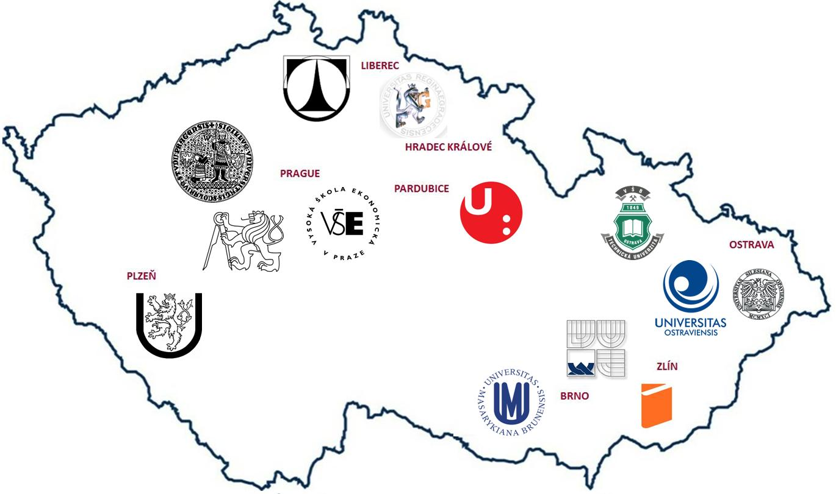
Czech IT University Students & Graduates
CZECH REPUBLIC
Students: 37,752
Graduates: 7,990
PRAGUE REGION
Students: 12,071
Graduates: 2,541
SOUTH MORAVIA
Students: 9,725
Graduates: 2,363
Source: Ministry of Education, Youth and Sport, 2014
Note: according to the selected educational fields
Notes:
Update: May 2014
Author: Bradacova

Slide 8
Czech IT sales and investment
Sales (in mil EUR - 2013) | 23,669
Production | 31%
Business | 23%
Services | 46%
Investments in ICT (in mil. EUR - 2013) | 5,565
ICT Equipment | 48%
Software | 52%

Slide 9
Michal Zalesak
Executive Director
http: //www.czechict.cz
info@czechict.cz

