Slide 1
The Macroeconomic context
OECD Economic Survey of the Czech Republic 2014

Slide 2
The Czech economy has double-dipped

Slide 3
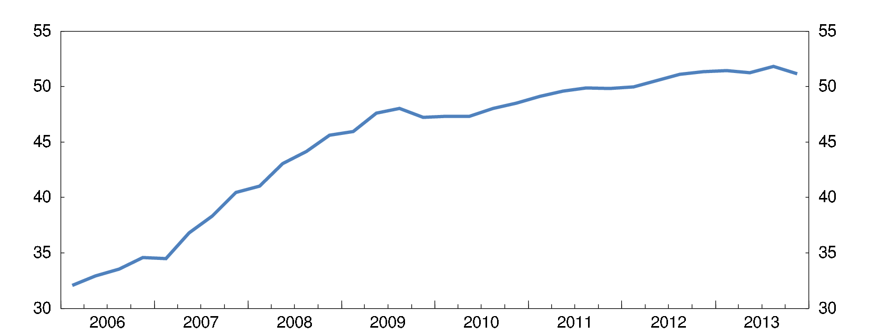
Credit financed domestic demand growth has ended
Credit expansion has slowed
Bank credits to resident in % of GDP

Slide 4
Which together with the international crisis => a recession that is only ending
Supporting the recovery:
Accommodative monetary stance until deflation risks recede
Preserve neutral fiscal stance in the short term
Secure fiscal sustainability
Higher effective retirement age
Lower pension indexation (avoid old-age poverty)
Diversifying pensioners’ income sources
Forwarding Accelerating increases in statutory retirement age
Independent fiscal council with a broad remit

Slide 5
Fiscal policy has room to postpone consolidation, but not for ever
Fiscal position, 2012

Slide 6
The zero interest rate floor has been reached

Slide 7
After a year of discussions CNB intervened on the exchange rate
Exchange rates vis-à-vis the Euro (National currency/EUR)

Slide 8
The exchange rate intervention seems to have worked – although a unconventionally
The exchange rate depreciated by a relatively small amount (less than 5%)
Prices see to have reacted with some delay and not as strongly as hoped
Quantities (exports, consumption) seem to react more or less immediately
The overall environment in the euro are is characterised by low inflation
Exit is well defined in theoretical terms but may become tricky in practical terms

Slide 9
Growth has been based on manufacturing exports
Bosting industry’s share of value added in the economy

Slide 10
Via high integration in the global (German) value chain

Slide 11
Income convergence has stalled, pointing to a need for new growth drivers

Slide 12
Looking ahead [all the following slides are very good, but not macro, more an overview for what is in the Survey]
Further income convergence cannot rely on manufacturing alone
Indeed, an implication of income convergence is the loss of current cost advantages
Benefiting more from global value chains:
Move up the value added chain:
in final exports goods
in intermediate inputs

Slide 13
Future income convergence must rely on:
A stronger service sector
Boost value added in production
Stimulate innovation
Exploit domestic resources of growth
Better skill use and school-to-work transitions
Moving up the value added chain requires new set of skills
Growth depend on an education system that adjusts to changes in labour market needs

Slide 14
This survey points to:
Strengthening the domestic economy via promotion of competition
Strengthening skill use and school-to-work transitions

Slide 15
Thank you
Merci
Muito obrigado
Mange tak
Děkuji
Danke für Ihre Aufmerksamkeit

