Slide 1


How the OECD is thinking about Green Growth
Prague, 16th May 2013
Simon Upton
Director
OECD Environment Directorate
For more information, see www.oecd.org/greengrowth

Slide 2
Intensity of GHG emissions and GDP (Why just making steady progress isn’t enough…)

Slide 3
What policies do we need?
Make pollution more costly
Notes:
Examples for each:
Value and price natural assets and ecosystem services:
Valuation is critical as the true benefits of biodiversity are largely ignored in market prices. Biodiversity and ecosystem service valuation is intended to help communicate to policy-makers (including those in agriculture, finance ministries, etc), the TRUE benefits of biodiversity and ecosystem services, so as to help more informed decision-making processes (e.g. do we convert the land to pasture or do we conserve it due to its high biodiversity value and the ecosystem services it provides?) – contrary to some concerns, valuation is NOT intended to turn biodiversity into a market commodity that is traded irresponsibly on financial markets. Pricing natural assets is necessary to CAPTURE the benefits provided by these goods and services.
Payments for Ecosystem Services are one example of an instrument that has proliferated rapidly over the last decade (more than 300 programmes operating around the world today)
Remove environmentally harmful subsidies: e.g. Norway reduced fishing subsidies by 120 billion, opportunities to go further in a number of different sectors abound.
Devise effective regulation: Protected Areas, fishing and hunting permits, etc
Make pollution more costly: fertiliser and pesticide taxes (e.g. in Norway and Denmark)

Slide 4
Revenues from environmentally related taxes
In per cent of GDP, 2011

Slide 5
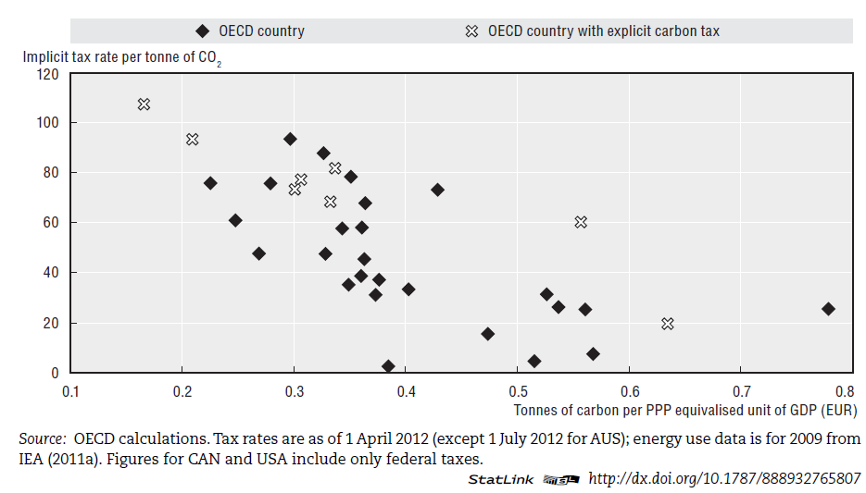
Average tax rates on CO2 and carbon efficiency in OECD countries
Implicit tax rate per tonne of CO2
Sweden
Switzerland
Czech Republic
Estonia
USA
Tonnes of carbon per PPP equivalised unit of GDP (EUR)
Source: OECD (2013) Taxing Energy Use - A Graphical Analysis
Notes:
Words same time, figure out which arrow

Slide 6
Taxation of energy in Czech Republic on an energy content basis
TRANSPORT
HEATING & PROCESS USE
ELECTRICITY
Source: OECD (2013) Taxing Energy Use - A Graphical Analysis
Notes:
Words same time, figure out which arrow

Slide 7
Taxation of energy in Czech Republic on a carbon emission basis
TRANSPORT
HEATING & PROCESS USE
ELECTRICITY
Source: OECD (2013) Taxing Energy Use - A Graphical Analysis
Notes:
Words same time, figure out which arrow

Slide 8
Taxation of energy in Austria on energy content basis
TRANSPORT
HEATING & PROCESS USE
ELECTRICITY
Source: OECD (2013) Taxing Energy Use - A Graphical Analysis
Notes:
Words same time, figure out which arrow

Slide 9
Taxation of energy in Austria on a carbon emission basis
TRANSPORT
HEATING & PROCESS USE
ELECTRICITY
Source: OECD (2013) Taxing Energy Use - A Graphical Analysis
Notes:
Words same time, figure out which arrow

Slide 10
Share of CO₂ emissions from energy taxed and implicit rates
Share of carbon emissions, %
Source: OECD (2013) Taxing Energy Use - A Graphical Analysis

Slide 11
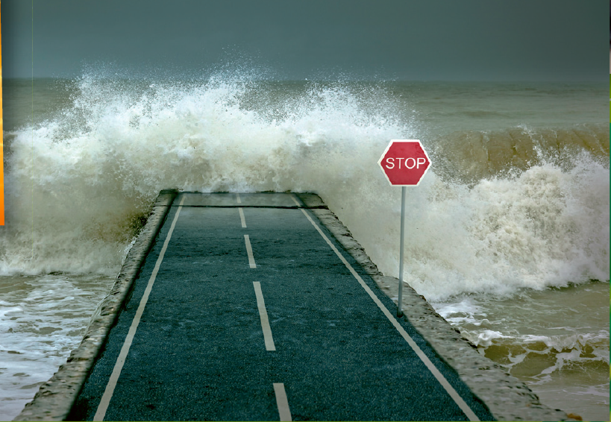
Challenges are so big that we can’t afford expensive solutions

Slide 12
“Average effective carbon price" for the main policy instruments used in the electricity generation sector
775
800
$USD costs per tonne of CO₂ abated
Simple Average
Source: OECD Effective Carbon Prices Analysis (forthcoming)
Notes:
This slide shows the ranges of effective carbon prices found for various types of instruments used for environmental policy in 14 selected countries (Australia, Brazil, Chile China, Denmark, France, Germany, New Zealand, South Africa, Spain, the UK and the US). The studies have assessed the amount of emission reduction triggered by each instrument, the costs to society of implementing the policies, and (by dividing the latter by the former), the average cost to society per tonne of CO₂ abated. The graph illustrates that there are very large differences in the estimated carbon prices both within and across instrument categories, with some very high costs per tonne abated related to feed-in tariffs and capital subsidies – and with clearly the lowest costs linked to emission trading schemes. Promoting renewables deployment is clearly an expensive way to address climate change. Several caveats should be kept in mind, though: Most importantly, so of the policies serve several policy objectives, so only looking at their impacts on GHG emissions does not provide the “full picture”. Also, the study is a “snapshot” of the situation in 2010, and it doesn’t necessarily give a correct impression of impacts of the policies in the long term.

Slide 13
Environmental Outlook to 2050: What policies do we need?
Make pollution more costly
Value and price the natural assets and ecosystem services
Notes:
Examples for each:
Value and price natural assets and ecosystem services:
Valuation is critical as the true benefits of biodiversity are largely ignored in market prices. Biodiversity and ecosystem service valuation is intended to help communicate to policy-makers (including those in agriculture, finance ministries, etc), the TRUE benefits of biodiversity and ecosystem services, so as to help more informed decision-making processes (e.g. do we convert the land to pasture or do we conserve it due to its high biodiversity value and the ecosystem services it provides?) – contrary to some concerns, valuation is NOT intended to turn biodiversity into a market commodity that is traded irresponsibly on financial markets. Pricing natural assets is necessary to CAPTURE the benefits provided by these goods and services.
Payments for Ecosystem Services are one example of an instrument that has proliferated rapidly over the last decade (more than 300 programmes operating around the world today)
Remove environmentally harmful subsidies: e.g. Norway reduced fishing subsidies by 120 billion, opportunities to go further in a number of different sectors abound.
Devise effective regulation: Protected Areas, fishing and hunting permits, etc
Make pollution more costly: fertiliser and pesticide taxes (e.g. in Norway and Denmark)

Slide 14
Sub-Saharan Africa – capital depletion
% of GNI
28% of wealth
Sub-Saharan Africa
Education
Net saving
+3.3%
7.6%
Resource depletion
-16.1%
Pollution
-1.0%
USD 2005, per capita
-6.2%
Adjusted net savings
Source: World Bank Wealth of Nations

Slide 15
Norway – capital substitution
Savings rate
Norway
Wealth
Education
Net saving
+6.0%
Resource depletion
26.2%
-16.1%
Pollution
-0.1%
16.2%
Adjusted net savings
OECD average, 6.8%
USD 2005, per capita
% of GNI
Source: World Bank Wealth of Nations

Slide 16
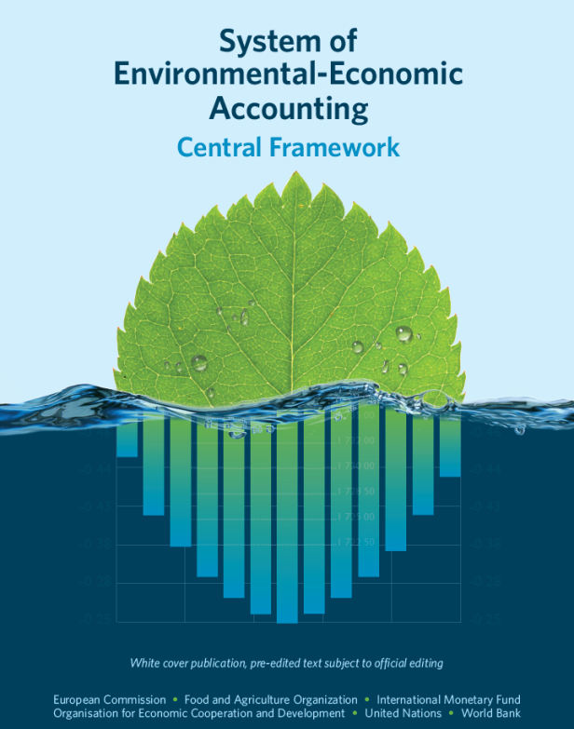
The System of Environmental-Economic Accounting (SEEA) – A framework for measuring interactions between the environment and the economy

Slide 17
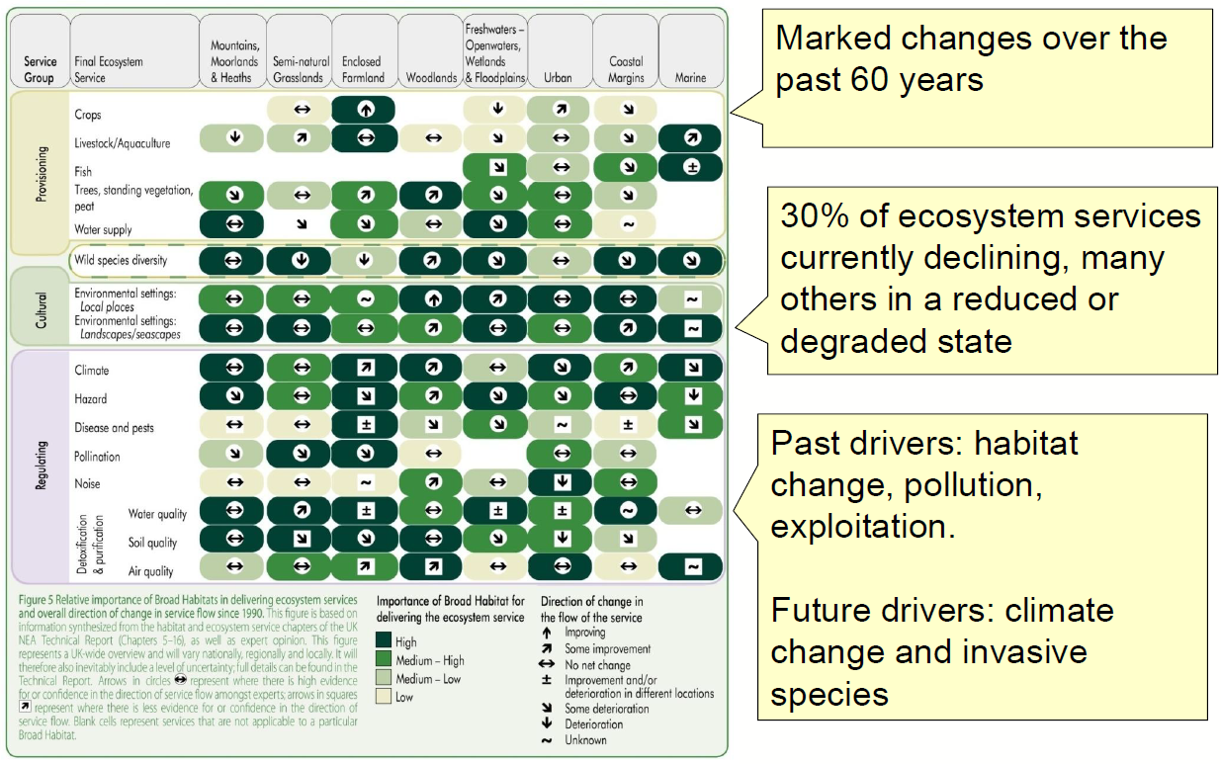
High level messages from UK NEA synthesis report
Source: DEFRA

Slide 18
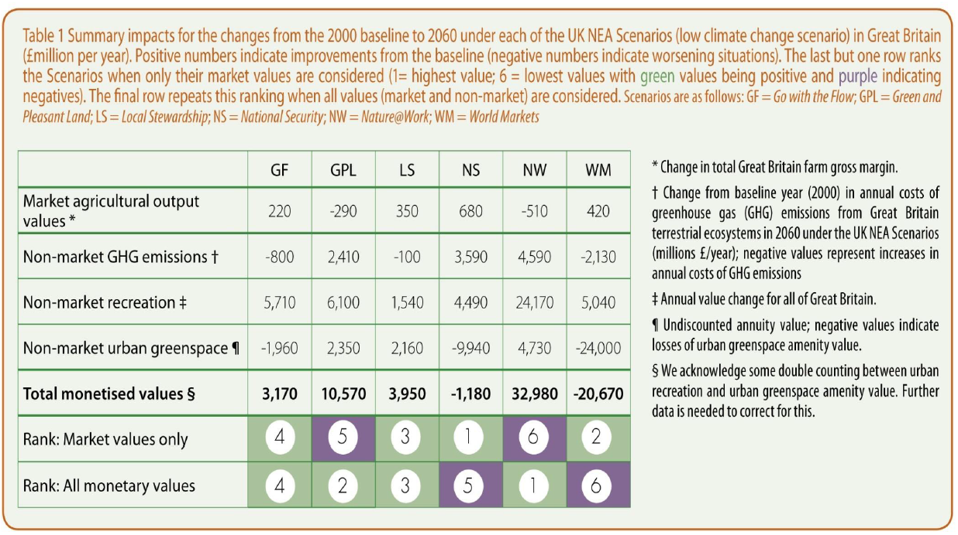
Monetised impacts 2000-2060 under different scenarios – UK NEA
Source: DEFRA

Slide 19
Environmental Outlook to 2050: What policies do we need?
Make pollution more costly
Value and price the natural assets and ecosystem services
Remove environmentally harmful subsidies
Notes:
Examples for each:
Value and price natural assets and ecosystem services:
Valuation is critical as the true benefits of biodiversity are largely ignored in market prices. Biodiversity and ecosystem service valuation is intended to help communicate to policy-makers (including those in agriculture, finance ministries, etc), the TRUE benefits of biodiversity and ecosystem services, so as to help more informed decision-making processes (e.g. do we convert the land to pasture or do we conserve it due to its high biodiversity value and the ecosystem services it provides?) – contrary to some concerns, valuation is NOT intended to turn biodiversity into a market commodity that is traded irresponsibly on financial markets. Pricing natural assets is necessary to CAPTURE the benefits provided by these goods and services.
Payments for Ecosystem Services are one example of an instrument that has proliferated rapidly over the last decade (more than 300 programmes operating around the world today)
Remove environmentally harmful subsidies: e.g. Norway reduced fishing subsidies by 120 billion, opportunities to go further in a number of different sectors abound.
Devise effective regulation: Protected Areas, fishing and hunting permits, etc
Make pollution more costly: fertiliser and pesticide taxes (e.g. in Norway and Denmark)

Slide 20
Support to fossil fuels in OECD countries by year and type of fuel (Millions of current USD)
Notes:
The above charts are based on an arithmetic sum of the individual support measures identified for all 34 OECD member countries. It includes the value of tax relief measured under each jurisdiction’s benchmark tax treatment. The estimates do not take into account interactions that may occur if multiple measures were to be removed at the same time. PSE = Producer Support Estimate; CSE = Consumer Support Estimate; GSSE = General Services Support Estimate
Data source: OECD (2013), Inventory of Estimated Budgetary Support and Tax Expenditures for Fossil Fuels.

Slide 21
Support to fossil fuels in OECD countries by year and indicator (Millions of current USD)
Notes:
The above charts are based on an arithmetic sum of the individual support measures identified for all 34 OECD member countries. It includes the value of tax relief measured under each jurisdiction’s benchmark tax treatment. The estimates do not take into account interactions that may occur if multiple measures were to be removed at the same time. PSE = Producer Support Estimate; CSE = Consumer Support Estimate; GSSE = General Services Support Estimate
Data source: OECD (2013), Inventory of Estimated Budgetary Support and Tax Expenditures for Fossil Fuels.

Slide 22
Consumer support element to fossil fuels in Czech Republic by year and fuel (Millions of CZK, nominal)
Support for gas
Support for coal
Support for oil
Notes: Tax expenditures for any given country are measured with reference to a benchmark tax treatment that is generally specific to that country. Consequently, the estimates contained in the table above are not necessarily comparable with estimates for other countries. In addition, because of the potential interaction between them, the summation of individual measures for a specific country may be problematic. The allocation of particular measures across fuel types was done by the OECD Secretariat based on the IEA’s Energy Balances.
Data source: OECD (2013), Inventory of Estimated Budgetary Support and Tax Expenditures for Fossil Fuels.

Slide 23
Environmental Outlook to 2050: What policies do we need?
Make pollution more costly
Value and price the natural assets and ecosystem services
Remove environmentally harmful subsidies
Devise effective regulations and standards
Encourage green innovation
Notes:
Examples for each:
Value and price natural assets and ecosystem services:
Valuation is critical as the true benefits of biodiversity are largely ignored in market prices. Biodiversity and ecosystem service valuation is intended to help communicate to policy-makers (including those in agriculture, finance ministries, etc), the TRUE benefits of biodiversity and ecosystem services, so as to help more informed decision-making processes (e.g. do we convert the land to pasture or do we conserve it due to its high biodiversity value and the ecosystem services it provides?) – contrary to some concerns, valuation is NOT intended to turn biodiversity into a market commodity that is traded irresponsibly on financial markets. Pricing natural assets is necessary to CAPTURE the benefits provided by these goods and services.
Payments for Ecosystem Services are one example of an instrument that has proliferated rapidly over the last decade (more than 300 programmes operating around the world today)
Remove environmentally harmful subsidies: e.g. Norway reduced fishing subsidies by 120 billion, opportunities to go further in a number of different sectors abound.
Devise effective regulation: Protected Areas, fishing and hunting permits, etc
Make pollution more costly: fertiliser and pesticide taxes (e.g. in Norway and Denmark)

Slide 24
“…large leaps in clean technology, triggering a structural shift in the way we produce and consume energy, are required.
This is a ‘green growth’ rather than a ‘no growth’ world. The continuation of growth in value to humans is consistent with us living within the material constraints imposed by a finite (if very large) planet, provided that we continue to expand the intellectual economy through innovation, technology development, an increased focus on services and, more fundamentally, the art of living.”

Slide 25
Israeli freshwater use (2009)ª

Slide 26
Israeli economic efficiency of agricultural water use, 1986-2008
Value of agricultural production per m³ of water utilized for irrigation
Real price of fresh water to agriculture (inflation adjusted)

Slide 27
Israeli Patents in selected environment & climate-related technologies
Number of
patents
Total number of patents
Water-related patents

Slide 28
Prices matter – and spur innovation
NOx Tax in Sweden
Source: OECD

Slide 29

You can’t manage what you don’t measure

Slide 30
Towards green growth - Monitoring progress
Headline indicators
Environmental and resource productivity
Carbon productivity
1. CO₂ productivity
Resource productivity
2. Non-energy material productivity
Multifactor productivity
3. Multifactor productivity including environmental services
The natural asset base
Renewable and non-renewable stocks
4. Natural resource index
Biodiversity and ecosystems
5. Changes in land use and cover
Environmental quality of life
Environmental health and risks
6. Air pollution (population exposure to PM 2.5)
Economic opportunities and policy responses
Technology and innovation, environmental goods and services, prices and transfers, etc.
Placeholder – no indicator specified
“Green” difficult to isolate
Diversity of country circumstances, of instruments
→ countries to choose

Slide 31
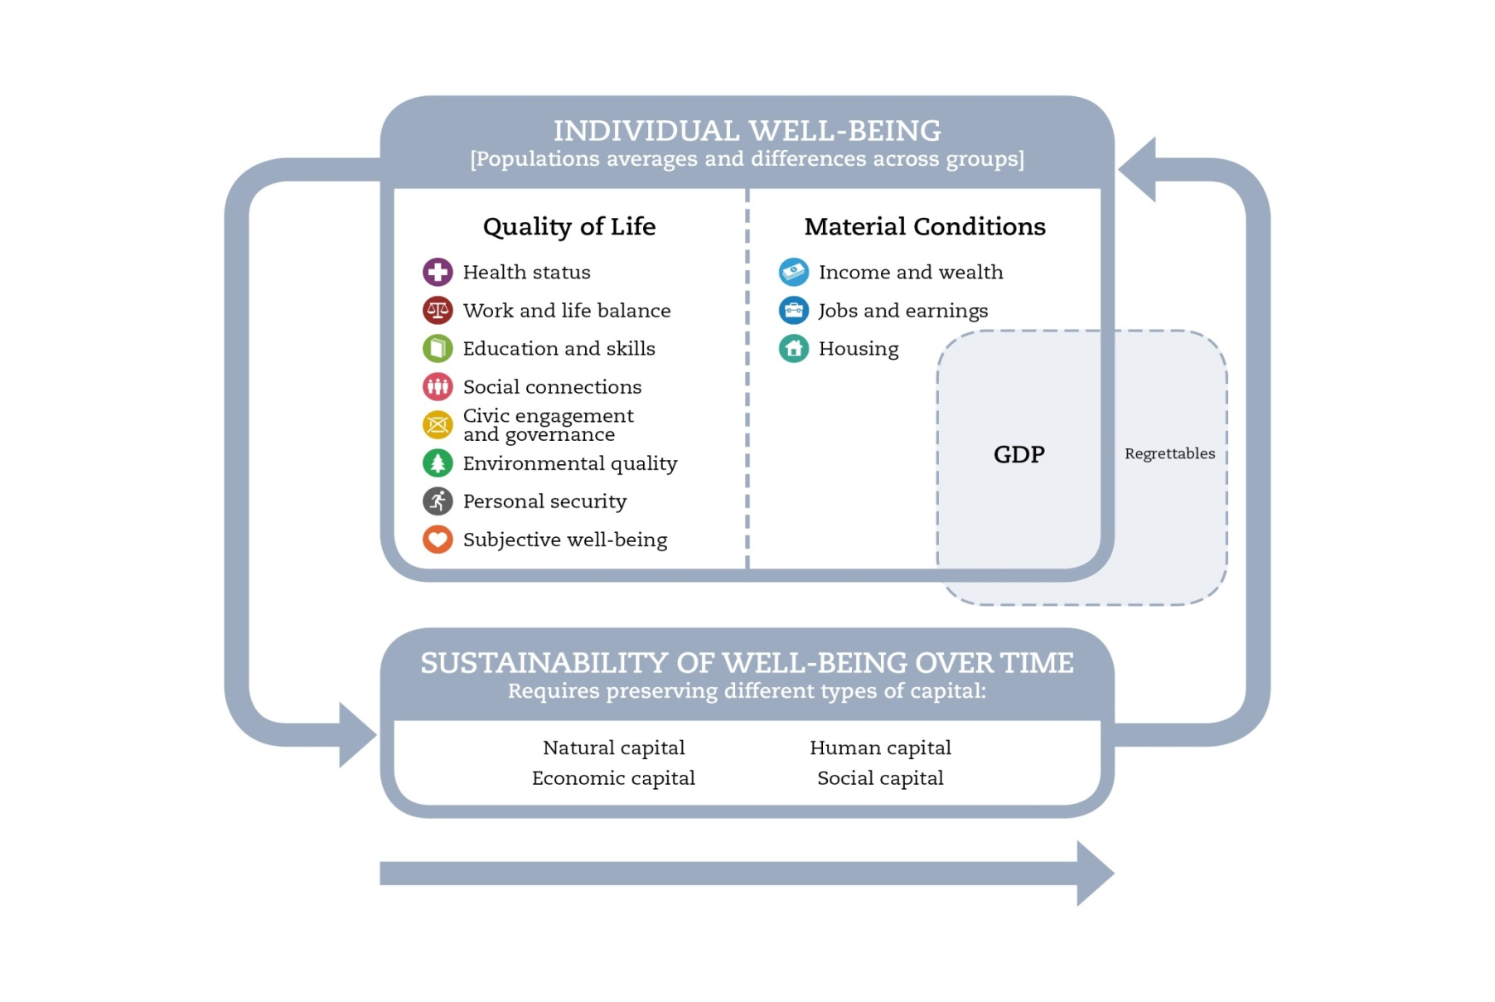
The OECD well-being framework
People rather than economic system
Outcomes rather than inputs and outputs
Both averages and inequalities
Both objective and subjective aspects
Attributes of both individuals and communities
Both ‘here & now’ and ‘elsewhere & later’

Slide 32
Agreement with attitudinal statements including on the role of technological progress to address environmental issues Source: OECD (2012) Greening Household Behaviour

